Slide 1
CloudMerger
система интеграции сетевых файловых хранилищ
{ Антон Толстов, Евгений Пешков, Артем Гайнанов }

Slide 2


Slide 3





Slide 4

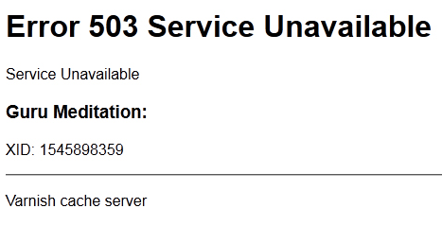
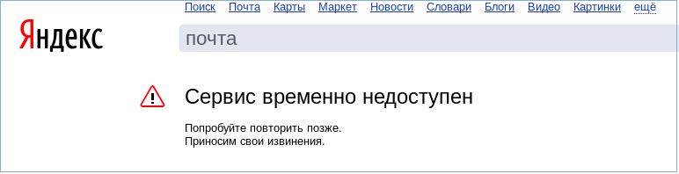

Slide 5
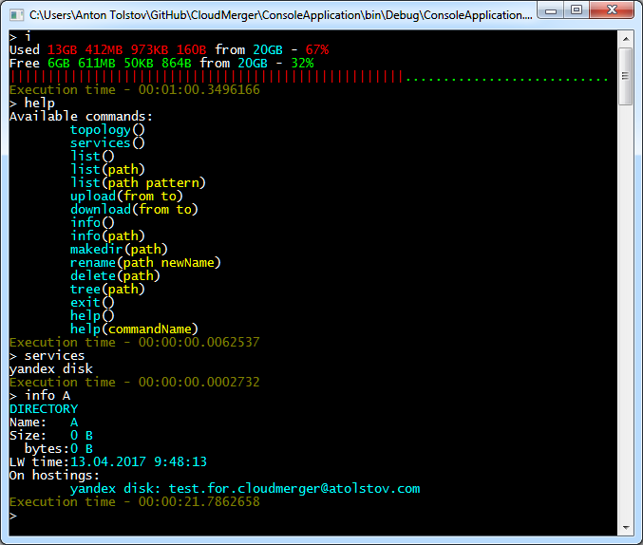

Slide 6
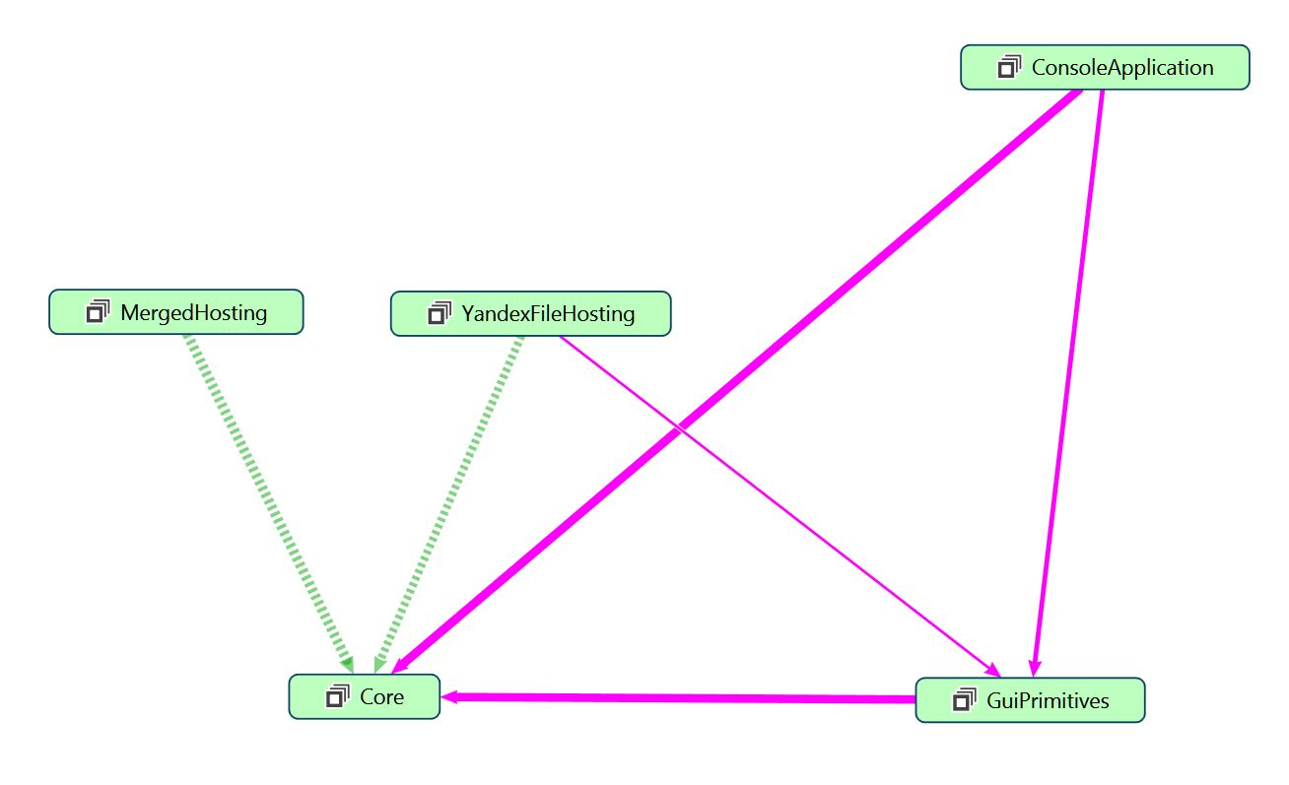

Slide 7
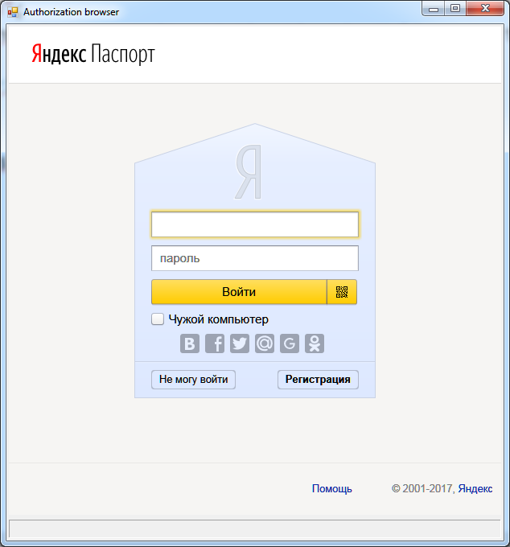
var token = "application-token";
var start = new Uri(string.Format(Resource.StartAuthenticationUrlFormat, token));
var credentials = await AuthorizationBrowser.CreateNewAsync
(
start,
(uri, content) => accessTokenRegex.IsMatch(uri.AbsoluteUri)
);

Slide 8
public class OAuthCredentials : IEquatable<OAuthCredentials>
{
public static OAuthCredentials FromString(string s) { … }
public string Service { get; set; }
public string Login { get; set; }
public string Token { get; set; }
public string SerializeToString() { … }
public override string ToString() { … }
public override bool Equals(object obj) { … }
public bool Equals(OAuthCredentials other) { … }
public override int GetHashCode() { … }
}

Slide 9
public interface IHostingManager
{
string Name { get; }
IHosting GetFileHostingFor(OAuthCredentials credentials);
Task<OAuthCredentials> AuthorizeAsync();
}
public interface IMultiHostingManager
{
string Name { get; }
IHosting GetFileHostingFor(IHosting[] hostings); }

Slide 10
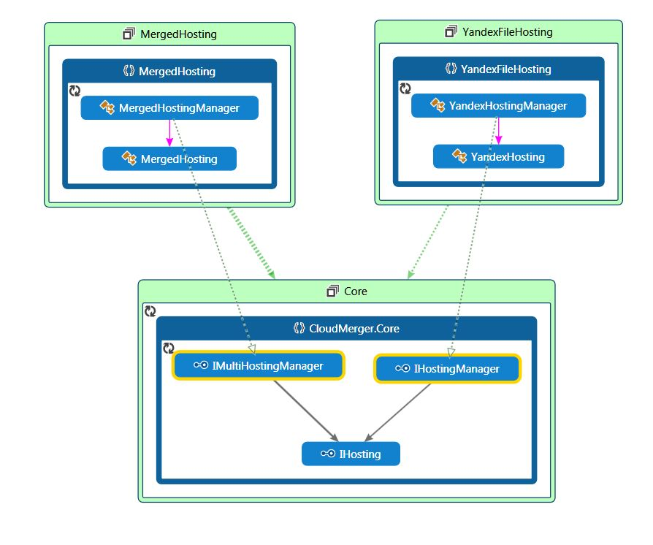

Slide 11
public class FileHostingClient
{
[Command("show list of nested files and directories (root directory)", true)]
public async Task List() { … }
[Command("show list of nested files and directories", true)]
public async Task List(string path) { … }
[Command("show list of nested files and directories (matched by regexp)", true)]
public async Task List(string path, string pattern) { … }
[Command("upload file to cloud", true)]
public async Task Upload(string from, string to = null) { … }
[Command("download file from cloud", true)]
public async Task Download(string from, string to = null) { … }
[Command("show info about free disk space", true)]
public async Task Info() { … }
[Command("show info about file or directory", true)]
public async Task Info(string path) { … }
}

Slide 12
var kernel = new StandardKernel();
kernel.Bind(scaner =>
{
scanner
.FromAssembliesInPath(hostings.FullName)
.Select(t => typeof(IHostingManager).IsAssignableFrom(t))
.BindAllInterfaces();
});
kernel.Bind(scaner =>
{
scaner
.FromAssembliesInPath(hostings.FullName)
.Select(t => typeof(IMultiHostingManager).IsAssignableFrom(t))
.BindAllInterfaces();
});
kernel.Bind<ServicesCollection>().ToSelf().InSingletonScope();
kernel.Bind<TopologyConfigurator>().ToSelf().InSingletonScope();
kernel.Bind<HostingTreeBuilder>().ToSelf().InSingletonScope();
kernel.Bind<CredentialsFormatter>().ToSelf().InSingletonScope();

Slide 13
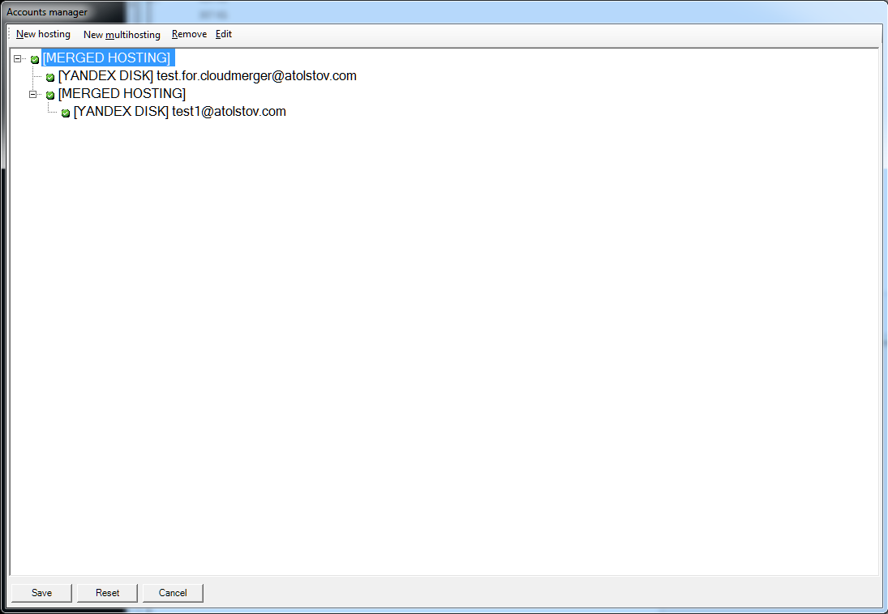
merged hosting ? ?
yandex disk test.for.cloudmerger@atolstov.com AQAEA709kxsa-bv4ho
merged hosting ? ?
yandex disk test1@atolstov.com AQAEA7qiBTLvvAtAwLxM

Slide 14
[TestFixture]
public class DirectoryListRequest_Should : HostingTestBase
{
[Test]
public async Task ReturnCorrectAnswer_ForNonEmptyDirectory()
{
var list = await Hosting.GetDirectoryListAsync("Non empty dir");
list
.Select(i => i.Name)
.ShouldBeEquivalentTo(new [] { "Горы.jpg", "Зима.jpg« });
}
[Test]
public void ThrowsException_WhenPathToFile()
{
AssertThrows<UnexpectedItemType>(Hosting.GetDirectoryListAsync("file.jpg"));
}
}

Slide 15

Спасибо за внимание!
https://github.com/anaym/CloudMerger

