Slide 1

Summary: May-July Research
Alex Nazareth
August 2020

Slide 2
Methodology

Slide 3
Data Collection - Python Scraping
Get @realDonaldTrump tweets from Trump Twitter Archive [1]
For any other accounts (e.g. @JustinTrudeau, @AOC), use a custom built python application. App uses tweepy library [2] to access Twitter API.
Gather tweets from timeline of user between two dates (by tweet id).
Remove retweets and non-English tweets.
Divide tweets into individual words and remove common stopwords.
Tweets | Length | Date | Source | Favourites | RTs | Username | id_str | in_reply_to_user_id | user_id | isRT | tco | Language | Month | Quarter
No Voter Fraud! | 15 | 2020-05-22 2:43 | Twitter for iPhone | 64638 | 18382 | realDonaldTrump | 1.26E+18 |  |  | FALSE | https://t.co/1hyr8jehFm | en | May | Q2
USA will be bigger and stronger than ever before! | 49 | 2020-05-22 2:40 | Twitter for iPhone | 66319 | 16369 | realDonaldTrump | 1.26E+18 |  |  | FALSE | https://t.co/R5vvAAoj1P | en | May | Q2
96% Approval Rating in the Republican Party. Thank you! | 55 | 2020-05-22 2:29 | Twitter for iPhone | 258407 | 37606 | realDonaldTrump | 1.26E+18 |  |  | FALSE |  | en | May | Q2
THANK YOU! #MAGA | 16 | 2020-05-22 1:34 | Twitter for iPhone | 70190 | 14633 | realDonaldTrump | 1.26E+18 |  |  | FALSE | https://t.co/hqyNTNoVHi | en | May | Q2

Slide 4
Keyword Analysis and Community Detection
Get top 100 most frequent keywords appearing in tweets by month, quarter, and overall.
Create a 100-by-100 weighted adjacency matrix for each period.
This represents a weighted graph where the nodes are keywords, and the edge weight corresponds to the number of co-occurrences of keywords within a tweet.
E.g. Add 1 to the weight of the edge between nodes “sleepy” and “joe” whenever both words appear in the same tweet.
For each period (month, quarter, year-to-date) find the likely number of communities.
Use the python-louvain package [3] to get the number of communities from a given matrix.
Note that the algorithm has an element of randomness, so the community detection is run 100 times to find the best value.

Slide 5
Tweets of Politicians
All tweets compiled in all_users_clean.csv
Results found in num_communities.xlsx sheet num_communities

Slide 6
Accounts Gathered
All governors (incl. D.C. Mayor Muriel Bowser) except:
John Bel Edwards (LA), Charlie Baker (MA), Gretchen Whitmer (MI), Mike DeWine (OH), Phil Murphy (NJ)
Toronto City Councillors:
Joe Cressy, Josh Matlow, Kristyn Wong-Tam
Other US Political Figures:
Donald Trump, Alexandria Ocasio-Cortez, Bernie Sanders, Lindsay Graham, Nancy Pelosi, Mitch McConnell, Bill DeBlasio
Other Canadian Political Figures:
Justin Trudeau, Doug Ford, Jagmeet Singh, Andrew Scheer

Slide 7
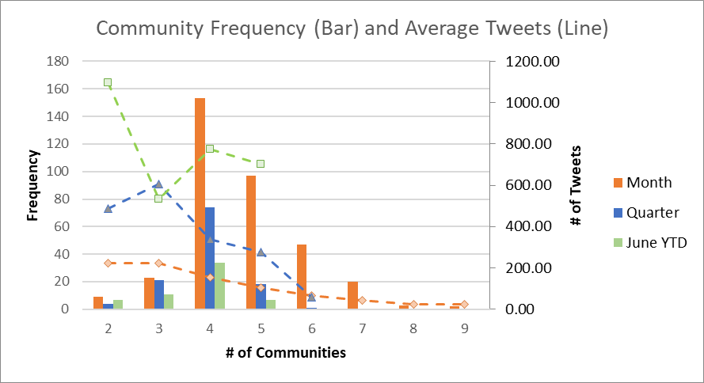
Results from Political Tweets

Slide 8
Results from Political Tweets - 2
Expected larger number of communities due to many different users (different language/word choice).
Results were slightly higher in 3 samples analyzed:
Taken from all users mixed together.
500 tweets, 250 tweets, and 500 tweets with only 30% US governors
(The 3rd sample had a specific proportion because I suspected the governors might be too self-similar, though it didn’t appear to have any effect in the end)
Period | Avg # of Communites
Month | 6.388889
Quarter | 5.5
YTD | 4.666667

Slide 9
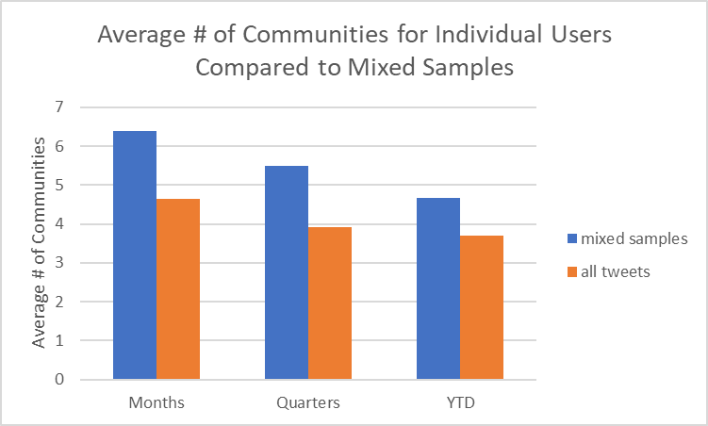
Results from Political Tweets - 3
Sample | Month | # Tweets | # Comm.’s | % of Louvain Trials
500 tweets, 30% gov. | jan | 58 | 6 | 0.5
500 tweets, 30% gov. | feb | 64 | 6 | 0.41
500 tweets, 30% gov. | mar | 100 | 5 | 0.68
500 tweets, 30% gov. | apr | 113 | 5 | 0.42
500 tweets, 30% gov. | may | 83 | 5 | 0.37
500 tweets, 30% gov. | jun | 75 | 8 | 0.53
500 tweets, 30% gov. | YTD | 493 | 5 | 0.57
500 tweets, 30% gov. | _q1 | 222 | 5 | 0.43
500 tweets, 30% gov. | _q2 | 271 | 5 | 0.66
500 tweets | jan | 52 | 8 | 0.72
500 tweets | feb | 42 | 9 | 0.39
500 tweets | mar | 106 | 6 | 0.77
500 tweets | apr | 108 | 6 | 0.34
500 tweets | may | 87 | 4 | 0.5
500 tweets | jun | 98 | 5 | 0.51
500 tweets | YTD | 493 | 4 | 0.59
500 tweets | _q1 | 200 | 6 | 0.62
500 tweets | _q2 | 293 | 5 | 0.53
250 tweets | jan | 30 | 7 | 0.88
250 tweets | feb | 22 | 11 | 0.7
250 tweets | mar | 56 | 6 | 0.51
250 tweets | apr | 47 | 5 | 0.79
250 tweets | may | 54 | 7 | 0.55
250 tweets | jun | 39 | 6 | 0.8
250 tweets | YTD | 248 | 5 | 0.84
250 tweets | _q1 | 108 | 6 | 0.58
250 tweets | _q2 | 140 | 6 | 0.53

Slide 10
Other Analysis for Comparison
Random English tweets
GPT-2

Slide 11
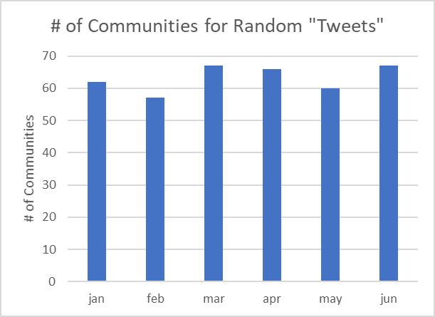
Random English Words
Using a list of English words found online [4], generate 600 “tweets” (strings of maximum 280 characters)
Run analysis on this set of “tweets”, expectation is a very large number of communities due to huge vocabulary compared to common language used by human tweeters.

Slide 12
GPT-2 Trump Generation
GPT-2 is an algorithm designed by OpenAI to predict the next word (repeatedly) in an English sentence [5].
Using the gpt-2-simple python package [6], finetune the GPT-2 learning model on all collected tweets from President Trump.
Generate 50 files of 600 tweets each, and run analysis on each file.

Slide 13
GPT-2 Trump – Example Generated Tweets
(Note that they don’t always make sense, but the vocabulary seems accurate for Trump.)
“Venezuelan President Nicolas Maduro on Wednesday accused the United States of trying to overthrow his government and called on other Latin American countries to do the same. We're not going to be bullied!”
“A great coach and a great friend. My fond memories of him are the many trips to his house and the many sit-down dinners he set up. He was a true American hero! Thank you @SenatorCory”
“Our Republic is not dead. It is on its way back to life. This is a very exciting time in our Nation's history. The Resistance is slowly but surely winning the day. We are winning in every conceivable way.”

Slide 14
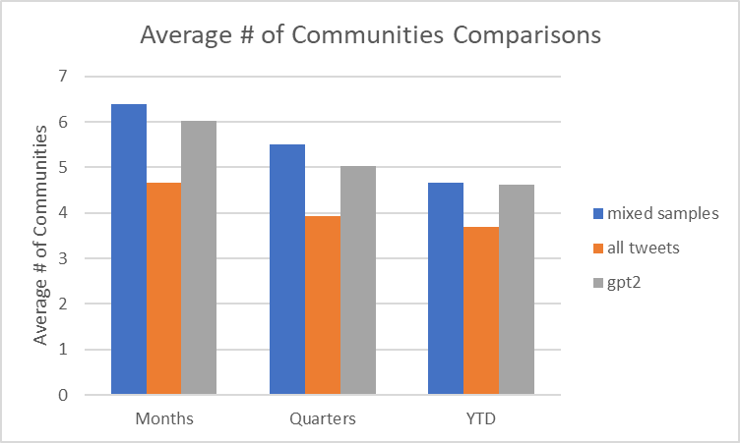
GPT-2 Trump Generation Results
Generated tweets are generally very high quality in terms of word choice and tone, so expectation is that number of communities is low.
Results are low and similar to that of mixed sample from all users.

Slide 15
Conclusion

Slide 16
Summary
Individual users have their own vocabulary and their tweets tend to form 4 communities using Louvain.
When users tweets are analyzed mixed together, tweets form 5 communities using Louvain.
GPT-2 does a pretty good job of faking user tweets, but not as focused as individual users, leading to more communities.

