Slide 1
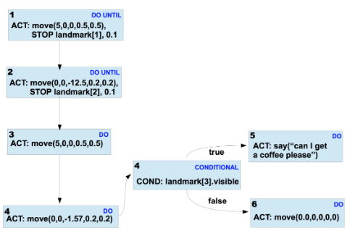
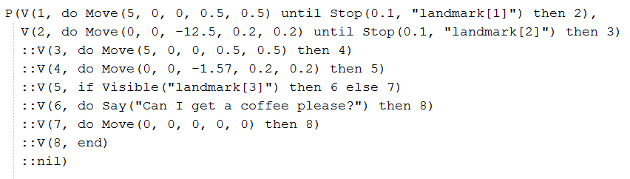
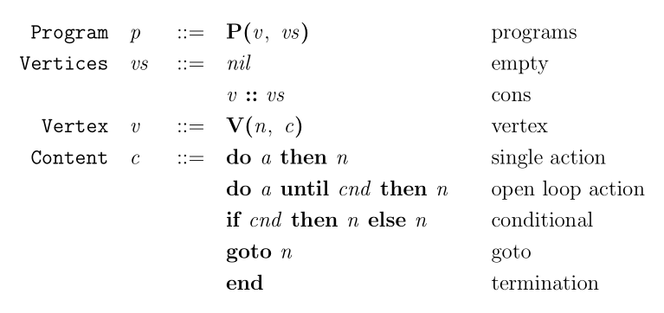
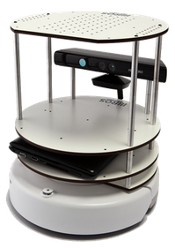
A Domain-Specific Programming Language for Robots Based on Instruction Graphs
Andrew Benson
Advisor: Jonathan Aldrich
Introduction
The Instruction Graph Language
Type Safety for Instruction Graphs
Instruction graphs are a recently proposed data structure that encodes a sequence of pre-determined actions for a robot to perform [1]. For example, in order for a robot to purchase coffee, a robot might move forward, looking for a barista every 5 meters, then ask for a coffee once a barista is found. The corresponding instruction graph for this group of tasks can be seen below.
We contribute a formalization of instruction graphs as a domain-specific programming language. A program in this language can be viewed as a list of vertices, each with its corresponding task and its possible tasks to follow (which are edges in the instruction graph). The instruction graph program that describes the instruction graph to the left can be seen below.
We showed type safety for the instruction graph language by first defining statics and dynamics for this language, then proving statements of progress and preservation.
We define these in terms of a configuration cfg which represents a program midway through execution. A cfg is a tuple (n, vs, I, O) representing respectively the current task being executed, the list of vertices in the instruction graph, the input sensory data to the robot, and the output actions performed by the robot.
Theorem 1: Progress
If cfg cfgvalid, then either
cfg terminated
cfg waiting
There exists cfg’ such that cfg -> cfg’.
Theorem 2: Preservation
If cfg cfgvalid and cfg -> cfg’ then cfg’ cfgvalid.
Instruction graphs can be expressed succinctly in this language. The grammar’s production rules are below.
Each individual task or condition is considered a vertex in the instruction graph, and the possible tasks a robot could perform after a task are its neighbors in the graph.
Instruction Graph Interpreter
To show the feasibility of this language, we wrote an interpreter in Python for the instruction graph language. The interpreter simulates the tasks of a robot using the TurtleBot simulator, an open source mobile robot simulator.
References
[1] Cetin Mericli, Steven Klee, Jack Paparian, and Manuela Veloso. An Interactive Approach for Situated Task Specification through Verbal Instructions. In Proc. of AAMAS, 2014.
a and c are respectively actions and conditions that are specific to a particular robot. In the example above, Move and Say are actions, and Stop and Visible are conditions.
The code for the interpreter can be found at https://github.com/anbenson/instructiongraphs.

