Slide 1
Backend Development
WebDevWeeks – ScottyLabs – Andrew Benson

Slide 2
If you haven’t set up your laptop, do it NOW
http://scottylabs.org/webdevweeks/backend/

Slide 3

We are ScottyLabs
We help people make their dream projects come to life.
Also, TartanHacks – that’s us.
http://www.scottylabs.org

Slide 4
Web Dev Weeks
September 4
Frontend, 8:00pm - 10:00pm, WEH 5202 (Windows Cluster)
Backend, 7:30pm - 9:30pm, PH 125B
September 5
HTML/CSS, 5:30pm - 7:30pm, WEH 5201 (Mac Cluster)
September 6
No sessions
September 7
Design, 2:30pm - 4:30pm, WEH 5421
September 8
No sessions
September 9
Backend, 7:30pm - 9:30pm, WEH 5201 (Mac Cluster)
September 10
Design, 8:30pm 10:30pm, PH 126A
September 11
HTML/CSS, 5:30pm - 7:30pm, CFA 317
September 12
Frontend, TBA
September 13
Deployment, TBA
September 15
Deployment, TBA

Slide 5
Startup Tour
Meet Pittsburgh startups. For free.
First one: September 19, application deadline: September 10
Alphalab, Blue Belt Technologies, Project Olympus

Slide 6
Hack+
Semester long hackathon
Awesome mentors
Hackplus.acmatcmu.org

Slide 7
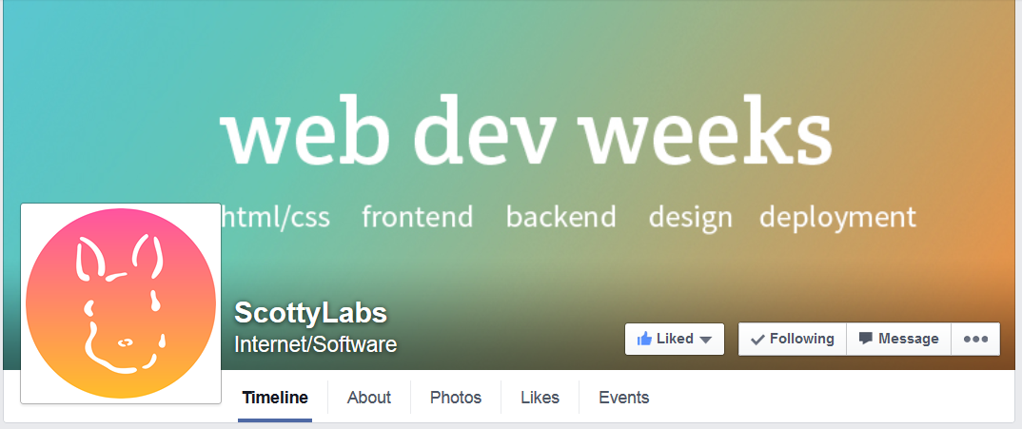
Like us on Facebook

Slide 8
Webpages are just files
HTML = content
<!DOCTYPE html>…
CSS = styling and looks
body { background:…
JavaScript = interactivity
document.onload(function(){…
“View page source”

Slide 9
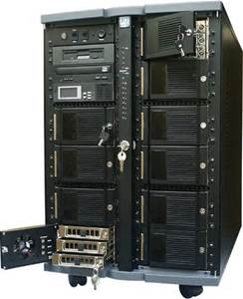

Webpage files are requested from servers
Request: create page from webdevblog
OK request, response is <!DOCTYPE html><html…
A FEW REQUESTS LATER
Request: give this data to new-post on webdevblog: name=“Andrew”&title…
Client - Firefox
OK request, response is redirecting to home page of webdevblog
WebDevBlog Server
Developer Tools Network Profiler

Slide 10
Webpage files are requested over HTTP
GET /create HTTP/1.1
Host: webdevblog.herokuapp.com…
HTTP/1.1 200 OK…
<!DOCTYPE html><html…
A FEW REQUESTS LATER
POST /newpost HTTP/1.1
Host: webdevblog.herokuapp.com…
name=“Andrew”&title…
Client - Firefox
WebDevBlog Server
HTTP/1.1 302 FOUND…
HTTP over Telnet

Slide 11
GET vs POST
GET is used when clients request that the server sends them data
POST is used when clients request that the server takes their data
HEAD
PATCH
DELETE

Slide 12
Start Lab
https://docs.google.com/document/d/1dUa36KFGPPwruOIOxDfKkVyqf5ZboZ0AiHdyNYniFWA/edit
http://goo.gl/8eEqYc

