Slide 1

Approach to Machine Learning in Business Applications
Dr. Anna Bernhard
THI in Ingolstadt, 16.10.2018

Slide 2

Learning goals
You know the different steps of a machine learning project
You can bring the steps of such a project in the right order and give examples for each step
You know the difference between supervised and unsupervised learning algorithms

Slide 3

Exercise: How would you start?
Bring these steps in the right order!
Model data
Communicate results
Define a problem
Implementation and Maintenance
Aquire data

Slide 4
Exercise: How would you start?
Define a problem
1
Aquire data
2
3
Model data
4
Implementation and Maintenance
5
Communicate results

Slide 5


A Project Lifecycle is iterative
Define a problem
1
A typical machine learning project should follow these steps
Define a problem
Acquire Data and explore data
Model data with ML algorithm
Implementation and Maintenance
Communicate results
Acquire data
2
Communicate results
5
Model data
3
Implementation & Maintenance
4
A given algorithm may work fine on 25MB of data, but may require changes in implementation to work with 25GB
Scale is central to the iterative approach
Validate an approach with a small sample of data and use a large amount of data to refine a proven solution (POC, Proof of Concept)
The approach will be explained based on an example of a fictional booking platform that wants to create flexible pricing
stayhere
Notes:
Scale is central to the itera=ve approach
– Validate an approach with a small sample of data
– Test implementaGon with a moderate amount
– Use a large amount of data to refine a proven soluGon
§ Implementa=ons and even algorithms themselves may hit limits
§ A given algorithm may work fine on 25MB of data
– But may require changes in implementaGon to work with 25GB
– And may be impossible to scale to handle 25TB
§ Each itera=on may involve a change to the amount of data used
– And to the code you use to analyze it

Slide 6




Define the Problem
1
The process begins by specifying a problem
This is often directly related to revenue or costs:
“People browse our site but don’t buy anything”
“Subscribers aren’t renewing their service”
“Our employees spend too much time searching for documents”
=> Translate a business case into a mathematical problem
1
Example: stayhere
$80
Problem: „There are too many unbooked nights“
Desired Outcome: reduce unbooked nights by 30%
Possible Solution: offer unbooked nights for a lower price
„smart pricing model: suggest prices depending on seasonal variations“
$100

Slide 7

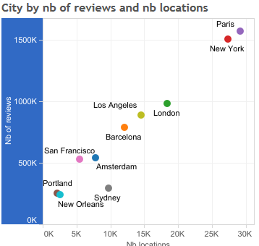
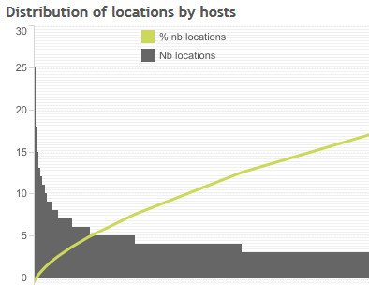
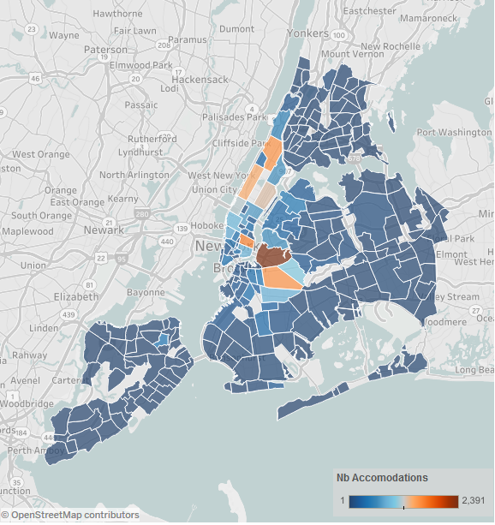

Acquire and explore Data
2
Approach:
Collect all of the relevant data and assess quality
Prepare and clean your data (e.g. filter out wrong data..)
Getting it into a format suitable for analysis, most likely into a flat file format such as a .csv or in a database
Do an exploratory data analysis (statistical overview) e.g. scatter plot, histograms…
2
Example: stayhere
Source: Jonathan Trajkovic https://public.tableau.com/en-us/s/blog/2015/07/analyzing-airbnb-data

Slide 8




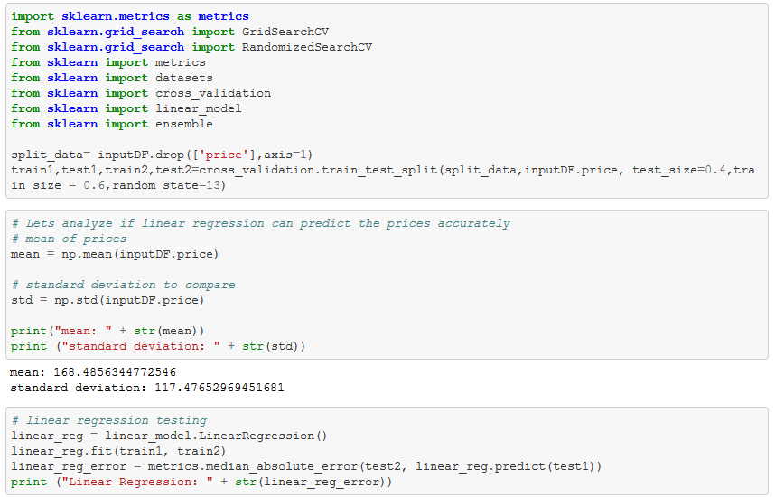
Model Data – two categories
3
Machine learning tasks are typically classified into two broad categories, depending on whether there is a learning "signal" or "feedback" available to a learning system:
Supervised learning:
The computer is presented with example inputs and their desired outputs, given by a "teacher“
The goal is to learn a general rule that maps inputs to outputs. Example: genre categorization of films
Approach:
Determine your target variable, the factor of which you are trying to gain deeper understanding.
Define your ML method and language/tools (R, python…)
Start with a POC (Proof of Concept) on a small amount of data
Split your data sample into a test and training set for cross-validation
Unsupervised learning:
No labels are given to the learning algorithm, leaving it on its own to find structure in its input.
Unsupervised learning can be a goal in itself (discovering hidden patterns in data) or towards a specific outcome. Example: customer segmentation
3
Example: stayhere
Code of supervised learning method „linear regression“

Slide 9



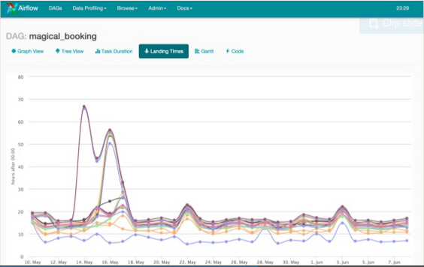
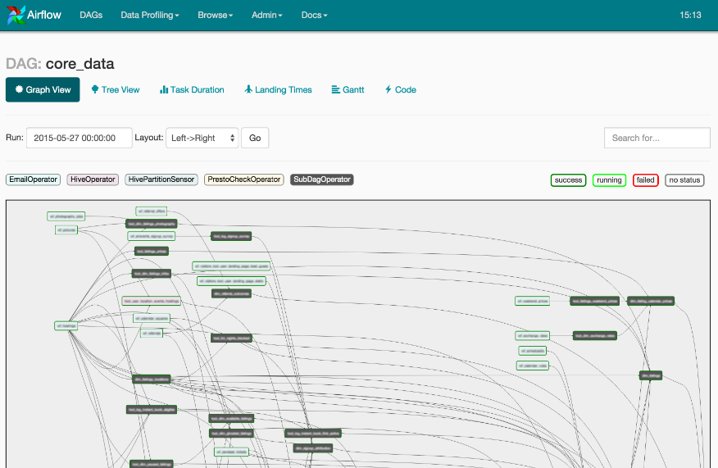
Implementation and Maintenance
4
Approach:
Set up API (Application Programming Interface) system with an automated workflow
Document modelling process for reproducibility
Write tests for the code
Create model for monitoring/logging and maintenance
4
Example: stayhere
Source: Data Works Summit, Airflow - An Open Source Platform to Author and Monitor Data Pipelines

Slide 10
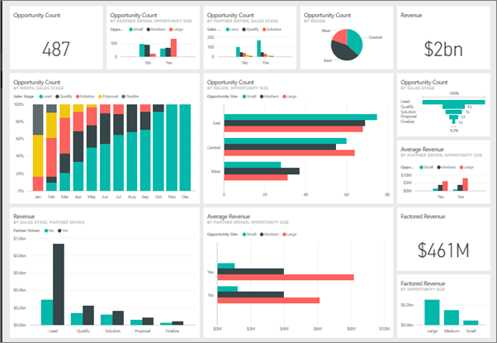
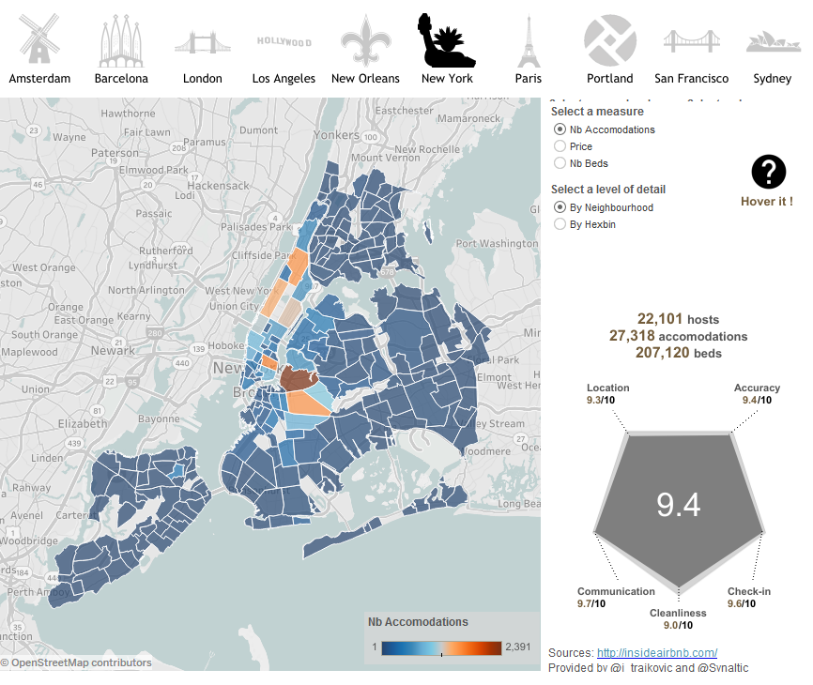
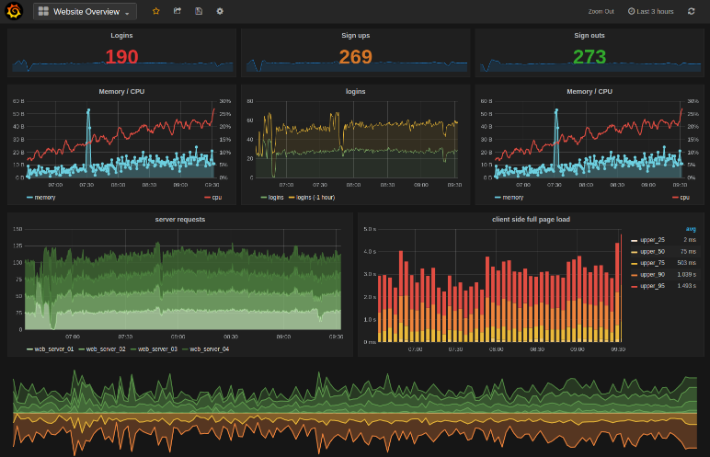
Communicate results
5
Approach:
Communication is an essential part of the process
Create meaningful visualizations that represent the data
Dashboards are a common tool for communicating results
Good for Statistics, Summaries, Visualizations
Get Customer feedback for further iterations
5
Example: stayhere
Source: Jonathan Trajkovic https://public.tableau.com/en-us/s/blog/2015/07/analyzing-airbnb-data

Slide 11


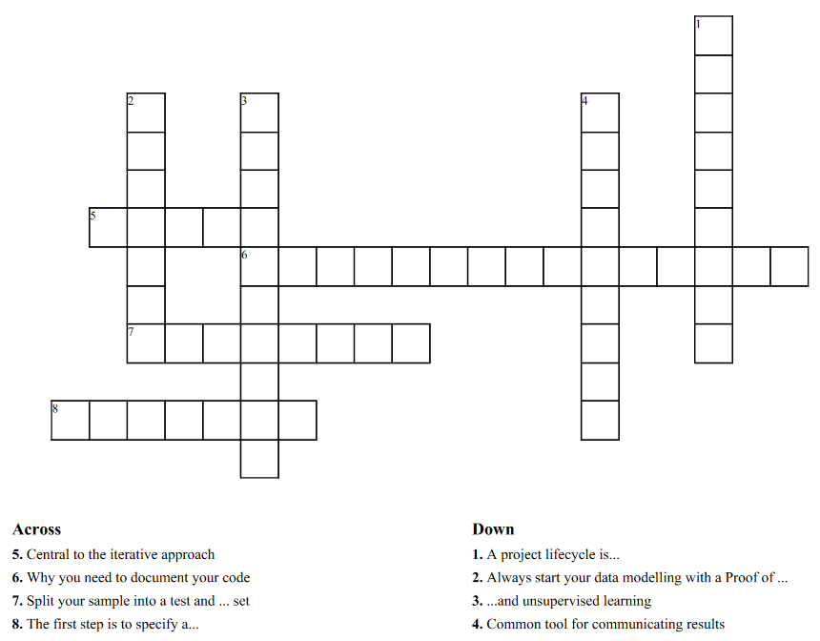
Outlook
Next lecture:
Introduction into exploratory data analysis (EDA) and visualization
For those interested in the analysis of the Airbnb data: https://github.com/ruchigupta19/Boston-Airbnb-data-analysis
Homework: Check your understanding!

Slide 12
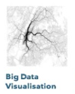
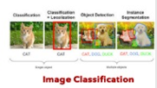

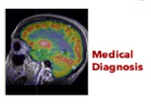

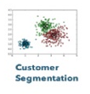





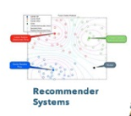
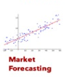
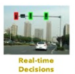
Exemplary overview on machine learning applications
Dimensionality Reduction
Unsupervised Learning
Machine Learning
Supervised Learning
Classification
Clustering
Regression
Reinforcement Learning
Linear regression
3

Slide 13
Examples of classification problems:
Will the customer buy this product or not buy this product?
Is this email spam or not spam?
Is this product a book, movie, or clothing?
Which category of products is most interesting to this customer?
Examples of regression classification problems:
What will the temperature be in Seattle tomorrow?
For this product, how many units will we sell?
What price will this house sell for?

Slide 14
Testing of the algorithm
Cross-validation
Split data in test and trainings data

Slide 15

Improve stayhere‘s business
There are so many unbooked nights
Can we do a machine learning project?
We don‘t earn money with unbooked nights
What do I need to do in a machine learning project?
stayhere
How to approach this task?

Slide 16

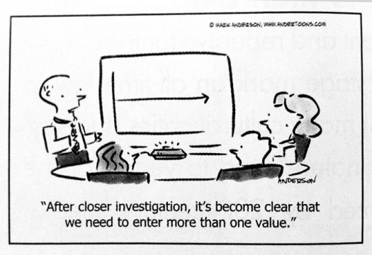
Outlook
Next lecture:
Introduction into exploratory data analysis and visualization
For those interested in the analysis of the airbnb data: https://github.com/ruchigupta19/Boston-Airbnb-data-analysis
Cartoon by Mark Anderson, www.andertoons.com

