Slide 1
Full Stack Machine Learning in AWS Course Project Heart disease prediction Andrey Beylin, 06/2020

Slide 2
Presentation Plan:
Data and Problem
Description and properties of data features
Algorithms
Data preparation for training
Balancing data classes
Versions of training data
AWS training jobs
Training results
Possible next steps

Slide 3
Data and Problem
We are solving binary classification problem trying to predict whether the patient has 10-year risk of future coronary heart disease (CHD).
The data includes over 4,000 records and 15 attributes, they are both demographic, behavioral and medical risk factors of patients.
The dataset is publicly available on the Kaggle website, and it is from an ongoing cardiovascular study on residents of the town of Framingham, Massachusetts.
Data link https://www.kaggle.com/dileep070/heart-disease-prediction-using-logistic-regression

Slide 4
Features description
Sex: [0, 1].
Age: continuous.
Current Smoker: [0, 1] - whether the patient is a current smoker.
Cigs Per Day: continuous - the number of cigarettes that the person smoked on average in one day.
BP Meds: [0, 1] - whether the patient was on blood pressure medication.
Prevalent Stroke: [0, 1] - whether the patient had previously had a stroke.
Prevalent Hyp: [0, 1] - whether the patient was hypertensive.
Diabetes: [0, 1] - whether the patient had diabetes.
Tot Chol: continuous - total cholesterol level.
Sys BP: continuous - systolic blood pressure.
Dia BP: continuous - diastolic blood pressure.
BMI: continuous - Body Mass Index.
Heart Rate: continuous - heart rate.
Glucose: continuous - glucose level. Target for prediction
10 year risk of coronary heart disease CHD: [0, 1] - “1”, means “Yes”, “0” means “No”.

Slide 5
Features consistency
Systolic and diastolic blood pressure are highly correlated with each other: corr(sysBP, diaBP) = 0.78 This is what we should expect from medical knowledge.
We can see that for people with prior hypertension blood pressure is higher. mean(sysBP for PrevHyp=0) = 122 < 155 = mean(sysBP for PrevHyp=0) This is expected from features definitions.
Current smokers and cigs per day are consistent with each other, that is cigs per day = 0 only if current smoker = 0 (False.)

Slide 6
Data properties
Class imbalance Out of total 4240 data points we have 3596 with target = 0 and 644 with target = 1. This is a very large imbalance between classes which we have to account for.
Missing values There are some missing values in the data education 105
cigsPerDay 29
BPMeds 53
totChol 50
BMI 19
heartRate 1
glucose 388
Categorical value for ‘education’. Feature education can take values [1,2,3,4] which correspond to progressively higher levels of education. It could be seen either as continuous value or categorical value, we can try both versions.

Slide 7
Possible problems with data
Overall this is quite a decent quantity of data, but it has some problems. If possible, the goal should be to collect more and higher quality data:
To improve balance between classes
Try to avoid having missing values
Collect data from different hospitals to avoid possible biases due limited patient sample.

Slide 8
ML Algorithms
For this binary classification task we will use XGBoost and Logistic Regression.
XGBoost
Can take care of missing values
Can take care of data imbalance
Should be better to one-hot-encode categorical variable ‘education’
Not necessary normalize/standardize variables
Logistic Regression
We have to take care of missing values before using algorithm
We need to use balanced dataset
We can leave education as continuous variable
It’s better to normalize/standardize features

Slide 9
Taking care of class imbalance
We want to compare how algorithms will perform on the same data. Thus, even thou XGBoost can work on imbalanced data we will ran both XGBoost and Logistic regression on balanced dataset.
I will try two approaches – subsample and data generation.
Subsample: Take all available data with target = 1, and randomly pick equal count of rows from data with target = 0
Data generation: Since we have quite little data with target = 1, I am afraid subsampling will make training data too small and prone to overfitting. Instead let’s use available 644 rows with target = 1 to generate 3596 rows to have 50/50 ratio between target = 1 and target = 0. To generate additional 2952 rows we will use following algorithm:
Get random data row with target = 1.
Keep all binary features the same.
Slightly randomly move most of the continuous features. I was adjusting medical measurements, since they may be more volatile: .totChol, sysBP, diaBP, BMI, heartrate, glucose. For each I
Calculated standard deviation std from available data (once in the beginning).
Used random sample from normal distribution with this std to adjust this value for generated data row.
This resulted in two datasets:
one with 644*2 rows of sampled data and another with 3596*2 rows of generated data.

Slide 10
Preparing data for training
Each of the created datasets (sampled and generated) I will prepare for each training algorithm. Specifically:
For XGBoost:
One-hot-encode ‘education’
For logistic regression:
Fill missing values:
Education with 1, BPMeds with 0
totChol, BMI, heartrate, glucose with average value
cigsPerDay with 0 if non-smoker or with average value if smoker
Min-max normalization for cigsPerDay and education
Standardization for totChol, sysBP, diaBP, BMI, heartrate, glucose.
I ended up with 4 types of data, which I split into train/test portion 70%/30%, then convert to AWS format and load to S3 for training.

Slide 11
Logistic regression – hyperparameters and training jobs.
There are several hyperparameters I tried to adjust in AWS for logistic regression:
mini_batch_size – fixed at 100.
epochs – I tried 10 and 50, but there was no different, so I set it at 10.
optimizer – fixed as ‘sgd’.
binary_classifier_model_selection_criteria – F1 or cross-entropy.
loss – logistic or hinge.
Overall I ran 10 different training jobs, screenshots below.

Slide 12
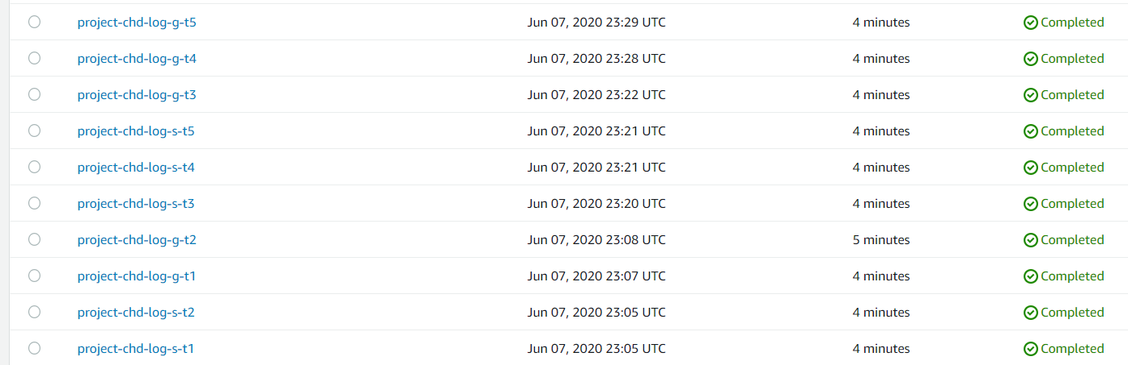
Logistic regression training jobs

Slide 13
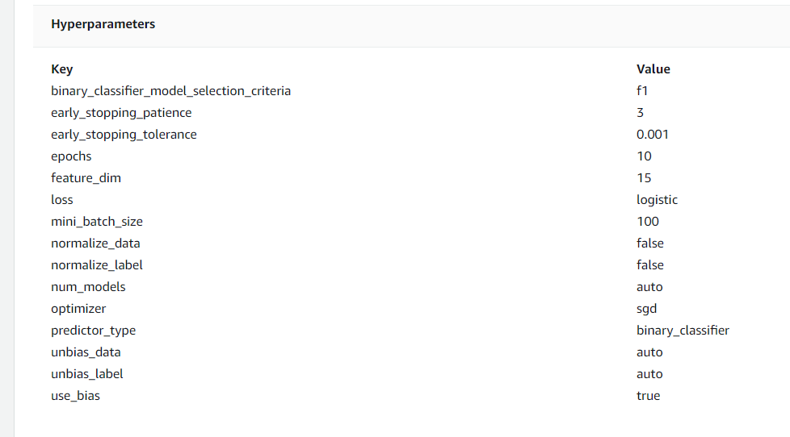
Logistic regression hyperparameters of the best model

Slide 14
XGBoost– hyperparameters and training jobs.
XGBoost has a lot of parameters to adjust, but it is also performing very well with default settings.
I only tried to adjust a few of them:
num_round: First I tried 10, 25 and 100. There are noticeable improvements from 10 to 100 so later I stayed with num_rounds = 100. These runs where done with all default parameters except subsample = 0.8 and max_depth = 5
num_rounds = 10 -> train:error = 0.19, validation:error = 0.24
num_rounds = 25 -> train:error = 0.11, validation:error = 0.16
num_rounds = 100 -> train:error = 0.02, validation:error = 0.09
max_depth: probably one of the most important parameters of xgboost. If there are only a few features and not a lot of training data, algorithm would readily overfit with too much tree depth. It was visibly overfitting with max_depth = 6, but with max_depth = 4 performance grows worse.
I also tried to adjust eta = [0.3, 0.5] and subsample = [0.5, 0.8, 1], but with no improvements.
Overall I ran 11 training jobs with XGBoost, screenshots below.

Slide 15
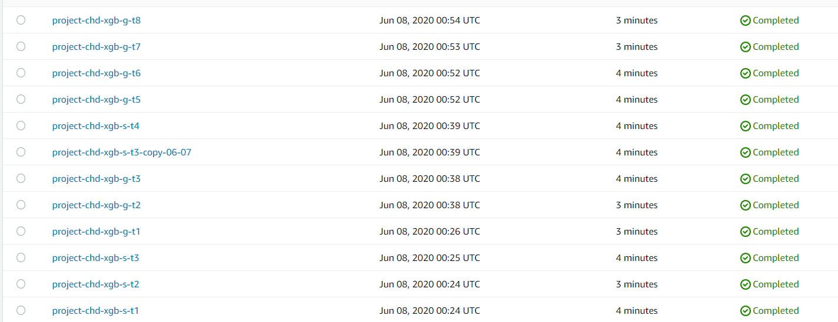
XGBoost training jobs

Slide 16
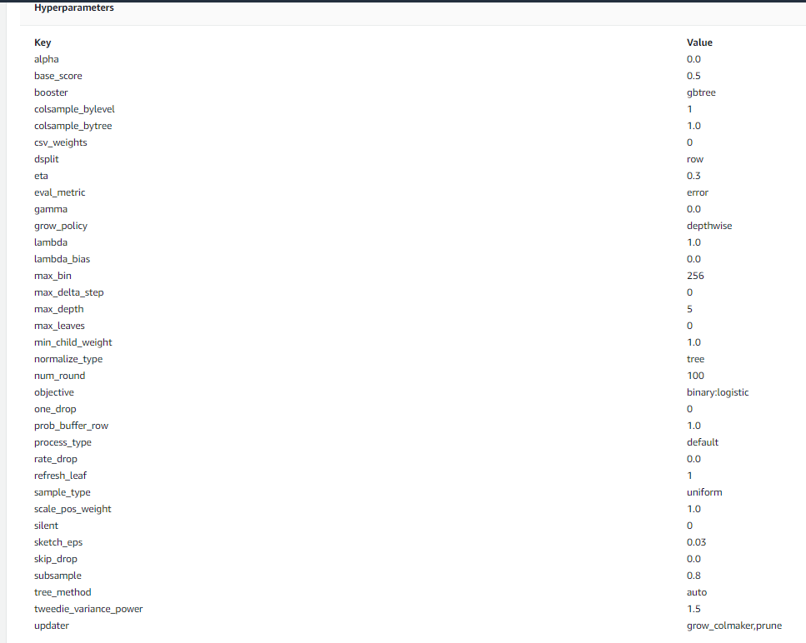
XGBoost hyperparameters of the best model

Slide 17
Training results – Logistic regression
Logistic regression best model:
Train:accuracy = 0.623, Test:accuracy = 0.619
Train:precision = 0.578, Test:precision = 0.575
Train:recall = 0.917, Test:recall = 0.910
Model is trained on dataset with extra generated data for target = 1. It has noticeably better performance, probably because dataset is larger.
Two things to note in this performance:
Test metrics are almost the same as training, so this model should have very predictable performance on real data.
Recall is very high while, precision is low. I do not know why it happened, however this is very good for disease prediction – you generally want high recall.

Slide 18
Training results – XGBoost
XGBoost best model:
Train:error = 0.020, validation:error = 0.094
Unfortunately, AWS do not report precision and recall metrics for xgboost jobs.
Nevertheless, performance is very high. However it is hard to be sure that this model did not overfit.

Slide 19
Possible next steps
Calculate precision and recall for xgboost model to compare it with logistic regression.
Do xgboost training with K-fold cross-validation and to control for overfitting.
Investigate feature importance for each algorithm.
Investigate why recall is high and precision is low for logistic regression.

