Slide 1


Supervisor Dr. Omer Baig Department of Computer Science
Aneeb Hassan i14-0329
Muhammad Aqib i14-0224
Rana Zubair Jawad i14-0285

Slide 2

Goal
Introduction
Mobile application
Find different type of events happening in your city
Validate event’s success rate for a user hosting a new event in the near future
Recommend users events that they would most likely like to attend in the near future
Outcome:
Removing all the hassle
Informed decisions regarding management and business perspective

Slide 3
Data Scrapping/Extracting and classification
Beautiful Soap (HTML and XML files)
HTML tags
xlwt module
Script(Scheduler, post API)

Slide 4
FireBase
User table
Events table
User-Event table
Recommendation table

Slide 5
Android Development
User History Class
Category Class
Firebase Class

Slide 6
Twitter to obtain data
Tweep to get tweets
Preprocessor to clean it
Clean_tweet Function
Textblob
Sentiment
Polarity
Sensitivity

Slide 7
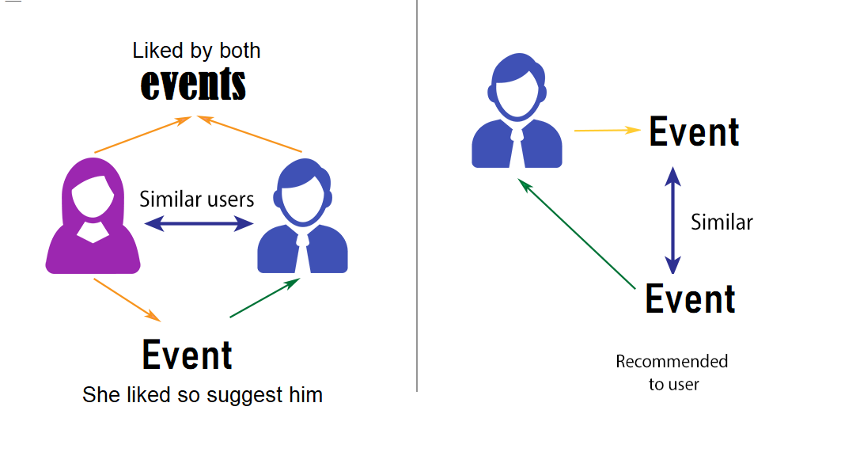

Slide 8
“A subclass of information filtering system that predicts the rating or preference a user would give to an item”
Type of Filtering Techniques
Content–Based Filtering (CBF)
User Content
Item Content
Collaborative Filtering (CF)
Users rating behavior
Relevant Event Recommender uses a hybrid approach
Cold start cater
Weighted predictions – better filtering

Slide 9
Backend: Python
Preprocessing Data
Cleaning (e.g. remove symbols)
Lower casing Normalization
Lemmas
Stop words remove
Models
KNN (Clustering method - unsupervised learning)
TFIDF (Frequency based model)
Single Value Decomposition
Cosine similarity
Dataset
Movieslen (Collaborative filtering)
Scrapped Events data (Content-Based filtering)
Front-end:
Mobile application
Android
9

Slide 10
Incorporating within the android studio/application:
recommendation system
DataBase
(flask API-> Get and post)Scrapping

Slide 11

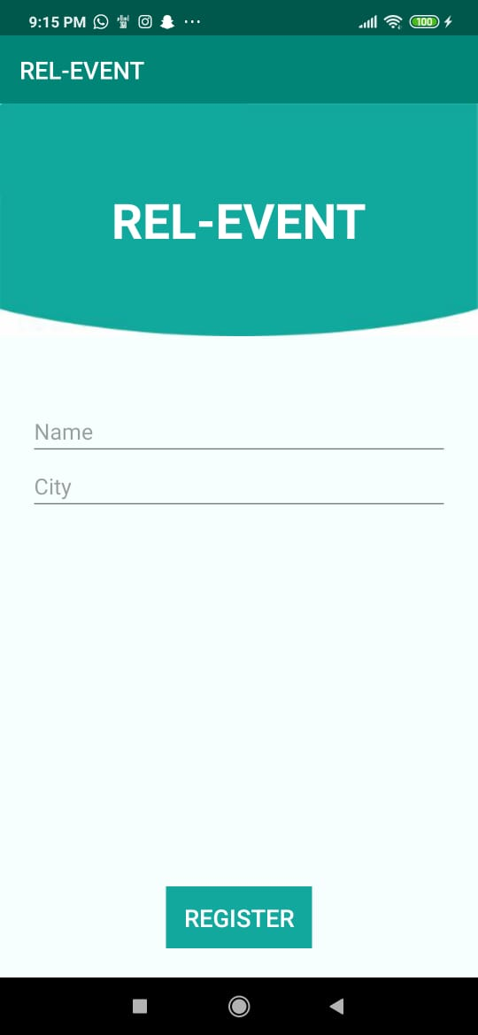
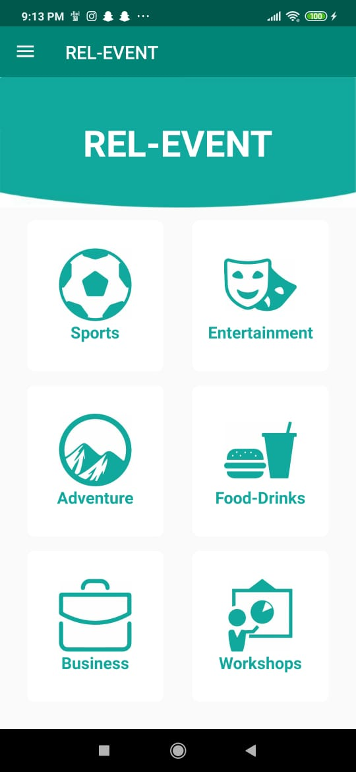
User Interface
Simplistic in Nature
2 Color Scheme Pattern
Consistent
Laws of Similarity
Aesthetic-Usability Effect
11

Slide 12
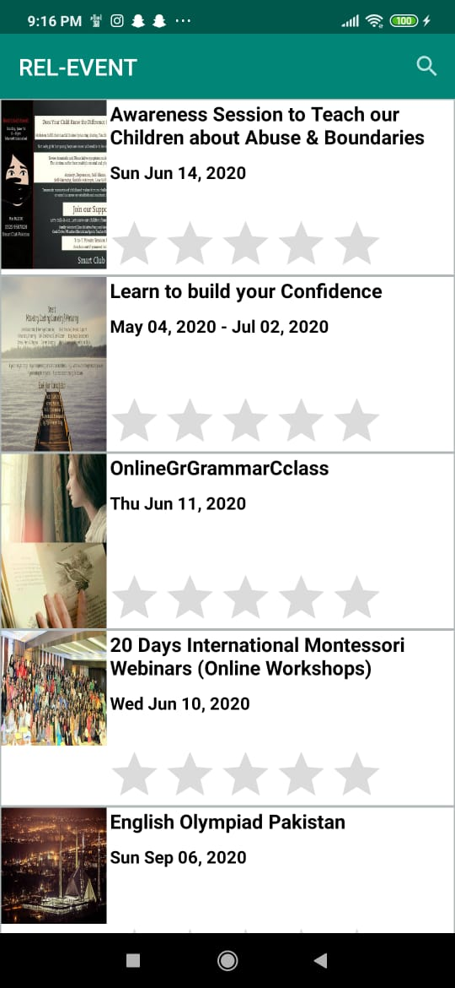
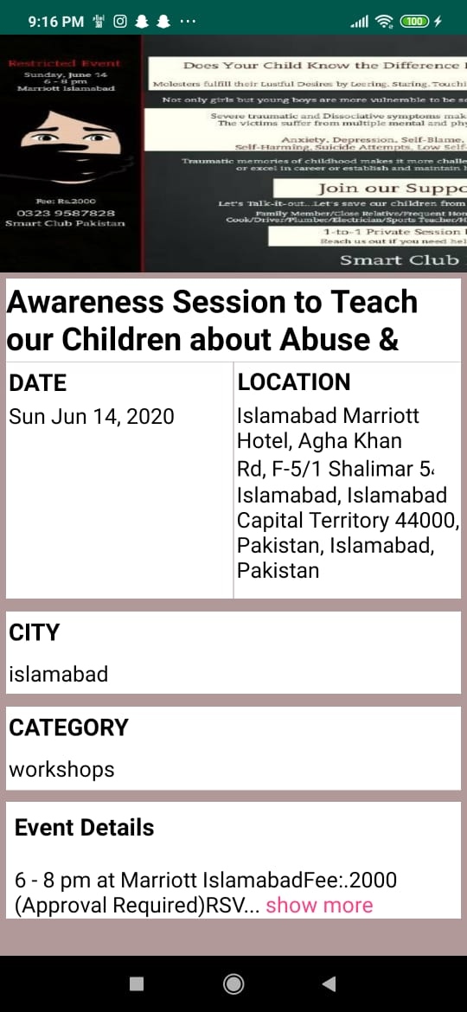
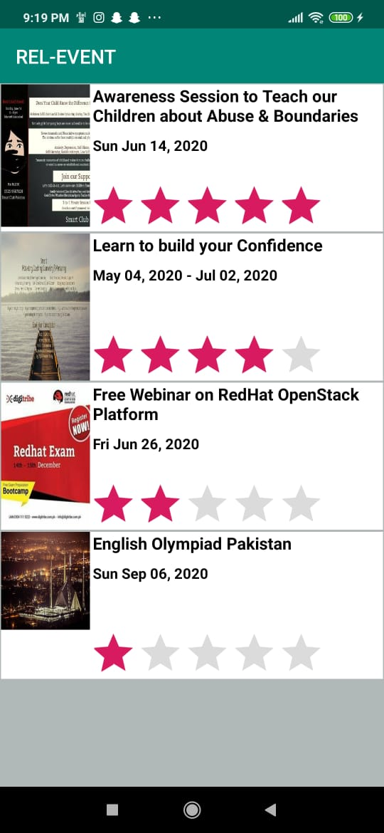
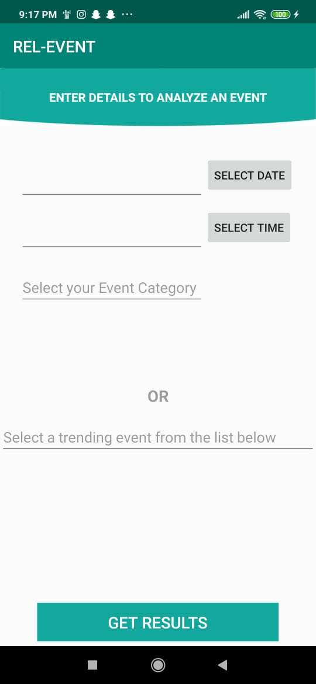
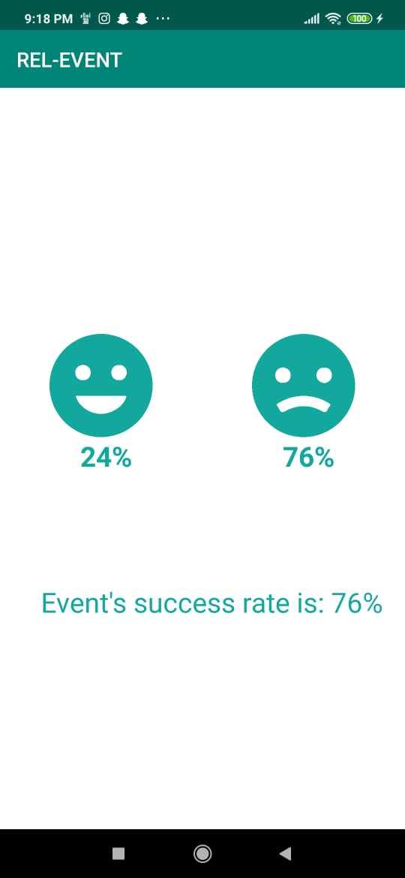
Conclusion
User Interface
12

Slide 13
THANK YOU ☺
Conclusion
13

Slide 14
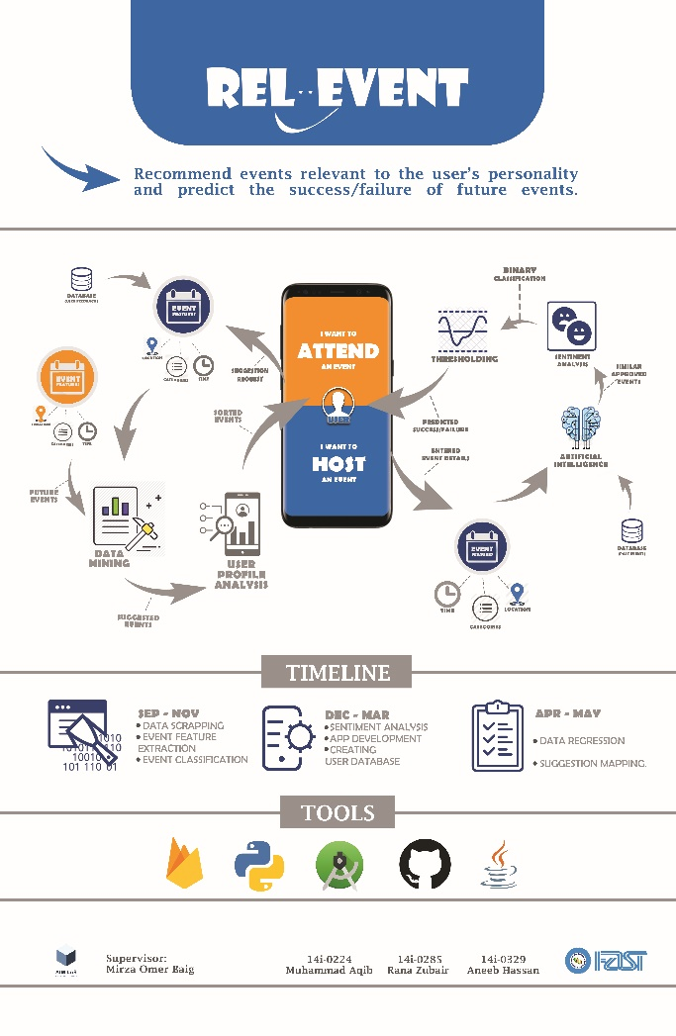
FYP POSTER

Slide 15
Demonstration
15

