Slide 1


Relevant
Aneeb Hassan i14-0329
Aqib Alvi i14-0224
Rana Zubair Jawad i14-0285
Supervisor
Dr. Omer Baig Department of Computer Science

Slide 2
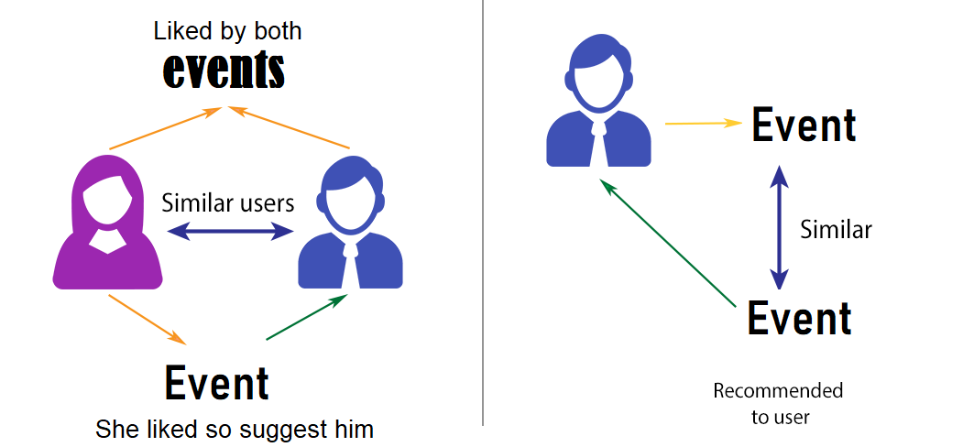

Goal
Mobile application with an event based environment
Recommend users events that they would most likely like to attend in the near future
Validate event’s success rate for a user hosting a new event in the near future
Recommendation system

Slide 3

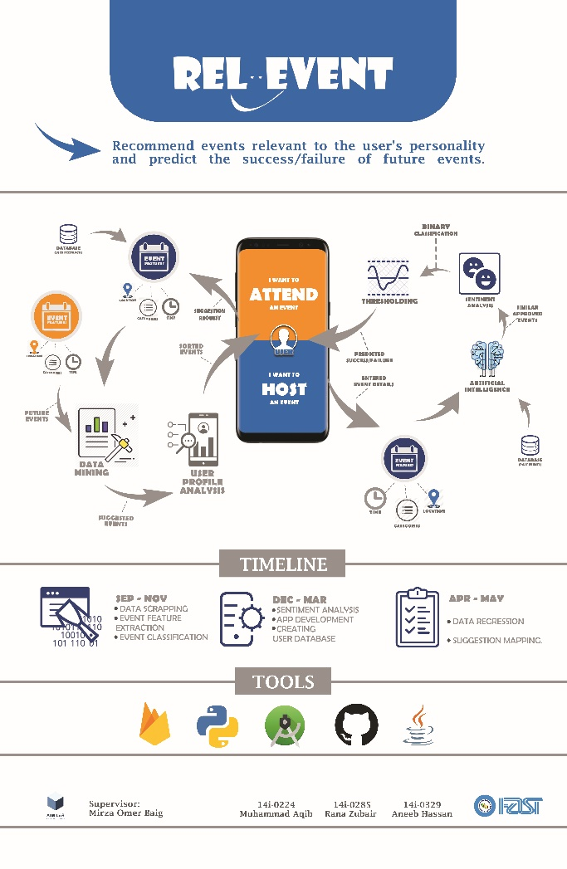
FYP POSTER

Slide 4
Scrapping and Extraction
Android Development
Database Development
Recommendation Engine
Sentiment Analysis
Integration

Slide 5

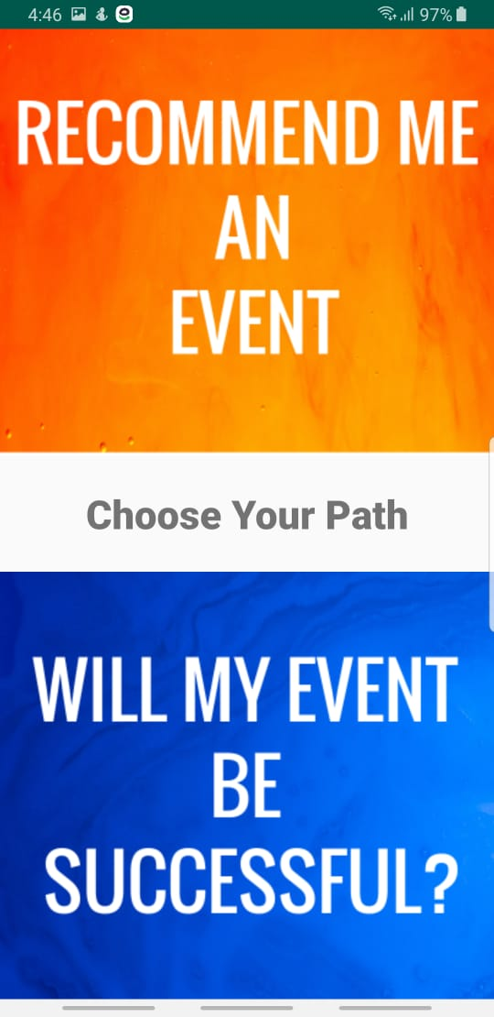
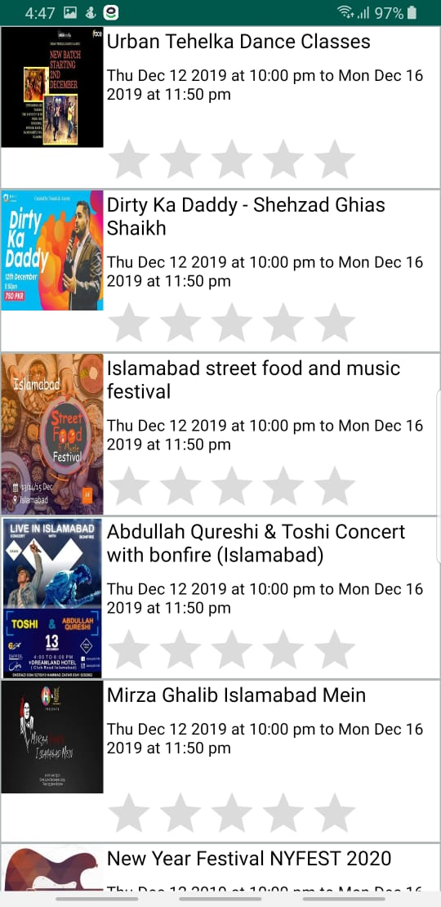
Front-end Application
5

Slide 6
Recommendation System
“A subclass of information filtering system that predicts the rating or preference a user would give to an item”
Type of Filtering Techniques
Content–Based Filtering (CBF)
User Content
Item Content
Collaborative Filtering (CF)
Users rating behavior
Relevant Event Recommender uses a hybrid approach
Cold start cater
Weighted predictions – better filtering

Slide 7
Hybrid Approach
1. Cold Start
Random start
Even sampling from all categories
Item based content filtering
TFIDF on features (event description, location, time, category)
Cosine similarity
Latent Dirichlet Allocation (LDA)
Topic Extraction through unsupervised learning
Bag of words features (description, location, time, category)
Conditional Probability

Slide 8
Hybrid Approach
2. After Cold Start
Popularity based item content filtering
Vote count and vote average
Collaborative filtering
Neighboring based method
Users Rating behavior
K nearest neighbor (KNN)
Matrix Factorization using single value decomposition
Individual user Rating based collaborative filtering

Slide 9
Recommender
Backend: Python
Preprocessing Data
Cleaning (e.g. remove symbols)
Lower casing Normalization
Lemmas
Stop words remove
Models
KNN (Clustering method - unsupervised learning)
LDA (Topic extraction - unsupervised learning)
TFIDF (Frequency based model)
Single Value Decomposition
Cosine similarity
Dataset
Movieslen (Collaborative filtering)
Scrapped Events data (Content-Based filtering)
Front-end:
Mobile application
Android
9

Slide 10
Conclusion
A recommendation system is a subclass of information filtering system that predicts the "rating" a user would give to an item.
Rel-event uses a hybrid approach based Event Recommendation system. It involves two filtering techniques; Content–Based Filtering (CBF) and Collaborative Filtering (CF).
Future work
Improve Accuracy Recommendation Model
User Based content filtering
Sentiment analysis
Updating Interface
THANKYOU
10

Slide 11
Demonstration
11

