Slide 1
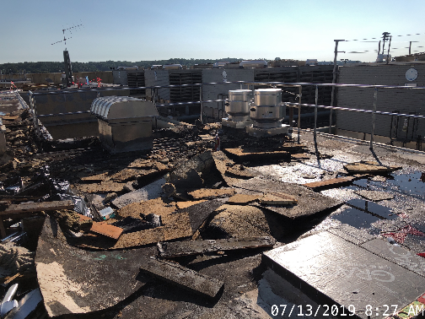
LESSONS LEARNED – RICKOVER HALL ROOF FIRE
Incident: The contractor was installing temporary roof patches after a welder installed handrails on the roof prior to an upcoming roof replacement. The Contractor’s carpenter was torching down a temporary patch and caught the existing roof insulation on fire. The initial fire was extinguished with fire extinguishers and water and the Contractor posted a fire watch for at least 2 hours. Around 4pm, contractor was convinced the fire had been entirely extinguished and left the site. Around 9pm, the utilities rover noticed smoke coming from the roof and called the Fire Department. Fire Department found an active fire on the roof and extinguished it with water. The Fire Department also connected to an FDC that was out of service due to ongoing renovations. The heat of the fire caused activation of a sprinkler head below the roof , all of which caused significant inundation of water throughout the building.
Causes and Lessons Learned:
Carpenter performed “torch-down” patching using a cold patch product whose label instructs not to apply heat to the product. This mistake may have triggered or accelerated the ignition of fire in the insulation. Workers must be familiar with the products and follow instructions.
Contractor’s carpenter performed the patching because the roofer wasn’t on site that day. Workers must be experienced and trained in the type of work they are performing.
1

Slide 2
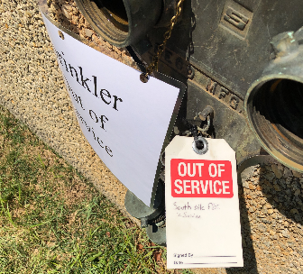
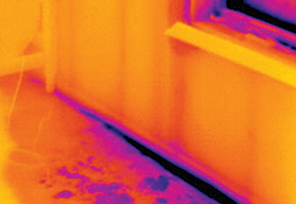
LESSONS LEARNED – RICKOVER HALL ROOF FIRE
Causes and Lessons Learned (continued):
Contractor did not notify the Fire Department of the initial fire. The Fire Department would use a heat sensing tool and other methods to determine that the fire had not been 100% extinguished or continued to check the roof for fire throughout the evening. Govt Safety Requirements and Roofing Specification Sections in addition to Hot Work Permits all require contractor to “report any fire, no matter how small, to the responsible fire division immediately.”
4. The Fire Department unknowingly connected to
an FDC that was not in service and
exasperated water damage. LOTO shall be
performed of all FDC’s removed from
service. LOTO shall be reviewed with Fire
Marshall during issuance of burn permits.
2

Slide 3
Similarities to Recent Fires on NAVFAC Roofing Projects (NAS JAX B110, 124 and Camp Lejeune HS)
Unqualified personnel, either non-roofers or roofers without CERTA certification and/or not certified on the roofing system being applied, involved in roofing work that resulted in fire.
A fire watch was present and on site for the required 60 minutes following hot work.
Smoldering material (insulation, wood nailing strips) ignited at some time after the fire watch was lifted.
Differences From Recent Fires on NAVFAC Roofing Projects
The roofing insulation ignited during hot work. The fire was extinguished by the work crew but not reported to the Station Fire Department as required.
The roofing patches used at Rickover Hall were a “cold patch” system that did not require heat for application. Use of a torch for installation was unnecessary and inappropriate.

Slide 4
The Way Ahead: Recommended Actions
Only trained/qualified personnel should perform roof installation work. Contract specifications should require proof (i.e. certificate) that all personnel working on roof installation are trained on the roofing system being installed. Certification to be provided as part of the Activity Hazard Analysis (AHA) for roof installation.
Only trained/qualified personnel should perform hot work during roofing installation/repair as required (i.e. using torch to activate adhesives). Contract specifications should require Certified Roofing Torch Applicator (CERTA) certification for all personnel performing hot work during a roof installation/repair project. Certification to be provided as part of the AHA for roof installation.
EM 385-1-1 Section 9 Fire Protection, paragraph 09.A.04.b states, “Areas shall be surveyed prior to performing any hot work to ensure they are free of fire hazards and to determine if a fire watch is required.” Contract specifications should require the contractor to submit a survey report as part of the AHA to ensure a survey has taken place, identify potential fire hazards such as nailing strips, and plan preventative measures.
EM 385-1-1 paragraph 09.K Fire Watch does not require monitoring with heat detection device (i.e. infrared camera or laser thermometer). However, in all four cases cited, doing so may have discovered the smoldering fire and prevented it from becoming a full blaze. Contract specifications should require that contractors performing hot work on a roofing installation/repair use an appropriate heat detection device to survey the work area prior to demobilizing the Fire Watch to ensure there are no potential fires present.
Communicate these recommendations via an Engineering and Construction Bulletin.

Slide 5
The Way Ahead: Recommended Actions (continued)
The NDW Fire Chief offered several recommendations following the Rickover Hall fire. Several were directed at establishing a stronger relationship between the FEAD and the local Fire Department. One specific recommendation stood out:
1. Hot work for roof operations should be covered under a separate hot work process and not included in a work site permit. This will ensure that the post inspection and fire watch process is adhered to by the fire department and the contractor (please note that this will be difficult at places that do not have organic fire department assets).
To make this happen, NAVFAC CI5 will work with NAVFAC Safety and/or CNIC Fire Safety to develop a hot work permit specifically tailored for roof work that can then be implemented in the field.

