Slide 1
31 March 2026
UNCLASSIFIED
DTRA Industry Day: TRIDENT (Decisive Action Follow-On)
Combat Support (CZ) Directorate, Program Management Office (PMO)
UNCLASSIFIED

Slide 2
Agenda
UNCLASSIFIED
Introductions and Logistics
Defense Threat Reduction Agency (DTRA) Overview
Combat Support (CZ) Overview
CZ Programs and Organizational Structure
Timeline and Next Steps
RFI Response Detail
Questions
UNCLASSIFIED

Slide 3
UNCLASSIFIED
Welcome & Introductions
DTRA PMO POCs:
Michael Hunt – Program Manager
Moronda Gage – Program Manager
DTRA Contracts POCs:
Christina Clark – Contracting Officer
Shaneice Brown – Contract Specialist
UNCLASSIFIED

Slide 4
Industry Day Rules of the Road
UNCLASSIFIED
All information, discussions and questions must be kept at the Unclassified level. There will be availability for Classified Discussions during pre-scheduled 1:1 session events.
Industry day is for research and planning purposes only; information provided does not represent a binding commitment by the U.S. Government.
This exchange of information does NOT constitute a Request for Proposal and is not to be construed as a commitment, implied or otherwise, by the Government that a procurement action will be issued.
Information in this presentation is subject to change.
The Government may not respond to any specific questions or comments. Any information submitted by respondents during this exchange is strictly voluntary.
UNCLASSIFIED

Slide 5
UNCLASSIFIED
Industry Day Purpose & Objectives
Purpose:
To explain the overall CZ vision and provide details regarding the requirements identified at this time.
The Government will present information regarding its current strategy and business drivers for a forthcoming acquisition.
Objective:
To encourage competition and facilitate partnering opportunities for both large and small business.
To provide an opportunity for Industry Partners (IPs) to ask questions and interact with the CZ-PMO Integrated Project Team (IPT).
UNCLASSIFIED

Slide 6
UNCLASSIFIED
Mission Overview
DTRA Mission:
DTRA provides cross-cutting solutions to enable the Department of War, the United States Government, and international partners to Deter strategic attacks against the U.S. and its allies; Prevent, reduce, and counter WMD and emerging threats; and Prevail against WMD-armed adversaries in crisis and conflict.
CZ Directorate Mission:
CZ provides advisory and operational support to Combatant Commands (CCMDs), Interagency partners, and Special Operations Forces (SOF) to enhance Countering Weapons of Mass Destruction (CWMD) capabilities. This support includes campaign management, operational planning, irregular warfare support, and WMD defeat advisory services.
UNCLASSIFIED

Slide 7
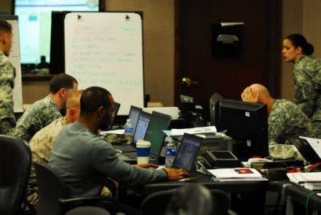
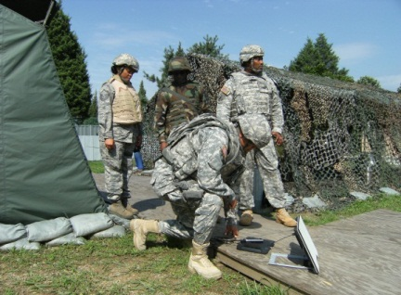
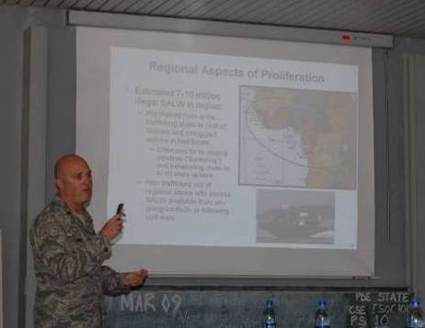
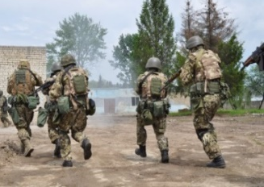
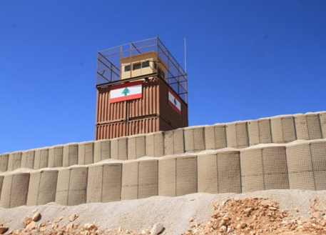
UNCLASSIFIED
CZ Mission & Core Functions
The CZ delivers specialized CWMD expertise, training plans, exercises, wargames, and innovative operational concepts that advance DoW’s CWMD capabilities and provide CCMDs with options to counter WMD-capable adversaries.
Plans, Exercises, and Wargaming (PL)
Global Engagement (GE)
Program Management Office (PMO)
Contingency Operations (CO)
WMD Defeat (WD)
UNCLASSIFIED

Slide 8

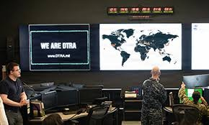
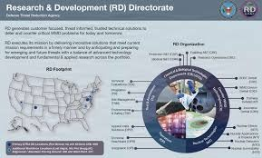
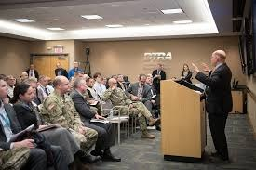
Program Management Office (PMO)
UNCLASSIFIED
Lead DTRA Operations and Integration Directorate's acquisition portfolio by providing acquisition advice and assistance, program and project management support, requirement development, cost and risk management principles to ensure requirements provide the best value.
UNCLASSIFIED

Slide 9
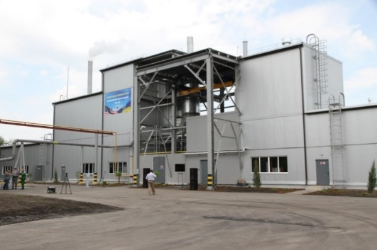
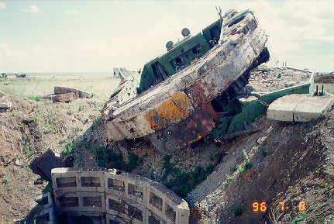
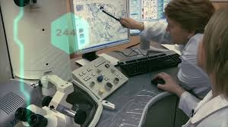
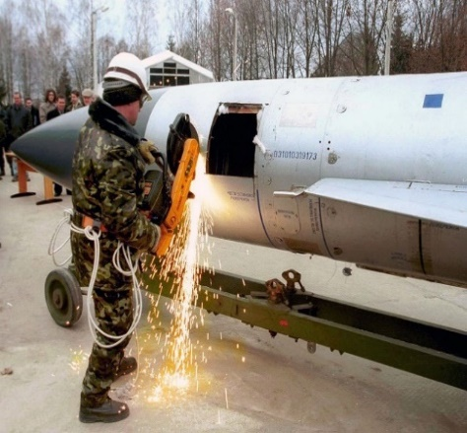
WMD Defeat (WD)
UNCLASSIFIED
The CZ-WD Department enables Joint, Interagency, and Allied forces to prevent, reduce, and counter the proliferation of weapons of mass destruction, protecting the United States and its vital interests through a global network of Sensitive Activities Advisors (SAA) and WMD Defeat Advisors (WDA).
UNCLASSIFIED

Slide 10
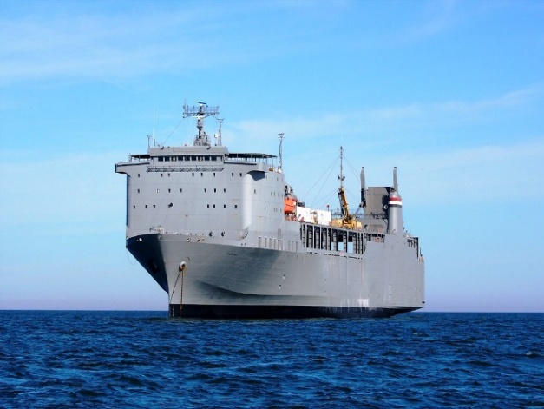
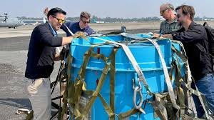

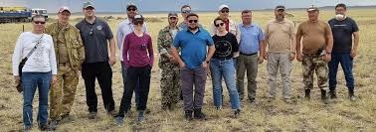
Global Engagement & Operations (GE)
UNCLASSIFIED
Engage the warfighters and broader CWMD community of interest to drive the Agency external focus as the face of DTRA at Combatant Commands (CCMDs), NATO, UK, AUS and the Joint Staff. Integrate Agency operations, key leader engagements, operations, activities and investments (OAIs) for effects to include the interagency and FVEY partners (CAN/UK/AUS).
UNCLASSIFIED

Slide 11
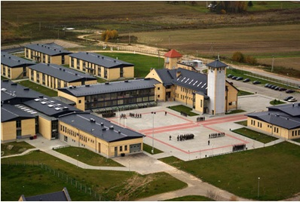
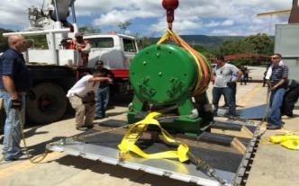

Contingency Operations (CO)
UNCLASSIFIED
Supports the cooperative dismantlement of nuclear weapons programs, as well as the transportation and disposition of associated materials; and builds the capacity of international partners to secure nuclear weapons, high-threat radiological material, and related components, materials, equipment, technology, and expertise, and to counter nuclear smuggling.
UNCLASSIFIED

Slide 12

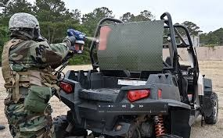
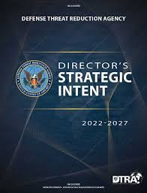
Plans, Exercises, and Wargaming (PL)
UNCLASSIFIED
Protect the United States, its Armed Forces, and our allies from biological threats by strengthening the capabilities of partner nations and the international community to prevent, detect, and prepare for outbreaks caused by high threat pathogens.
Plans Division
Wargaming Division
Exercises Division
Strategic Priorities Division
UNCLASSIFIED

Slide 13
UNCLASSIFIED
CZ Acquisition Objectives
Satisfy DTRA Requirements:
Increase mission efficiency:
Comply with law, regulations, policy and best practices such as:
Improve synergy within and among DTRA elements
Fulfill DTRA requirement to Counter and deter Weapons of Mass Destruction (WMD) and Improvised Threats
Shift time and resources currently performing repetitive administrative tasks toward accomplishing core capabilities and mission outcomes
Optimize total cost of ownership considering human and fiscal resources
Federal Acquisition Regulation (FAR) and agency policies /supplements
Competition in Contracting Act (CICA)
President’s Management and Budget Agenda
Small Business initiatives
Best practices and recommendations
UNCLASSIFIED

Slide 14
UNCLASSIFIED
TRIDENT’s Scope & Requirements
Scope: The scope of this requirement will provide effective support for globally integrated operations, timely responses to WMD threats and activities, and enhanced collaboration with interagency and international partners. The requirements of this effort will provide Professional Services to DTRA CZ across multiple tasks to include classified and compartmented support, operational and strategic planning, data-driven decision support, and campaign management.
Task Number | Task Title
Task 1 | Program Management
Task 2 | CWMD Advisory Support
Task 3 | Global Engagements (GE) Department Support
Task 4 | Contingency Operations (CO) Department Support
Task 5 | Systems Engineering and Operational Planning Support
UNCLASSIFIED

Slide 15
UNCLASSIFIED
15
Acquisition Strategy
Anticipated Contract Vehicle: General Services Administration (GSA) One Acquisition Solution for Integrated Services Plus (OASIS+) Multiple Award (MA) Indefinite Delivery/Indefinite Quantity (IDIQ) Unrestricted – Pool 1 Contract
Anticipated Contract Type: Cost-Type Contract
Projected Award: 1st Quarter, Fiscal Year 2027
Follow-on Requirement: This is a follow-on to tasks currently performed under:
Decisive Action (DA) - HDTRA1-23-F-0020 (CACI NSS, LLC)
Diamond Harbor (DH) - HDTRA1-26-F-E016 (Applied Research Associates, Inc.)
Codes: PSC: R499, NAICS: 541990
Performance Locations: DTRA locations in Northern Virginia, plus other CONUS/OCONUS locations
Security Requirements: TS//SCI
Anticipated Period of Performance: A twelve (12) month base period with four (4) 12-month option periods.
UNCLASSIFIED

Slide 16
UNCLASSIFIED
Anticipated Schedule & Milestones
Current Acquisition Phase: Market Research
Draft RFP Release: FY26 Q3
Final RFP Release: FY26 Q4
Estimated Award: FY27 Q1
16
UNCLASSIFIED

Slide 17
Requirement Overview – Task 1
UNCLASSIFIED
Task 1: Program Management Support (PMO)
Provide overall contract management, reporting, and cost tracking.
Ensure compliance with program milestones, security, and quality standards.
Develop Transition-In and Transition-Out plans for contract continuity.
UNCLASSIFIED

Slide 18
Requirement Overview – Task 2
UNCLASSIFIED
Task 2: CWMD Advisory Support (WD)
Support DTRA’s countering WMD threats in support of Pathway Defeat and Device Defeat operations across the full spectrum of conflict.
Advise on technical CWMD capabilities and capability development with SOCOM tactical units.
Develop operational approaches for Deeply Buried and Hardened Targets (DBHTs).
Provide forward-deployed advisory support and special technical operations planning.
Exercise tailored Systems Engineering processes to meet DTRA, and partner unit organizational requirements
Prepare technical analysis reports of commercial and government off-the-shelf (COTS/GOTS) and prototype technologies, to be adapted and integrated with identified requirements.
Support the WMD Defeat Department in planning and integrating Sensitive Activities (SAs) into CWMD operations.
Provide expertise in Irregular Warfare (IW) and Military Deception (MILDEC), to enhance deterrence efforts.
Develop and refine non-attributable influence operations targeting WMD proliferation networks.
UNCLASSIFIED

Slide 19
Requirement Overview – Task 3
UNCLASSIFIED
Task 3: Global Engagements (GE) Department Support:
Provide administrative, analytical, and coordination support to the Global Engagement Department (GE) to enhance DTRA’s ability to facilitate collaboration with external partners
Facilitate scheduling, logistics, and administrative support for GE engagements with CCMDs, interagency, and foreign partners.
Develop and maintain databases and tracking systems to monitor partner engagements, agreements, and strategic initiatives.
Assist in the preparation of reports, briefing materials, and correspondence for senior leadership engagement.
Support the planning and execution of GE-hosted events, working groups, and information-sharing initiatives.
Maintain and update internal knowledge management repositories to ensure continuity of operations and historical reference.
Assist in tracking and reporting mission activities, engagement efforts, and operational coordination at forward-deployed sites.
Ensure consistency in reporting and alignment with GE’s mission objectives across all CONUS and OCONUS locations.
UNCLASSIFIED

Slide 20
Requirement Overview – Task 4
UNCLASSIFIED
Task 4: Contingency Operations (CO)
Perform facility management of assigned facilities.
Provide operational and policy support for CZ-CO.
Support the development of plans for program planning and resource utilization.
Deployment and coordination support, as required, for personnel and equipment deployment.
Provide comprehensive logistics support, to include property management, vehicle management, and shipping requirements.
Uncrewed Systems support and operation.
Provide communications support to include, but is not limited to, communication system evaluation, testing, setup, research, maintenance, and ability to act as COMSEC support custodian for NSA-provided authorized COMSEC account.
Provide additive manufacturing SME support.
Provide chemical, biological, radiological, and nuclear sensor integration and communications support to uncrewed systems efforts.
UNCLASSIFIED

Slide 21
Requirement Overview – Task 5
UNCLASSIFIED
Task 5: Systems Engineering and Operational Planning Support (PL)
Provide Operational Planning Support embedded with partner unit planning teams and system engineering support.
Monitoring current commercial-of-the-shelf / government off-the-shelf state-of-the-art and niche technologies
Provide prototype development of key performance parameters decomposed from mission planning, and technology / capability validation event planning support
Obtain systems engineering an integration (SE&I) activities necessary to support DTRA CZ and select partner units
Inclusion of scientific and technical analysis and evaluation of vulnerabilities
Development of technical solutions that shall address capability gaps identified by partners during concept development.
UNCLASSIFIED

Slide 22
Requirement Overview, Cont’d
UNCLASSIFIED
Delivery Period: The Period of Performance shall be a twelve (12) month base period from the date of award with four (4), twelve (12) month option periods. Performance will occur at locations CONUS and OCONUS.
All personnel will require at least a DoD Top Secret clearance or Interim Top-Secret clearance, with a majority requiring a Top Secret/SCI clearance
4.0 Facility Clearance and Secure Facility Requirements
Due to anticipated Government facility constraints, the contractor must be able to provide secure facilities to accommodate classified work requirements. The following capabilities are required:
Secure Workspaces:
Ability to provide Secure Compartmented Information Facilities (SCIFs) or equivalent for TS//SCI-level work.
Capability to host classified meetings and workspaces for contractor personnel.
UNCLASSIFIED

Slide 23
Requirement Overview, Cont’d
UNCLASSIFIED
Information Technology (IT) and Communications Security (COMSEC) Compliance:
Ability to meet Department of War (DoW) cybersecurity and information assurance (IA) requirements for handling classified data.
Provide classified IT infrastructure in compliance with DoW policies and standards.
Geographical Considerations:
Secure facilities should be within reasonable proximity to DTRA headquarters or key mission partner locations.
Contractors without existing secure facility capabilities should describe in detail their approach to meeting these requirements, including potential partnerships, facility acquisition plans, or alternatives.
UNCLASSIFIED

Slide 24
Current CZ Contract Details
UNCLASSIFIED
Competed and awarded to CACI as task order HDTRA1-23-F-0020)
All CZ functional programs provide funding, which is then commingled in obligation and performance/billing
In-scope surge feature, up to 20% of dollars annually, with pre-approval
One-year base plus four one-year options
UNCLASSIFIED

Slide 25
SSN Response Detail
UNCLASSIFIED
SSN / RFI issued on www.sam.gov on 20 February along with draft SSN
Received responses from 32 companies (25 large, 7 small per NAICS 541990) by submission deadline
Feedback summary: All respondents were provided with a posting via sam.gov to the posted SSN link pertaining to the DA Follow-On requirement.
UNCLASSIFIED

Slide 26
RFI Questions & Answers
UNCLASSIFIED
The initial RFI Questions and Answers have been posted to www.sam.gov pertaining previously submitted questions. Further communications will be discussed during individual 1 on 1 sessions scheduled for 31 March 2026.
UNCLASSIFIED

Slide 27
UNCLASSIFIED
One-on-One Sessions
Schedule & Location:
Sessions will begin at 10:00.
Each session is limited to 15 minutes.
Your specific session time has been sent to the email address you registered with. Further communication from Mrs. Moronda Gage will be provided upon arrival.
Ground Rules:
Information discussed is for market research and is not binding on the Government.
No information will be provided that would create an unfair competitive advantage.
The focus should be on your company's capabilities and questions related to the requirement's scope. We may not be able to answer definitive questions about the final acquisition strategy at this time.
UNCLASSIFIED

