Slide 1
UNCLASSIFIED
(U) Foundation GEOINT Operation & Sustainment Support, Software, Hardware, and Integration (FS3i) Industry Day Overview
(U) Mapping Charting and Geodesy (MC&G)
February 2 – 3, 2026
UNCLASSIFIED
1060806
CoNGA
20490531
UNCLASSIFIED

Slide 2
(U) Industry Engagement
UNCLASSIFIED
(U) Ground Rules:
Please ensure that you are only attending on your assigned group’s day and use the sign-in sheet provided upon arrival
Industry partners should identify proprietary information
Time will be provided at the end of each session for teaming opportunities
(U) FS3i team can discuss with you:
Any questions about scope of FS3i
Any questions about the RFP process
Any questions about the technical requirements, with a focus on Common Services and Air
UNCLASSIFIED

Slide 3
(U) Schedule
UNCLASSIFIED
Location: Patriot Ridge (GDIT) located at 7770 Backlick Rd, Springfield, VA
* Meet at front desk/lobby – we will be in the main auditorium
February 2 (Monday) – Session 1 (Group A)
12:00pm – 12:30pm: Opening & Introductions (OCS: Dan Fadely & MC&G PEO: Donna Frazier)
12:30pm – 2:00pm: Industry Day Brief and Leadership/Mission Owner Remarks (OCS: Dan Fadely; MC&G PEO: Victor Trimarchi & Donna Frazier; Foundation GEOINT: LtCol Andrew Barstow)
2:00pm – 3:00pm: Q&A Session – Government to address some key questions submitted by 23 Jan
3:00pm – 4:00pm: Government exit - teaming opportunities/discussions
February 3 (Tuesday) – Session 2 (Group B) (mirrored session)
9:00am – 9:30am: Opening & Introductions (OCS: Dan Fadely & MC&G PEO: Donna Frazier)
9:30am – 11:00am: Industry Day Brief and Leadership/Mission Owner Remarks (OCS: Dan Fadely; MC&G PEO: Victor Trimarchi & Donna Frazier; Foundation GEOINT: LtCol Andrew Barstow)
11:00am – 12:00pm: Q&A Session – Government to address some key questions submitted by 23 Jan
12:00pm – 1:00pm: Government exit - teaming opportunities/discussions
**Not all questions submitted by 23 January will receive a response on Industry Day but we will follow up to all responses by posting them to all vendors via SAM.gov as soon as possible
UNCLASSIFIED

Slide 4
(U) Agenda – Program Vision
UNCLASSIFIED
➢ (U) Industry Day Purpose
➢ (U) Organization
➢ (U) Mission Overview
➢ (U) FS3i Background
➢ (U) FS3i Scope & Structure
(U) FS3i Task Orders
➢ (U) Closing Remarks & Continuing Industry Engagement
➢ (U) Questions?
UNCLASSIFIED

Slide 5
(U) Industry Day Purpose
UNCLASSIFIED
➢ (U) The objectives of the FS3i Industry Day are to:
Provide a greater understanding of operational context and organizational fit
Discuss specific requirement concepts
Gather industry’s feedback
Gauge technology readiness
Provide Q&A opportunities
Provide time for teaming opportunities
UNCLASSIFIED

Slide 6
MC&G|
UNCLASSIFIED
Last Updated 5/6/2025
Mapping, Charting, & Geodesy “MC&G” PEO
Victor Trimarchi
PM PEO MC&G (acting)
FS3i Contracting Officer
Daniel Fadely
Contract Specialist
Hannah Pulcher
Liz Lyon (acting) &
Danny Ohlendorf SF Mission Deputies
Dr. Umesh Singh
Senior Engineer
Stacie Bauer Director of Staff
Jim McIntyre Technical Director
Office Groups
Engineering Management
PME
Plans & Programs
PMF
Safety of Navigation
PMM
Geospatial Info
PMG
Geomatics (Science)
PMT
Bill Symolon
Chief Engineer
Adam Thurau
Program Manager
Terry Windmiller
Program Manager
Maritime (Sea)
Patrick Berryman
Aeronautical (Air)
Robert Pauli
Tomica Mishorich
Project Manager
Geography
Capt Jon Smith
Dissemination
Daniel Takane
Brian Mosteller
Project Manager
PMOs
UNCLASSIFIED

Slide 7






UNCLASSIFIED
Mission: Provide assured, timely, relevant, and accurate foundation data, products, and services in support of prioritized requirements of the warfighter, our national security objectives, and the Safety of Navigation needs of the U.S. government.
GEOMATICS
TOPOGRAPHIC FEATURE PRODUCTION
HUMAN & POLITICAL GEOGRAPHY
SAFETY OF NAVIGATION
350
MILLION
SQUARE KILOMETERS OF ELEVATION DATA COVERAGE
MARITIME
AERONAUTICAL
5+
BILLION
TOPOGRAPHIC FEATURES IN THE MANAGEMENT DATABASE
13.7
MILLION
GEOGRAPHIC NAMES
70
MILLION
HYDROGRAPHIC FEATURES
4.5
BILLION
AERONAUTICAL DATA ELEMENTS
200+ Million Gravity Records
104 Million Square Kilometers of Mono-orthorectified Imagery
2+ Million Human Geography Features
16,500 Support US Government and Commercial Vessels
24+ Million Vertical Obstructions
3,600+ geodetic and geophysical surveys
118 Million Square Kilometers of Precise Stereo Imagery
37 Foreign Languages Spoken by analysts
15,000 Submarine electronic navigational charts
18,000+ IFPs in FAA Flight Information Publications
World Geodetic System 1984 (WGS 84)
100 Percent of the Earth’s Surface has
12-Meter High-resolution Elevation Data
16 Million GEOnet Names Servers hits annually
24/7 Worldwide Navigational Warning Service
49,000+ Airfields in Automated Air Facilities Intelligence File
8.4 Million Features in Geographic Names Database
3,900 Digital Nautical Chart Libraries
11,600+ Airfields with Airfield Foundation Data vectors collected
350 million square kilometers of elevation data
90,000 Topographic Maps
Boundaries ; 900+ International Land and Maritime , 74,000+ Administrative
11,000 Electronic Navigation Charts
9,800+ airfields in the Digital Aeronautical Flight information File
Space Launch and Weapons Systems Support
1,400 Tactical Ocean Data Libraries
13,000 DOD AERO Platforms supported throughout DOD (title 10)
17 NGA Global Positioning System (GPS) Sites
Populated Places Framework: Settlements, Villages and Cities
4,100 nautical hard copy charts
118 Million Square Kilometers of Precise Imagery
79 Nautical Publications
DISSEMINATION, Software and Common IT support services
Data as of August 2025
UNCLASSIFIED

Slide 8
FS3i Background
UNCLASSIFIED
Source Foundation GEOINT production methods were developed over many years and are unique to each specific Foundation GEOINT mission area.
Current and future demands for Foundation GEOINT mission modernization necessitates continual iterative improvement to NGA’s operational production and dissemination environments.
FS3i, follow-on to FS2, is primarily an operations, sustainment and integration focused effort for the Foundation GEOINT’s MC&G mission. The effort will include Software development, engineering (cloud, architecture, cybersecurity, and configuration) support; COTS, Hardware, and Software procurement is also included.
FS3i has a 7-year performance period; and will be focused on modernization and automation capabilities to improve performance and cost delivery.
The current FS2 contract provides operational sustainment support for over 50 systems.
UNCLASSIFIED

Slide 9
(U) FS3i Key Focus Areas Across ALL Task Orders
UNCLASSIFIED
➢ (U) Improvements Sought From FS2 Contract:
Faster Development/Deployment of Technologies and Upgrades Into Operations
More/Better/Faster Integration of Artificial Intelligence/Machine Learning Advancements
Increased Cost Efficiencies while Simultaneously Improving System(s) Performance
Dashboards and Metrics that Constantly Monitor System Performance/Usage, Downtime, and Trouble Ticket Handling/Status Updates
UNCLASSIFIED

Slide 10
UNCLASSIFIED
RFP Release Schedule
Milestone Dates | Date
Draft RFP Release (Common Svcs & Air) | January 5, 2026
Questions Due | January 23, 2026
Industry Day(s) | February 2 – 3, 2026
Final RFP Release | June 2026 TBR
Questions Due | July 2026 TBR
Proposals Due | August 2026 TBR
Contract Award | Target Date: December 2026
UNCLASSIFIED

Slide 11
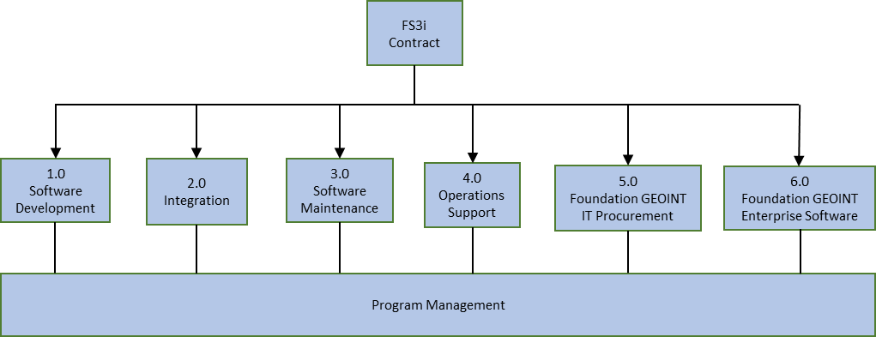
FS3i Scope
UNCLASSIFIED
1 - Software Development
Select new software development to enhance the value to the MC&G mission customer.
2 - Integration
Integrate FS3i capabilities into the greater MC&G and NGA enterprise solution architectures.
3 - Software Maintenance
Maintain select legacy code bases to continue to be performant in the evolving MC&G and NGA enterprise solution architectures.
4 - Operations & Sustainment
Operate and sustain the FS3i capabilities in production at a mission-ready performance level.
5 - Foundation GEOINT IT Procurement
Provide the option to acquire select IT physical equipment that cannot be obtained a timely or existing manner through NGA’s equipment procurement processes.
6 – Foundation GEOINT COTS and Common Services Procurement
Provide the option to acquire select IT COTS software that cannot be obtained in either a timely or existing manner through NGA’s equipment procurement processes.
UNCLASSIFIED

Slide 12
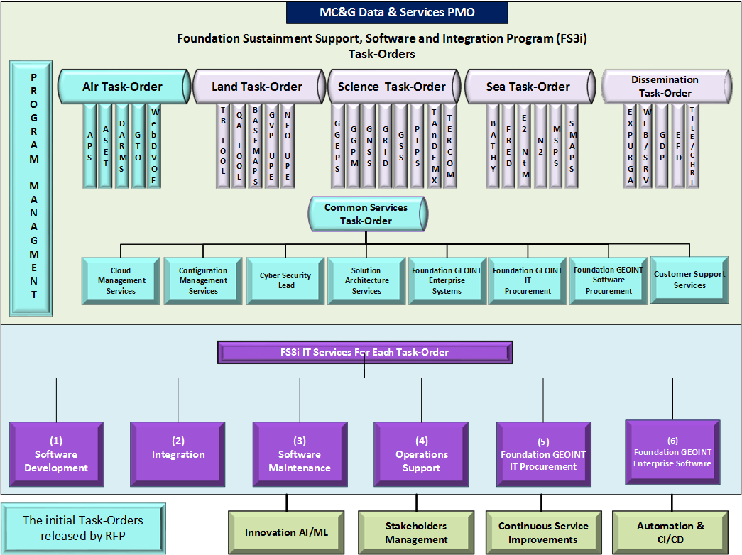
UNCLASSIFIED
UNCLASSIFIED

Slide 13
UNCLASSIFIED
Task Orders That Will Be Released with the RFP
UNCLASSIFIED

Slide 14
(U) COTS Software and Common Services Approved Requirements and Business Case
UNCLASSIFIED
Statement of capabilities: Procurement Support: Includes all labor required to track, coordinate, and facilitate the acquisition of approved COTS software (coordinated through SAM office). IT & System Support: Provides common IT services for production/testing events, configuration management, VDA support, and management of shared data storage needs. Contract-Level Services: Delivers a suite of common services that support all task orders under the main FS3i contract.
Objectives: Provide on time delivery of COTS SW (Via SAM office or FS3i TO) and commonly shared IT (non-UDS IT requirements) services in support of the SF mission.
Priorities: Deliver COTS SW and Common services to accommodate existing and emergent mission requirements within 30 days of verified mission need; deliver and maintain crucial operational compliance with Cloud and cybersecurity
Requirements: Purchase pre-authorized COTS SW licenses and IT Common services support
Business Case: The FS3i will meet the requirements stated above by providing COTS SW and IT Common services support to result in the outcomes stated above approved over the FYDP (FY26 to FY32)
UNCLASSIFIED
UNCLASSIFIED SOURCE SELECTION SENSITIVE

Slide 15
(U) Air Approved Requirements and Business Case
UNCLASSIFIED
Statement of capabilities: Air sustains and modernizes the system architectures utilized to produce aeronautical foundation GEOINT for Aero Safety of Navigation (SoN), Airfield Foundation Data (AFD), Vertical Obstruction (VO), and other contingency requirements for the DoD, US Government Agencies and Allied Partner nations.
Objectives:
Sustain and maintain the Aeronautical Application Suite (AAS)
Sustain and maintain the Aeronautical Obstruction Environment (AOE)
Sustain the Web Digital Vertical Obstruction File (WebDVOF) capability
Sustain the Aeronautical Unclassified Production Environment (UPE)
Sustain the modernized Geospatial Terminal Operations (GTO) application
Priorities: Operational support for existing SFA mission systems and microservices are the highest priorities. Integrate, refactor, and modernize legacy systems as required and prioritized by SFA & PEO-MC&G.
Requirements: Air currently sustains several SFA production baselines in support of the SFA Safety of Navigation mission. Each of these IT capabilities require maintenance, DevOps sustainment and Cybersecurity support, in order to meet the SFA production mission function and availability requirements as well as DoD and IC cyber compliance standards.
Business Case: Air will meet the requirements stated above by providing software development, integration, and operations & maintenance to result in the outcomes stated above over the FYDP (FY26 –FY32)
UNCLASSIFIED

Slide 16
UNCLASSIFIED
Task Orders That Could Be Released After Award
UNCLASSIFIED

Slide 17
(U) Sea Approved Requirements and Business Case
UNCLASSIFIED
Statement of capabilities: The Maritime Safety Office produces timely, relevant, validated, and accessible worldwide Maritime foundational Geospatial Intelligence, on-line and on-demand, to meet Safety of Navigation at Sea requirements, joint military operations support, international obligations, and other contingency requirements, for the Department of Defense, other US Government Agencies, and our Allied Partner nations in accordance with Statutory requirements.
Objectives:
Accelerate the support of automation and Artificial Intelligence/Machine Learning (AI/ML) for ENC and other Maritime systems.
Modernize the dissemination of Safety of Nautical Publications, improve source management for Publication production.
Upgrade source acquisition, management, and processing and offer Source as a Service to better support and automate production processes.
Support the non-FS3i Development Teams to move capabilities into production
Meet specific Maritime IMDP requirements, e.g. meeting the requirements levied for surface, sub-surface, and nautical publications.
Priorities: Upgrade PUB’s production processes, extend automation, ML and AI to improve accuracy and analysts' productivity.
Requirements: Sea baseline requirements are comprised of systems that acquire and process Maritime sources from variety of locations inside and outside of the US, e.g. Maritime Source Processing Services (MSPS). The systems that produce Maritime products using variety of architectures and complex techniques such as change detection, use of ML and AI, e.g. FRED and DALE. Systems that disseminate data, products, and services such as Source Maritime Automated Processing (SMAPS). And systems such as PMBI that is used to manage the entire production workflow and provide metrics and business intelligence.
Business Case: Sea will meet the requirements stated above by providing Software Development, Integration, Software Maintenance, Operations and Sustainment to result in the outcomes stated above over the FYDP (FY26 to FY32)
UNCLASSIFIED
<Insert classification of slide>

Slide 18
(U) Science Approved Requirements and Business Case
UNCLASSIFIED
Statement of capabilities: Foundation GEOINT – Science enables Geospatial Intelligence (GEOINT) accuracy through functional management of geodetic, geophysical, and photogrammetric sciences and content. It provides the collection of sciences, technology and tradecraft measuring and modeling the Globe to provide three-dimensional accuracy of every point in, on, or above the Earth.
Objectives:
Maintain secure operational reliability and availability of production systems
Support the GOTS and non-FS3i Development Teams to move capabilities into production
Provide software development for select capabilities
Priorities: Production of the earth science models: World Geodetic System (WGS-84), World Magnetic Model (WMM), and Earth Gravitational Model (EGM), are the highest priorities for Science. Production of Elevation Products and Precise Imagery are tied for the second highest priority.
Requirements: Science currently utilizes a diverse set of Information Technology (IT) baselines, each characterized by distinct hardware and software architectures, to execute its daily mission. The continued relevance and functionality of these IT capabilities are contingent upon dedicated IT development and sustainment services.
Business Case: Program will meet the requirements stated above by providing software development, integration, operations & maintenance, and select software acquisition services to result in the outcomes stated above over the FYDP (FY26 –FY32)
UNCLASSIFIED

Slide 19
(U) Land Approved Requirements and Business Case
UNCLASSIFIED
Statement of capabilities: Foundation GEOINT – Land enables Geospatial Intelligence (GEOINT) accuracy through functional management of topographic, human geography, and geographic names content. It provides the collection of sciences, technology and tradecraft for the worldwide Land foundational Geospatial Intelligence, on-line and on-demand, to meet Safety of Navigation requirements, joint military operations support, international obligations, and other contingency requirements, for the Department of Defense, other US Government Agencies, and our Allied Partner nations in accordance with Statutory requirements.
Objectives:
Provide software maintenance and operations and sustainment for select Land mission applications
Maintain secure operational reliability and availability of production systems
Support the GOTS and non-FS3i Development Teams to move capabilities into production
Provide software development for select capabilities
Priorities: Production of topographic content and select Land mission-related capabilities to National System for Geospatial Intelligence (NSG) customers
Requirements: Land predominately relies on the Vector-Cartographic Production System (VCPS) IT baseline to produce the majority of Land content. The FS3i scope provides enabling capabilities to augment the VCPS core capabilities. These are: Basemaps / Business Analytics (SFC), Geography Virtual Production (GVP) Unclassified Production Environment (UPE), Transliteration Tool, Non-combatant Evacuation Operations (NEO) UPE, PDF Quality Assurance Tool.
Business Case: Program will meet the requirements stated above by providing software development, integration, operations & maintenance, and select software acquisition services to result in the outcomes stated above over the FYDP (FY26 –FY32).
UNCLASSIFIED
UNCLASSIFIED SOURCE SELECTION SENSITIVE

Slide 20
(U) Dissemination Approved Requirements and Business Case
UNCLASSIFIED
Statement of capabilities: Foundation GEOINT – Dissemination embodies the IC/DoD definition of dissemination allowing mission partners to discover and retrieve content (pull) and/or a service where NGA sends users content (push).
Objectives:
Maintain operational reliability and availability of dissemination systems
Provide software development for select capabilities
Priorities: Operational support for NGA Gateway dissemination systems and microservices are the highest priorities. Data Ingest/Management and Tile Services are tied for the second highest priority.
Requirements: Dissemination currently relies on many different IT baselines in order to support multiple Foundation GEOINT missions. Each of these IT capabilities require some level of IT development and sustainment service support, in order to support dissemination to mission partners.
Web-based Interfaces to information and data hosted on the Gateway managed servers.
Information Discovery and Retrieval - The capability to browse, search, retrieve and download content that has been provided to the Gateway.
Tile Services and Tile Generation - The capability to create/generate multi-resolution Vector and Raster map tile cluster sets based on multiple Source Foundation GEOINT content.
Business Case: The FS3i will meet the requirements stated above by providing software development, integration, and operations & maintenance to result in the outcomes stated above over the FYDP (FY26 –FY32)
UNCLASSIFIED

Slide 21
UNCLASSIFIED
UNCLASSIFIED

