Slide 1
NTC Industry Day: Layered Protection Capability of Needs (CoN) Statement Overview
Purpose: (Information): Provide industry stakeholders with an understanding of the battlefield application of layered protection as it pertains to the LP CoN to facilitate substantive dialogue drive material solution innovation.
MG Christopher Beck, LP Program Acquisition Executive (PAE)
Controlled By: FCC, T2COM
CUI Category(ies): OPSEC, INFOSEC
Limited Dissemination Control: REL TO USA, FVEY
POC: LTC Marcus Dyl,(573) 563-7599
Notes:
COL Terrence Soule
Formation based layered protection as a critical component of the all-new Army warfighting concept for 2040.
This is driving emerging doctrine and will influence how we operationalize protection on the battlefield of the future.
Still in its infancy, this was just added as a component of the AWC in February 2025 and the only formal description comes from a few paragraphs in the concept itself and in General Raniy’s white paper.
We are currently in the process of creating a cross-functional annex to the concept that will drive follow-on doctrine creation etc.
We are on the cutting edge of FBLP development

Slide 2
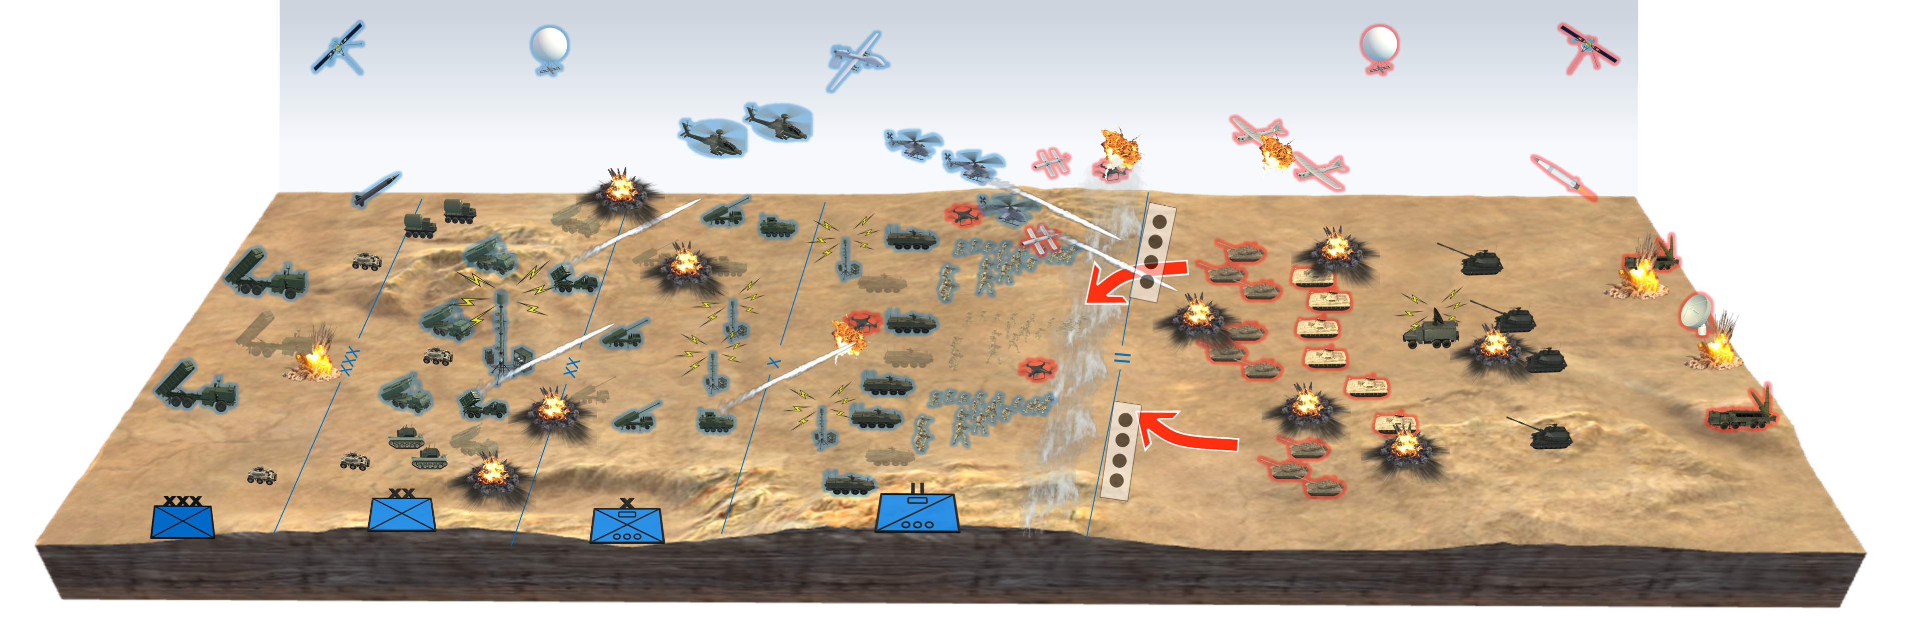

Layered Protection Battlefield Application
Problem: Layered protection differs from contemporary notions in several critical ways and represents a fundamental shift in how the Army conceptualizes and employs protection capabilities. Not merely a collection of defensive technologies and actions. Rather it emphasizes the integration of foundational elements, operational protection assets, and warfighting systems synchronization to generate protective layers.
Scenario: SBCT in the defense against an enemy armored BDE. This depiction demonstrates how a unit could integrate foundational elements, operational assets and warfighting systems integration to successfully defeat an enemy attack.
1
1
3
2
5
3
1
8
1
3
2
7
2
1
1
4
6
4
3
2
3
2
5
6
4
Layered Protection Technical Challenges: The technical challenges associated with layered protection fall into four general categories: Detection-Avoid being seem, Characterization-Avoid being understood, Engagement-Avoid being struck, and Survive-survive if hit or attacked.
Detection: The minimization of detectable signatures through camouflage, obscuration, emission reduction, tactical sensor defeat, and patterns of life control.
Visual and Multi Spectral Detection
Signature management
Tactical Sensor Defeat
Obscuration
Characterization: Disruption of adversary capability to identify, locate, and target friendly critical capabilities, assets, and activities (CCAAs).
Signature manipulation
Decoys
Tactical EW
Engagement: Neutralizing the ability of adversaries to converge multi-domain effects.
Resilient C2
Long range sensor defeat
Space Interdiction
MILDEC
Enemy data contamination
CBRN sensing & recon
Detainee operations
Survive: The employment of foundational and operational means to mitigate the effects of enemy attacks to preserve combat power.
Air and missile defense
Unit level CBRN detection & defense
Engineer survivability, counter-mobility, and counter-explosives hazard ops
Engineer mobility ops
CBRN mitigation
Unit level C-UAS
Vehicle protection systems
Individual soldier readiness

Slide 3



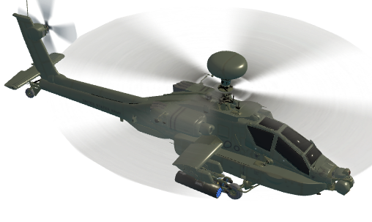





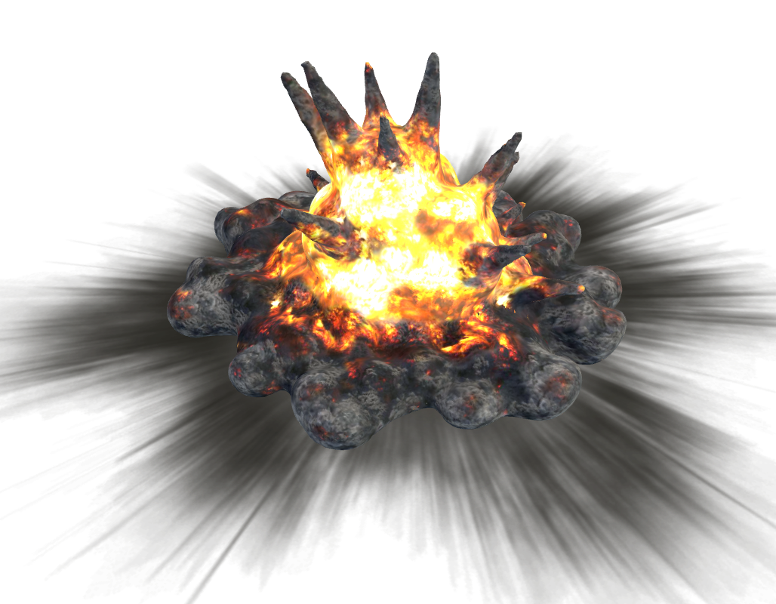
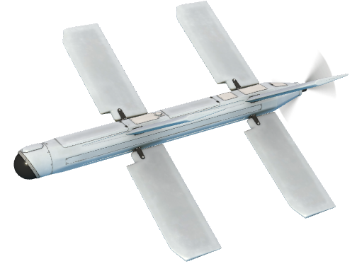
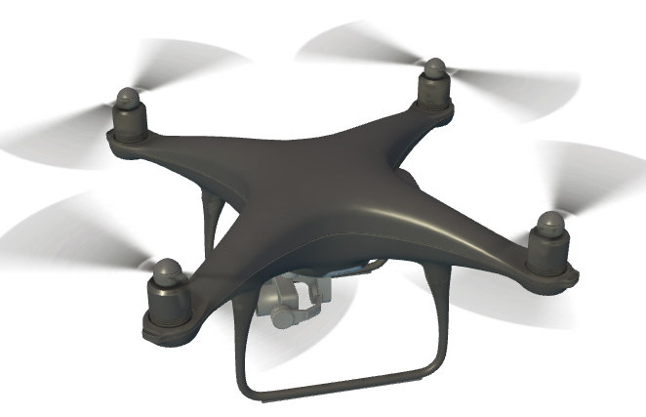
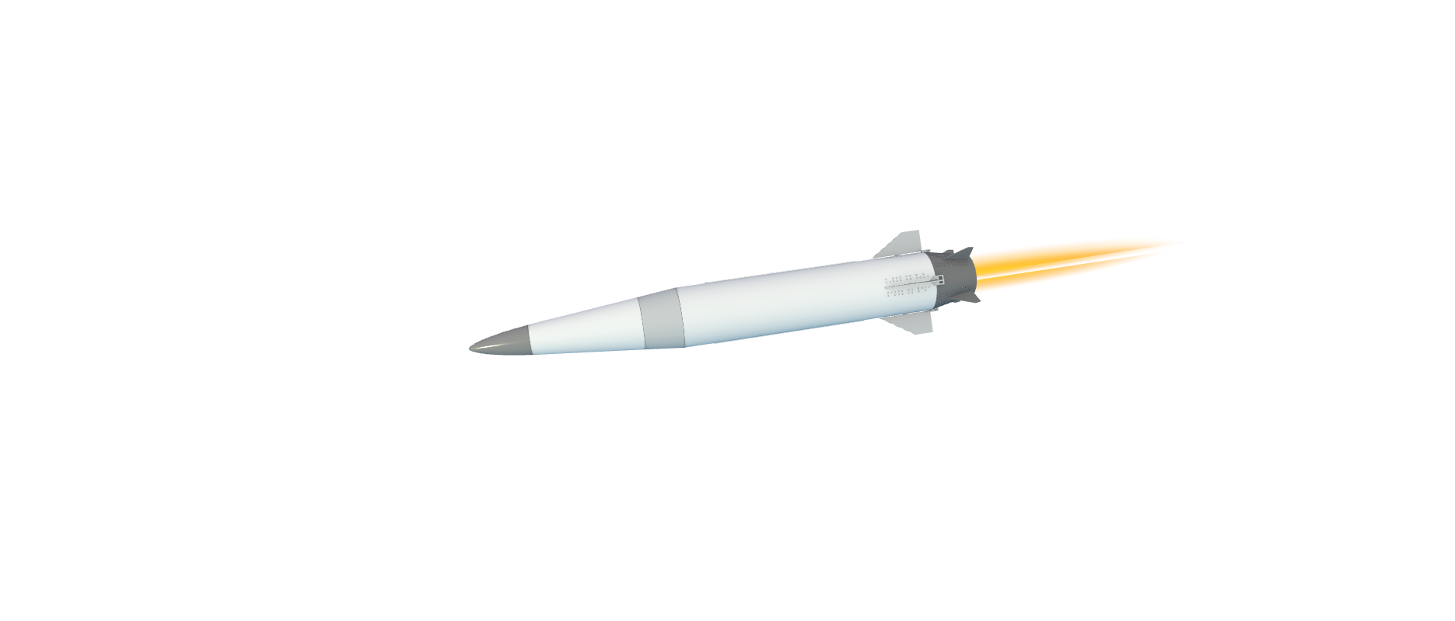
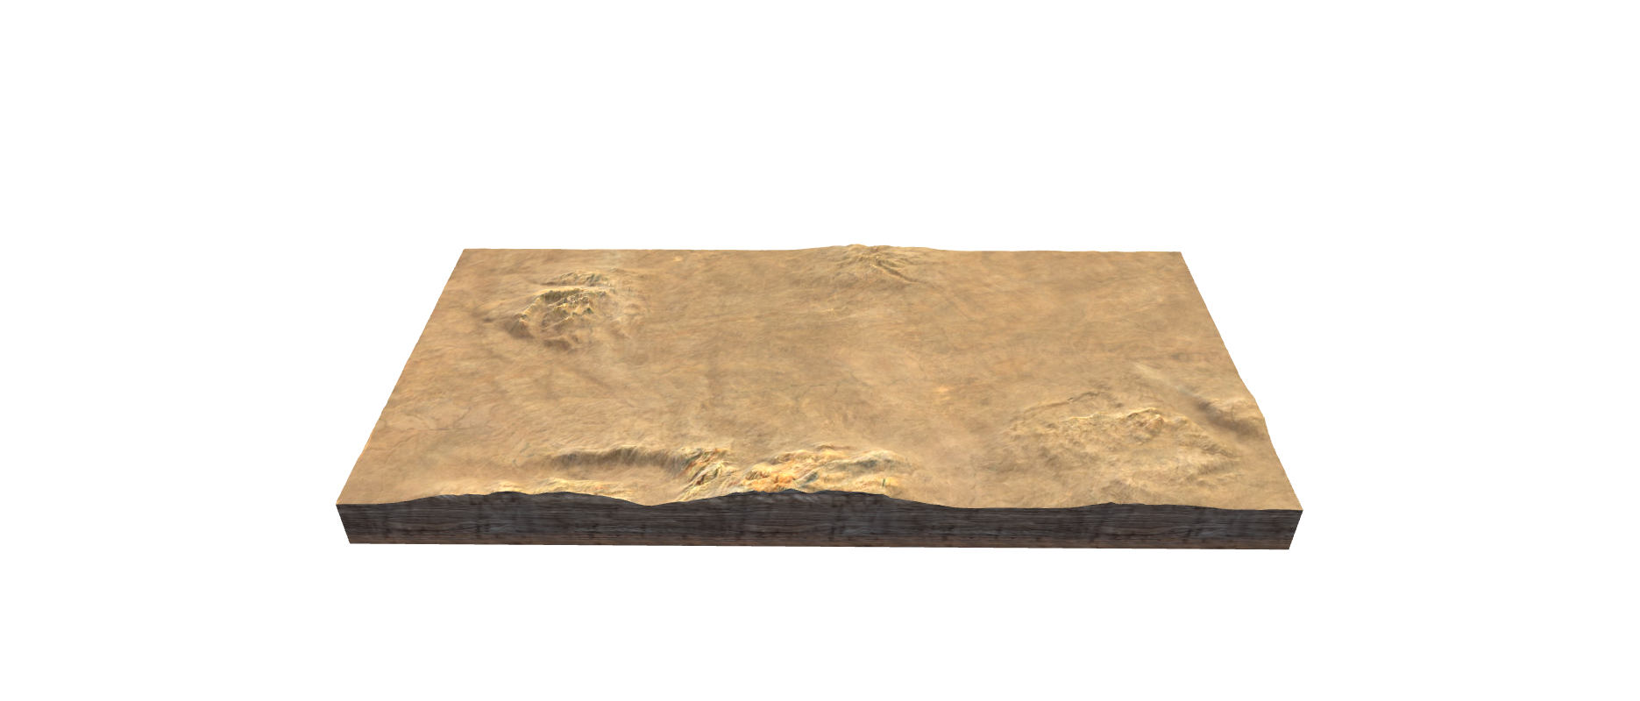
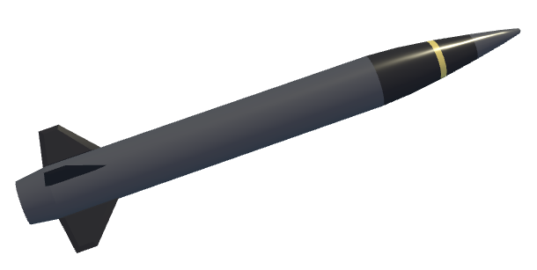
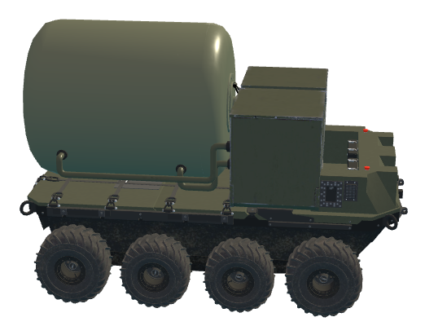
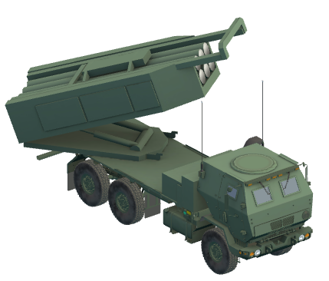


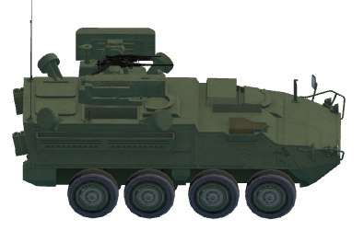

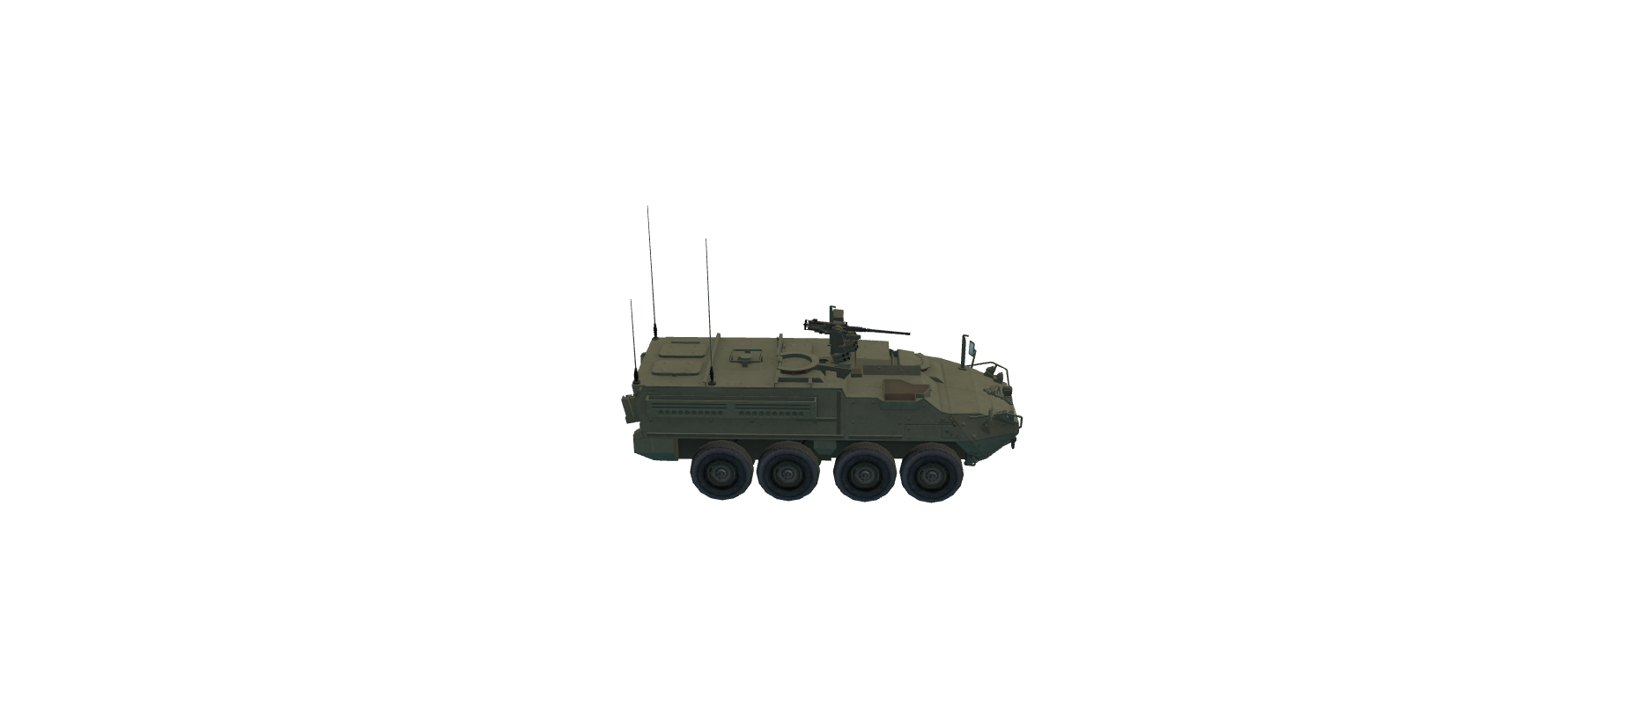


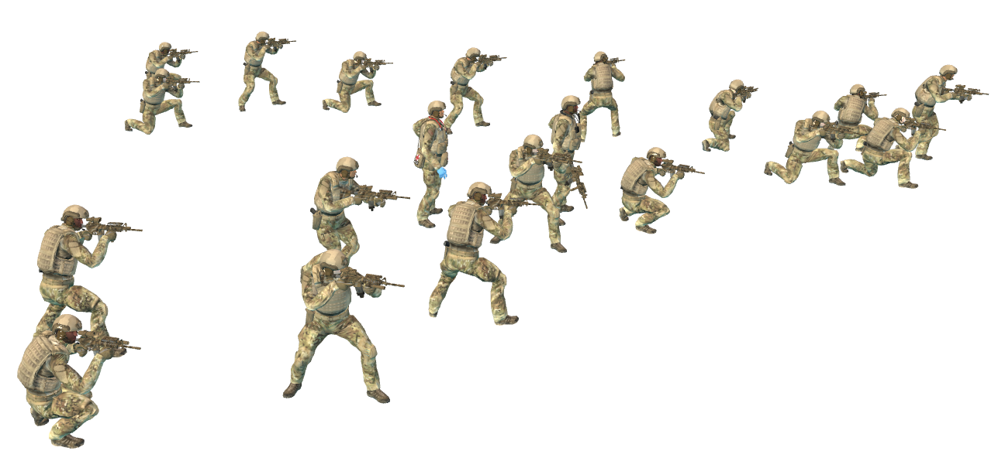
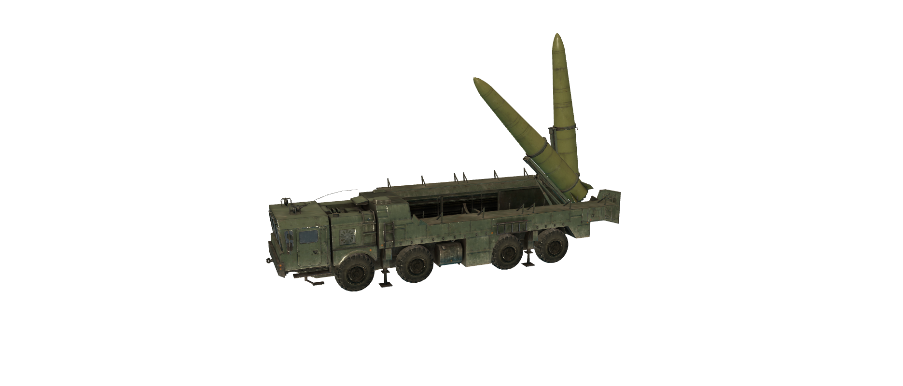
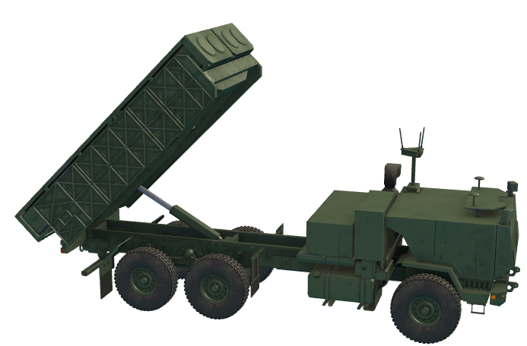

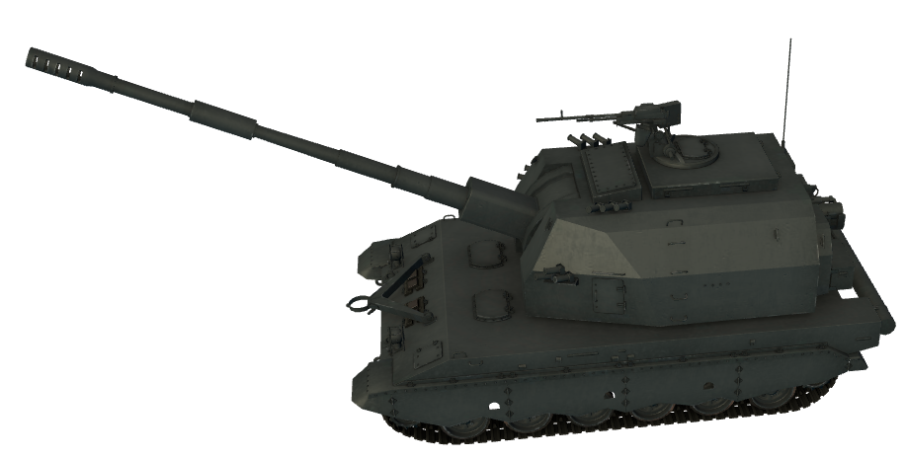
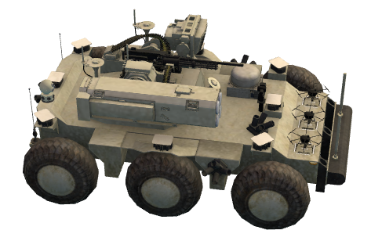

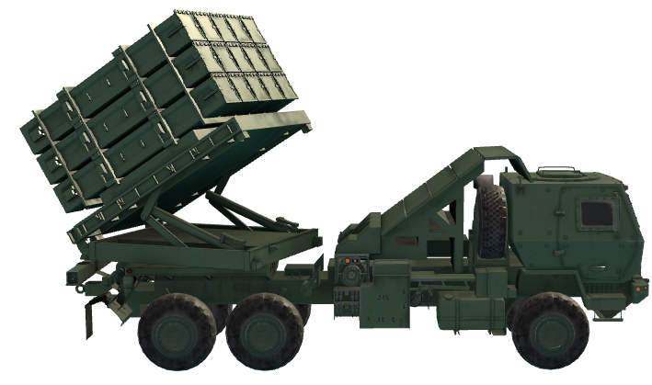


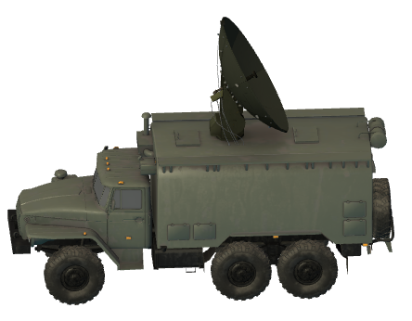
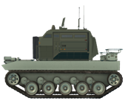




XXX
X
II
XX

