Slide 1
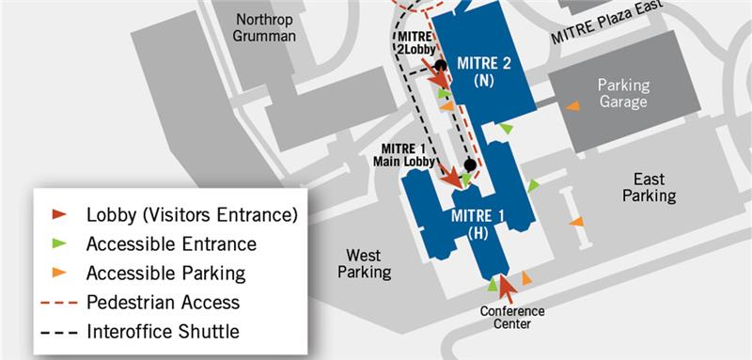

Slide 2
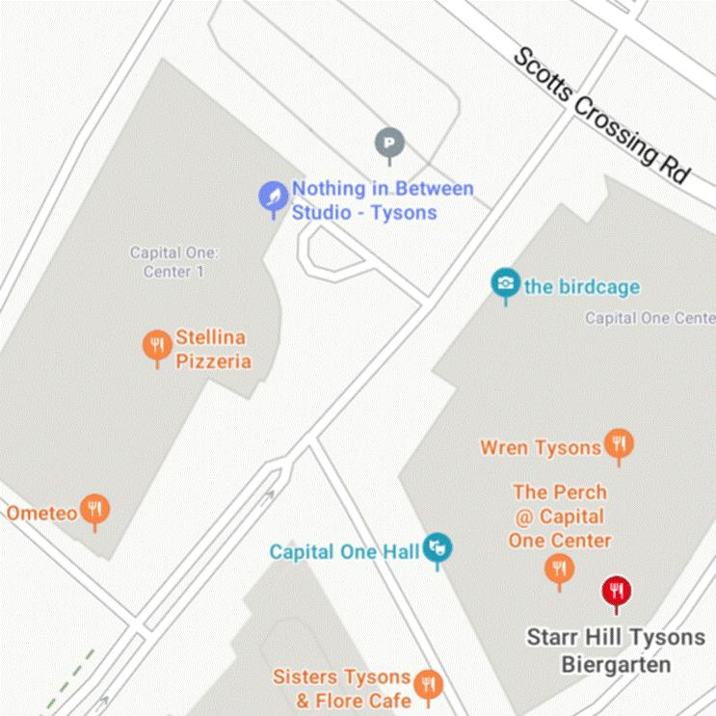
Map of restaurants in the area
Notes:
Lunch options:
Capital One Center (pictured)
MITRE cafeteria (need directions/map)
Yu noodles (http://yunoodles.com), 1690 Anderson Rd, McLean, VA 22102
Sushi Umi Tysons (https://sushiumiva.com), 7615 Colshire Dr, Tysons Corner, VA 22102
Tysons Biergarten (https://tysonsbiergarten.com), 7581 Colshire Dr, McLean, VA 22102
Shipgarten, (https://shipgarten.com), 7581 Colshire Dr, McLean, VA 22102

