Slide 1
Agenda
On 4 March 2026, the following slides were provided as informational hand-outs at the Europe TRI-Services Regional Summit hosted by the Society of American Military Engineers
Türkiye & Spain BOS Program Overview
Requirement History
Hyper Inflation in Türkiye
Acquisition Strategy Decisions
Notional CLIN Structure

Slide 2
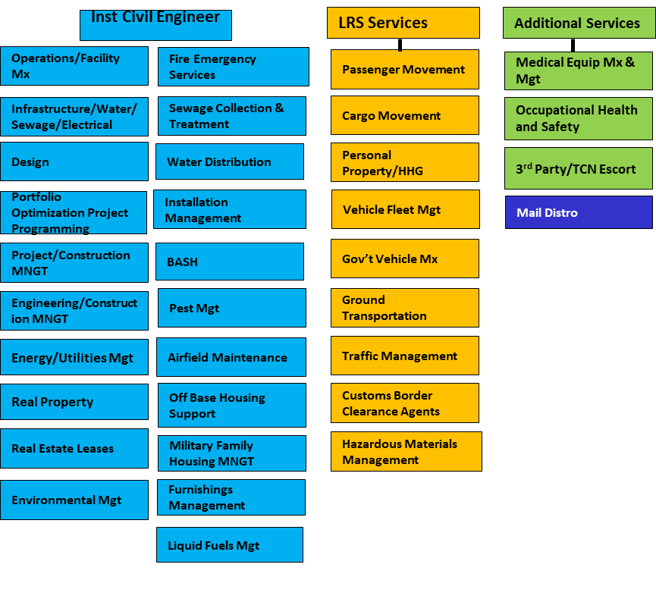
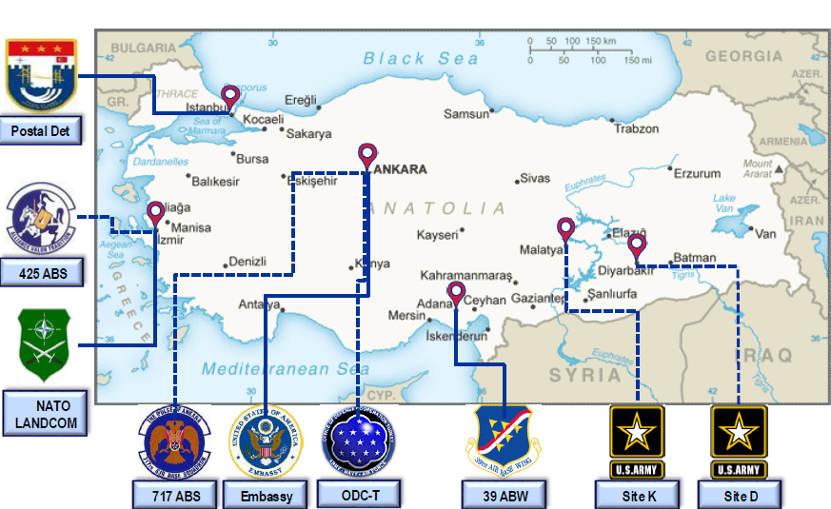
Türkiye BOS Requirements
BOS Service Summary Türkiye:
Customer: 39th Air Base Wing
39 ABW Footprint
Base:
3.3K Acres/770 Main Base Facilities
932 Housing Units/9 Dormitories
1537 Active Duty
30 US Civilians
364 Local National (contract employees)
240 NATO Service Members
The BOS requirements mirror the USAF Wing-level organic functional areas

Slide 3
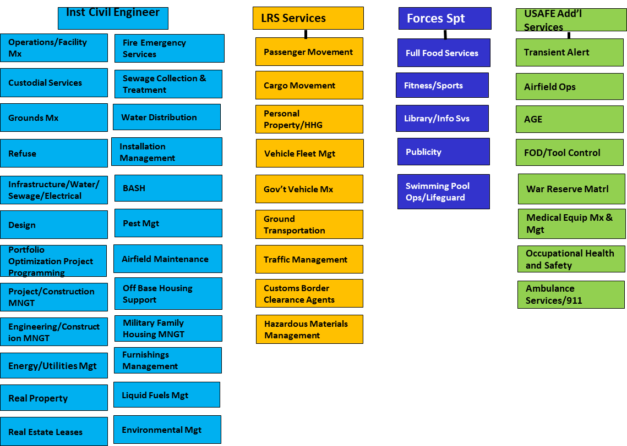
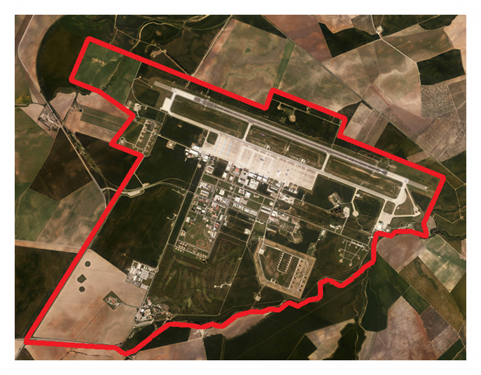
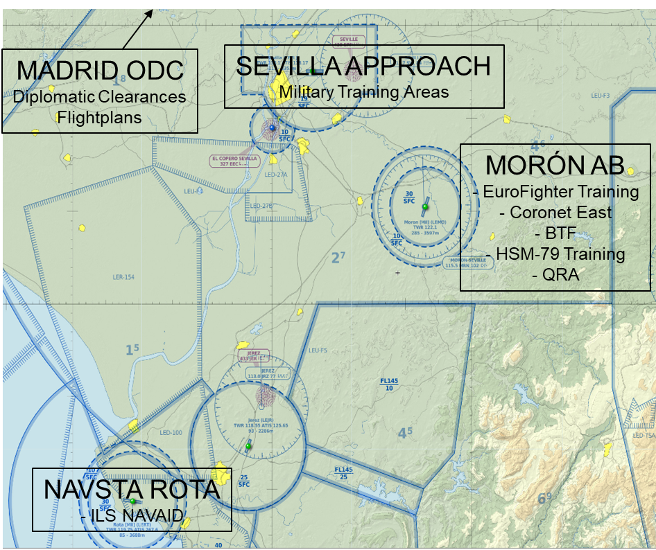
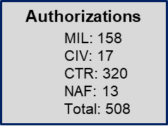
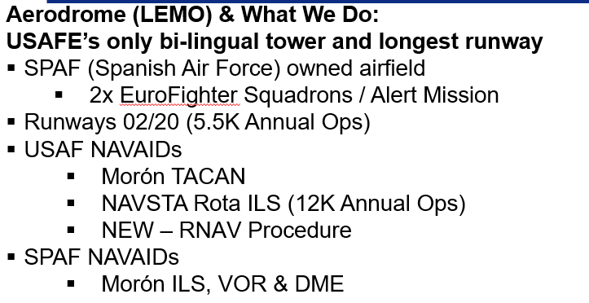
Spain BOS Requirements
BOS Service Summary Spain:
Customer: 496th Air Base Group – Moron AB
The BOS requirements mirror the USAF Wing-level organic functional areas

Slide 4
Turkieye Spain BOS Contract History
Türkiye BOS Contract Initiated 1958
Spain/Moron AB BOS Contract Initiated 1971
2010 - First Acquisition that combined Türkiye BMC and Spain BMC into single contract
Contract | Title | Provider | Performance
FA5613-10-C-5400 | TSBMC-I | Vinnell Brown & Root | Sep 2010 – Jan 2015
FA5641-15-C-0001 | TSBMC-II | Vectrus Systems Corp | Jan 2015– May 2021
FA5641-20-D-0009 | UA-BOS | Kellog Brown & Root | May 2021 - Present
Union Labor Agreements: Providers required to manage local national workforce IAW Host Nation Labor Laws and Collective Labor Agreements

Slide 5
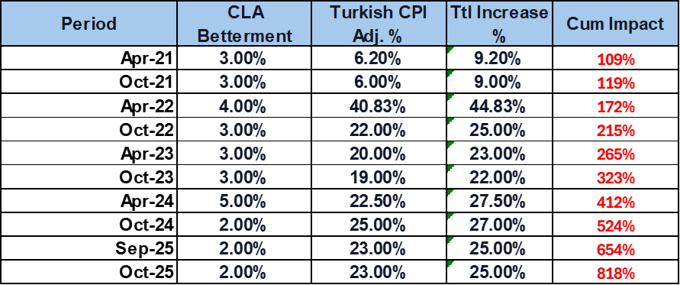
Turkish Labor Inflation
Turkish CLA
Hyper Inflation
Parties: Service Provider & Türk Harb-İş Union
Establishes Labor Categories & Skill Levels
Sets Wage Rates & Fringe Benefit Rates for Job type & skill level
Workforce Reduction Barriers
Prohibitions on Subcontracting/Temp workers
Severance Payments
Automatic Cost Escalation
Semiannual increases each Apr/Oct tied to Turkish inflation
Turkish Statistics Agency sets semiannual rates
Applies to all wages and all benefit packages
No cost ceiling enabling FAR based EPA caps ineffective
Over the life of the current contract, Turkish hyper-inflation resulted in an ~800% cumulative increase in Turkish Lira-denominated Direct Labor.

Slide 6
Acquisition Decisions impacting the T-S BOS Requirement
Contractually separate BOS requirements in Türkiye from BOS requirements at Morón AB
Remove Services from Türkiye BOS- Transfer to 39th ABW Incirlik for Local Award
Full Food Service
Grounds Maintenance
Golf Course Maintenance & Operations
Custodial
Ankara Refuse
Executed during current contract (Est Summer 2027)
Unique Economic Price Adjustment Clause to manage Turkish Hyper Inflation
Currency & Labor Adjustment Clause

Slide 7
Projected Contract Duration
Türkiye BOS: Maximum 5.5-Year Contract Duration (including 52.217-8 “6-month extension)
Spain BOS: Maximum 7.5-Year Contract Duration (including 52.217-8 “6-month extension)
60-day Mob | Base 1 | Base 2 | Base 3 | Option 1 | Option 2
Dec 27 – Jan 28 | Jan 28 – Jan 29 | Jan 29 – Jan 30 | Jan 30 – Jan 31 | Jan 31-Jan 32 | Jan 32 – Jan 33
6-mos
52.217-8
60-day Mob | Base 1 | Base 2 | Base 3 | Option 1 | Option 2 | Option 3 | Option 4
Dec 27 – Jan 28 | Jan 28 – Jan 29 | Jan 29 – Jan 30 | Jan 30 – Jan 31 | Jan 31-Jan 32 | Jan 32 – Jan 33 | Jan 33– Jan 34 | Jan 34– Jan 35
6-mos
52.217-8

Slide 8
Source Selection Strategy & Tradeoff Approach
RFP issues O/A 1 May 2026
Source Selection Strategy & Tradeoff Approach: Best-Value Tradeoff
Evaluation Factors & Relative Importance
Factor | Rating Method | Relative Importance
Factor I: Technical | Subjective (Adjectival/Color) | Significantly More Important than Price
Factor II: Past Performance | Acceptable / Unacceptable | Must be "Acceptable" to be considered
Factor III: Price | Fair & Reasonable, Balanced | Equal to all non-price factors combined

Slide 9
Source Selection Strategy & Tradeoff Approach
Draft Technical Evaluation Factors: Subjective
Eval Area | Evaluation Factors
1. Program Leadership/Staffing & Continuity | Realism & Efficiency of Staffing plan & Basis of Estimate (Fully burdened Price per FTE) Proposed FTEs per function Proposed phase-in plan Key Personnel Continuity Plan: plan for specific strategies to recruit, retain, and backfill Pass/Fail for Union Labor Management Plan
2. Performance Oversight & Technology | Proposed Key Performance Indicators & dashboard mock-ups that will be delivered post-award Technical Innovations that provide verifiable savings or efficiencies
Source Selection Information – See FAR 2.101 & 3.104

Slide 10
Source Selection Strategy & Tradeoff Approach
Draft Evaluation Factor: Past Performance
Recency/Relevancy Threshold | Minimum Requirement (for both Spain and Türkiye)
Recency | Offeror must provide min 2 max 5 contract references demonstrating experience as a prime contractor within the last 3 years from RFP date with at least 1 contract that is ongoing at the time of proposal submission
Relevancy | Must demonstrate experience on efforts of similar size, scope, and complexity including: Managing a comprehensive portfolio of OCONUS Civil Engineer & Logistics functions, including at minimum facility maintenance, repair, operations, and engineering services for multiple facilities. Operations and maintenance of a diverse vehicle and equipment fleet Managing a multi-function OCONUS BOS-type contract employing a total direct employee workforce of at least 200 personnel Experience may be as a prime contractor with US Government or commercial entities of similar scale and complexity

Slide 11
Notional CLIN Structures Provided Below Conclusion

Slide 12
Notional CLIN Structure
General/Applicable to both contracts
CLIN | Definition | Unit | Type
X001 | Integrated Base Operating Support Management | Month | FFP
X002 | Reimbursable Travel | Lot | CR
X003 | Independent Job Orders | Lot | FFP
X004 | Independent Job Orders | Lot | CPFF
X005 | Over & Above | Lot | CR
X006 | Mobilization | Month | FFP
X007 | Labor Adjustment | Lot | FFP
X008 | Severance | Lot | FFP

Slide 13
Notional CLIN Structure Türkiye
Chapter 3 – Civil Engineering
CLIN | Definition | Unit | Type
X301 | Civil Engineer Installation Management | Month | FFP
X302 | Permanent Party Housing Management | Month | FFP
X303 | Furnishing Management | Month | FFP
X304 | Comprehensive Environmental Management | Month | FFP
X305 | Engineering, Construction, Project, Construction and Portfolio Management | Month | FFP
X306 | Energy and Utilities | Month | FFP
X307 | Facilities Operations Management | Month | FFP
X308 | Facility & Infrastructure Preventive and Corrective Maintenance | Month | FFP
X309 | Utility Systems Operations & Maintenance Labor | Month | FFP
X310 | Contractor Escort Services | Month | FFP
X311 | Integrated Pest Management | Month | FFP
X312 | Fire and Emergency Services | Month | FFP
X313 | Reimbursable Material & Equipment | Lot | CR
Chapter 5 – Force Support Services
CLIN | Definition | Unit | Type
X501 | Mail Distribution for USMILGP-T | Month | FFP
X502 | Sports/Recreations/Intramural | Month | FFP
X503 | Reimbursable Material & Equipment | Lot | CR

Slide 14
Notional CLIN Structure Türkiye
Chapter 6 – Logistic Support Services
CLIN | Definition | Unit | Type
X601 | Supply and Materiel Management Services | Month | FFP
X602 | Vehicle Fleet Management and Maintenance | Month | FFP
X603 | Traffic Management Services | Month | FFP
X604 | Ground Transportation - Passenger Movement | Month | FFP
X605 | USMILGP-T Supply and Equipment Clearance | Month | FFP
X606 | Reimbursable Material & Equipment | Lot | CR
Chapter 8 - Medical Maintenance Operation Management Services (MMOMS) - Incirlik Only
CLIN | Definition | Unit | Type
X801 | Medical Maintenance Operations Mgt | Month | FFP
X802 | Patriot Village Support | Month | FFP
X803 | Reimbursable Material & Equipment | Lot | CR
Chapter 9 - Türkiye Administration Services
CLIN | Definition | Unit | Type
X901 | Türkiye Personnel Services | Month | FFP
X902 | Reimbursable Material & Equipment | Lot | CR

Slide 15
Notional CLIN Structure Spain
Chapter 3 – Civil Engineering
CLIN | Definition | Unit | Type
X301 | Civil Engineer Installation Management | Month | FFP
X302 | Permanent Party Housing Management | Month | FFP
X303 | Furnishing Management | Month | FFP
X304 | Comprehensive Environmental Management | Month | FFP
X305 | Engineering, Construction, Project, Construction and Portfolio Management | Month | FFP
X306 | Energy and Utilities | Month | FFP
X307 | Facilities Operations Management | Month | FFP
X308 | Facility & Infrastructure Preventive and Corrective Maintenance | Month | FFP
X309 | Utility Systems Operations & Maintenance Labor | Month | FFP
X310 | Custodial/Grounds | Month | FFP
X311 | Integrated Pest Management | Month | FFP
X312 | Fire and Emergency Services | Month | FFP
X313 | Reimbursable Material & Equipment | Lot | CR
Chapter 4 – Communications
CLIN | Definition | Unit | Type
X401 | Communications and Information Technology Support | Month | FFP
X402 | Reimbursable Material & Equipment | Lot | CR

Slide 16
Notional CLIN Structure Spain
Chapter 5 – Force Support Services
CLIN | Definition | Unit | Type
X501 | Food Services | Month | FFP
X502 | Sports / Recreation / Intramural / Library / Publicity Support | Month | FFP
X503 | Reimbursable Material & Equipment | Lot | CR
Chapter 7 - Ambulance and Medical Support Services
CLIN | Definition | Unit | Type
X701 | Ambulance and Emergency Medical Services | Month | FFP
Chapter 10 – USAFE Operations (WRM & Transient Alert)
CLIN | Definition | Unit | Type
X101 | Transient Alert and Airfield Support | Month | FFP
X319 | War Reserve Materiel (WRM) Asset Maintenance | Month | FFP
X320 | Reimbursable Material & Equipment | Lot | CR

