Slide 1
Above Water Sensors and Lasers (PEO IWS 2.0)
AN/SPY-6(V) Family of Radars
PEO IWS 2.0

Slide 2
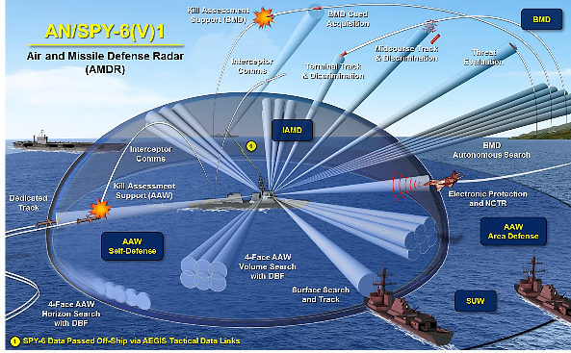
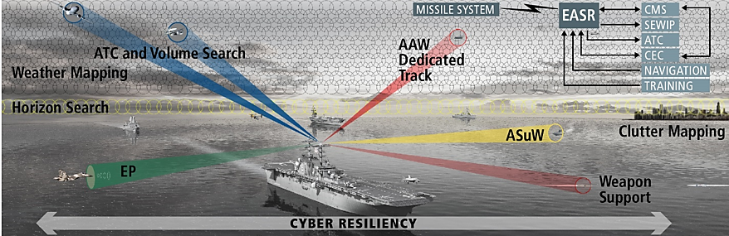
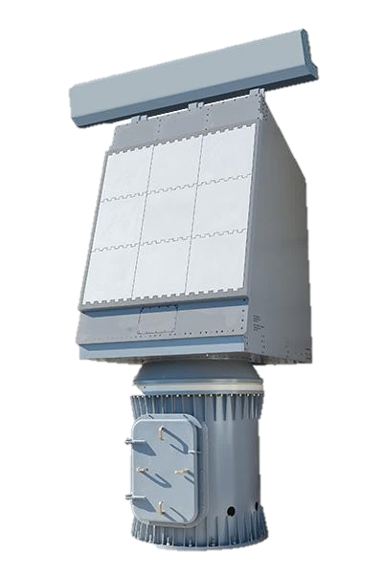
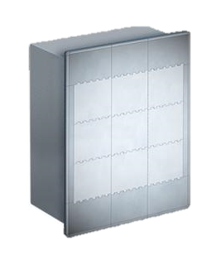
AN/SPY-6 Family of Radars Overview
Air and Missile Defense Radar (AMDR)
AN/SPY-6(V)1 and (V)4
Integrated Air and Missile Defense (IAMD)
Anti-Surface Warfare (ASuW)
Electronic Protection (EP)
Enterprise Air Surveillance Radar (EASR)
Rotator Variant AN/SPY-6(V)2
Fixed-Face Variant AN/SPY-6(V)3
Anti-Air Warfare (AAW)
ASuW
Air Traffic Control
Weather Mapping
EP
Notes:
SPY-6 family provides increased detection range for increased performance of hardkill and softkill weapons across the spectrum of warfighting domains
Scalable – adaptable, programmable, open interfaces, ease of integration
Affordable – low operational and total ownership cost
SPY-6(V)’s open architecture design and inherently scalable critical technologies provide an opportunity for use on various ship classes
Flight III DDG – installed in DDG 125
FORD Class CVNs – delivering system now to CVN 79
Back-fit in NIMITZ CVNs (RCOH) – CVN 74
Back-fit in Flight IIA DDGs (DDG Modernization)
LPD 29+
LHA 8+
CONSTELLATION Class FFGs

Slide 3
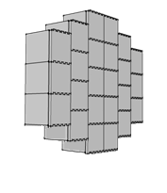

AN/SPY-6(V) Modular Design for Scalability
SPY-6 Radar Module Assembly (RMA)
SPY-6(V)1
4 X 37 RMA (148)
SPY-6(V)2
1 X 9 RMA (9)
SPY-6(V)3
3 X 9 RMA (27)
SPY-6(V)4
4 X 24 RMA (96)
Basic building block of SPY-6 radar apertures across the Family of Radars
Enables scaling of SPY-6 variants with low non-reoccurring engineering costs
Only 2 maintenance tools for LRU replacement (in less than 6 minutes)
AMDR
EASR Rotator
EASR Fixed Face
AMDR FLTIIA Backfit

Slide 4
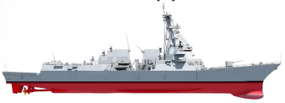
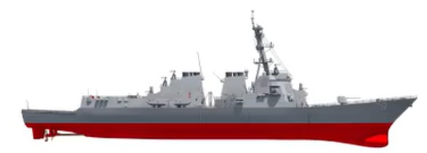
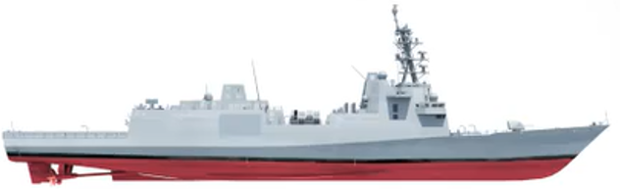
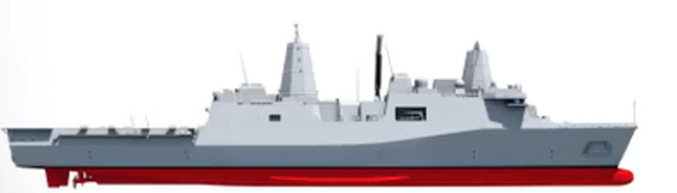
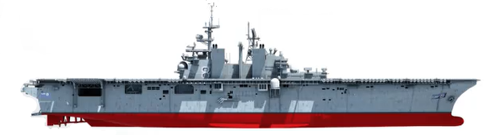
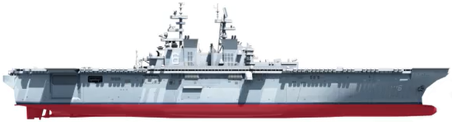
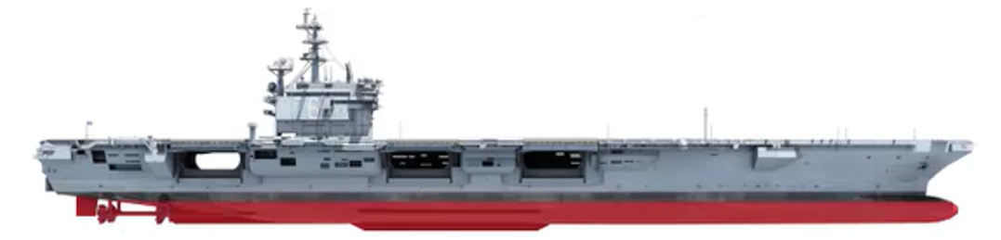
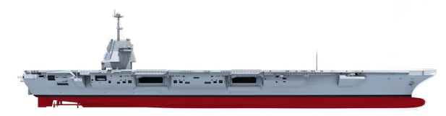
Outfitting the Fleet
Arleigh Burke Class DDG FLT III
AMDR SPY-6(V)1
4 X 37 RMA (148)
Arleigh Burke Class DDG FLT IIA
AMDR SPY-6(V)4
4 X 24 RMA (96)
Constellation Class FFG
EASR SPY-6(V)3
3 X 9 RMA (27)
San Antonio Class LPD
EASR SPY-6(V)2
1 X 9 RMA (9)
Wasp Class LHD
EASR SPY-6(V)2
1 X 9 RMA (9)
America Class LHA
EASR SPY-6(V)2
1 X 9 RMA (9)
Nimitz Class CVN
EASR SPY-6(V)2
1 X 9 RMA (9)
Gerald R Ford Class CVN
EASR SPY-6(V)3
3 X 9 RMA (27)

Slide 5





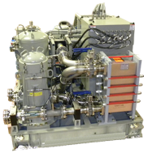

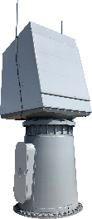
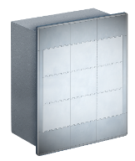
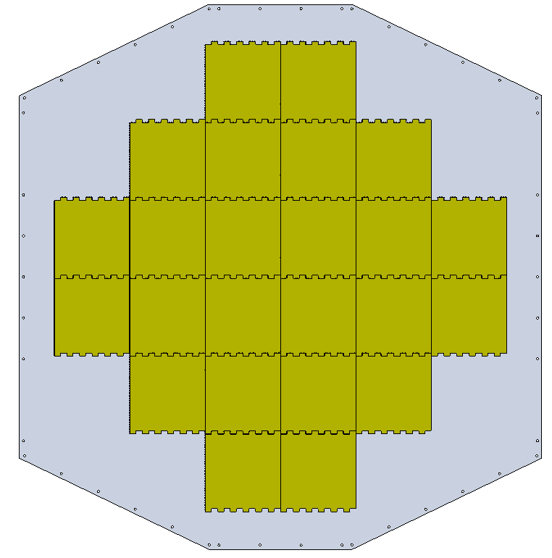
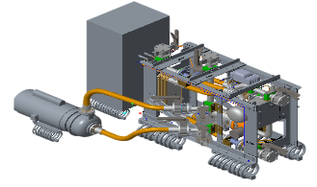
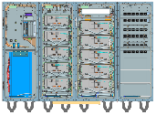
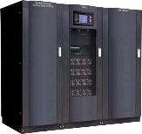
SPY-6 Variants – Hardware Commonality
Unclassified
AN/SPY-6(V)1
SPY-6 Family of Radars
Antenna Subsystem
Back End Processing Subsystem
AN/SPY-6(V)1
Radiator
Radar Modular Assembly (RMA)
Array Structure
4 Faces, 37 RMAs/Face
Flight III Destroyers
AN/SPY-6(V)2 (Rotator)
Amphibious Assault Ships (LHAs & LHDs)
Amphibious Transport Dock Ships (LPDs)
Calibration RMA
INS
Nimitz Class Aircraft Carriers
Antenna Interface
Digital Beamforming
Real Time
Simulator
Digital Signal Processing
Radar Control Processor /
Radar Suite Controller
AN/SPY-6(V)3
Ford Class Aircraft Carriers
Cooling Subsystem
Power Subsystem
Constellation Class Guided Missile Frigates
Common Array Cooling System (2 Units)
AN/SPY-6(V)4 (Backfit)
Flight IIA Destroyers
Array Power Distribution
Array DC Disconnect
Main Power Distribution
UPS
Batteries
LEGEND
Same
Scaled
Modified
V2 Qualified
HP&S New
HP&S Obsolescence Upgrades
AN/SPY-6(V)2
AN/SPY-6(V)3
AN/SPY-6(V)4
Antenna Subsystem
Back End Processing Subsystem
Antenna Subsystem
Back End Processing Subsystem
Antenna Subsystem
Back End Processing Subsystem
Radiator
RMA
Structure
1 Face Rotator 9 RMAs
Radiator
RMA
Structure
3 Faces 9 RMAs/Face
Radiator
RMA
Structure
4 Faces 24 RMAs/Face
Modified V1
Same as V1
Scaled/ Modified V1
Modified V1
Same as V1
Scaled V2
Same as V1
Same as V1
Same as V1
Cal RMA
INS
Cal RMA
INS
Cal RMA
INS
Scaled V1
Same as V1
Same as V2
Same as V1
Same as V1
Same as V1
DBF SW
Scaled V1
Scaled V1
Cooling Subsystem
Power Subsystem
Cooling Subsystem
Power Subsystem
Cooling Subsystem
Power Subsystem
Cooling Equipment Unit (CEU)
PPE
UPS
Scaled V2 (4X)
Scaled V2
(2X)
Same as V1 (1 Unit)
Power Distribution
Prime Power
Array Dist. same as V1
New Power Control Dist.
Same as V3
New

Slide 6
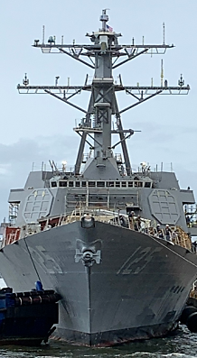
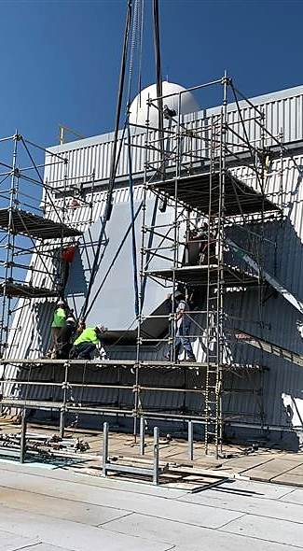
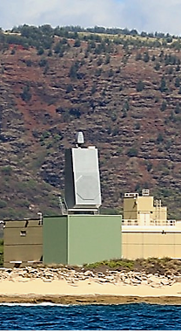
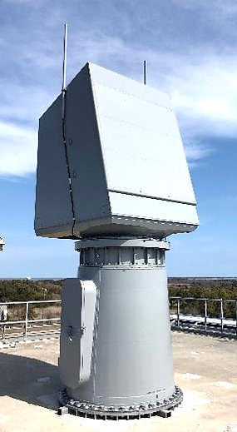

AN/SPY-6(V) Activities Map
System Integration and Test Sites
MIT/LL
Systems Engineering Support
Arc Technology Solutions
Electronics Assembly Cabinet
Raytheon Technologies
SPY-6 Radar Systems Prime, Arrays, Combat System Integration
NSWC Crane
System Engineering Support
Espey Mfg & Electronics Corp
Uninterruptable Power Supply
Whitmor Co
Breaker Panels
Raytheon Technologies
SPY-6 Radar Systems Prime, Digital Control and Processing
Becon Inc
Cooling Equipment
NSWC Corona
System Engineering Support
CSEDS
AEGIS Integration and Test
NSWC PHD
System Engineering Support
Johns Hopkins
University/APL
Systems Engineering Support
HII / BIW
CSEDS
Northrop Grumman Corp
AMDR Main and Array Power Eqpt
MSM Industries
Arc-Fault Detector, Array Mounting Kits
PEO IWS
Navy Management
Cobham Advanced Electronic Systems
Dual Channel Converter Aux Power Controller
NSWC Dahlgren
Systems Engineering Support
Nova Power Solutions Inc
EASR Prime Power Equipment
PMRF
Test and Evaluation Support
General Dynamics Mission Systems
Antenna RF and Power Modules
GTRI
Systems Engineering Support
NRL
Systems Engineering Support
SCSC Wallops Is.
Test and Evaluation Support
SPA
Program Support
PMRF
SCSC Wallops

