Slide 1
OUTREACH EVENT
INDEFINITE DELIVERY CONTRACT
SURVEYING AND MAPPING SERVICES
Professional Surveying and Mapping Services
USACE Caribbean District

Slide 2
AGENDA
27 February 2026
Morning Session: 0900 – 1200
Focus: Registration: 8:00/30-9:00 am
9:00 am – 10:00 am
Contract Overview: Indefinite delivery contract for architect and engineering (A-E) survey services
Contracting Requirements & Acquisition Timelines
Requirements Considerations
Requirement Technical Criteria and Standards
10:00 am – 10:30 am
Question and Answer Session – Note cards are at the registration table
10:30 am – 10:45 am
Break
11:00 am – 1:00 PM
“One on One”

Slide 3
QUESTION AND ANSWER SESSION
27 February 2026
1000 - 1030
Notecards are available at the registration table
Write down your questions on the notecards and place them in the basket on the registration table
Questions that can be answered during this event will be addressed during the Q&A session
All questions and answers will be provided on SAM.gov

Slide 4
CONTRACT OVERVIEW
MATOC: Multiple Award Task Order Contract
Contract Type: SF 252 - Indefinite Delivery Contract
Geographic Coverage:
Area of Responsibility of the Caribbean District
NAICS: 541370 - Surveying and Mapping Services
Contractor Role: Independent contractor providing all labor, materials, and equipment.
PSC Code: C219 Architect and Engineering—General: Other
Contracting Officer: Katrina L. Chapman
Contracting Specialist: Jose O. Vazquez-Torres

Slide 5


58
CONTRACT OVERVIEW – Acquisition Timeline
- Anticipated Milestones
Estimated Advertisement – Mon 6/29/26
Estimated Award – Sun 2/20/28
IDIQ Amount, NTE - $30M
Task Order Amount: $2.5K - $5M Max per order
Guarantee Amounts: $5K
Number of awards: Target of 5 awards
Estimated Period of Performance: 60 months

Slide 6
HOW TO SUBMIT QUESTIONS
All questions to be submitted through ProjNet
Deadline: TBD
Name: Indefinite delivery contract for architect and engineering (A-E) services
Solicitation Number: W51DQV26RA0## (Sample)
Bidder Inquiry Key: I7W97W-UH6XGS (Sample)
https://www.projnet.org/projnet/binKornHome/index.cfm

Slide 7
AREA OF RESPONSIBILITY
CARIBBEAN BASIN
SAA
Headquartered
in Puerto Rico

Slide 8
LOCATION OF WORK
Primary Area: Caribbean Basin, Commonwealth of Puerto Rico, U.S. Virgin Islands, and the Antilles
Secondary Area: The contract may be used to provide services to other South Atlantic Division (SAD) districts outside of the geographic boundaries of The UCASE Caribbean District. Commonwealth of Puerto Rico and the Antilles. (The contractor will have the right to refuse orders for services to be performed outside the geographic boundaries of The USACE Caribbean District.
Project Types: USACE Caribbean District assigned projects
Applications: Civil Works, Military Construction, and related projects

Slide 9
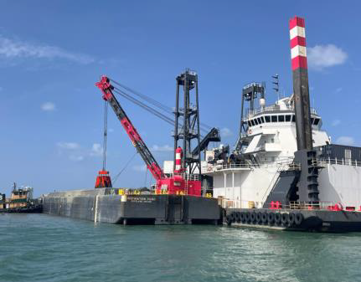
Types of Projects Supported.
RIO GUANAJIBO
Río Puerto Nuevo Roosevelt Avenue Bridge Replacement
Dredging Work
Río de la Plata Channel Bank Stabilization

Slide 10
Types of Projects Supported.
RIO PUERTO NUEVO
RIO GUAYANILLA

Slide 11
TECHNICAL CRITERIA AND STANDARDS
USACE ER_5-1-11, USACE Business Process
USACE EM 385-1-1, SAFETY AND HEALTH REQUIREMENTS
USACE EM 405-1-03, Real State Geospatial Data and Mapping
USACE EM 1110-1-1000, Photogrammetric and LiDAR Mapping
USACE EM 1110-1-1002 Survey Markers and Monumentation
USACE EM 1110-1-1003 NAVSTAR Global Positioning System Surveying
USACE EM 1110-1-1005 Control and Topographic Surveying
USACE EM 1110-1-2909 Geospatial Data and Systems
USACE EM 1110-1-2910 Remote Sensing
USACE EM 1110-2-1003:Hydrographic Surveying
USACE EM 1110-2-1009 Structural Deformation Surveying
USACE EM 1110-2-6056 Standards and Procedures for Referencing Project Evaluation Grades to Nationwide Vertical Datums
Federal Acquisition Regulation 31.205-46 Travel Cost
Federal Geographic Data Committee (FGDC) Standards
American Society for Photogrammetry and Remote Sensing (ASPRS) Standards

Slide 12
SERVICES TO BE PERFORMED
Topographic Surveying and Mapping
Boundary/Property Surveys
Construction Support Surveys
Beach Profiles
Horizontal and Vertical Geodetic Control Surveys
Ground Penetrating Radar and Vacuum Excavation for Utility Location
Static Terrestrial and Mobile Laser Scanning
Near-shore and Offshore Hydrographic Surveys
Seabed Classification, Side Scan Sonar, Sub-bottom Profiling
CADD/GIS Services
Photogrammetry
Aerial LiDAR

Slide 13
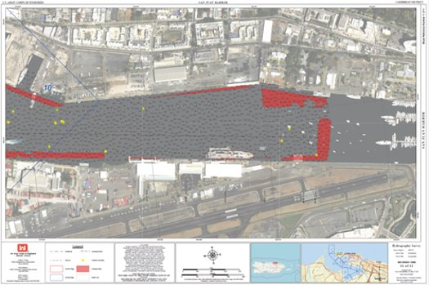
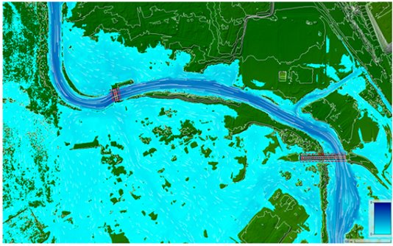
Surveying & Mapping Support Areas
Land Acquisition Process
Hydraulic & Hydrologic Analysis
Construction Support
Permitting & Regulatory Compliance
Engineering Design
Harbor Inspections & Post‐Event Assessments
MILCON Programs

Slide 14
PROCEDURES AND REQUIREMENTS
Fully equipped survey crews with professional personnel
Appropriate instrumentation consistent with industry standards
Standard permanent bound field books for observational data
Adequate professional supervision and Quality Control
Government review and approval for accuracy standards compliance
Direct contact with responsible personnel for progress estimates

Slide 15
PERSONNEL REQUIREMENTS
Survey Crew: Party chief (2+ years experience) and instrument operator (1+ year experience)
Survey Helper: Capable of assisting survey/crews
Specialist: 10+ years experience with current professional registration
Analyst: 5+ years experience in surface modeling, GIS analysis, data processing, remote sensing
Technician: 1+ year experience in engineering or GIS/CADD

Slide 16
QUALITY CONTROL AND ASSURANCE
All mapping data must conform to EM 1110-1-1005 accuracy standards
Survey Control and Datum Verification
Accuracy and Standards Compliance
Data Processing, Validation, and Review
Professional Oversight
Government QA for acceptance.

Slide 17
SUBMITTAL REQUIREMENTS
CADD files
Pdf Signed & Sealed files
All processed and unprocessed electronic data ( .job, .cvs, etc)
Field records in standard 7.5" x 4.5" bound books
Monument reporting to U-Smart.
Certified Report of Survey by licensed Professional Survey and Mapper
GIS data and metadata
Individual Task Order Requirements Submittals

Slide 18
General procedures for evaluation boards
Information used by boards:
Boards will consider only the following information: SF 330 Parts I and II
Any required supplemental information; documented performance evaluations from CPARS (or PPQs if example projects are non-federal)
DoD contract award data and the results of discussions of the MHQ firms
A board will not assume qualifications that are not clearly stated in a firm’s submission or available from CPARS
A board will review the entire submission of each firm and not excerpts or summaries
A firm will not be contacted to clarify or supplement its submission
Boards will not consider any cost factors
A-E submissions are electronic and will be handled by the government consistent with FAR 15.207 and FAR 15.208, including the late proposal rules in FAR 15.208. A firm will not be considered if its SF 330 Part I is not signed unless the SF 330 Part I is accompanied with a signed cover letter or a current signed SF 330 Part II.
If a contract has been set aside for SB consistent with FAR 19.5, the CS must check that each prime firm is an SB under the appropriate NAICS in SAM.gov and on the SF 330 Part II.
A board may use any qualitative method

Slide 19
FAR 36.602-1 Selection criteria.
Agencies shall evaluate each potential contractor in terms of its:
Professional qualifications necessary for satisfactory performance of required services *
Specialized experience and technical competence in the type of work required
Capacity to accomplish the work in the required time
Past performance on contracts with Government agencies and private industry in terms of cost control, quality of work, and compliance with performance schedules
Location in the general geographical area of the project and knowledge of the locality of the project; provided, that application of this criterion leaves an appropriate number of qualified firms, given the nature and size of the project
Acceptability under other appropriate evaluation criteria
* Comply with PR State law' (Dep. Of State Examining Boards and College of Engineers & Surveyors of PR (CIAPR) and Corporate Institutional Policy Pursuant to Act No. 173 of 1988

Slide 20
DRAFT CONTRACT LINE ITEMS OVERVIEW
0001 - Miscellaneous: Negotiated per task order
0001AA - Per Diem As per FAR 31.205-46
0001AB - Air Transportation
0002 - Vehicles:
0002AA - Pickup Trucks
0002AB - ATV’s
0003AC - Vessels
0003AD - Heavy Equipment
0003 - Equipment:
0003AA - GPS units
0003AB - Total Stations
0003AC - Hydrographic systems
0003AD - Sensors
0004 - Personnel:
0004AA - Survey crews
0004AB - Specialists
0004AC - Analysts
0004AD - Technicians
0005 - Special Assignment: Negotiated as required

Slide 21
PARTNERING AND COMMUNICATION
Initial Partnering Meeting (Kickoff) for process overview
Bilateral project partnership approach
Goals: Effective performance, on-time completion, customer satisfaction
Weekly reporting requirements by close of business Mondays
Close liaison with COR and Technical Point of Contact (TPOC)
Response to RFPs within 10 calendar days

Slide 22
SAFETY AND COMPLIANCE
Compliance with USACE EM 385-1-1 Safety and Health Requirements
FAR 52.236-13 Accident Prevention requirements
Site investigation responsibility per FAR 52.236-3
Professional supervision and quality management
Technical accuracy responsibility per FAR 52.236-23

Slide 23
PAYMENT AND INVOICING
Payment based on negotiated unit prices
Task Order (TO) will be a Firm Fix Price Contract (FFP) - is an agreement where the buyer pays a set price, regardless of the seller’s actual costs, placing maximum risk on the contractor. It requires clear, well-defined, and stable specifications. The contract offers high certainty for budgets, as costs are not subject to adjustment based on contractor experience.
Monthly payments per FAR 52.232-10
Standard 10% retainage on partial payments
ENG Form 93 submission to ENG-93-tfvipr@usace.army.mil
Daily time sheets and lodging receipts required
Final payment includes release of claims

Slide 24

CONTACT INFORMATION
USACE Caribbean District
Engineering/Surveying, Technical Support Branch
Building, Suite 202
383 Franklin D. Roosevelt Avenue
San Juan, PR 00918

Slide 25
Teams | "One on One" Time Schedule
A
Aula Centro Educativo Montessori | 11:00 | 11:10
CAHB LLC | 11:10 | 11:20
CAPTA PSC | 11:20 | 11:30
Carla Rivera | 11:30 | 11:40
Christian Construction Service, LLC | 11:40 | 11:50
CONDADO WINDOW HURRICANE PROTECTION, INC. | 11:50 | 12:00
Fugro | 12:00 | 12:10
DIO PR Division of CRACCO ENTERPRISES LLC | 12:10 | 12:20
JJM Construction | 12:20 | 12:30
Velocity LLC | 12:30 | 12:40
B
Gahagan & Bryant Associates, Inc. | 11:00 | 11:10
Ing. Juan A. Torres Berrios, DBA | 11:10 | 11:20
Juan Carlos Davila | 11:20 | 11:30
PAUSA365 | 11:30 | 11:40
PR SOAR | 11:40 | 11:50
Precision Measurements, Inc. | 11:50 | 12:00
Q&A Diversified LLC | 12:00 | 12:10
Miro Cividanes, Carlos | 12:10 | 12:20
Constructora V&M | 12:20 | 12:30
Rincon Reality | 12:30 | 12:40
Agrotex | 12:40 | 12:50

