Slide 1
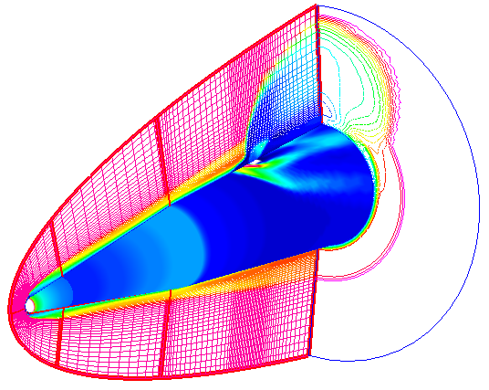
Project Name (Project Acronym)
Description
T&E Need: Provide a short/bulletized description of T&E need being addressed.
{Provide a description of the technology, either in paragraph or in bullets. Include pictures or drawings in this section if it helps describe the technology}
Why is it needed?
Enables: Provide short/bulletized description of what this technology will enable.
How does it improve current T&E or enable new T&E?
This section is to answer “What the project is developing?”
S&T Challenges: Provide short/bulletized description of S&T challenges.
Why is it tough to do?
Deliverables: Provide list of technical deliverables.
What will result?
Project Plan (Major Tasks by Stages)
Programmatic Information
Prime Performer: {Organization (Location)}
Subcontractors: Organization 1 (Location1); Organization 2 (Location 2); Organization 3 (Location 3); etc.
Concept Formulation (FY 2017 – FY 201_)
Evaluated …..
Developed ……
Develop ….
Develop ….
Develop ….
Develop ….
Development (FY 201_ – FY 201_)
Integrate ….
Conduct ….
Integrate ….
Develop ….
Transition Plans (FY 201_ – FY 201_)
Test at AEDC during Q4 FY 201_
Who is doing the work?
All tasks start with a verb. Use check mark and past tense verbs for completed tasks.
Current
Effort
How will the technology be developed in terms of stages?
How long and at what cost?
If test location is not known, state: “Test in a relevant environment”
Transition Partner(s):
Who benefits from the work?

