Slide 1
INDUSTRY DAY FORUM Devens RFTA COLLECTIVE TRAINING barracks Army Reserves: army reserve center
DATE: 15 APR 2026
TIME: 1000 ET
LOCATION:
31 Quebec Street
Devens, MA 43015
Tony Spicer- Project Manager Michael Barry- Project Engineer
Daniel Kobzar – New England District COR
Ryan King- Contracting Specialist Crystal Harbin – Deputy for Small Business
”The views, opinions and findings contained in this report are those of the author(s) and should not be construed as an official Department of the Army position, policy or decision, unless so designated by other official documentation.”

Slide 2
ADMINISTRATIVE ANNOUNCEMENTS
Introduction
Please ensure that you have signed in
Company Name, POC Name, Email, Phone
Are you interested in being the Prime or Subcontractor
If you’re interested in being a Subcontractor, state the Type of Work you are interested in (Electrical, Mechanical, etc.)
No recording (please turn off or put away all mobile devices)
This briefing and the attendee roster will be posted to SAM.gov
Please be advised that none of the information discussed today is contractually-binding

Slide 3
AGENDA
Design Overview
Procurement Process
Small Business Opportunities
Questions

Slide 4
Project scope
Project: Construct a 300-bed open-bay Collective Training Enlisted Barracks.
Location: Devens, Ma
Includes: Army Reserve Center Building 46,000 SF
Construct a 300-bed open-bay Collective Training Enlisted Barracks on Devens Reserve Forces Training Area (RFTA), Massachusetts. The barracks will consist of open bay sleeping rooms, storage, team rooms, laundry, restrooms, and showers. The project will include information systems, fire protection, alarm systems, and energy monitoring control systems. Supporting facilities include site development, utilities with connections, lighting, paving, sidewalks, curbs and gutters, storm drainage, landscaping and signage. Sustainability/Energy and cybersecurity measures are included. Demolition of two (2) adjacent buildings.

Slide 5
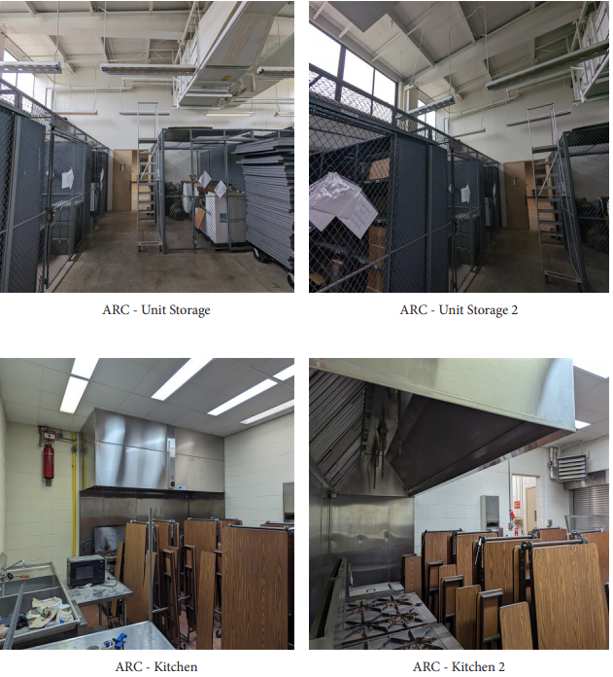
Unit storage / kitchen

Slide 6
Project site

Slide 7

PROCUREMENT PROCESS OVERVIEW
Ryan King
CONTRACT SPECIALIST
USACE-LOUISVILLE DISTRICT
Jesse Scharlow
CONTRACTING OFFICER
USACE-LOUISVILLE DISTRICT

Slide 8
THE PROCUREMENT PROCESS
Request for Proposal (RFP) issued for offers for this Design-Bid-Build (D-B-B) project
Unrestricted (full and open) procurement
LRL will conduct a Single-Phase Source Selection Evaluation Board (SSEB) to evaluate offerors’ proposals based on specific factors as defined in the RFP Package
“Best Value Trade-off” process used that allows us to award to the offeror whose proposal offers the best value to the government
Proposals must be submitted on time.
The Louisville District is located within the Eastern time zone.
Notes:
This project will be a Single-Phase Design-Bid-Build Unrestricted procurement.

Slide 9
HOW TO OBTAIN THE SOLICITATION
System for Award Management (SAM) at www.SAM.gov
Solicitation Number W912QR26RA051 – FOLLOW!
Solicitations for USACE-Louisville begin with W912QR
Search using Keyword Search Feature (Select “Any Words” or “All
Words”): Fort Devens Collective Training Barracks
Register as an Interested Vendor and view the Interested Vendors List if you are looking to partner with another company of firm to compete for this project
Register to receive notifications and updates / amendments*
RFP Technical Information (i.e., Plans and Specs) will be available for download from www.SAM.gov

Slide 10
DOCUMENTS / NOTICES POSTED to SAM.gov
Pre-Solicitation Notice
– Minimum 15 days prior to Solicitation
Advertisement
– Minimum 30 days to prepare Proposals
Amendments issued to the RFP will also be posted on www.SAM.gov

Slide 11
OBTAINING SOLICITATION DOCUMENTS
Requirements to Download Technical Data Package:
Register for a SAM account and Sign-In to:
- “Follow” to receive email notifications (i.e., amendments)
- View interested vendors list
- Sign up as an Interested Vendor
Locate and access the Solicitation notice in the SAM database.
- Go to the “Attachments/Links” section to download the
solicitation and all technical documents.

Slide 12
SUBMITTING YOUR PROPOSAL
Requirements to Submit Proposals:
All proposals will be submitted through the PIEE Solicitation Module. Please note proposals must be submitted on time.
Offerors must register in advance for a user ID and Password to access this system.
Register your business entity (you as an individual or your organization) to be able to propose on contracts as the Prime.

Slide 13
PROPOSAL REQUIREMENTS
Source Selection Evaluation Criteria for Volume I may consist of the following elements (subject to change)
1) Volume I – Factor I: Past Performance Evaluation
Project(s) completed as the Prime Contractor (maximum 3)
Relevancy - Recent projects, similar in size, scope, magnitude of effort & complexities
Quality of performance on submitted projects
Other sources of relevant past performance information (i.e., CPARS, FAPIIS)
Volume I – Factors II & III: Technical Factors (e.g. Management Plan,
Schedule Narrative)
Technical
Evaluation
Factors
Notes:
Section 00 22 12 will contain the proposal submission requirements and evaluation criteria. Follow the format described in Section 00 22 12 to keep the proposal in order, success is in the details. Please pay close attention to the requirements of the RFP.
For the Past Performance Factor, we will evaluate both the relevancy of experience and performance quality of prior experience. We will, at a minimum, review CPARS information available but reserve the right to check any and all sources of past performance information. This review will result in an overall assessment of confidence in performance.
For the Technical Evaluation Factors (Management Plan and Commissioning Plan), consider providing specifically tailored approaches for the solicited project. Don’t just tell us how you generally execute construction projects; tell us how you plan to execute this specific project and mitigate project specific risks (schedule, environmental, labor, etc.).

Slide 14
PROPOSAL REQUIREMENTS
Source Selection Evaluation Criteria for a Volume II consists of the following elements:
3) Volume II – Pro Forma (& Price) Information
Tab A: Standard Form 1442
Tab B: Joint Venture Agreements (if applicable)
Tab C: Evidence of Ability to Obtain Bonding & Proof of Financial Ability
Tab D: Pre-Award Information
(i.e., Reps & Certs, offeror information, etc.)
Notes:
As a reminder, the Small Business Participation Plan is a rated evaluation factor and applies to all businesses, both large and small, and is based on total contract value. Only large businesses are required to submit a Subcontracting Plan.

Slide 15
PROPOSAL REQUIREMENTS
Technical Factors listed in relative order of importance (example):
Volume I – Factor I: Past Performance Most Important
Volume I – Factor II: Management Plan Equal to Factor III
Volume I – Factor III: Schedule Narrative Equal to Factor II
All Technical Evaluation Factors, other than Price, when combined are considered approximately equal to Price.
Submit your best proposal the 1st time. If we receive an initial proposal that is awardable, discussions may not be opened.
Notes:
The Government intends to evaluate proposals and award a contract without discussions with offerors (except clarifications as described in FAR 15.306(a)). Therefore, the offeror’s initial proposal should contain the offeror’s best terms from a price and technical standpoint. The Government reserves the right to conduct discussions if the Contracting Officer later determines them to be necessary.

Slide 16
PROPOSAL REQUIREMENTS
Instructions for submitting a Request for Information (RFI) will be
included in the Solicitation.
RFIs for these projects will be received and answered through the ProjNet system: www.ProjNet.org
Any RFIs submitted/emailed directly to the Project Team will NOT receive a response, and offerors will be directed to the ProjNet system.
A ProjNet Bidder’s Key included in the solicitation’s Project Instructions section of the RFP, which is used to post your RFIs/questions.
RFIs and their responses will be available for public review through ProjNet.
Optional Site Visit held to familiarize Offerors with the jobsite and conditions, not for the purposes of answering questions.
Notes:
An Optional Site Visit will be held solely to provide the Offerors with an opportunity to familiarize themselves with the jobsite and conditions
to be encountered and is not for the purpose of answering questions. All questions and inquiries shall be submitted
via ProjNet only, in accordance with the Solicitation instructions provided in Section 00 21 00, PROJNET
INSTRUCTIONS, OFFEROR’S QUESTIONS AND COMMENTS.

Slide 17
PROPOSAL SUBMISSION
We will utilize the Electronic Receipt of Proposal process – Instructions will be in Section 00 21 00 of the solicitation package
Proposals are uploaded to and submitted through PIEE Solicitation Module
Recommend performing a test run well in advance
Don’t wait until the last minute to upload your proposal. Late is Late - No exceptions!
Notes:
As mentioned earlier, all proposals will be submitted through the PIEE Solicitation Module on time. Therefore, offerors must register in advance for a user ID and Password to access this system.
****Note: Attachments will not be available in PIEE, and will be downloadable from SAM. The Solicitation and Amendments take time to fully process from PIEE to SAM. If you see the solicitation or amendment without attachments in SAM, please continue to check periodically as they will be available by the close of business (COB).

Slide 18
PROCUREMENT SCHEDULE Dates are approximate AND SUBJECT TO CHANGE
ISSUE SOLICIATION APRIL 2026
SOLICITATION CLOSES MAY 2026
EVALUATION BOARD MAY / JUNE 2026
AWARD JUNE 2026

Slide 19
Crystal Harbin
Deputy for Small Business
Louisville District
Courtney Luckett
Small Business Professional
Louisville District
SBO-LRL@usace.army.mil

Slide 20
NETWORKING
Networking is an important part of preparing for the upcoming project. Please post the below information in the chat:
Company Name
POC Name, Email, Phone
Are you interested in being the Prime or Subcontractor
If you’re interested in being a subcontractor, state the type of work you are interested (Electrical, Mechanical, Roofing, etc.)
The sign-in sheet and presentation slides will be posted to the www.SAM.gov notice following the close of this industry day. Please be sure to use this information to network with other firms and build your team.
Interested Vendors List in SAM

Slide 21
Small Business Participation plan & Subcontracting PLAN
The Small Business Participation Plan is a rated evaluation factor in all unrestricted procurements
Both large and small business offerors must submit a participation plan.
The participation plan is based on total contract value.
The Small Business Participation Plan must meet the minimum Total Small Business Participation goal. The percentage will be included the solicitation.
Small Business prime self-performance counts as Small Business Participation.
Large Business offerors must submit a Small Business Subcontracting Plan
Mandated by FAR 19.702
This is not a rated element as a part of the Source Selection process but the offeror shall submit an acceptable plan prior to award
The subcontracting plan is based on total subcontracted dollars
Failure to comply in good faith is in material breach of the contract

Slide 22
Obtain information
Attend Site Visits, Pre-Proposal Conferences, & Industry Days
Obtain copies of attendee roster for subcontracting opportunities
Register as an Interested Vendor on SAM
Attend Workshops and Conferences
Louisville District Open House
Construction & IDIQ Forecast is maintained on the Business with Us page of the Great Lakes and Ohio River Division website, https://www.lrd.usace.army.mil/Opportunity-Forecast/

Slide 23
opportunities
We anticipate executing approximately $1.5B in FY26 through both small and large businesses.
Contracting opportunities are posted in the System for Award Management (SAM) website at www.sam.gov. Use “W912QR” to search for Louisville District projects.
Actively Respond to Sources Sought Notices (Market Surveys) posted to SAM
Actively Respond to Competitive Requirements posted to SAM

Slide 24

Thank you for your time and interest!

Slide 25
Q&A

