Slide 1
AFCEC/CZQE F2F Site Visit
06 – 07 MAY 2026
Time: 8:00am EST
Tamy Dabu, AFCEC/CZQ
East Installation Support Branch

Slide 2
Purpose of the Site Visit
Provide a forum for vendor(s) to view the installations, site conditions, and example locations, as well as develop questions to assist the AF in clarifying scope requirements.

Slide 3
Overview of Schedule
Acquisition Overview
Introductions
Type of Acquisition
Ground Rules
Acquisition Timeline
Installation Overview
Introductions
Installation Facts
Environmental Program Areas
Unique Considerations
Site Tour

Slide 4
Acquisition Overview
Any changes will be incorporated by formal amendment to the Request for Proposal (RFP)
Amendments will be posted to FEDBIZOPPS
Unless the formal solicitation is amended, it remains unchanged as a result of this conference
Pre-proposal conference minutes, presentation, attendees and questions/answers will be made available on FEDBIZOPPS

Slide 5
Acquisition Team Introductions
DAF
Contracting Officer’s Representative (COR):
Scott Flash, scott.flash@us.af.mil
Technical Program Manager (TPM):
Mark Dixon, mark.dixon.5@us.af.mil
GSA
Contracting Officer (KO): Clyde Gardner
Project Manager: Patricia (Pat) Hammons
Contract Specialist: Jada Morrow
Only the CO has authority to bind government contractually

Slide 6
Acquisition Overview
Contract Title: F2F Environmental Services for SLD45 & APAFR
Contract Vehicle: MAS 8a Competitive, SIN 541620
7600A-GT&C-A2511-057-047-086084
Acquisition ID#: 47QFWA26K0005
Solicitation#: 47QFWA26Q0005
Contract Type: Tasks-FFP; Travel & MES-T&M
Period of Performance: 8-mo Base Year (BY) + 4 12-mo. Option Years (OY)

Slide 7
Ground Rules for Site Visit
Attendance at site visit is based on company’s decision to participate
Government will not provide reimbursement for site visit
Offeror shall not contact any AFCEC or Base personnel
Offeror shall not contact regulatory agencies
All communication MUST be through the GSA CO/PM

Slide 8
Ground Rules for Site Visit
All Technical or Contractual questions resulting from this site visit must be submitted per the Contracting Officer’s instructions in the solicitation.
No questions will be asked or answered during the site visit.
If questions are asked/answered orally, the vendor takes a risk in relying on that response rather than receiving the response in writing.
Written responses to questions shall take precedence over information given verbally during the site visit.

Slide 9
Overview of PWS General
Includes support for five (05) geographically separate installations with four (4) satellite radar locations in Florida (one state)
Scope encompasses the full range of methods, technologies, and supporting activities necessary to conduct environmental operations and services
Contractor shall furnish the personnel, services, equipment, tools, materials, vehicles, supervision, and other requirements necessary to perform work unless otherwise noted
i.e., government furnished material, vehicle, etc.
PWS requirements apply to each applicable installations, unless otherwise identified

Slide 10
Overview of PWS Table 1 Requirements
Table 1 summarizes requirements by Basic and Optional requirements
Basic requirements are included in each year for the installation identified
Optional requirements may be exercised in the year identified for the base, as determined by bona fide need / funding and as executed via modification
Table 1 is also presented in Attachment 4 of the PWS organized by base indicating basic or option for each year

Slide 11
PWS References
Task Requirements (Chapter 3.0 of the PWS)
Contract Data Requirements List (CDRLs) Deliverables
Distribution to AFCEC (COR and/or Base PM)
Primary Format is electronic unless specified hard copy eMail, CD, or Files Transfer Program/eDASH acceptable
Format: 1) IAW Standardized Format; 2) Coordinated w/PM
Submit all required deliverables/reports through ASSIST
Supporting Documents (List on Atch 3)
Program Requirements, Permit Requirements, Sampling Requirements, Deadlines, Formatting, etc.
Available electronically (no hard copy)
Program Details (Atch 4)
HW/HM, ESAM, Air Quality, Water Quality, Solid Waste, EMS, POL, Toxics, Public Notification, Plans/Permits
Contains historical averages to be used as reference only and includes relevant Government Furnished Equipment
Additional References: GIS Maps

Slide 12
Acquisition Timeline
Site Visit: 6 - 7 May 2026 (Time: 8:00 am EST)
Vendor Questions Due: 18 May 2026
Anticipated Government Response: 17 June 2026
Anticipated RFQ Posting: 17 June 2026
RFQ Closing Date: 17 July 2026
Estimated Award Date: 17 Aug 2026
Any Requests for Information after the required Due date and time WILL NOT be accepted. No Exceptions.

Slide 13
Installation Overview
This solicitation outlines the requirements for comprehensive Fence-to-Fence Environmental Service Support across multiple Department of Air Force (DAF) installations and associated facilities in Florida.
Locations Included:
Patrick Space Force Base (PSFB)
Cape Canaveral Space Force Station (CCSFS)
Jonathan Dickinson Missile Tracking Annex (JDMTA)
Malabar Transmitter Annex (MTA)
Satellites: KARS Park, Tel IV, Shiloh, and Cocoa Doppler
Avon Park Air Force Range (APAFR)
* PSFB, CCSFS, JDMTA, and MTA will be collectively referred to as Space Launch Delta 45 (SLD 45).

Slide 14
Discussion
Installation Facts (next slides)
Infrastructure
Base Access (DBIDS, CAC)
Communications
Data Systems (EESOH-MIS, APIMS, eDASH, LAN)
Program Review (PWS Requirements)
HW/HM, Env Sampling, Air Quality, Water Quality, Solid Waste, EMS, POL and Toxics
Unique Considerations
CCSFS and the other GSUs are a GOCO. CTR will be the day-to-day on-site MPM for ENV compliance oversight.
Notes:
LAN – CTR will be provided access to the F2F share drive. All files, documents, maps, etc. will be stored on this drive. No CD deliverable will be provided at the end of the contract. CTRs MUST utilize the Government provided computers and all files stored as noted.

Slide 15
Installation Facts – (PSFB)
MAJCOM: United States Space Force (USSF)
Host Unit: Space Launch Delta 45 (SLD45)
Wings: AFRC 920th Rescue Wing
Major Tenants: AFTAC, Space and Missile System Center, DOS, NASA, FAA, DEOMI, Joint Stars Test Force
Mission: Processing and launching of gov’t and commercial satellites from CCSFS. SLD45 is the final authority for all launches on the Eastern Range
Size: 2,002 acres
Runway(s): 2 (Runways: 9,003 feet and 3,992 feet long)

Slide 16
Installation Facts – (CCSFS)
MAJCOM: United States Space Force (USSF)
Host Unit: Space Launch Delta 45 (SLD45)
Wings: AFRC 920th Rescue Wing
Major Tenants: NASA, NOTU, NRO, Aerospace Fuels Laboratory, Military Sealift Command, Military Surface Deployment and Distribution Command, United Launch Alliance, SpaceX, Blue Origin, Relativity Space and Stoke Space
Mission: Processing and launching of gov’t and commercial satellites from CCSFS. SLD45 is the final authority for all launches on the Eastern Range
Size: 15,800 acres
Runway(s): 1 (Runway: 10,000 feet long)

Slide 17
Installation Facts – (APAFR)
MAJCOM: Air Combat Command
Host Unit: Moody Air Force Base
Wings: 23 WG
Major Tenants: Florida National Guard
Mission: Provide a sustainable world class training complex focused on advanced, realistic and relevant training for joint, interagency and multinational partners excelling in air ground integration and Agile Combat Employment
Size: 106,074 acres
Runway(s): 1 (Runway: 8,000 feet long)

Slide 18
Base Access – PSFB
Gates: PSFB East Gate
Operating Hours: 24 / 7
Essential Activities: Authorized DoD ID card holders can escort passengers in their vehicle. EVERY passenger 18+ must show a REAL ID–compliant ID at the gate. This ensures 100% verification of all personnel entering the installation. All individuals entering Patrick SFB must be U.S. citizens and meet federal access standards
Visitor Center: 0730-1630 (321) 494-0427

Slide 19
Base Access – CCSFS
Gates: CCSFS Main Gate
Operating Hours: 24 / 7
Essential Activities: Authorized DoD ID card holders CANNOT escort passengers in their vehicle. EVERY passenger 18+ must show a compliant ID at the gate. This ensures 100% verification of all personnel entering the installation. All individuals entering CCSFS must be U.S. citizens and meet federal access standards
Visitor Center: 0730-1630 (321) 853-5261

Slide 20
Base Access – APAFR
Gates: APAFR Park Entry Gate 29 – Code Required
Operating Hours: 24 / 7
Essential Activities: There is no active guard on duty at APAFR. All visitors must have a valid reason to obtain access. Access is granted by calling Production Control.
Production Control: 863-452-3100 call for access code

Slide 21
Spaceport of the Future
The U.S. Space Force’s Range of the Future 2028 Strategic Intent identified the requirement to increase launch posture over the next 10 years. Infrastructure must be improved to meet this new requirement.
Primary Goals:
Range must be able to support launching EVERY day.
Range must be able to support multiple launches per day.
Range must eliminate all critical day restrictions.
Establish infrastructure redundancy and resiliency.
Reduce personnel impacts associated with launch and landing activities.
Quick execution projects by completing environmental planning upfront.

Slide 22
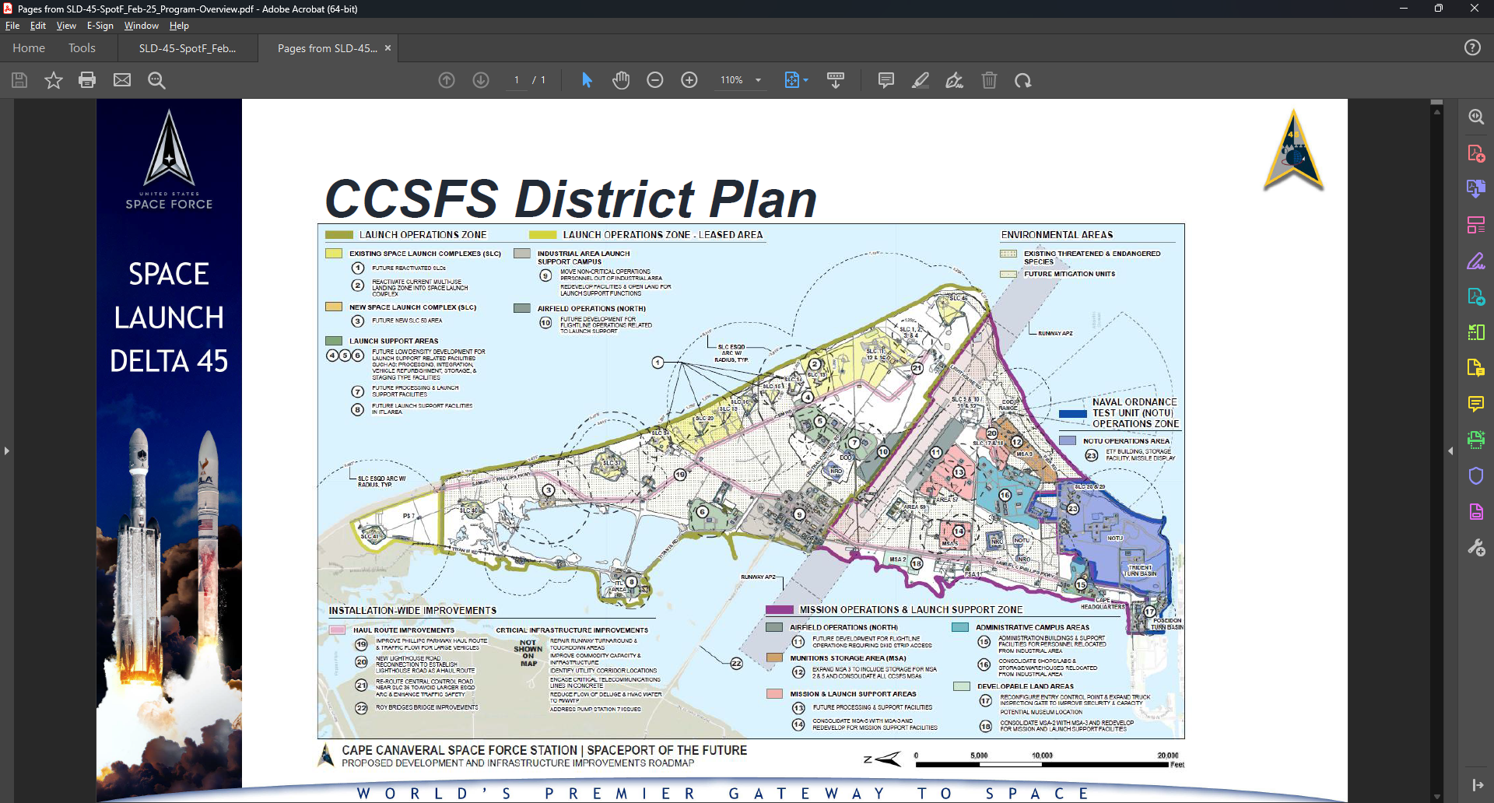
Spaceport of the Future

Slide 23
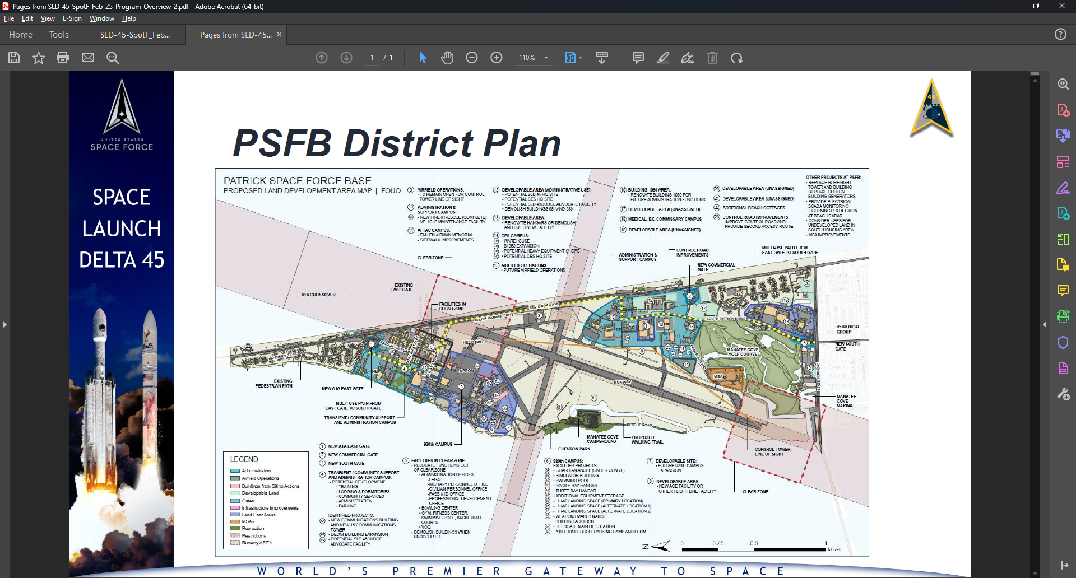
Spaceport of the Future

Slide 24
Environmental Program Areas
Hazardous Waste/Hazardous Materials
Env Sampling, Analysis & Monitoring
Air Quality
Wastewater/Stormwater
Solid Waste
Environmental Management System
Petroleum, Oil and Lubricants
Toxics
Public Notifications
Plans/Permits
Review Taskers
NEPA

Slide 25
Hazardous Waste
TSDF: HWAS:
PSFB (LQG) 2 11
CCSFS (LQG) 1 15
APAFR (SQG) 1 1
HM Shops: IAP/HWAP:
PSFB (LQG) 136 53
CCSFS (LQG) 96 31
APAFR (SQG) 11 3

Slide 26
Env Sampling, Analysis & Monitoring
Installation Sampling requirements have all been captured in the ESAM Plan
Landfill, Wastewater, Stormwater, EOD
Unique Considerations
Planning and scheduling are important due to launches
Will have to contact EOD and CLOIS to gain access to the landfill and EOD range
PWQ/TRP process is local to SLD 45
Strict adherence to time frame to prevent mission impact
Complete review of all chemical profiles every 5 years

Slide 27
Air Quality
Currently operating Air General Permit – Stationary Generators
Multiple FDEP exemptions
AEI completed in APIMS
Semi-annual Monitoring Report – RICE NESHAP
Trending toward Title V permit

Slide 28
Wastewater & Stormwater
MS4 Stormwater Permit
PSFB – Base has (35) total outfalls
MSGP Stormwater Permit
CCSFS – (Sector Q and S) Wharves (4 qty) and Skid Strip; 20 outfalls
PSFB – (Sector N, Q, and S) Marina (2 qty), Runway, and MRF; 21 outfalls,
APAFR – (Sector S), Runway and Laydown Yard
ERP Stormwater Permit
CCSFS – 171
PSFB – 108
Wastewater Permit
CCFSS - 1

Slide 29
Solid Waste
Solid Waste Program
Consolidated permit consisting of 3 landfills
C&D, Asbestos and Closed Class 1
Landfills are not accepting waste
Monitoring groundwater, surface water & gas – semi annual
Recycling Program
Oil/Rag recycling managed by F2F as depicted in PWS

Slide 30
Petroleum, Oil and Lubricants
Spill Plan
SPCC – APAFR, PSFB/MTA and CCSFS/JDMTA with satellite locations
FRP – PSFB only
Tanks
PSFB – 85 ASTs / 4 USTs
CCSFS – 100 ASTs (includes satellite sites)
MTA – 1 AST
JDMTA – 5 ASTs
APAFR – 6 ASTs

Slide 31
Toxics
Optional Task that will not be exercised in the BY but may in the OY’s
Plans review (design review)
Records research
Data management
Visual confirmation - No sampling

Slide 32
Public Notification
Public Notices are permit driven
Needed for permit compliance
New, Modifications, and renewals

Slide 33
Plans/Permits
Plans
CCSFS – 2 (SWPPP, SPCC)
PSFB – 6 (SWMP, SWPPP, SPCC, FRP, ISWMP and HWMP)
APAFR – 4 (HWMP, SWPPP, ISWMP, SPCC)
Permits
CCSFS – 5 (RCRA C & D, MSGP, Air General, and Wastewater)
PSFB – 3 (MS4, MSGP, RCRA)
APAFR – 1 (MSGP)
Exemptions
Clean Air Act, Stormwater No Exposure, Clean Water Act
Notes:
SLD 45 operates utilizing several exemptions defined by FDEP. Compliance with exemptions is equivalent if not harder than permit compliance.

Slide 34
Review Taskers
Day to Day requirements (103 & 332)
Environmental Baseline Survey Support
Responsible for 100% review of 30,60,90 and 100 percent design review evaluation and commenting to ensure compliance with DAF and regulatory compliance.
Environmental Protection Plans
Construction Submittals (Dewatering, Stormwater, Solid Waste, etc.)
Contractor is expected to provide qualitative comments which can be implemented by design teams.

Slide 35
NEPA
Provide comprehensive evaluation and review of respective program areas in NEPA documents (AF Form 813s, EA, EIS)
ACAM – Air Conformity Applicability Model

Slide 36
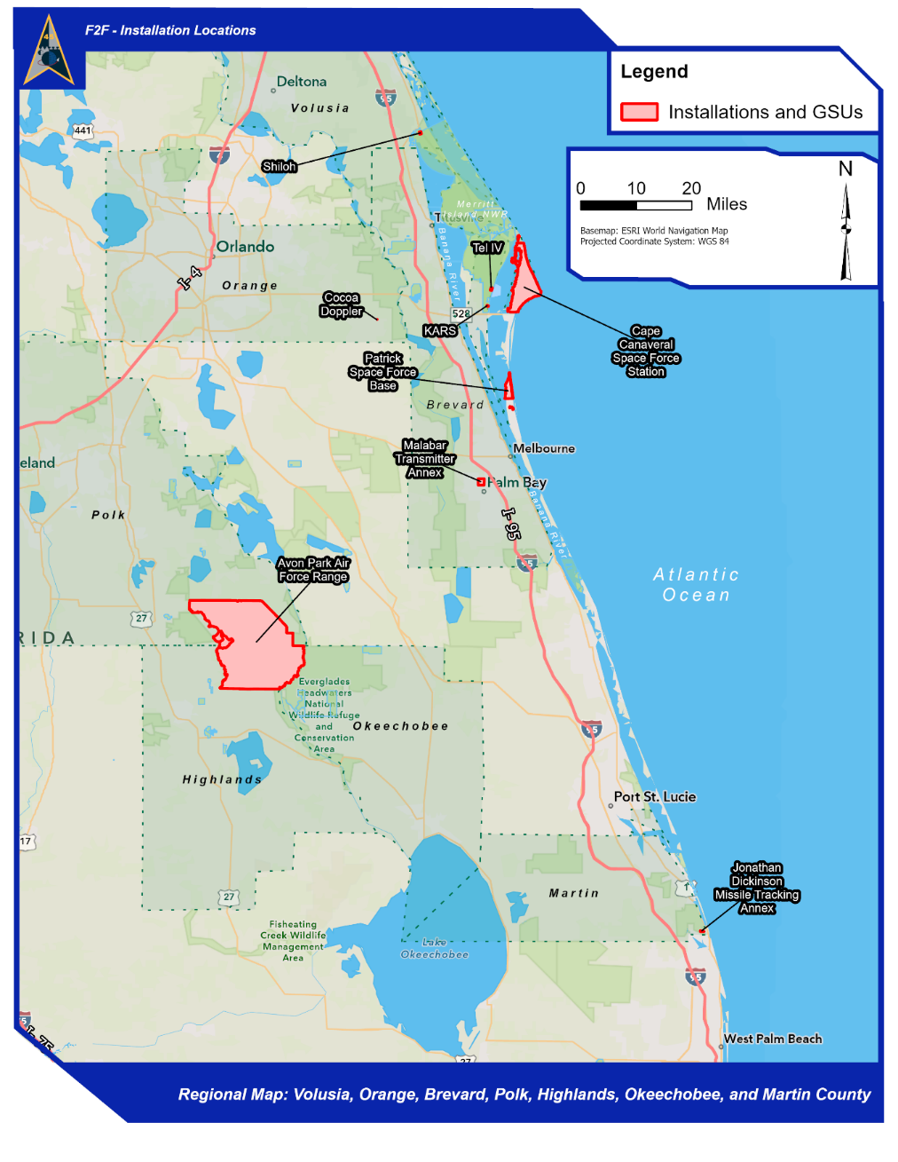
Map of Patrick ISS Locations

Slide 37
Data Management Systems
APIMS (Air, Power, Refrigerants, STAR, WET)
EESOH-MIS
eDASH (EASIER, EAP, MICT, RAIT, TEMP)
TEACH
ACAM
FDEP Business Portal (EzDMR)
RCRA Info
EPCRA – E-plan

Slide 38
Unique Considerations
Building Space Port of the Future
CCSFS Wastewater Permit compliance
Total Maximum Daily Load (TMDL) compliance
OB/OD Permit requirements / SWMU Sites
Stormwater permit compliance (proximity to waters of the US)

Slide 39
Site Tour - PSFB
TSDF (Space Force and AFTAC)
Stormwater Sampling – Outdoor Recreation (FAC 345), Manatee Cove Marina, Material Recycling Facility (FAC 631), Fuel Storage(FAC 676) (Visual Sample Only)
CEIE Office/Conf room

Slide 40
Site Tour - CCSFS
TSDF
EOD Thermal Treatment Unit / Waste Site
Stormwater Sampling – Air Force Wharf, Poseidon Wharf, Trident Wharf
WWTP, Trident Pretreatment
Landfill monitoring and surface water wells
CLOIS HAZMART @ Logistics
[Please provide access to any GFE /current contractor equipment and the process of how they are used during the site tour.]

Slide 41
Site Tour – Avon Park
90-day HWAP
3 MSGP Sample locations
CEIE Office/Conf room
[Please provide access to any GFE /current contractor equipment and the process of how they are used during the site tour.]

