Slide 1
The Municipal Reference Model
Understanding the DNA of Government
Roy Wiseman Jim Amsden
Executive Director Senior Software Engineer
MISA/ASIM Canada IBM Software Group
roy.wiseman@rogers.com jamsden@us.ibm.com
Notes:
I’m delighted to be speaking to you again today and also to be co-presenting with Jim Amsden, a Senior Software Engineer for IBM and someone who has worked with us over the past 2-3 years on implementing the Municipal Reference Model within IBM business modeling software. Jim has also become another MRM evangelist, spreading the word on the MRM throughout IBM and in a number of assignments in the United States.
In our presentation today, I’m going to update you on what has been happening with the MRM over the past year or two – as well as talk about our plans for the future.
Jim will be focusing on how the MRM has been implemented within IBM business modeling software – and how this can add value for those who seek to apply the MRM to address various business needs.

Slide 2

About Me
CIO (Retired), Region of Peel (Ontario, Canada)
Past President, Municipal Information Systems Association (MISA Ontario)
Executive Director, MISA/ASIM Canada
Board Member and Past President, Institute for Citizen Centred Service
Project Director, Municipal Reference Model Program (MRM)
Former Municipal Co-Chair, SMSC
Roy Wiseman
roy.wiseman@ rogers.com
Notes:
Most of you know who I am and much of this information was provided in my bio, as part of the introduction.
But for the record, here are a few key details.
In a nutshell, I retired late last year, after many years as CIO for Peel Region, but have remained active in a number of volunteer roles with MISA/ASIM Canada, ICCS, SMSC and with the MRM.

Slide 3
Municipal Reference Model Context
Notes:
I plan to skip very quickly over the early slides in my presentation. Many of you have seen these, or slides like these, in the past. However, it is necessary to provide some context, especially for those less familiar with the background.

Slide 4
MRM Context
Government Service Reviews
Within the past 2-3 years, Canadian municipalities have issued RFPs such as the following:
  City of Toronto, Ontario – Core Services Review
  City of Saint John, New Brunswick – Operational Review
  City of Windsor, Ontario – Service Delivery Review
  City of Vancouver, British Columbia – Review of the City’s Businesses, Service Delivery Practices And General Operations
  City of Ottawa, Ontario – Efficiency Savings Initiative
  City of Calgary, Alberta –Core Service Review
  City of Moncton, New Brunswick – Corporate Services Review
  City of Hamilton, Ontario – Strategic Services Operational Review
  City of Penticton, British Columbia – Review of the City’s General Operations, Service Delivery And Organizational Review
Similar requests are appearing at the provincial and federal levels
  Commission for Reform of Ontario’s Public Services (Path to Sustainability and Excellence) – Drummond Commission
… and the list goes on, and on!
Notes:
This slide references a number of examples of core service or operational reviews, undertaken by Canadian municipal governments. SMSC members may recall a previous presentation on the Core Service Review undertaken in Toronto, with the assistance of KPMG. More recently, the Drummond Commission provided a fairly comprehensive review (given the available time) of opportunities to reduce expenditures by the Government of Ontario. Similar reviews at the federal level were reflected in many cuts to services included in the recent federal budget (although the government has been reluctant to refer to these as service cuts).
In any case, it is apparent that governments at all levels are examining their services in an effort to identify cost savings.

Slide 5
Municipal, Provincial, State, Federal all have the same challenges…
Common threads in almost every study:
  Defining our Services – Do we know what services we provide? Are they core to our business? What value are they offering? Are we offering the right Services?
  Improving our Services – What is the cost of our services? How do we compare with other governments? Can we improve our efficiency, effectiveness and quality?
  Service Levels – What is our current Service Level? How was it determined? What are the cost and service implications if we raise or lower Service Levels?
  Service Accountability – Who is accountable for which Services? Is the allocation correct or does it need to be adjusted?
  Alternate Service Delivery – Can we outsource, in-source, privatize or contract out all or a portion of our Services?
  Service Operations – How do we deliver a service? Are there better ways? What can we learn from others?
Notes:
Whether explicitly or implicitly, many of these reviews start with the same basic questions:
What are we doing today?
How much does it cost?
What can we stop doing or do differently – all with the goal of reducing costs and/or increasing efficiency or effectiveness.
To an outsider, the first question seems almost a no-brainer. Of course, we should know what we do – have a catalogue of the services that we offer. We assume that any private sector organization would have a catalogue of the goods and services that it has to offer to its customers. But the reality is that many governments have no such comprehensive catalogue. Nor do they have a good guide for how to create one.

Slide 6
What are Reference Models?
Definition (Wikipedia)
An abstract framework …consisting of an interlinked set of clearly defined concepts produced by an expert or body of experts in order to encourage clear communication.
Definition (OASIS)
An abstract framework for understanding significant relationships among the entities of some environment, and for the development of consistent standards or specifications supporting that environment.
“Essentially all models are wrong, but some are useful.”
George E. P. Box
In short:
A reference model is a set of rules for how you describe things.
Notes:
In this context, we can introduce the concept of a Reference Model.
While I quite like the longer definitions included here, the short definition is sufficient for our purposes – a reference model is nothing more than a set of rules for describing “things” – “the entities and relationships involved in a problem space”.
In this case, the thing we are trying to describe is the business of government.
However, we are trying to describe it from a particular context – in terms of the programs and services that we provide, rather than the activities that we undertake.
It is also worth noting the quotation from George Box. Abstract frameworks can, inevitably, provide only an approximation of an inherently messy reality, which defies categorization into neat boxes. In fact, the same environment can be described using many such frameworks. The difference is that some of these will be more useful than others.
In my view, the reference models that we are describing have proved their usefulness in many jurisdictions. They have consistently provided greater insight about the programs and services that governments provide – and how these contribute to achieve the policy outcomes that have been explicitly or implicitly defined.

Slide 7

Coherent Government by design
If we really want:
  to move to a “whole of government” approach,
  seamless, citizen-centred services,
  legislation, regulations and policies designed rather than crafted,
  alignment, integration, interoperability, etc. in our business systems,
  to do more with less,
  etc.
We really need:
  a consistent and more formal business design capability based on a common language and set of rules for using it to create better descriptions of what we want (e.g. more coherent ones). A pan-Canadian standard along these lines will enable any conceivable government line-of-business (and inter-collaborations thereof) to better:
    interpret and clarify their missions, strategies, outcomes, etc.
    accurately depict or map how they work (and how they can work together),
    discover opportunities for business improvements,
    support their planning and successful implementation.
We really need:
a Governments Reference Model
Notes:
Essentially, we believe that a well constructed reference model - a common framework and language to describe the business of government - can help us “do government better”.
To some extent, this has been the mandate and purpose of the Service Mapping Subcommittee.
But it is also important that the reference model describe government in terms of the value that we provide to our citizens and residents. Focusing on what we do (activities and processes) leads to doing more of the same – perhaps a bit more efficiently. By focusing instead on outcomes – and how we are achieving those outcomes through the services that we provide – we move the discussion to a whole new level.
This is what makes the MRM, and its related models at the provincial and federal levels, more useful than many other frameworks which may purport to describe the business of government.

Slide 8
Municipal Reference Model Brief History
Notes:
So that’s the context, again familiar to many of you.
Some of you will also be very familiar with the MRM history, but it is still worth a few moments to review the key milestones.

Slide 9
MRM Brief History
1990: 20+ Ontario municipalities create Joint Venture to develop Municipal Reference Model and Engineering Database – initially as “data models”
1992: JV Awards RFP to Chartwell IRM (acquired by KPMG in 2009)
1995-2000: MRM evolves from data to business model and is successfully marketed by Chartwell to other Canadian, US and overseas municipalities
2000-2008: MRM adopted and adapted by Province of Ontario (PSRM) and Government of Canada (GSRM)
2007-2011: MRMv2 Project undertaken by MISA/ASIM Canada to update and re-establish MRM at municipal level and align with PSRM/GSRM
2007: Joint Councils create SMSC to integrate and standardize service mapping approaches across Canadian governments
Notes:
The first point is that the MRM has been around for a long time – almost 20 years.
Throughout that time, its adoption and use has ebbed and flowed – hopping almost like a virus from one jurisdiction to another and from one order of government to another.
The MRM may be unique in being a framework developed first for a group of Ontario municipalities and then subsequently being adopted by at least two provincial governments (Ontario and Alberta), as well as the Government of Canada.
In 2007, MISA initiated a project to update the MRM for municipalities. While individual municipalities had continued to apply the MRM, collective involvement had languished over the previous ten years.
Coincidentally, 2007 is also the year in which SMSC was established (or re-established) by the Joint Councils to integrate and standardize the work on service mapping being undertaken by various Canadian jurisdictions.

Slide 10
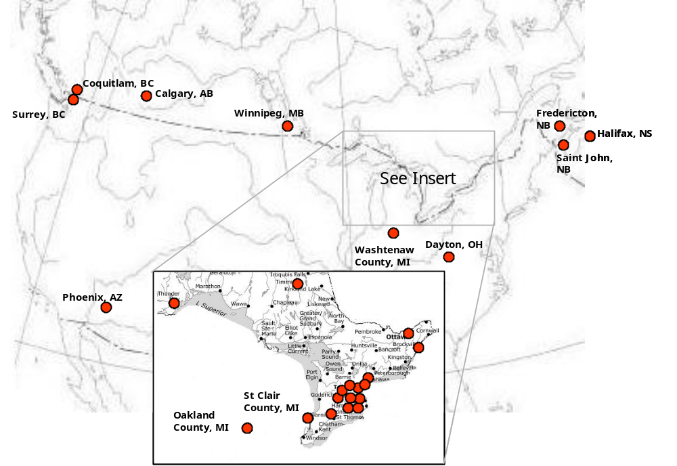
MRM Municipal Users (c1998)
Shanghai
Warsaw
Notes:
This map illustrates the municipal penetration achieved by the MRM in the late 1990’s, primarily due to the work of Chartwell. You will note the penetration into the United States (some local governments in the State of Michigan, as well as Phoenix) – and of course, a group of Polish municipalities and Shanghai, in China.

Slide 11
Municipal Reference Model Concepts
Notes:
So what are the key concepts underlying the MRM framework.
I will again review these very quickly, assuming that these are familiar to most of you.

Slide 12
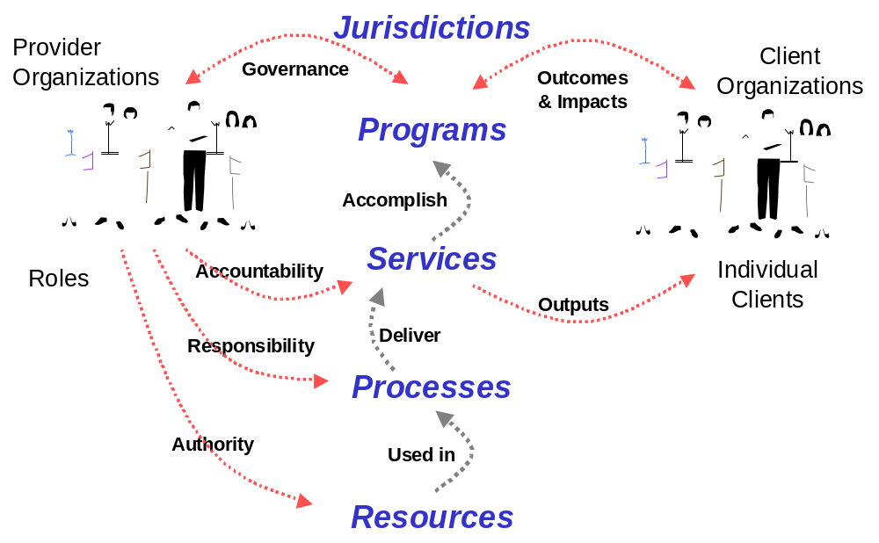
Your core business elements expressed in a standard language: SERVICE
Service Key Concepts:
Client (external)
Final output
Contribute to program outcomes
Complete/stand-alone
Sub-service
Service: provision of specific final outputs that satisfy client needs and contribute to program outcomes
The MRM Provides a Common Language and Structure for describing the business of Government from the outside-in, as our citizens see us.
Notes:
I expect that most of you are familiar with this diagram, which describes government in terms of the services that it delivers.
I find it interesting that many other government architectures refer to services but never actually define what a service is. One of the strengths of the MRM is in its definitions – for example, this definition of a service as being fundamentally about delivering outputs to clients. This differentiates services from other activities in government, which may support service delivery, but are not services in themselves. Services represent what people receive from government. In the private sector, services (or products) are the things that we pay for. No one in the private sector would confuse a billing function with being one of their products. So why would we call tax collection a service?

Slide 13
Your core business elements expressed in a standard language: PROGRAM
Program Key Concepts:
Target Group
Need
Delivered through services
Outcome (a positive change in the level of need of the target group)
Public and Internal Programs
Sub-program
Program: a mandate to achieve outcomes that address the needs of a target group. Programs are delivered through a collection of services that contribute to program goals.
The MRM Provides a Common Language and Structure for describing the business of Government from the outside-in, as our citizens see us.
Notes:
In the private sector, products and services are delivered and justified simply by whether they generate a profit for the company. The uniqueness of government is that our services must be justified on an entirely different basis – that they contribute to broad program outcomes, addressing the needs of individuals or groups in society. Such needs can be defined broadly –improved health, enhanced public safety or protection of the environment – or more narrowly, such as protection from a specific disease or safety from crime.
A program is the organizing concept that defines the needs which governments have chosen to address, as well as the target groups which have those needs.

Slide 14
Your core business elements expressed in a standard language: PROCESS
Process: a linked sequence of activities or tasks that use resources to produce outputs. Processes participate in a chain to produce service final outputs.
Process Key Concepts:
Interim outputs
Resources
Linked to deliver a service final output
The MRM Provides a Common Language and Structure for describing the business of Government from the outside-in, as our citizens see us.
Notes:
And finally processes are where most of the work in government occurs. Processes are the things that we need to do, in order to deliver a service and ultimately to address program outcomes. This is where functions like billing, registration, eligibility review, service request tracking, planning and monitoring belong. While there is a natural tendency for those involved in government to wish to elevate what they do to the service, or even program, level, most of our activity is around processes. Viewing matters from the client perspective (what do they get, what would they pay for in the private sector analogy) can make this clear.

Slide 15
MRM Concepts Illustrated: Public Health
Program | Public Health
Target Group | Municipal Residents and visitors
Need | Health
Outcome | Improved Health (Can we define this more precisely?)
 | Service 1 | Service 2
Service | Food Premise Inspection | Flu Immunization
Service Output | Inspection Report (permission to continue operation) | Immunization
Direct Client | Food premise owner / operator | Resident (at-risk) receiving immunization
Indirect Client | Food premise patron | Others in the community (residents and visitors)
Service Value | Reduced illness resulting from improper food preparation | Reduced illness resulting from fewer residents contracting H1N1
Process | Schedule inspection, conduct inspection, produce report, schedule follow-up | Establish clinic, prepare public communication, operate clinic, decommission clinic
Notes:
Putting it all together, we can create a hierarchy of programs, services and processes, such as illustrated in this slide. The program is addressing a need for improved health. The food inspection service contributes to this need by reducing the incidence of illness, due to improperly prepared food. An immunization service contributes by reducing the risk of contracting a specific disease against which we are being immunized. There may be many other services that contribute to the public health outcome – e.g. services dealing with smoking cessation, diabetes, obesity or sexually transmitted diseases - all of which contribute to the public health outcome. The challenge for government is to define the optimal mix of such services that will provide the greatest impact on the outcome for the available funds.

Slide 16
MRM Concepts, Performance Measurement: Public Health
 | Program | Service | Process
 | Public Health | H1N1 Immunization | Clinic Operation
Effectiveness (relates to outcome) | Change in level of public health | Reduction in incidence of Flu | Set up on time, design effectiveness
Efficiency | Public Health cost/capita | Cost per delivered immunization (cost/output) | Operating cost/day
Quality (cf. to standard) | n/a | Immunizations to standard | # of operating issues – e.g. out of stock
Customer Satisfaction | Customer Satisfaction (reputation) | Service Satisfaction (Specific experience) | n/a
Notes:
The same hierarchy of programs, services, processes and their related outcomes and outputs provides a natural framework for defining appropriate performance measures. When we know what a service is intended to achieve (to what outcomes is it intended to contribute and in what way), then we also know how to measure its effectiveness.
In this regard, I would point out that while customer satisfaction is an important measure, it is not the only measure of a service and probably not even the most important measure. We know from the work of ICCS that the drivers of customer satisfaction for a service such as immunization relate to factors such as how long you had to wait in line and how you were treated during the experience. Outcome is only one of these drivers, but it is the key for measuring service effectiveness. In fact, it is possible to receive high customer satisfaction for a service that is largely ineffective in achieving the desired program outcomes.

Slide 17
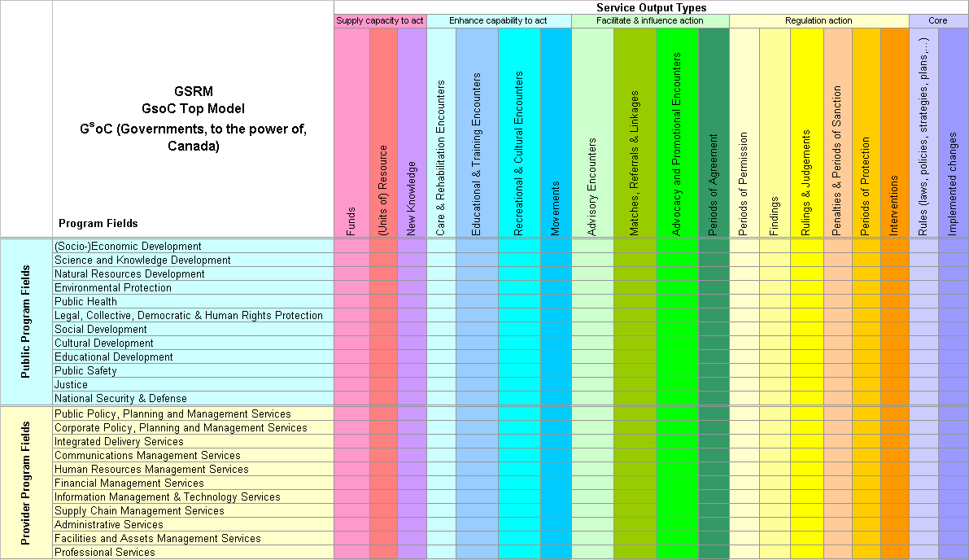
Classification of Reference Model Services based on need & output types
MRMv2
Index
Framework
Fire Permit Service
Elevator Permit Service
Ski Lift Permit Service
Gas Line Permit Service
Boiler Permit Service
Etc.
Source: GSRM Top Model
Notes:
Finally, when the MRM framework was adapted by the Government of Canada, it was significantly enhanced by the refinement of various classification schemes. For instance, the GSRM Top Model introduced the 19 service output types, as one means of classifying services. Similarly, the 23 program fields can best be thought of as a classification of needs categories.
We have been doing some further work in this area, as part of the MRMv2 efforts, including introducing a hierarchy of needs categories, as well as adapting them to municipal services. For instance, Recreation and Leisure does not appear in the GSRM program fields. The Government of Canada also did some work on classifying target groups although, to my knowledge, this was never formally adopted into their model. We are continuing work in this area, as part of the MRMv2 project.
I should also mention that the GSRM introduced a number of very useful diagrams (PSAM, SIAM, etc.) to further illustrate the relationships among the model components. Jim Amsden will be referring to some of these in his presentation in a few minues.

Slide 18
Municipal Reference Model Components
Notes:
So those are some of the key concepts.
I can now turn to the components of an MRM solution that can be provided to interested jurisdictions. Some of these components are, by now, quite well developed. Others still require more work and will continue to evolve over time.

Slide 19
Key Components of the MRM
Metamodel - specifies the contents of your business model, e.g. what information should you record about each service
Reference Model - repository of business model content to get you started, e.g. well-defined examples of services
Toolkit - applications for business users and business analysts to create, analyze and share business model content within the municipality, and with other municipalities
Use Cases - instructions for using the MRM to support common management practices, e.g. strategic planning
Support – an MRM community offering training and support, and a governance structure so you can influence continuing development and direction of the MRM
Notes:
In the following slides, I will touch briefly on the main components of the MRM, as summarized here.

Slide 20
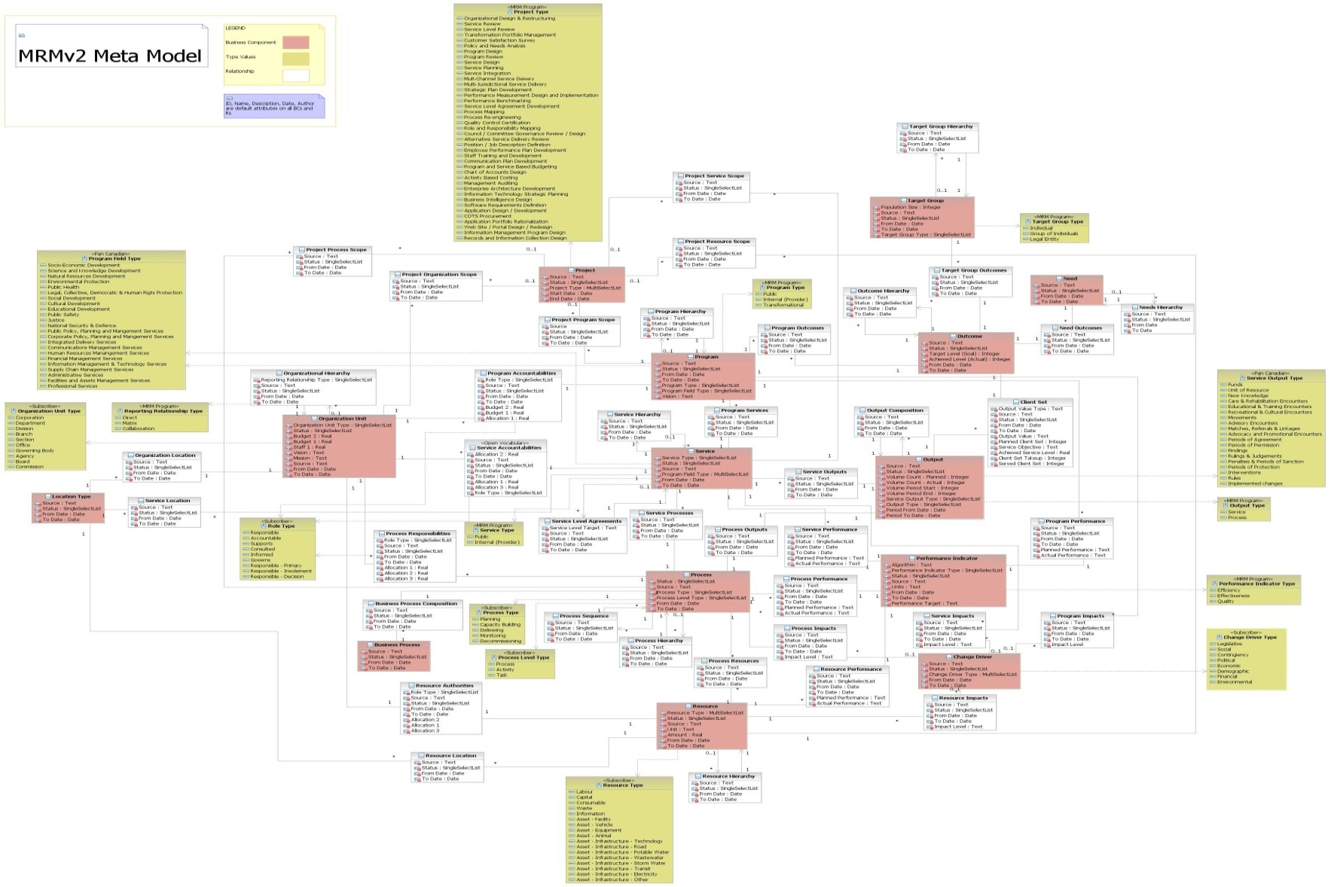
The complete Meta-model
Don’t Try to Read!
Notes:
In particular, a fairly complete meta-model has been developed, as illustrated here.
I should, however, acknowledge that many components are, at this time, merely placeholders, in the sense that a full description is not yet available in the documentation and these components have not yet been implemented in any delivered solution.

Slide 21
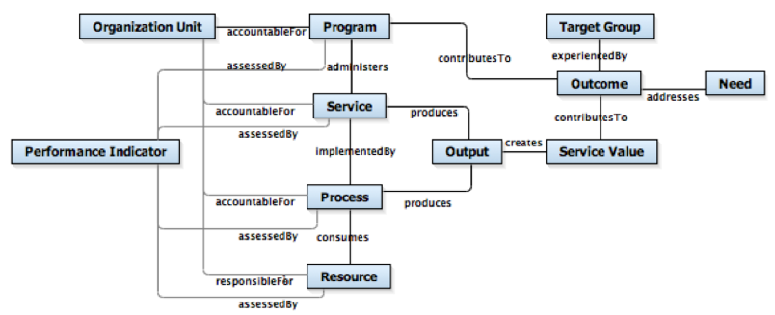
MRM Metamodel
Implemented Subset
Notes:
This diagram provides a more realistic example of the subset of the meta-model components which have been implemented at this time. You will recognize that this are essentially the same components as were included in my earlier slides, dealing with the MRM programs, services and processes.

Slide 22
Modeling Principles and Rules - Extract
Service
Definition: A Service is a commitment to deliver Outputs that contribute to Outcomes
Naming:
The name of a Service should be defined as a combination of “modifier” (optional), “noun” (mandatory) and “gerund” (mandatory). For example, a Service should be named ‘Solid Waste Collection’ rather than ‘Solid Waste’. Modifiers are not always required, e.g. Business Licensing. The Service's name should make sense with and without the word “Service” following the name when required by context.
Valid Instances:
The Service’s existence should not depend essentially on the existence of another Service; if that is the case, the activity is typically a feature or configuration of that other Service. (Independence Rule)
  Example: traffic control and signage are not Services because they depend on the existence of the ‘Roads Service’. Traffic control and signage are features that increase the quality and effectiveness of the ‘Roads Service’ because they enable more, safer, and more convenient trips.
Delivery of the Output defined for the Service should fully satisfy the Need(s) addressed by the Service, commensurate with the intentions of the government and the legitimate expectations of the client. (Closure Rule)
  Example: fixing a pothole does not by itself satisfy a driver’s expectation of a trip, nor the government’s intent to enable it, and is therefore not a Service but a Process forming part of the ‘Roads Service’.
  Example: processing an application form for a building permit does not by itself satisfy a client’s need for permission to build, nor the government’s intent to grant compliant requests, and is therefore not a Service but a Process forming part of the ‘Building Permit Service’.
The Service’s Output cannot be mandatory for all members of its Target Group; otherwise the Service is an Enterprise Management Process or Program Management Process. (Non-Mandatory Rule)
  Example: developing a strategic plan is not a service if each department must participate in it. If, on the other hand, an Organization Unit offers assistance with the preparation of individual strategic plans, e.g. departmental or program plans, then an Enabling Service is formed.
Notes:
But the meta-model is more than a diagram of entities, attributes and relationships. Each of these needs to be carefully defined, including a set of rules which describe what are or are not valid instances. Many of these “rules” were in the original MRM dating back to 1995. However, they have been significantly refined with use over time – including in the work done by the Province of Ontario and the Government of Canada. The Modeling Principles and Rules document, produced as part of the MRMv2 Project, captures our current thinking, although as with other parts of the work, there is still more to be done.

Slide 23
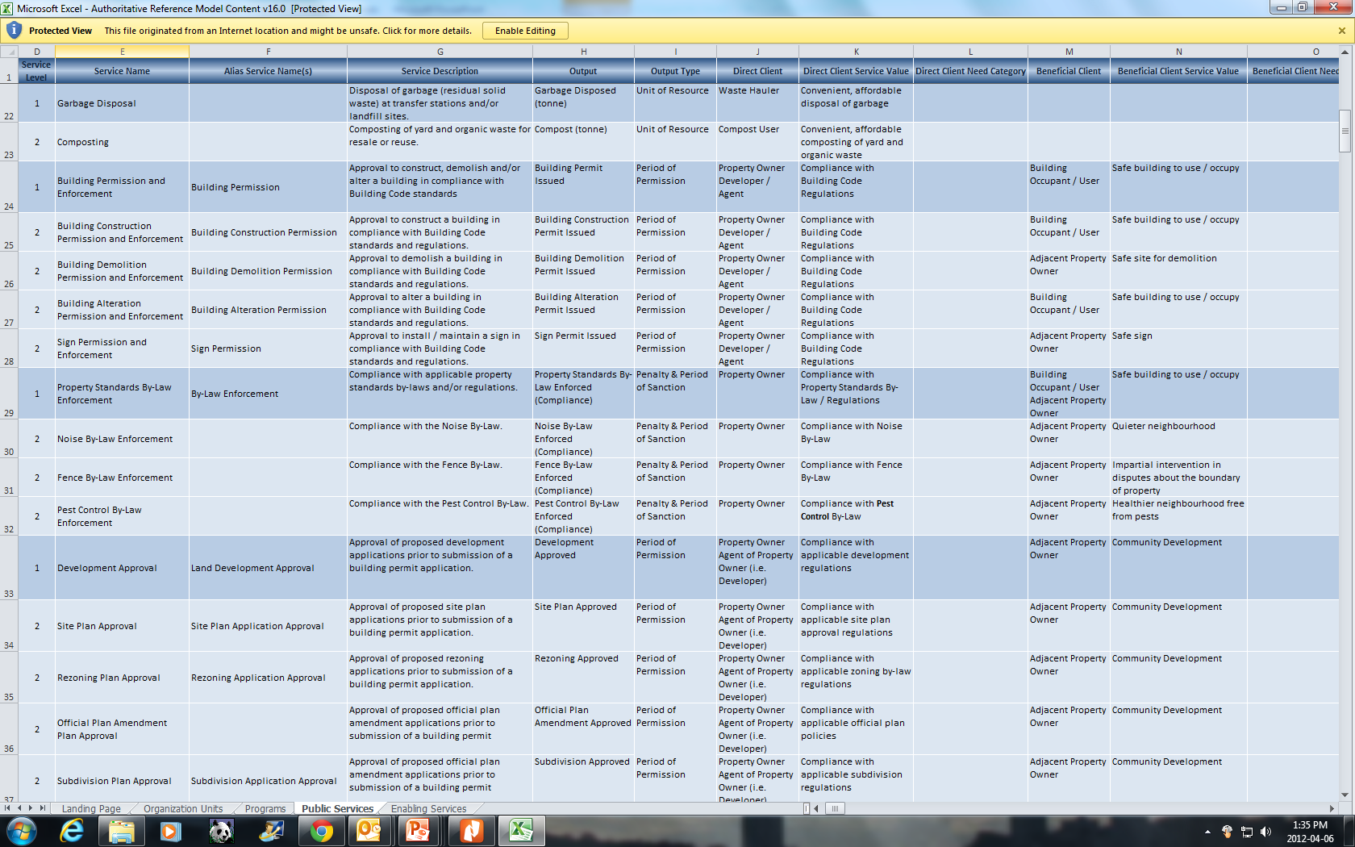

Authoritative Reference Model
of Municipal Programs and Services
April 2012 <number>
Notes:
Similarly, the original 1995 Municipal Reference Model included a generic catalogue of municipal services. Since that time, many municipalities have created their own service catalogues / service inventories. In 2011, a team of municipal “experts” from Edmonton, Fredericton, Peel, Windsor and Toronto collaborated to produce an updated “Authoritative Reference Model” of municipal programs and services, applying carefully the definitions and “rules”, while reflecting their individual experiences in developing such service catalogues in their respective municipalities.
But this is, again, merely Version 1 of an Authoritative Reference Model. There is much more to be done. As one example, the services at the most detailed level are by no means exhaustive. While we have business licensing as a top level service and included examples of many types of business licensing services – from body rub parlours to taxis – we did not attempt to provide a complete list of all types of businesses which may be and are being licensed by Canadian municipalities.
Perhaps more importantly, many of the elements in the meta-model have not yet been populated. For instance, we have not yet populated the processes used to implement a service or the performance measures appropriate for the service.

Slide 24
Standard Set of Program & Service Profiles
“MyTown” Emergency Care and Preventative Care Service Profile
Service Type | Public
Accountable Unit | EMS
Purpose Statement | Provide emergency and preventative care services to the people of MyTown through activities such as pre-hospital emergency care, community medicine and inter-facility patient transport services
Customer | EMS Patient EMS Patient Family / Relatives
Service Types | Primary /Advanced Critical | Stand By special event Stand By Emergency
Output | EMS Emergency Care, Preventative Care, Facility Transport
Delivery Method | Upon Request
Service Level | 24/7/365
Efficiency | $ / Emergency Care & Preventative Care by type
Value Statement | improved health reduction in mortality | reduced pain reduced health care cost
Effectiveness | Response Time to Incident ( Road Response Time + Process Time) Correct Resource response time according to Call priority (90% of the time) Percentage of Unit Hour Utilization | Cost of Unit Hour Production Mean Hospital Wait Time (Total Wait Time / # of Hospital Visit ) # of Public Access Defibrillators
Service Objective | Improve the response time to life threatening calls (delta & echo) from 70% to 90% within 8:59 minutes and stated targets for alpha, bravo and charlie category type calls. Reduce the in hospital time from 60 minutes to 45 minutes by 20012
Community Impact | Health Care Public Safety
Notes:
Finally, once you have a fully populated Reference Model, you can produce the type of Program or Service Profiles illustrated here.
One of the values of implementing the MRM in software, is that the same information can be collected and reported in many different ways.
Those of us who have developed and implemented our service catalogues in Word or Excel documents are aware of the inherent limitations that this provides, in terms of more flexible analysis and reporting.

Slide 25
MRMv2 Putting it all Together
MRM Reference Model
(i.e. Public Safety Program, Fire Rescue Service, etc.)
Customized “My Municipality’s” Model
MRM Meta-Model
(i.e. Shell Program, Shell Service, etc.)
Customized Municipality C Model
Best Practice Model
(i.e. AWWA Potable Water Supply Service, etc.)
Customized Municipality B Model
Customized Municipality A Model
Notes:
When you put the pieces together, it looks like this. We have already talked about the meta-model and the reference model. Any municipality can start with these and develop their own custom model for their municipality, deleting services from the Reference Model which they don’t provide and adding any services which may be missing. Municipalities may also add to their custom model elements which don’t lend themselves to standardization in the reference model – for instance, the organization unit delivering the service or specific performance targets or actual results achieved by the service.
Also implied by this diagram is a repository for such individual customizations, which could allows municipalities to access (with permission) the custom models from other municipalities and which could, in the longer run, allow comparative analysis and reporting.

Slide 26









What does the MRM mean to you today?
You can create a standard business model of your municipality and apply it to produce better business plans and results!
  Based on a proven common language, usable by all stakeholders
  Can be tailored to your needs and capabilities
  Backed by a community of your peers providing governance, support, comparisons and best practices
  Includes tools, training and support
Resource
& Financing
Improvements
Information
& Automation
Improvements
Process
& Quality
Improvements
MRM
Reference
Model
Your
“Live”
Business
Model
To-be
Municipal
Model
Customize & Extend
Transition Initiatives
Strategy
& Policy
Improvements
Organization
Improvements
Leadership &
Management
Improvements
Task & Job
Improvements
Notes:
Managing change starts with a thorough understanding of the current, or as-is situation.
Establishing an as-is municipal architecture can be a huge endeavor in its own right. However, municipalities can fairly easily instantiate the existing Municipal Reference Model, and customize it to reflect their as-is municipal model. The MRM:
Provides a starting point for developing a municipal model
Contains hundreds of programs and services
Is based on municipal analysis and best practices over the last 20 years
Shows municipalities what a good municipal model looks like and provide guiding principles for evolving the model to meet community needs
Provides a list of candidate programs and services that can be immediately mined to address community needs
In summary, the MRMv2 project was successful in updating many elements of the MRM to today’s standards. Some of this work is still to be completed. But the good news is that many of the pieces are now in place to assist municipalities in applying the MRM to develop a systematic description of their municipality, based on the MRM framework.

Slide 27
Municipal Reference Model Software Implementation
Notes:
At this point, I will turn the presentation over to Jim Amsden, who will speak about an enhanced implementation of the MRM using IBM’s Business Modeling software.
Before hearing Jim, I would like to make two key points.
The first is that the arrangement with IBM is non-exclusive. MISA is more than open to working with other vendors to implement the MRM in their software. Nor is there anything in the IBM arrangement which precludes this. In fact, IBM has been very clear in not requesting any exclusivity in our arrangement.
The second is that IBM has been a wonderful partner. They have truly embraced the MRM. People like Jim have dedicated countless hours in working with us on a solution which we now believe can meet the needs of many organizations looking for the enhanced capabilities that business modeling software can provide. As you will hear, they have also made arrangements with a third party supplier, so that this solution is now available “through the cloud”.
And with this background, I will turn things over to Jim.

Slide 28
Municipal Reference Model Future Directions
Notes:
Thanks, Jim.
I trust that your presentation has sparked some interest regarding how business modeling software can support the work of implementing a framework like the MRM in a municipality or other government.

Slide 29
MISA/ASIM Canada
Guiding Principles for the Future of the MRM
Enable MRM to become a widely adopted standard for municipal (government) services modeling
Ownership to remain with MISA/Canadian Public Sector (could be Joint Councils/ICCS in the future)
Core concepts to be freely available through Creative Commons type of licensing
Maintain alignment with other orders of government in Canada;
Not-for-profit. Any revenues would be applied to cover costs for support, further development
Admit and encourage private sector participation to develop complementary tools and services.
Vendor/technology neutral – MISA will partner with any vendors to provide technology implementations, training or support, based on mutually beneficial terms
Notes:
Turning now to MISA/ASIM Canada’s plans for the future of the MRM, I would like to start with the principles adopted late last year by the MRMv2 Steering Committee and the MISA/ASIM Canada Board of Directors.
Our years of experience have taught us that the MRM and its related models are powerful instruments for understanding government. In the words of George Box, they are “useful”.
Our goal is to find a way to keep these models alive, vibrant and in broad use in municipal governments and, more generally, in the Canadian public sector. While we believe that the model can also be applied internationally, our focus, like the focus of the Joint Councils and ICCS, is, at least for now, the Canadian public sector.
For this reason, we believe that ownership of the underlying intellectual property should remain with the Canadian public sector. At present, this is vested in MISA/ASIM Canada, but this could be transferred to another appropriate custodian (like ICCS) in the future.
MISA is also committed to maintaining alignment with similar models in use in other orders of government in Canada. At the same time, we recognize that each jurisdiction will have its own priorities and focus, and so will need to further develop the model in areas which address its own needs. The goal, therefore, is more a loose collaboration and sharing of ideas, rather than a tight standard. The Service Mapping Subcommittee is the ideal vehicle for hosting this inter-jurisdictional collaboration.
Finally, we have come to understand that the MRM and related models will never be an “out of the box” solution. It takes time for any organization to integrate these ideas into their processes for business planning, budgeting, performance measurement or performance improvement. The key ingredient for the success of the MRM during the 1990’s and early 2000’s was the presence of a consulting firm (Chartwell) incorporating them into its consulting practice and, essentially, spreading the word with each consulting assignment. They were assisted by partnerships with training firms (like Nexient) who developed courses around the GSRM and BTEP.
I believe that success in the next decade requires fostering a new level of private sector interest. While KPMG, as the successor to Chartwell, is still in the field, they may lack the missionary zeal of a smaller firm. In any case, we will need more KPMG’s – and more IBM’s - if these models are to achieve the penetration that they deserve.
The above implies another lesson learned by our experience over the past 2-3 years. MISA, as a small, volunteer organization with very limited resources, is not positioned to be either a software developer or software provider. While we can promote and facilitate the development of such solutions, we can’t be the solution provider. Similarly, while we can introduce the MRM concepts to interested municipalities, we can’t provide the full set of training and consulting support required for successful implementation. At most, we can point municipalities to qualified training and consulting firms – but even this has its risks.

Slide 30
MISA/ASIM Canada
MRM Next Steps
  Finalize and publish MRM materials
  Create MRM web/collaboration site
  Promote and support collaboration among existing and future MRM users
  Further develop MRM content, through expert working groups
  Promote and integrate MRM concepts into national and international standards – e.g.
    ICCS Service Management and Certification
    TOGAF and BMM
  Foster and promote private sector participation and related services (software implementations, consulting, training)
April 2012 <number>
Notes:
Based on these principles, we now have a better understanding of the required next steps for the MRM.
Our first priority is to finalize and public the MRM materials produced by the MRMv2 project. As noted here, most of these are in near final form, and simply need to be finalized and “packaged” for distribution – first to those who contributed to development of the MRM, but ultimately to any interested jurisdiction.
While we still need further discussion as to whether all of these products will be provided free of charge, even to jurisdictions who did not originally contribute, if there are any costs, they should be minimal – consistent with the goal of an established standard.
Our second, and related priority, involves creation of an MRM collaboration web site. We have learned, yet again, through our recent initiatives, that municipalities who have adopted this model are crying out for the opportunity to learn from and share their experiences with others who have undertaken the same journey. There is also a wealth of materials contained in emails and draft documents, not yet ready for “publishing” as part of the MRM “standard”, but of potentially great interest to a much broader audience.
We need a place to host these materials and the related discussions. Creation of MRM as a standard requires easy access to such materials.
But a web site does not by itself, create collaboration. We need to actively engage those that we know are involved in applying the MRM, as well as those who are merely interested in learning about it. We need to find ways to bring this people together to engage in ongoing discussion – in much the same way that SMSC is trying to do at an inter-jurisdictional level.
One way to engage them is through the creation of working groups that can further develop the MRM content, addressing areas of interest for the various participants – developing performance measures, further defining a hierarchy of needs or target groups, or fully elaborating the service definitions in a specific area (like IT services). As noted previously, there is much more to be done.
Our partnership with IBM has also alerted us to the potential for promoting and integrating the MRM into broader national and international standards. As a member of the Open Group, Jim Amsden has already drafted some material on how the MRM can be integrated with existing TOGAF or Business Motivation Modeling (BMM) standards. I have also long held the notion that certain MRM concepts (such as the definitions of programs, services, ouptuts, outcomes, etc.) should be incorporated into ICCS’ training and certification programs for Service Management.
Finally, I have already spoken about the need to foster and promote private sector participation and related services. The MRM has only been successful when these services exist. It can only be successful in the future, if a new generation of services is developed. MISA can’t be the provider, but it has an interest in ensuring that they are available to those who need them. In this regard, we will continue to work with IBM, as we will with other suppliers who are interested in developing products and services to support this market.

Slide 31

QUESTIONS
Notes:
Thanks for your attention. I hope this has provided a useful update on our work on the MRM. I think we are now ready to take any questions.

