Slide 1
MAPA SOCIETARIO · PRE-SEED · AUGUST 2026
The relationship
intelligence layer
for Spain
Turning fragmented public filings into searchable corporate networks, continuous monitoring and decision-ready due diligence.
mapasocietario.es
Notes:
Open with the category, not the feature. Mapa Societario is a relationship-intelligence product built on Spain's corporate-publication stream.
[Sources]
- https://mapasocietario.es/?guide=1

Slide 2
THE PROBLEM
Corporate facts are public. Relationships are hidden.
A company name is not a company history.
Records arrive as documents
The authoritative source is optimized for publication, not connected investigation.
Professionals still reconstruct the network manually—across filings, dates, role changes and name variants—before they can make a decision.
Time changes the answer
Appointments, resignations, mergers and renamings turn a current snapshot into an incomplete story.
Risk lives in the network
Shared officers and related entities matter, but ordinary company reports keep them peripheral.
CONFIDENTIAL · MAPA SOCIETARIO
02
Notes:
The problem is not lack of data. It is the cost of reconstructing context: identity, time, status and relationships. This is why a graph-first workflow creates differentiated value.
[Sources]
- https://www.boe.es/diario_borme/ayuda.php?lang=en
- https://mapasocietario.es/about.html

Slide 3
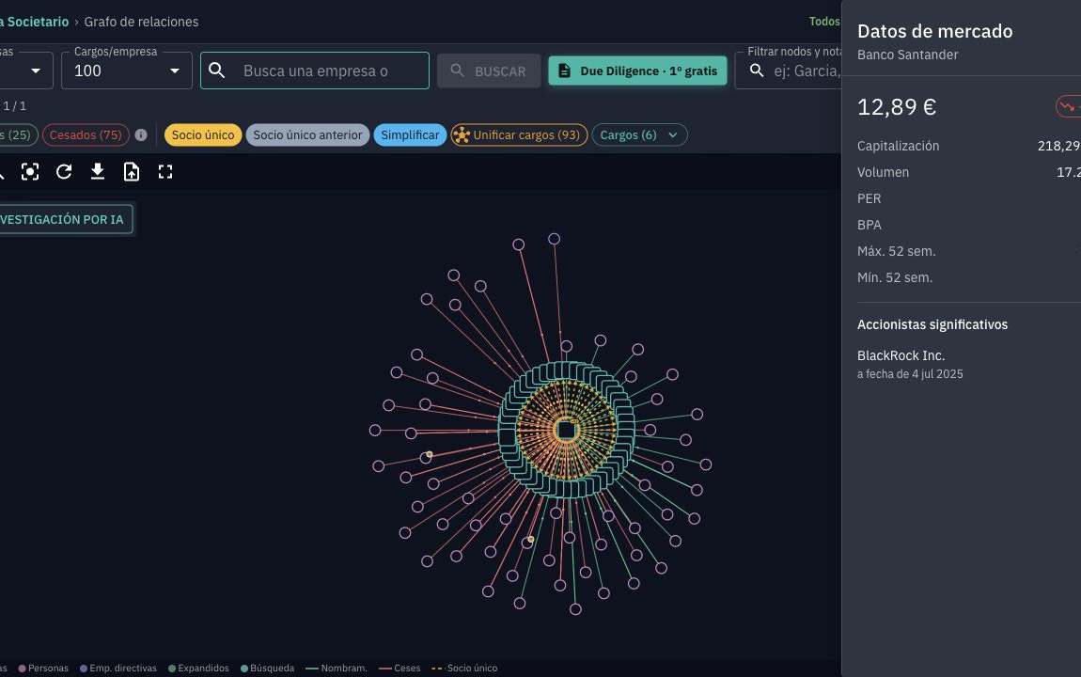
THE PRODUCT
A corporate network you can explore in seconds
Search
Find a company or officer through normalized, fuzzy entity search.
Explore
Expand current and historic roles, shared officers, related companies and corporate events.
Act
Save the investigation, monitor changes, or generate a sourced due diligence report.
CONFIDENTIAL · MAPA SOCIETARIO
03
Notes:
Demonstrate the workflow in one sentence: search a name, expand the network, then preserve or monetize the result. The screenshot is a live capture of Banco Santander on 14 August 2026.
[Sources]
- https://mapasocietario.es/app
- Live product screenshot captured 14 August 2026; stored in the deck build assets.

Slide 4
WHY NOW
Three forces make the timing right
01
The source is machine-readable
3.31m
Spain's electronic BORME has been official and authentic since 2009, creating a long public history to structure.
economically active enterprises in Spain
02
The compliance bar is rising
The EU's AML package tightens due diligence and beneficial-ownership requirements across a harmonized rulebook.
Each onboarding, supplier review, investment and investigation begins with an identity question.
03
AI makes evidence usable
Entity resolution, graph traversal and cited report generation can now become one professional workflow.
CONFIDENTIAL · MAPA SOCIETARIO
04
Notes:
Use the market count as the object base, not as revenue TAM. The core timing argument is the convergence of official digital history, stricter diligence expectations and usable AI workflows.
[Sources]
- https://www.ine.es/dyngs/Prensa/en/DIRCE2025.htm
- https://www.boe.es/diario_borme/ayuda.php?lang=en
- https://www.consilium.europa.eu/en/press/press-releases/2024/05/30/anti-money-laundering-council-adopts-package-of-rules/

Slide 5
THE DATA ASSET
The hard foundation is already substantial
Daily ingestion, parsing, normalization and graph construction turn public documents into a proprietary research layer.
3.15m
9.56m
6.48m
companies
corporate events
officer changes
Tracked across names, mergers, spin-offs and registry transfers.
Structured from official BORME publication records.
Appointments and resignations preserved with time and status.
Coverage since 2009 · 1.73m company formations · refreshed on business days
CONFIDENTIAL · MAPA SOCIETARIO
05
Notes:
These are asset-scale metrics, not vanity metrics. The defensibility comes from continuously improving resolution and temporal context on top of the public source.
[Sources]
- Repository src/components/LandingPage.jsx; fallback refreshed from /bormes/stats/overview on 13 August 2026.
- https://mapasocietario.es/?guide=1

Slide 6
THE GROWTH LOOP
Free discovery creates paid moments
The graph earns trust first. Monetization begins when a professional needs persistence, monitoring, documentation or integration.
Discover
Investigate
Retain
Monetize
Free search and graph
Expand and annotate
Monitor changes
Report, Pro or API
01
02
03
04
SEO, direct links, Chrome and API entry points
Follow people, companies, roles and events
Return when BORME or IOSCO produces a signal
Charge when evidence becomes a workflow or deliverable
Investment thesis
Convert a proven free research surface into a recurring professional system of record.
CONFIDENTIAL · MAPA SOCIETARIO
06
Notes:
This is the business architecture. Free access is the acquisition mechanism; retention and revenue come from monitoring, collaboration, reports and integration.
[Sources]
- Repository docs/market-adoption-playbook.md
- Repository src/components/landingCopy.jsx and src/components/DueDiligencePage.jsx

Slide 7
EARLY PROOF
Commercial signals are already emerging
Four-week property baseline, 16 July–12 August 2026. Raw user counts; not a strict funnel.
2
due diligence reports sold
Willingness to pay is real. Repeatability is the next proof point.
Major Spanish news agency · active discussion
Exploring potential applications with the team.
CONFIDENTIAL · MAPA SOCIETARIO
07
Notes:
Be explicit about the stage. The four-week analytics show genuine product exploration; the two sold reports show willingness to pay. A major Spanish news agency is in an active discussion about potential applications, not a partnership or committed pilot. The round is designed to make conversion repeatable.
[Sources]
- Repository docs/market-adoption-playbook.md (513 users; 69 graph-selection users; 41 node-click users).
- Founder-reported on 14 August 2026: two due diligence reports sold.
- Founder-reported on 14 August 2026: ongoing discussion with a major Spanish news agency about potential applications; no agreement claimed.

Slide 8
BUSINESS MODEL
One data asset, three revenue layers
The live one-off product proves value today. Recurring workflow and data products expand contract size without changing the underlying asset.
LIVE
NEXT
SCALE
Self-serve reports
Pro workspace
API & enterprise
€22.50
€99–299
Annual
per due diligence report
per team / month · planned
usage or contract pricing · planned
Free first report acquisition
Shared investigations
Embedded company intelligence
+€17.50 annual accounts
Monitoring and audit trail
Bulk monitoring and screening
Volume pricing already designed
Exportable client deliverables
Data partnerships and SLAs
CONFIDENTIAL · MAPA SOCIETARIO
08
Notes:
Separate current product from roadmap. Reports are live; Pro and enterprise layers are the monetization plan the round funds. The free graph remains the top-of-funnel advantage.
[Sources]
- https://mapasocietario.es/pricing
- Repository docs/due-diligence-pricing-proposal.md
- Repository src/components/PricingPage.jsx

Slide 9
COMPETITIVE POSITION
Connect the records before selling the report
Mapa Societario does not replace authoritative documents or credit bureaus. It owns the relationship-research step that comes before them.
Route
Primary job
What remains unresolved
Commercial Registry
Authoritative current documents
Manual synthesis across documents and relationships
Report aggregators
Company, financial and credit reports
Company-centric output; network exploration is secondary
Generic graph tools
Visualize data already supplied
No Spanish corporate data asset or daily filing pipeline
Mapa Societario
Search, connect, monitor and document
Graph-first workflow; escalate to official evidence when needed
Wedge
Faster relationship discovery → better-qualified document purchases and professional workflows.
CONFIDENTIAL · MAPA SOCIETARIO
09
Notes:
Position against jobs, not feature checklists. The registry is authoritative; aggregators are strong at reports and credit data. Mapa's differentiated job is relationship discovery and continuity.
[Sources]
- https://sede.registradores.org/site/home?lang=es_ES
- https://www.infoempresa.com/es-es/es/informe-de-empresa
- https://www.einforma.com/informacion-empresas/informes-empresas

Slide 10
MARKET EXPANSION
Spain is the wedge into Europe
34m
Spain
1
Deepest public graph and professional workflow
SMEs in the EU in 2025
Mapa Societario
Five-country base
Corporate identity and relationship diligence is a repeatable problem across fragmented national registries.
2
Reuse NC Data coverage in UK, France, Switzerland and Italy
Existing operating knowledge
Cross-border layer
3
Resolve entities across jurisdictions and sell one graph/API
Venture-scale expansion
CONFIDENTIAL · MAPA SOCIETARIO
10
Notes:
Spain is the focused wedge, not the ceiling. NC Data gives the team practical multi-country experience; the venture outcome is a cross-border relationship layer and API.
[Sources]
- https://single-market-economy.ec.europa.eu/smes/sme-strategy-and-sme-friendly-business-conditions/sme-performance-review_en
- https://mapasocietario.es/about.html

Slide 11
EXECUTION
Founder velocity is already visible
Built inside an operating corporate-intelligence firm—not as a prototype detached from the work.
Round-funded focus
Nurnberg Consulting SL
01
Data / ML
Entity resolution, quality systems and cross-border graph
Madrid · operating since 2013
Corporate intelligence, business research and multi-jurisdiction investigation experience provide the domain context behind the product.
02
Product engineering
Pro workspace, collaboration, reporting and scale
03
Professional GTM
Design partners, conversion, channels and enterprise sales
738 commits
40k source lines
45 test files
Web · Android · Chrome · Public API
CONFIDENTIAL · MAPA SOCIETARIO
11
Notes:
The team slide is intentionally honest: the product has been founder-led. The investable opportunity is converting proven velocity and domain expertise into a focused multidisciplinary team.
[Sources]
- https://mapasocietario.es/about.html
- Repository snapshot on 14 August 2026: git history, source-line count and test-file count.
- Repository chrome-extension/README.md and package structure.

Slide 12
THE ROUND
€750k to prove repeatable revenue
18 months of focused execution
€750k
18-month proof points
01
Pro workspace live
recommended pre-seed raise
Collaboration, monitoring and export become a recurring product.
02
100 paying organizations
Use of funds
Professional design partners convert into repeatable accounts.
03
€25k MRR
A €300k run-rate validates the next institutional round.
40% Data & engineering
25% Product & AI
04
5 API / enterprise partners
20% Go-to-market
Prove that the data asset embeds beyond the web app.
15% Infra, legal & security
mapasocietario.es · mapasocietario@ncdata.eu
CONFIDENTIAL · MAPA SOCIETARIO
12
Notes:
Close on a specific round and a falsifiable plan. The amount, allocation and milestones are recommendations for investor discussion, not historical commitments. Adjust once the founder confirms current burn, hiring geography and desired dilution.
[Sources]
- Funding plan is a recommended scenario prepared 14 August 2026; no external claim.

Slide 13
STRATEGIC INVESTOR APPENDIX
The graph can become a reporting advantage
For a media owner, the value is not only financial. Mapa Societario can become proprietary research infrastructure and a differentiated data product.
01
02
03
Faster story development
Evidence-led newsroom workflow
New commercial products
Move from a company or person to connected entities, role histories and source documents before competitors assemble the same context.
Give journalists a shared, reproducible investigation path with notes, saved graphs, monitoring and cited outputs.
Create corporate-network alerts, sector intelligence, data licensing or premium research products on top of the same asset.
Current signal
A major Spanish news agency is discussing potential applications with the team.
CONFIDENTIAL · MAPA SOCIETARIO
13
Notes:
Use this appendix only with a news-agency owner or another strategic media investor. The purpose is to make the strategic upside concrete without implying exclusivity, partnership, pilot status or a commercial commitment.
[Sources]
- Founder-reported on 14 August 2026: ongoing discussion with a major Spanish news agency about potential applications; no agreement claimed.
- Repository product capabilities: graph exploration, annotations, saved workspaces, monitoring and due diligence reports.

