Slide 1
SUMMER INTERNSHIP PROJECT | IT3711
Vehicle Service Management System
Java Swing + JDBC + MySQL desktop application to automate customer, vehicle, service and billing records
Anbukumar M (810023205106)
B.Tech Information Technology, VII Semester
University College of Engineering (BIT Campus), Anna University, Tiruchirappalli
Internship: Samcore Solutions, Trichy

Slide 2
Introduction & Internship
Project overview
Samcore Solutions, Trichy
Replaces paper registers with a computerized system
Manages customers, vehicles, services, billing and reports
Built with Java Swing GUI, JDBC and MySQL
Developed during 30-day internship on Java Full Stack
Software development and IT training company: Java Full Stack, web development, MySQL, Spring Boot and real-time student projects.
Internship objectives
Core Java and OOP practice
Database design with MySQL and JDBC
Full SDLC: analysis to testing
Vehicle Service Management System
2

Slide 3
Existing vs Proposed System
Existing (manual)
Proposed (VSMS)
Paper registers and spreadsheets
Slow searching of service history
Billing mistakes from manual calculation
Lost or duplicated records
Limited data security, no easy reports
Centralized MySQL database
Secure login and authentication
Instant search, update and delete
Automatic bills and full service history
Reports with less paperwork and fewer errors
Vehicle Service Management System
3

Slide 4
System Architecture
User
Login Authentication
Vehicle Service System
Customer Management
Vehicle Management
Service Management
Billing Management
Reports Management
JDBC connectivity > MySQL Database
All modules read and write through one database layer: store, retrieve, update and delete records.
Vehicle Service Management System
4

Slide 5
Project Modules
1
Login
2
Customer
3
Vehicle
Username and password check, secure access, logout
Add, update, search and delete customer details
Register vehicles with model, fuel type, chassis and engine numbers
4
Database
5
Search
6
Record Management
JDBC bridge to MySQL for all CRUD operations
Find records by customer name, ID or vehicle number
Create, read, update and delete with confirmation
Vehicle Service Management System
5

Slide 6
Algorithms
Login algorithm
1
Show login window
2
Enter username and password
3
Validate fields not empty
4
Connect to MySQL via JDBC
5
Compare with stored record
6
Match: open dashboard; else show error
Other algorithms in the report
Customer registration
Vehicle registration
Search record
Update record
Delete (with confirm)
DB connectivity
Vehicle Service Management System
6

Slide 7
Code Implementation
8.2 DbConnection.java
8.6 DeleteCar.java
public class DbConnection {
private static Connection connection = null;
public Connection OpenConnection() {
String ds = "DataBase/try2.accdb";
String dir = System.getProperty("user.dir");
String url = "jdbc:ucanaccess://"
+ dir + "/" + ds;
try {
connection = DriverManager
.getConnection(url);
} catch (Exception e) {
System.out.println(e);
}
return connection;
}
}
public DeleteCar() {
initComponents();
try {
Car c = new Car();
ResultSet rst = c.getCarsData();
CarsList.setModel(
DbUtils.resultSetToTableModel(rst));
} catch (Exception e) {
JOptionPane.showMessageDialog(
null, "Cars List Error");
}
}
Also implemented: LoginMain, Vehicle, AddVehicle and RegistrationForm classes using Swing GUI.
Vehicle Service Management System
7

Slide 8
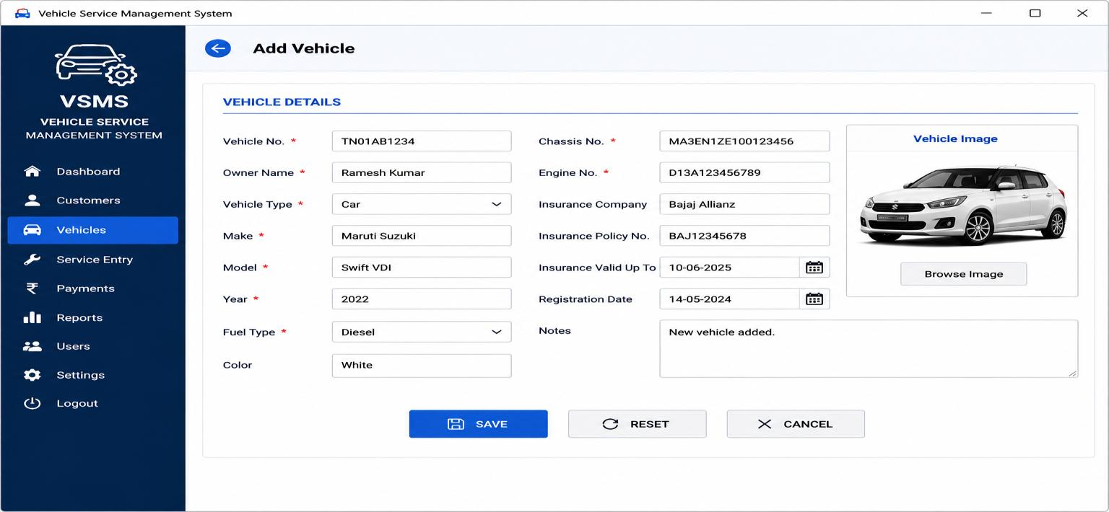
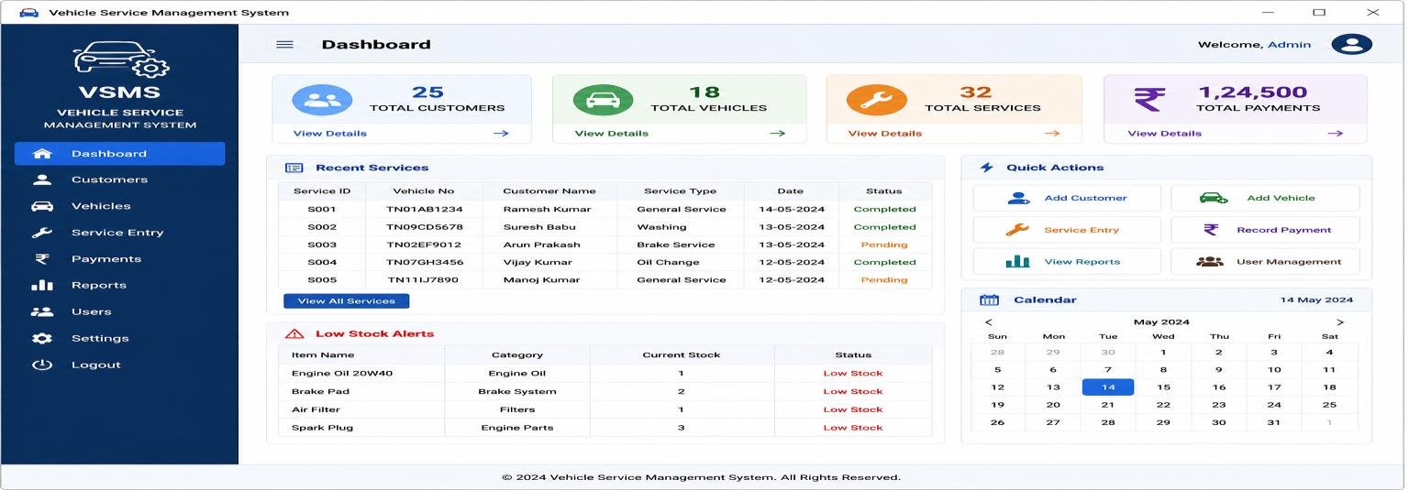
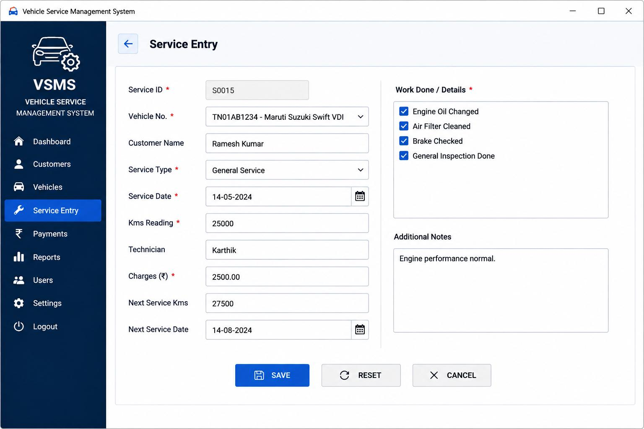
Sample Output: Dashboard, Vehicle, Service
Dashboard: totals for customers, vehicles, services and payments; recent services and stock alerts.
Add Vehicle: vehicle, chassis, engine and insurance details.
Service Entry: work done, charges and next service date.
Vehicle Service Management System
8

Slide 9
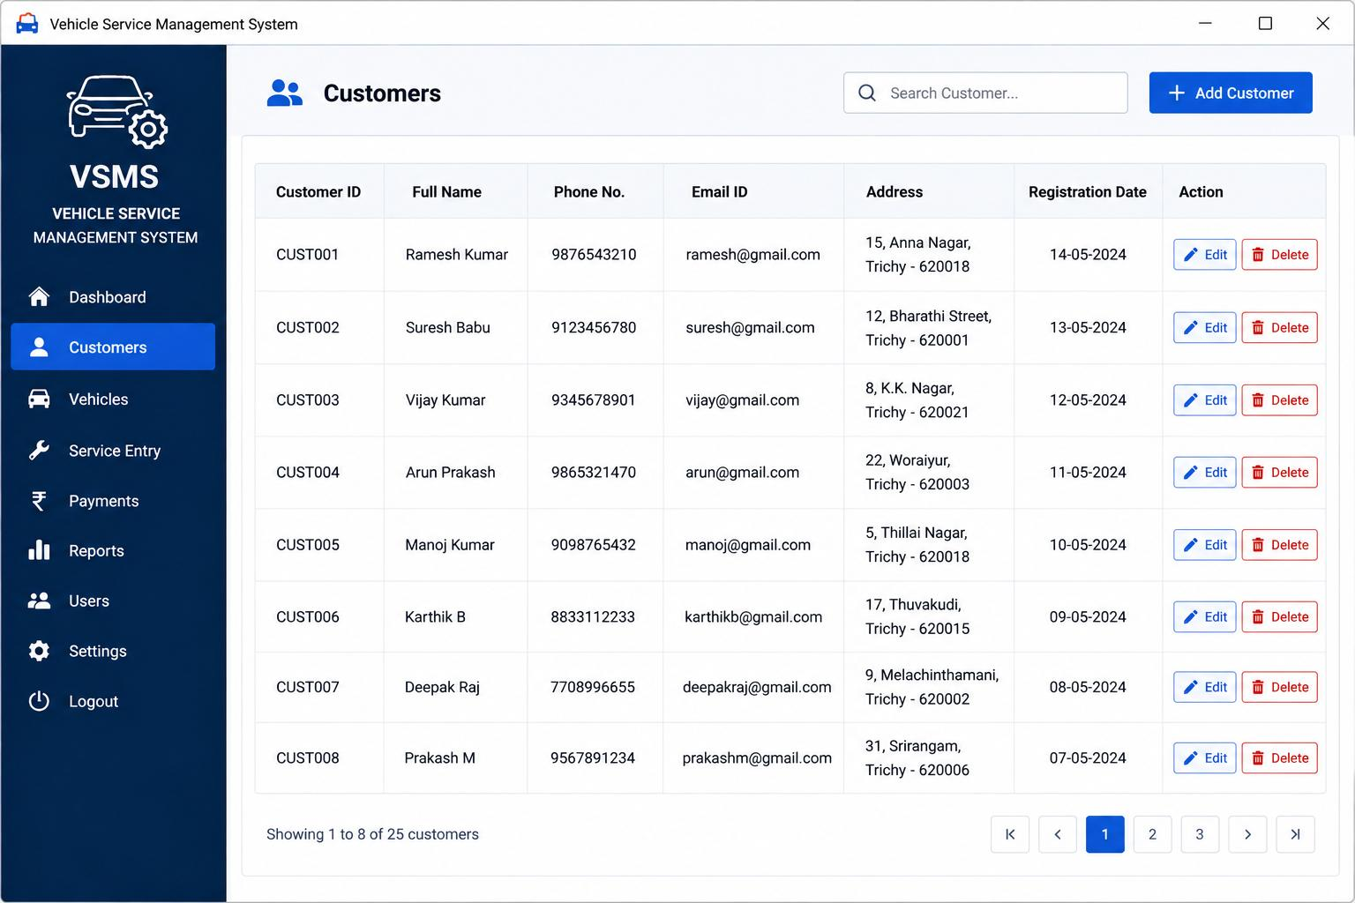
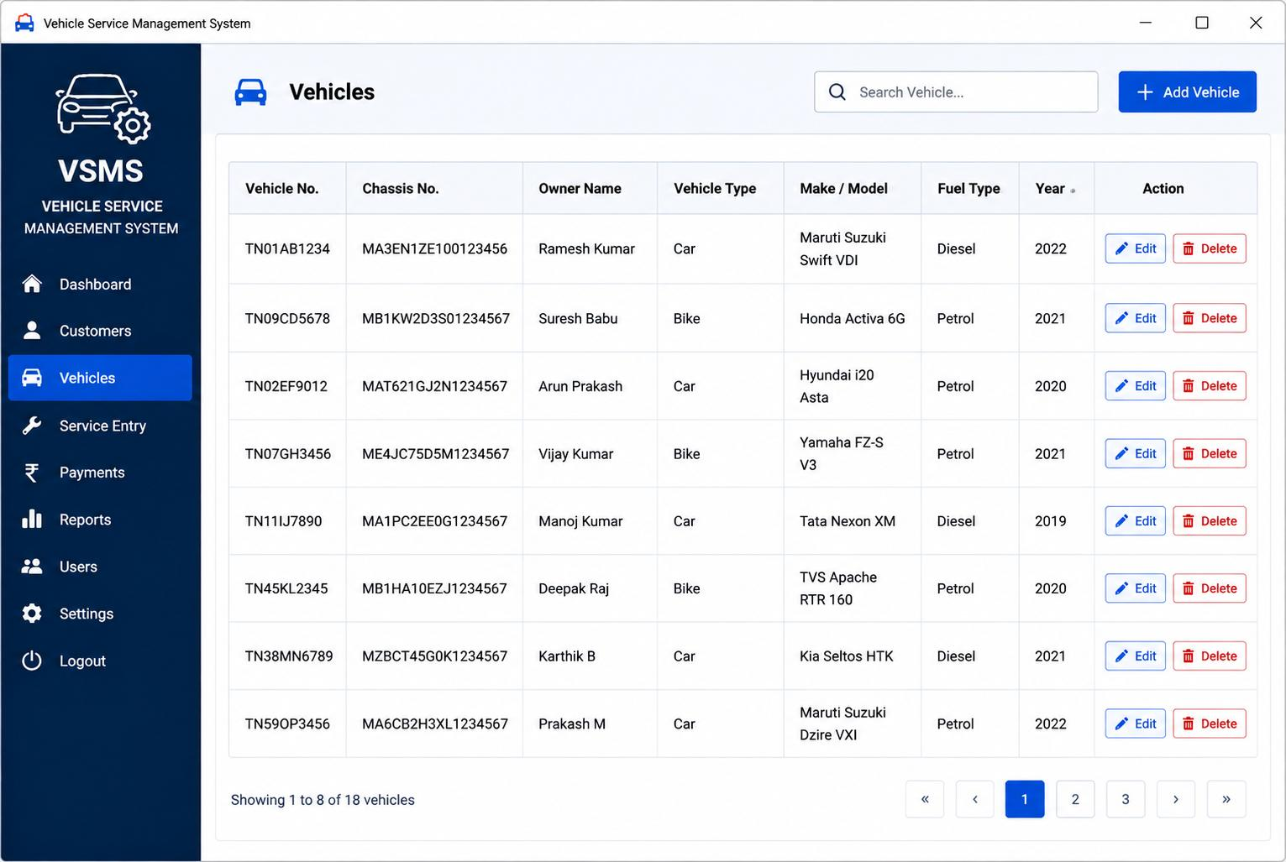
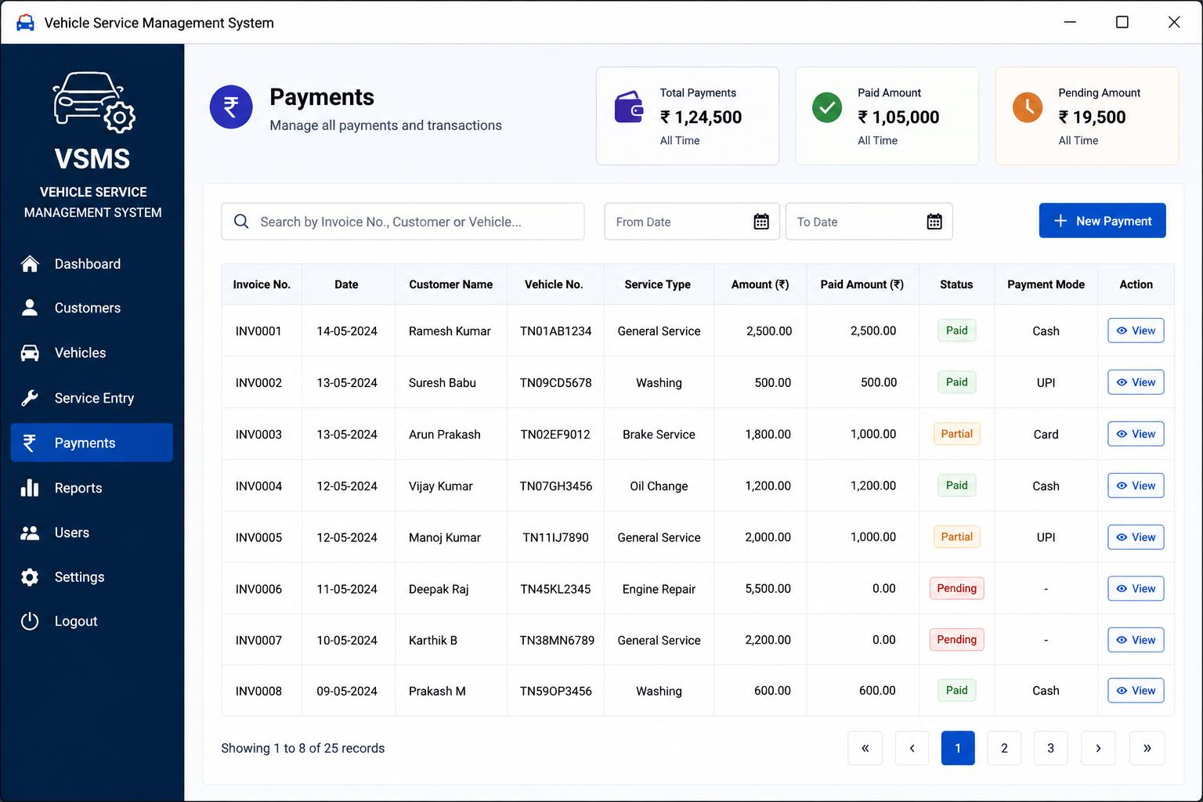
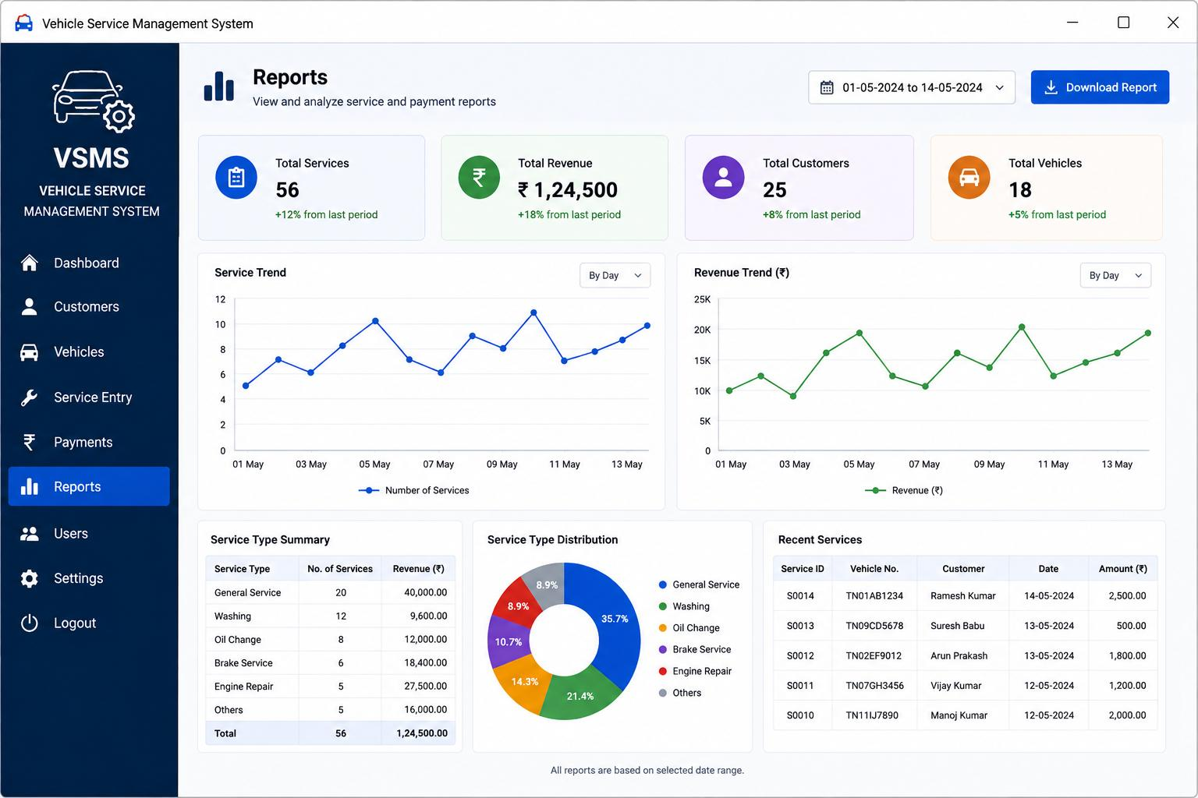
Sample Output: Records, Payments, Reports
Customers: add, edit, delete, search
Vehicles: full details with actions
Payments: paid, partial, pending
Reports: trends and service summary
Vehicle Service Management System
9

Slide 10
Conclusion & Future Enhancements
Conclusion
Future work
Working Java + MySQL system for customer, vehicle, service and payment records
Cuts manual work, redundancy and errors
Modular design eases maintenance
Gained hands-on SDLC, OOP and JDBC experience
Web and mobile versions
Online service booking
SMS and email reminders
Payment gateway integration
Cloud backup, password encryption, MFA
AI-based maintenance prediction
Vehicle Service Management System
10

