Slide 2





GPT
137Million
548MB
16GB RAM
42Minutes
80 Records
Prompt
Create a SQL Query using for the given text statement using the table schema provided
Context
customer(custid,first_name,last_name,date_of_birth,address,phone_number,email),
obligor(obligor_id,custid,relationship,credit_score,risk_rating),
facility(facility_id,obligor_id,facility_type,facility_amount,drawdown_date,maturity_date),
credit_score(credit_score_id,obligor_id,credit_score_agency,credit_score,credit_score_date),
risk_rating(risk_rating_id,obligor_id,risk_rating,risk_rating_date)
Question
Calculates the average credit score for customers with multiple obligors grouped by first name, last name, and relationship
Output
Calculates the average credit score for customers with multiple obligors grouped by first name, last name, and relationship

Slide 3
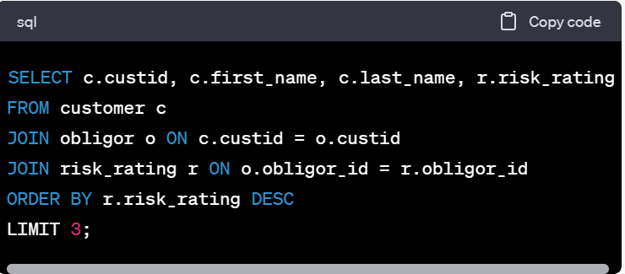
Requirement: Find top 3 highest risk rated customers

