Slide 1

AR – Contactless Cash Withdraw
AR Free Thinkers
Amith Jain
RD Karthikeyan
Anbarasan Murthy
Ramya Sivaramakrishnan

Slide 2
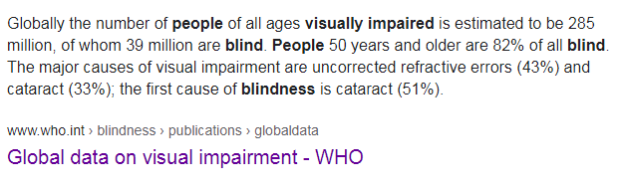
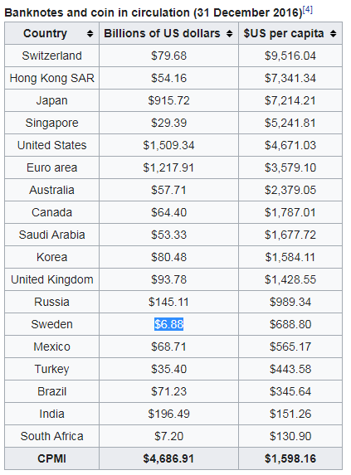
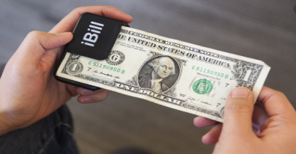

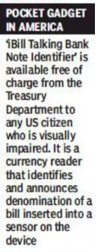


AR – Contactless Cash Withdraw
Physical Currency
Digital Inclusion?
Social Distancing

Slide 3





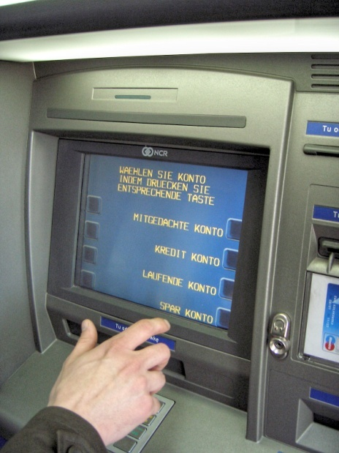





Augmented Reality
ATMs to become virtual bank branches
Contactless -Social Distancing
Immersive Experience to customers
Digital Inclusion
Tools Evaluated
Chrome
Mobile
User Interface
A-Frame
WebXR
Augmented Reality – Cash Withdraw
OpenCV.js
Object Detection

Slide 4

Demo
https://anbu992003.github.io/work/index.html
https://anbu992003.github.io/work/a.html
https://github.com/anbu992003/anbu992003.github.io

