Slide 1

Credit Card Fraud Detection
Team: CRP Free Thinkers
Amith Jain
RD Karthikeyan
Anbarasan Murthy
Ramya Sviaramakrishnan
AI/ML

Slide 2
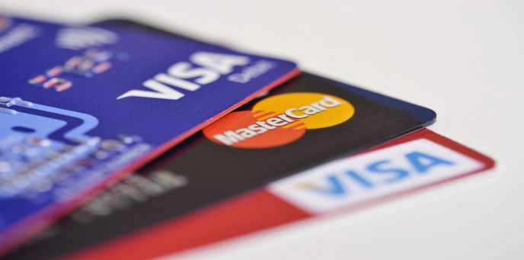

Problem Statement
Current Scenario
Challenges
The Federal Trade Commission estimates that 10 million people are victimized by credit card theft each year
Credit card companies lose close to $50 billion dollars per year because of fraud
These costs “trickle down” in higher interest rates and fees for all consumers
Imbalanced Data i.e most of the transactions (99.8%) are not fraudulent which makes it really hard for detecting the fraudulent ones
Misclassified Data can be another major issue, as not every fraudulent transaction is caught and reported.
Dataset
Kaggle Credit Card Fraud Detection Dataset
Two-day transactions made on 09/2013 by European cardholders.

Slide 3
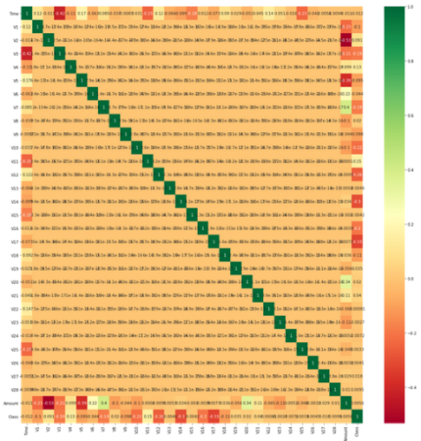
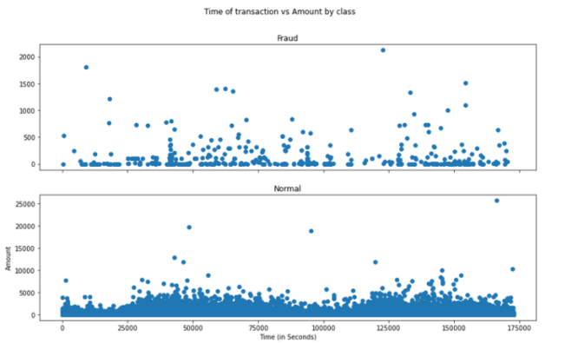
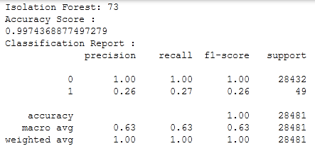
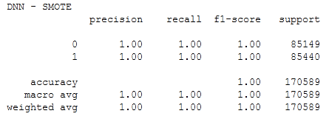
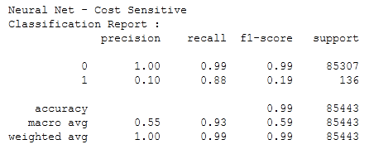
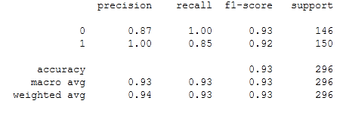


AI/ML Models
Models | AU-ROC | AU-PRC
Cost Sensitive NN | 0.979551 | 0.716
DN Undersample | 0.988447 | 0.992
DNN SMOTE Upsample | 0.99981 | 1
Isolation Forest | 0.653377 | 0.321
Local Outlier Factor | 0.49918 | 0.001
SVM | 0.500234 | 0.501
Tech Stack :

