Slide 1
✓ AVAILABLE FOR NEW GROWTH PARTNERSHIPS
Digital Growth Strategy
for D2C, B2C & B2B
Turning marketing investment into measurable business growth — qualified leads, customer acquisition, revenue and ROI.
$320M+ Client Revenue Generated
Prepared for your business • Anbarasan, Growth Partner

Slide 2
Proven Track Record
11+ years turning digital marketing into measurable business growth across D2C, B2C and B2B.
38+
450M+
1,340
$320M+
PROJECTS DELIVERED
IMPRESSIONS GENERATED
KEYWORDS RANKED #1–10
CLIENT REVENUE GENERATED
Growth is compounding: revenue generated per client engagement keeps climbing year over year.
38+ engagements across Manufacturing, Healthcare, Technology, E-commerce, Finance and more
Average return of 8–12x marketing spend across case studies
Work spans lead generation, ARR growth, e-commerce revenue and patient/customer acquisition
Growth Partner • Digital Marketing Consultant
2

Slide 3
About Anbarasan
Over 11+ years, I've worked across D2C, B2C and B2B businesses, helping companies fix inconsistent lead generation, rising acquisition costs, low organic visibility, weak conversion rates and disconnected marketing data.
11+
My approach goes beyond managing individual channels — I look at the full growth journey (objectives → audience → acquisition → conversion → retention → measurement) and build a practical strategy around it.
YEARS TURNING DIGITAL
MARKETING INTO BUSINESS
GROWTH
Growth Strategy
SEO & Content
Performance Marketing
Conversion Optimization
Brand Strategy
AI-Powered Marketing
GA4 & Analytics
CRM Integration
“From startups looking to establish demand to established businesses looking to scale efficiently — my focus stays the same: find what's limiting growth, fix it, measure the impact and continuously improve.”
Growth Partner • Digital Marketing Consultant
3

Slide 4
My Approach to Growth
Three strategic pillars: acquiring customers efficiently, converting them at higher rates, and retaining them for lifetime value.
01
02
03
Customer Acquisition
Conversion Optimization
Customer Retention
Building efficient channels to attract your ideal customers.
Maximize the revenue potential of every visitor.
Building loyalty and long-term customer value.
Performance Marketing (Google, LinkedIn, Meta)
SEO & Organic Growth
Content Strategy & Thought Leadership
Website UX & CRO Testing
Landing Page & Funnel Design
Data-Driven A/B Testing
Email Marketing & Automation
CRM & Lifecycle Campaigns
Community & Advocacy Programs
Growth Partner • Digital Marketing Consultant
4

Slide 5
Core Services
Eight growth capabilities built around your business goals.
★
↗
●
¶
Consulting & Strategy
Performance Marketing
SEO & Organic Growth
Content & Thought Leadership
Audit, roadmap and growth strategy formulation.
Google, LinkedIn, Meta — paid channels optimized for ROI.
Technical SEO, content strategy, long-term search authority.
Blogs, whitepapers, case studies, executive positioning.
▲
@
#
■
Conversion & CRO
Email & Automation
Social & Community
CRM & Analytics
A/B testing, landing pages, funnel analysis.
Segmentation, nurture sequences, lifecycle campaigns.
Content, community management, influencer partnerships.
GA4, dashboards, CRM/martech integration.
Growth Partner • Digital Marketing Consultant
5

Slide 6
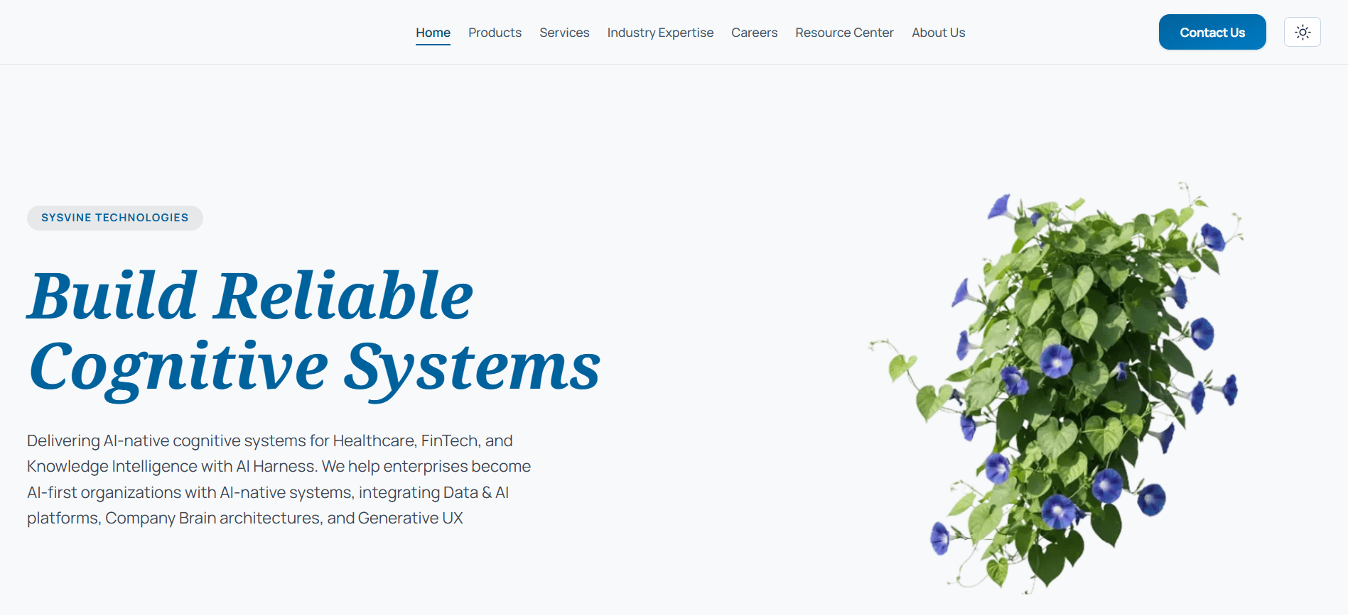
CASE STUDY • PROFESSIONAL SERVICES
₹28L → ₹5.5Cr
in Project Contracts
Sysvine — B2B Branding + Business Acquisition
A ₹28L investment in brand positioning and business-development marketing generated ₹5.5Cr in enterprise project pipeline — a nearly 20x return.
+5
₹5.5Cr
+300%
Enterprise Contracts
Project Pipeline
Brand Awareness
Growth Partner • Digital Marketing Consultant
6

Slide 7
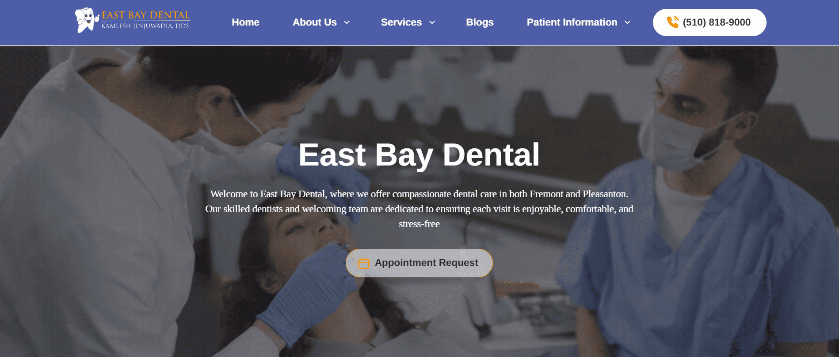
CASE STUDY • DENTAL HEALTHCARE
$600K → $5.4M
in Patient Revenue
East Bay Dental Care — Performance Marketing for Patient Acquisition
A $600K annual marketing investment generated $5.4M in patient revenue (9x ROAS) with 1,000+ qualified leads/month at ~$4 CPL — enabling expansion from 8 to 10 clinic locations.
9x
1,000+
8→10
ROAS
Leads / Month
Locations
Growth Partner • Digital Marketing Consultant
7

Slide 8
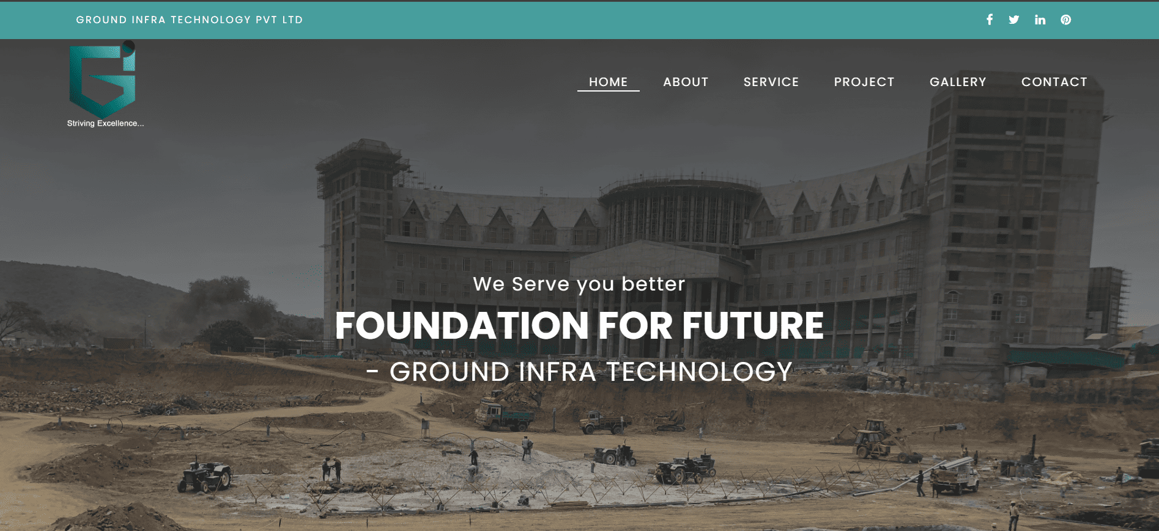
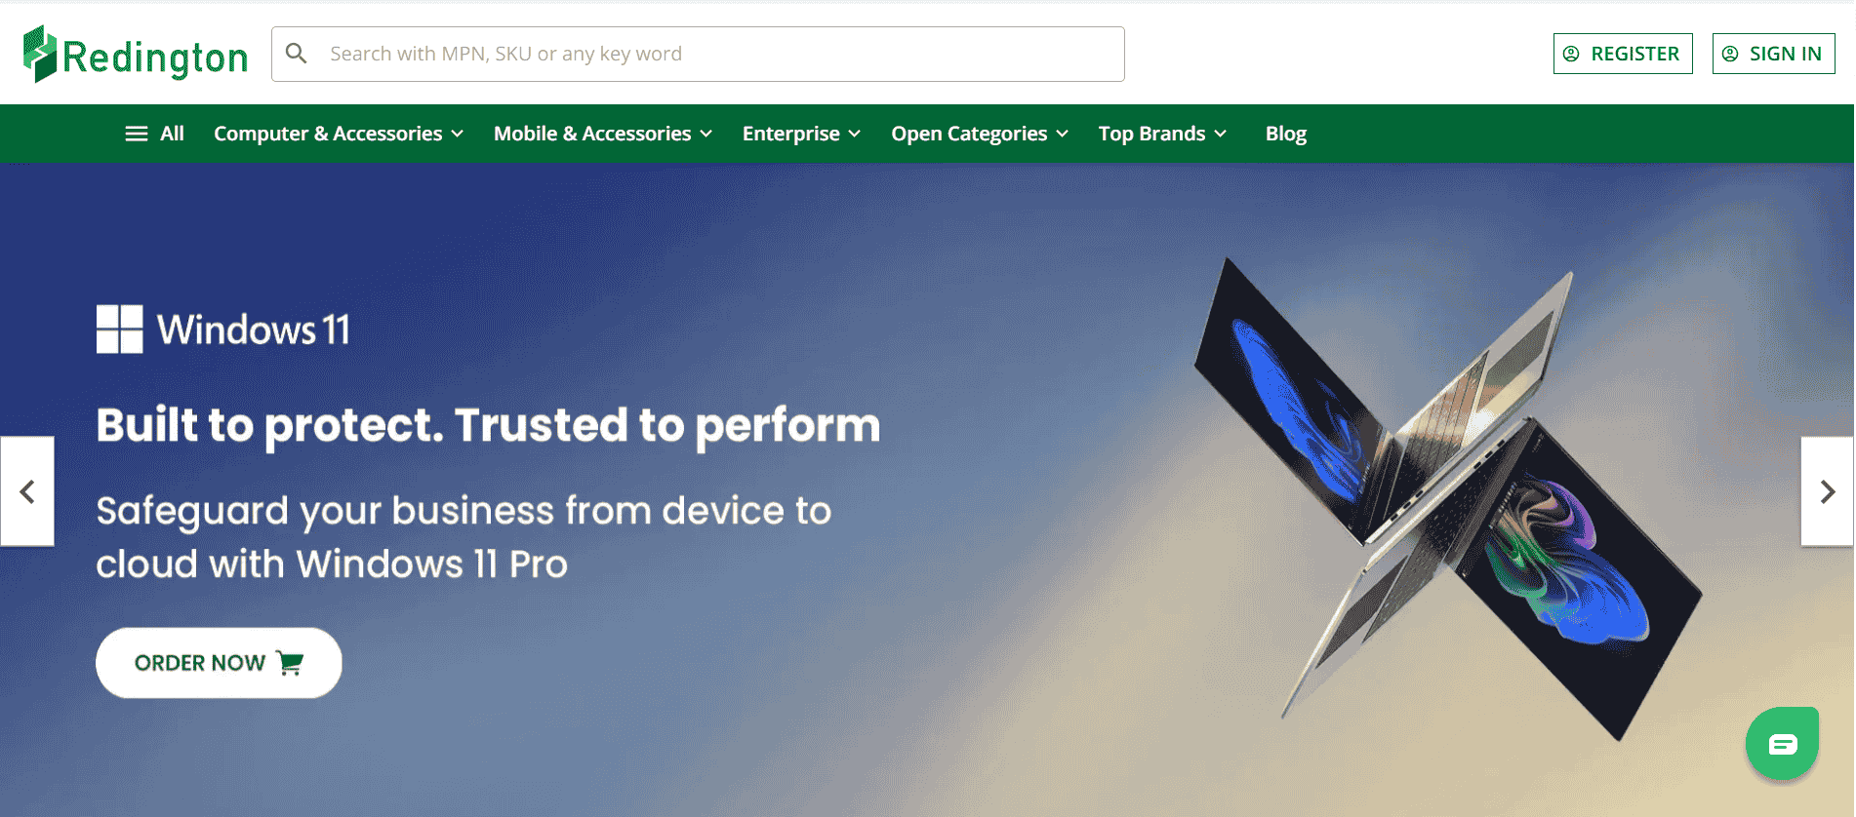
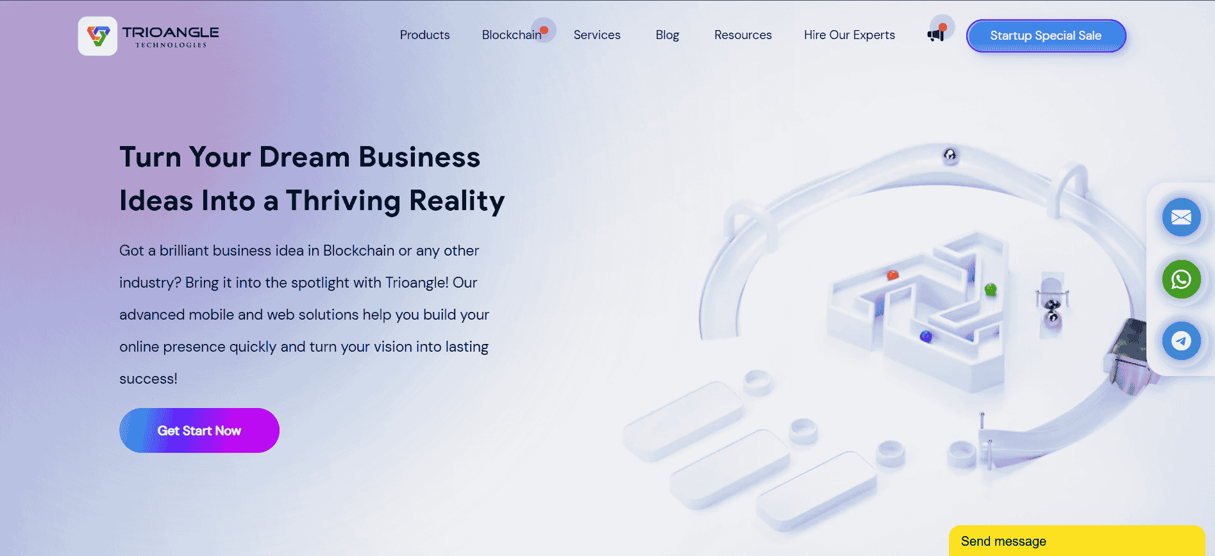
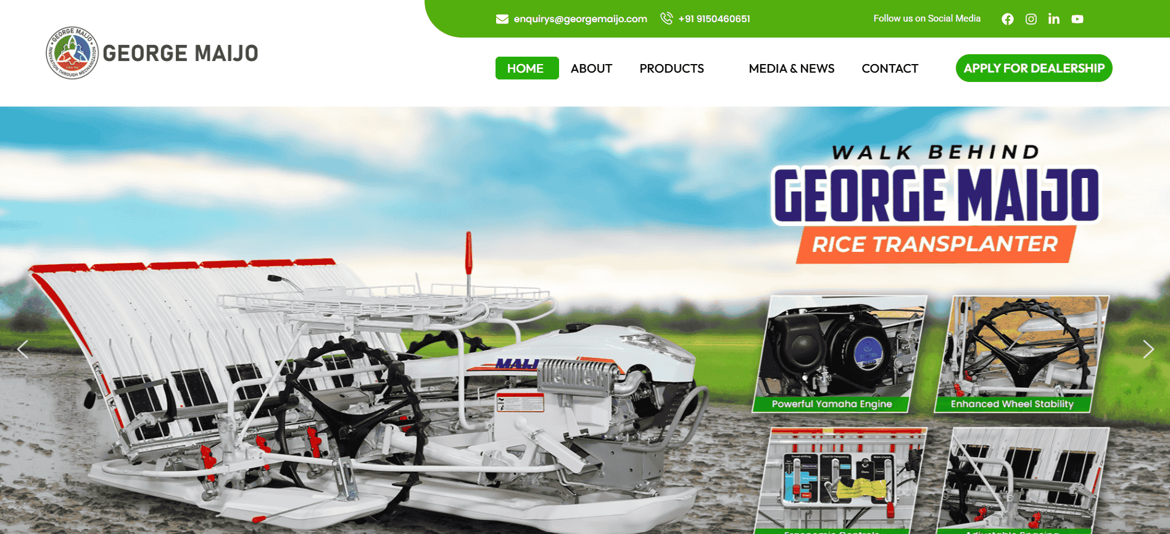
Results Across Industries
A sample of engagements spanning real estate, technology and manufacturing.
REAL ESTATE
TECHNOLOGY
₹25L → ₹3Cr in Property Sales
₹50L → ₹2Cr in Closed Deals
Ground Infra
Redington
SEO + branding drove +280% property inquiries and +120% units sold.
+400% B2B leads, +250% pipeline value, 3.5x ROAS.
TECHNOLOGY
MANUFACTURING
₹25L → ₹2Cr in Client Contracts
₹60L → ₹2.4Cr in Revenue
Trioangle
George Maijo Agri Machinery
Digital branding won 8 new enterprise clients.
4x ROAS across dealer and farmer acquisition.
Growth Partner • Digital Marketing Consultant
8

Slide 9
Industries Served
Growth strategy adapts to your industry — not the other way around.
🏭
✈️
💻
⚕️
🦷
💰
🛍️
Manufacturing
Travel & Hospitality
Technology
Healthcare
Dental
Finance
E-commerce
🚗
🏠
🛒
🚚
🖥️
💼
📈
Automobile
Real Estate
Retail
Logistics
IT Services
Professional Services
Business Services
Growth Partner • Digital Marketing Consultant
9

Slide 10
What Clients Say
Trusted by founders and marketing leaders at growth-focused companies.
★ ★ ★ ★ ★
★ ★ ★ ★ ★
★ ★ ★ ★ ★
“Anbarasan helped us increase qualified leads by 60% within three months and reduce CPL by 21%, while organic traffic grew 40% over six months.”
“He brought structure and a strong performance focus to our digital marketing — a more consistent approach to generating relevant business enquiries.”
“Lead generation strategy transformed our B2B pipeline. Cost per qualified lead dropped 62% while lead volume tripled. Clear ROI on every dollar spent.”
Jeo Maijo
Gopi Krishan
Meera Choudhury
CEO, George Maijo
Redington
VP Marketing, ProConnect
Growth Partner • Digital Marketing Consultant
10

Slide 11
Ready to Scale Your Business?
Let's discuss your growth goals, challenges, and what's possible. No fluff — just strategy and execution.
💬
WhatsApp / Call
+91 81220 80143
📧
Email
anbupartneritech@gmail.com
🌐
Portfolio
dm-anbarasan-portfolio.netlify.app
Growth Partner • 38+ Projects • $320M+ Client Revenue Generated

