Slide 1
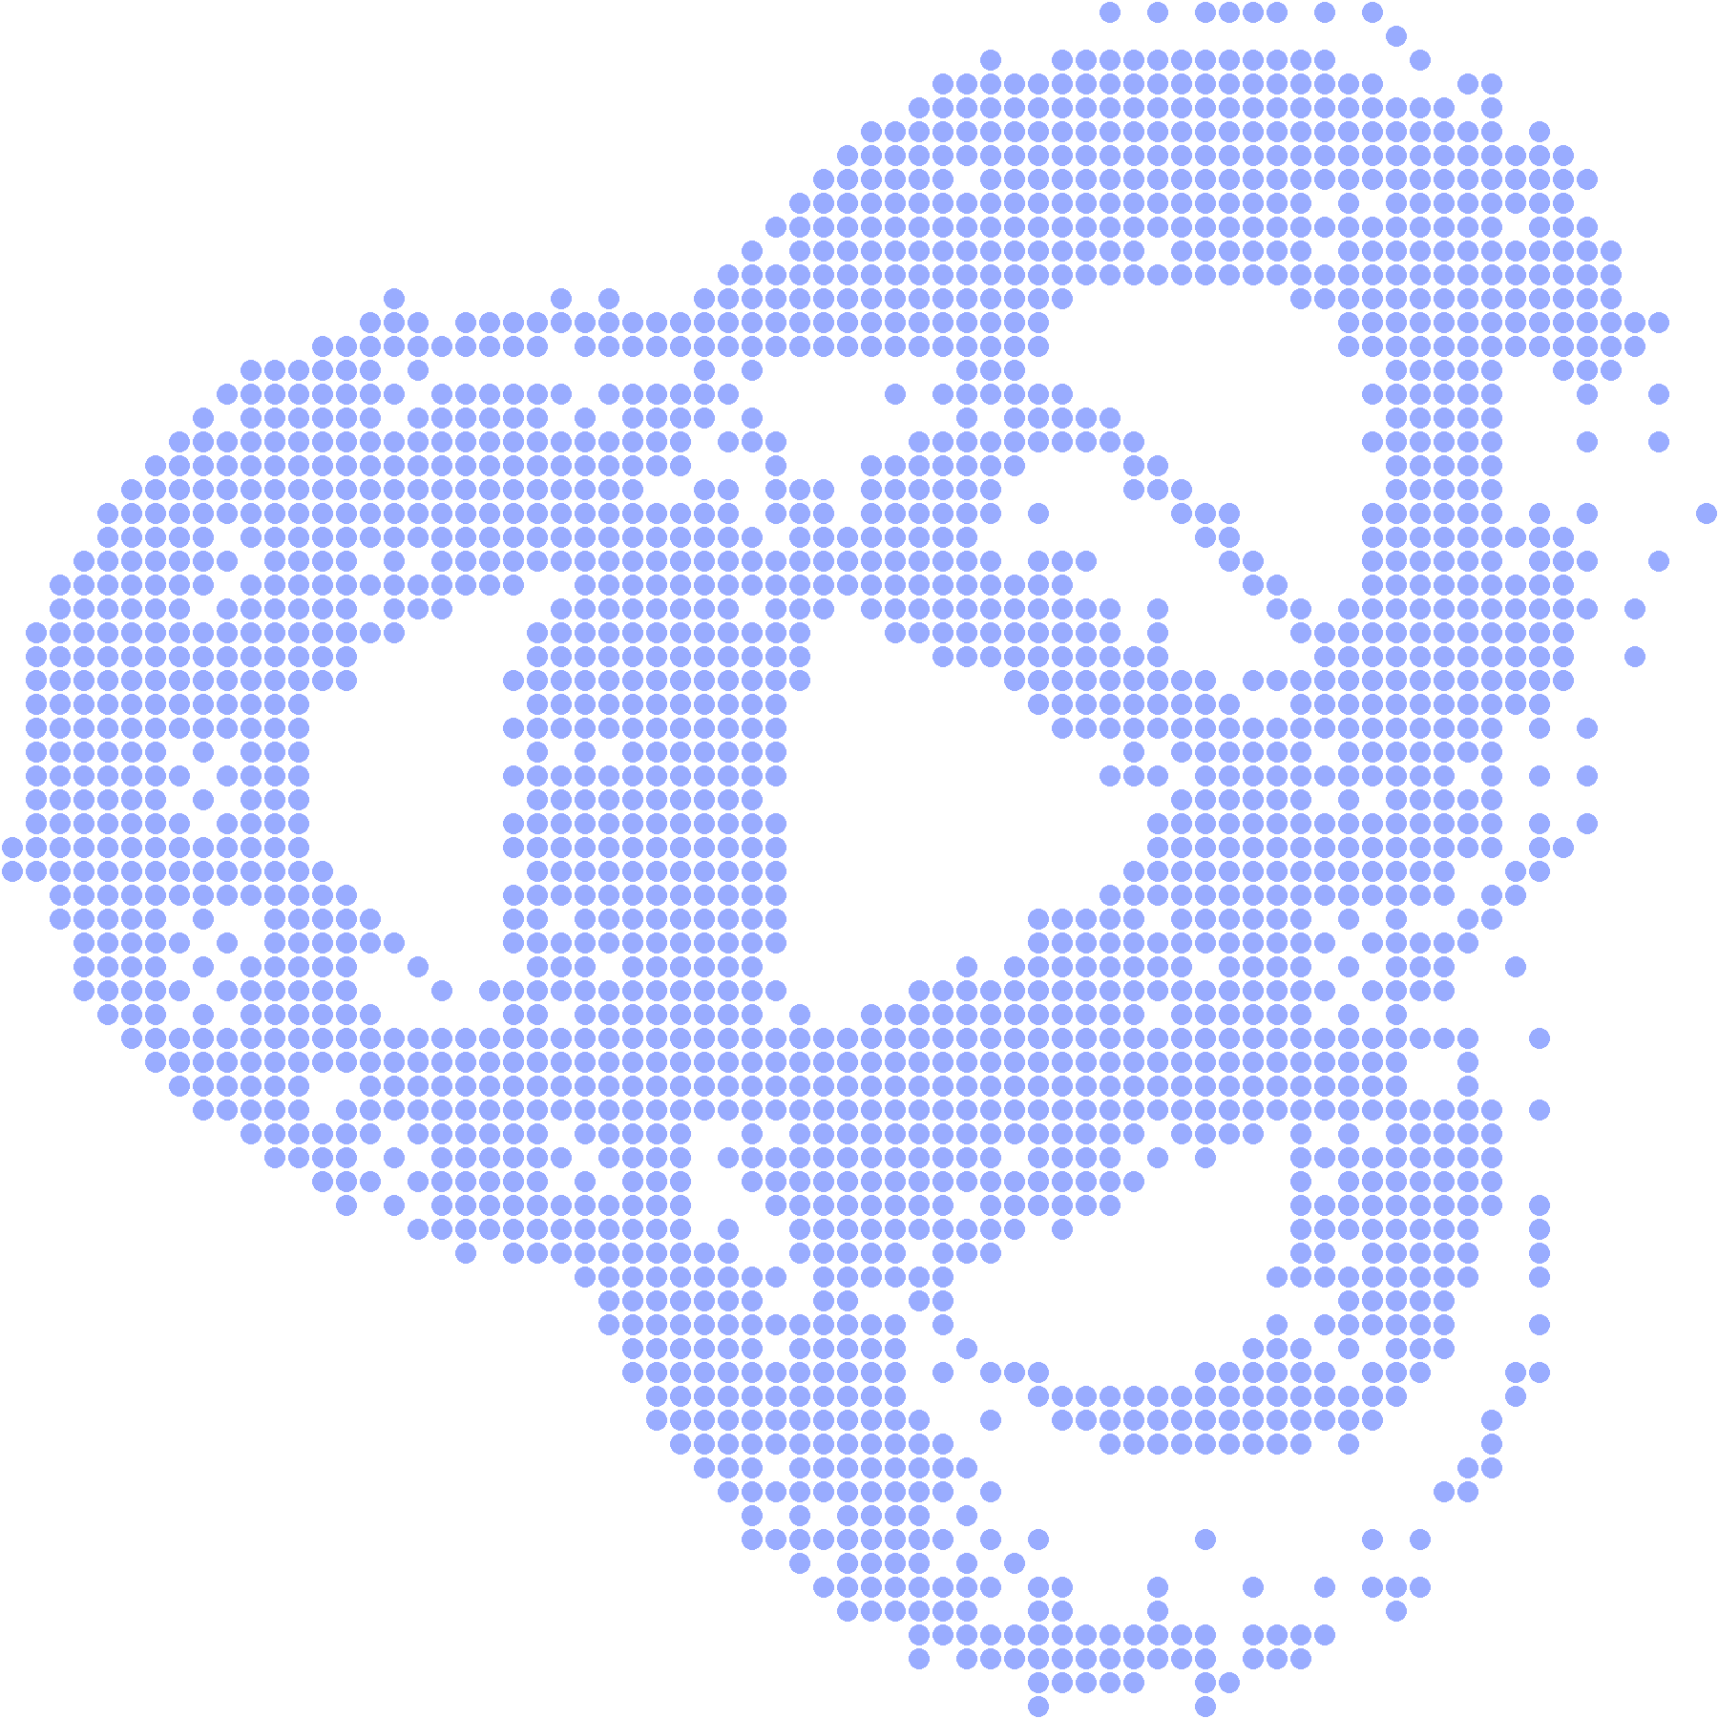
CLOCK IN · A SOLANA MOBILE HACKATHON
Nothing moves
without your Nod.
The approval layer for AI agents on Solana.
ANDROID · MOBILE WALLET ADAPTER · DEVNET
Notes:
Nod is an approval layer for AI agents on Solana. The agent proposes, your phone decodes, you approve with your fingerprint, your wallet signs. Nothing moves without your Nod.

Slide 2
01 · THE PROBLEM
Agents are starting to move money.
OPTION A
OPTION B
Give the agent a hot key
Sign everything in a wallet
Fast, but one prompt injection or bug can drain the wallet.
Safe, but a wallet shows opaque bytes, so people tap approve without knowing what they sign.
What is missing: a human in the loop that reads the transaction for you.
Notes:
AI agents are starting to pay for APIs, trade and rebalance. Today there are two bad options. Hot keys are fast but one injection can drain a wallet. Signing everything in a wallet UI is safe, but people approve opaque bytes. What is missing is a human in the loop that reads the transaction for you.

Slide 3
02 · HOW NOD WORKS
Four steps between an agent and your money.
01
02
03
04
The agent proposes
Your phone decodes
You give your Nod
Your wallet signs
Sends a transaction and a one-line reason. It never holds the key.
Reads the real bytes and simulates them locally.
Fingerprint, face or screen lock. Reject or let it expire.
Over Mobile Wallet Adapter. Keys never enter Nod.
Notes:
Four steps. The agent proposes a transaction and a reason. Your phone decodes and simulates the real bytes. You approve with biometrics. Your own wallet signs over Mobile Wallet Adapter.

Slide 4
03 · WHAT YOU SEE
Read what it really does.
demo-agent
EXPIRES IN 0:42
wants to send
0.05 SOL
Decoded from the transaction, not from the agent's description
Simulated on your phone: your balance before and after
The agent's stated intent is checked against what the transaction does
A countdown, and a fresh check if the quote goes stale
To
7xKX…9fQ2
Program
System Program
Your balance
1.2400 → 1.1900
Matches what the agent said.
REJECT
HOLD TO APPROVE
Notes:
The approval card is built on the phone from the transaction itself, so it does not rely on the agent or the backend. You see who, how much, to whom, which program, and your balance before and after.

Slide 5
04 · DECODED, NOT DESCRIBED
The agent can say anything. The transaction cannot.
THE AGENT SAYS
THE TRANSACTION DOES
“Weather API credits”
Sends 4.80 SOL
Pay 0.05 SOL
To 9bQr…T3mA, a recipient you never allowed
Does not match. Over the hard cap, so it is blocked automatically.
Illustrative example.
Notes:
An agent can say anything. Nod compares what the agent claimed with what the transaction actually does. A mismatch is flagged before you ever reach an approve button, and anything over the hard cap is blocked automatically.

Slide 6
05 · YOUR LIMITS
You decide how much trust an agent gets.
AUTO
NOD
BLOCK
Small and expected
Everything else
Never allowed
Under your limit, to allowed recipients. Goes through without a prompt.
Larger amounts, new recipients, swaps. Your phone waits for your biometric.
Unknown programs, authority changes, over the hard cap. Refused automatically.
DAILY SPEND CAP
ALLOWED RECIPIENTS
FREEZE IN ONE TAP
REVOKE KEYS ANY TIME
Notes:
Limits are set per agent, in the app, and enforced before anything reaches your phone. Auto for small expected payments, Nod for everything else, Block for what should never happen. On top: daily caps, allowed recipients, freeze and key revocation.

Slide 7
06 · BUILT ON SOLANA MOBILE
Native to Solana Mobile.
Mobile Wallet Adapter
Seed Vault ready
Biometric gate
Signing in your own wallet. Keys never enter Nod.
Works with any MWA wallet, Seed Vault on a Seeker included.
Android system prompt with screen-lock fallback. Hold to approve.
Minimal push
Local simulation
Jupiter-aware
Notifications carry only a proposal id, never amounts.
Decodes and simulates the exact bytes about to be signed.
Swaps are decoded from the route, on mainnet.
Notes:
Nod is built on the Solana Mobile stack. Mobile Wallet Adapter signing, any MWA wallet and Seed Vault on a Seeker, the Android biometric prompt, push with only a proposal id, local simulation, and Jupiter swap decoding on mainnet.

Slide 8
07 · ARCHITECTURE
How the pieces fit.
AI AGENT
›
NOD BACKEND
›
NOD APP
›
WALLET
›
SOLANA
nod-sdk
policy + push
decode, simulate, approve
MWA or Seed Vault
RPC, programs
Never holds a key
Verifies what it signs
Keys stay here
The backend is a messenger and a policy gate, never the source of truth.
Notes:
The backend is a messenger and a policy gate. It cannot sign. The phone decodes, simulates and verifies. Keys stay in the wallet. Everything that protects your money happens on the device.

Slide 9
08 · OPEN SOURCE
Open, and yours to run.
agent.ts
npx nod-server: your own backend in one command
--tunnel for a public https address
SDK, OpenAPI spec and a conformance suite
Docker image, MIT licensed
# run your backend
npx nod-server --tunnel
// propose from your agent
const result = await nod
.proposeAndWait({
...built,
reason: "Weather API credits",
});
if (isConfirmed(result))
console.log(result.signature);
Notes:
Anyone can run their own backend with one command and connect any agent through the SDK or plain HTTP. There is an OpenAPI spec and a conformance suite for other implementations. Everything is MIT licensed.

Slide 10
09 · STATUS
Working on a real phone, and honest about the rest.
CONFIRMED ON DEVICE
ALSO VERIFIED
Mobile Wallet Adapter authorize and sign
Approval flow end to end
Push notification on the lock screen
Tamper demos: blocked programs, delegate, swapped transaction
Local decode and simulation with balance changes
Activity feed with filters
Biometric gate with screen-lock fallback
Demo agent proposing against devnet
Prototype, not audited. Auto-approved proposals are recorded but not executed yet. Devnet by default.
Notes:
This is a hackathon prototype. These pieces are confirmed on a real Android phone against devnet. It is not audited, and in this version auto-approved proposals are recorded but not executed by the backend.

Slide 11
10 · ROADMAP
Where it goes next.
NEXT
LATER
ECOSYSTEM
Squads multisig and on-chain spending limits
iOS and hardware-key approvers
SKR integration for the Seeker ecosystem
More decoders: lending, staking, perps
Policy as code, with simulation-based rules
Agent reputation and audit exports
Notes:
Next: Squads multisig and on-chain spending limits as the default treasury, and more program decoders. Later: iOS and hardware-key approvers, policy as code, agent reputation, and SKR integration for the Seeker ecosystem.

Slide 12
GET NOD
Nothing moves
without your Nod.
An Android app, an open-source backend and an SDK. Running on Solana devnet.
APK
REPOSITORY
DEMO VIDEO
DOCS
Notes:
Close: nothing moves without your Nod. The app, the open-source backend and the SDK all exist today and run on devnet. Add the APK link, repository, demo video and docs.

