Slide 1


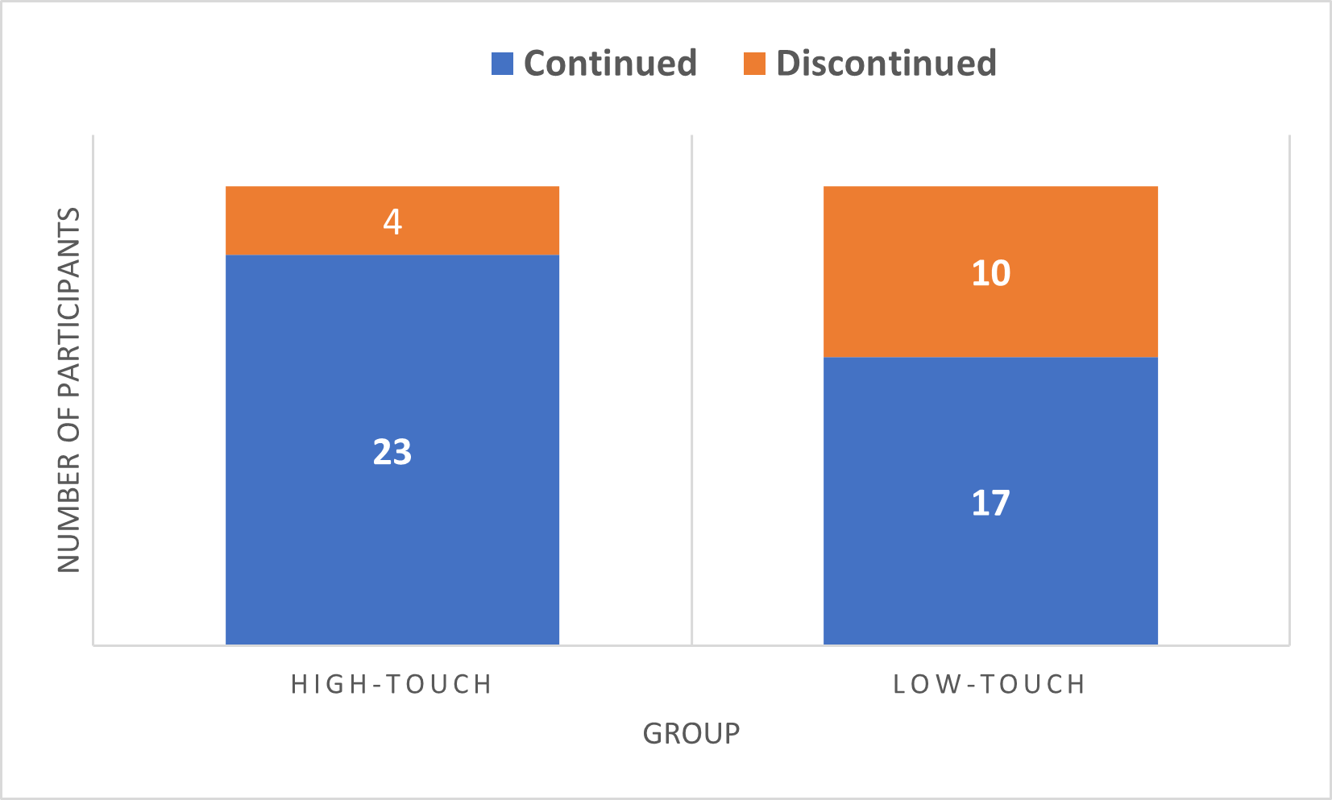
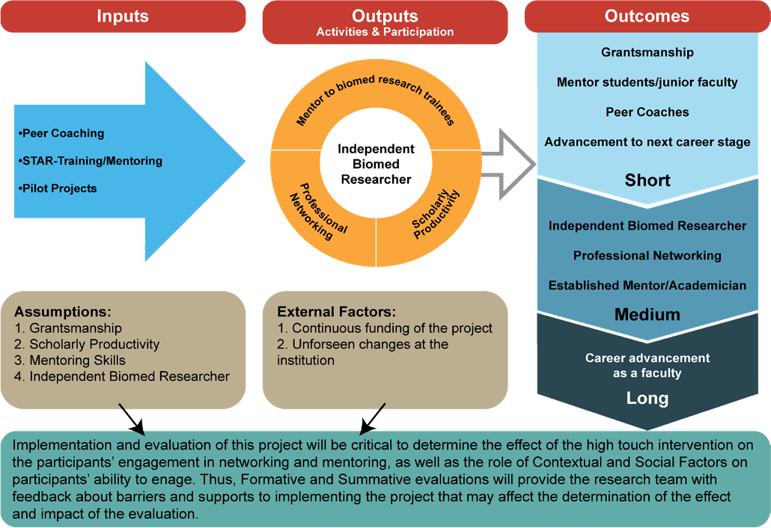
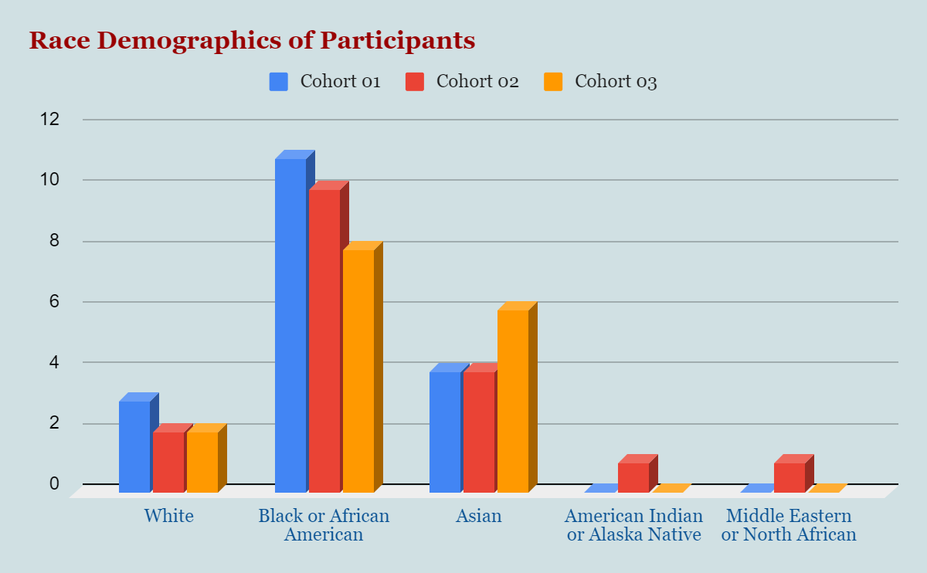


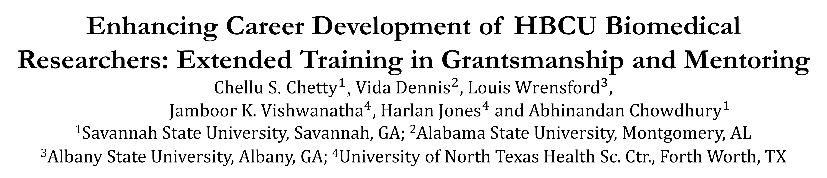
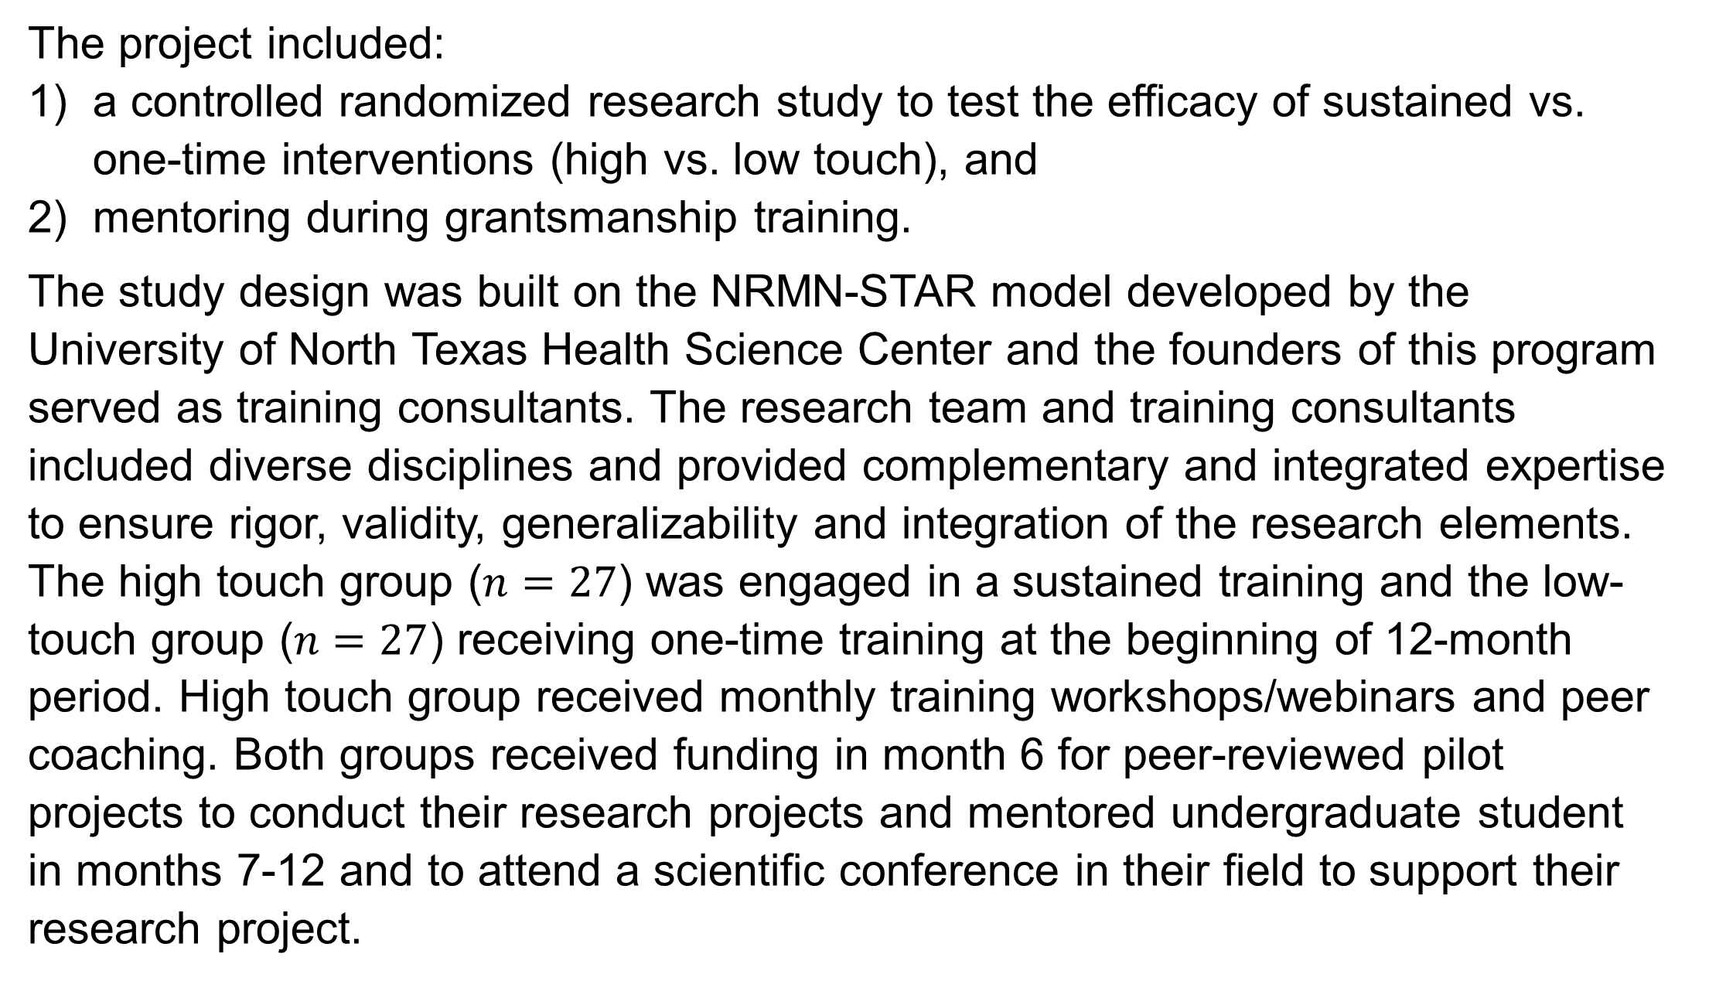
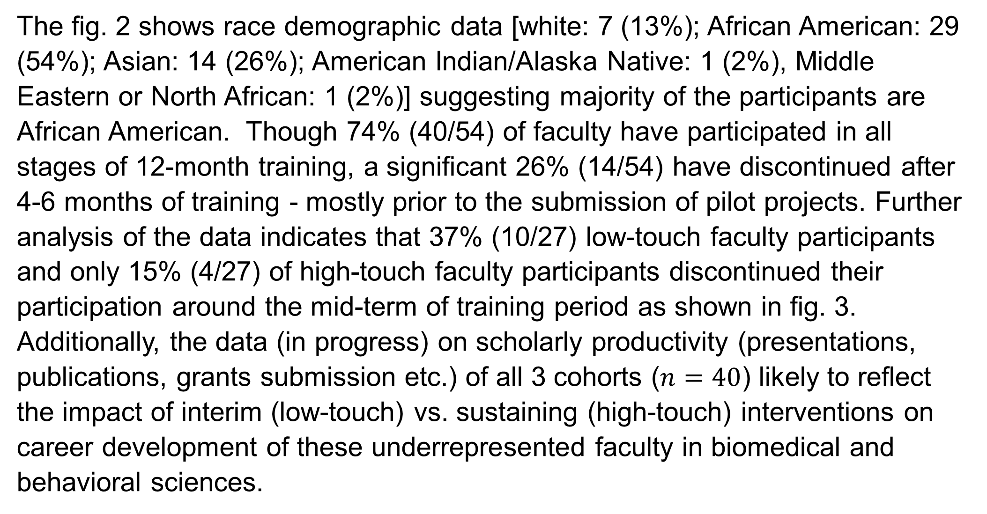
Enhancing Career Development of HBCU Biomedical Researchers: Extended Training in Grantsmanship and Mentoring
Chellu S. $Chetty^{1}$, $Vida Dennis^{2}$, Louis $Wrensford^{3}$,
Jamboor K. $Vishwanatha^{4}$, Harlan $Jones^{4}$ and Abhinandan $Chowdhury^{1}$
¹Savannah State University, Savannah, GA; ²Alabama State University, Montgomery, AL
³Albany State University, Albany, GA; ⁴University of North Texas Health Sc. Ctr., Forth Worth, TX
Abstract
Study Design
Results and Discussion
This 3-year study is a 12-month training experiment and engaged 3 cohorts of 54† faculty from 3 HBCUs (Savannah State University, Alabama State University and Albany State University) to test the hypothesis that sustained commitment to mentoring and grantsmanship is a significant determinant of success in HBCU faculty. The study combined both grant-writing and mentoring interventions to increase persistence, engagement and scientific productivity of faculty at HBCUs which traditionally have found barriers compared to majority institutions. The study compared immediate and long-term impacts on self-efficacy for both participating faculty and their student mentees. The demographic/background/social capital data, participation rates, and the faculty and mentee self-efficacy surveys (pre and post) were collected for statistical analysis in the framework of structural equation modeling (SEM). We expect that study research findings and outcomes will lead to a predictive model that can be translated to persistence and career development of faculty at other HBCUs and majority institutions.
The project included:
a controlled randomized research study to test the efficacy of sustained vs. one-time interventions (high vs. low touch), and
mentoring during grantsmanship training.
The study design was built on the NRMN-STAR model developed by the University of North Texas Health Science Center and the founders of this program served as training consultants. The research team and training consultants included diverse disciplines and provided complementary and integrated expertise to ensure rigor, validity, generalizability and integration of the research elements. The high touch group ($n=27$) was engaged in a sustained training and the low-touch group ($n=27$) receiving one-time training at the beginning of 12-month period. High touch group received monthly training workshops/webinars and peer coaching. Both groups received funding in month 6 for peer-reviewed pilot projects to conduct their research projects and mentored undergraduate student in months 7-12 and to attend a scientific conference in their field to support their research project.
Background and Significance
Having a diverse biomedical research workforce is essential to address the nation’s public health challenges including the significant health disparities borne by minority populations. The need to recruit diverse scientists is particularly important in the biomedical and behavioral science fields which will increasingly require collaborative research among basic and clinical scientists across multiple disciplines and communication of the research to the public. Though blacks presently compose >13% of the U.S. population, they represented only 4.4% of the U.S. Biological Scientist workforce in 2011. Blacks represented 1.62% of individual R01 awards issued in 2012 (NIH, 2014). Research has found that black applicants remain 10 percentage points less likely than whites to be awarded NIH research funding (Ginther et al., 2011). Contributing factors include: UR faculty receive less mentoring compared to their WR peers (Beech et al., 2013), many UR faculty assigned mentors feel unsupported and neglected (Zambrana et al., 2015) and UR faculty face institutional barriers (inadequate research infra- structure and training, limited access to mentors, institutional bias at NIH, etc.) (Shavers et al., 2005).
Figure 3: Group-wise distribution of faculty involvement.
The fig. 2 shows race demographic data [white: 7 (13%); African American: 29 (54%); Asian: 14 (26%); American Indian/Alaska Native: 1 (2%), Middle Eastern or North African: 1 (2%)] suggesting majority of the participants are African American. Though 74% (40/54) of faculty have participated in all stages of 12-month training, a significant 26% (14/54) have discontinued after 4-6 months of training - mostly prior to the submission of pilot projects. Further analysis of the data indicates that 37% (10/27) low-touch faculty participants and only 15% (4/27) of high-touch faculty participants discontinued their participation around the mid-term of training period as shown in fig. 3. Additionally, the data (in progress) on scholarly productivity (presentations, publications, grants submission etc.) of all 3 cohorts ($n=40$) likely to reflect the impact of interim (low-touch) vs. sustaining (high-touch) interventions on career development of these underrepresented faculty in biomedical and behavioral sciences.
Conclusion
Figure 1: Logic Model to use sustained interventions towards faculty participant’s career development.
In summary, the data on participation rates suggests that engagement in sustained training (high-touch) as compared to limited (one-time) training (low-touch) will have significant impact on commitment to mentoring and grantsmanship. Though the sustained and high-touch training model strengthen faculty’s capacity to establish themselves as independent funded researchers and enhance their mentoring skills for their UR students, the sustainability funding provided by the institution’s US Department of Education Title III grant funding and indirect costs is required for long-term faculty development.
Specific Aims
Based on historical data and background, we hypothesized that sustained commitment to mentoring and grantsmanship is a significant determinant of success in HBCU faculty. This hypothesis was tested in the following specific aims:
Specific Aim 1: Determine the effects of short-term vs. sustained grantsmanship and career development activities on engagement, skills, knowledge and competencies of faculty at HBCUs.
Specific Aim 2: Determine the role of short-term vs. sustained mentor training and networking on quality of mentorship at participating HBCUs.
Specific Aim 3: Determine the effects of immediate post-intervention engagement and success of faculty on distal engagement and success of faculty in grantsmanship and mentoring.
References
Beech et al. (2013). J Assoc. Am. Med. Colleges, 88(4):541–549.
Ginther et al. (2011). Science 333 (6045):1015-1019.
NIH, Physician-Scientist Workforce Report (2014). https://report.nih.gov/Workforce/
Zambrana et al. (2015). Am. Edu. Res. J., 52(1):40-72.
Acknowledgements
Figure 2: Race distribution of 52† participants over 3 years.
The project is supported by NIGMS/NIH award # U01GM138434.
† The study includes data from 52 participants as two faculty did not participate in demographic survey.

