Slide 1
RED EYE DETECTION AND REMOVAL FROM DIGITAL IMAGES
Presentation by:
Anca Mihai

Slide 2
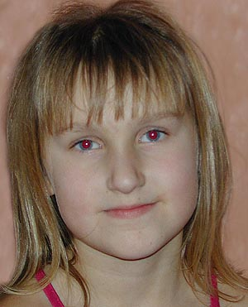
THE PROBLEM
Photographs in dimly lit environments
=> Flash usage => Red-eye effect
One solution: another light source IMPRACTICAL
Another solutions: Hardware-based
> distance between lens and flash IMPRACTICAL (cameras are large enough)
Pre-exposure flash TOO MUCH POWER
=> software-based post-processing solution

Slide 3
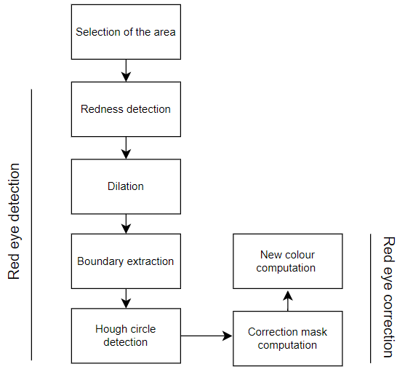
THE SOLUTION

Slide 4
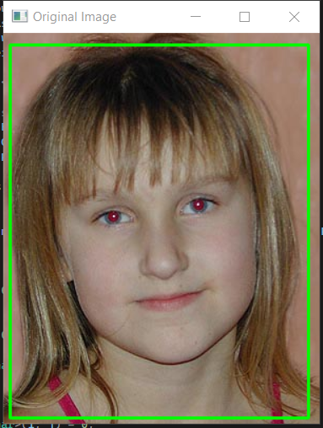
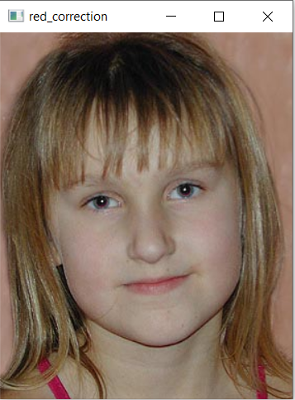
THE RESULTS
On 16 images, detection worked well on 15 of them and correction worked well on 13 of them
Limitations:
detection – eyes must be in center of ROI
correction – pupil of uniform colour

Slide 5
FURTHER IMPROVEMENTS
detection of multiple pairs of red eyes
detection in ROI’s where eyes not in center
detection in blurry/noise/small images
correction for not-uniformly coloured pupils

