Slide 1
.NET Core
MVC

Slide 2
Content
NET Core
MVC
Introduction
First Project

Slide 3
NET CORE
.NET Core is a general purpose development platform
Characteristics:
Flexible deployment
Cross-platform
Command-line tools
Compatible with the other .NET implementations
(via .NET Standard library)
Open source
Supported by Microsoft

Slide 4
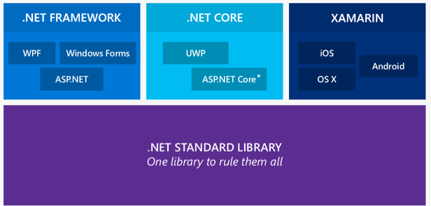
NET Core

Slide 5
ASP NET Core
ASP.NET Core is a new open-source and cross-platform framework for building modern cloud based internet connected applications

Slide 6
ASP NET CORE
A unified story for building web UI and web APIs
Integration of modern client-side frameworks and development workflows
A cloud-ready environment-based configuration system
Built-in dependency injection
New light-weight and modular HTTP request pipeline
Ability to host on IIS or self-host in your own process
Built on .NET Core, which supports true side-by-side app versioning
Ships entirely as NuGet packages
New tooling that simplifies modern web development
Build and run cross-platform ASP.NET apps on Windows, Mac and Linux
Open source and community focused

Slide 7
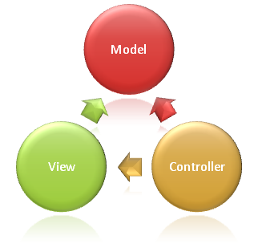
ASP NET CORE MVC

Slide 8
MODEL
The Model in an MVC application represents the state of the application and any business logic or operations that should be performed by it.
Business logic should be encapsulated in the model, along with any implementation logic for persisting the state of the application.
Notes:
The Model in an MVC application represents the state of the application and any business logic or operations that should be performed by it. Business logic should be encapsulated in the model, along with any implementation logic for persisting the state of the application. Strongly-typed views will typically use ViewModel types specifically designed to contain the data to display on that view; the controller will create and populate these ViewModel instances from the model.

Slide 9
VIEW
Views are responsible for presenting content through the user interface.
They use the Razor view engine to embed .NET code in HTML markup.
Minimal logic within views
Logic in views should relate to presenting content.

Slide 10
Controller
Controllers are the components that handle user interaction, work with the model, and ultimately select a view to render.
In an MVC application:
the view only displays information
the controller handles and responds to user input and interaction
In the MVC pattern
Controller is the initial entry point
It is responsible for selecting which model types to work with
Sets which view to render

Slide 11
Demo – First MVC Project

Slide 12
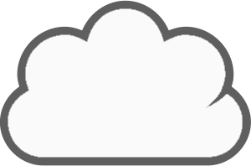
WEB Application
ASP.NET Internal Server
(Kestrel)
Middleware
Middleware
Run {…}
Reverse
Proxy

Slide 13
WEB Application
Web Server
(i.e., IIS)
HTTP
HTTP
Embedded
Web server
Your ASP.NET code
Internet

Slide 14
MiDDLEWare
public delegate
Task RequestDelegate(HttpContext context);
app.Use(async (context, next) => { // ... });

Slide 15
MiddleWare
app.Use(async (context, nextMiddleware) =>
{
context.Response.OnStarting(() =>
{
context.Response.Headers.Add("hello", "world");
return Task.FromResult(0);
});
await nextMiddleware();
});

Slide 16
Startup
Middleware to be added to the pipeline and configured
Only configured middleware runs
All you have is only all you add (and configure)

Slide 17
Configure MVC
public void ConfigureServices(IServiceCollection services)
{
services.AddMvc();
}
public void ConfigureServices(IServiceCollection services)
{
var builder = services.AddMvcCore();
builder.AddViews();
builder.AddRazorViewEngine(); builder.AddJsonFormatters();
}

Slide 18
Controllers

Slide 19
Views

Slide 20

One Common Goal

