Slide 1


Docker
2026 Fall
조상구교수

Slide 2

Mirror dimension
Is the Mirror dimension a different Universe/Realm/dimension?
https://qph.cf2.quoracdn.net/main-qimg-3689237bccaa810158485a0f34e8a334-lq

Slide 3
Contents
Introduction of Docker
Understanding Docker
Docker 실습하기
Docker 용어 및 개념 분류
Docker Mechanism
Docker와 가상머신(VM)
2학기 개발환경 구성도

Slide 4
Why SW Virtualization ?
Different Programming Language versions : java, python
Different Data Base versions : MySQL, Postgres, Maria DB, Mongo DB
Different Operating Systems (OS application Interface, OS Kernel) : Win, Mac, Linux
의존성(Dependency)를 줄이고 독립(격리)시키는 것이 어떨까?
물리적 독립이 아니라 논리적 가상적(Virtualization) 독립?
가상화가 가능하다면 누구에게나 배포가 가능
Binary File(bin), Library(lib)만 Image로 만들어 Containing하면 어떨까?

Slide 5
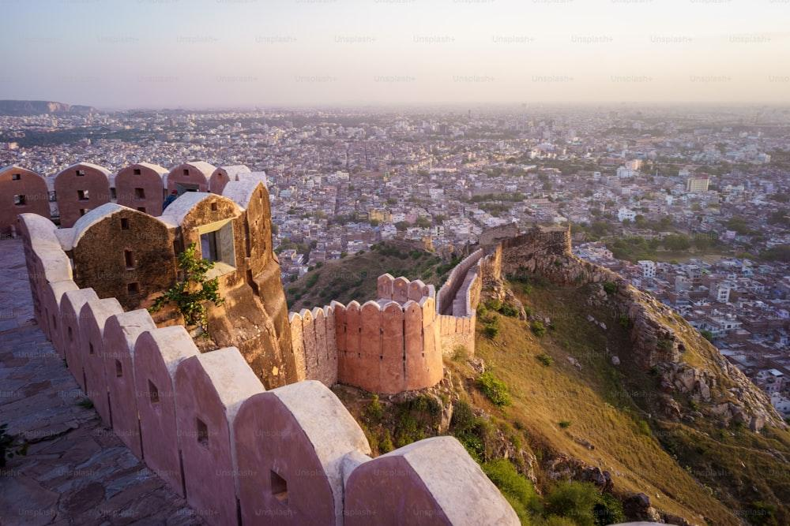
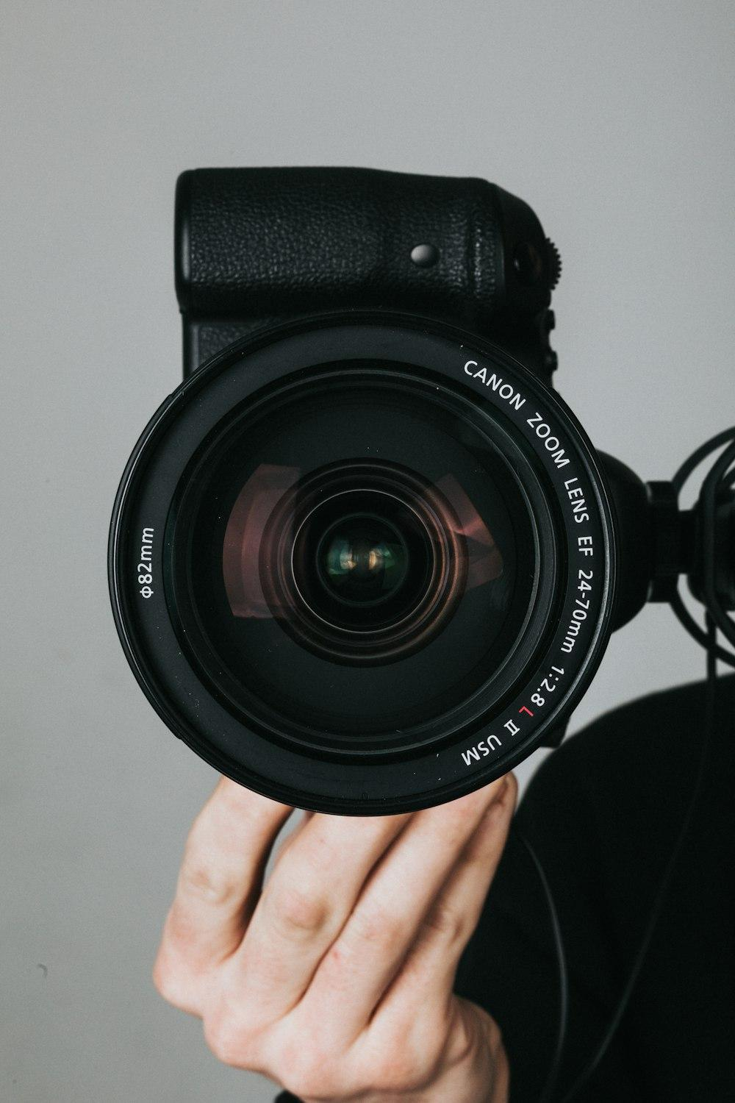


사진기로 사진찍고 인화하기

Slide 6
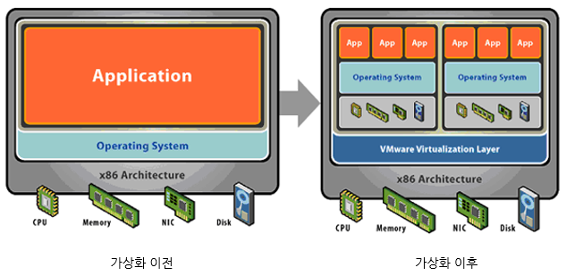
가상화(Virtualizaion)
가상화란 컴퓨터 자원을 가상 환경으로 분리하여 프로그램들이 상호 충돌없이 실행 가능하도록 하는 아키텍처 기술

Slide 7
가상화(Virtualizaion) 종류
1. OS 수준 가상화 - (docker)
하나의 OS 커널을 여러 개의 공간으로 격리하여 각각의 컨테이너가 마치 독립된 것처럼 사용하여 OS를 새로 설치하지 않고 host OS의 커널을 공유하게 되어 실행 속도가 빠르고 성능 상의 손실이 적다. 사용자에게는 가상머신처럼 보임
2. 머신 가상화 – (virtual machine, virtualbox, WSL)
다수의 OS를 동시에 실행하는 플랫폼으로 하이퍼바이저에 OS를 설치하여 운영하는 구조이며, 여러 가지 종류의 하이퍼바이저(Hypervisor)가 존재하게 되며 대표적으로 virtualbox, wsl 등이 있음
3. 개발 환경 가상화
venv 등 특정 폴더를 가상환경으로 만들어서 라이브러리나 소스코드를 관리하는 가상화 방식

Slide 8
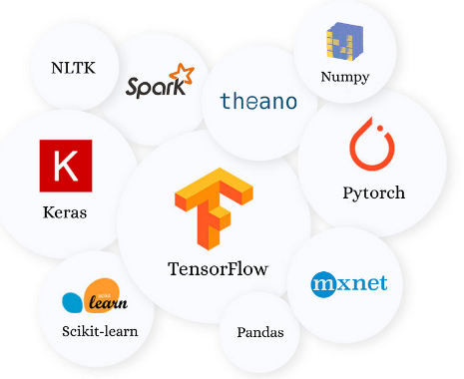
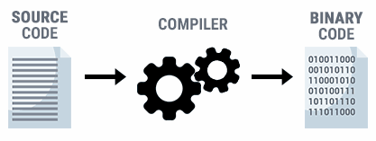

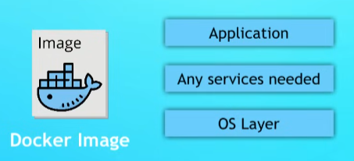
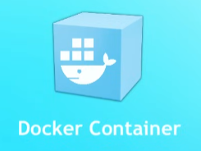
Docker Images vs Docker Containers
프로그램 컴파일 bin과 lib를 Database, OS를 Docker(사진기)로 찍어(Docker Image) 다른 사람에게 나누어 준다(Docker Container)

Slide 9
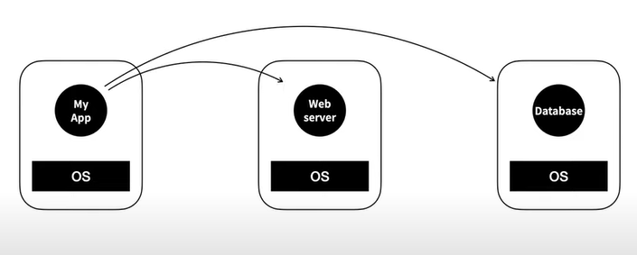
Traditional Installation before docker
Network:port
생활코딩_Docker

Slide 10
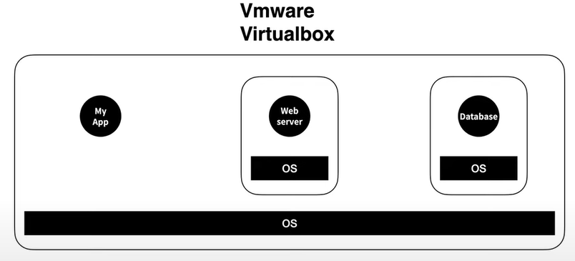
Virtual Machine (Linux)
생활코딩_Docker

Slide 11
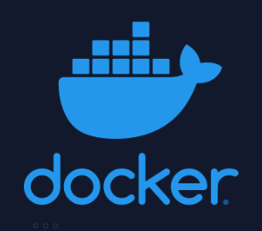
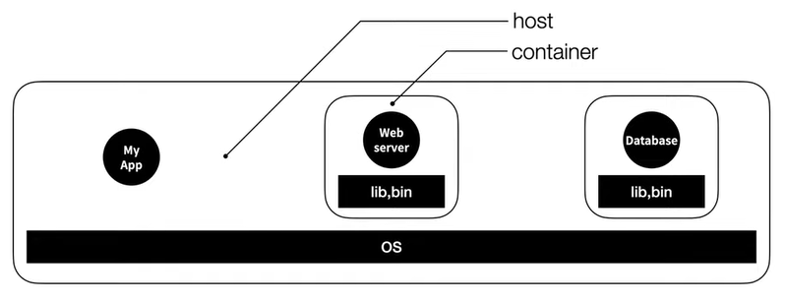
Docker
생활코딩_Docker

Slide 12
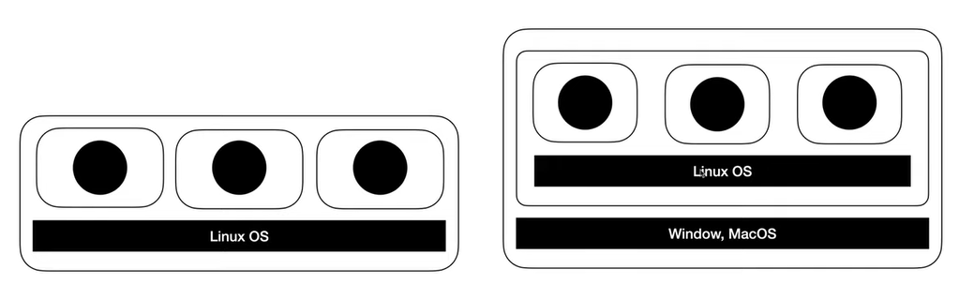
Docker 설치(WSL)

Slide 13
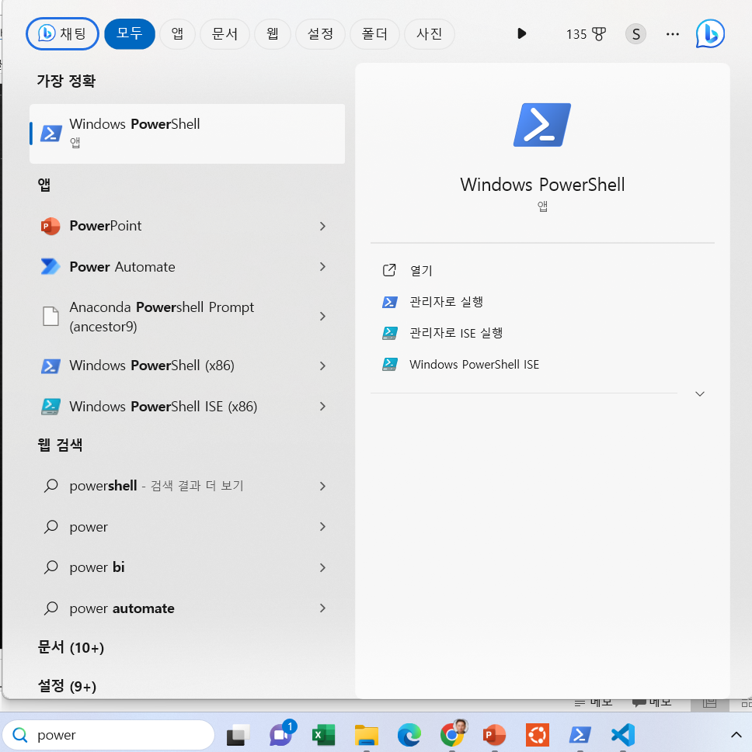
Windows PowerShell
PS C:\WINDOWS\system32> wsl --version
PS C:\WINDOWS\system32> wsl --list –online
NAME FRIENDLY NAME
Ubuntu Ubuntu
Debian Debian GNU/Linux
kali-linux Kali Linux Rolling
Ubuntu-18.04 Ubuntu 18.04 LTS
Ubuntu-20.04 Ubuntu 20.04 LTS
Ubuntu-22.04 Ubuntu 22.04 LTS
OracleLinux_7_9 Oracle Linux 7.9
OracleLinux_8_7 Oracle Linux 8.7
OracleLinux_9_1 Oracle Linux 9.1
openSUSE-Leap-15.5 openSUSE Leap 15.5
SUSE-Linux-Enterprise-Server-15-SP4 SUSE Linux Enterprise Server 15 SP4
SUSE-Linux-Enterprise-15-SP5 SUSE Linux Enterprise 15 SP5
openSUSE-Tumbleweed openSUSE Tumbleweed
PS C:\WINDOWS\system32> wsl --status

Slide 14
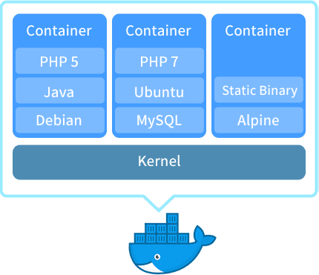
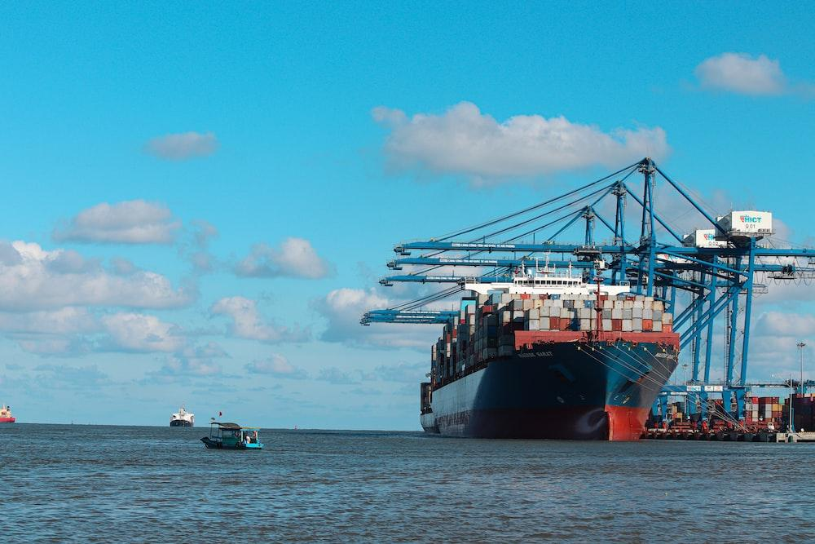
Docker
도커(Docker)는 컨테이너(Container)기반의 오픈소스 가상화 플랫폼
어떤 프로그램을 외부 환경과 격리시켜 구동할 수 있게 해주는 소프트웨어
https://www.asustor.com/ko/solution/what_is_docker

Slide 15
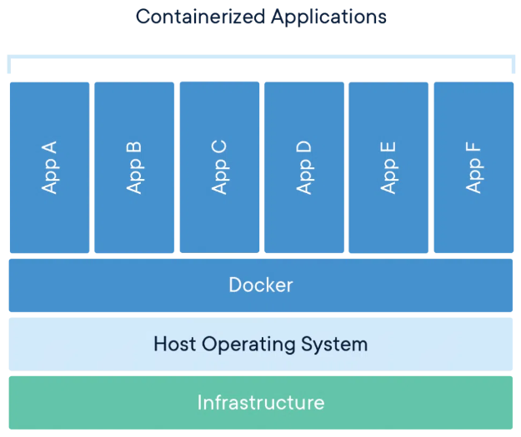
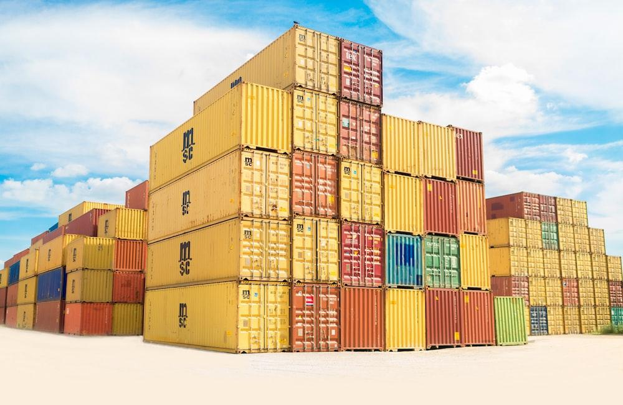
Container
컨테이너(Container)란 OS 사에 논리적인 영역을 구축하여 애플리케이션이 작동하는데 필요한 요소만을 모아(오버헤드가 없음) 별도의 서버처럼 격리되어 동작하는 것
https://www.docker.com/resources/what-container/

Slide 16

WSL2 Installation
PS C:\WINDOWS\system32> wsl --install
Ubuntu이(가) 이미 설치되어 있습니다.
Ubuntu을(를) 시작하는 중...
To run a command as administrator (user "root"), use "sudo <command>".
See "man sudo_root" for details.
ancestor9@DESKTOP-LMLFU0S:~$ ls
ancestor9@DESKTOP-LMLFU0S:~$ ls -al
total 28
drwxr-x--- 3 ancestor9 ancestor9 4096 Dec 20 00:06 .
drwxr-xr-x 3 root root 4096 Dec 19 23:02 ..
-rw------- 1 ancestor9 ancestor9 179 Dec 20 10:53 .bash_history
-rw-r--r-- 1 ancestor9 ancestor9 220 Dec 19 23:02 .bash_logout
-rw-r--r-- 1 ancestor9 ancestor9 3771 Dec 19 23:02 .bashrc
drwx------ 2 ancestor9 ancestor9 4096 Dec 19 23:02 .cache
-rw-r--r-- 1 ancestor9 ancestor9 0 Dec 20 10:42 .motd_shown
-rw-r--r-- 1 ancestor9 ancestor9 807 Dec 19 23:02 .profile
PS C:\WINDOWS\system32> wsl -l -v
NAME STATE VERSION
Ubuntu Running 2
Ubuntu
WSL2
Window 11 Home

Slide 17
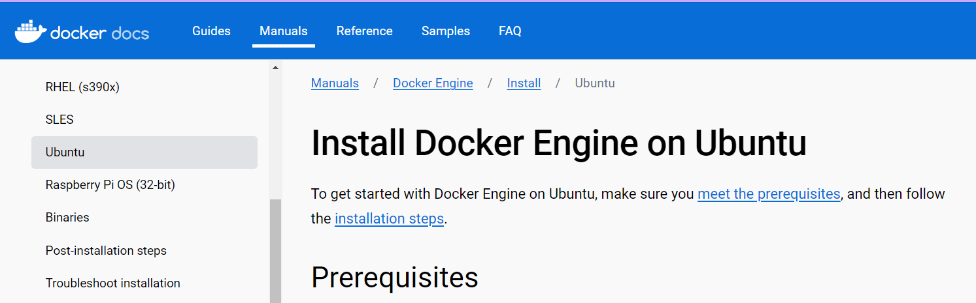
Docker Desktop on Ubuntu
With Docker Desktop running on WSL2, users can leverage Linux workspaces and avoid having to maintain both Linux and Windows build scripts
https://docs.docker.com/engine/install/ubuntu/
ancestor9@DESKTOP-LMLFU0S:~$ sudo service docker start # docker 시작하는 명령어

Slide 18
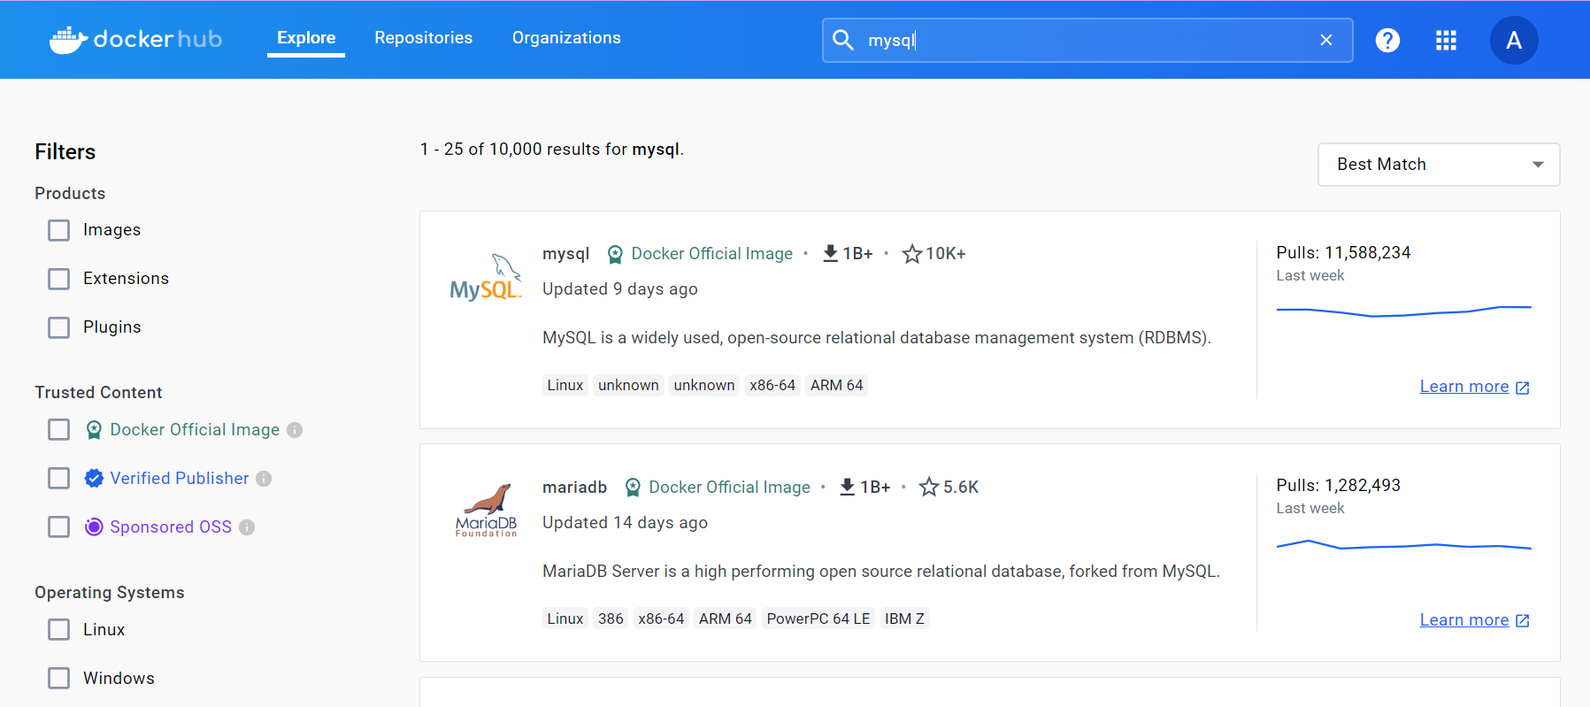
Docker hub 가입하기
도커 허브(https://hub.docker.com/ ) 가입하기
MySQL Image
MariaDB Image

Slide 19
Contents
Introduction of Docker
Understanding Docker
Docker 실습하기
Docker 용어 및 개념 분류
Docker Mechanism
Docker와 가상머신(VM)
2학기 개발환경 구성도

Slide 20
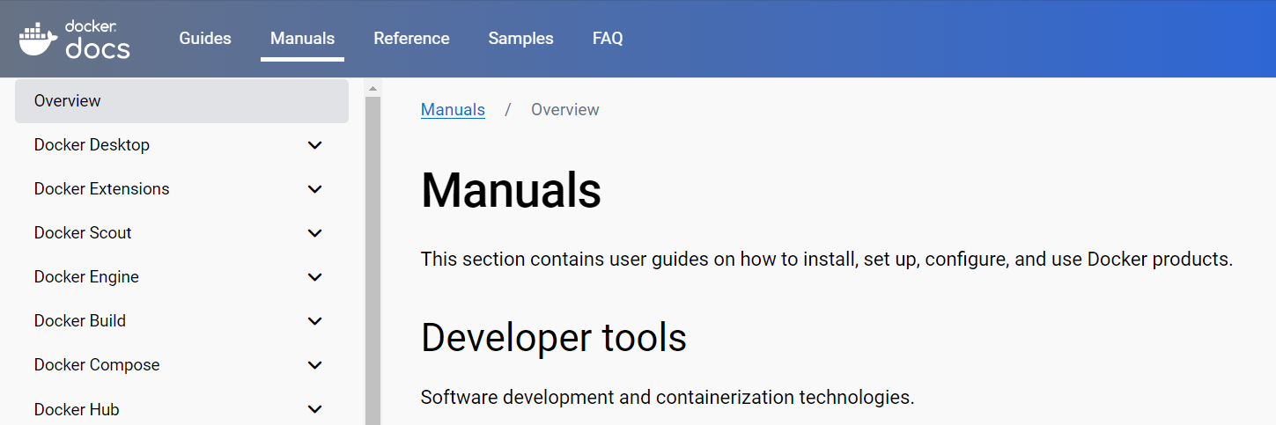
Docker Manual
Docker.documents manual https://docs.docker.com/manuals/

Slide 21
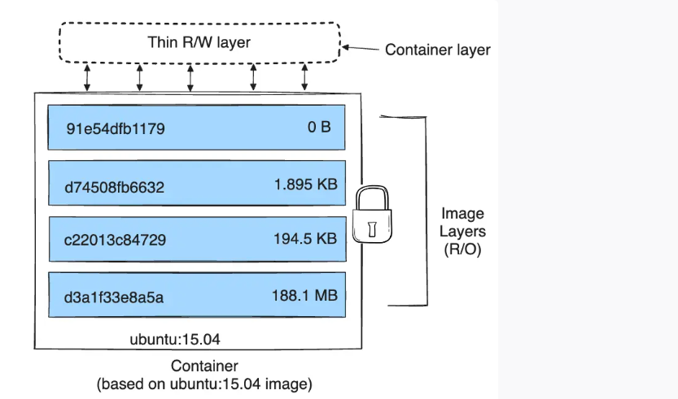
Docker container 구조
It's important to know how Docker builds and stores images(R/O), and how these images are used by containers(R/W).
Read/Write
Read Only
https://docs.docker.com/storage/storagedriver/

Slide 22
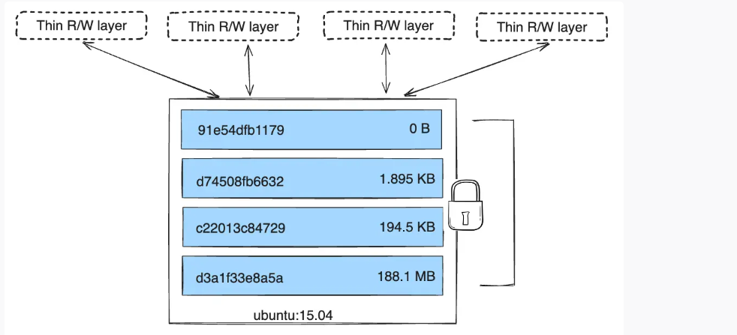
Docker container 구조
Because each container has its own writable container layer, and all changes are stored in this container layer, multiple containers can share access to the same underlying image and yet have their own data state.
https://docs.docker.com/storage/storagedriver/

Slide 23
Contents
Introduction of Docker
Understanding Docker
Docker 실습하기
Docker 용어 및 개념 분류
Docker Mechanism
Docker와 가상머신(VM)
2학기 개발환경 구성도

Slide 24

실습하기
Beginner’s guide to use docker (Build, Run, Push and Pull)
docker run / build

Slide 25
Basic docker commands
ancestor9@DESKTOP-LMLFU0S:~$ sudo docker ps
ancestor9@DESKTOP-LMLFU0S:~$ sudo docker stop $(sudo docker ps -aq)
[sudo] password for ancestor9:
5f294e77eb90
197f4e8eeac4
ancestor9@DESKTOP-LMLFU0S:~$ sudo docker ps
CONTAINER ID IMAGE COMMAND CREATED STATUS PORTS NAMES
ancestor9@DESKTOP-LMLFU0S:~$ docker version
ancestor9@DESKTOP-LMLFU0S:~$ sudo docker run hello-world
ancestor9@DESKTOP-LMLFU0S:~$ docker ps –a
CONTAINER ID IMAGE COMMAND CREATED STATUS PORTS NAMES
915c52a43a32 hello-world "/hello" About a minute ago Exited (0) About a minute ago sad_galois
Docker 컨테이너를 모두 중지

Slide 26
Basic docker commands
ancestor9@DESKTOP-LMLFU0S:~$ docker run docker/whalesay cowsay Hello there!
Unable to find image 'docker/whalesay:latest' locally
latest: Pulling from docker/whalesay
< Hello there! >
## .
## ## ## ==
## ## ## ## ===
/""""""""""""""""___/ ===
~~~ {~~ ~~~~ ~~~ ~~~~ ~~ ~ / ===- ~~~
\______ o __/
\ \ __/
\____\______/
ancestor9@DESKTOP-LMLFU0S:~$ docker images
REPOSITORY TAG IMAGE ID CREATED SIZE
hello-world latest d2c94e258dcb 8 months ago 13.3kB
docker/whalesay latest 6b362a9f73eb 8 years ago 247MB
docker run --rm chuanwen/cowsay
The first time you run a software image, the docker command looks for it on your local system. If the image isn’t there, then docker gets it from the hub.
When you run an image in a container, Docker downloads the image to your computer. This local copy of the image saves you time. Docker only downloads the image again if the image’s source changes on the hub

Slide 27
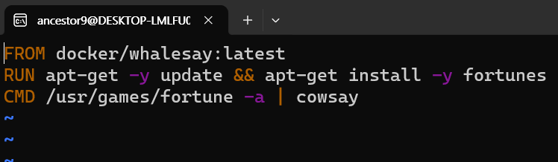

Docker FIle
ancestor9@DESKTOP-LMLFU0S:~$ mkdir mydockerbuild
ancestor9@DESKTOP-LMLFU0S:~$ cd mydockerbuild
ancestor9@DESKTOP-LMLFU0S:~/mydockerbuild$ vi Dockerfile
ancestor9@DESKTOP-LMLFU0S:~/mydockerbuild$ docker build -t docker-whale .
[+] Building 22.5s (6/6) FINISHED docker:default
=> [internal] load .dockerignore 0.1s
=> => transferring context: 2B 0.0s
=> [internal] load build definition from Dockerfile 0.1s
=> => transferring dockerfile: 153B 0.0s
=> [internal] load metadata for docker.io/docker/whalesay:latest 0.0s
=> [1/2] FROM docker.io/docker/whalesay:latest 0.1s
Esc 키를 눌러 일반 모드로 전환하고 :wq를 입력한 다음 Enter
If you see ‘no permission’ error, try to prefix above command with ‘sudo’ as shown in above snapshot.

Slide 28
Docker FIle
ancestor9@DESKTOP-LMLFU0S:~/mydockerbuild$ docker images
REPOSITORY TAG IMAGE ID CREATED SIZE
docker-whale latest b2c4b9c8f746 4 minutes ago 278MB
hello-world latest d2c94e258dcb 8 months ago 13.3kB
docker/whalesay latest 6b362a9f73eb 8 years ago 247MB
ancestor9@DESKTOP-LMLFU0S:~/mydockerbuild$ docker run docker-whale
____________________________________
/ <-- Overfiend has quit ("venturing \
| forth to destroy strange new |
| |
| worlds, and eat life and new |
\ civilizations") /
------------------------------------
\
\
\
## .
## ## ## ==
## ## ## ## ===
/""""""""""""""""___/ ===
~~~ {~~ ~~~~ ~~~ ~~~~ ~~ ~ / ===- ~~~
\______ o __/
\ \ __/
\____\______/

Slide 29
실습하기
Image pull & run

Slide 30


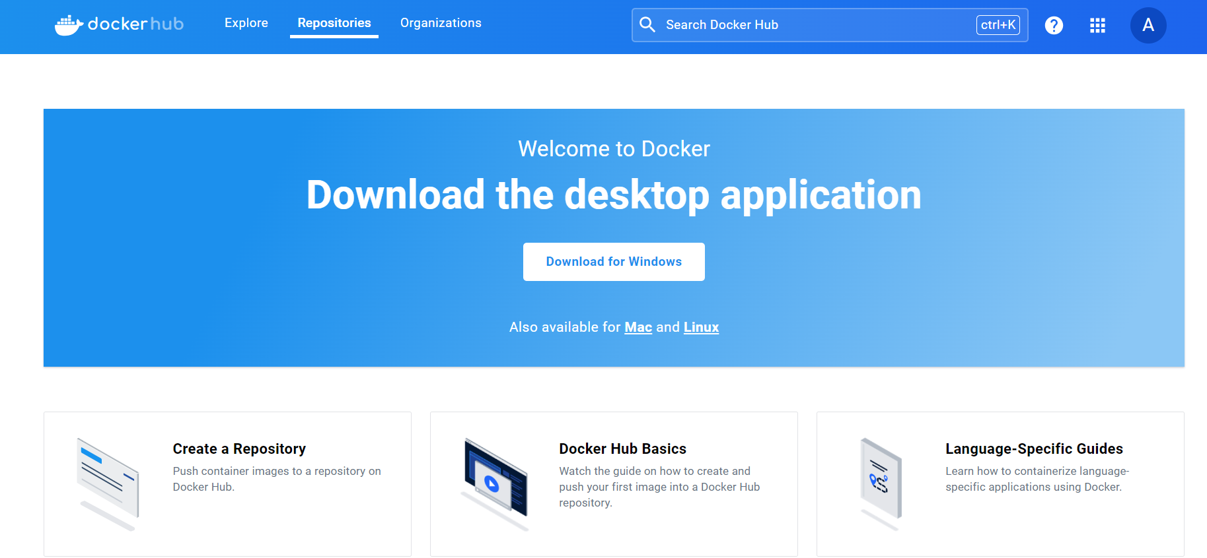
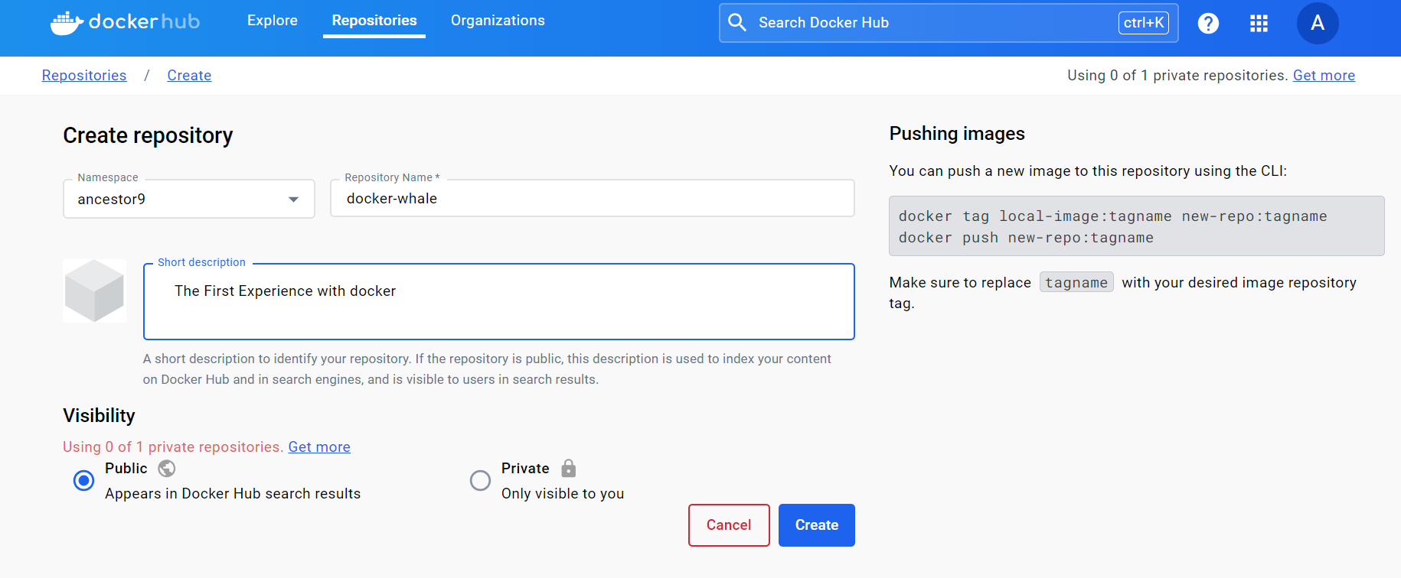
Docker Hub - Github
Docker Hub에 my repository를 Create

Slide 31
‘tag’ and ‘push’ image to your docker hub account.
ancestor9@DESKTOP-LMLFU0S:~/mydockerbuild$ docker images
REPOSITORY TAG IMAGE ID CREATED SIZE
docker-whale latest b2c4b9c8f746 4 minutes ago 278MB
hello-world latest d2c94e258dcb 8 months ago 13.3kB
docker/whalesay latest 6b362a9f73eb 8 years ago 247MB
ancestor9@DESKTOP-LMLFU0S:~/mydockerbuild$ docker tag b2c4b9c8f746 ancestor9/docker-whale:lates
ancestor9@DESKTOP-LMLFU0S:~/mydockerbuild$ docker push ancestor9/docker-whale
The push refers to repository [docker.io/ancestor9/docker-whale]
tag does not exist: ancestor9/docker-whale:latest
#docker tag <image-id of docker-whale> <your dockerhub username>/docker-whale:latest

Slide 32
‘tag’ and ‘push’ image to your docker hub account.
ancestor9@DESKTOP-LMLFU0S:~/mydockerbuild$ docker login
Log in with your Docker ID or email address to push and pull images from Docker Hub. If you don't have a Docker ID, head over to https://hub.docker.com/ to create one.
You can log in with your password or a Personal Access Token (PAT). Using a limited-scope PAT grants better security and is required for organizations using SSO. Learn more at https://docs.docker.com/go/access-tokens/
Username: ancestor9
Password:
WARNING! Your password will be stored unencrypted in /home/ancestor9/.docker/config.json.
Configure a credential helper to remove this warning. See
https://docs.docker.com/engine/reference/commandline/login/#credentials-store
Login Succeeded
ancestor9@DESKTOP-LMLFU0S:~/mydockerbuild$ docker push ancestor9/docker-whale
Using default tag: latest
The push refers to repository [docker.io/ancestor9/docker-whale]
33544e2ded03: Pushed
5f70bf18a086: Mounted from docker/whalesay
d061ee1340ec: Mounted from docker/whalesay
d511ed9e12e1: Mounted from docker/whalesay
091abc5148e4: Mounted from docker/whalesay
b26122d57afa: Mounted from docker/whalesay
37ee47034d9b: Mounted from docker/whalesay
528c8710fd95: Mounted from docker/whalesay
1154ba695078: Mounted from docker/whalesay
latest: digest: sha256:cd3ef3c2e313b1b49844fc09ded897458145d1e00d73f4f3aee7db587903b4c3 size: 2614

Slide 33
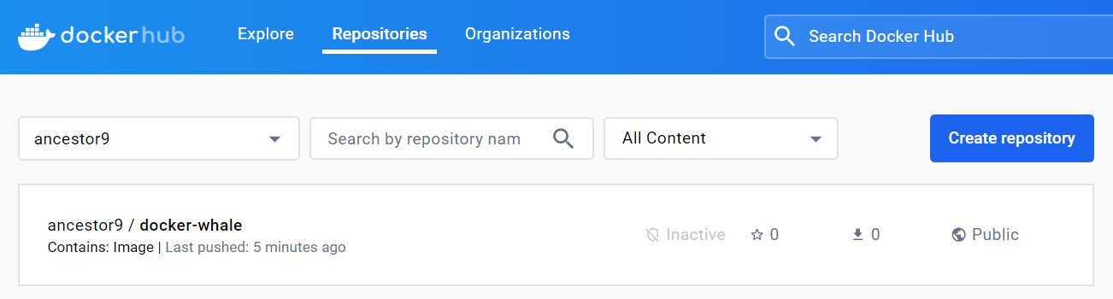
‘tag’ and ‘push’ image to your docker hub account.
ancestor9@DESKTOP-LMLFU0S:~/mydockerbuild$ docker images
REPOSITORY TAG IMAGE ID CREATED SIZE
ancestor9/docker-whale lates b2c4b9c8f746 45 minutes ago 278MB
docker-whale latest b2c4b9c8f746 45 minutes ago 278MB
hello-world latest d2c94e258dcb 8 months ago 13.3kB
docker/whalesay latest 6b362a9f73eb 8 years ago 247MB
ancestor9@DESKTOP-LMLFU0S:~/mydockerbuild$ docker rmi -f b2c4b9c8f746
Untagged: ancestor9/docker-whale:lates
Untagged: docker-whale:latest
Deleted: sha256:b2c4b9c8f74607e6de72765229717bd132d1fe8c2338fd0498d90890ca103625
ancestor9@DESKTOP-LMLFU0S:~/mydockerbuild$ docker images
REPOSITORY TAG IMAGE ID CREATED SIZE
hello-world latest d2c94e258dcb 8 months ago 13.3kB
docker/whalesay latest 6b362a9f73eb 8 years ago 247MB

Slide 34


Docker hub
app store
docker hub
Pull
program
image
Run
process
container

Slide 35
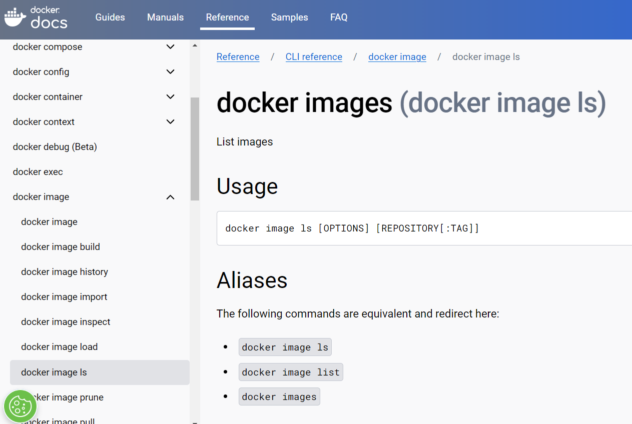
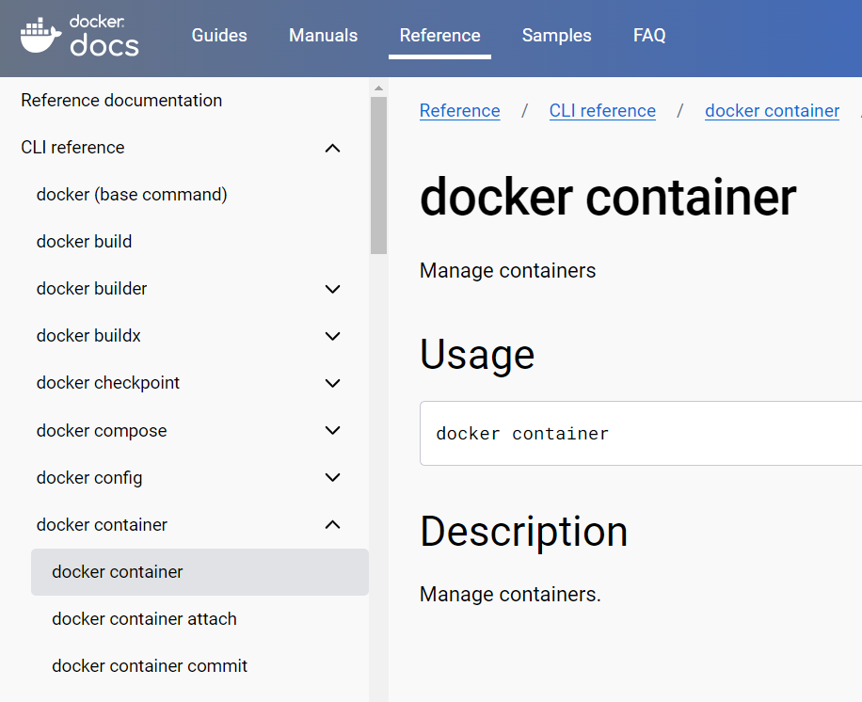
Docker hub
docker hub
docker pull
Pull
image
docler run
Run
container
https://docs.docker.com/engine/reference/commandline/image_ls/

Slide 36
pull from my repository and run
ancestor9@DESKTOP-LMLFU0S:~/mydockerbuild$ docker run ancestor9/docker-whale:latest
Unable to find image 'ancestor9/docker-whale:latest' locally
latest: Pulling from ancestor9/docker-whale
e190868d63f8: Already exists
b8ee27aeda96: Already exists
Digest: sha256:cd3ef3c2e313b1b49844fc09ded897458145d1e00d73f4f3aee7db587903b4c3
Status: Downloaded newer image for ancestor9/docker-whale:latest
_________________________________________
/ Payeen to a Twang Derrida Ore-Ida \
| potato. |
| |
| If you dared, I'd ask you to go dig up |
| your ides under brown- tubered skies. |
| |
\ where pitchforked you will ask Derrida? /
-----------------------------------------
\
\
\
## .
## ## ## ==
## ## ## ## ===
/""""""""""""""""___/ ===
~~~ {~~ ~~~~ ~~~ ~~~~ ~~ ~ / ===- ~~~
\______ o __/
\ \ __/
\____\______/
When you use ‘docker run’ it automatically downloads (pulls) images that don’t yet exist locally, creates a container, and starts it. Use the following command to pull and run the ‘docker-whale’ image, substituting your Docker Hub username.

Slide 37
Contents
Introduction of Docker
Understanding Docker
Docker 실습하기
Docker 용어 및 개념 분류
Docker Mechanism
Docker와 가상머신(VM)
2학기 개발환경 구성도

Slide 38
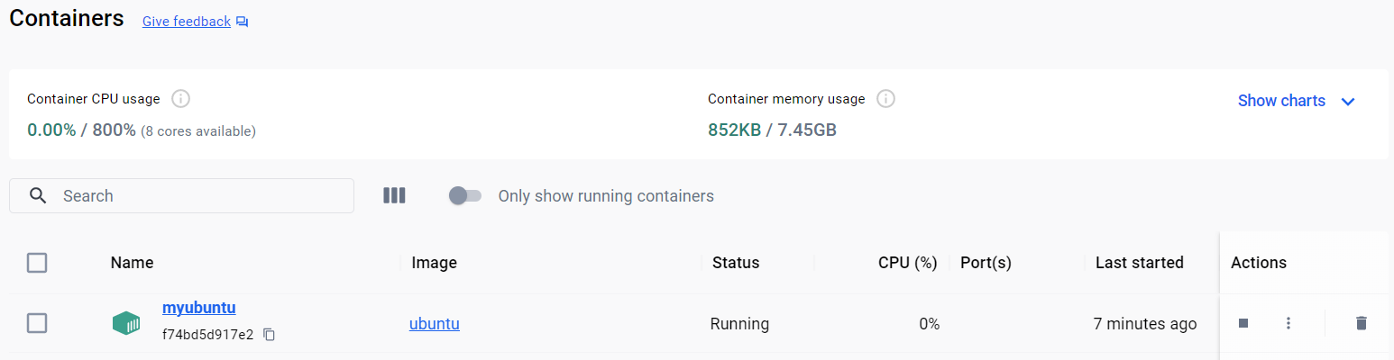


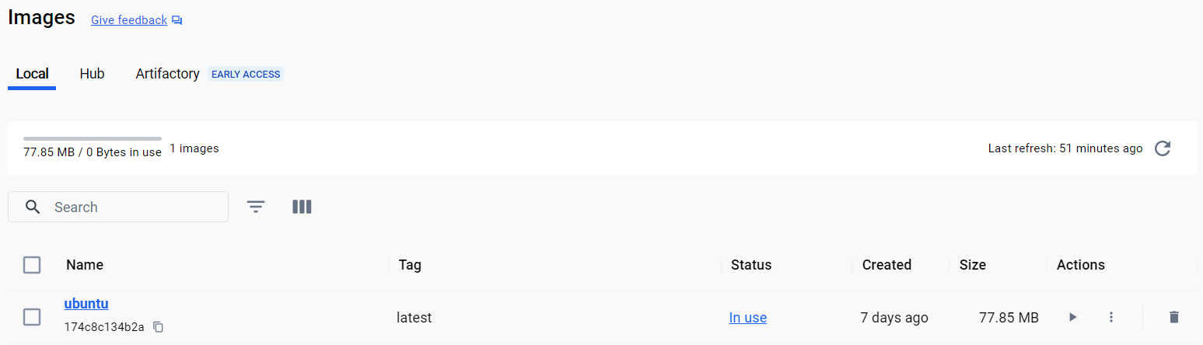

Ubuntu-Window docker
PS C:\demo> docker ps -a
CONTAINER ID IMAGE COMMAND CREATED STATUS PORTS NAMES
f74bd5d917e2 ubuntu "/bin/bash" About a minute ago Up 8 seconds myubuntu
f74bd5d917e2969f56d21f53bfc47615b31b91c2c02a63892f586bc35c577251

Slide 39
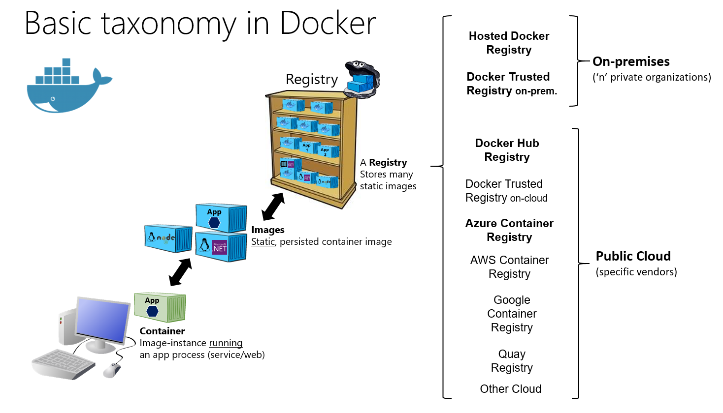
Docker 용어 및 개념분류
https://learn.microsoft.com/ko-kr/dotnet/architecture/microservices/container-docker-introduction/docker-containers-images-registries

Slide 40
Contents
Introduction of Docker
Understanding Docker
Docker 실습하기
Docker 용어 및 개념 분류
Docker Mechanism
Docker와 가상머신(VM)
2학기 개발환경 구성도

Slide 41




Computer Mechanism
Process
User
Socket(File)
TCP
S/W
Kernel
IP
Driver
H/W
NIC
(Network Interface Card)

Slide 42



Process 식별자는 Port 번호
Process
Port
Socket(File)
Port 111
Port 112
Port 113
TCP
Port Forwarding
Router
IP
Driver
NIC
(Network Interface Card)
Data

Slide 43


Digress : network data의 단위(stream)
Process
File I/O, Write
Stream
Port
Socket(File)
TCP
Segment
Router
IP
Packet
Driver
NIC
(Network Interface Card)
Frame
Data

Slide 44
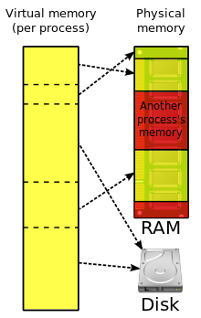

가상 메모리(Virtual Memory)
Process
Socket(File)
Multi-Tasking
TCP
IP
Driver
CPU(Core)
NIC
(Network Interface Card)
HDD
Memory

Slide 45

vmware(가상머신, 가상화 SW)
Process
Process
Process
3
5
1
Socket(File)
Socket(File)
S/W
Socket(File)
TCP
TCP
4
6
TCP
IP
IP
Driver
Driver
2
IP
NIC
(Network Interface Card)
NIC
(Network Interface Card)
Driver
Router~~
Vmnet 0
Vmnet 1
Vmnet 2
H/W
NIC
(Network Interface Card)

Slide 46
vmware(가상머신, 가상화 SW)
Application
bin/lib
Application
bin/lib
Process
Process
Process
Socket(File)
Socket(File)
S/W
Socket(File)
Docker Engine
TCP
IP
Driver
H/W
NIC
(Network Interface Card)

Slide 47
Contents
Introduction of Docker
Understanding Docker
Docker 실습하기
Docker 용어 및 개념 분류
Docker Mechanism
Docker와 가상머신(VM)
2학기 개발환경 구성도

Slide 48
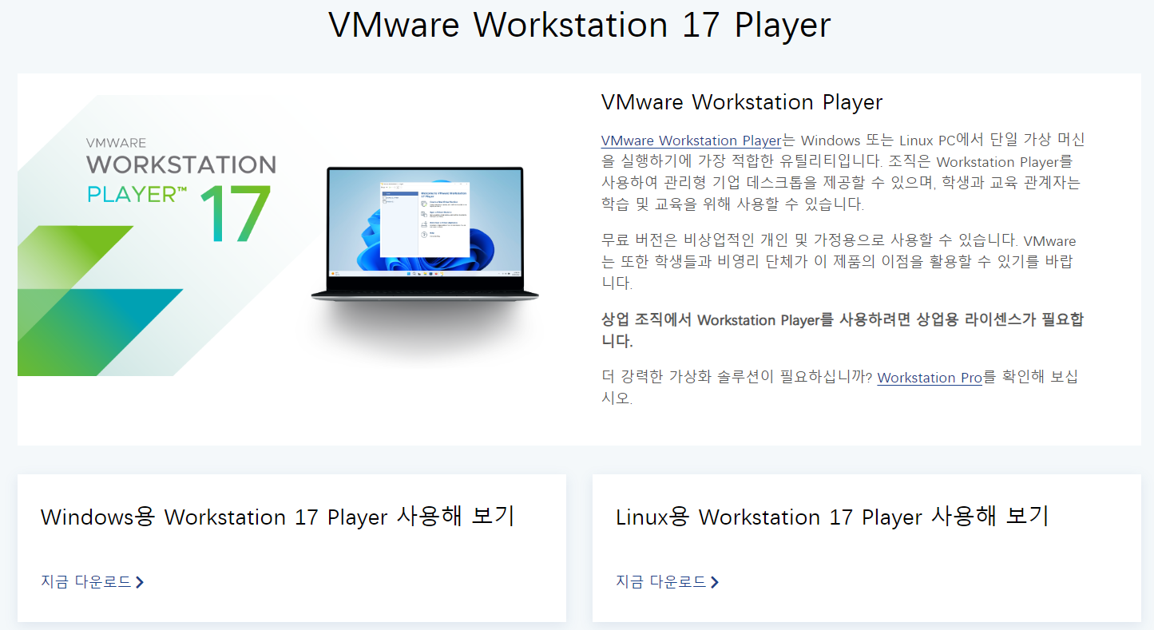
VM-Installation
https://www.vmware.com/kr/products/workstation-player/workstation-player-evaluation.html

Slide 49


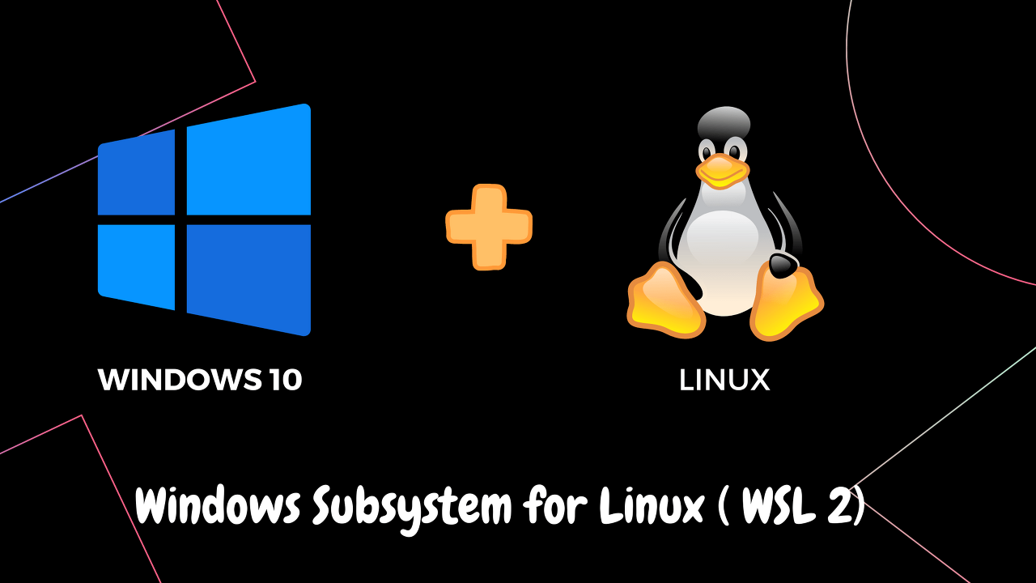
vmware(가상머신, 가상화 SW)
Ubuntu Docker Engine
S/W
TCP
IP
Driver
H/W
NIC
(Network Interface Card)

Slide 50
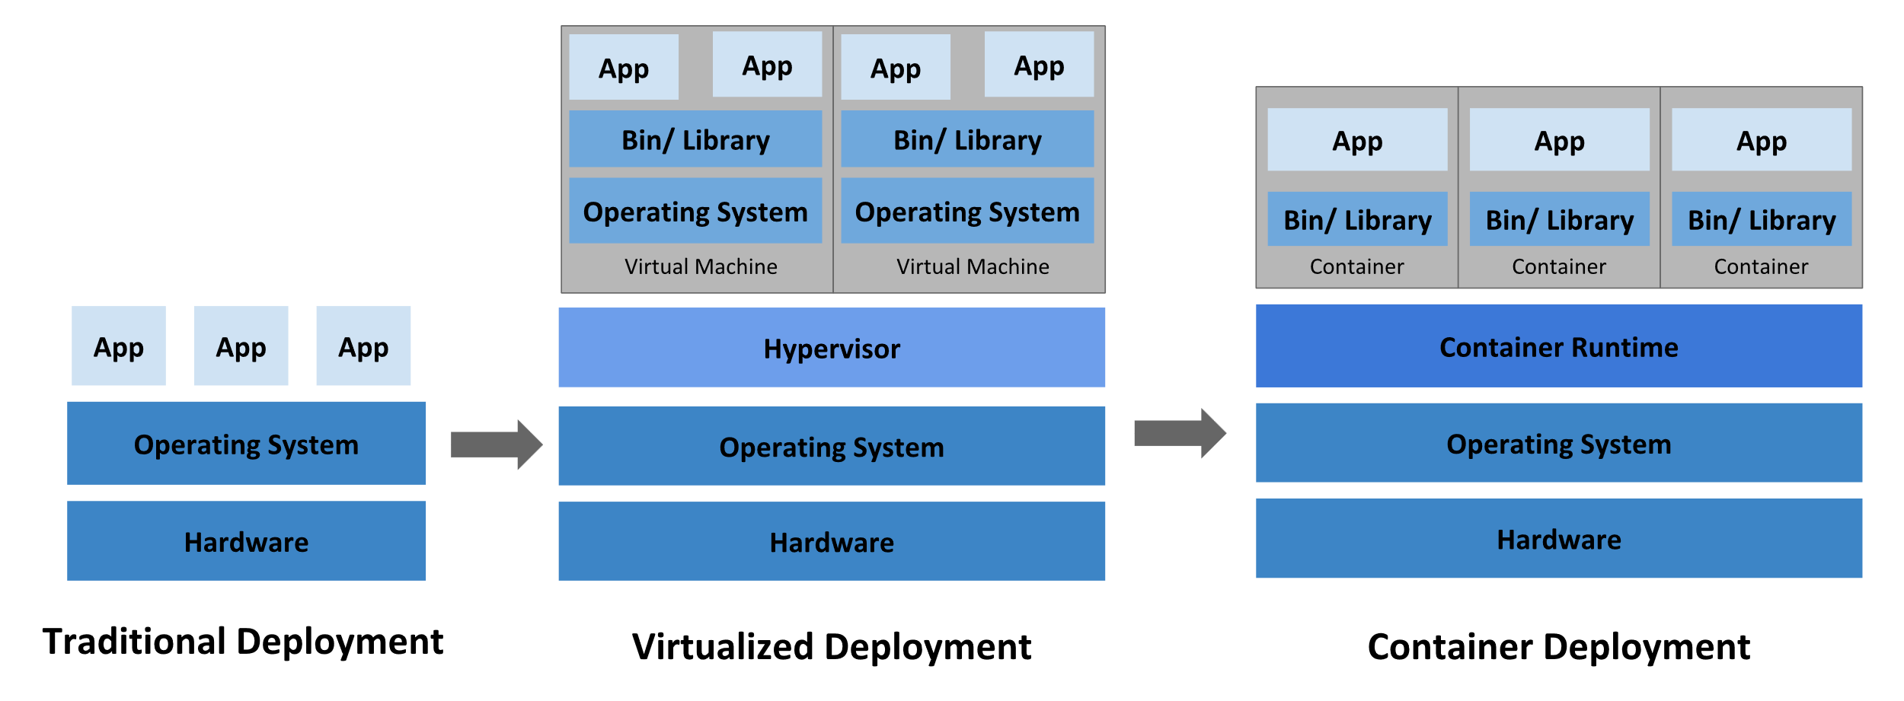
Container Evolution
쿠버네티스와 컨테이너, 도커에 대한 기본개념 (https://www.samsungsds.com/kr/insights/220222_kubernetes1.html )
https://kubernetes.io/docs/concepts/overview/

Slide 51
Contents
Introduction of Docker
Understanding Docker
Docker 실습하기
Docker 용어 및 개념 분류
Docker Mechanism
Docker와 가상머신(VM)
2학기 개발환경 구성도

Slide 52



개발 환경 구성도
원격영역(클라우드)
로컬영역(내 컴퓨터)
VS code
Python
Virtual Environment(venv)
WSL
Docker
Ubuntu
Apache Airflow
Bash Shell Script
*.py
*.py
*.sh

Slide 53
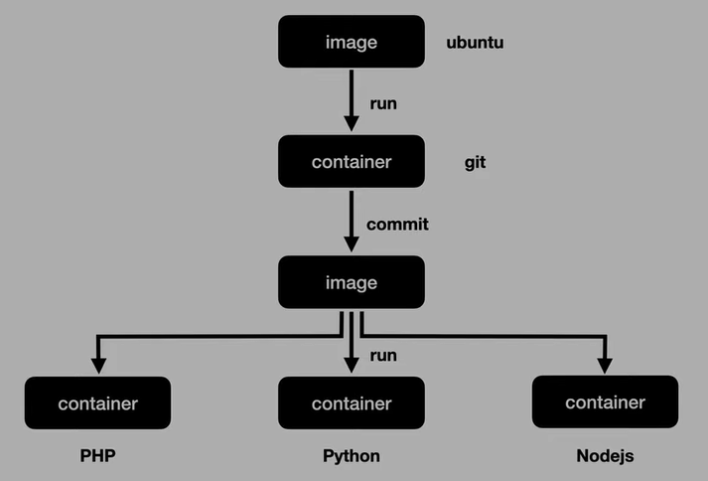
Quiz
당신은 Ubuntu Image를 pull하여 사용하다가 A, B, C프로젝트에서는 각각 Ubuntu환경에 PHP, Python, Nodejs 개발이 각각 필요한 경우? 어떻게 각 프로젝트의 개발팀과 코드를 공유 할 것인가?

Slide 54
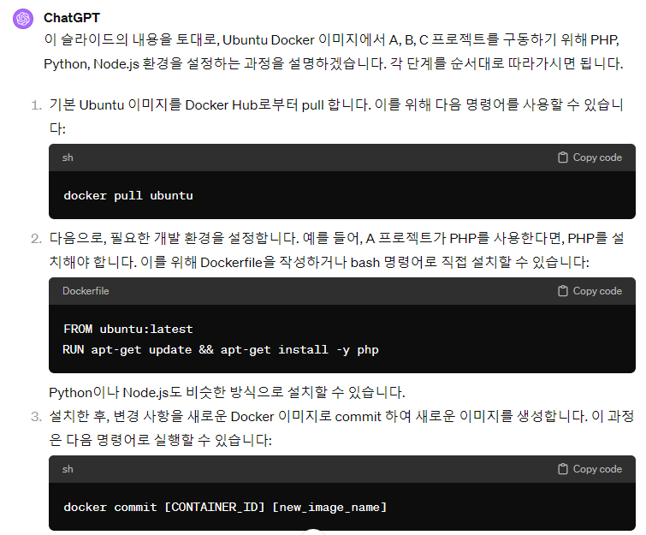
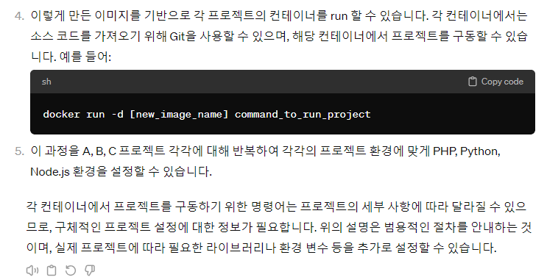
Answer

Slide 55
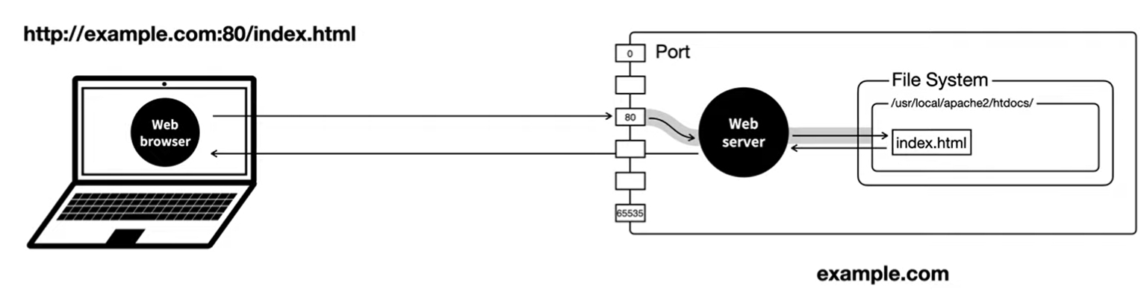
Network
HOST : Client
SERVER : Server

Slide 56
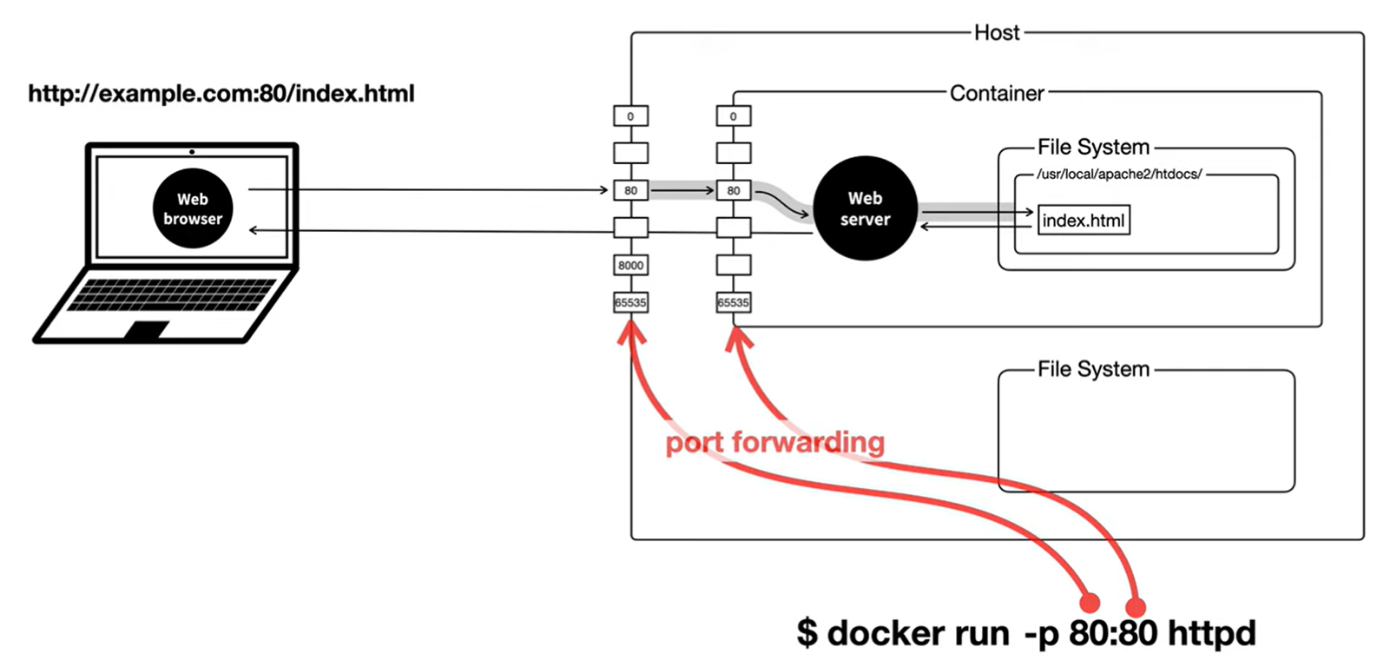
Network
My Local Computer

Slide 57
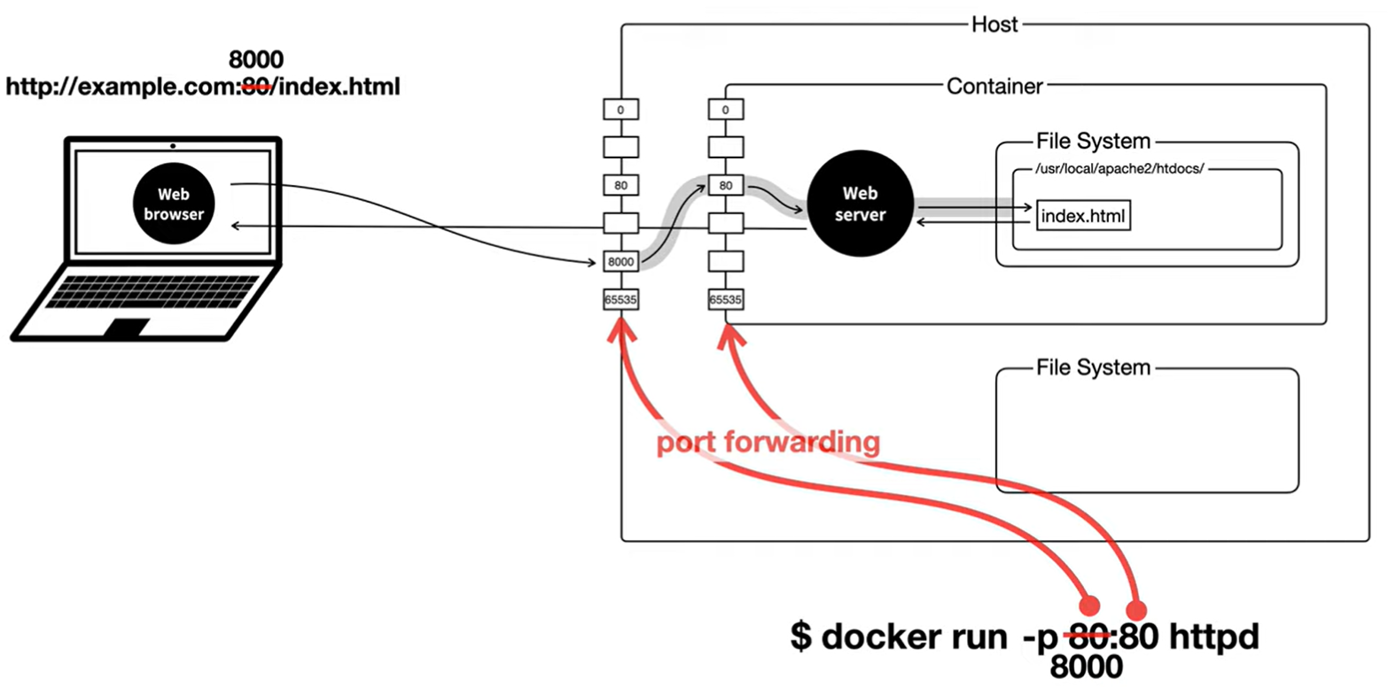
Network
My Local Computer

Slide 58
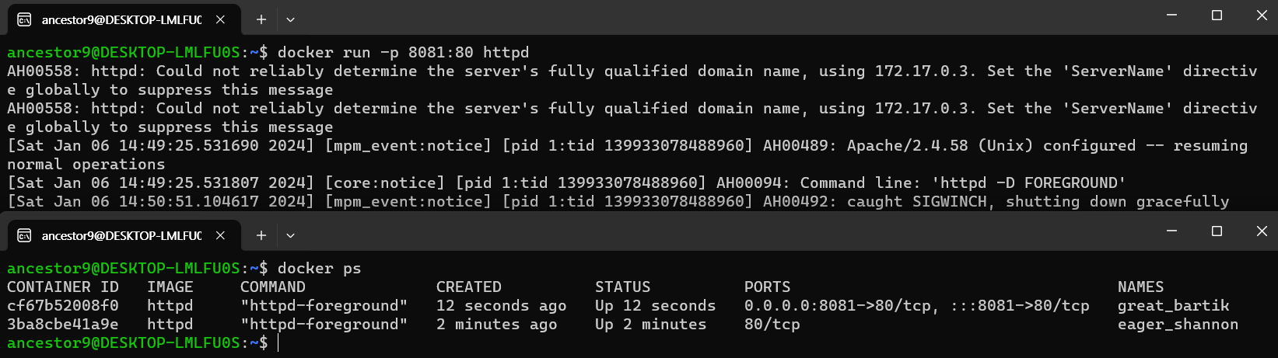
Docker 환경

Slide 59
실습하기
MySQL docker with DBeaver

Slide 60


MySQL 도커 컨테이너 설치 후 DBeaver 연결하기
Local Host
DBeaver (https://dbeaver.io/download/ )
Docker
MySQL (https://hub.docker.com/_/mysql )
Image pull
Run ~~ -p 3307:3306 mysql
Connect MySQL via DBeaver
CRUD

Slide 61
MySQL 도커 컨테이너 설치(Run)
>> docker pull mysql
>> docker ps
>> docker images
>> docker run --name test_mysql -e MYSQL_ROOT_PASSWORD=1111 -d -p 3307:3306 mysql
>> docker ps
CONTAINER ID IMAGE COMMAND CREATED STATUS PORTS NAMES
7ca8d808ff22 mysql "docker-entrypoint.s…" About a minute ago Up About a minute 33060/tcp, 0.0.0.0:3307->3306/tcp, :::3307->3306/tcp test_mysql

Slide 62
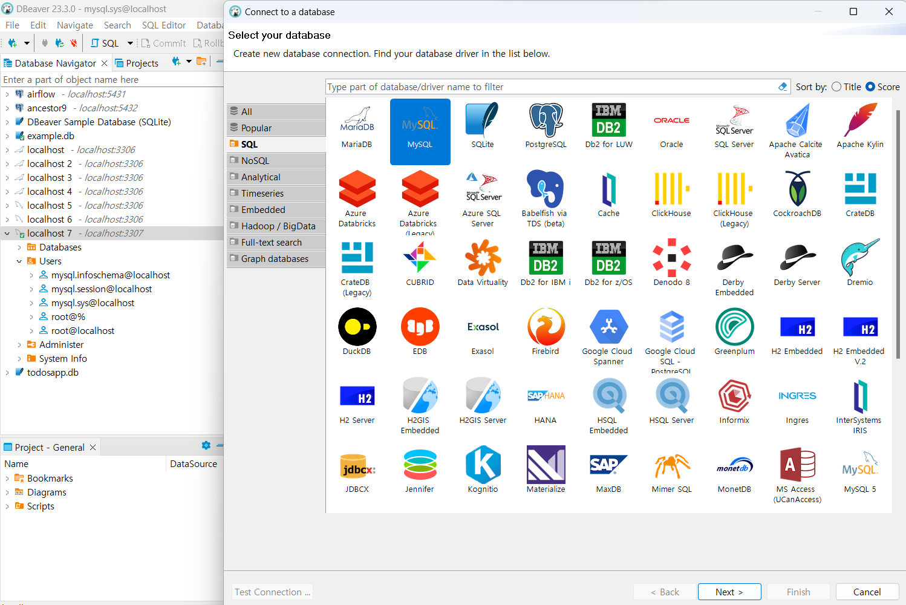
DBeaver로 MYSQL 연결하기
컨테이너 내부의 MySQL 서버에 할당된 3306번 포트를 컨테이너 외부(로컬 호스트)의 3307번 포트에 포트 포워딩 했으므로 로컬 호스트의 3307번 포트를 호스트 주소로 설정
참고자료_media.com

Slide 63
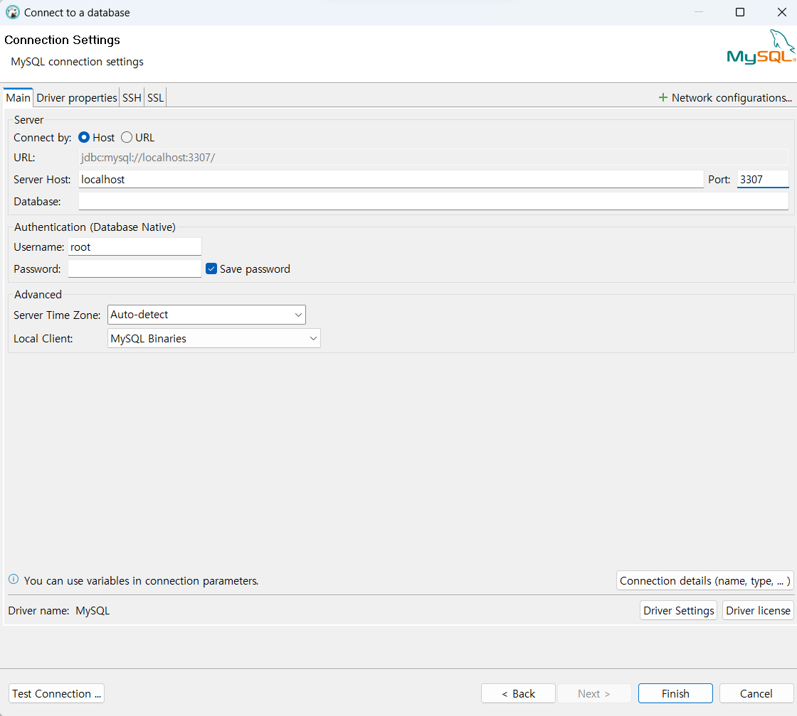
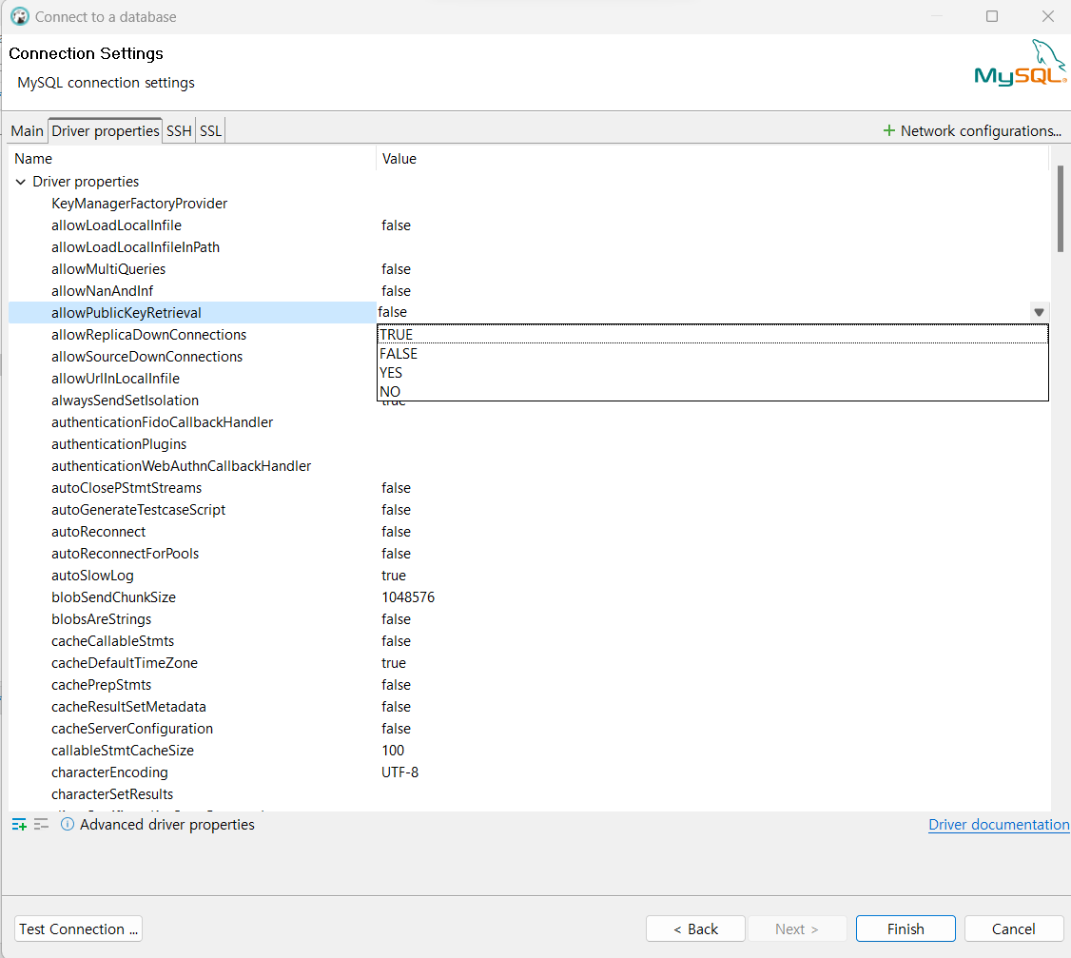
DBeaver로 MYSQL 연결하기
컨테이너 내부의 MySQL 서버에 할당된 3306번 포트를 컨테이너 외부(로컬 호스트)의 3307번 포트에 포트 포워딩 했으므로 로컬 호스트의 3307번 포트를 호스트 주소로 설정
MySQL 8.0 이상에서의 보안 설정값의 문제로 연결 구성 화면의 Driver properties 설정 창에서 allowPublicKeyRetrieval 값을 true 로 설정

Slide 64
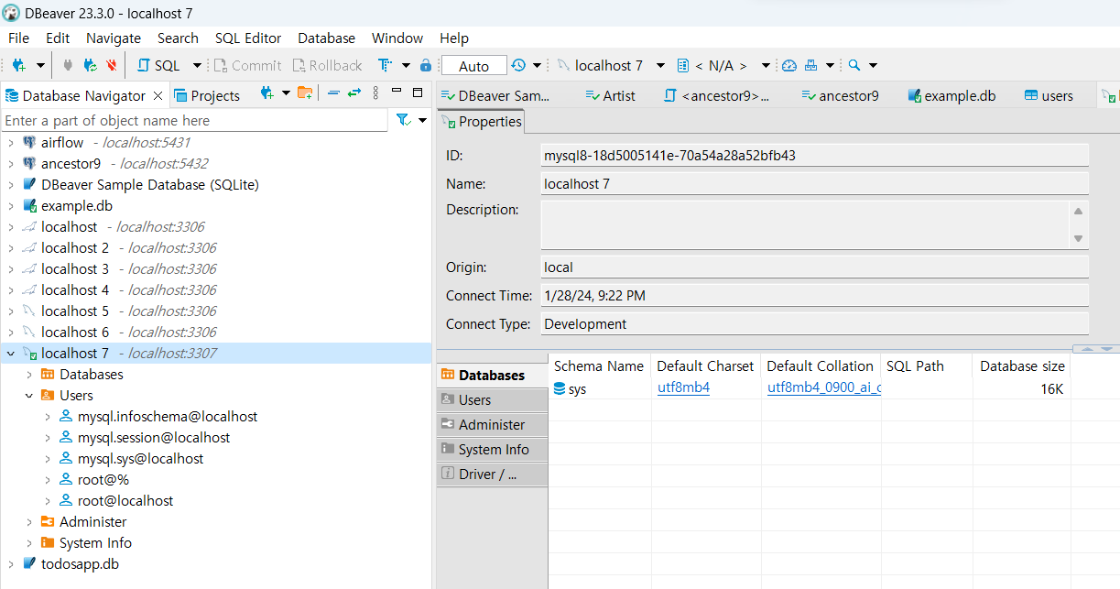
DBeaver로 MYSQL 연결하기
내부 데이터 Schema 확인

Slide 65
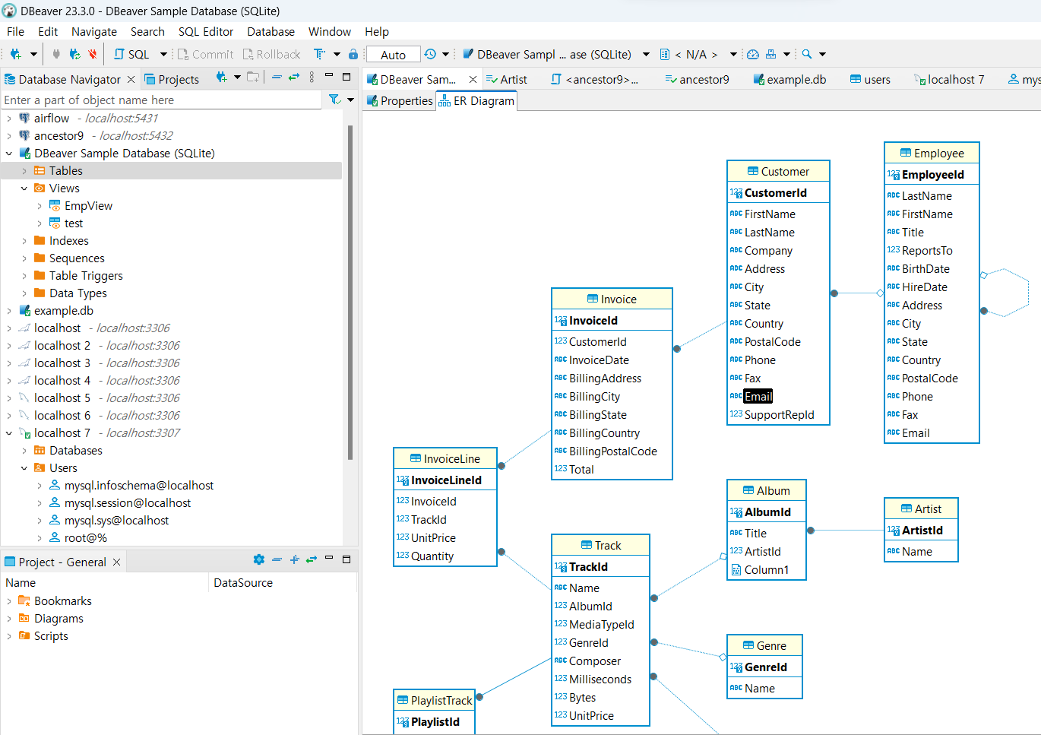
Digress: DBeaver로 ERD

Slide 66
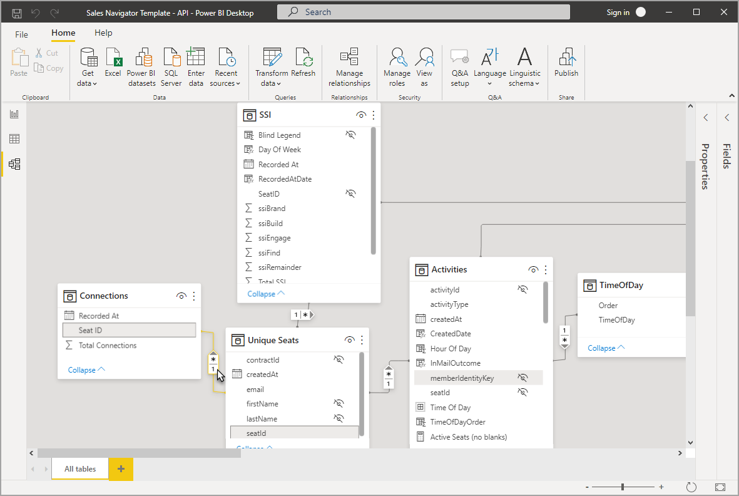
Digress: Power BI
https://learn.microsoft.com/ko-kr/power-bi/transform-model/desktop-relationship-view

Slide 67
실습하기
mlflow

Slide 68
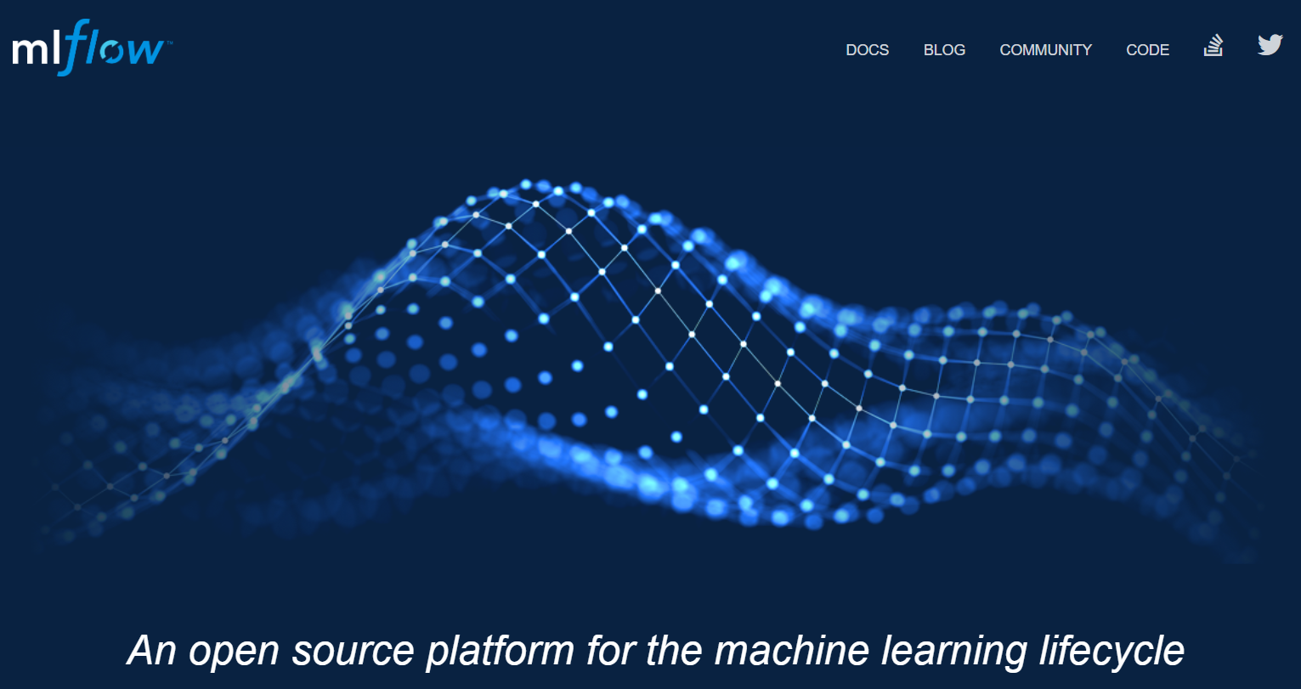
mlflow
머신 러닝(Machine learning) 모델의 실험을 tracking하고 model을 공유 및 deploy 할 수 있도록 지원하는 오픈 소스 라이브러리 (Open source Library)
https://mlflow.org/

Slide 69
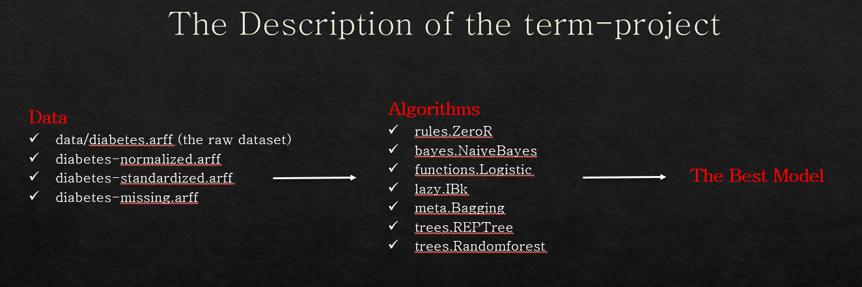
실험(Experiment)
실험(Experement)이란 데이터전처리 – 모델의 파라미터 – 성능지표 등의 다양한 경우를 Try하여 모델 평가 및 선택하기 위한 과정
2023/2 – 데이터활용능력(WEKA)의 기말과제

Slide 70


실험(Experiment) – Tunning
K-Nearest Neighbors Demo
sklearn.neighbors.KNeighborsClassifier

Slide 71

mlflow docker
MLflow를 포함하는 Docker 이미지를 빌드하고 실행하면 MLflow 서버를 실행하고 해당 서버에 대한 포트 매핑을 설정하여 외부에서 접근 가능
ancestor9@DESKTOP-LMLFU0S:~$ git clone https://github.com/devinlife/mlflow-demo.git
ancestor9@DESKTOP-LMLFU0S:~$ cd mlflow-demo
ancestor9@DESKTOP-LMLFU0S:~$ docker build -t my-mlflow-image .
ancestor9@DESKTOP-LMLFU0S:~$ docker run -p 5010:5010 my-mlflow-image

Slide 72

mlflow UI
https://devinlife.com/mlflow/intro-mlflow/

Slide 73

과제 - 2

Slide 74
Docker Lifecycle
https://www.linkedin.com/pulse/understanding-docker-container-lifecycle-depth-rohit-kumar-shaw/

Slide 75

Docker Engine
https://seosh817.tistory.com/353?category=1035901, https://docker-saigon.github.io/post/Docker-Internals/

Slide 76

Docker for Data Science – A Step by Step Guide
https://dagshub.com/blog/setting-up-data-science-workspace-with-docker/

Slide 77



Docker
Docker에 대하여 잘 설명된 글(https://seosh817.tistory.com/tag/docker )

Slide 78

How to start / stop docker on WSL2
&> sudo docker service start
&> sudo docker compose up # down
&> docker ps # To list running containers and find the container name or ID
&> docker stop my_container # Replace 'my_container' with your actual container name or ID
&> docker stop $(docker ps -q)

Slide 79

docker commit
docker image 만들기

Slide 80
과제 - 3

Slide 81


Docker command 실습
유튜브 동영상 3장(8:06)을 실습하고 실습 증거 이미지 파일을 과제로 제출
https://www.youtube.com/watch?v=prohMhNwZF0&list=PLlTylS8uB2fDLJRJCXqUowsOViG-ZKnWy&in

Slide 82

docker youtube
for index in range(1, 17):
if practice :
index = 3, Watch
https://www.youtube.com/watch?v=prohMhNwZF0&list=PLlTylS8uB2fDLJRJCXqUowsOViG-ZKnWy&index=index

Slide 83
실습하기
mlflow

Slide 84
Image & Containers
Docker Containers
518e199c8b16
test
baace6a0d62a
naughty_ellis
Thin Writable Layer
Thin Writable Layer
Thin Writable Layer
CONTAINER ID IMAGE COMMAND CREATED STATUS PORTS NAMES
518e199c8b16 httpd "httpd-foreground" 5 minutes ago Exited (0) 45 seconds ago test
baace6a0d62a httpd "httpd-foreground" 13 minutes ago Exited (0) 11 minutes ago naughty_ellis
c57ee5000d61: Pull complete
ef22398cad3c: Pull complete
4f4fb700ef54: Pull complete
f420b40fd7be: Pull complete
ea4892b1a58d: Pull complete
1fe3871b50ff: Pull complete
Docker Image

Slide 85
Image & Containers
>> sudo snap install docker
>> docker
>> sudo docker container ls
>> sudo docker image
>> sudo docker container run httpd
Unable to find image 'httpd:latest' locally
latest: Pulling from library/httpd
c57ee5000d61: Pull complete
ef22398cad3c: Pull complete
4f4fb700ef54: Pull complete
f420b40fd7be: Pull complete
ea4892b1a58d: Pull complete
1fe3871b50ff: Pull complete
>> sudo docker container ls
>> sudo docker container stop naughty_ellis
>> sudo docker container run --help
>> sudo docker container run --name test -d -p 8080:80 httpd
(sudo docker container rm test, sudo docker contianer ls -a)
>> sudo docker container ls
>> sudo docker container stop test
>> sudo docker container ls
>> sudo docker container ls -a
CONTAINER ID IMAGE COMMAND CREATED STATUS PORTS NAMES
518e199c8b16 httpd "httpd-foreground" 5 minutes ago Exited (0) 45 seconds ago test
baace6a0d62a httpd "httpd-foreground" 13 minutes ago Exited (0) 11 minutes ago naughty_ellis

Slide 86
image : container = 1: m
>> sudo docker container rm test
>> sudo docker container ls -a
CONTAINER ID IMAGE COMMAND CREATED STATUS PORTS NAMES
baace6a0d62a httpd "httpd-foreground" 14 minutes ago Exited (0) 12 minutes ago naughty_ellis
>> sudo docker image ls
>> sudo docker image rm httpd
Error response from daemon: conflict: unable to remove repository reference "httpd" (must force) - container baace6a0d62a is using its referenced image 59bcd61b45fd
>> sudo docker container ls -a
CONTAINER ID IMAGE COMMAND CREATED STATUS PORTS NAMES
baace6a0d62a httpd "httpd-foreground" 19 minutes ago Exited (0) 17 minutes ago naughty_ellis
>> sudo docker rm baace6a0d62a
>> sudo docker container ls -a
>> sudo docker image rm httpd
Untagged: httpd:latest
Untagged: httpd@sha256:bf3df534d25718ac5b206f6705ebd157f9ed5d62687766aa058556ed4b760027
Deleted: sha256:59bcd61b45fd94a7f19314d259effc3da8b42a0e157263af2246a22c07e96595
Deleted: sha256:93fa866339bf3706ef00e42e492a4556c1700d2ee8c0e11898f413f13d0b6eff
Deleted: sha256:314e706d4e17551bf069fbaa820e534914927a3da3d85bff437feb9565512512
Deleted: sha256:7154a59f53e1142dcc59619c79662c0958d0669dc01d29bbdfd89ca3c54d01ab
Deleted: sha256:fcf298244b58fe6e8ffc56798a2117062ab8eab3e786824871e6978f31a31c87
Deleted: sha256:52729c98f9892f98242389453d460c8737d34d97b3b5f82bcc1f2ce2a7b323d1
Deleted: sha256:fb1bd2fc52827db4ce719cc1aafd4a035d68bc71183b3bc39014f23e9e5fa256

Slide 87
실습하기
mlflow

Slide 88
Network with containers via ports using port mapping
Docker Containers
518e199c8b16
test
baace6a0d62a
naughty_ellis
MySQL
bravo_brave
Thin Writable Layer
Thin Writable Layer
Thin Writable Layer
Local host

Slide 89

Docker: Port Mapping
Port mapping enables the connection between a container’s internal port and a host’s external port, making the application within the container accessible from outside.
https://yuminlee2.medium.com/docker-port-mapping-12dd1d94fa54

Slide 90
Docker: Port Mapping
ancestor9@DESKTOP-D86SSPQ:~$ sudo docker run --name test1 -d httpd
ancestor9@DESKTOP-D86SSPQ:~$ sudo docker ps -a
ancestor9@DESKTOP-D86SSPQ:~$ sudo docker run --name test1 -d httpd
ancestor9@DESKTOP-D86SSPQ:~$ sudo docker run --name test2 -d httpd
ancestor9@DESKTOP-D86SSPQ:~$ sudo docker ps -a
CONTAINER ID IMAGE COMMAND CREATED STATUS PORTS NAMES
d24c450d11ae httpd "httpd-foreground" 2 minutes ago Up 2 minutes 80/tcp test2
d154e7cf5c94 httpd "httpd-foreground" 3 minutes ago Up 3 minutes 80/tcp test1
6c98dca516fb httpd "httpd-foreground" 58 minutes ago Up 58 minutes 80/tcp brave_mahavira
ancestor9@DESKTOP-D86SSPQ:~$ sudo docker run --name test2 -d -p 8080:80 httpd
ancestor9@DESKTOP-D86SSPQ:~$ sudo docker run --name test3 -d -p 8080:80 httpd
ancestor9@DESKTOP-D86SSPQ:~$ sudo docker ps -a
CONTAINER ID IMAGE COMMAND CREATED STATUS PORTS NAMES
767ca933cf4a httpd "httpd-foreground" 26 seconds ago Up 23 seconds 0.0.0.0:8080->80/tcp, :::8080->80/tcp test3
d24c450d11ae httpd "httpd-foreground" 3 minutes ago Up 3 minutes 80/tcp test2
d154e7cf5c94 httpd "httpd-foreground" 5 minutes ago Up 5 minutes 80/tcp test1
6c98dca516fb httpd "httpd-foreground" 59 minutes ago Up 59 minutes 80/tcp brave_mahavira

Slide 91
Docker: Port Mapping
ancestor9@DESKTOP-D86SSPQ:~$ docker container ls -a
CONTAINER ID IMAGE COMMAND CREATED STATUS PORTS NAMES
767ca933cf4a httpd "httpd-foreground" 23 minutes ago Up 23 minutes 0.0.0.0:8080->80/tcp, :::8080->80/tcp test3
d24c450d11ae httpd "httpd-foreground" 26 minutes ago Exited (0) 32 seconds ago test2
d154e7cf5c94 httpd "httpd-foreground" 28 minutes ago Exited (0) 42 seconds ago test1
6c98dca516fb httpd "httpd-foreground" About an hour ago Up About an hour 80/tcp brave_mahavira
ancestor9@DESKTOP-D86SSPQ:~$ sudo docker rm test1
ancestor9@DESKTOP-D86SSPQ:~$ sudo docker stop test1
ancestor9@DESKTOP-D86SSPQ:~$ sudo docker stop test2
ancestor9@DESKTOP-D86SSPQ:~$ sudo docker container ls
ancestor9@DESKTOP-D86SSPQ:~$ sudo docker container ls -a
ancestor9@DESKTOP-D86SSPQ:~$ sudo docker rm test1
ancestor9@DESKTOP-D86SSPQ:~$ sudo docker rm test2
ancestor9@DESKTOP-D86SSPQ:~$ sudo docker container ls -a
CONTAINER ID IMAGE COMMAND CREATED STATUS PORTS NAMES
767ca933cf4a httpd "httpd-foreground" 23 minutes ago Up 23 minutes 0.0.0.0:8080->80/tcp, :::8080->80/tcp test3
6c98dca516fb httpd "httpd-foreground" About an hour ago Up About an hour 80/tcp brave_mahavira
ancestor9@DESKTOP-D86SSPQ:~$ sudo docker ps -a

Slide 92
과제 - 4

Slide 93

Docker Container Hands-On

Slide 94


Docker Container Hands-On

Slide 95

Docker Container Hands-On

Slide 96


Docker Container Hands-On

Slide 97

Docker Container Hands-On
Ubuntu 새로운 Terminal을 열어서 “docker ps”로 확인 : docker 현재상태(ps, present status)

Slide 98

Docker Container Hands-On
Container를 중지하려면 sudo docker stop [컨테이너_이름_또는_ID]
Image를 먼저 stop 할 수는 없음

Slide 99


Docker Container Hands-On
Container는 중지 시킨 후 삭제한 후 해당 Image를 삭제
“sudo docker ps –al” 명령어로 상세하게 확인

