Slide 1


Data Engineering with Apache Airflow
2026 Fall
조상구

Slide 2
Contents
What is Data Engineering?
Linux 개발환경
Apache Airflow Container

Slide 3
Who is a Data Engineer? which skill required?
Data Engineering
Data Analysing
Data Science
Business Intelligence

Slide 4
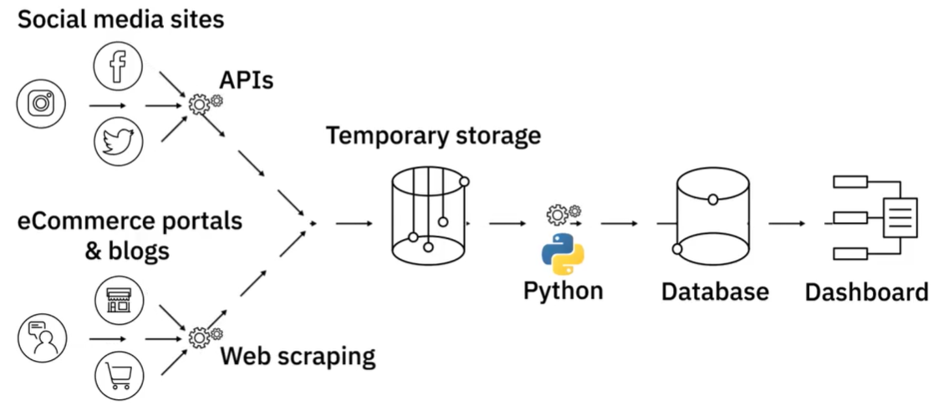
A Day in the Life of a Data Engineer
https://learning.edx.org/course/course-v1:IBM+DB0100EN+1T2021/block-v1:IBM+DB0100EN+1T2021+type@sequential+block@e8012a6f7334458281a743562e0fc897/block-v1:IBM+DB0100EN+1T2021+type@vertical+block@de7b397903a547bda6b1e79dbc05d990

Slide 5
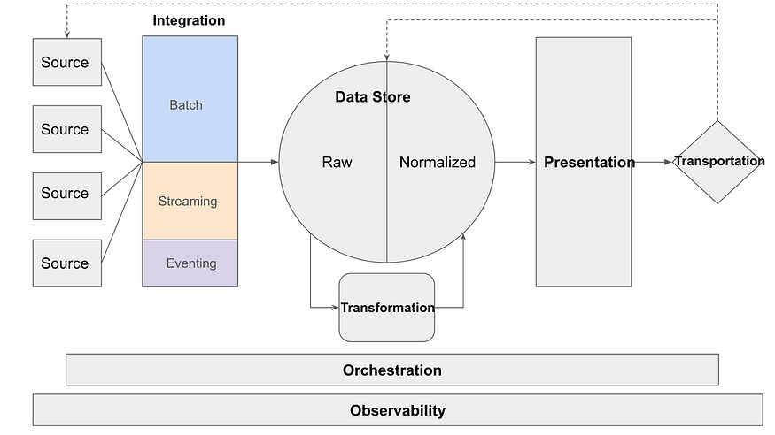
Modern data platform Architecture
https://medium.com/towards-data-science/building-a-data-platform-in-2024-d63c736cccef

Slide 6
Modern data platform Architecture
DataBase, SQL
DBeaver
Streamlit
Poewr BI
Matplotlib, Seaborn
Window
Linux
Ubuntu
Fast API
Django
Pandas, SQL
Python
VM, VE
Docker
git/github
Scikit-learn
Keras, Tensorflow
Pytorch
LLM, Langchain
Pandas
Request
Beautifulsoup
Apache Airflow

Slide 7

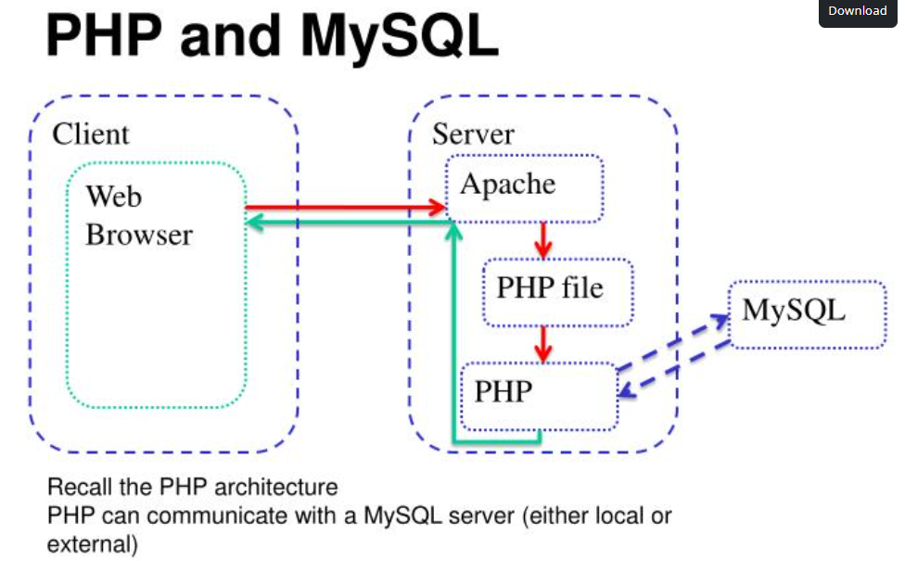
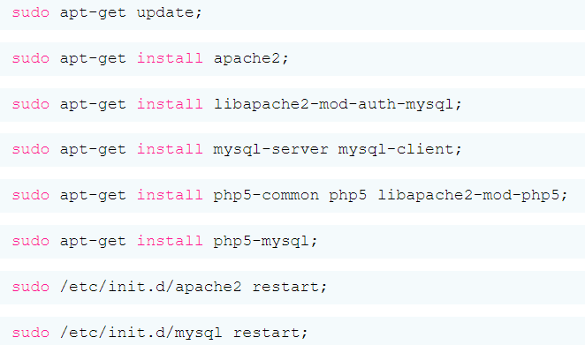


LAPM; Web/Server Programing
LAPM; Linux(Ubuntu), Apache, PHP, MySQL
Application
download/installation
https://www.slideserve.com/alvis/php-mysql

Slide 8
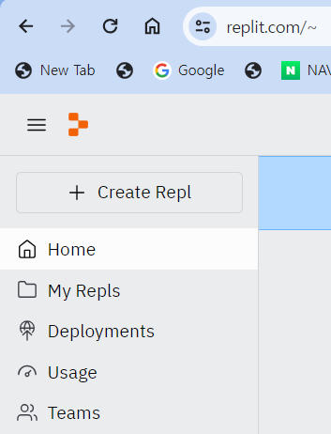

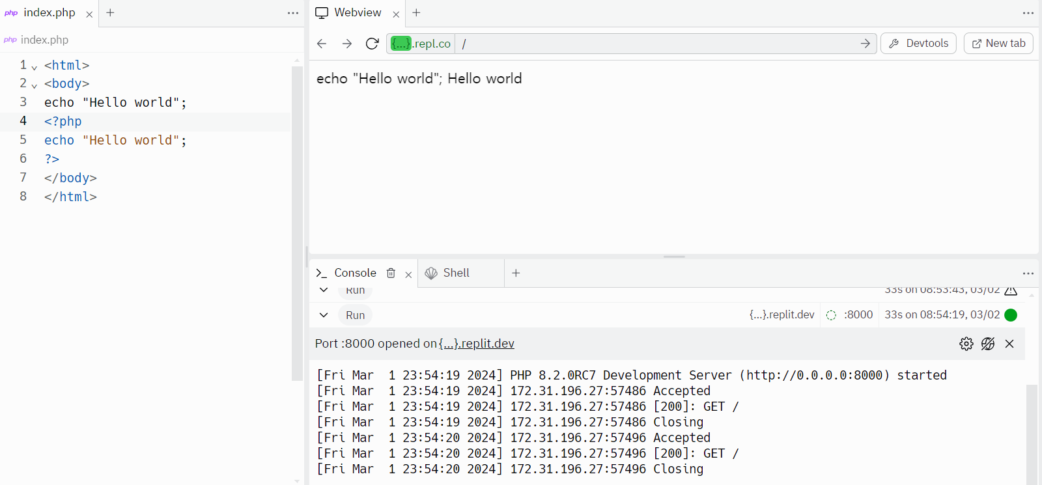
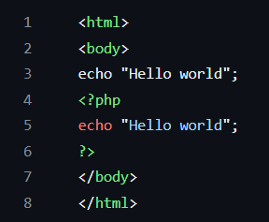
LAPM; Web/Server Programing
https://opentutorials.org/course/62/233

Slide 9
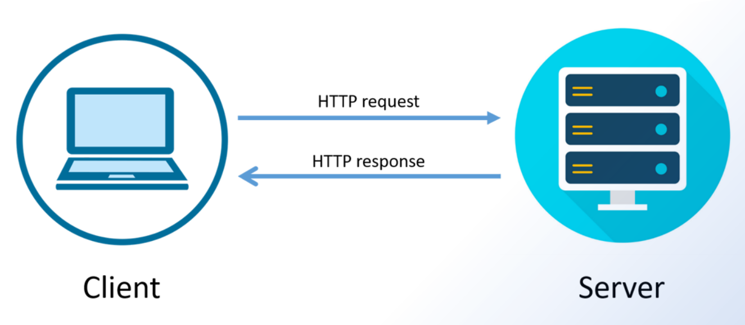

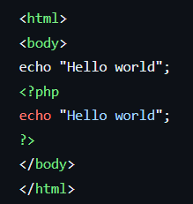
LAPM; Web/Server Programing
php Application
Web
helloworld.php
PHP
MySQL
Apache
Ubuntu (Linux OS)
로컬영역(내 컴퓨터)
글로벌 원격영역
www.google.com

Slide 10
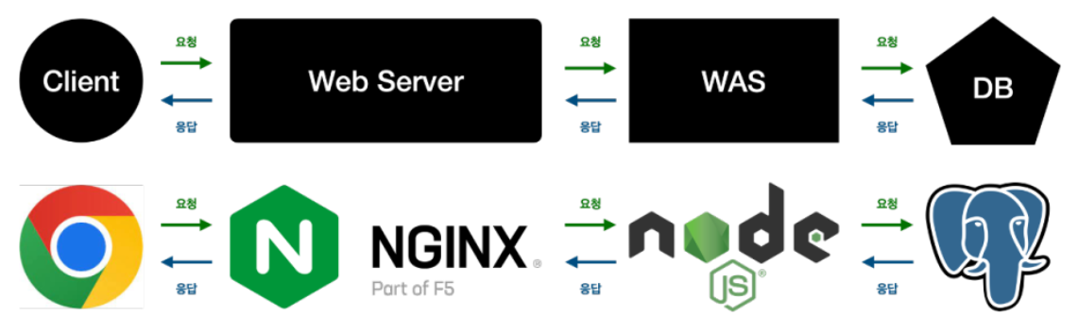
Web Service Architecture
https://blog.naver.com/gi_balja/223028077537

Slide 11
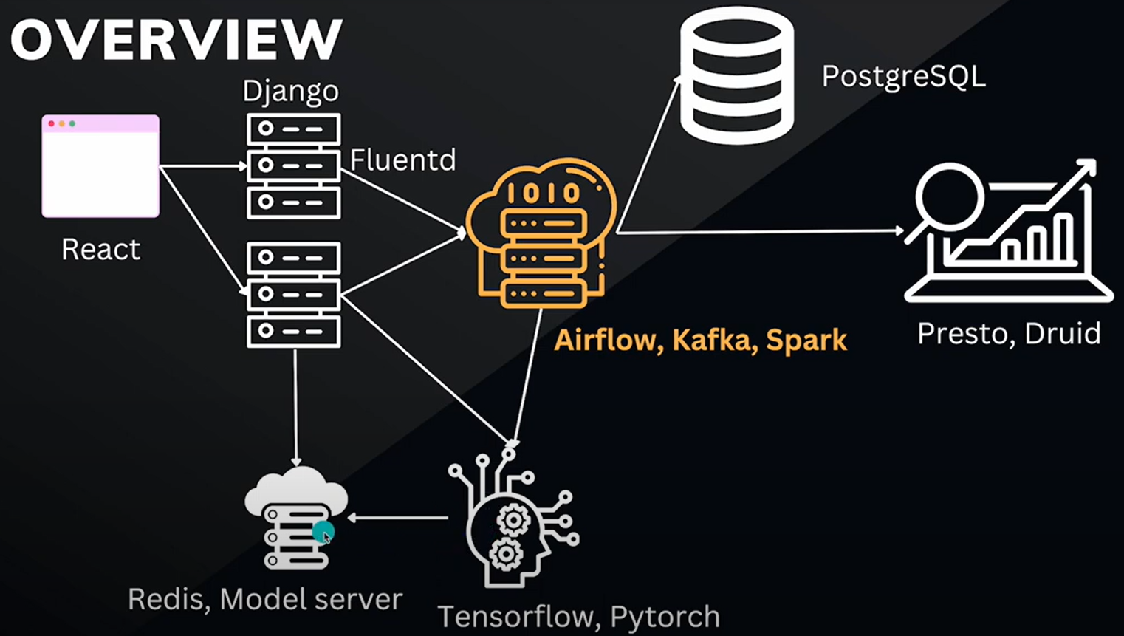

Modern S/W Architecture

Slide 12
What is Data Engineering?
Overview of Inside Data Pipeline
Extract
Transform
Load
https://realpython.com/python-data-engineer/

Slide 13
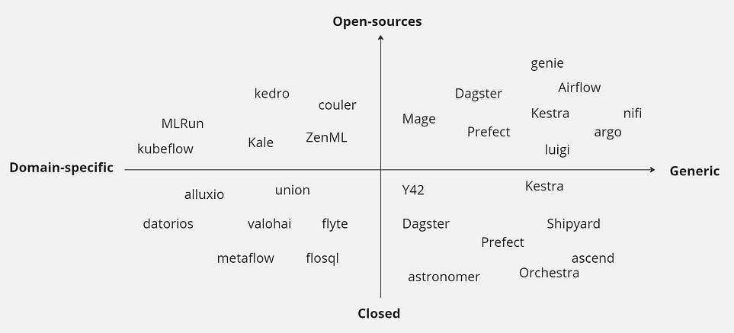
Data Orchestration Tools: Ultimate Review
Apache Airflow
*Astronomer
Dagster
Prefect
Mage
Luigi
Apache Oozie
Flyte
DAGWorks
Shipyard
Kestra
Datorios
MLtwist
*Astro is a fully-managed SaaS application for data orchestration that helps teams write and run data pipelines
with Apache Airflow at any level of scale.

Slide 14
What Are Common Data Engineering Skills?
General programming concepts
Python, Scala, and Java / Apache Airflow
Databases
SQL / Maria DB, Postgres, MySQL, Mongo DB, Oracle
Distributed systems and cloud engineering
Apache Spark / Amazon S3, GCP, and Microsoft Azure
https://realpython.com/python-data-engineer/

Slide 15
Contents
What is Data Engineering?
Linux 개발환경
Apache Airflow Container

Slide 16



개발 환경 구성도
원격영역(클라우드)
로컬영역(내 컴퓨터)
VS code
Python
Virtual Environment(venv)
WSL
Docker
Ubuntu
Apache Airflow
Bash Shell Script
*.py
*.py
*.sh

Slide 17

Docker start / stop on WSL2
&> sudo docker service start
&> sudo docker compose up # down
&> docker ps # To list running containers and find the container name or ID
&> docker stop my_container # Replace 'my_container' with your actual container name or ID
&> docker stop $(docker ps -q)

Slide 18


최종 개발환경
docker
docker
compose
Ubuntu
WSL2
Window 11 Home

Slide 19
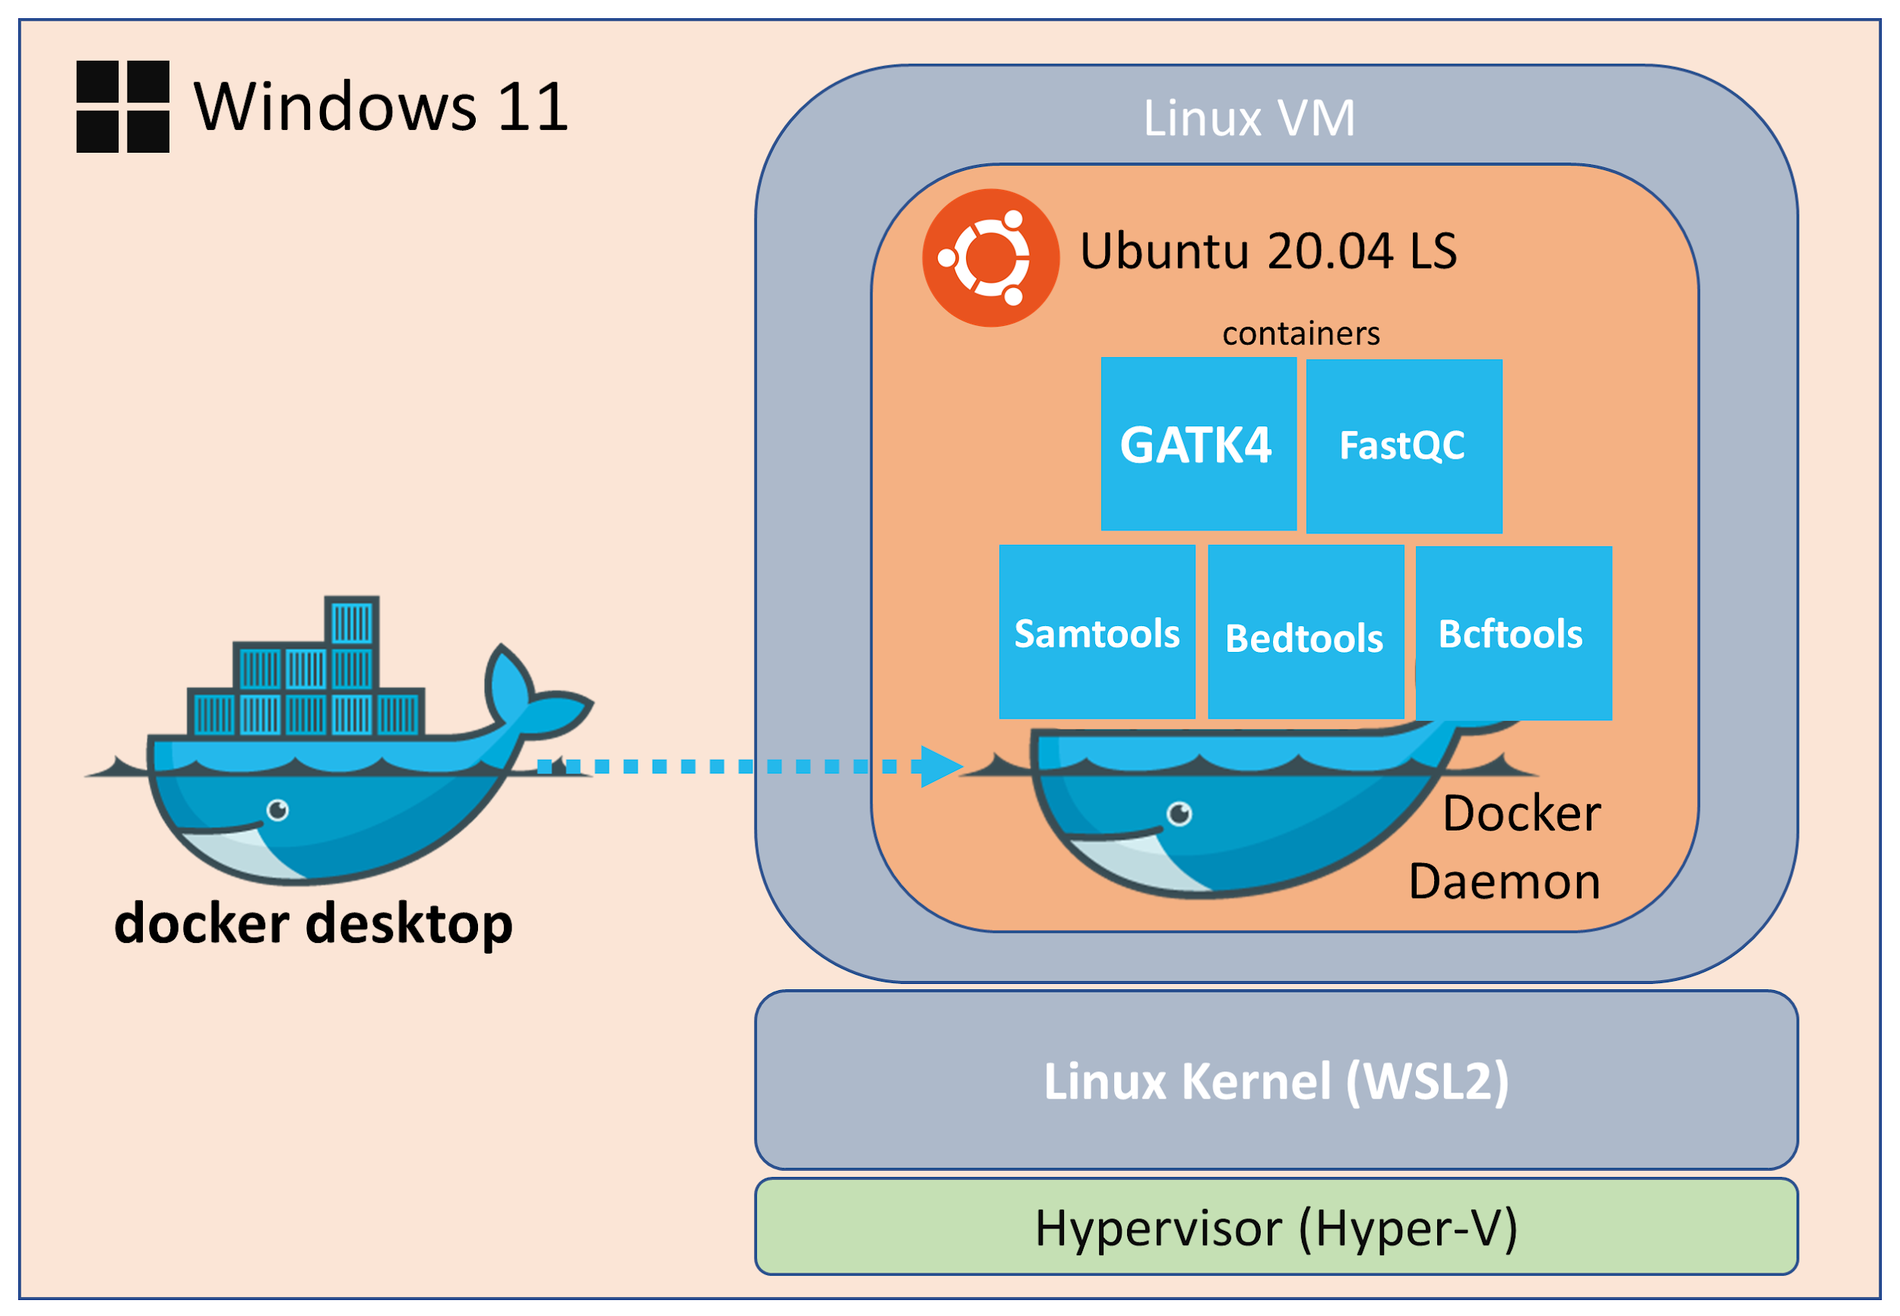
Docker on WSL2(Ubuntu)
Docker is a widely-used container technology that allows users to create an isolated copy (instance) of one or more applications, including their dependencies and deploy them on a host system.

Slide 20
Docker Desktop on Ubuntu
ancestor9@DESKTOP-LMLFU0S:~$ docker --version
Docker version 24.0.7, build afdd53b
ancestor9@DESKTOP-LMLFU0S:~$ sudo systemctl status docker
[sudo] password for ancestor9:
● docker.service - Docker Application Container Engine
Loaded: loaded (/lib/systemd/system/docker.service; enabled; vendor preset: enabled)
Active: active (running) since Sat 2024-01-06 23:13:45 KST; 3h 9min ago
ancestor9@DESKTOP-LMLFU0S:~$ sudo systemctl stop docker.socket
ancestor9@DESKTOP-LMLFU0S:~$ sudo systemctl status docker
○ docker.service - Docker Application Container Engine
Loaded: loaded (/lib/systemd/system/docker.service; enabled; vendor preset: enabled)
Active: inactive (dead) since Sun 2024-01-07 02:24:43 KST; 51s ago
ancestor9@DESKTOP-LMLFU0S:~$ docker version
Client: Docker Engine - Community
Version: 24.0.7
API version: 1.43
Go version: go1.20.10
Git commit: afdd53b
Built: Thu Oct 26 09:07:41 2023
OS/Arch: linux/amd64
Cannot connect to the Docker daemon at unix:///var/run/docker.sock. Is the docker daemon running?

Slide 21
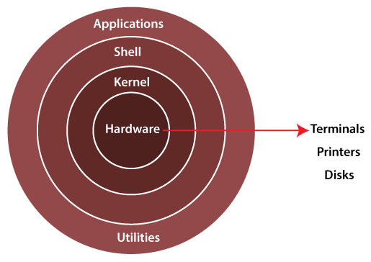
WSL2(Ubuntu)
Architecture of Linux system

Slide 22
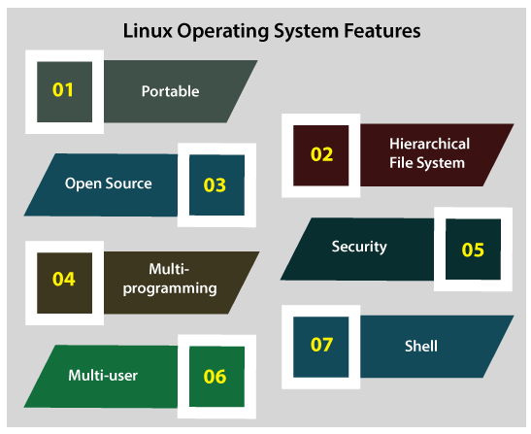
WSL2(Ubuntu)

Slide 23
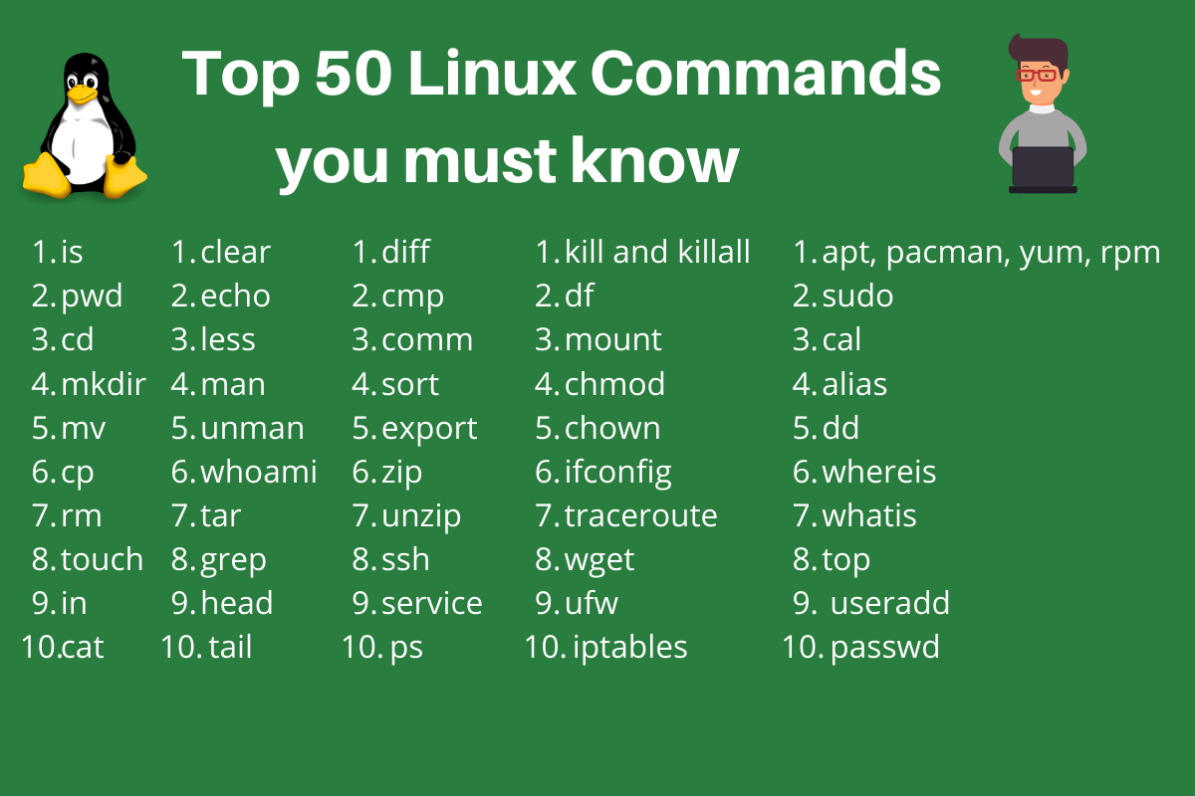
Ubuntu-Run on shell mode
## Container에 접속 (Ubuntu CLI)
PS C:\demo> docker attach myubuntu
root@f74bd5d917e2:/#
root@f74bd5d917e2:~# la -al
total 16
drwx------ 2 root root 4096 Dec 11 14:08 .
drwxr-xr-x 1 root root 4096 Dec 19 11:34 ..
-rw-r--r-- 1 root root 3106 Oct 15 2021 .bashrc
-rw-r--r-- 1 root root 161 Jul 9 2019 .profile

Slide 24
Contents
What is Data Engineering?
Linux 개발환경
Apache Airflow Container

Slide 25
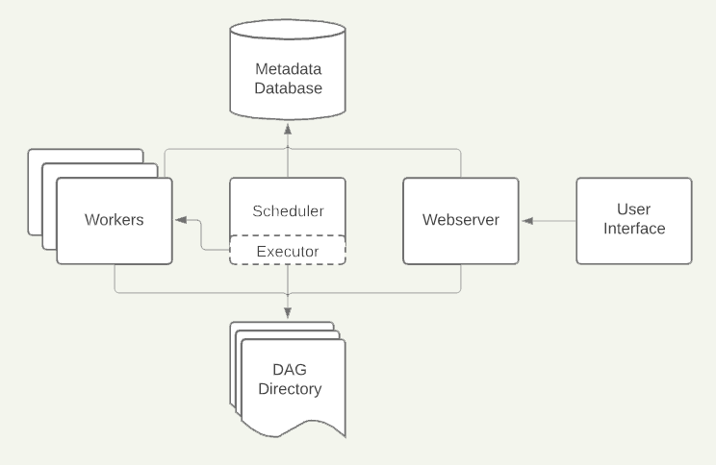
Apache Airflow Architecture
https://www.blef.fr/airflow-getting-started/

Slide 26
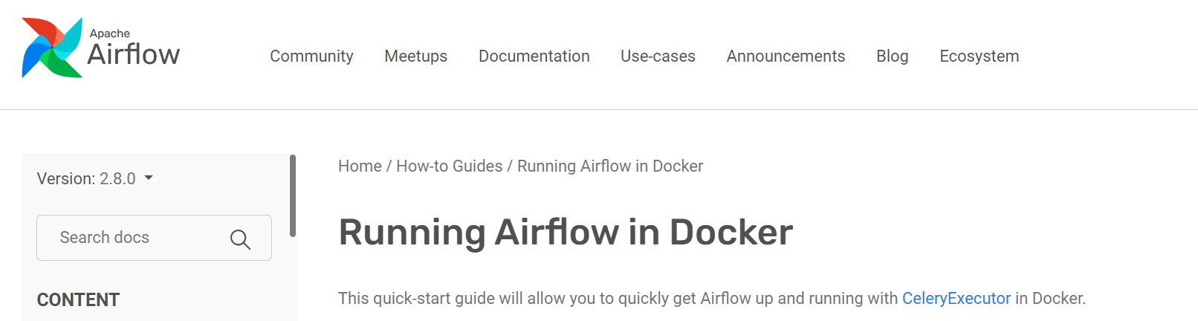
Apache airflow
# https://airflow.apache.org/docs/apache-airflow/stable/howto/docker-compose/index.html
root@f74bd5d917e2:~# apt-get update && apt-get install -y curl
Get:1 http://archive.ubuntu.com/ubuntu jammy InRelease [270 kB]
Get:2 http://security.ubuntu.com/ubuntu jammy-security InRelease [110 kB]
Get:3 http://security.ubuntu.com/ubuntu jammy-security/universe amd64 Packages [1046 kB]
root@f74bd5d917e2:~# curl -LfO 'https://airflow.apache.org/docs/apache-airflow/2.8.0/docker-compose.yaml’ # 오른쪽 마우스 클릭
% Total % Received % Xferd Average Speed Time Time Time Current
Dload Upload Total Spent Left Speed
100 10940 100 10940 0 0 22708 0 --:--:-- --:--:-- --:--:-- 22744
root@f74bd5d917e2:~# ls
docker-compose.yaml

Slide 27
Apache airflow
root@f74bd5d917e2:~# mkdir -p ./dags ./logs ./plugins ./config
root@f74bd5d917e2:~# echo -e "AIRFLOW_UID=$(id -u)" > .en
root@f74bd5d917e2:~# ls -al
total 48
drwx------ 1 root root 4096 Dec 19 13:29 .
drwxr-xr-x 1 root root 4096 Dec 19 11:34 ..
-rw-r--r-- 1 root root 3106 Oct 15 2021 .bashrc
-rw-r--r-- 1 root root 14 Dec 19 13:29 .en
-rw-r--r-- 1 root root 161 Jul 9 2019 .profile
drwxr-xr-x 2 root root 4096 Dec 19 13:29 config
drwxr-xr-x 2 root root 4096 Dec 19 13:29 dags
-rw-r--r-- 1 root root 10940 Dec 19 13:23 docker-compose.yaml
drwxr-xr-x 2 root root 4096 Dec 19 13:29 logs
drwxr-xr-x 2 root root 4096 Dec 19 13:29 plugins
root@f74bd5d917e2:~# AIRFLOW_UID=50000
PS C:\demo> docker compose up airflow-init
[+] Running 39/45
- postgres 13 layers [⣿⣿⣿⣿⣿⣿⣿⠀⣿⣿⣿⠀⠀] 526.7kB/106.5MB Pulling

Slide 28
Apache airflow
root@f74bd5d917e2:~# mkdir -p ./dags ./logs ./plugins ./config
root@f74bd5d917e2:~# echo -e "AIRFLOW_UID=$(id -u)" > .en
root@f74bd5d917e2:~# ls -al
total 48
drwx------ 1 root root 4096 Dec 19 13:29 .
drwxr-xr-x 1 root root 4096 Dec 19 11:34 ..
-rw-r--r-- 1 root root 3106 Oct 15 2021 .bashrc
-rw-r--r-- 1 root root 14 Dec 19 13:29 .en
-rw-r--r-- 1 root root 161 Jul 9 2019 .profile
drwxr-xr-x 2 root root 4096 Dec 19 13:29 config
drwxr-xr-x 2 root root 4096 Dec 19 13:29 dags
-rw-r--r-- 1 root root 10940 Dec 19 13:23 docker-compose.yaml
drwxr-xr-x 2 root root 4096 Dec 19 13:29 logs
drwxr-xr-x 2 root root 4096 Dec 19 13:29 plugins
root@f74bd5d917e2:~# AIRFLOW_UID=50000
PS C:\demo> docker compose up airflow-init
[+] Running 39/45
- postgres 13 layers [⣿⣿⣿⣿⣿⣿⣿⠀⣿⣿⣿⠀⠀] 526.7kB/106.5MB Pulling

Slide 29
Apache airflow
https://it-is-my-life.tistory.com/21
# docker-compose.yml
C:/> docker –v
C:/> docker-compose –v
# creat the ‘docker-compose.yaml’ file that defines multiple services like server, scheduler and worker in the corresponding folder.
https://airflow.apache.org/docs/apache-airflow/2.5.1/docker-compose.yaml
# docker-compose는 yaml file로 multi container 관리할 수 있는 client이고 명령어를 적어서 컨테이너를 정의하고 관리
# 동일한 dir에 ‘.env’라는 파일안에 AIRFLOW_UID = 50000 내용으로 작성
# Configuration to perform initialization tasks such as creating the necessary data tables, default users and setting up other configurations required to run Apache Airflow.
C:\demo>docker-compose up airflow-init
C:\demo>docker-compose up

Slide 30
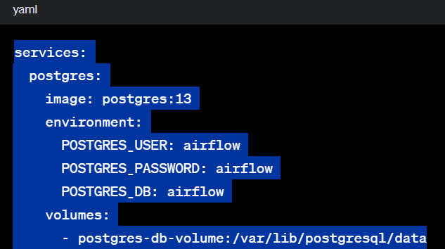
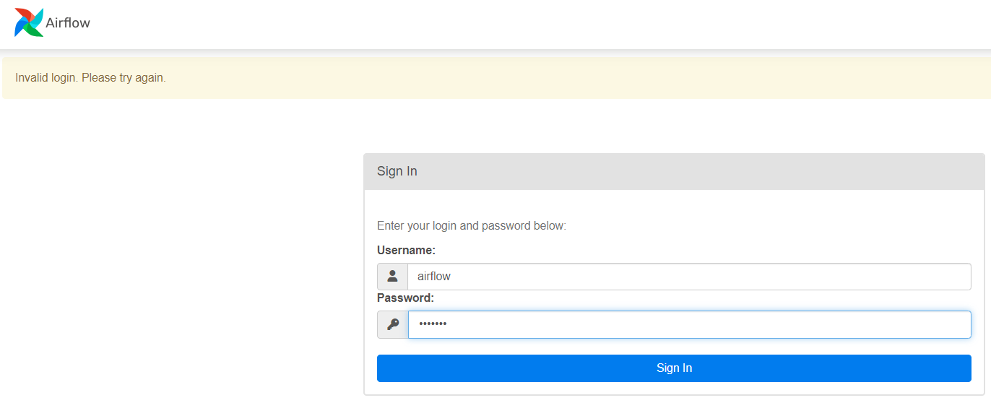
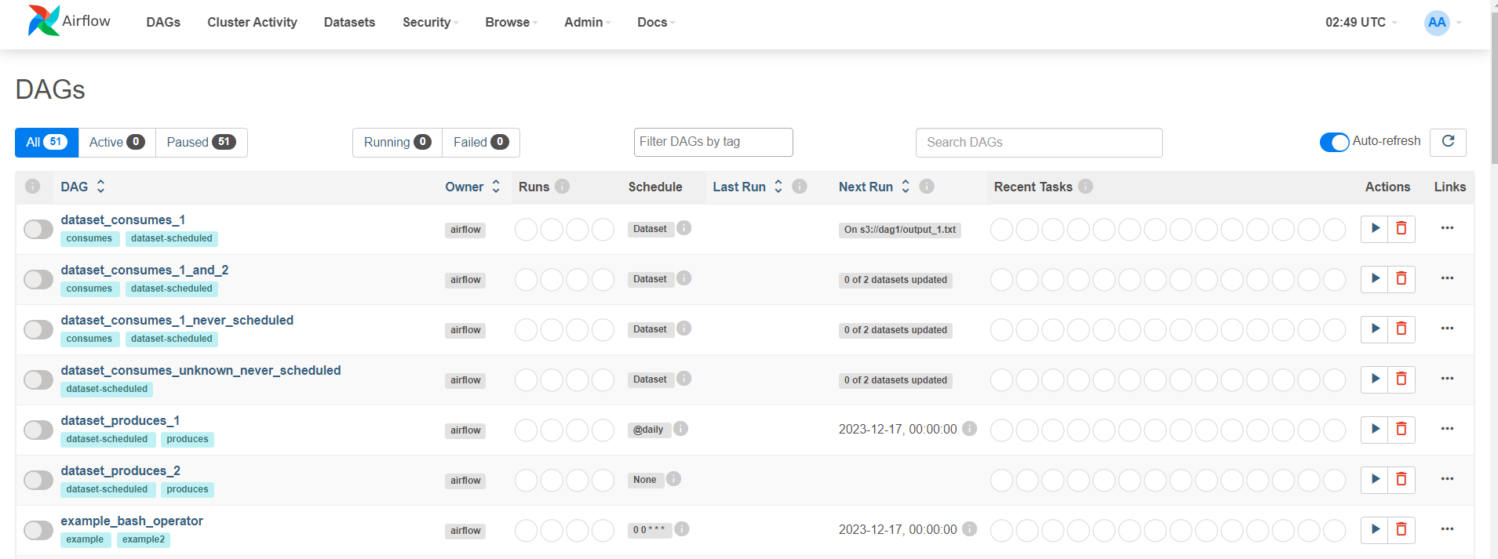
Apache airflow

Slide 31
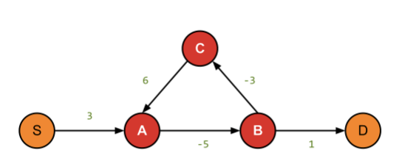
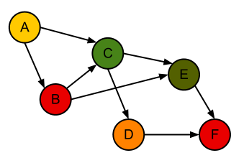
Apache airflow
The Directed Acyclic Graph (DAG) is a directed graph with no directed cycles. That is, it consists of vertices and edges (also called arcs), with each edge directed from one vertex to another, such that following those directions will never form a closed loop.
Negative Graph
DAG(Directed Acyclic Graph)
https://steemit.com/dag/@cryptodreamers/dag-dag-directed-acyclic-graph

Slide 32
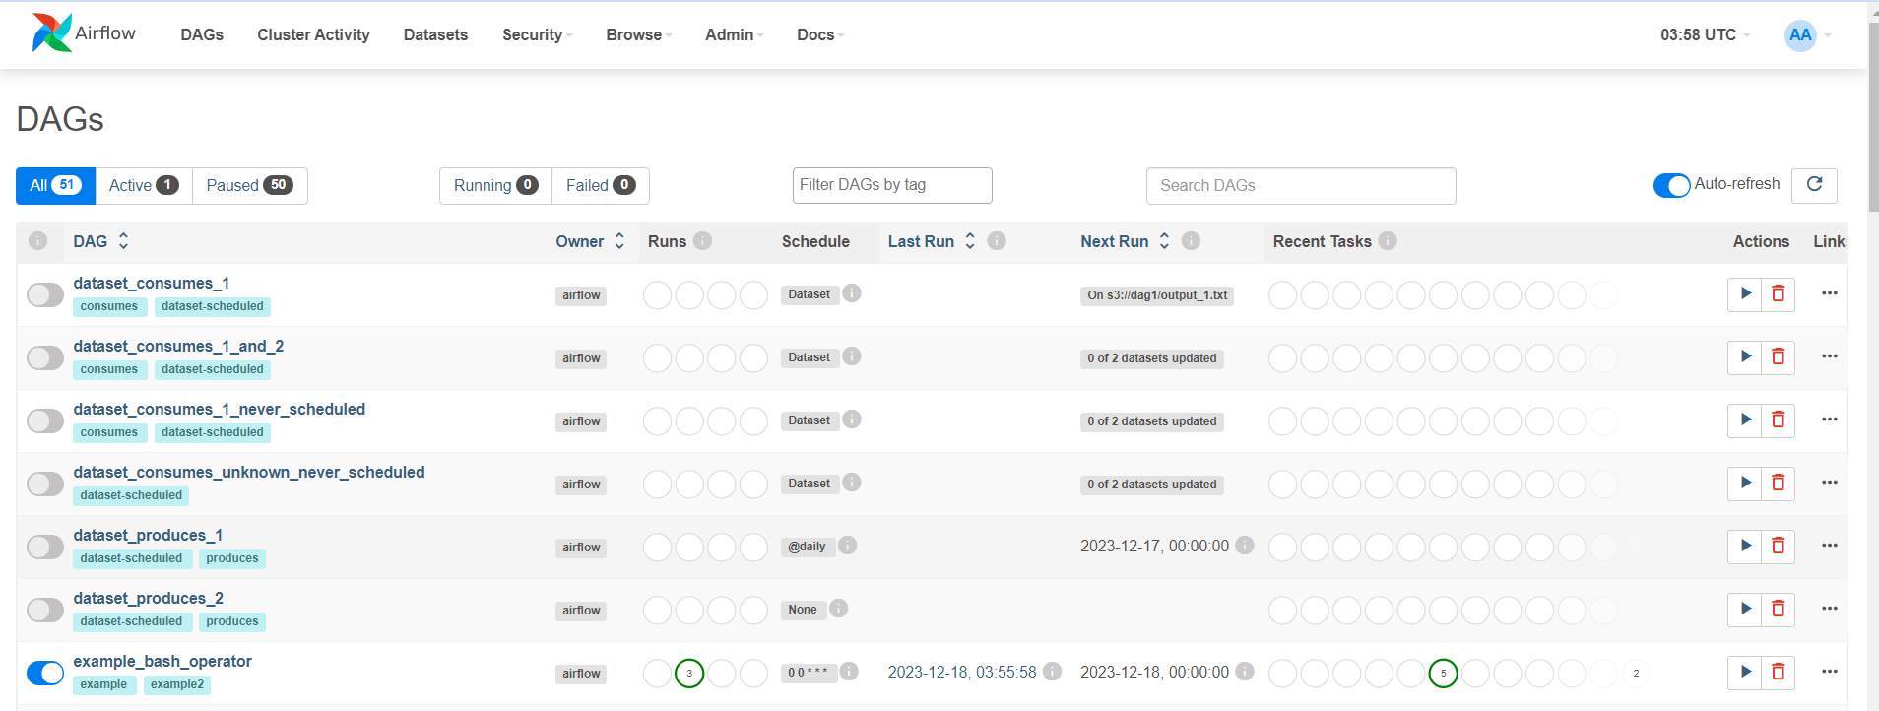
Apache airflow
Names of registered workflows
Workflow Schedules
State of workflow tasks from recent runs

Slide 33
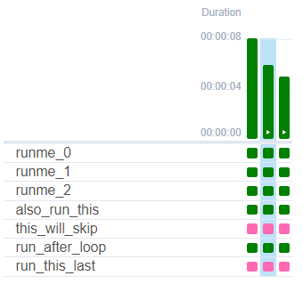
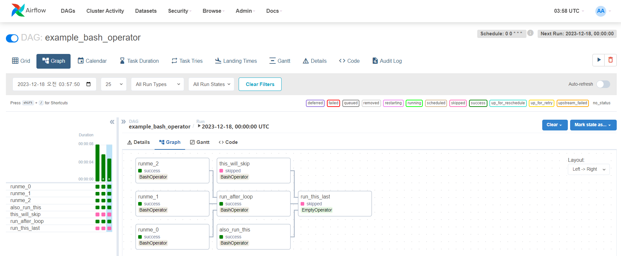
Apache airflow
All runs of one task
State of a single task
One run of a workflow

Slide 34
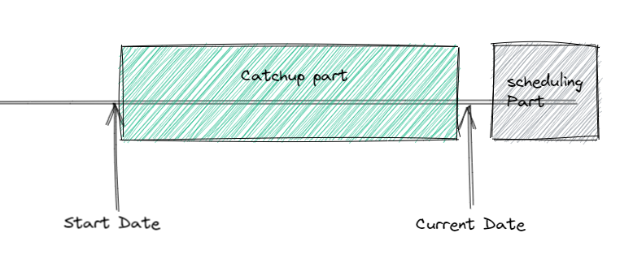
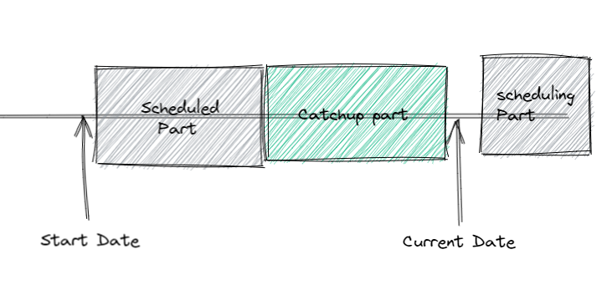
Backfilling
DAG가 이미 배포되어 실행 중이며 해당 DAG를 사용하여 DAG의 시작 날짜 이전에 데이터 처리 경우
Backfill은 지정한 기간동안 DAG 다시 재시작, 지정한 기간동안 전체 재시작, 지정한 기간 지정한 상태 동안 전체 재시작을 지정 하여 사용이 가능
과거 주가데이터를 다시 수집하는 경우

Slide 35

Digress: Apache NIFI
# Create ‘docker-compose.yml’ as follows;
version: '3'
services:
nifi:
image: apache/nifi:latest
ports:
- "8080:8080"
volumes:
- ./nifi-data:/opt/nifi/nifi-current/conf
environment:
- NIFI_WEB_HTTP_PORT=8080
C:\demo>docker-compose -p myproject up
C:\demo>docker ps # process status

