Slide 1
빅데이터 처리
경복대학교 빅데이터과
조상구교수
2024.10.10

Slide 2
목차
Python (Syntax, Module, Package, Class)
Data Wrangling Visualization (Pandas, Matplotlib, Seaborn)
Network & Database (REST API, Sqlite, FastAPI, Streamlit/Gradio)
Machine Learning (Scikit-learn, Pycaret)
Deep Learning (Keras)

Slide 3
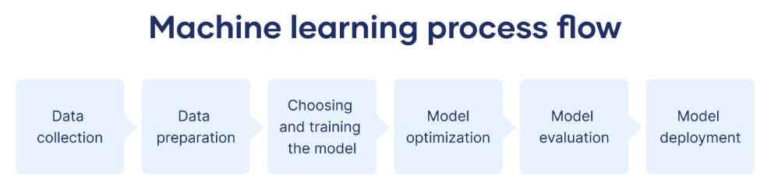
머신러닝 절차
https://www.scribbr.co.uk/using-ai-tools/what-is-machine-learning/

Slide 4
Python
Task | Single Value | Multiple Values | numpy, pandas
Presentation (value, variable) | int, float, string, boolean | list, tuple, dictionary, set | ndarray, Series, DataFrame
Operation (algebra) | expressions | operations, mutable operations | expressions, get, set, reshape, …
Control flow | if for while
Use and reuse | Functions Standard libraries Modules and Packages
Input and output | Standard I/O File I/O |  | Standard I/O File I/O CSV, Excel
https://github.com/ancestor9/24_spring_python-programimming-1

Slide 5
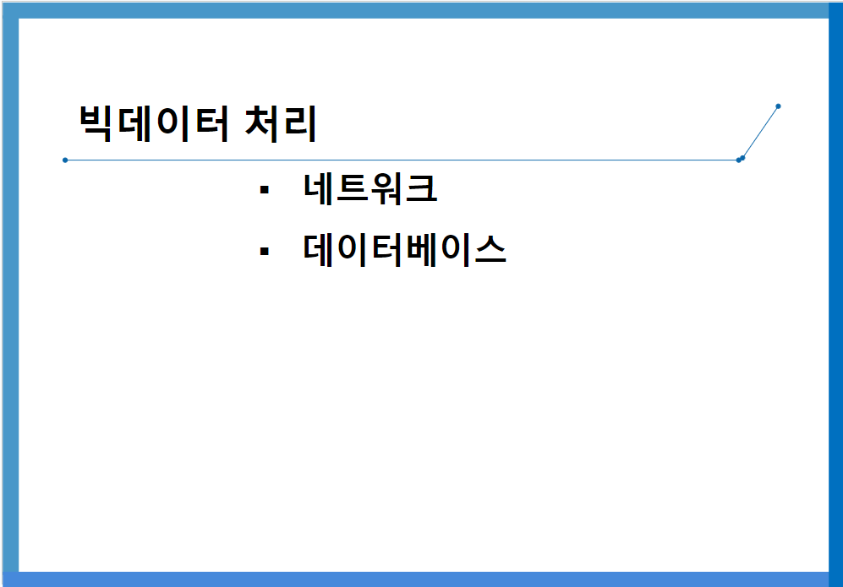
Network & Database
https://github.com/ancestor9/24_fall_Big-Data-Processing-coding-/blob/main/빅데이터처리_네트워크_DB_20241010.pptx

Slide 6
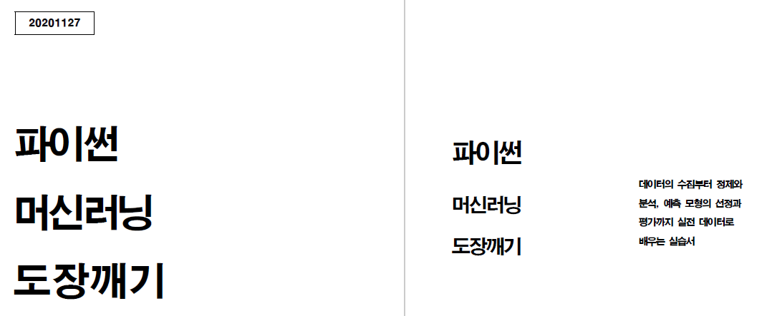
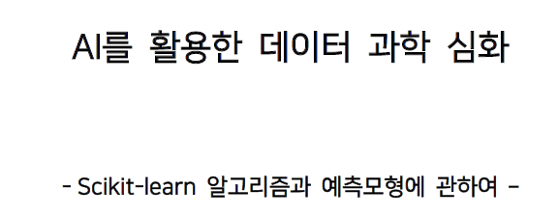
Machine Learning
https://github.com/ancestor9/24_spring_python-programimming-1

Slide 7
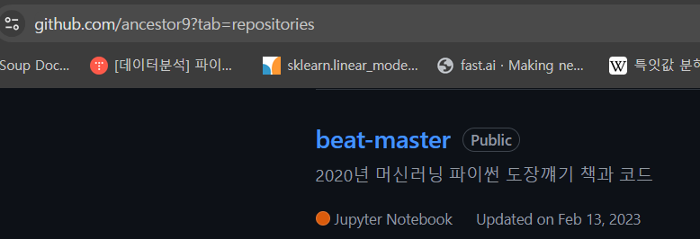
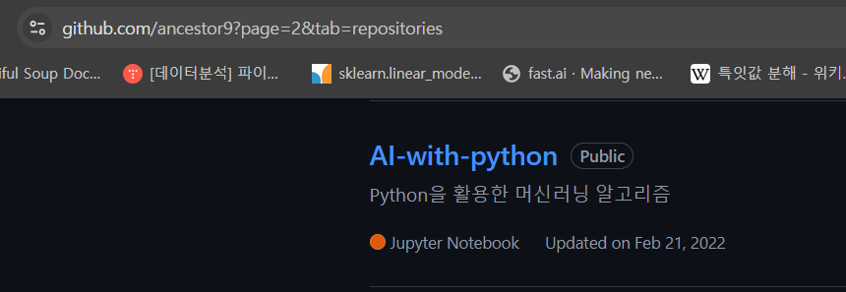
Machine Learning

Slide 8
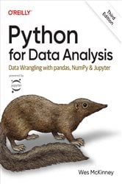
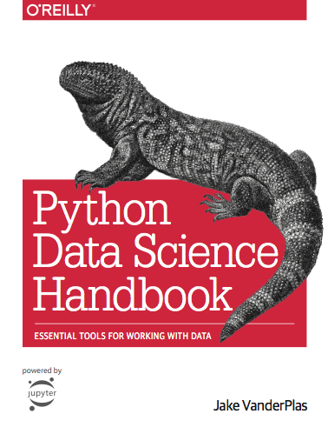
참고교재

Slide 9
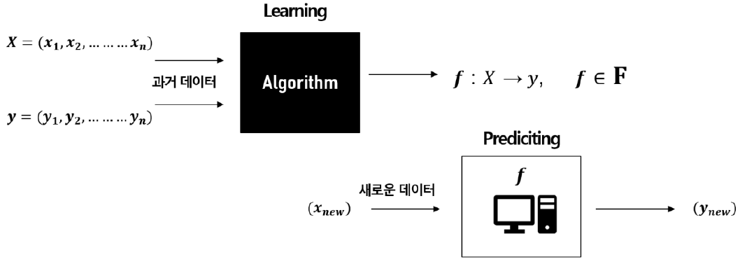
Machine Learning
https://web.stanford.edu/class/stats202/intro.html

Slide 10
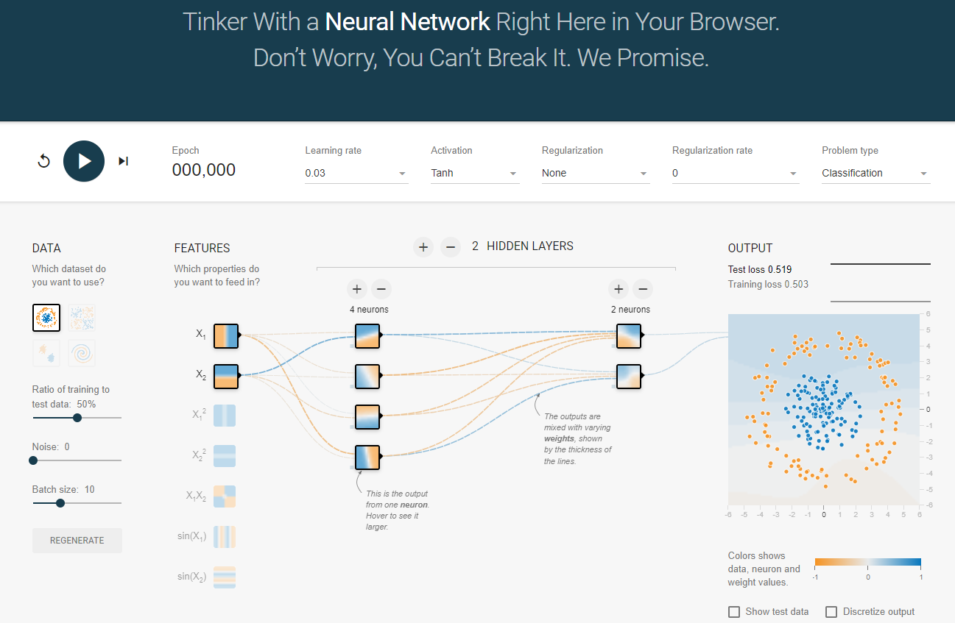
Deep Learning
https://playground.tensorflow.org/

Slide 11
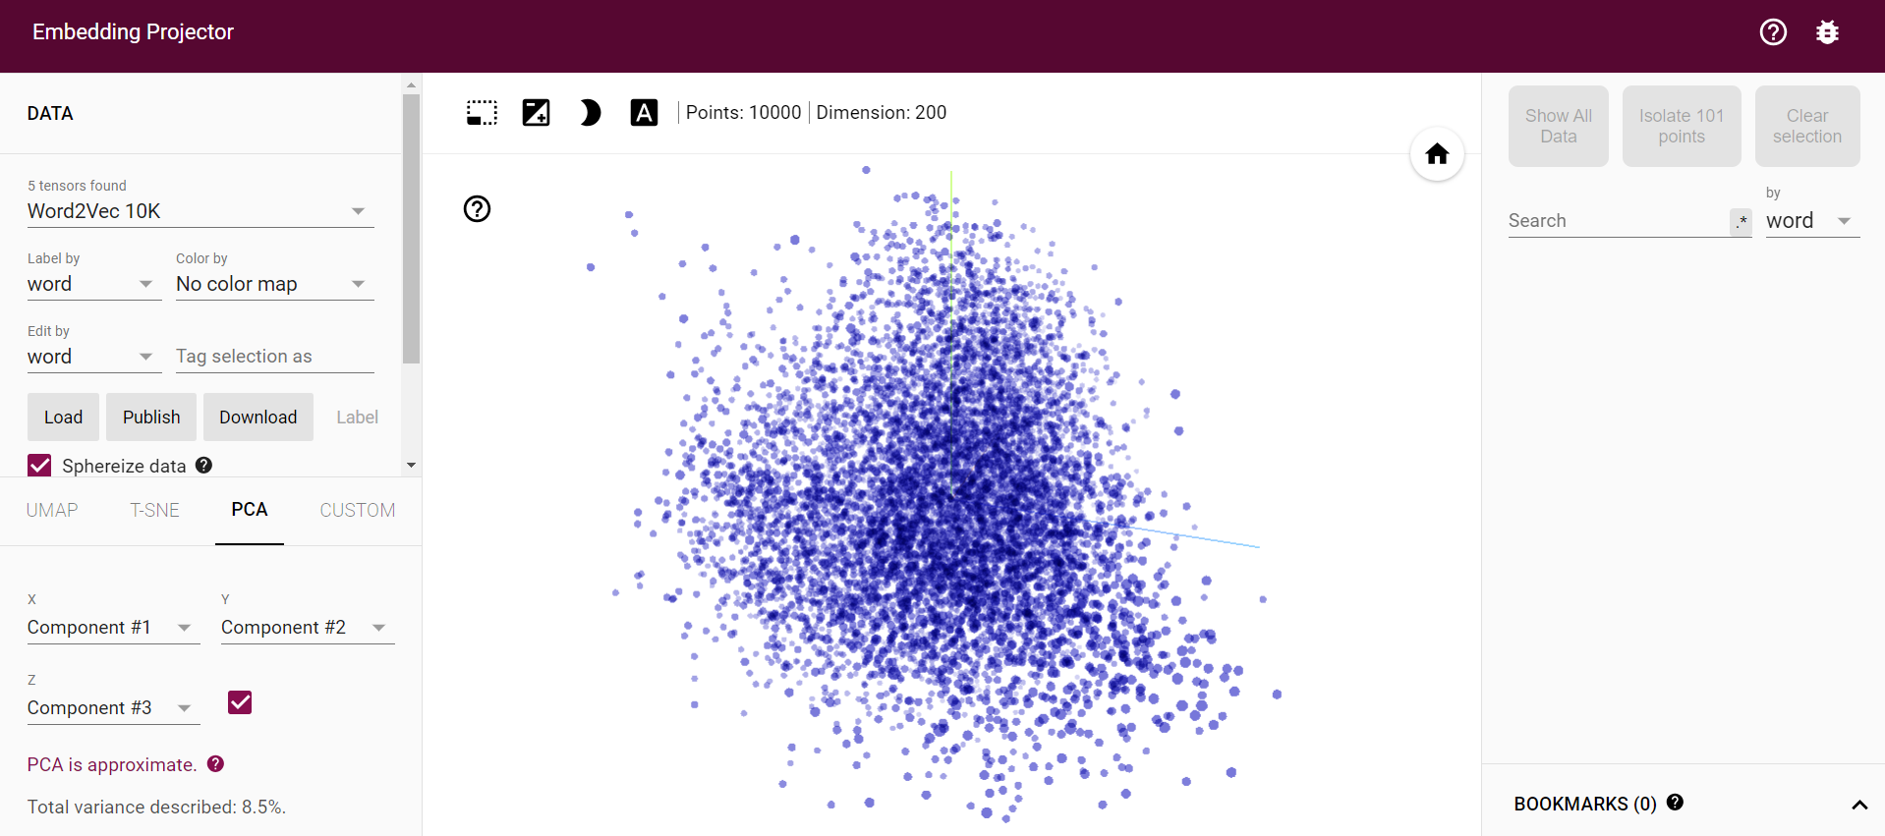
Deep Learning
https://projector.tensorflow.org/

Slide 12
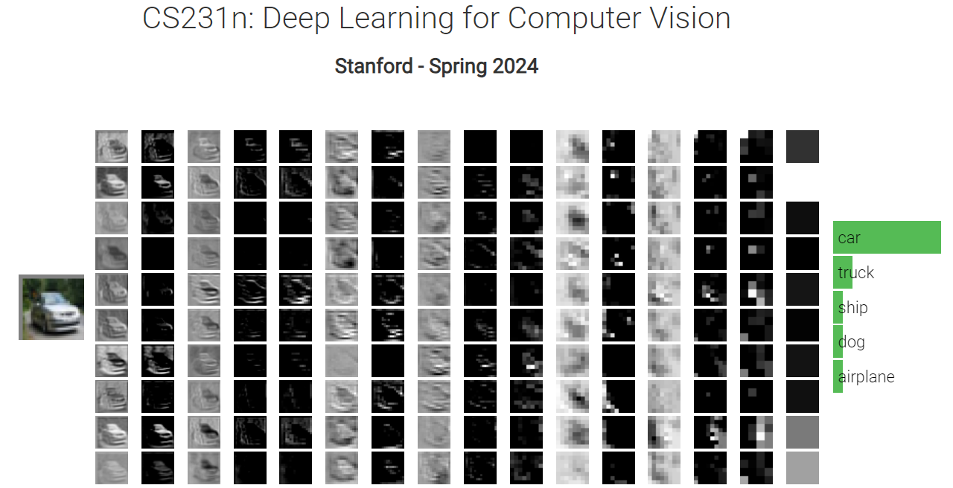
Deep Learning
http://vision.stanford.edu/teaching/cs231n/2024/

