Slide 1
빅데이터 처리
경복대학교 빅데이터과
조상구교수
2024.10.10

Slide 2
목차
Python (Syntax, Module, Package, Class)
Data Wrangling Visualization (Pandas, Matplotlib, Seaborn)
Network & Database (REST API, Sqlite, FastAPI, Streamlit/Gradio)
Machine Learning (Scikit-learn, Pycaret)
Deep Learning (Keras)

Slide 3
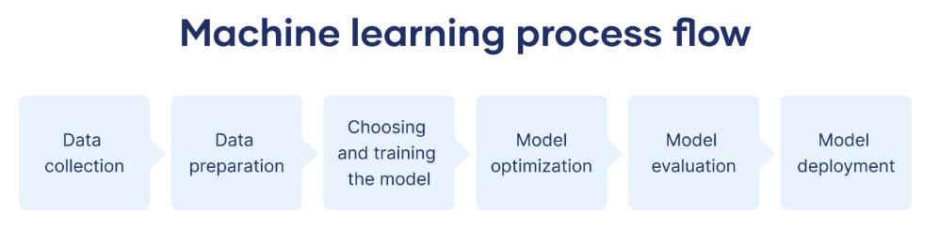
머신러닝 절차
https://www.scribbr.co.uk/using-ai-tools/what-is-machine-learning/

Slide 4
Python
Task | Single Value | Multiple Values | numpy, pandas
Presentation (value, variable) | int, float, string, boolean | list, tuple, dictionary, set | ndarray, Series, DataFrame
Operation (algebra) | expressions | operations, mutable operations | expressions, get, set, reshape, …
Control flow | if for while
Use and reuse | Functions Standard libraries Modules and Packages
Input and output | Standard I/O File I/O |  | Standard I/O File I/O CSV, Excel
https://github.com/ancestor9/24_spring_python-programimming-1

Slide 5
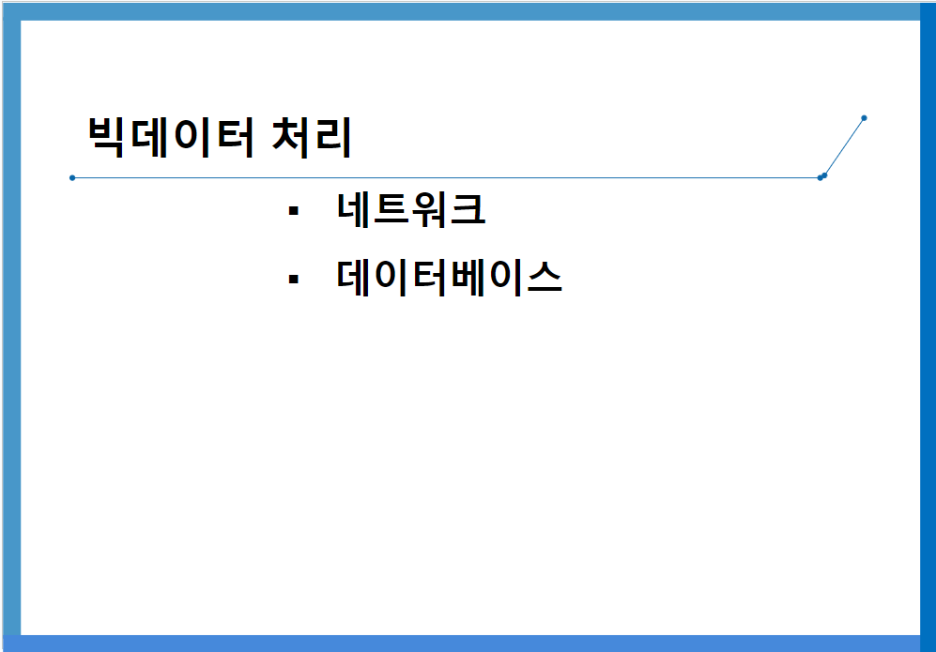
Network & Database
https://github.com/ancestor9/24_fall_Big-Data-Processing-coding-/blob/main/빅데이터처리_네트워크_DB_20241010.pptx

Slide 6
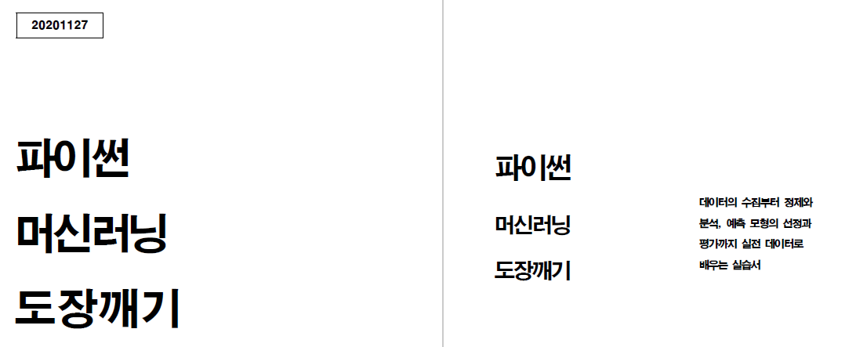
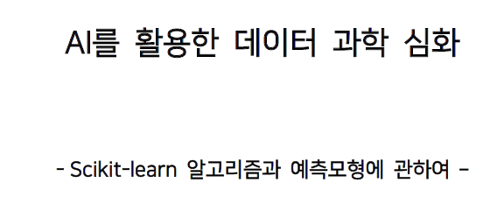
Machine Learning
https://github.com/ancestor9/24_spring_python-programimming-1

Slide 7
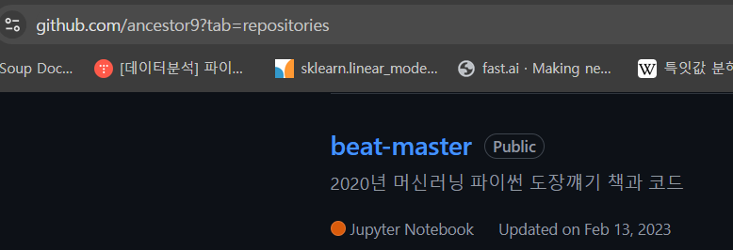
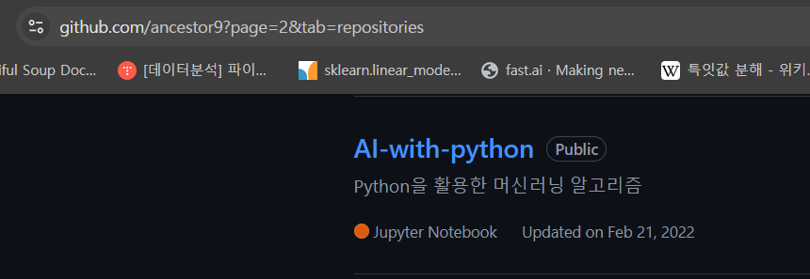
Machine Learning

Slide 8
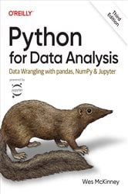
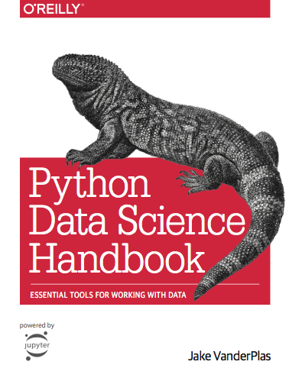
참고교재

Slide 9
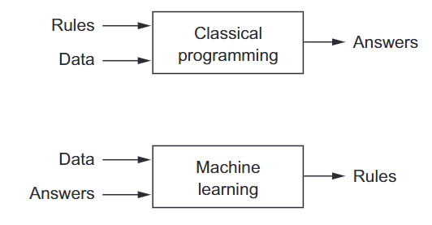
A new programming paradigm

Slide 10
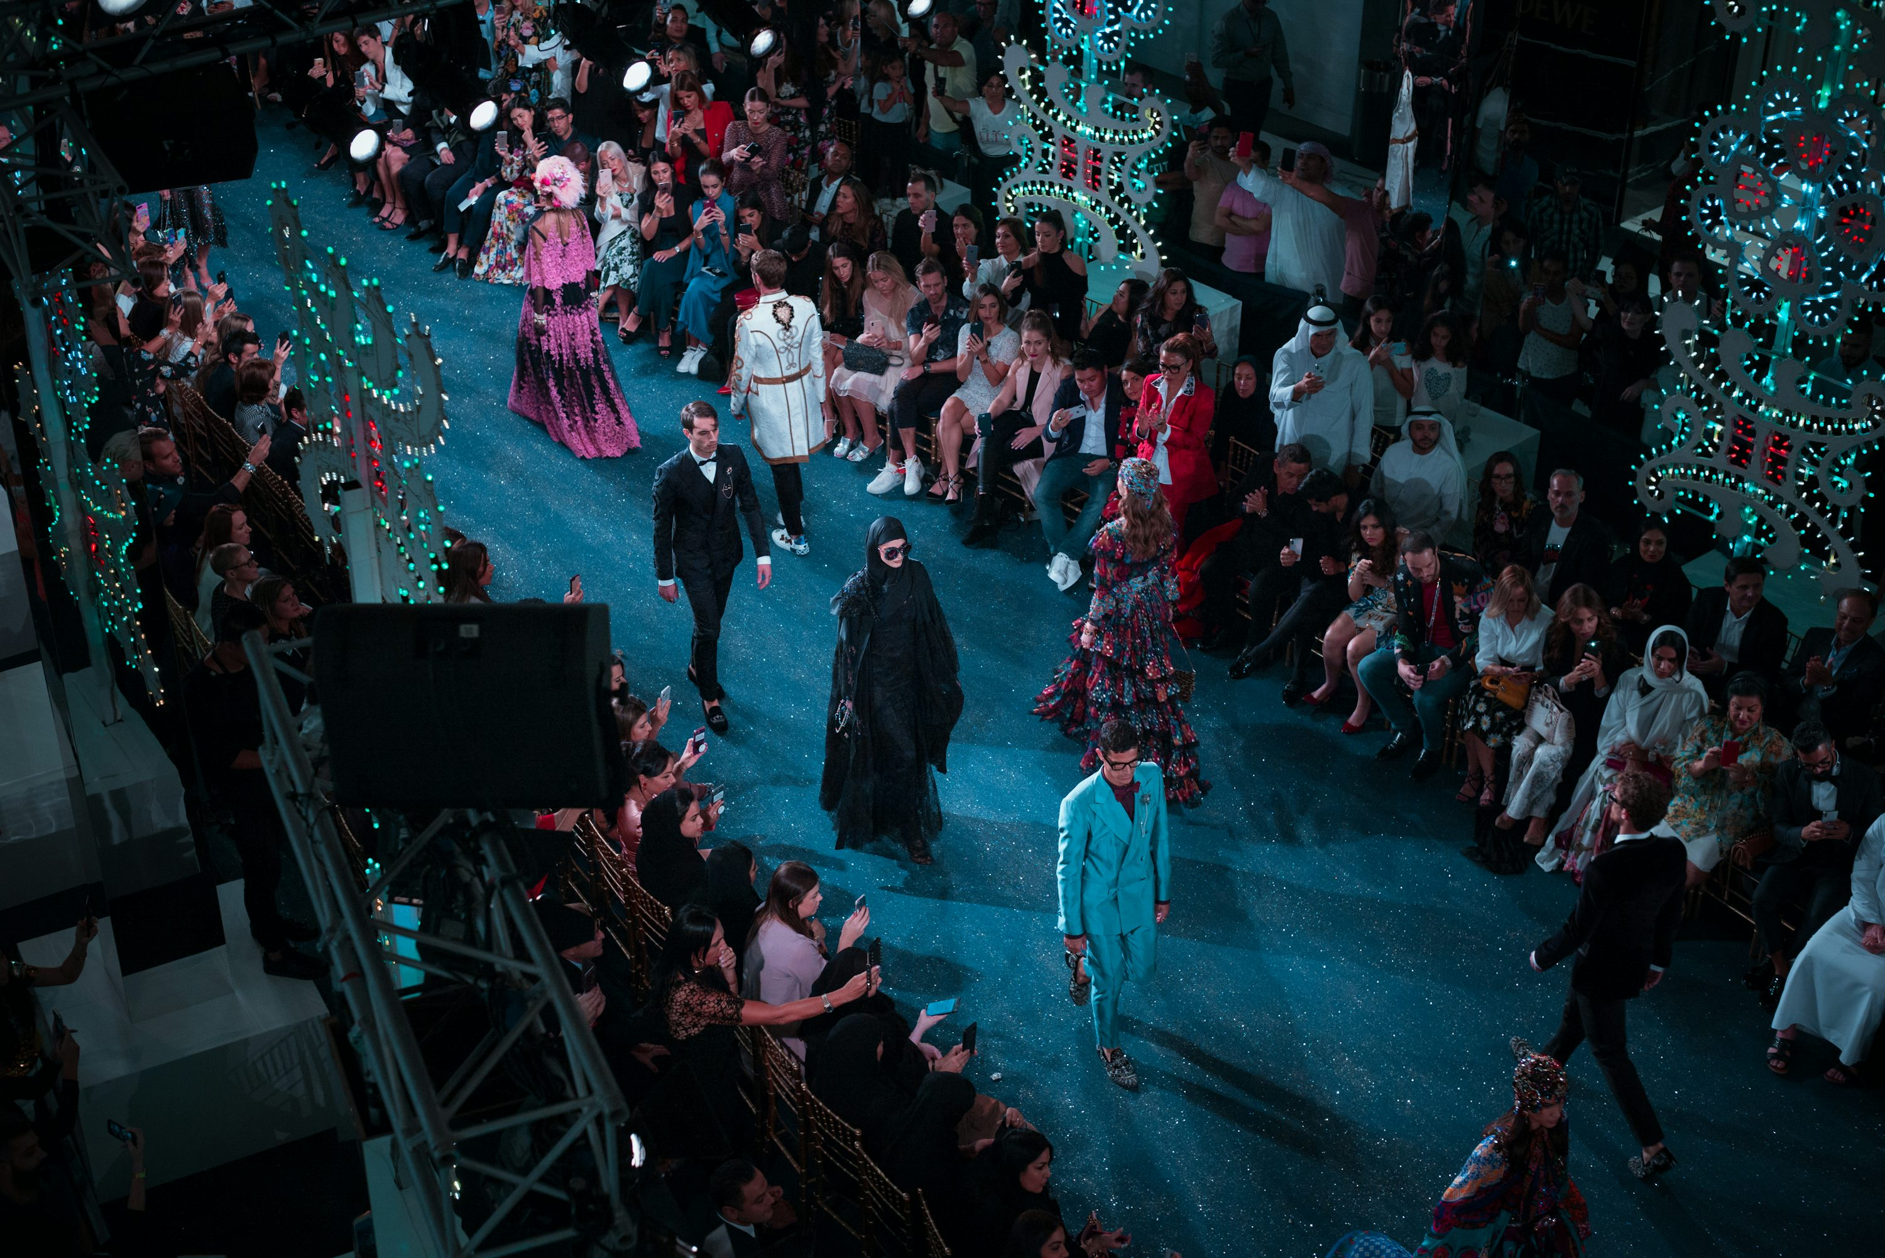
Fashion model

Slide 11
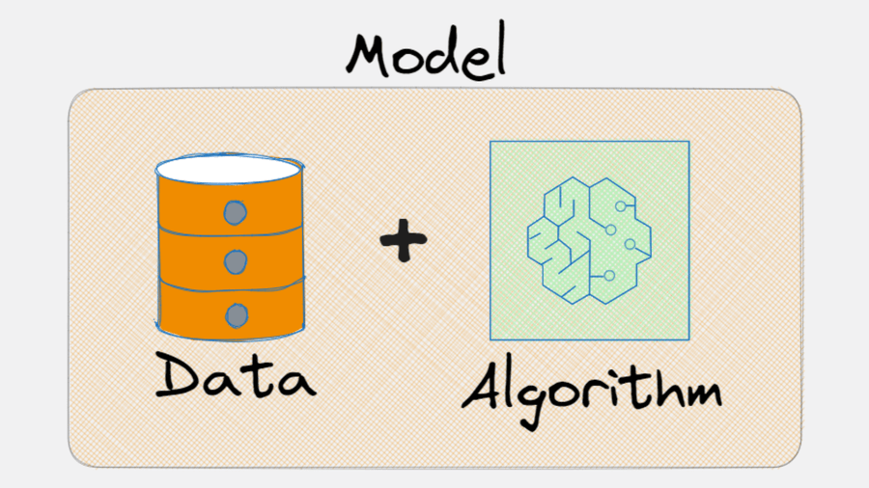


Machine Learning model
유일한 데이터를 바탕으로 여러 가지 알고리즘으로 여러 가지 모델을 생성
Data : $X,y$
Algorithm : $f$
Model :$f(X)$
$g\left(X\right), h\left(x\right)$, ……………….,
$$deeplearning\left(X\right), chatGPT(X)$$
https://x.com/levikul09/status/1676884107018551296

Slide 12
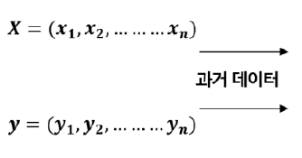
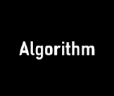

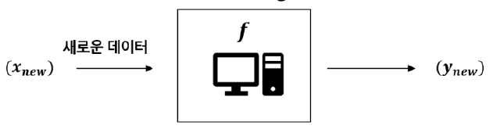
Machine Learning
과거의 데이터에 숨겨진 패턴을 찾아내기 위해 컴퓨터에게 알고리즘을 학습시켜 목적을 달성
학습(Learn/Fit/Training)
예측(Predict)

Slide 13
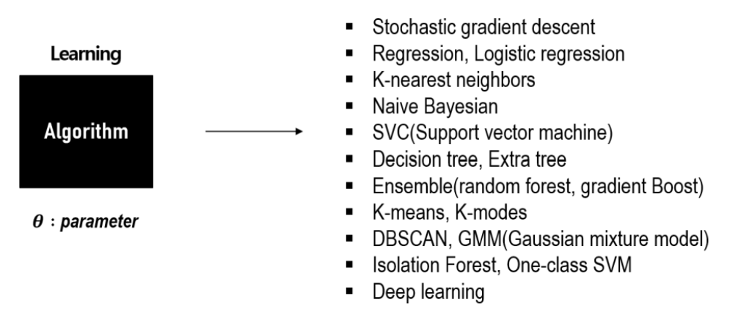
Machine Learning
알고리즘의 종류

Slide 14
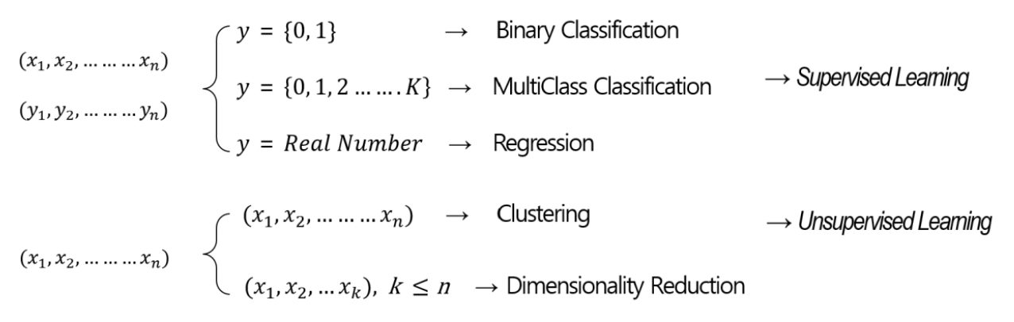
Machine Learning
머신러닝 모델의 종류

Slide 15
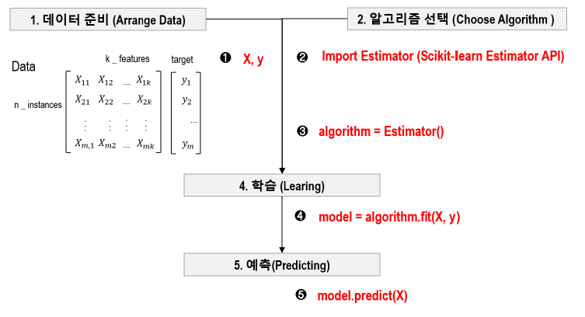
Machine Learning
데이터와 알고리즘을 선택하여 컴퓨터에게 학습시켜 목적(예측, 변환)을 달성

Slide 16
Machine Learning
데이터와 알고리즘을 선택하여 컴퓨터에게 학습시켜 목적(예측, 변환)을 달성
# Load the iris dataset & use the 'target' as labels and the 'data' as features
iris = load_iris()
X = iris.data; y = iris.target
# Split the dataset into training and testing sets
X_train, X_test, y_train, y_test = train_test_split(X, y, test_size=0.3)
# Initialize the logistic regression model
log_reg = LogisticRegression()
# Fit the model to the training data
log_reg.fit(X_train, y_train)
# Predict on the test data
y_pred = log_reg.predict(X_test)
https://scikit-learn.org/1.5/modules/generated/sklearn.linear_model.LogisticRegression.html

Slide 17
Machine Learning
데이터와 알고리즘을 선택하여 컴퓨터에게 학습시켜 목적(예측, 변환)을 달성
# Build the Keras model with Single logistic regression layer
model = Sequential()
model.add(Dense(1, input_dim=4, activation='sigmoid’))
# Compile the model
model.compile(optimizer=SGD)
# Train the model
model.fit(X_train, y_train)
# Predict on test data
y_pred = (model.predict(X_test)

Slide 18
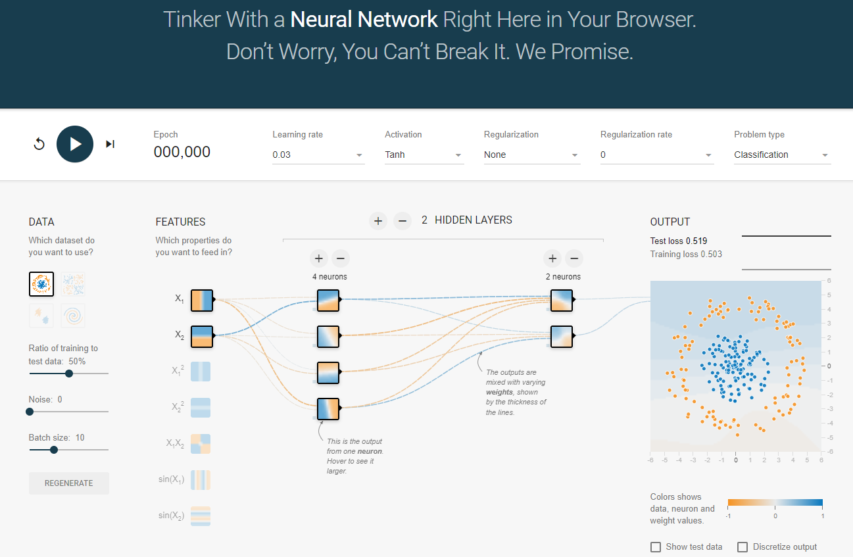
Deep Learning
https://playground.tensorflow.org/

Slide 19
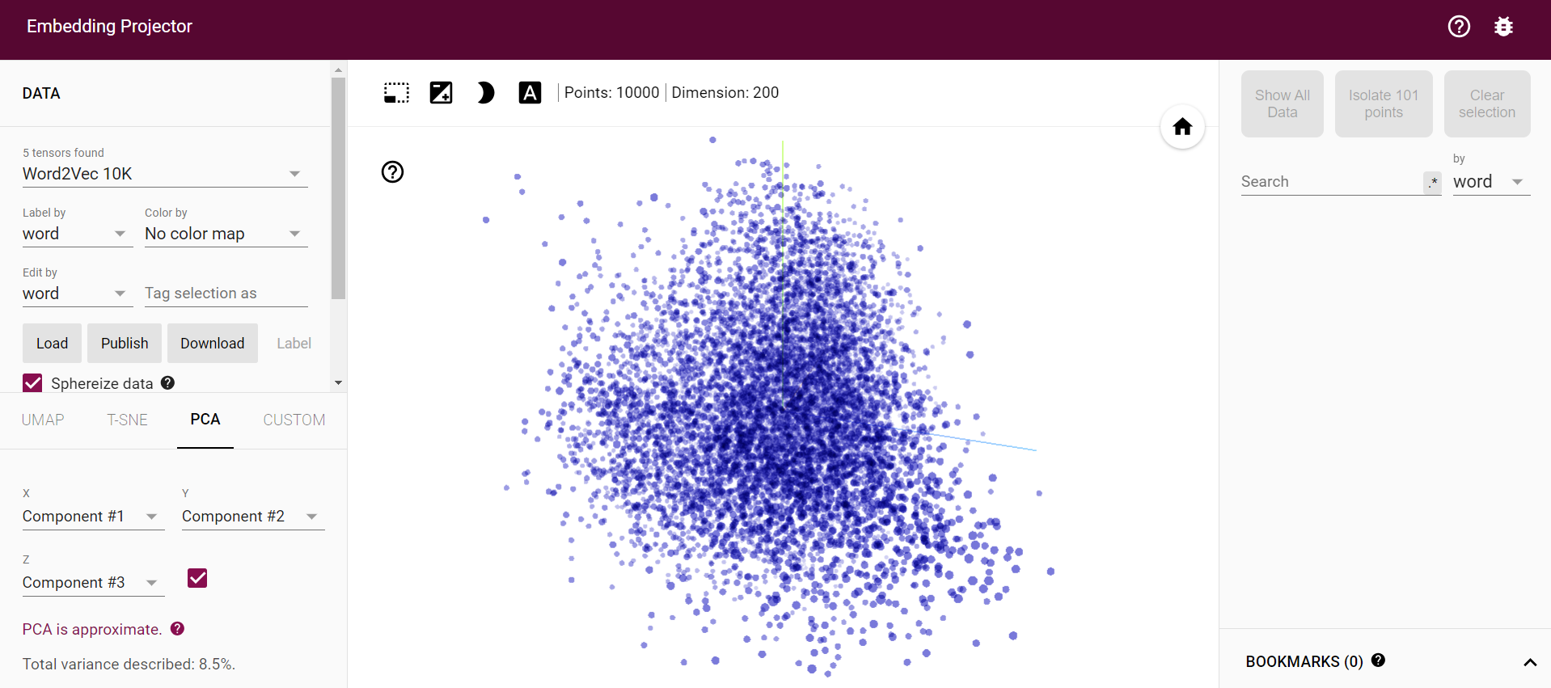
Deep Learning
https://projector.tensorflow.org/

Slide 20
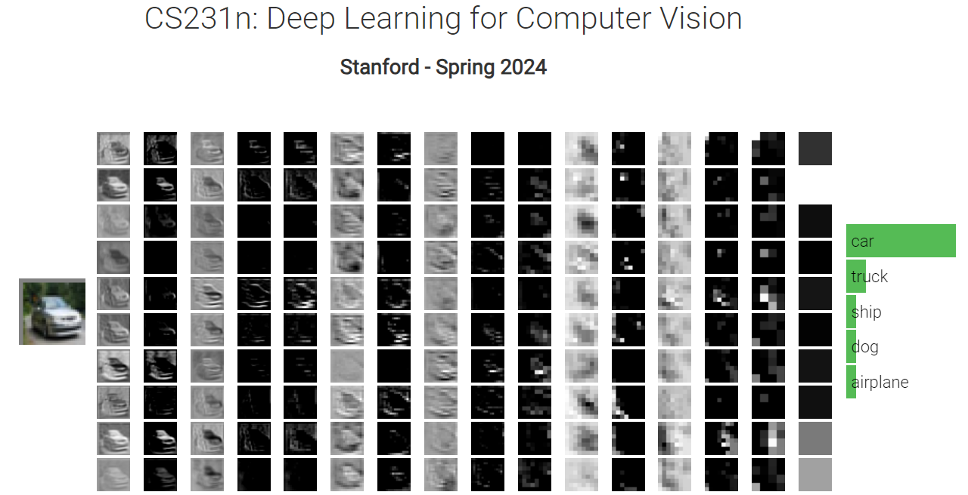
Deep Learning
http://vision.stanford.edu/teaching/cs231n/2024/

