Slide 1
빅데이터 처리
경복대학교 빅데이터과
조상구교수
2024.10.10

Slide 2
목차
Python (Syntax, Module, Package, Class)
Data Wrangling Visualization (Pandas, Matplotlib, Seaborn)
Network & Database (REST API, Sqlite, FastAPI, Streamlit/Gradio)
Machine Learning (Scikit-learn, Pycaret)
Deep Learning (Keras)

Slide 3
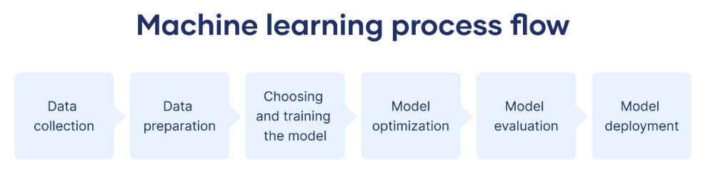
머신러닝 절차
https://www.scribbr.co.uk/using-ai-tools/what-is-machine-learning/

Slide 4
Python
Task | Single Value | Multiple Values | numpy, pandas
Presentation (value, variable) | int, float, string, boolean | list, tuple, dictionary, set | ndarray, Series, DataFrame
Operation (algebra) | expressions | operations, mutable operations | expressions, get, set, reshape, …
Control flow | if for while
Use and reuse | Functions Standard libraries Modules and Packages
Input and output | Standard I/O File I/O |  | Standard I/O File I/O CSV, Excel
https://github.com/ancestor9/24_spring_python-programimming-1

Slide 5
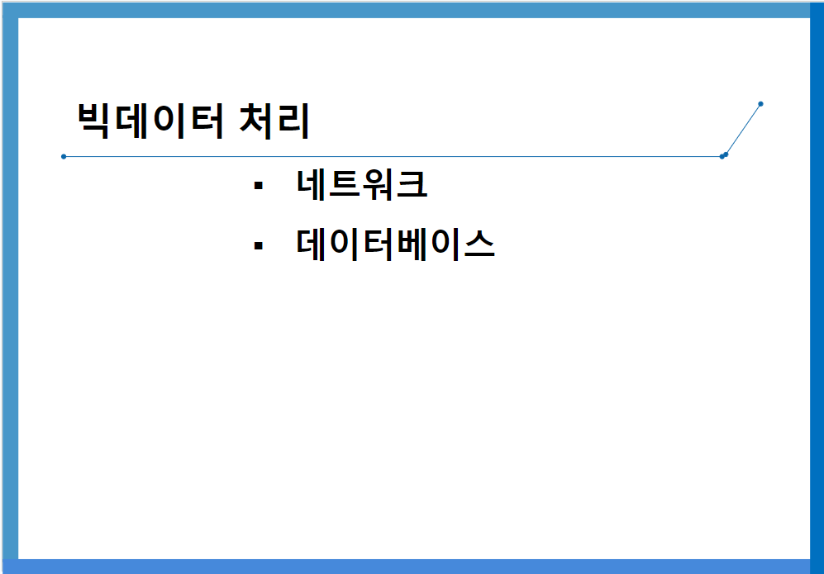
Network & Database
https://github.com/ancestor9/24_fall_Big-Data-Processing-coding-/blob/main/빅데이터처리_네트워크_DB_20241010.pptx

Slide 6
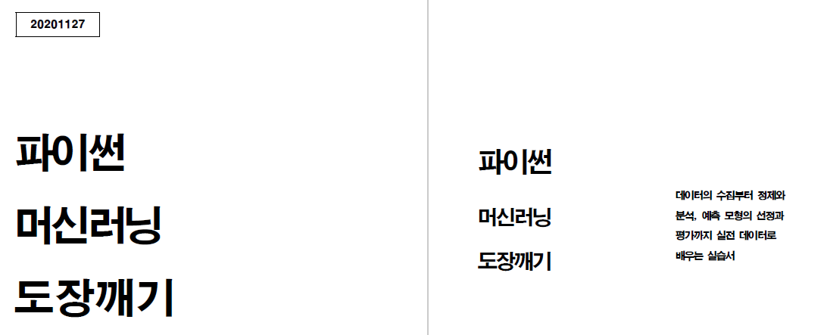
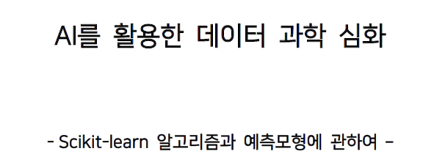
Machine Learning
https://github.com/ancestor9/24_spring_python-programimming-1

Slide 7
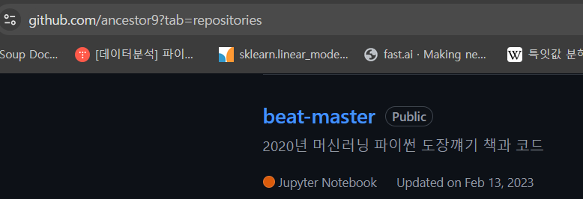
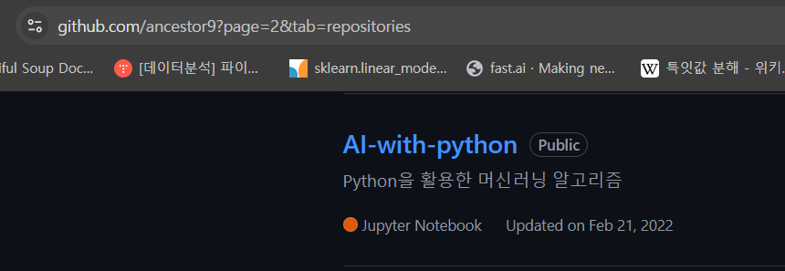
Machine Learning

Slide 8
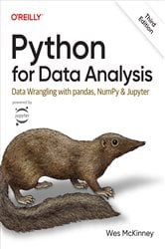
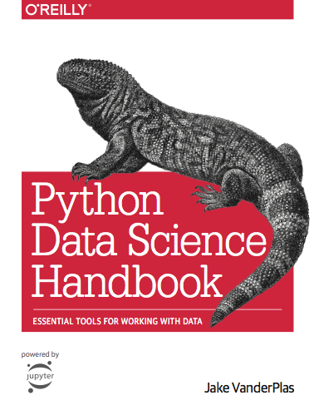
참고교재

Slide 9
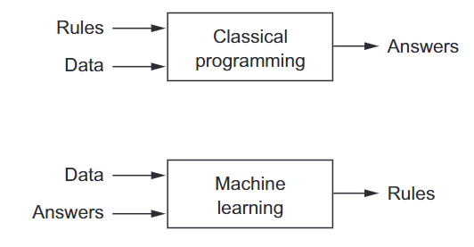
A new programming paradigm

Slide 10
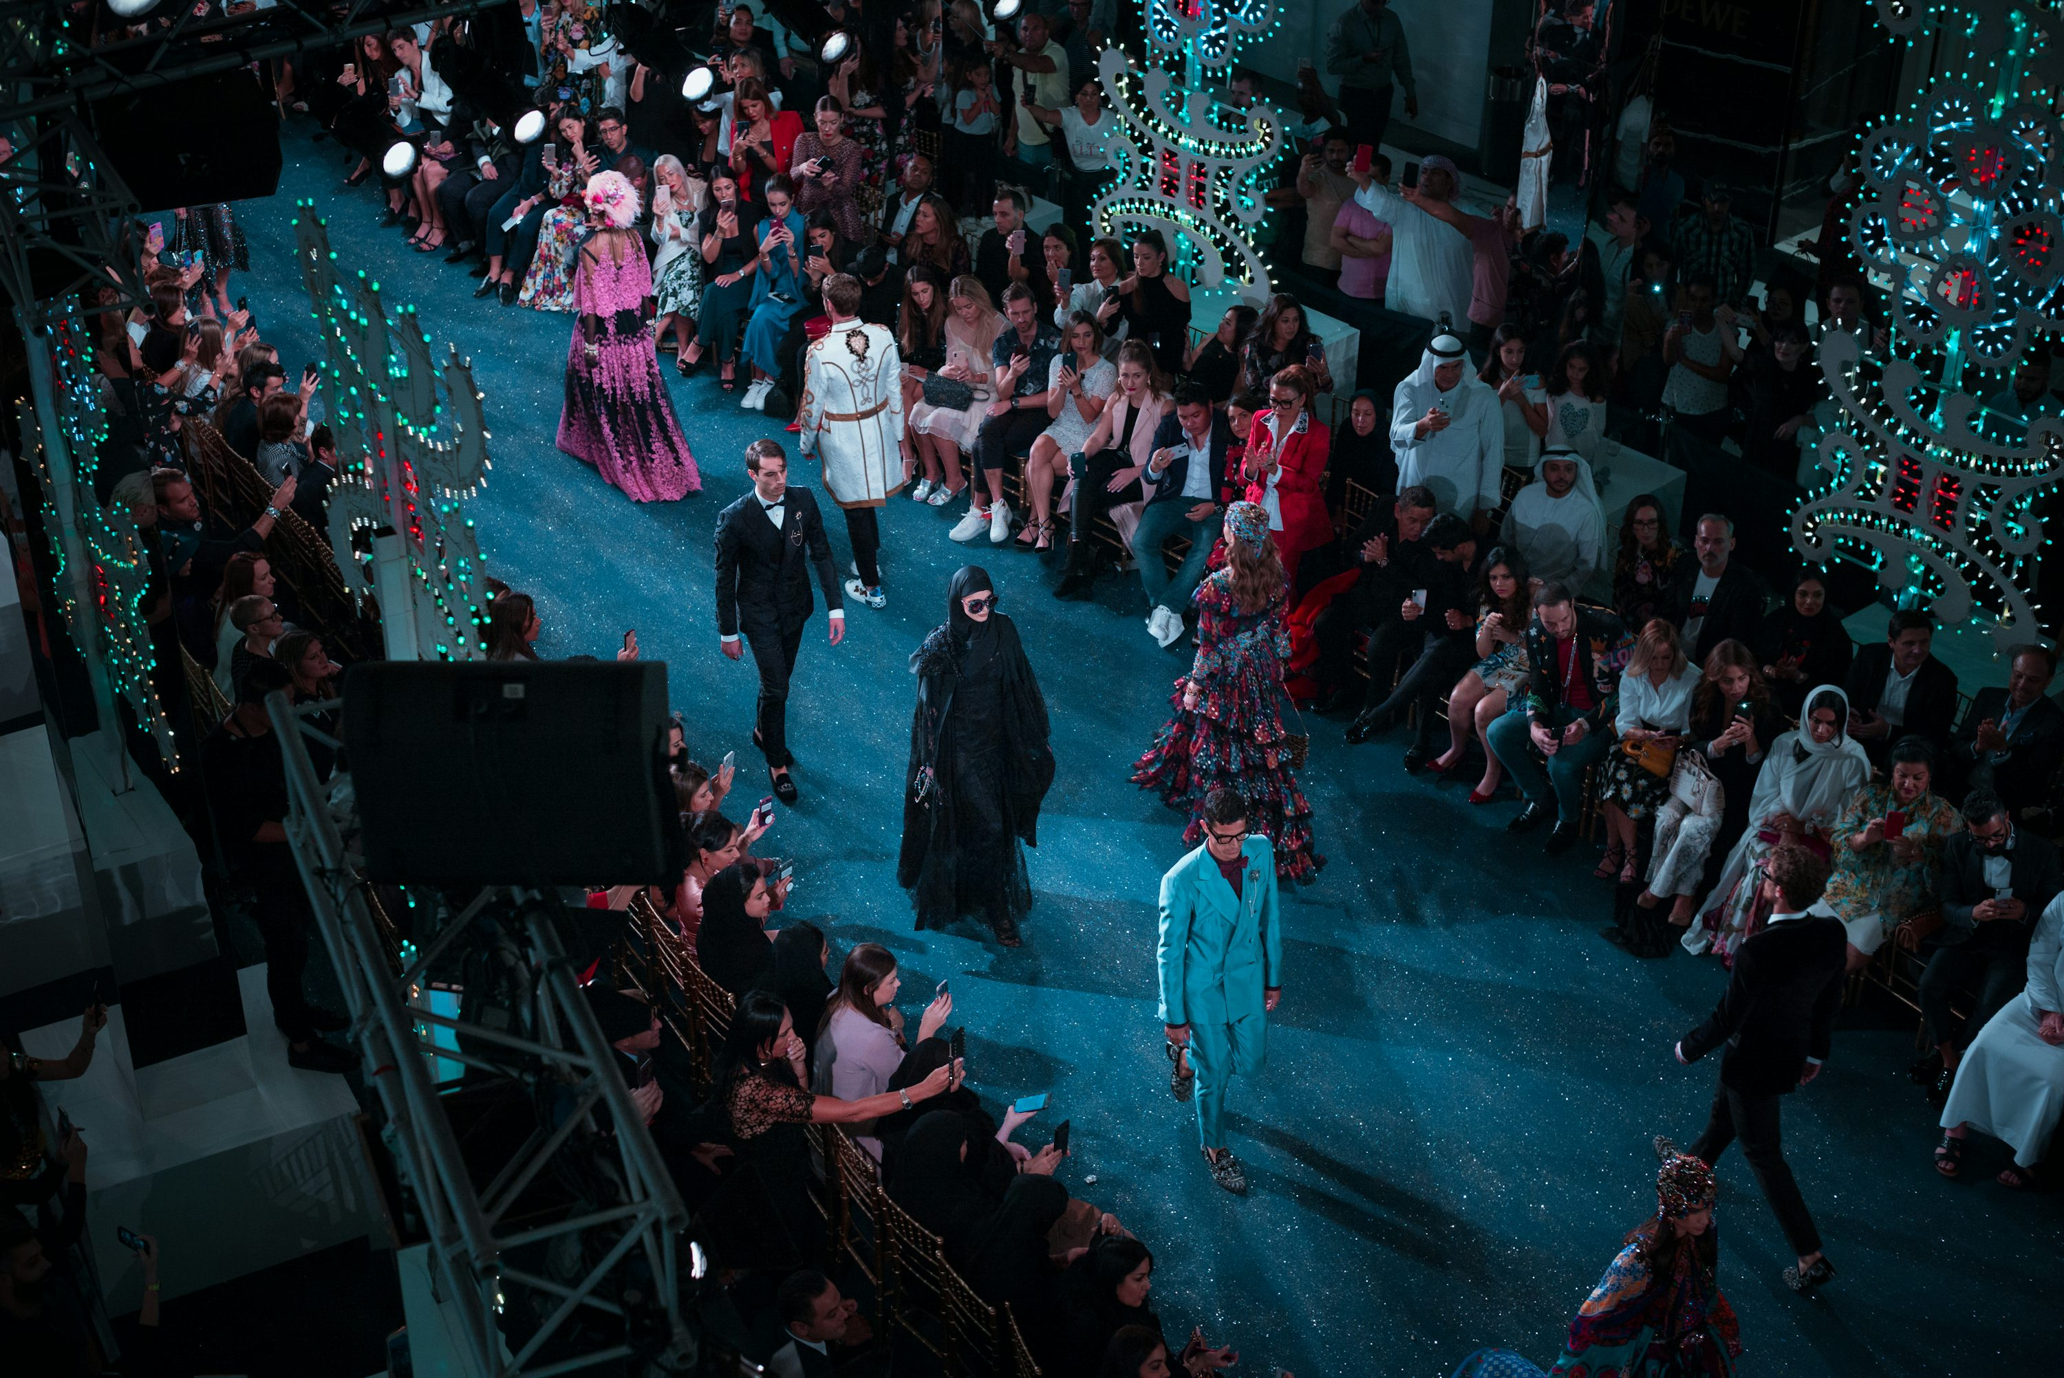
Fashion model

Slide 11
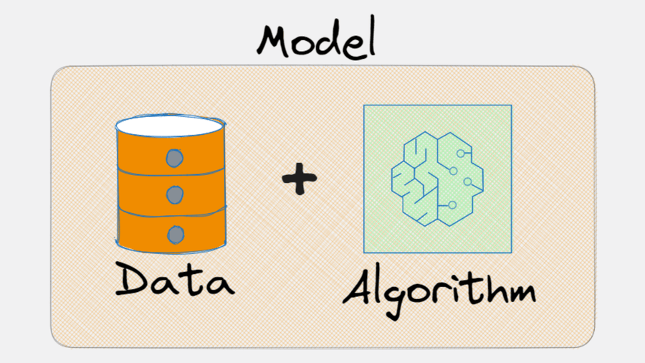

Machine Learning model
유일한 데이터를 바탕으로 여러 가지 알고리즘으로 여러 가지 모델을 생성
Data : $X,y$
Algorithm : $f$
Model :$f(X)$
https://x.com/levikul09/status/1676884107018551296

Slide 12
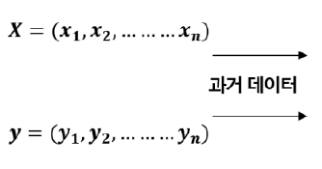
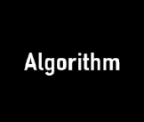

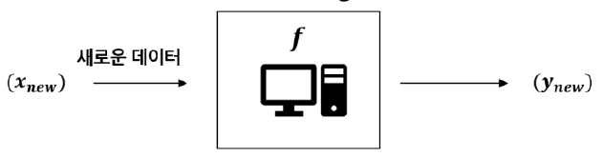
Machine Learning
과거의 데이터에 숨겨진 패턴을 찾아내기 위해 컴퓨터에게 알고리즘을 학습시켜 목적을 달성
학습(Learn/Fit/Training)
예측(Predict)

Slide 13
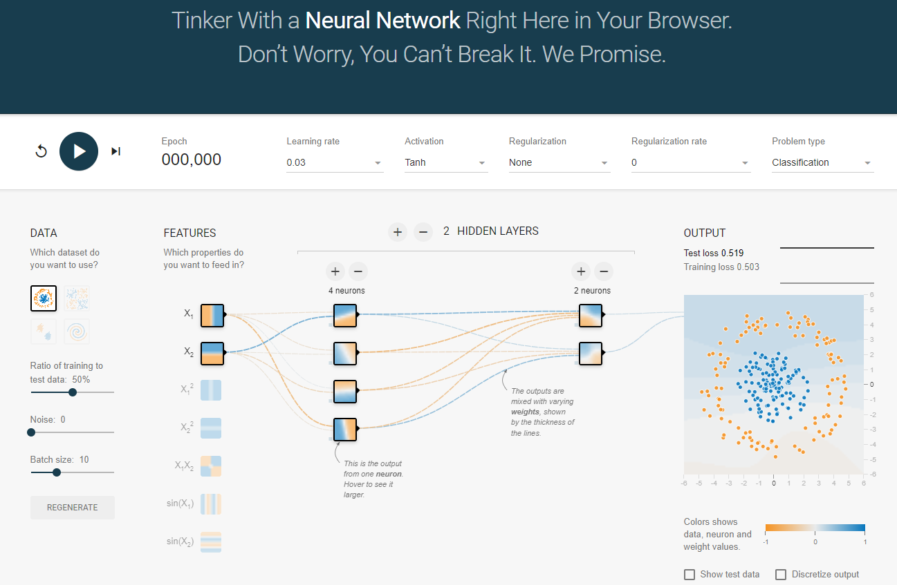
Deep Learning
https://playground.tensorflow.org/

Slide 14
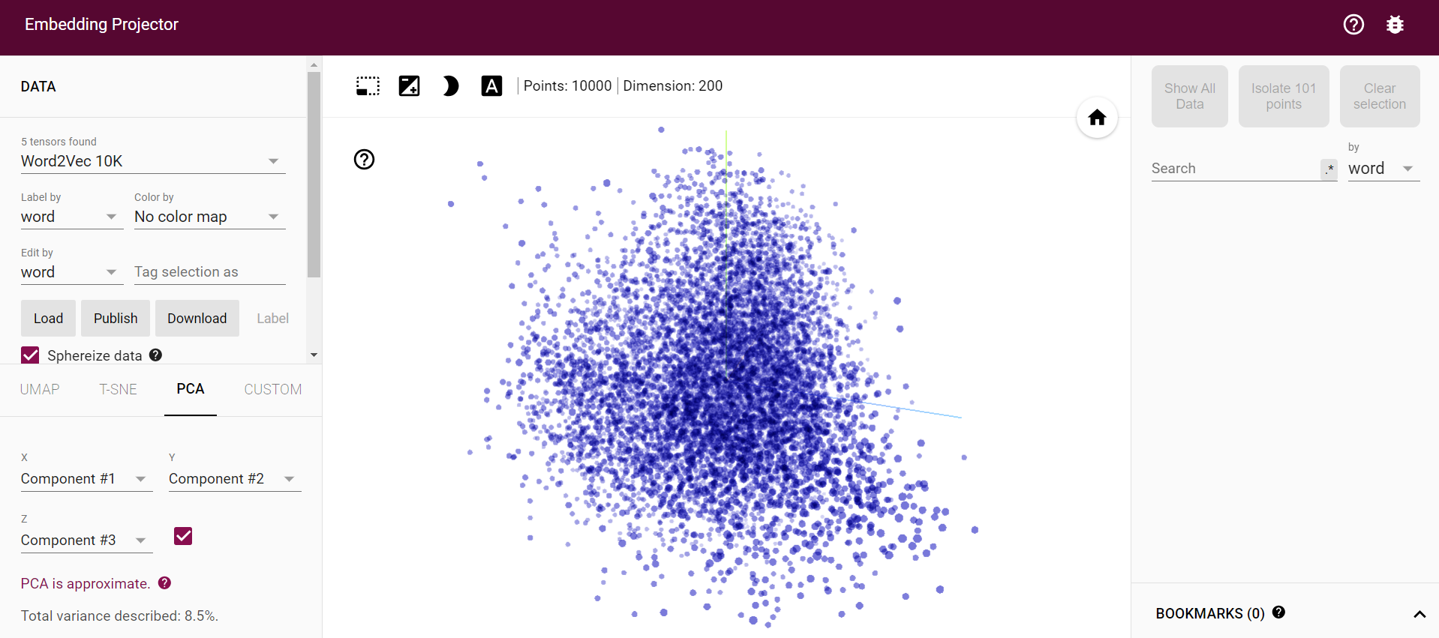
Deep Learning
https://projector.tensorflow.org/

Slide 15
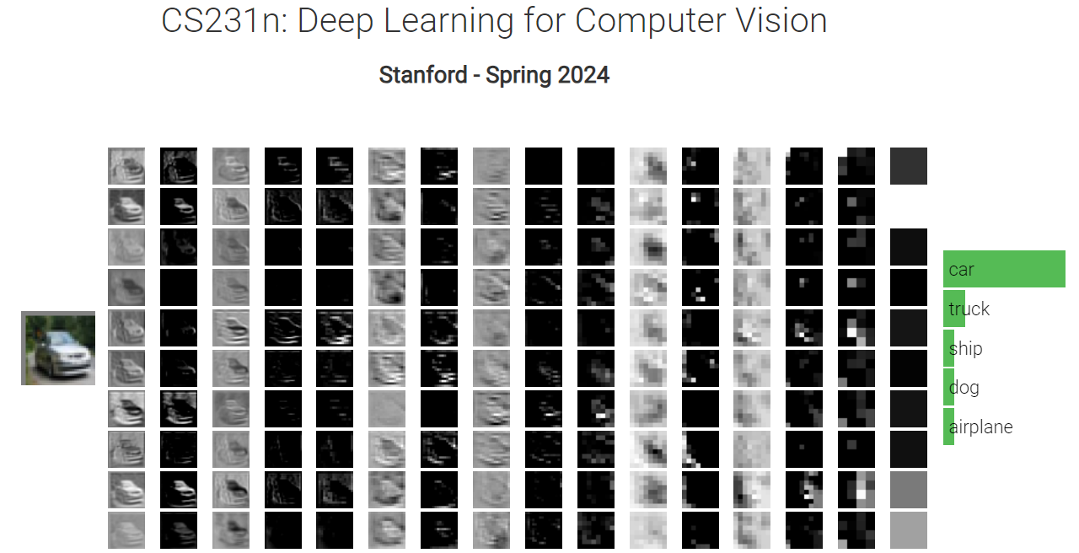
Deep Learning
http://vision.stanford.edu/teaching/cs231n/2024/

