Slide 1
빅데이터 처리
경복대학교 빅데이터과
조상구교수
2024.10.10

Slide 2
목차
Python (Syntax, Module, Package, Class)
Data Wrangling Visualization (Pandas, Matplotlib, Seaborn)
Network & Database (REST API, Sqlite, FastAPI, Streamlit/Gradio)
Machine Learning (Scikit-learn, Pycaret)
Deep Learning (Keras)

Slide 3
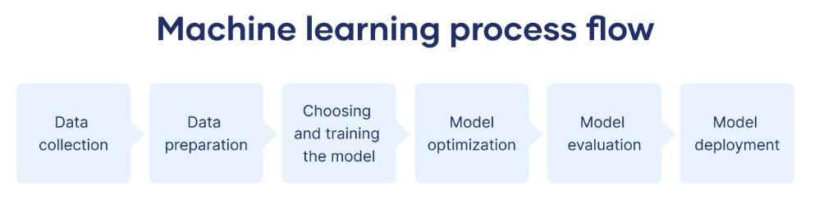
머신러닝 절차
https://www.scribbr.co.uk/using-ai-tools/what-is-machine-learning/

Slide 4
Python
Task | Single Value | Multiple Values | numpy, pandas
Presentation (value, variable) | int, float, string, boolean | list, tuple, dictionary, set | ndarray, Series, DataFrame
Operation (algebra) | expressions | operations, mutable operations | expressions, get, set, reshape, …
Control flow | if for while
Use and reuse | Functions Standard libraries Modules and Packages
Input and output | Standard I/O File I/O |  | Standard I/O File I/O CSV, Excel
https://github.com/ancestor9/24_spring_python-programimming-1

Slide 5
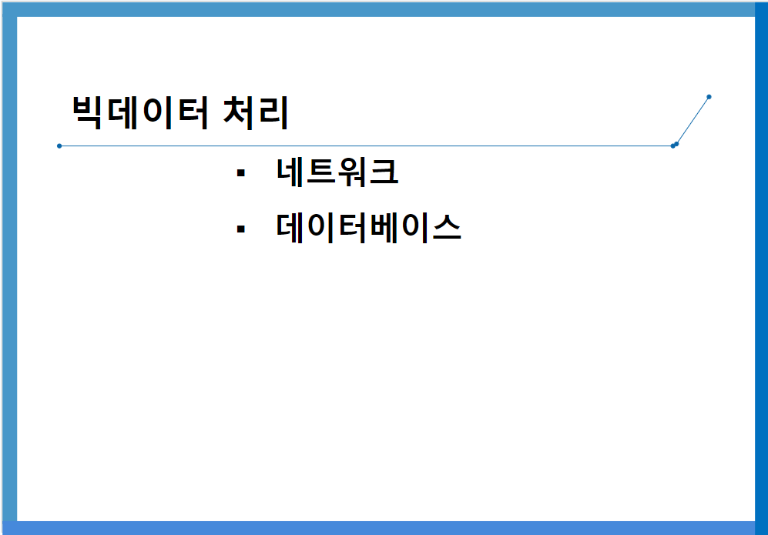
Network & Database
https://github.com/ancestor9/24_fall_Big-Data-Processing-coding-/blob/main/빅데이터처리_네트워크_DB_20241010.pptx

Slide 6
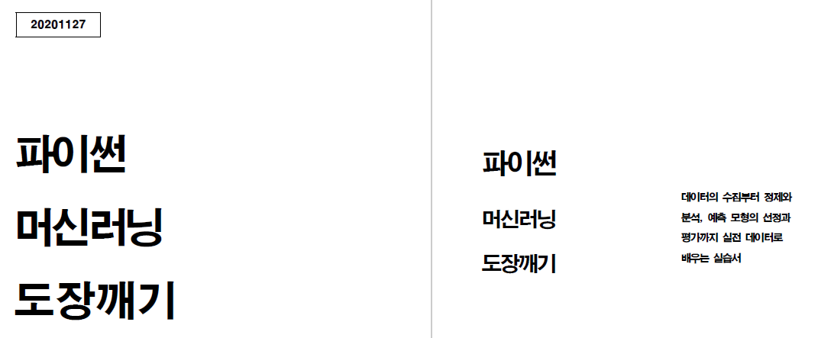
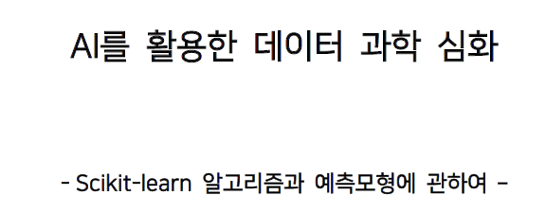
Machine Learning
https://github.com/ancestor9/24_spring_python-programimming-1

Slide 7
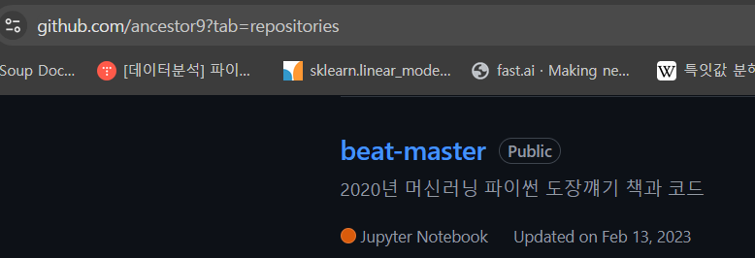
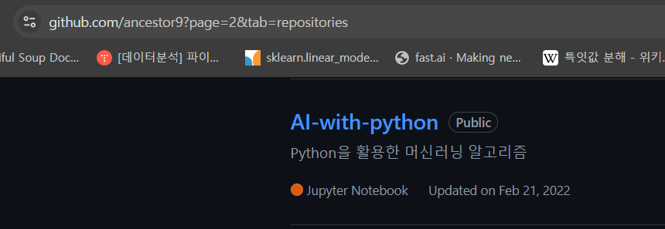
Machine Learning

Slide 8
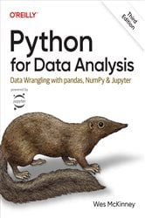
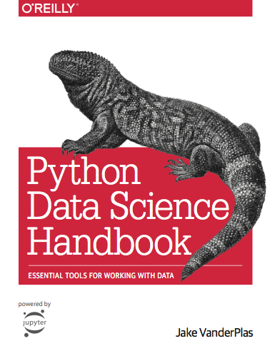
참고교재

Slide 9
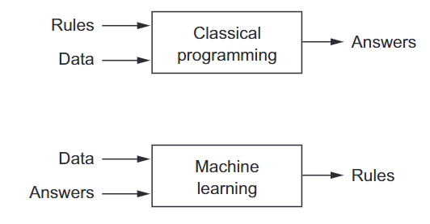
A new programming paradigm

Slide 10
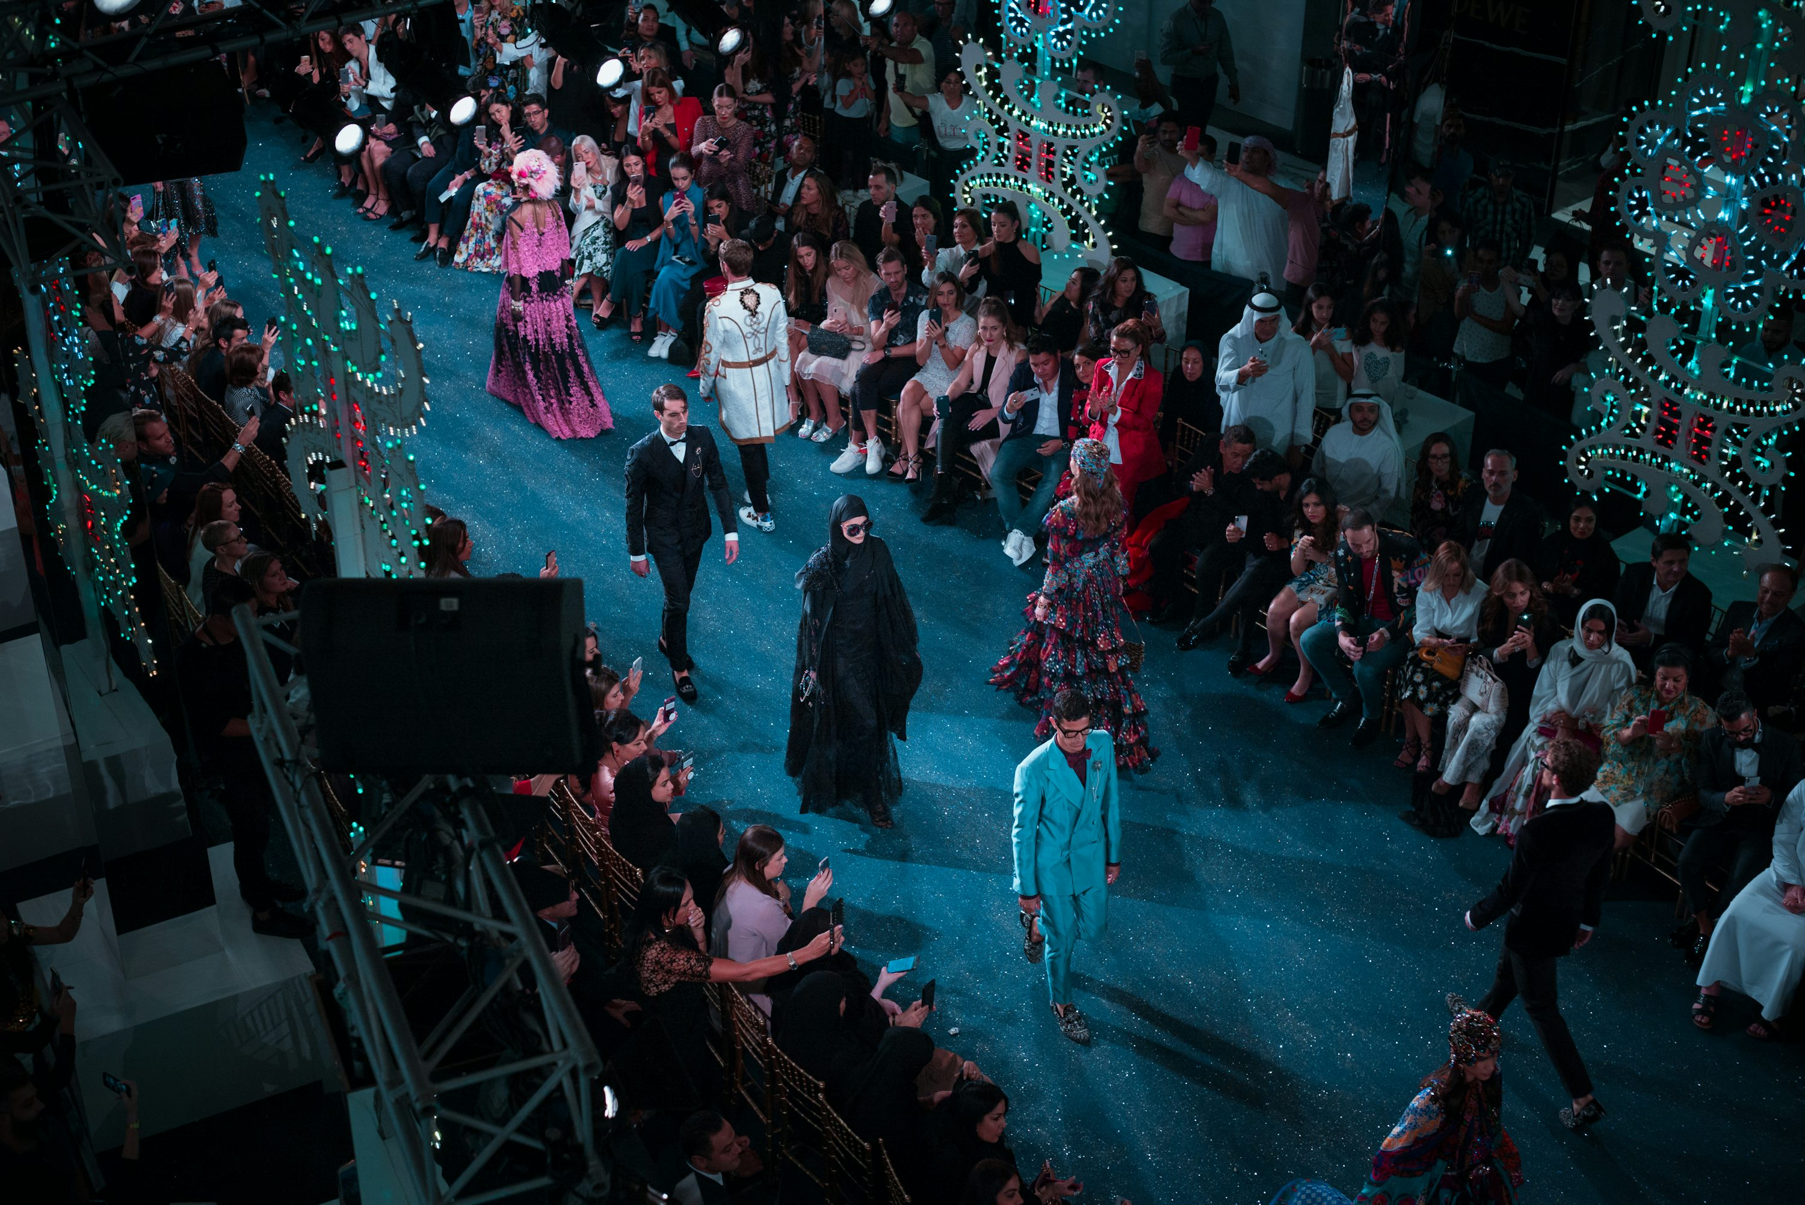
Fashion model

Slide 11
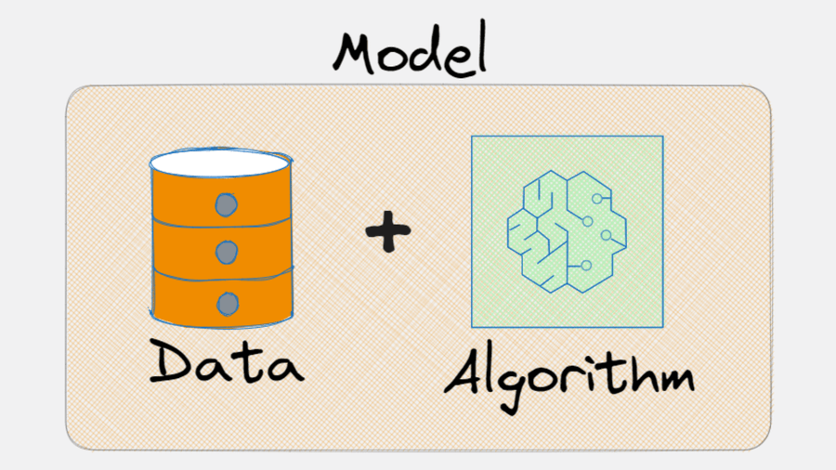


Machine Learning model
유일한 데이터를 바탕으로 여러 가지 알고리즘으로 여러 가지 모델을 생성
Data : $X,y$
Algorithm : $f$
Model :$f(X)$
$g\left(X\right), h\left(x\right)$, ……………….,
$$deeplearning\left(X\right), chatGPT(X)$$
https://x.com/levikul09/status/1676884107018551296

Slide 12
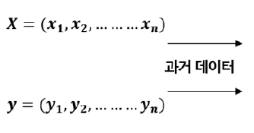
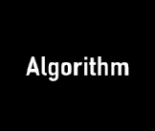

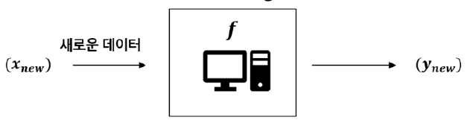
Machine Learning
과거의 데이터에 숨겨진 패턴을 찾아내기 위해 컴퓨터에게 알고리즘을 학습시켜 목적을 달성
학습(Learn/Fit/Training)
예측(Predict)

Slide 13
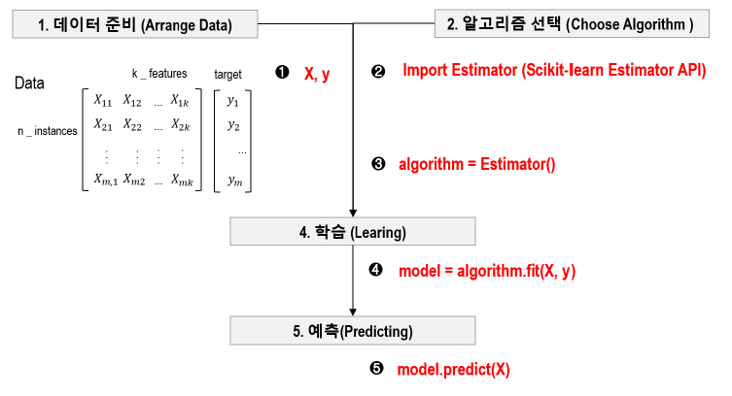
Machine Learning
데이터와 알고리즘을 선택하여 컴퓨터에게 학습시켜 목적(예측, 변환)을 달성

Slide 14
Machine Learning
데이터와 알고리즘을 선택하여 컴퓨터에게 학습시켜 목적(예측, 변환)을 달성
# Load the iris dataset & use the 'target' as labels and the 'data' as features
iris = load_iris()
X = iris.data; y = iris.target
# Split the dataset into training and testing sets
X_train, X_test, y_train, y_test = train_test_split(X, y, test_size=0.3)
# Initialize the logistic regression model
log_reg = LogisticRegression()
# Fit the model to the training data
log_reg.fit(X_train, y_train)
# Predict on the test data
y_pred = log_reg.predict(X_test)
https://scikit-learn.org/1.5/modules/generated/sklearn.linear_model.LogisticRegression.html

Slide 15
Machine Learning
데이터와 알고리즘을 선택하여 컴퓨터에게 학습시켜 목적(예측, 변환)을 달성
# Build the Keras model with Single logistic regression layer
model = Sequential()
model.add(Dense(1, input_dim=4, activation='sigmoid’))
# Compile the model
model.compile(optimizer=SGD)
# Train the model
model.fit(X_train, y_train)
# Predict on test data
y_pred = (model.predict(X_test)

Slide 16
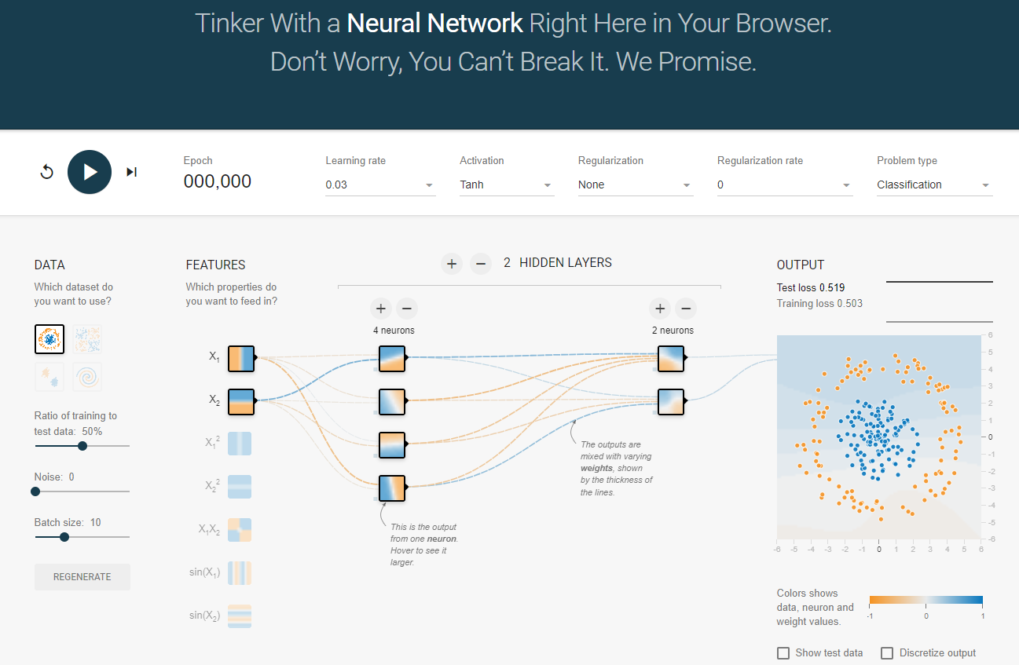
Deep Learning
https://playground.tensorflow.org/

Slide 17
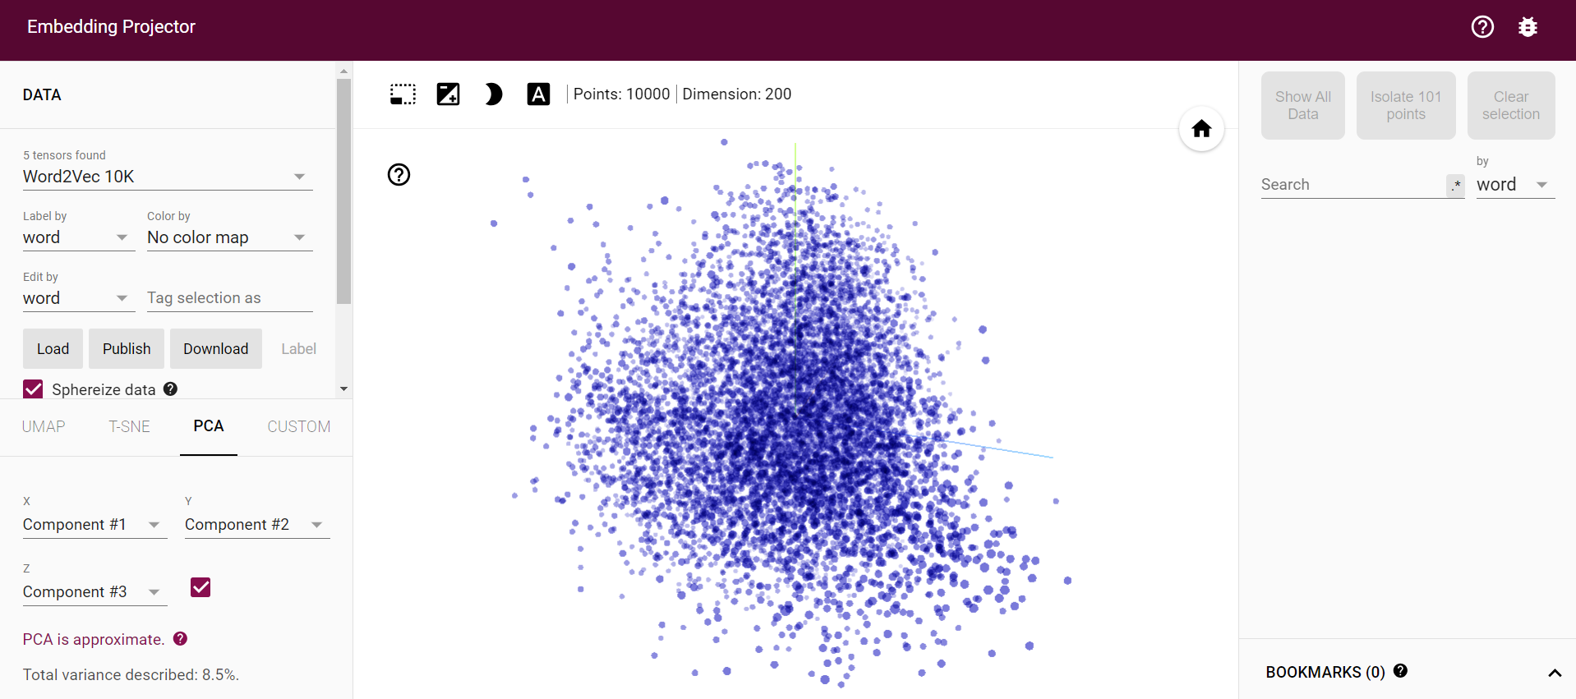
Deep Learning
https://projector.tensorflow.org/

Slide 18
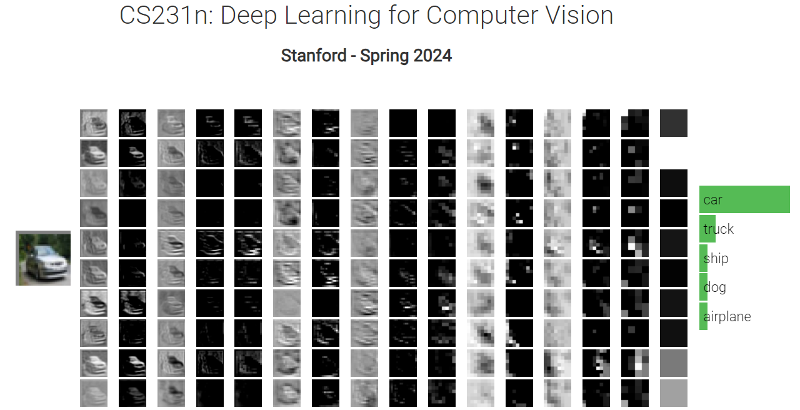
Deep Learning
http://vision.stanford.edu/teaching/cs231n/2024/

