Slide 1


Buffer, Stream

Slide 2
Contents
Computer Mechanism
Buffer & Stream

Slide 3





Computer Mechanism
Process
User
Socket(File)
TCP
S/W
Kernel
IP
Driver
H/W
NIC
(Network Interface Card)

Slide 4



Process 식별자는 Port 번호
Process
Port
Socket(File)
Port 111
Port 112
Port 113
TCP
Port Forwarding
Router
IP
Driver
NIC
(Network Interface Card)
Data

Slide 5


Network Data의 단위(stream)
Process
File I/O, Write
Stream
Port
Socket(File)
TCP
Segment
Router
IP
Packet
Driver
NIC
(Network Interface Card)
Frame
Data

Slide 6
socket program_sever
def start_echo_server():
HOST = "127.0.0.1"
PORT = 65432
with socket.socket(socket.AF_INET, socket.SOCK_STREAM) as s:
s.bind((HOST, PORT))
s.listen()
print("Server listening on port", PORT)
conn, addr = s.accept()
with conn:
print(f"Connected by {addr}")
while True:
data = conn.recv(1024)
if not data:
break
conn.sendall(data)
server_thread = threading.Thread(target=start_echo_server)
server_thread.start()
# Expose the server using ngrok (TCP)
tcp_tunnel = ngrok.connect(65432, "tcp")
print("TCP Tunnel URL:", tcp_tunnel.public_url)
!pip install pyngrok
# Import ngrok
# set up the authentication token
from pyngrok import ngrok
ngrok.set_auth_token('2bLpL????vLJn5’)
import socket
import threading

Slide 7
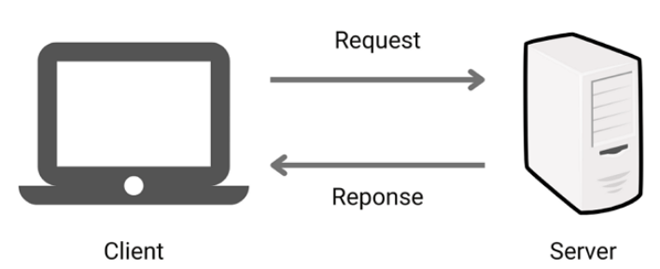
socket program_client
import socket
# Replace this with the TCP URL printed by the ngrok in the previous cell
NGROK_TCP_URL = tcp_tunnel.public_url
# Extract the host and port from the ngrok TCP URL
_, host_port = NGROK_TCP_URL.split("//")
host, port = host_port.split(":")
port = int(port)
with socket.socket(socket.AF_INET, socket.SOCK_STREAM) as s:
s.connect((host, port))
s.sendall(b"Hello, world")
data = s.recv(1024)
print(f"Received {data!r}")
Connected by ('127.0.0.1', 42096)
Received b'Hello, world'
Server listening on port 65432
TCP Tunnel URL: tcp://6.tcp.ngrok.io:11761

Slide 8
Contents
Computer Mechanism
Buffer & Stream

Slide 9
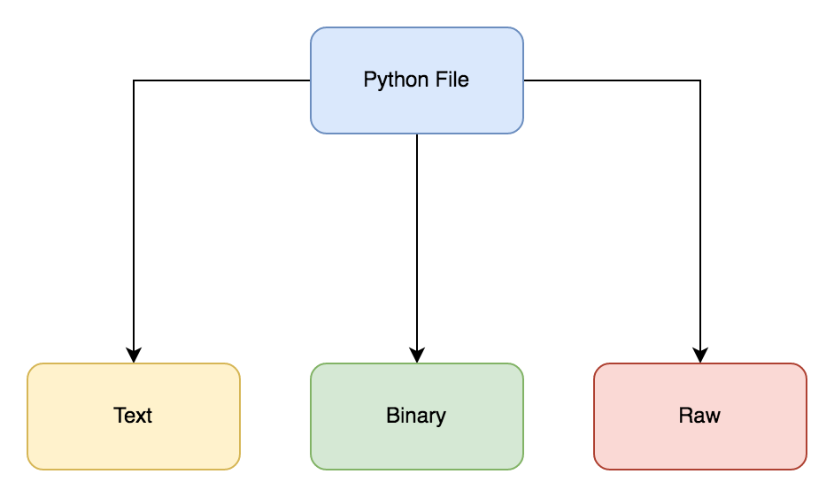
Python I/O streams and buffers
https://medium.com/dev-bits/ultimate-guide-for-working-with-i-o-streams-and-zip-archives-in-python-3-6f3cf96dca50

Slide 10
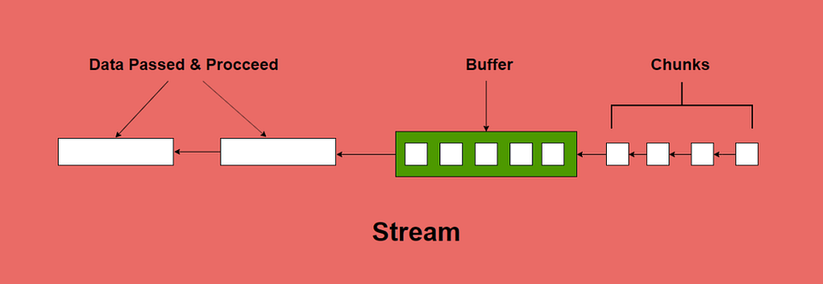
Buffer, Stream
https://blog.stackademic.com/difference-between-buffer-and-streams-in-node-js-3df61531414c

Slide 11
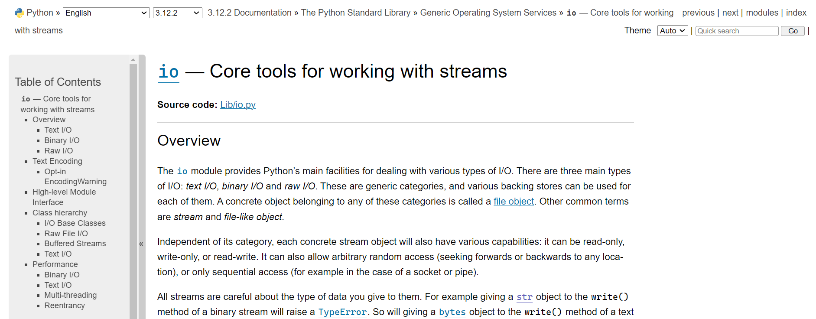
Buffer, Stream
https://docs.python.org/ko/3/library/io.html
https://docs.python.org/3/library/io.html

