Slide 1


Pandas
week 14

Slide 2
pandas

Slide 3
Topic Structure
Task | Single Value | Multiple Values | numpy, pandas
Presentation (value, variable) | int, float, string, boolean | list, tuple, dictionary, set | ndarray, Series, DataFrame
Operation (algebra) | expressions | operations, mutable operations | expressions, get, set, reshape, …
Control flow | if for while
Use and reuse | Functions Standard libraries Modules and Packages
Input and output | Standard I/O File I/O |  | Standard I/O File I/O CSV, Excel

Slide 4
Learning Objectives
What is pandas
Core
Object Creation
Viewing Data
Selection
Operations
Merge
Grouping
Reshaping
Time Series
Categoricals
Plotting
Getting Data In/Out

Slide 5
Merge: Concat
pandas provides various facilities for easily combining together Series, DataFrame, and Panel objects with various kinds of set logic for the indexes and relational algebra functionality in the case of join / merge-type operations.
Concatenating pandas objects together with concat():
import numpy as np
import pandas as pd
df = pd.DataFrame(np.random.randn(10, 4))
print(df)
# 0 1 2 3
# 0 -1.084581 -1.798968 -0.572917 -0.408600
# 1 0.261568 -0.918721 -0.742123 -0.202920
# 2 -0.832632 0.295318 0.868902 -0.776710
# 3 -0.284358 0.816428 0.036101 -0.658961
# 4 0.569674 0.543140 1.253828 -0.608703
# 5 -0.485940 -0.504054 -0.554351 -0.584281
# 6 -0.215461 0.059088 2.453443 -0.430747
# 7 1.354619 2.163310 -1.813315 -1.052961
# 8 1.495016 0.171376 0.942575 0.257720
# 9 0.728801 -1.163338 -1.450089 -1.305426
# break it into pieces
pieces = [df[:3], df[3:6], df[7:]]
print(pd.concat(pieces))
# 0 1 2 3
# 0 -1.084581 -1.798968 -0.572917 -0.408600
# 1 0.261568 -0.918721 -0.742123 -0.202920
# 2 -0.832632 0.295318 0.868902 -0.776710
# 3 -0.284358 0.816428 0.036101 -0.658961
# 4 0.569674 0.543140 1.253828 -0.608703
# 5 -0.485940 -0.504054 -0.554351 -0.584281
# 7 1.354619 2.163310 -1.813315 -1.052961
# 8 1.495016 0.171376 0.942575 0.257720
# 9 0.728801 -1.163338 -1.450089 -1.305426

Slide 6
Merge: Concat
Concatenating pandas objects together with concat():
import pandas as pd
import glob
# generate dataframes and upload those into google root drive
for i in range(10):
filename = f'df_{i}.csv’
pd.DataFrame(np.random.randn(100,4)).to_csv(filename)
files = glob.glob(‘*.csv’)
files
# Reads multiple files via for loop and merge single dataframe.
df = pd.DataFrame()
for file in files:
tf = pd.read_csv(file)
df = pd.concat([tf, df])
df.index = range(len(df))
# Using list comprehension syntax
df = pd.concat([pd.read_csv(file) for file in files],
ignore_index=True)

Slide 7
Merge: Concat
pandas provides various facilities for easily combining together Series, DataFrame, and Panel objects with various kinds of set logic for the indexes and relational algebra functionality in the case of join / merge-type operations.
Concatenating pandas objects together with concat():
import numpy as np
import pandas as pd
df = pd.DataFrame(np.random.randn(6, 4))
print(df)
# 0 1 2 3
# 0 0.418580 -1.687929 0.620796 0.464855
# 1 -1.839742 0.032308 1.353352 1.704181
# 2 0.232234 0.430497 0.873095 -0.639765
# 3 0.056312 0.146127 -0.543622 -1.017337
# 4 1.039911 -1.055262 0.834883 1.079062
# 5 0.004134 0.481104 -1.525144 0.654838
df3 = pd.DataFrame(np.random.randn(3, 4))
print(df3)
# 0 1 2 3
# 0 0.035366 0.291673 0.026395 -0.997831
# 1 -0.977021 -0.159758 -0.919864 0.016417
# 2 -0.068417 -1.221108 0.358600 -0.628889
pieces = [df, df3]
print(pd.concat(pieces))
# 0 1 2 3
# 0 0.418580 -1.687929 0.620796 0.464855
# 1 -1.839742 0.032308 1.353352 1.704181
# 2 0.232234 0.430497 0.873095 -0.639765
# 3 0.056312 0.146127 -0.543622 -1.017337
# 4 1.039911 -1.055262 0.834883 1.079062
# 5 0.004134 0.481104 -1.525144 0.654838
# 0 0.035366 0.291673 0.026395 -0.997831
# 1 -0.977021 -0.159758 -0.919864 0.016417
# 2 -0.068417 -1.221108 0.358600 -0.628889

Slide 8
Merge: Join
SQL style merges:
import pandas as pd
left = pd.DataFrame({'key': ['foo', 'foo'], 'lval': [1, 2]})
print(left)
# key lval
# 0 foo 1
# 1 foo 2
right = pd.DataFrame({'key': ['foo', 'foo'], 'rval': [4, 5]})
print(right)
# key rval
# 0 foo 4
# 1 foo 5
print(pd.merge(left, right, on='key’))
# cartesian product, 순서쌍
# key lval rval
# 0 foo 1 4
# 1 foo 1 5
# 2 foo 2 4
# 3 foo 2 5

Slide 9
Merge: Join
Another example that can be given is:
import pandas as pd
left = pd.DataFrame({'key': ['foo', 'bar'], 'lval': [1, 2]})
print(left)
# key lval
# 0 foo 1
# 1 bar 2
right = pd.DataFrame({'key': ['foo', 'bar'], 'rval': [4, 5]})
print(right)
# key rval
# 0 foo 4
# 1 bar 5
print(pd.merge(left, right, on='key')) # natural join
# key lval rval
# 0 foo 1 4
# 1 bar 2 5

Slide 10
Merge: Append
Append rows to a dataframe:
import numpy as np
import pandas as pd
df = pd.DataFrame(np.random.randn(8, 4), columns=['A', 'B', 'C', 'D'])
print(df)
# A B C D
# 0 1.328701 -1.196459 0.737132 0.251009
# 1 -0.074176 0.487712 1.723963 -1.251651
# 2 1.125521 0.348822 -0.744930 0.495948
# 3 0.451943 -0.131888 -0.728642 1.034037
# 4 1.415927 -0.342016 1.853674 -0.140663
# 5 -0.168039 -0.933839 0.446256 -0.178408
# 6 1.227551 -0.345053 -0.915640 -0.294697
# 7 0.002324 -1.038764 1.326291 -0.395847
s = df.iloc[3]
print(df.append(s, ignore_index=True))
# A B C D
# 0 1.328701 -1.196459 0.737132 0.251009
# 1 -0.074176 0.487712 1.723963 -1.251651
# 2 1.125521 0.348822 -0.744930 0.495948
# 3 0.451943 -0.131888 -0.728642 1.034037
# 4 1.415927 -0.342016 1.853674 -0.140663
# 5 -0.168039 -0.933839 0.446256 -0.178408
# 6 1.227551 -0.345053 -0.915640 -0.294697
# 7 0.002324 -1.038764 1.326291 -0.395847
# 8 0.451943 -0.131888 -0.728642 1.034037

Slide 11
Merge: Append
Append rows to a dataframe:
import numpy as np
import pandas as pd
df = pd.DataFrame(np.random.randn(8, 4), columns=['A', 'B', 'C', 'D'])
print(df)
# A B C D
# 0 1.328701 -1.196459 0.737132 0.251009
# 1 -0.074176 0.487712 1.723963 -1.251651
# 2 1.125521 0.348822 -0.744930 0.495948
# 3 0.451943 -0.131888 -0.728642 1.034037
# 4 1.415927 -0.342016 1.853674 -0.140663
# 5 -0.168039 -0.933839 0.446256 -0.178408
# 6 1.227551 -0.345053 -0.915640 -0.294697
# 7 0.002324 -1.038764 1.326291 -0.395847
s = df.iloc[3]
print(df.append(s, ignore_index=False))
# A B C D
# 0 1.328701 -1.196459 0.737132 0.251009
# 1 -0.074176 0.487712 1.723963 -1.251651
# 2 1.125521 0.348822 -0.744930 0.495948
# 3 0.451943 -0.131888 -0.728642 1.034037
# 4 1.415927 -0.342016 1.853674 -0.140663
# 5 -0.168039 -0.933839 0.446256 -0.178408
# 6 1.227551 -0.345053 -0.915640 -0.294697
# 7 0.002324 -1.038764 1.326291 -0.395847
# 3 0.451943 -0.131888 -0.728642 1.034037

Slide 12
Practice(1/3)
Let’s practice all kinds of merge methods ;
import pandas as pd
# Show all results
from IPython.core.interactiveshell import InteractiveShell
InteractiveShell.ast_node_interactivity = 'all’
# Display all results side by side
from IPython.display import display_html
def display_side_by_side(*args):
html_str=''
for df in args:
html_str += df.to_html()
display_html(html_str.replace('table','table style="display:inline"'), raw=True)
# Create an example DataFrame
def make_df(var, obs):
data = {c: [str(c) + str(i) for i in obs]
for c in var}
return pd.DataFrame(data, obs)

Slide 13
Practice(2/3)
Create two datasets and display
df1 = make_df('ABCD', [0,1,2,3]); df2 = make_df('DEFG', [1,2,3,4])
show_side_by_side(df1, df2)
Merge two datasets with 1:1 relationship and display
df3 = pd.merge(df1, df2)
show_side_by_side(df1, df2, df3)
Merge two datasets with 1:M relationship and display
df4 =make_df('DHIJ', [0,1,1,2,2,3])
show_side_by_side(df3, df4)
df5 =pd.merge(df3,df4)
show_side_by_side(df3, df4, df5)

Slide 14
Practice(3/3)
Merge two datasets with M:1 relationship and display
show_side_by_side(df4, df3)
df6 = pd.merge(df4, df3)
show_side_by_side(df4, df3, df6)
Merge two datasets with M:M relationship and display
show_side_by_side(df4, df5)
show_side_by_side(df4, df5, pd.merge(df4, df5))
Concatenate multiple same datasets
show_side_by_side(df1,
pd.concat([df1, df1, df1]),
pd.concat([df1, df1, df1]).reset_index(),
pd.concat([df1, df1, df1], ignore_index=True))
Concatenate multiple same datasets
show_side_by_side(df1,
df1.append([df1, df1], ignore_index=True)
)

Slide 15
Learning Objectives
What is pandas
Core
Object Creation
Viewing Data
Selection
Operations
Merge
Grouping
Reshaping
Time Series
Categoricals
Plotting
Getting Data In/Out

Slide 16
Grouping
By "group by" we are referring to a process involving one or more of the following steps:
Splitting the data into groups based on some criteria
Applying a function to each group independently
Combining the results into a data structure
Grouping and then applying the sum() function to the resulting groups:
import numpy as np
import pandas as pd
df = pd.DataFrame({'A': ['foo', 'bar', 'foo', 'bar', 'foo', 'bar', 'foo', 'foo'],
'B': ['one', 'one', 'two', 'three', 'two', 'two', 'one', 'three'],
'C': np.random.randn(8),
'D': np.random.randn(8)})
print(df)
# A B C D
# 0 foo one -0.040955 -1.548653
# 1 bar one 0.534660 0.531058
# 2 foo two -1.061675 -1.545052
# 3 bar three -1.101773 0.654828
# 4 foo two 0.198572 -1.740565
# 5 bar two 1.275893 -1.087366
# 6 foo one -0.472633 -1.427343
# 7 foo three -2.230571 0.127562
print(df.groupby('A').sum())
# C D
# A
# bar 0.708780 0.098520
# foo -3.607262 -6.134051

Slide 17
Grouping
print(df)
# A B C D
# 0 foo one -1.636098 1.966528
# 1 bar one -1.637800 -0.304297
# 2 foo two -0.018609 -0.577963
# 3 bar three -0.567921 -1.814612
# 4 foo two -0.674567 -1.129757
# 5 bar two 0.215128 0.756085
# 6 foo one 0.607956 0.783899
# 7 foo three -0.003163 -1.310437
print(df.groupby(['A', 'B']).sum())
# C D
# A B
# bar one -1.637800 -0.304297
# three -0.567921 -1.814612
# two 0.215128 0.756085
# foo one -1.028143 2.750427
# three -0.003163 -1.310437
# two -0.693176 -1.707720
Grouping by multiple columns forms a hierarchical index, and again we can apply the sum() function:
import numpy as np
import pandas as pd
df = pd.DataFrame({'A': ['foo', 'bar', 'foo', 'bar', 'foo', 'bar', 'foo', 'foo'],
'B': ['one', 'one', 'two', 'three', 'two', 'two', 'one', 'three'],
'C': np.random.randn(8),
'D': np.random.randn(8)})

Slide 18
Grouping : value_counts().unstack().fillna(0) (1/5)
Grouping by product into a value_counts() and again we can impute the nan with unstack() function:
import numpy as np
import pandas as pd
import matplotlib.pyplot as plt
df = pd.DataFrame({'상품' : [np.random.choice(list('ABCDEFGHI')) for _ in range(100)],
‘고객' : [np.random.choice(30) for _ in range(100)]})
df.groupby('상품')['고객'].value_counts()
df.groupby('상품')['고객'].value_counts().unstack()
df.groupby('상품')['고객'].value_counts().unstack().fillna(0) # No customer chosen the specific product.

Slide 19
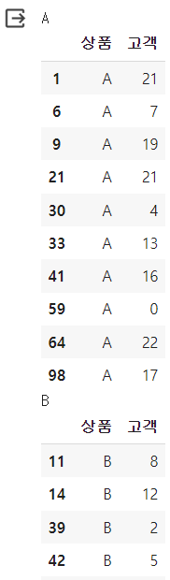
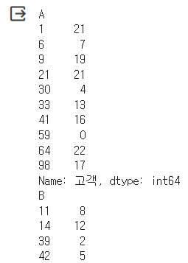
Digress : Dive into the groupby
Let’s see the details into Grouping by product
for i, j in df.groupby('상품'):
print(i) # group by ‘상품’
display(j) # display dataframe grouped by ‘상품’
for i, j in df.groupby('상품')['고객’]: # ‘고객’ 컬럼만 display
print(i) # group by ‘상품’
display(j) # display series grouped by ‘상품’

Slide 20
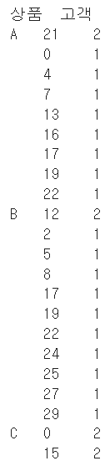
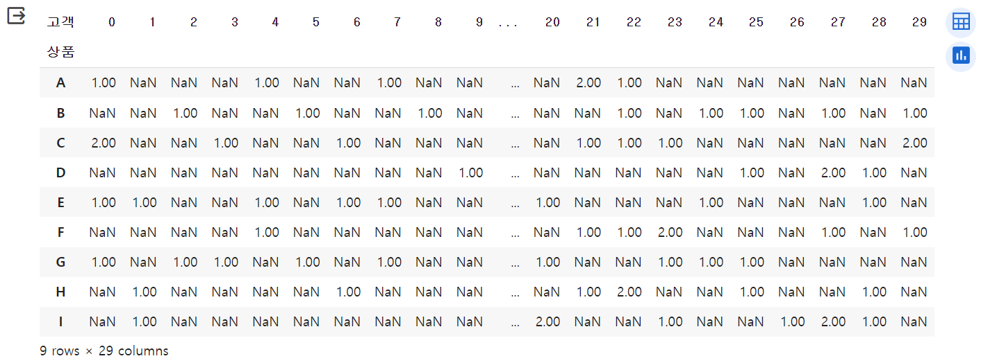
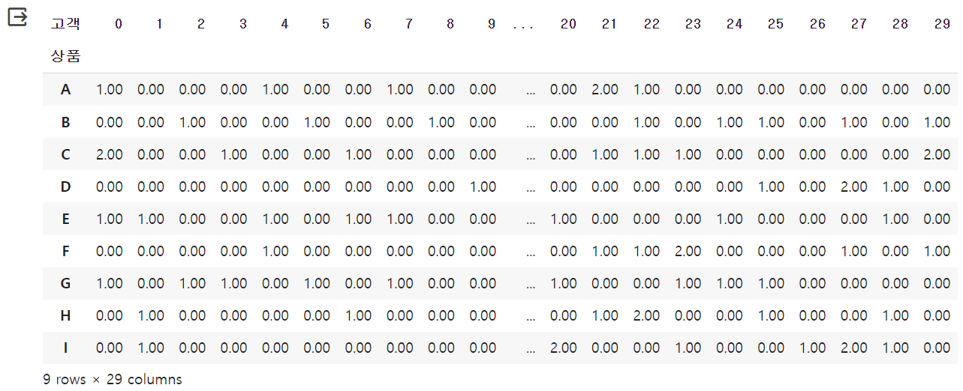
Grouping : value_counts().unstack().fillna(0) (2/5)
df.groupby('상품')['고객'].value_counts()
df.groupby('상품')['고객'].value_counts().unstack()
df.groupby('상품')['고객'].value_counts().unstack().fillna(0)

Slide 21

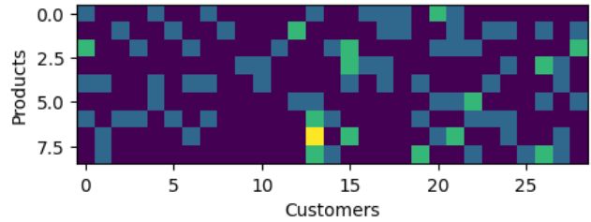
Grouping : value_counts().unstack().fillna(0) (3/5)
Data visualization by groupby() + value_counts():
X = df.groupby('상품')['고객'].value_counts().unstack().fillna(0)
plt.imshow(X)
plt.xlabel('Customers')
plt.ylabel('Products')
plt.colorbar()

Slide 22
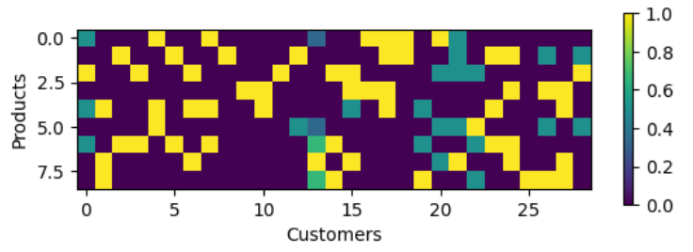
Grouping : value_counts().unstack().fillna(0) (4/5)
Data visualization by data scaling minmax:
plt.imshow(X/X.max()) # data scaling
plt.xlabel('Customers')
plt.ylabel('Products')
plt.colorbar(shrink=0.4)

Slide 23
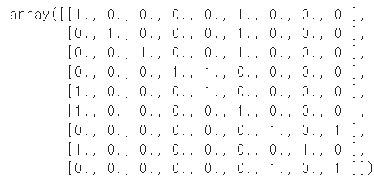
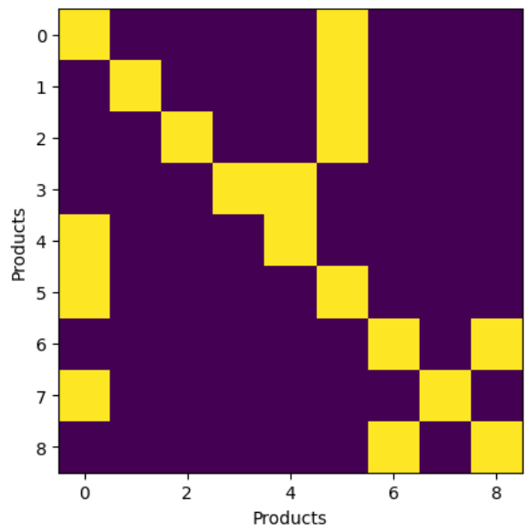
Grouping : value_counts().unstack().fillna(0) (5/5)
Data visualization by nearest neighbors: https://scikit-learn.org/stable/modules/neighbors.html#finding-the-nearest-neighbors
from sklearn.neighbors import NearestNeighbors
nbrs = NearestNeighbors(n_neighbors=2).fit(X)
distances, indices = nbrs.kneighbors(X)
indices # 가까운 상품이 어떤건지 보여줌
nbrs.kneighbors_graph(X).toarray() # 8개 상품 간 이웃관계를 보여줌
plt.imshow(nbrs.kneighbors_graph(X).toarray()) # 시각화
plt.xlabel('Products') # 0~8은 상품 A ~ I
plt.ylabel('Products')

