Slide 1
Deep Learning I
with pytorch
2026 Spring
조상구교수

Slide 2
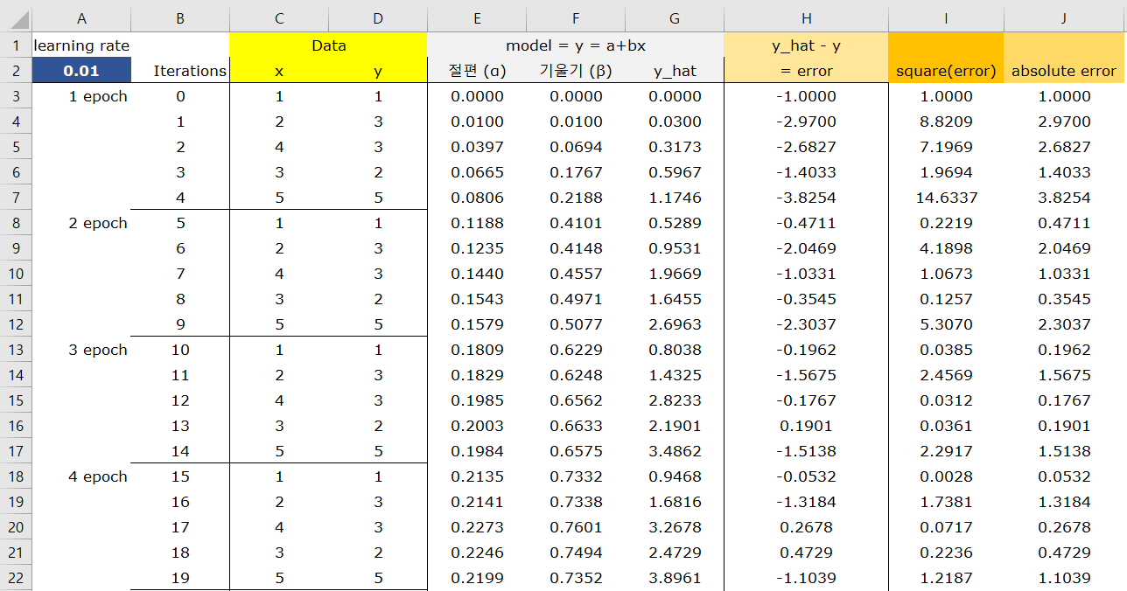
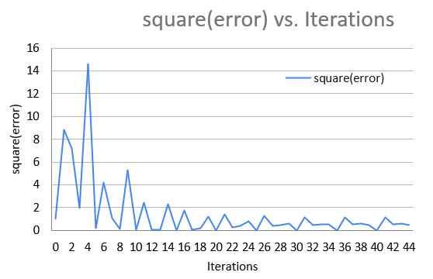
Stochastic Gradient Descent
모델 설정 > 예측 값 생성 > 손실함수 값 생성 > gradient 만큼 손실을 감소 > 반복 : Optimization Process

Slide 3
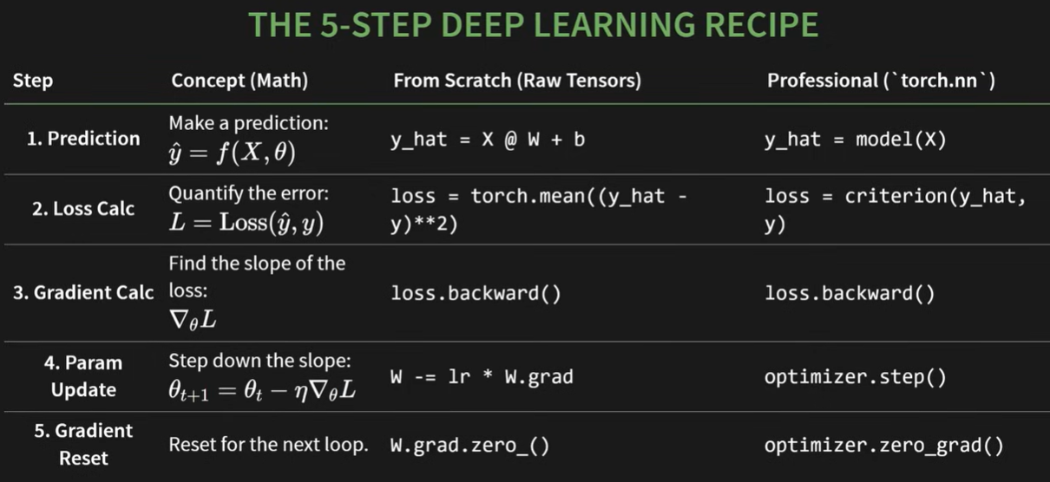

5 Step Deep Learning Recipe
Iterate 5-steps until finding the parameters to minimize the loss function.

Slide 4
Contents
Tensor
Autograd
Backpropagation
Forward & Backward Pass
Optimizer & Model
Optimizers
Loss Function with L1, L2 regularization
Regularizations
Pytorch with fashion mnist
Understanding basic CNN
Roadmap to ML & ML

Slide 5
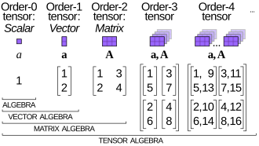
tensor
A torch.Tensor is a multi-dimensional matrix containing elements of a single data type.
IT'S THE BASIC "NOUN" OF THE PYTORCH LANGUAGE.
https://simple.wikipedia.org/wiki/Tensor

Slide 6
w4_torch_autograd_backward.ipynb
Learning PyTorch in 30 Min
Pytorch 기본 입문 코드, tensor 까지 학습하기

Slide 7
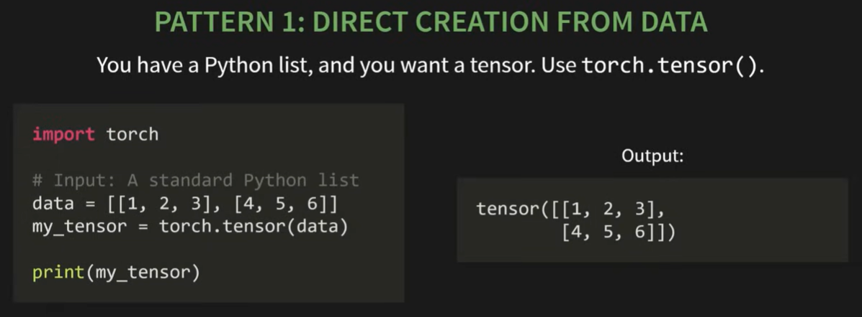
tensor

Slide 8
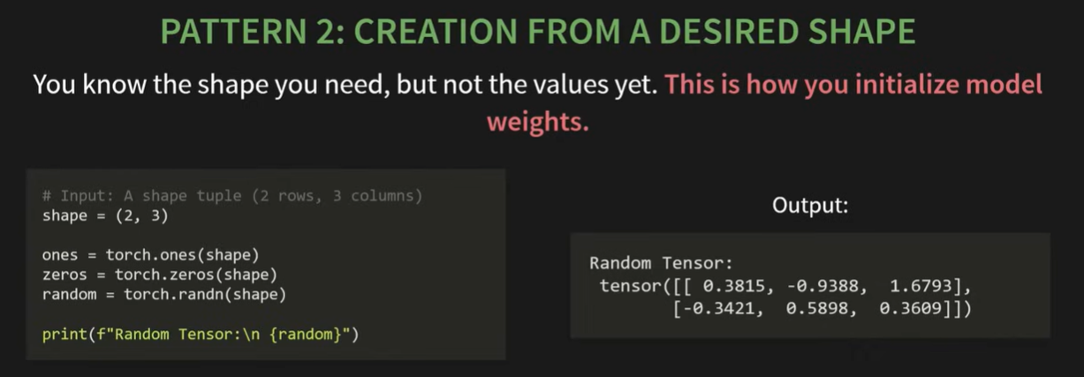
tensor

Slide 9
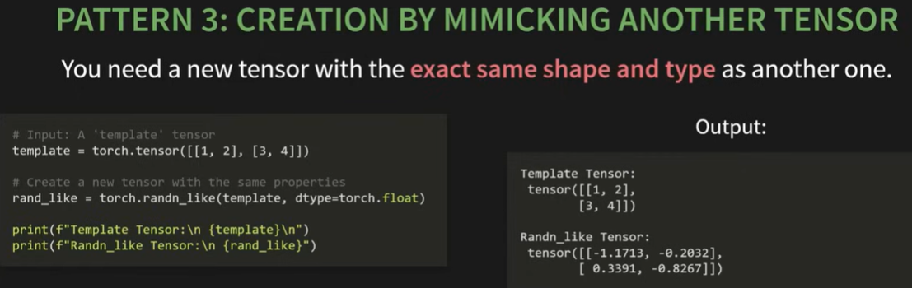
tensor

Slide 10

tensor

Slide 11
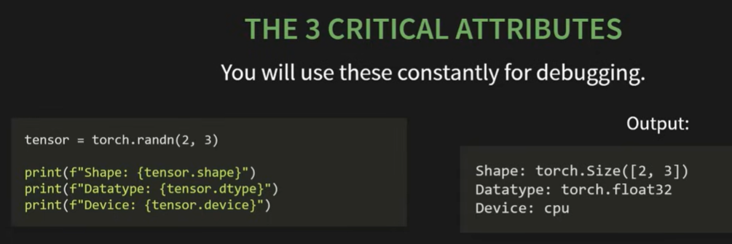
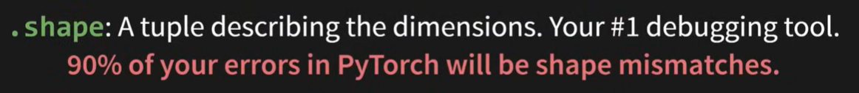
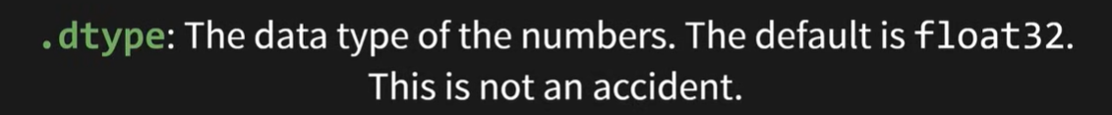
tensor

Slide 12

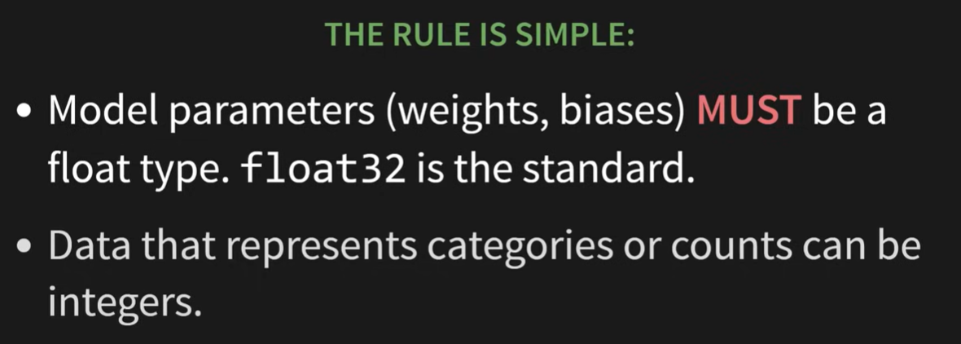
tensor

Slide 13
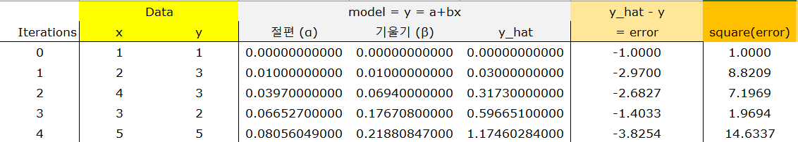
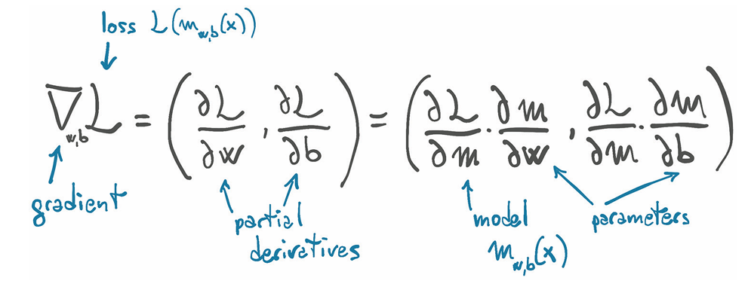
tensor
The derivative of the loss function with respect to the weights(float.32)

Slide 14
Contents
Tensor
Autograd
Backpropagation
Forward & Backward Pass
Optimizer & Model
Optimizers
Loss Function with L1, L2 regularization
Regularizations
Pytorch with fashion mnist
Understanding basic CNN
Roadmap to ML & ML

Slide 15
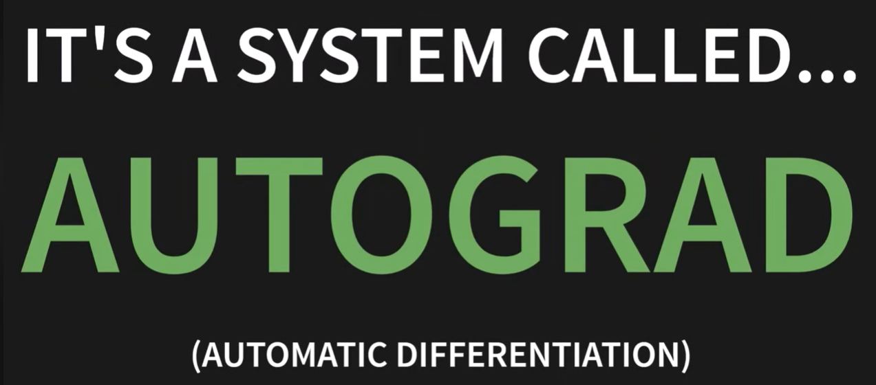

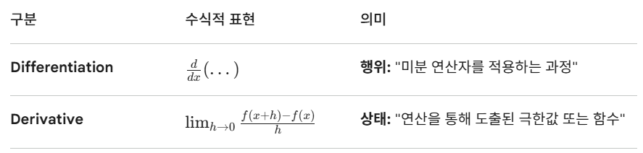
AUTOGRAD
The derivative of the loss function with respect to the weights(float.32)

Slide 16
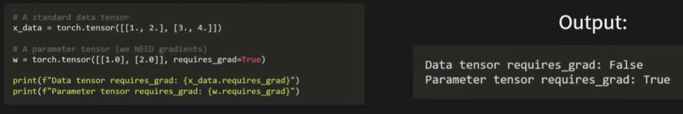
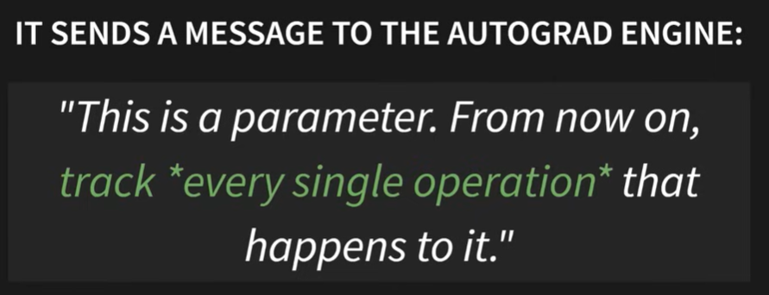
AUTOGRAD
Data vs. Parameter

Slide 17

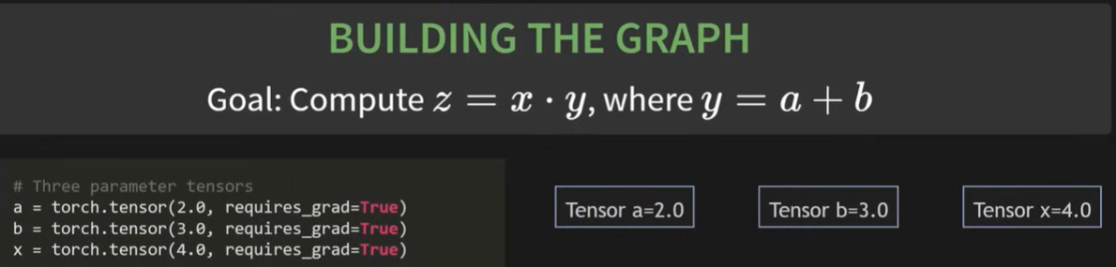
AUTOGRAD : LIVE RECORDING OPERATION
Computational Graph

Slide 18
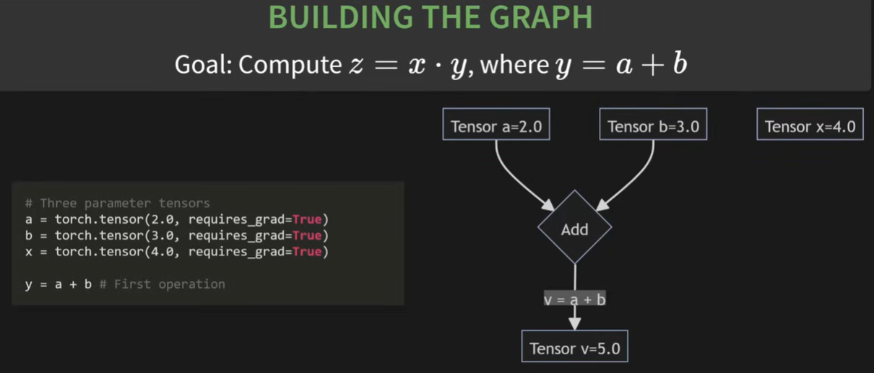
Forward

Slide 19
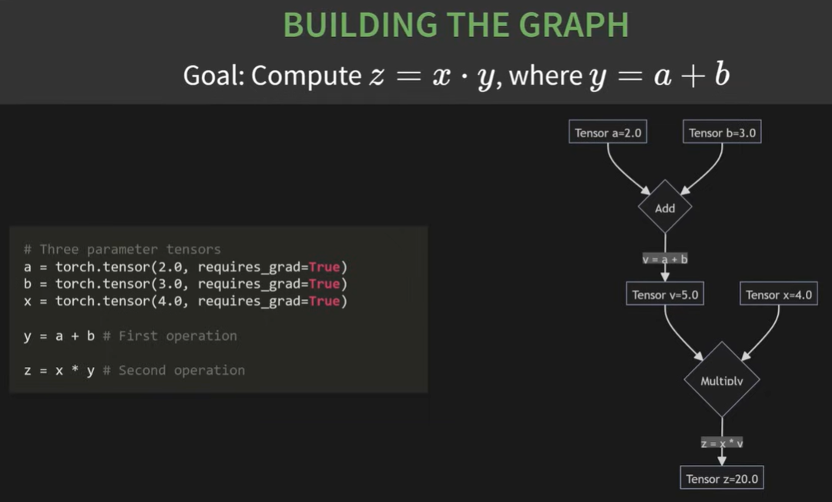
Forward

Slide 20
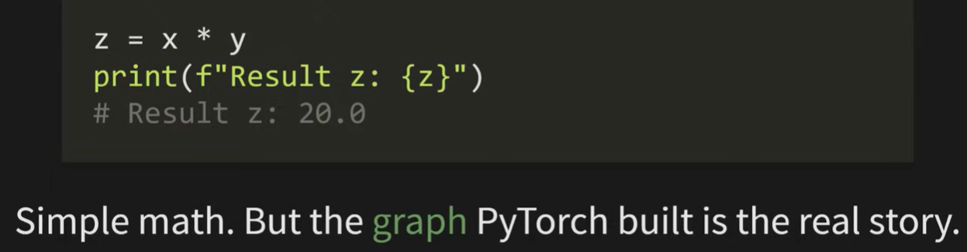
Forward

Slide 21
Contents
Tensor
Autograd
Backpropagation
Forward & Backward Pass
Optimizer & Model
Optimizers
Loss Function with L1, L2 regularization
Regularizations
Pytorch with fashion mnist
Understanding basic CNN
Roadmap to ML & ML

Slide 22
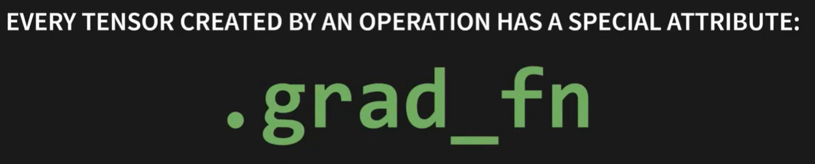
Backward

Slide 23
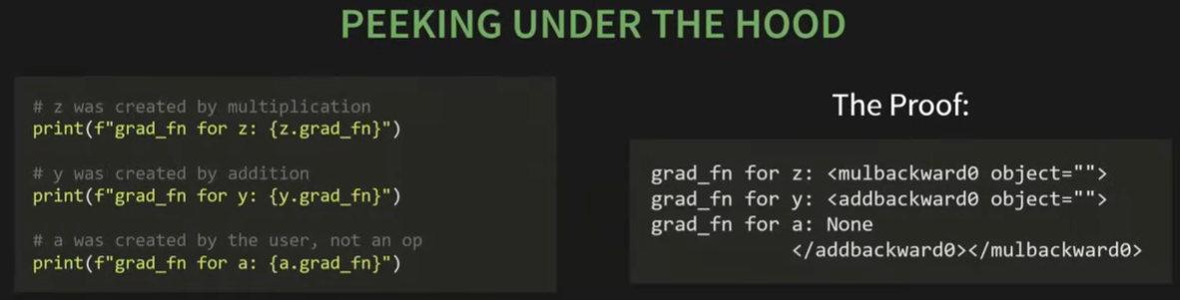
Backward

Slide 24

backward()

Slide 25
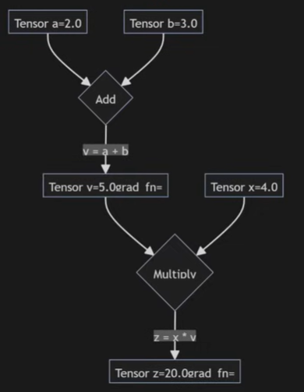
backward()

Slide 26
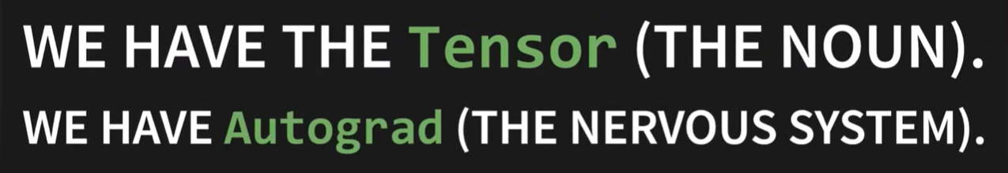

Operations : Inner Product

Slide 27
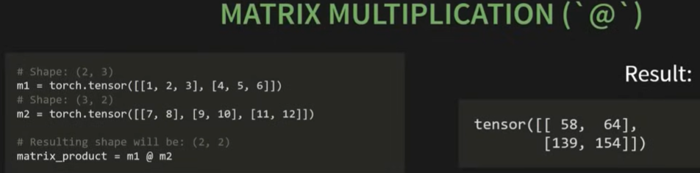
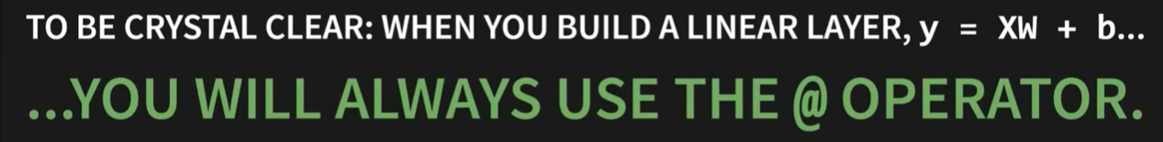
Operations : Inner Product

