Slide 1
Deep Learning II
with pytorch
2026 Spring
조상구교수

Slide 2
Contents
Tensor
Autograd
Backpropagation
Forward & Backward Pass
Optimizer & Model
Optimizers
Loss Function with L1, L2 regularization
Regularizations
Pytorch with fashion mnist
Understanding basic CNN
Roadmap to ML & ML

Slide 3
The Forward Pass
1. Prediction
From Scratch
The Forward Pass

Slide 4
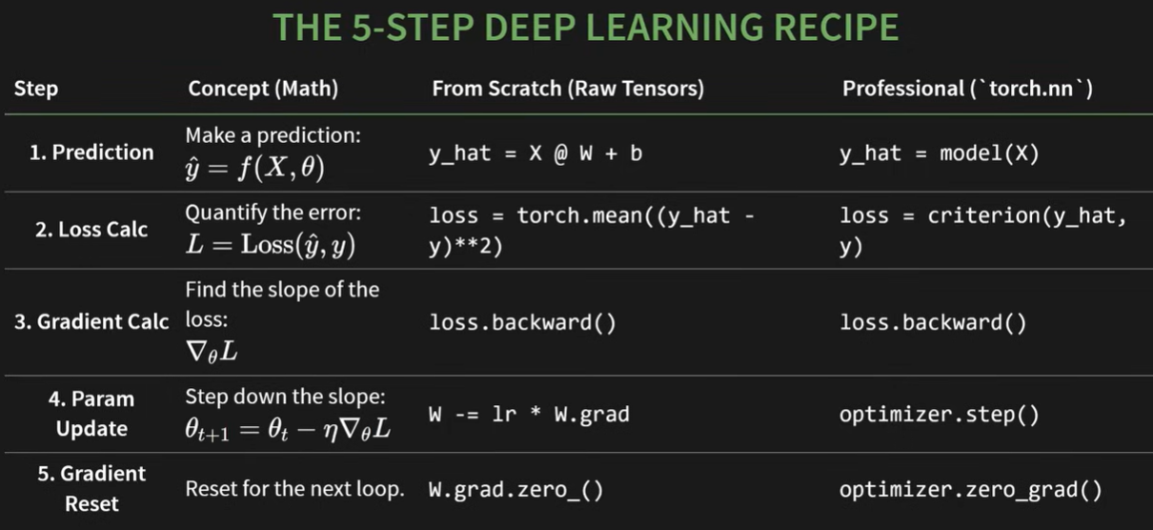
The Forward Pass
1. Prediction

Slide 5
The Forward Pass
1. Prediction
MAKING A GUESS
THINK OF THE FORWARD PASS AS THE MODEL'S FIRST GUESS.
INITIALLY, ITS GUESS IS COMPLETELY RANDOM.
OUR GOAL IS SIMPLE:
IMPLEMENT A MODEL'S FIRST GUESS USING ONLY THE RAW TENSOR OPERATIONS.

Slide 6
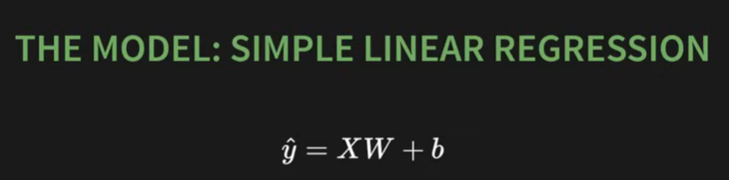

The Forward Pass
1. Prediction

Slide 7

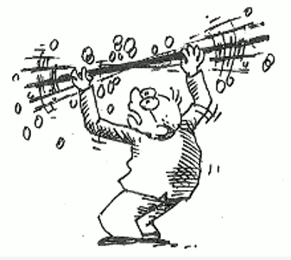
The Forward Pass
1. Prediction

Slide 8
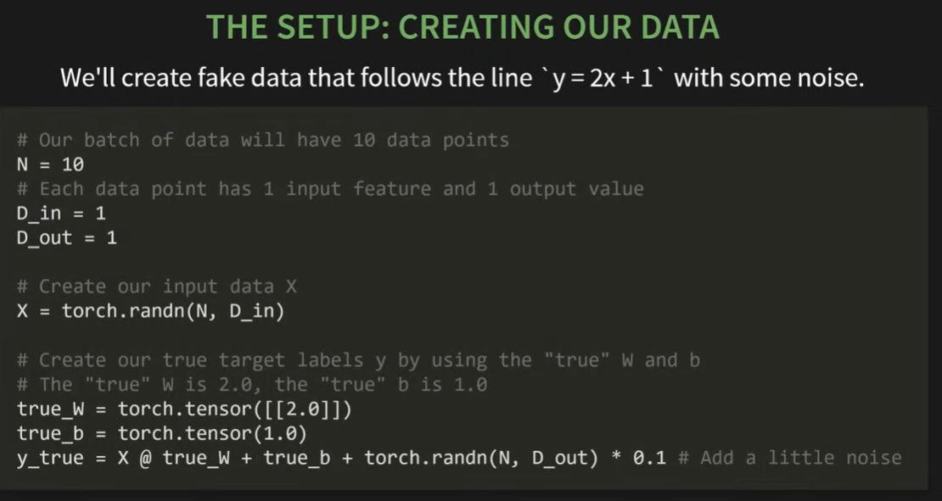
Generate Data

Slide 9
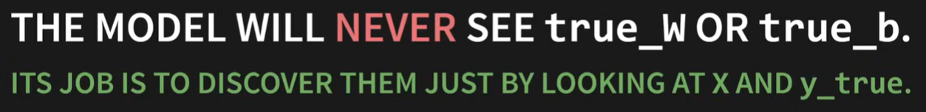
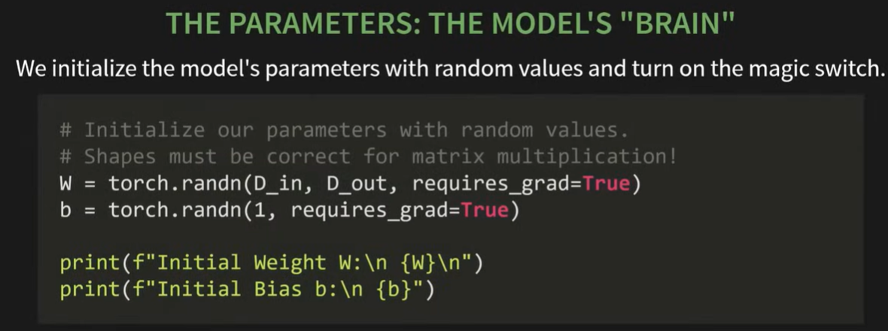
The Forward Pass
1. Prediction

Slide 10
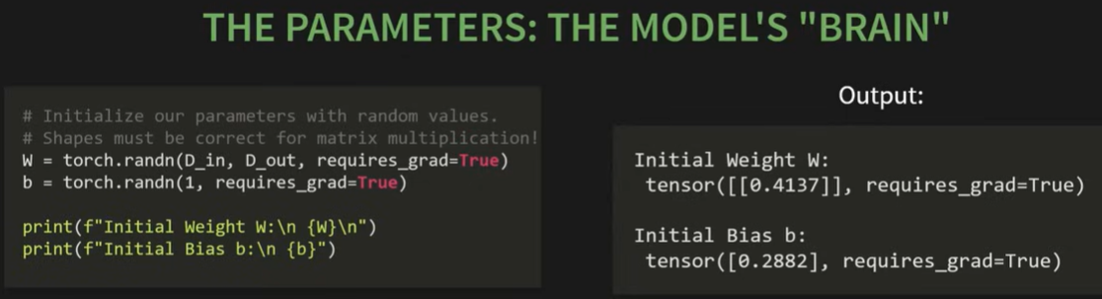
The Forward Pass
1. Prediction

Slide 11
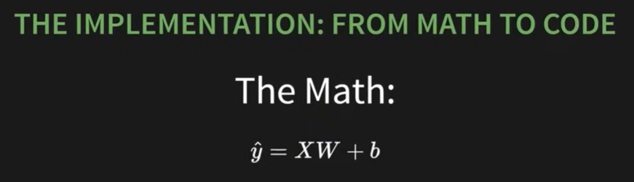
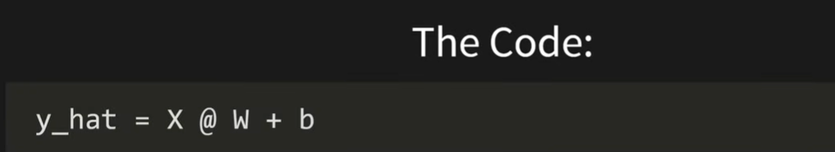
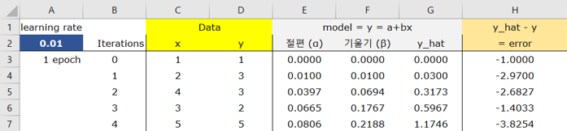
The Forward Pass
1. Prediction

Slide 12
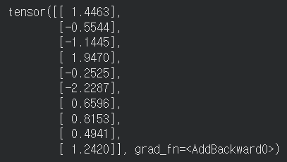
The Forward Pass
1. Prediction
LET'S SEE OUR FIRST GUESS...
The result is a disaster, as expected:
y_hat = X@W + b
y_hat

Slide 13
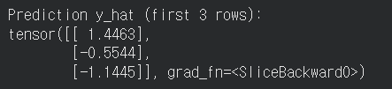
The Forward Pass
1. Prediction
OUR GUESS IS TERRIBLE. THEY AREN'T EVEN CLOSE.
BUT NOTICE SOMETHING ELSE...
AUTOGRAD WAS WATCHING. THE NERVOUS SYSTEM IS ACTIVE.

Slide 14
The Backward Pass
2,3. Gradient Calculation
OUR Y_HAT IS NOWHERE NEAR THE TRUE Y. BUT THAT'S OKAY! THE QUESTION IS:
HOW DO WE QUANTIFY EXACTLY HOW WRONG WE ARE?
THIS IS THE BACKWARD PASS. STEP 2 OF OUR LOOP.
IF THE FORWARD PASS WAS THE "GUESS," THE BACKWARD PASS IS THE "POST-MORTEM ANALYSIS."
WE COMPARE OUR GUESS TO THE TRUTH...
...AND THEN WE FIGURE OUT EXACTLY WHO TO BLAME.

Slide 15
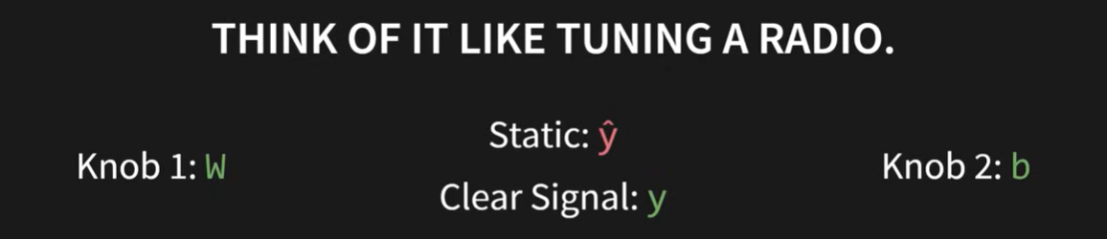
The Backward Pass
2,3. Gradient Calculation
The backward pass is figuring out which direction to turn each knob to make the static go away.

Slide 16

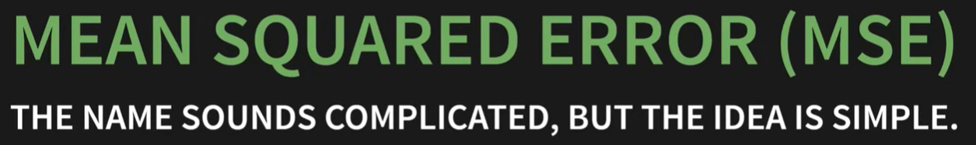
The Backward Pass
2,3. Gradient Calculation

Slide 17
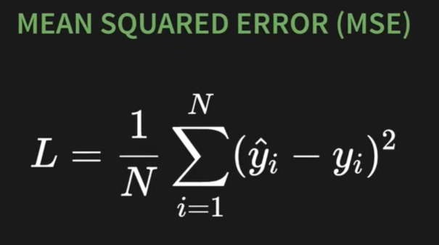
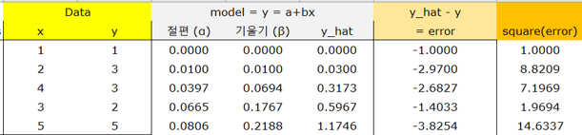
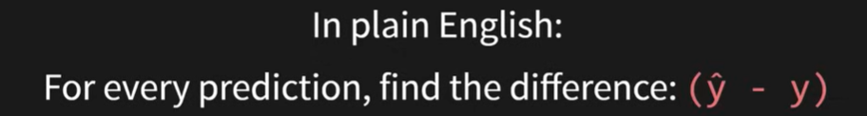
The Backward Pass
2,3. Gradient Calculation

Slide 18
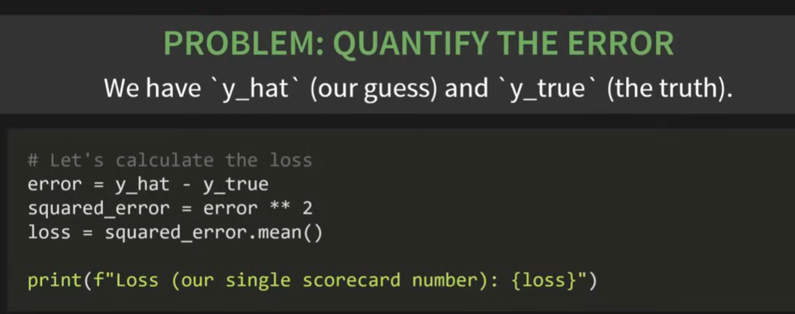
The Backward Pass
2,3. Gradient Calculation

Slide 19
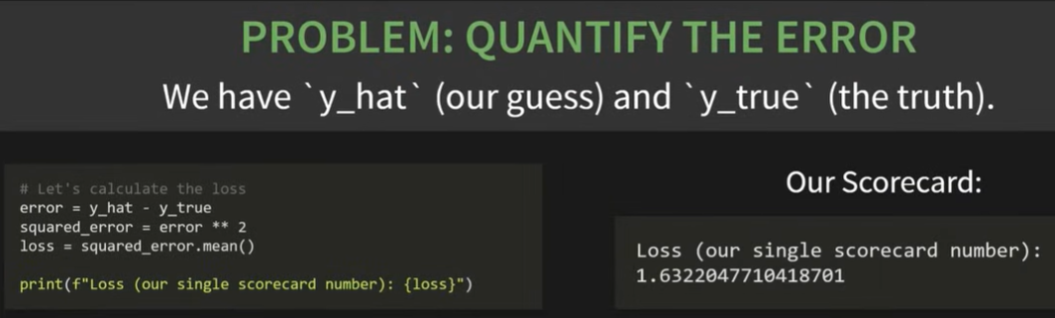
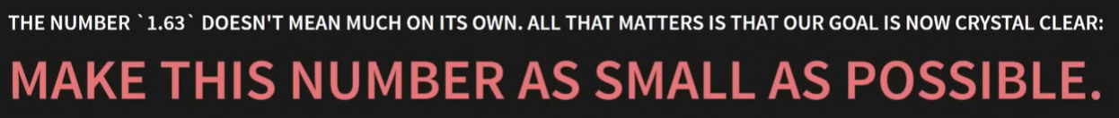
The Backward Pass
2,3. Gradient Calculation

Slide 20
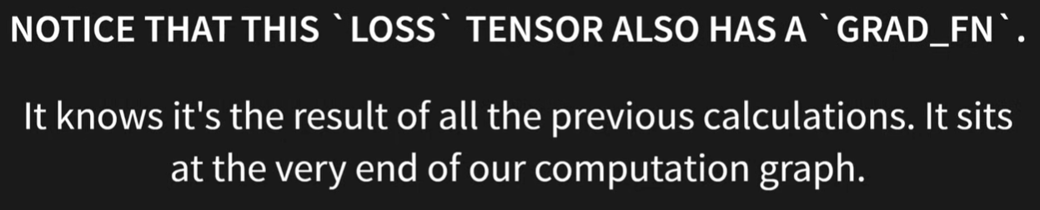

The Backward Pass
2,3. Gradient Calculation

Slide 21
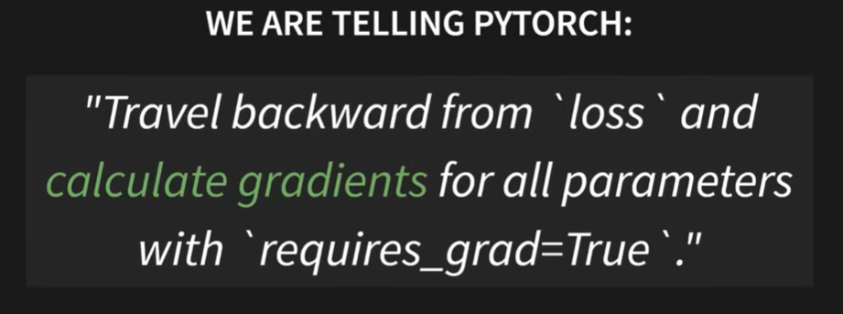
The Backward Pass
2,3. Gradient Calculation

Slide 22
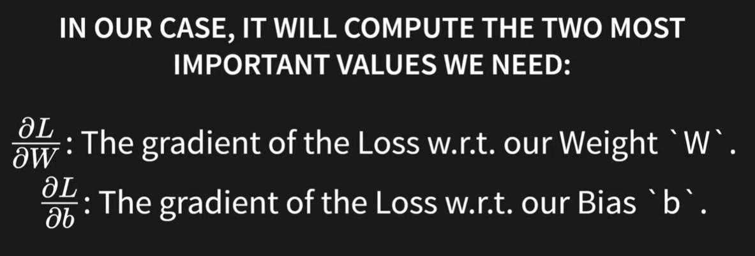
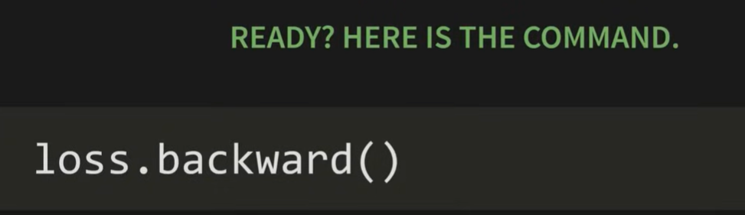
The Backward Pass
2,3. Gradient Calculation

Slide 23
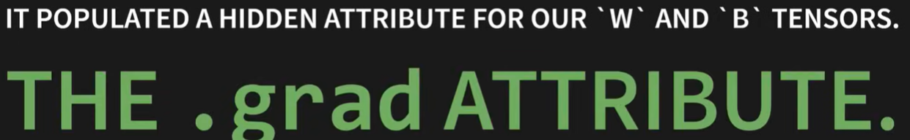
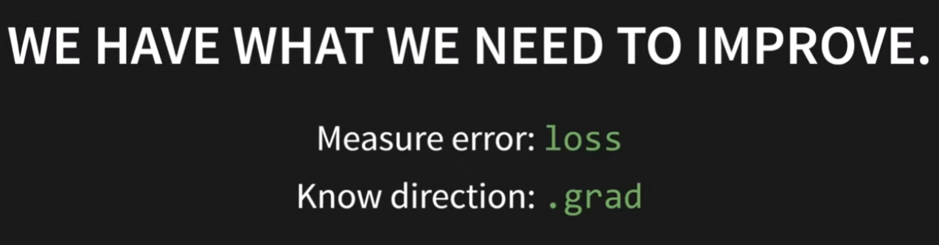
The Backward Pass
2,3. Gradient Calculation

Slide 24
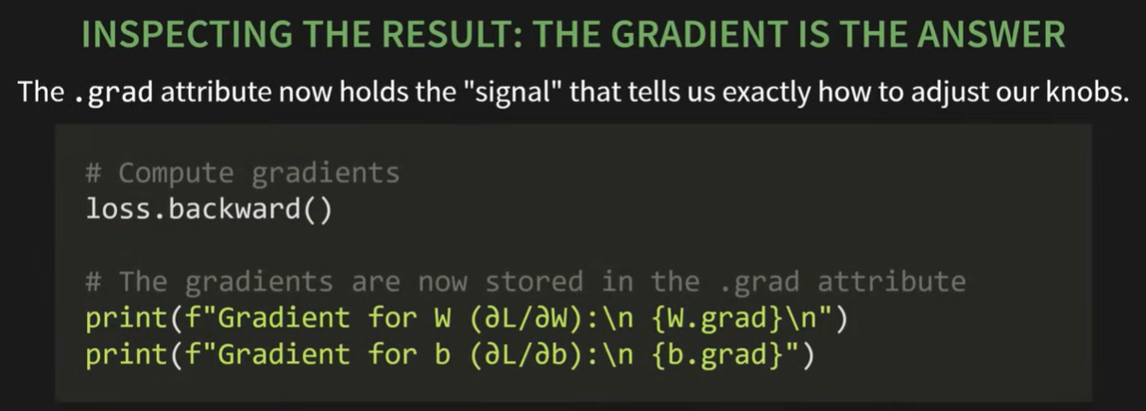
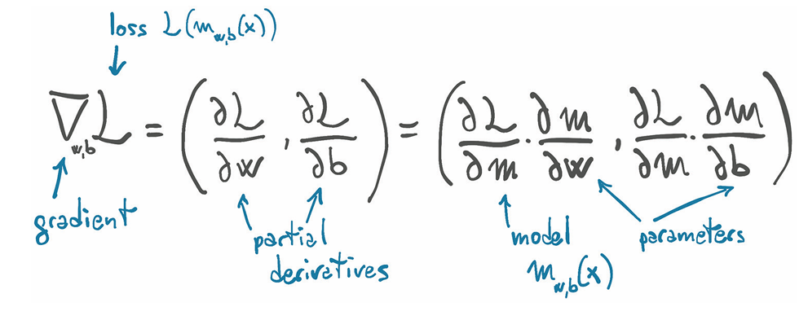
The Backward Pass
2,3. Gradient Calculation

Slide 25
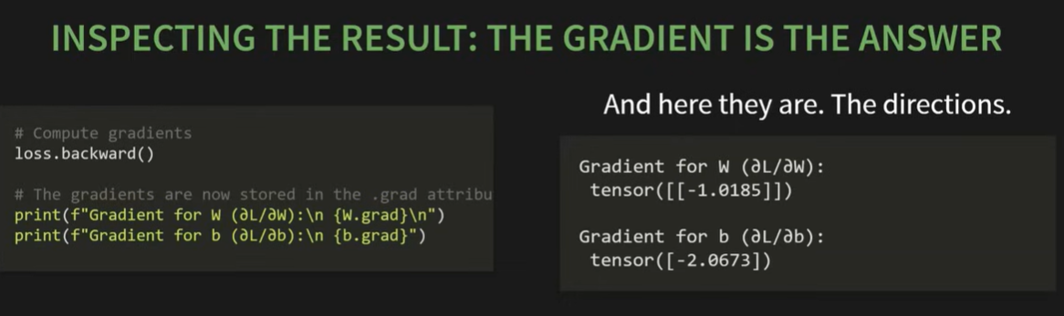
The Backward Pass
2,3. Gradient Calculation

Slide 26


The Backward Pass
2,3. Gradient Calculation

Slide 27
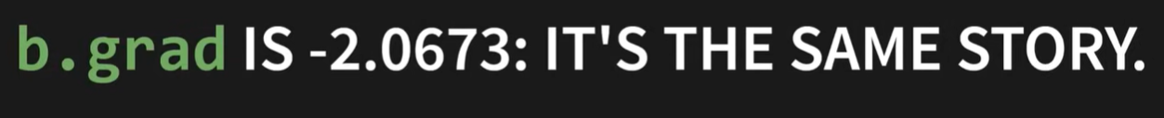

The Backward Pass
2,3. Gradient Calculation

Slide 28


The Backward Pass
2,3. Gradient Calculation

Slide 29
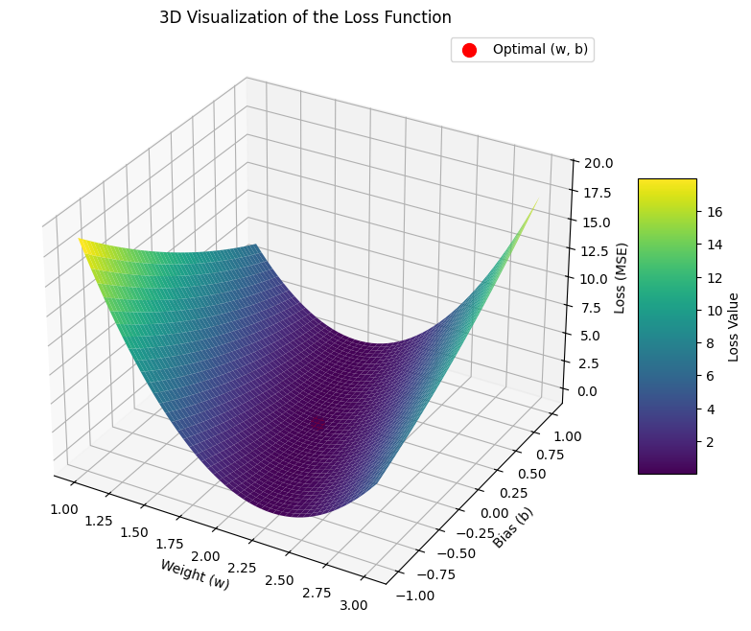

The Backward Pass
2,3. Gradient Calculation

Slide 30

The Backward Pass
2,3. Gradient Calculation

Slide 31
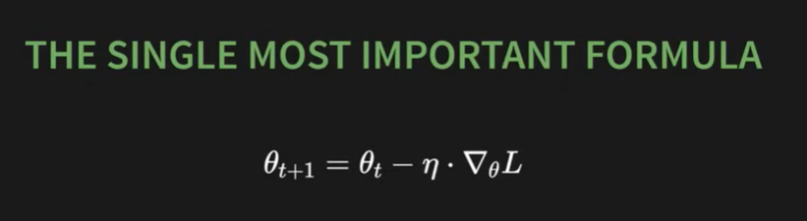
The Backward Pass
2,3. Gradient Calculation

Slide 32
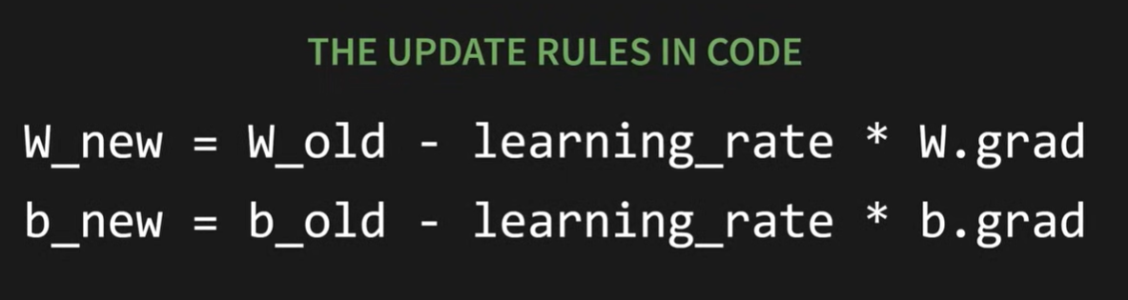
The Backward Pass
2,3. Gradient Calculation

Slide 33
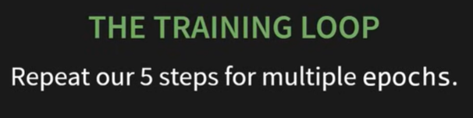
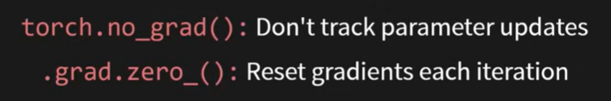
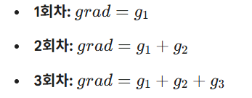
The Training Loop
4,5. Parameter Update & reset
Gradient Accumulation : PyTorch의 디자인 철학은 loss.backward()를 호출할 때마다 기울기를 덮어쓰는 것이 아니라 기존 값에 더하도록 되어 있기 때문에 만약 리셋을 안 하면 다음과 같이 작동하여 학습(훈련)이 안됨

Slide 34
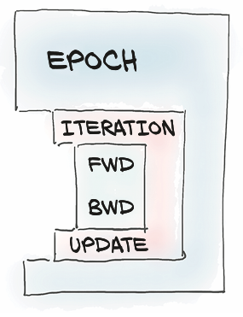
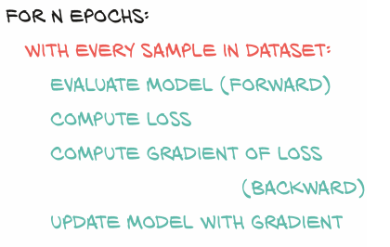
The Training Loop
4,5. Parameter Update & reset

Slide 35
The Entire Training Process
Generate Data
# import torch
# Our batch of data will have 10 data points
N = 10
# Each data point has 1 input feature and 1 output value
D_in = 1
D_out = 1
# Create our input data X
X = torch.randn(N, D_in)
# Create our true target labels y by using the "true" W and b
# The "true" W is 2.0, the "true" b is 1.0
true_W = torch.tensor([[2.0]])
true_b = torch.tensor(1.0)
y_true = X @ true_W + true_b + torch.randn(N, D_out) * 0.1 # Add a little noise
# Hyperparameters
learning_rate, epochs = 0.01, 300

Slide 36
The Entire Training Process
Parameter Update & reset
# Re-initialize parameters
W = torch.randn(1, 1, requires_grad=True)
b = torch.randn(1, requires_grad=True)
# Training Loop
for epoch in range(epochs):
# Forward pass and loss
y_hat = X @ W + b
loss = torch.mean((y_hat - y_true)**2)
# Backward pass
loss.backward()
# Update parameters
with torch.no_grad():
W -= learning_rate * W.grad
b -= learning_rate * b.grad
# Zero gradients
W.grad.zero_(); b.grad.zero_()

Slide 37
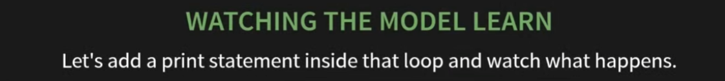
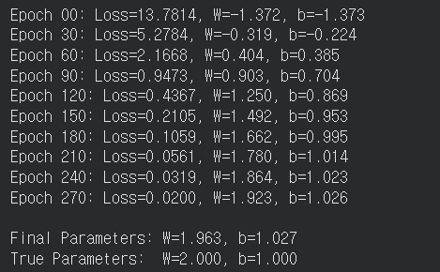
The Training Loop
Parameter Update & reset
if epoch % 30 == 0:
print(f"Epoch {epoch:02d}: Loss={loss.item():.4f}, W={W.item():.3f}, b={b.item():.3f}")
print(f"\nFinal Parameters: W={W.item():.3f}, b={b.item():.3f}")
print(f"True Parameters: W=2.000, b=1.000")

Slide 38
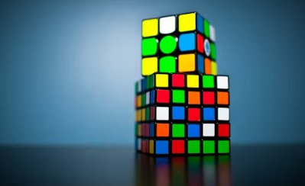
Hands-on
입력변수가 5개 100개의 가상데이터를 학습하고 총 몇 개의 parameter를 찾아내는가?
입력변수가 3개 출력변수가 5개인 가상데이터를 학습하고 총 몇 개의 parameter를 찾아내는가?

