Slide 1
Vectors and Linear Transformations
Vectors and their properties
2026 Spring
조상구교수

Slide 2

Neural Networks – AI generates images
AI-generated human faces.
Generative learning: Generating realistic looking images.

Slide 3
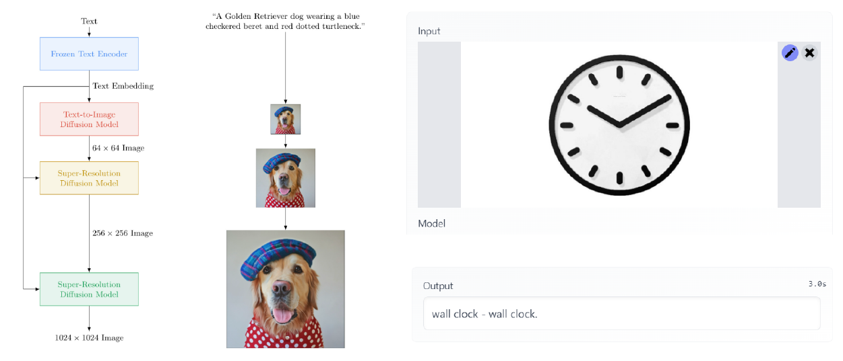
Text-to-image and image-to-text generation

Slide 4
Math for Machine Learning
Vectors
Matrices
Dot product
Matrix multiplication
Linear transformations

Slide 5
Contents
Vectors and their properties
Sum and difference of vectors
Distance between vectors
Multiplying a vector by a scalar
The dot product
Geometric dot product
Multiplying a matrix by a vector
Matrices as linear transformations
Matrix multiplication

Slide 6
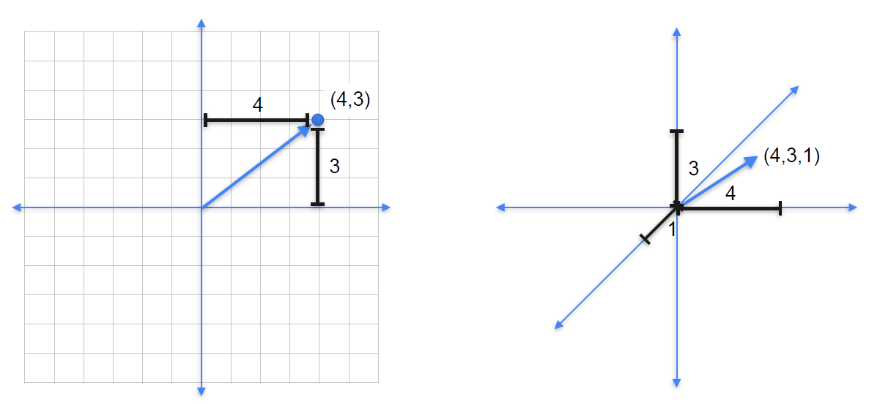
Vectors
Magnitude
Directions

Slide 7
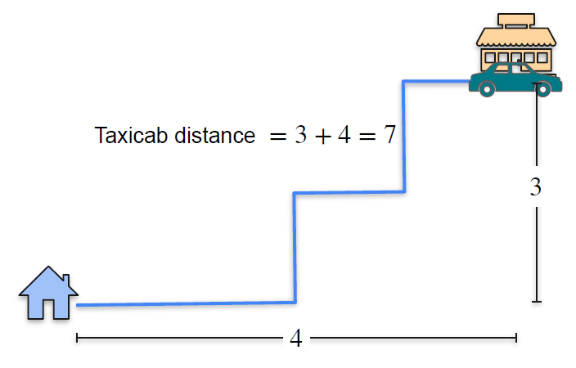
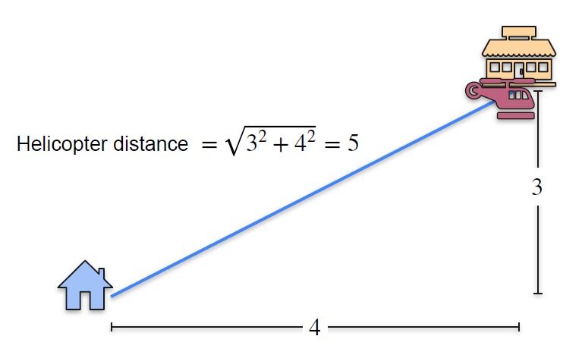
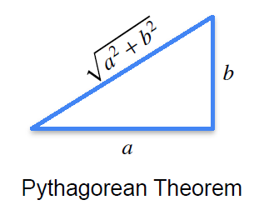
How to get from point A to point B?

Slide 8
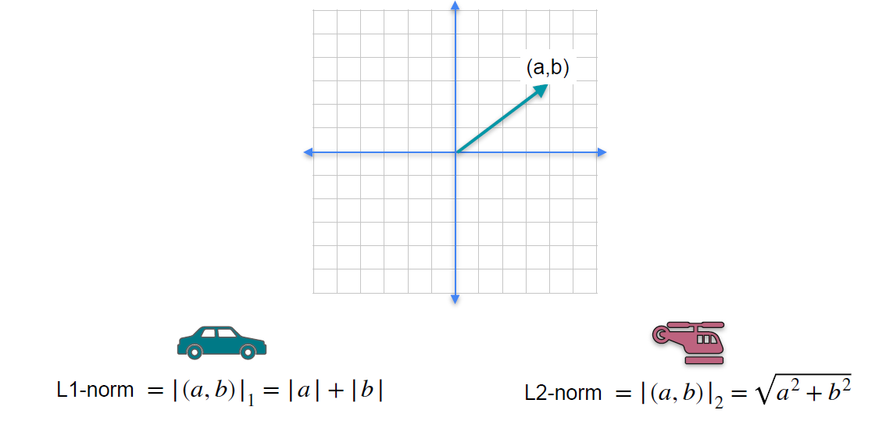
Magnitude of a vector : Norms

Slide 9
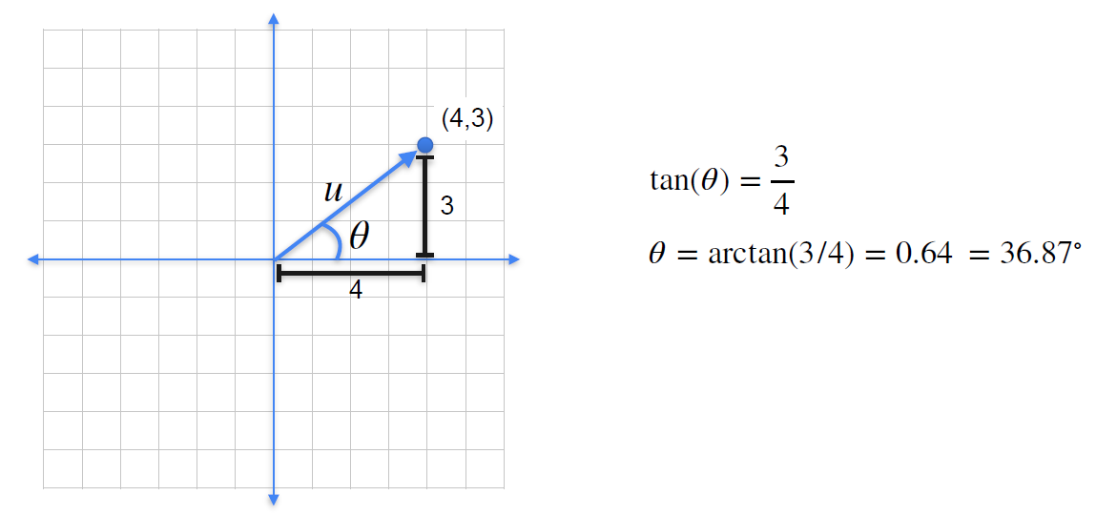
Directions of a vector

Slide 10
Contents
Vectors and their properties
Sum and difference of vectors
Distance between vectors
Multiplying a vector by a scalar
The dot product
Geometric dot product
Multiplying a matrix by a vector
Matrices as linear transformations
Matrix multiplication

Slide 11
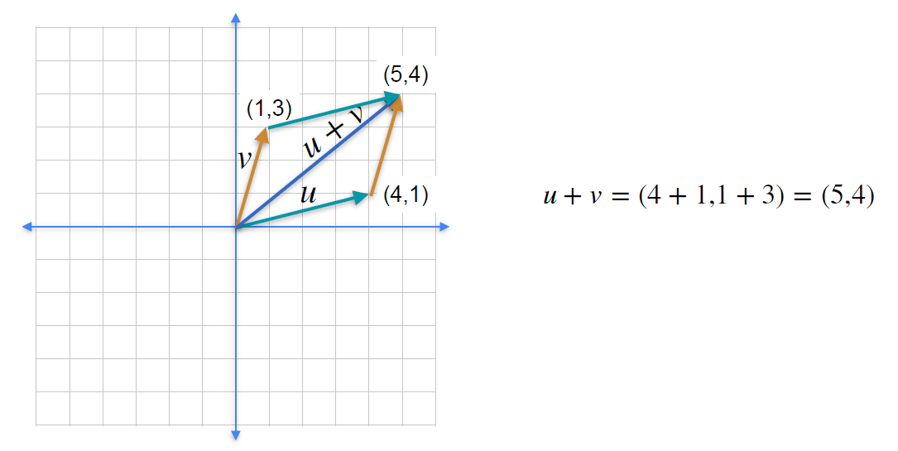
Sum of vectors
벡터 (4,1)은 X축으로 1 step
Y축으로 3 steps 를 이동하여
벡터 (5,4)로 변환

Slide 12
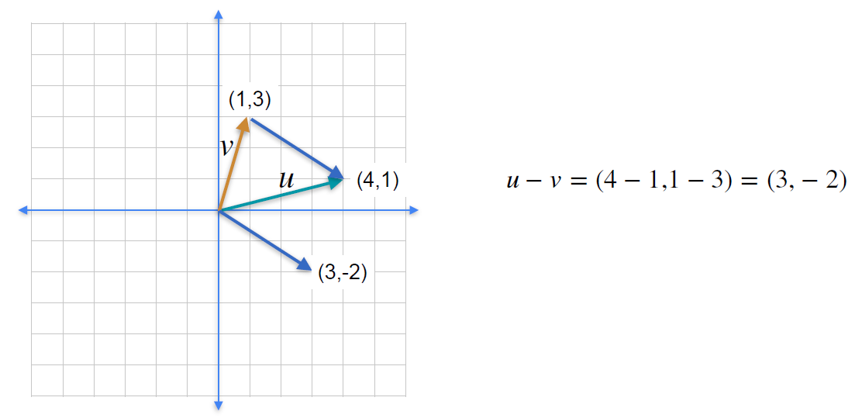
Difference of vectors

Slide 13
Contents
Vectors and their properties
Sum and difference of vectors
Distance between vectors
Multiplying a vector by a scalar
The dot product
Geometric dot product
Multiplying a matrix by a vector
Matrices as linear transformations
Matrix multiplication

Slide 14
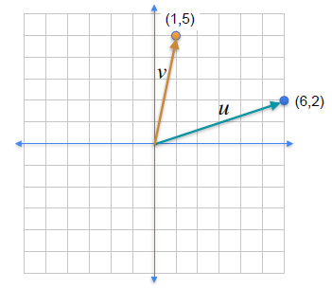
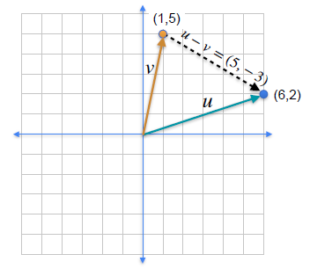
Distances

Slide 15
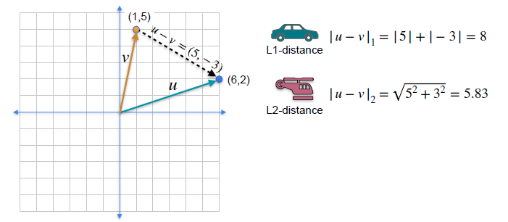
Distances

Slide 16
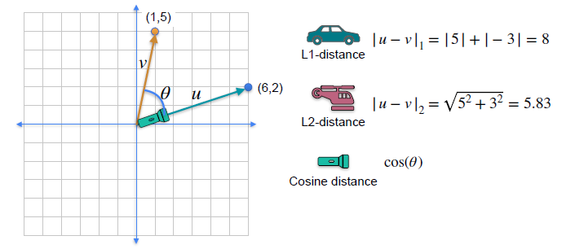
Distances

Slide 17
Contents
Vectors and their properties
Sum and difference of vectors
Distance between vectors
Multiplying a vector by a scalar
The dot product
Geometric dot product
Multiplying a matrix by a vector
Matrices as linear transformations
Matrix multiplication

Slide 18
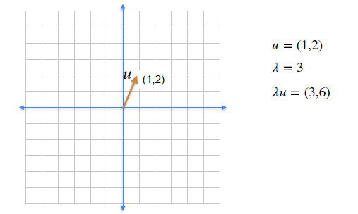
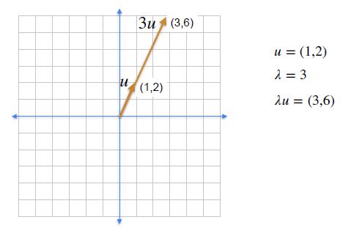
Multiplying a vector by a scalar

Slide 19
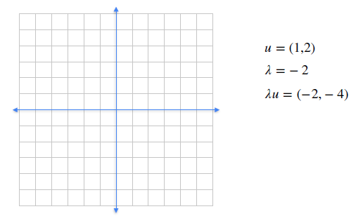
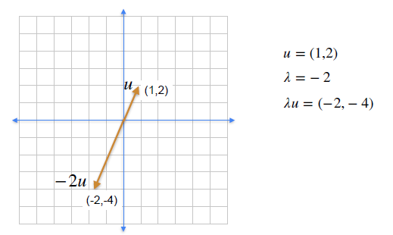
Directions of a vector

Slide 20
Contents
Vectors and their properties
Sum and difference of vectors
Distance between vectors
Multiplying a vector by a scalar
The dot product
Geometric dot product
Multiplying a matrix by a vector
Matrices as linear transformations
Matrix multiplication

Slide 21
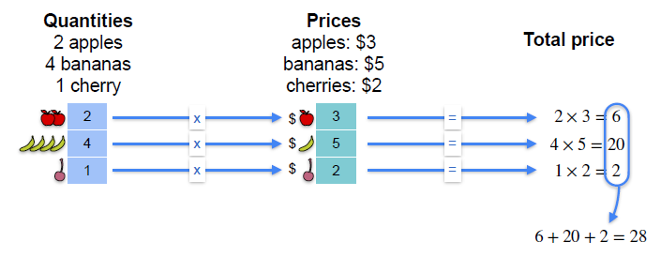
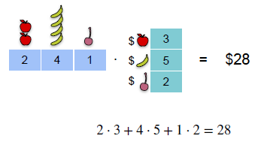
A shortcut for linear operations

Slide 22
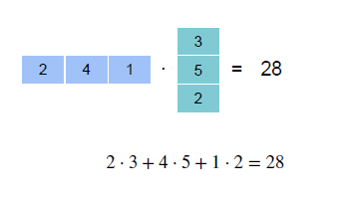
The dot product
(1 x 3)
(3 x 1)

Slide 23
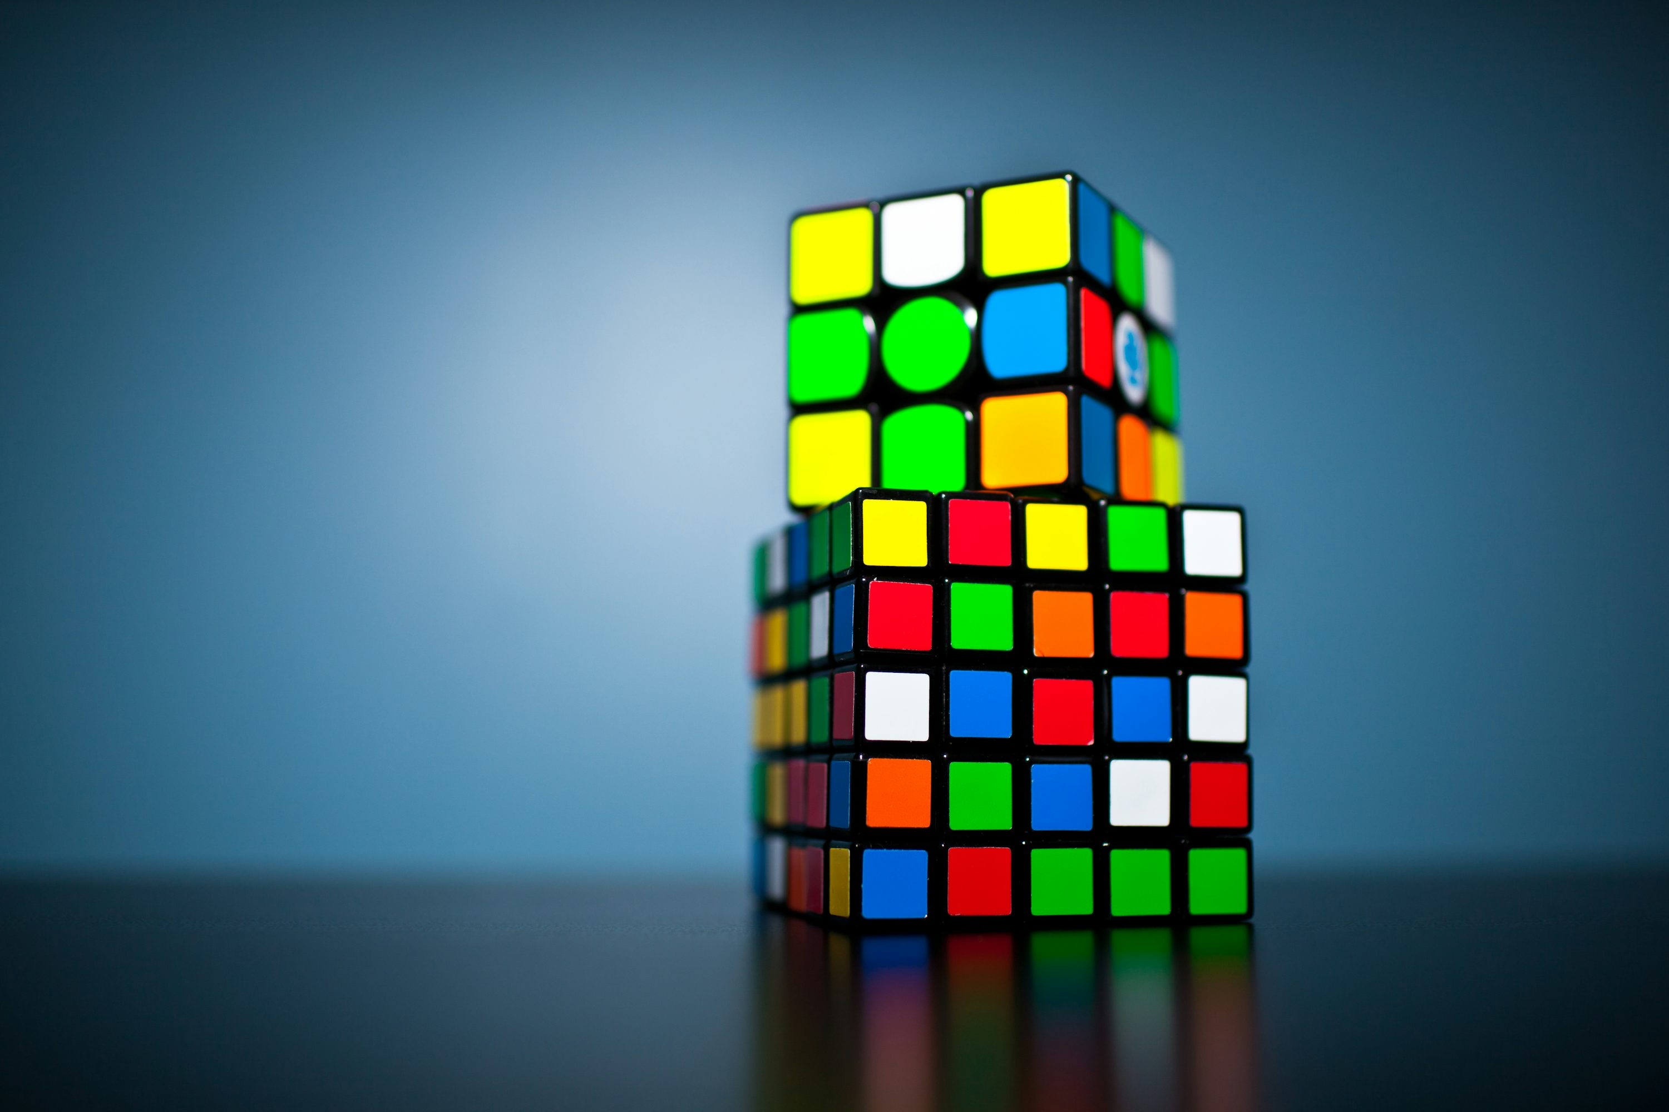

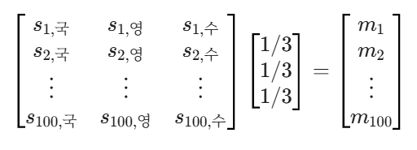
calculating the means of each person using dot product
100명의 학생의 국어, 영어, 수학의 점수를 평균이 각각 65, 80, 75 분산은 10, 20, 30인 가상의 데이터를 생성하고 모든 학생의 평균을 내적을 이용하여 구하라
국어 영어 수학 | 평균(내적 계산)
66.57 79.38 78.55 | 74.83
69.82 78.95 73.72 | 74.16
69.99 83.43 72.43 | 75.28
66.72 77.93 72.45 | 72.36
65.77 71.44 65.55 | 67.59
63.22 75.47 76.72 | 71.80
62.13 73.68 83.03 | 72.95
64.29 80.30 67.20 | 70.59
63.28 80.50 68.70 | 70.82
66.19 77.31 73.40 | 72.30
(100, 3)
(3, 1)
(100, 1)

Slide 24
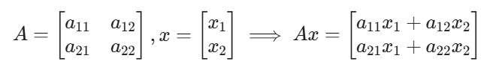
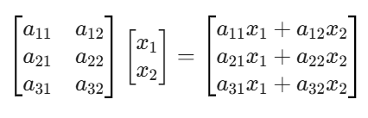

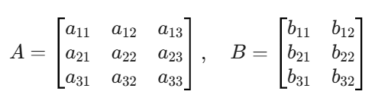
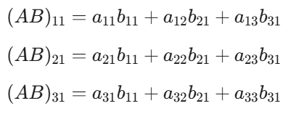
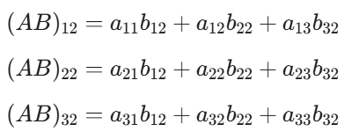
dot product of matrix, vector
(2, 2)
(2, 1)
(2, 1)
(3, 2)
(2, 1)
(3, 2)
(1, 2)
(2, 1)
(1, 1)
(3, 3)
(3, 2)
(3, 2)

Slide 25
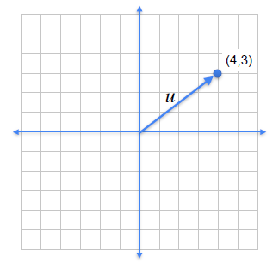
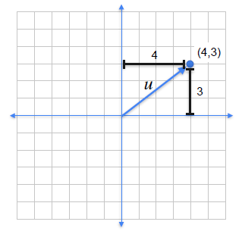
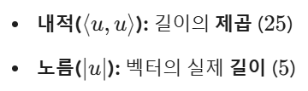
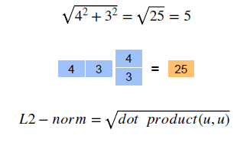
Norm of a vector using dot product
벡터의 Norm을 이해하는 두 가지 관점
기하학적 관점: 피타고라스 정리를 이용한 빗변의 길이, 즉 L2 Norm
대수적 관점: 자기 자신과의 내적에 루트를 씌운 값

Slide 26
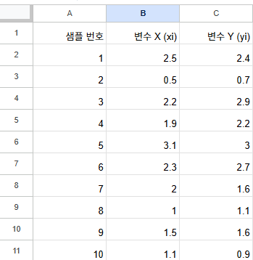


Variance & Covariance of a vector using dot product
Data를 사용하여 각 변수에서 평균차감(Mean Centering)을 한 후에 내적을 이용한 분산과 공분산을 구하라(Numpy로)
data = np.array([ [2.5, 2.4], [0.5, 0.7], [2.2, 2.9], [1.9, 2.2], [3.1, 3.0], [2.3, 2.7], [2.0, 1.6], [1.0, 1.1], [1.5, 1.6], [1.1, 0.9] ])

Slide 27
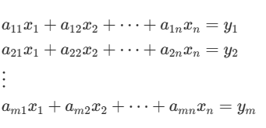
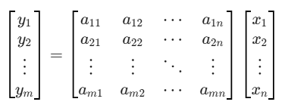
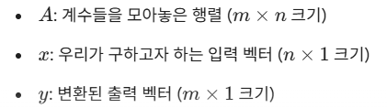

System of Linear Equations
연립선형방정식(System of Linear Equations)
$$y=Ax$$
행렬 형태 (Matrix Form)

Slide 28
Contents
Vectors and their properties
Sum and difference of vectors
Distance between vectors
Multiplying a vector by a scalar
The dot product
Geometric dot product
Multiplying a matrix by a vector
Matrices as linear transformations
Matrix multiplication

Slide 29
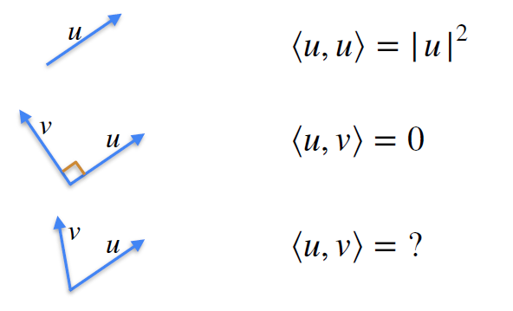
The dot product
내적은 “한 벡터가 다른 벡터의 방향으로 얼마나 힘을 보태고 있는가"를 수치화한 것
L2 Norm의 제곱 값

Slide 30
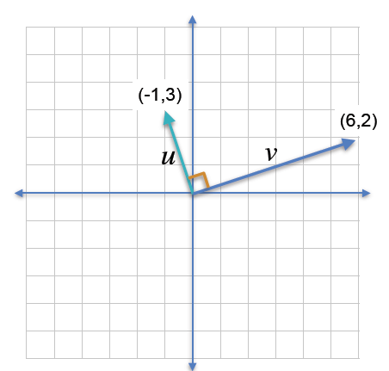
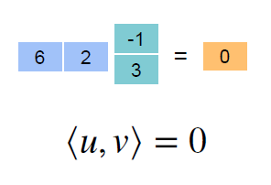
Orthogonal vectors have dot product 0

Slide 31
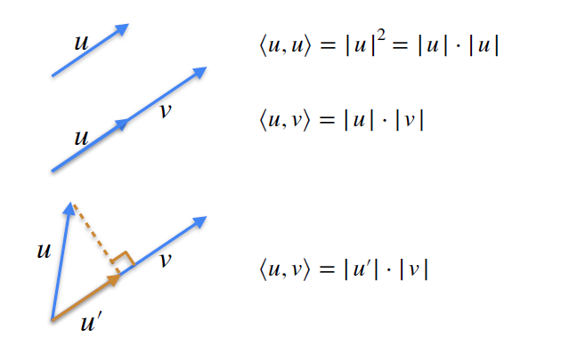
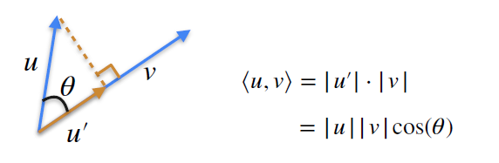
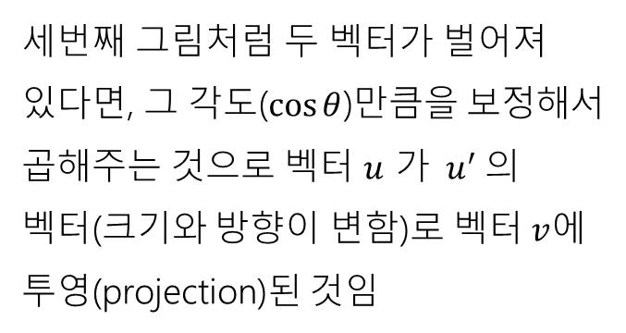
The dot product
세번째 그림처럼 두 벡터가 벌어져 있다면, 그 각도($\cos{θ}$)만큼을 보정해서 곱해주는 것으로 벡터 $u$ 가 ${ u}^{′}$의 벡터(크기와 방향이 변함)로 벡터$v$에 투영(projection)된 것임

Slide 32

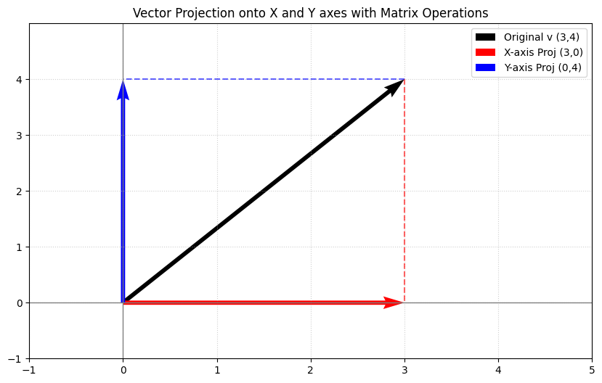


Projection $≈$ Landing $≈$ Dot product
어떤 벡터 $v$ = (3,4)를 특정 축에 투영한다는 것은, 해당 축 방향의 정보만 남기고 나머지 직교하는 방향의 정보는 0으로 만드는 것으로 투영 행렬(Projection Matrix)과의 내적(행렬 곱)으로 표현할 수 있음
y 축으로 projection
X 축으로 projection

Slide 33
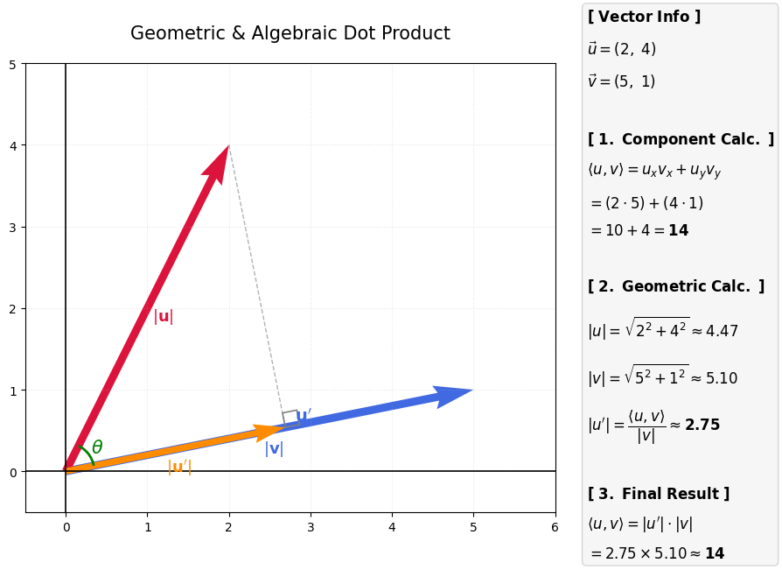
The dot product of two vectors

Slide 34
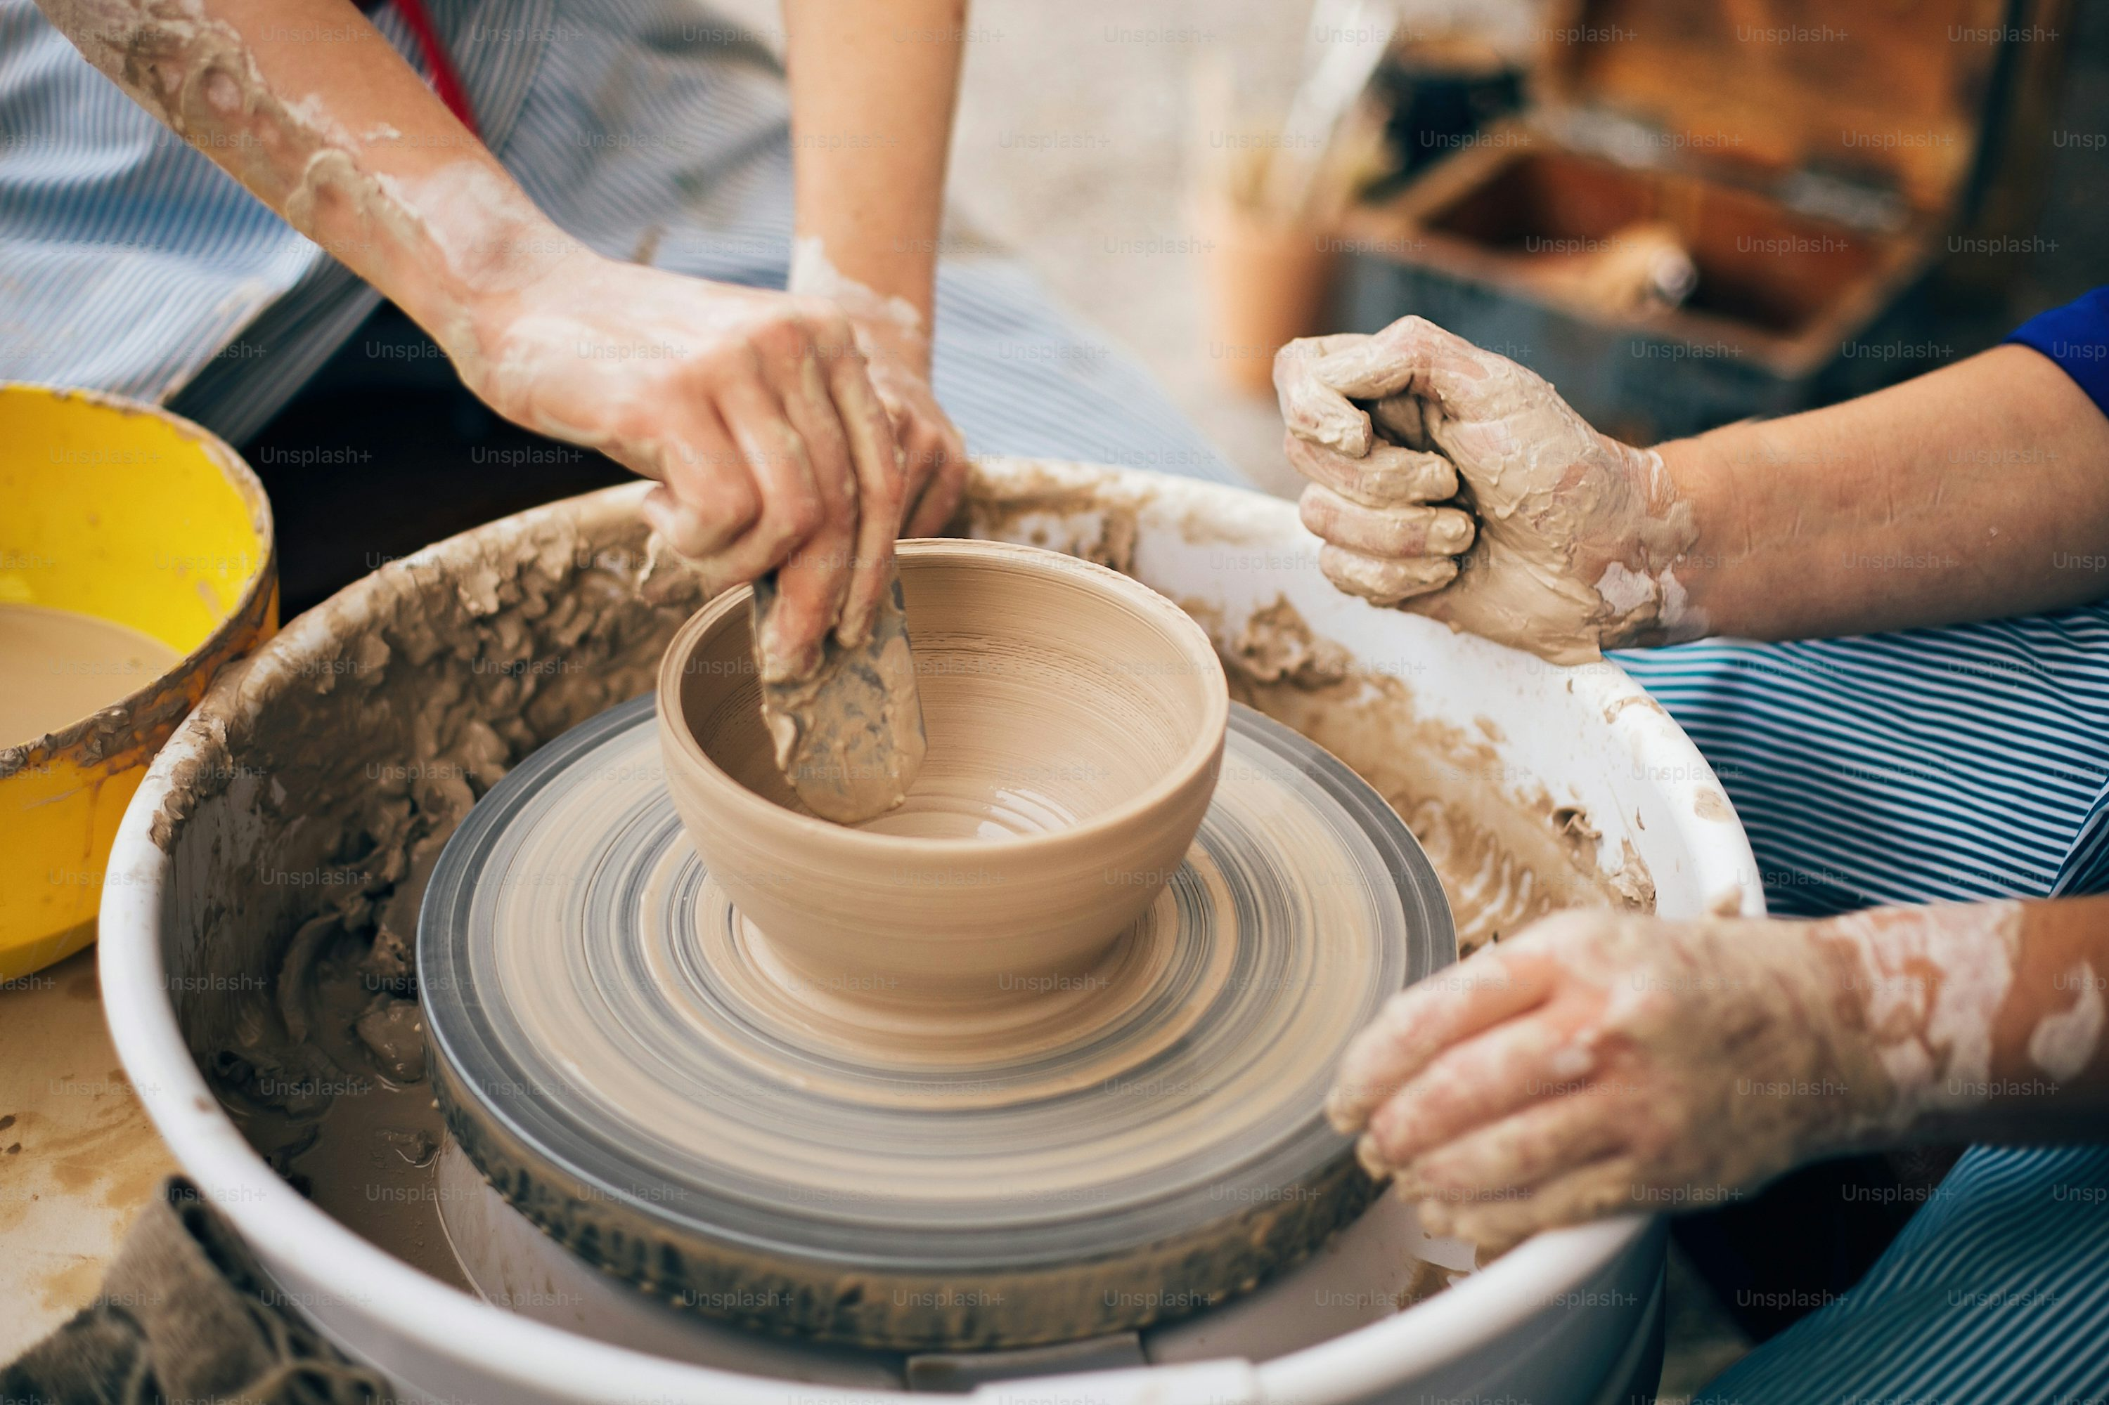
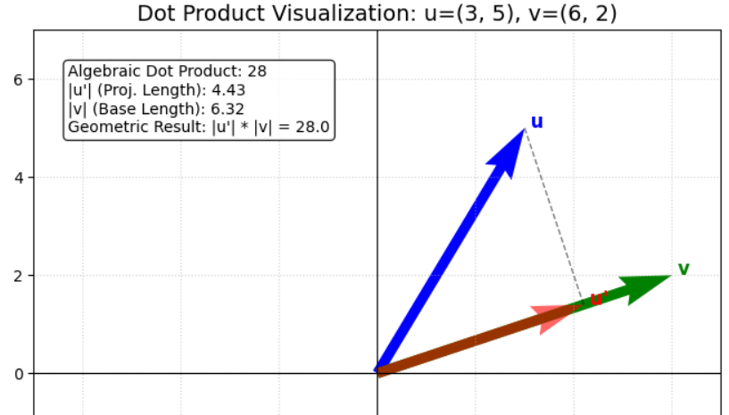
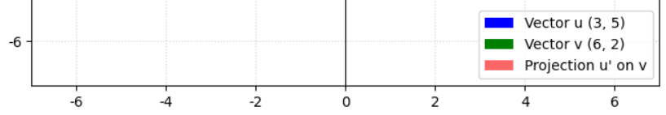
The dot product
아래 2 벡터의 내적을 구하고 cos()각과 norm을 이용한 수식과 비교하라
import numpy as np
u = np.array([3, 5]); v = np.array([6, 2])
dot_product = np.dot(u, v)
norm_u = np.linalg.norm(u); norm_v = np.linalg.norm(v)
# Calculate the cosine of the angle
cos_theta = dot_product / (norm_u * norm_v)
print(f"Vector u and v: {u} and {v}")
print(f"Dot product (u · v): {dot_product}")
print(f"Norm of u (||u||) and v (||v||): {norm_u:.2f} & {norm_v:.2f}")
print(f"Cosine of the angle (cos(theta)): {cos_theta:.4f}")
print(f"Result of norm_u*norm_v*cos_theta: {norm_u * norm_v * cos_theta:.2f}")

Slide 35
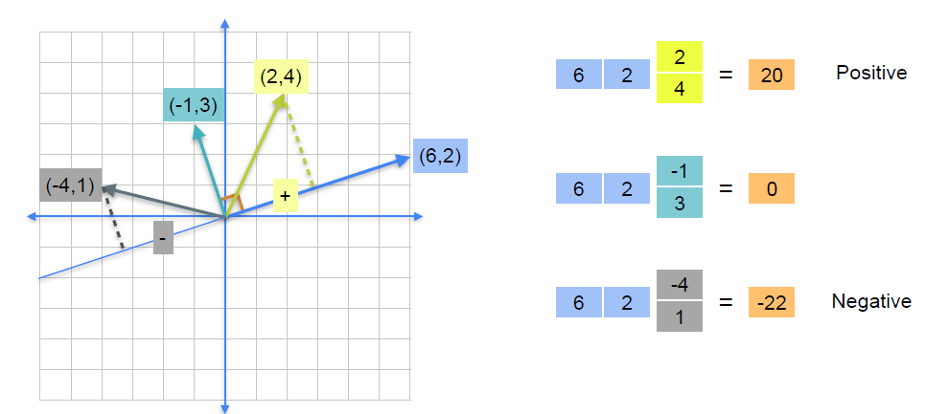
Geometric dot product

Slide 36
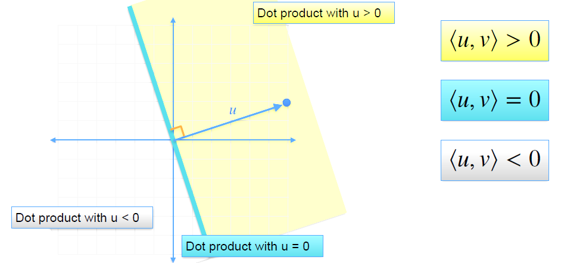
Geometric dot product

Slide 37
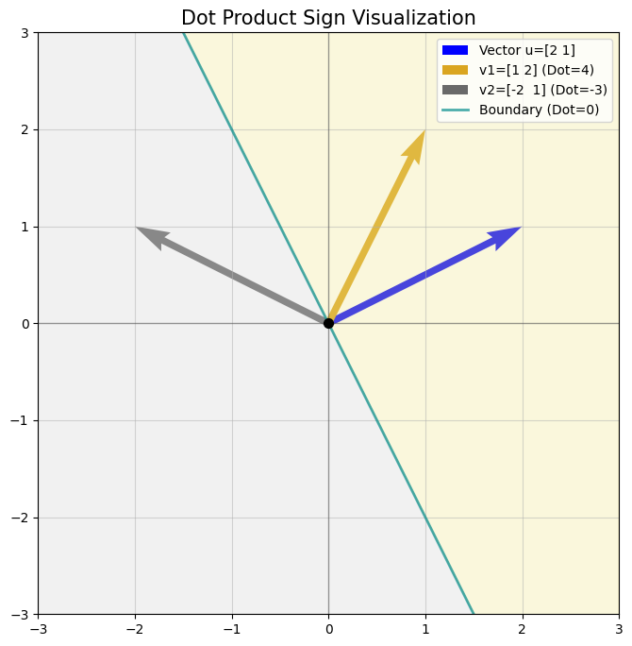
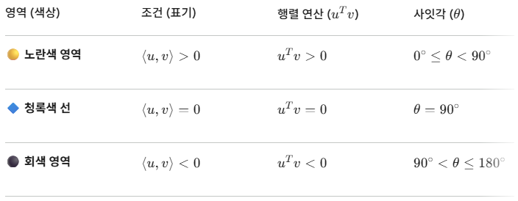
Geometric dot product

Slide 38
Contents
Vectors and their properties
Sum and difference of vectors
Distance between vectors
Multiplying a vector by a scalar
The dot product
Geometric dot product
Multiplying a matrix by a vector
Matrices as linear transformations
Matrix multiplication

Slide 39

Equations as dot product

Slide 40


Equations as dot product

Slide 41
Contents
Vectors and their properties
Sum and difference of vectors
Distance between vectors
Multiplying a vector by a scalar
The dot product
Geometric dot product
Multiplying a matrix by a vector
Matrices as linear transformations
Matrix multiplication

Slide 42






Matrices as linear transformations

Slide 43


Matrices as linear transformations

Slide 44

Matrices as linear transformations

Slide 45

Matrices as linear transformations

Slide 46
Contents
Vectors and their properties
Sum and difference of vectors
Distance between vectors
Multiplying a vector by a scalar
The dot product
Geometric dot product
Multiplying a matrix by a vector
Matrices as linear transformations
Matrix multiplication

Slide 47

Combining linear transformations

Slide 48

Matrices as linear transformations

Slide 49

Matrices as linear transformations

Slide 50

Matrices as linear transformations

Slide 51

Matrices as linear transformations

Slide 52


Matrices as linear transformations

Slide 53



Matrices as linear transformations

Slide 54



선형변환
선형대수학에서 선형변환($T$)은 Vector $x에$ matrix $A$ 가 내적하는 것으로 표현
$$T\left(x\right)=Ax$$
일반적을 Vector 공간(차원) $V$에서 matrix $A$ 를 통해 Vector 공간(차원) $W$ 것이 선형변환 ($T$)
$$T :V→W$$

Slide 55



1차원 선형변환
$$A=T（x） ＝ r^{2}$$
# python code
T = 3
x = np.array(3)
T*x
T = -0.5
T*x

Slide 56

2차원 선형변환
# python code
T = np.array([[-2,0], [0,-2])
T = np.array([[-2,0], [0,-2]])
x = np.array([1,1])
T.shape, x.shape
((2, 2), (2,))
# Linear Transformation
T@x

Slide 57

2차원 sheer 선형변환
# python code
# Shear in x
sheer_matrix = np.array([[1,10], [0,1]])
x = np.array([1,1])
sheer_matrix@x
# Shear in y
sheer_matrix = np.array([[1,0], [10,1]])
sheer_matrix@x
# Arbitrary shear
sheer_matrix = np.array([[1,5], [10,1]])
sheer_matrix@x
http://15462.courses.cs.cmu.edu/fall2019/lecture/transformations/slide_028

Slide 58


2차원 sheer & rotate 선형변환

Slide 59

실습하기
아래 코드를 직접 실행해보고 이미지에 대한 선형변환을 이해하자
2026_Spring_Data-Management/LA/w3/w3_linear_transformation_image.ipynb

Slide 60

Digress : Shear Bradpit Image
# python code
from PIL import Image, ImageOps, ImageFilter
# Load the image (Brad Pit)
image_url = "https://people.com/thmb/h67yba4NaGbpnv9DZVZm894kSjo=/1500x0/filters:no_upscale():max_bytes(150000):strip_icc():focal(979x292:981x294)/Brad-Pitt_1-2000-e8a294b80b034e659785ad813d3f02f2.jpg"
response = requests.get(image_url)
image = Image.open(BytesIO(response.content))
# Define the shear factor (adjust as needed)
shear_factor = 1.2
# Create a shear matrix for horizontal shear
shear_matrix = (1, shear_factor, 0, 0, 1, 0)
# Apply the shear transformation to the image
sheared_image = image.transform(image.size, Image.AFFINE, shear_matrix, Image.BICUBIC)

Slide 61



Digress : Kernel Transformation
np.random.seed(0)
X = np.random.randn(500); tr = 1
X_pos = X[np.logical_and(X<tr, X>-tr)]; X_neg = X[np.logical_or(X>=tr, X<=-tr)]
plt.scatter(X_pos, y=X_pos*0, c='r', marker='o', label='class 1', s=30)
plt.scatter(X_neg, y=X_neg*0, c='b', marker='d', label='class 0', s=30)
plt.legend(); plt.xlabel('x1', fontsize='16'); plt.ylabel('x2', fontsize='16');
plt.title('Problem', fontsize='18');plt.show()
plt.scatter(X_pos, y=X_pos**2, c='r', marker='o', label='class 1', s=30)
plt.scatter(X_neg, y=X_neg**2, c='b', marker='d', label='class 0', s=30)
plt.legend(); plt.xlabel(r'$\phi_1$',fontsize='16'); plt.ylabel(r'$\phi_2$',fontsize='16')
plt.title('Problem solving in Transformed higer Space', fontsize='18')
plt.axhline(y= tr, color='g', linestyle='-')

Slide 62



Digress : Kernel Transformation
# python code
from sklearn.datasets import make_circles
X, y = make_circles(n_samples=500, random_state=11, noise=0.1)
plt.scatter(X[:, 0], X[:, 1], c=y, s=20, cmap='coolwarm’);
r =np.exp(-(X ** 2).sum(1))
from mpl_toolkits import mplot3d plt.figure(figsize=(8,6))
ax = plt.axes(projection='3d')
ax.scatter3D(X[:, 0], X[:, 1], r, c=y, cmap='coolwarm’)
#ax.view_init(10, 250)

Slide 63

과제제출_Homework

