Slide 1
System of Linear Equations
Deep learning motivation
2026 Spring
조상구교수

Slide 2


Neural Networks – Matrix operations
It’s a face.

Slide 3
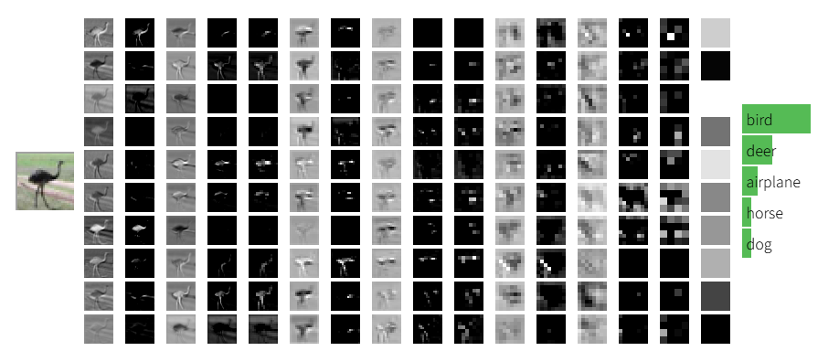
Neural Networks – Image recognition
CS231n: Deep Learning for Computer Vision

Slide 4
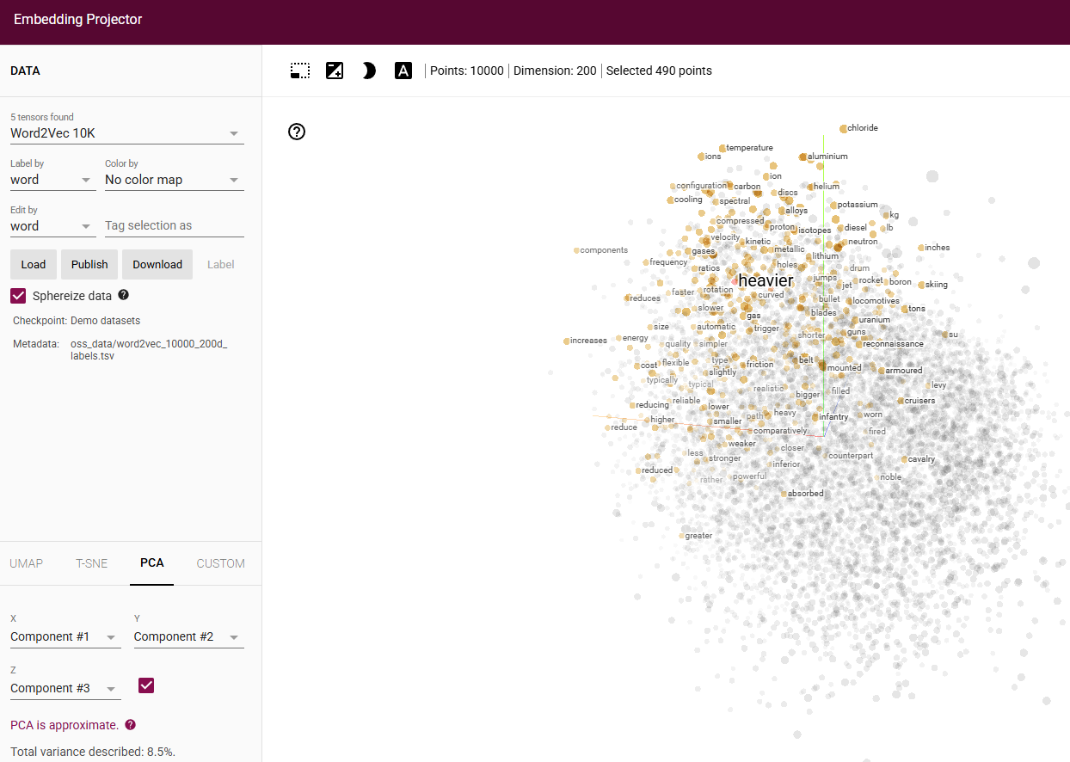
Neural Networks – text recognition
Embedding projector

Slide 5

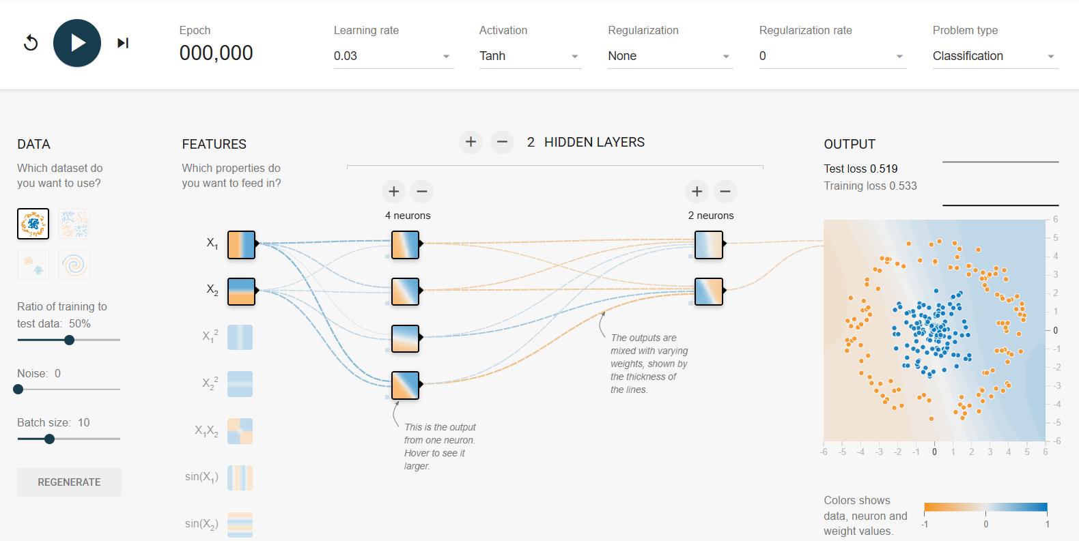
Neural Networks – tensorflow playground
Neural Network in Browser

Slide 6
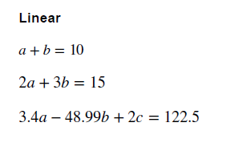
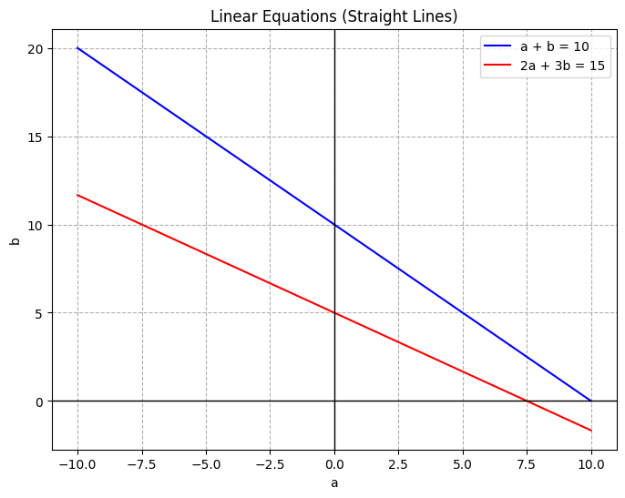
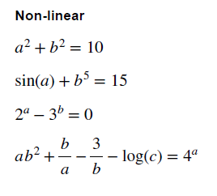
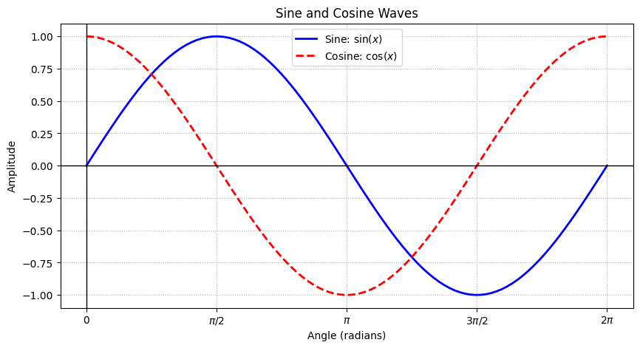
Linear, Non linear equations
Line
Not Line

Slide 7
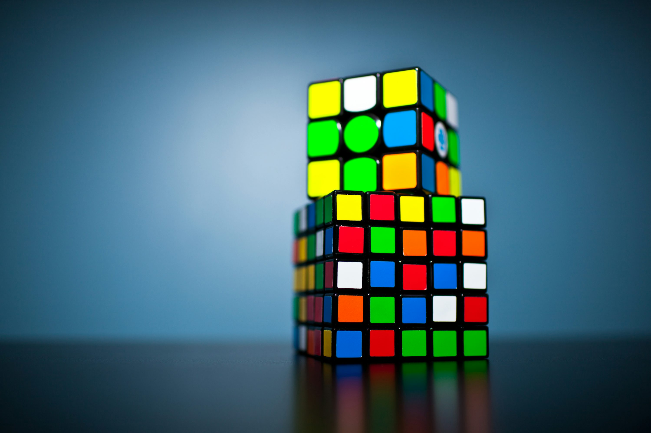
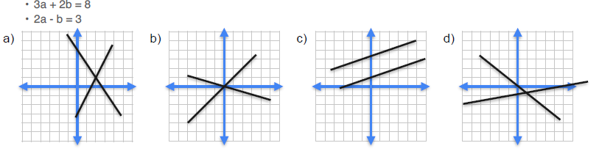
System of linear equation

Slide 8
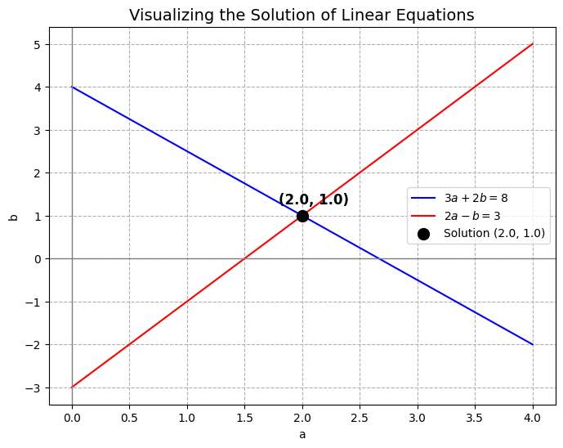
System of linear equation

Slide 9

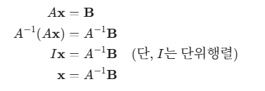






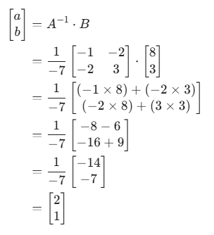
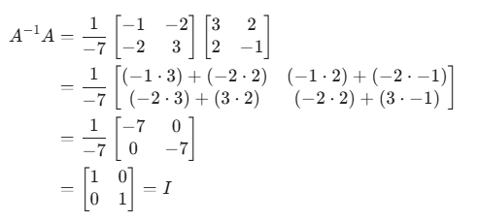
Matrix Formation- Inverse, determinant
(2 x 2)
(2 x 1)
(2 x 1)

Slide 10
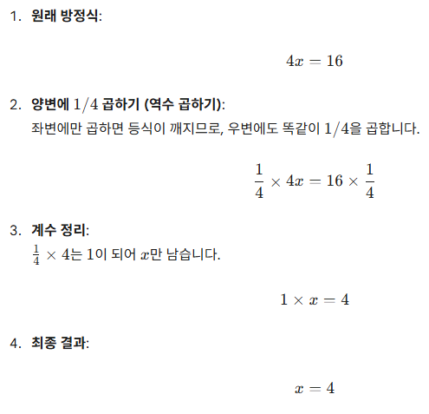
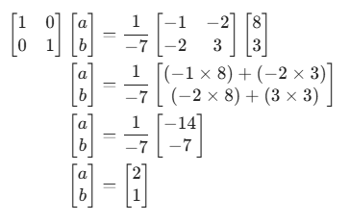
Matrix Formation- Inverse, determinant

Slide 11
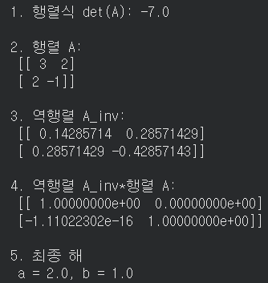
Solution with python
import numpy as np
# 1. 행렬 설정
A = np.array([[3, 2], [2, -1]]); B = np.array([[8], [3]])
# 2. 행렬식(Determinant) 계산
det_A = np.linalg.det(A); print(f"1. 행렬식 det(A): {det_A:.1f}")
if det_A != 0:
# 3. 역행렬 계산
print("\n2. 행렬 A:\n", A); A_inv = np.linalg.inv(A)
print("\n3. 역행렬 A_inv:\n", A_inv); print("\n4. 역행렬 A_inv*행렬 A:\n", A_inv@A)
# 4. 해 계산 (x = A_inv @ B)
# @ 기호는 파이썬에서 행렬 곱셈을 의미합니다.
X = A_inv @ B; print(f"\n5. 최종 해 \n a = {X[0][0]:.1f}, b = {X[1][0]:.1f}")
else:
print("행렬식이 0이므로 역행렬이 존재하지 않습니다.")

Slide 12
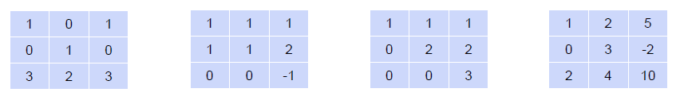
Quiz : Linear dependence and independence
Determine if the following matrices have linear dependent or independent rows
다음 중 모든 행벡터가 선형 독립인 행렬을 고르세요.

Slide 13
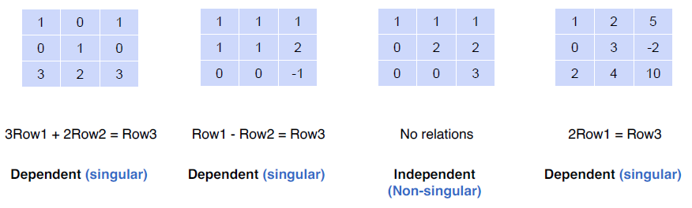
Solution: Linear dependence and independence
Determine if the following matrices have linear dependent or independent rows

Slide 14
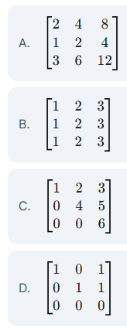
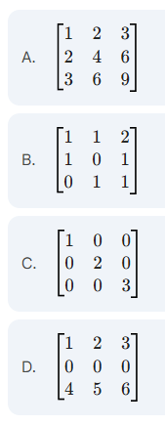
Quiz : Linear dependence and independence
Determine if the following matrices have linear dependent or independent columns
다음 중 모든 열벡터가 선형 독립인 행렬을 고르세요.

Slide 15
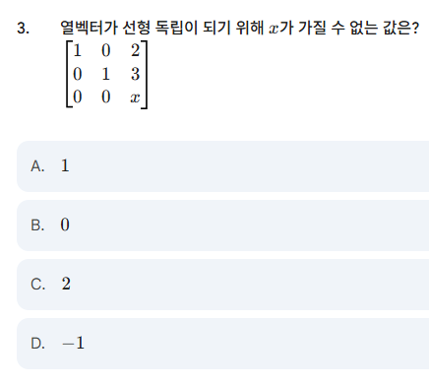
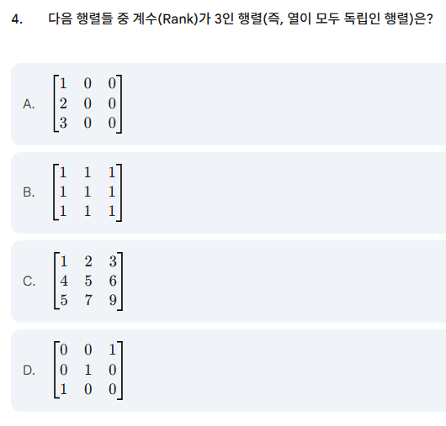
Quiz : Linear dependence and independence

Slide 16
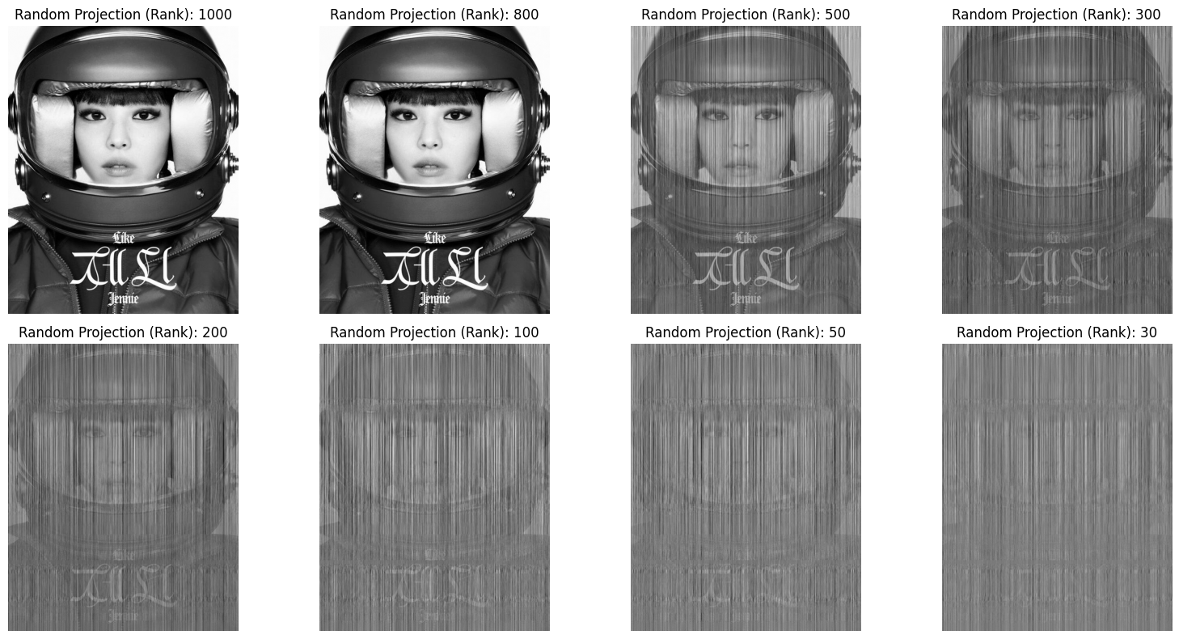
Compressing Images – Reducing rank by random choice of features
url = "https://img.tf.co.kr/article/home/2025/07/22/202598011753169335.jpg"

Slide 17
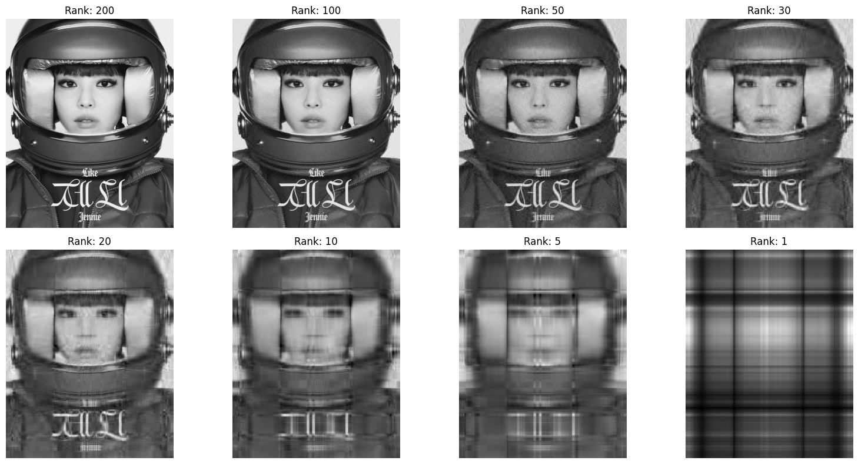
Compressing Images – Reducing rank by SVD, PCA
Rank 가 30, 10, 5인데도 face 식별이 가능한 이유?

