Slide 1
Custom CNN-Based 11-Class
CT Image Classification
Dataset Analysis • Custom CNN Design • Experimental Evaluation
Phase 1 — Final Report

Slide 2
PHASE 1
Problem & Objective
The professor provided a pre-split image dataset and asked us to build custom CNN architectures — not pretrained models.
• 64×64 grayscale images
• 11-class classification problem
• Objective: design custom CNNs, evaluate rigorously
• Investigate model behavior, not just chase a score
Image
Custom CNN
11 Classes
→
→
64×64×1
Learned Features
Softmax Output
Dataset provenance was not independently confirmed from any file in the workspace. This project reports only verified, directly-checked properties of the data.
2

Slide 3
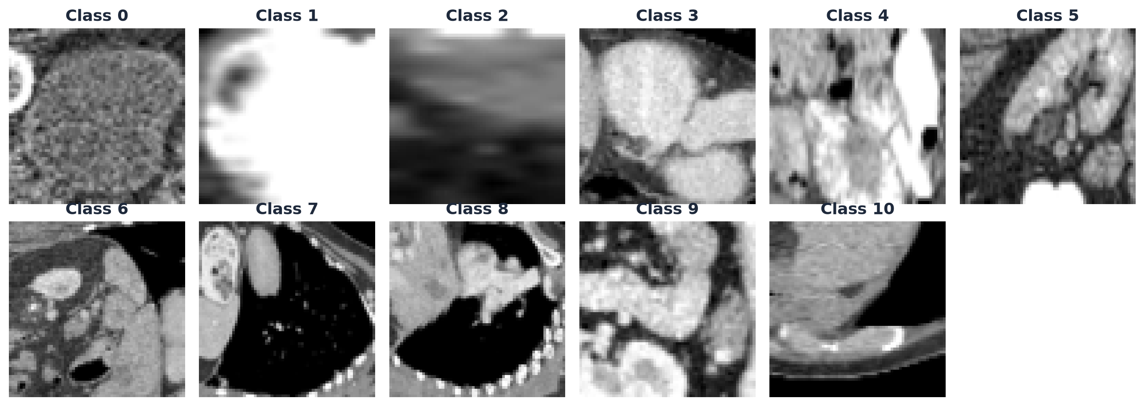
PHASE 1
The Dataset
13,932
2,452
8,827
11
Train images
Validation
Test
Classes
Verified properties
• Resolution: 64×64 px, single-channel (grayscale)
• Pixel dtype: uint8, range 0–255
• Labels: integer-encoded (0–10), not one-hot
• Zero duplicate images found in or across any split
Real training-set sample images, by class
3

Slide 4
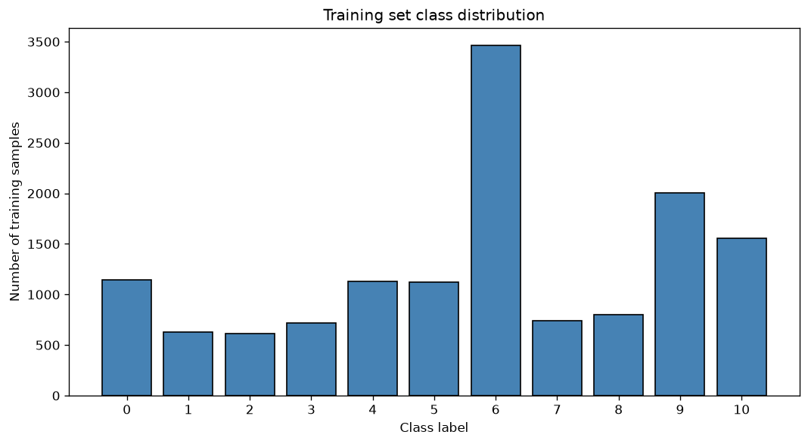
PHASE 1
Dataset Analysis — Class Imbalance
5.64×
Imbalance ratio (max/min class)
24.9%
Largest class share (class 6)
4.4%
Smallest class share (class 2)
This imbalance directly motivated using Macro F1, not just accuracy, as our primary evaluation metric (see Slide 7).
4

Slide 5
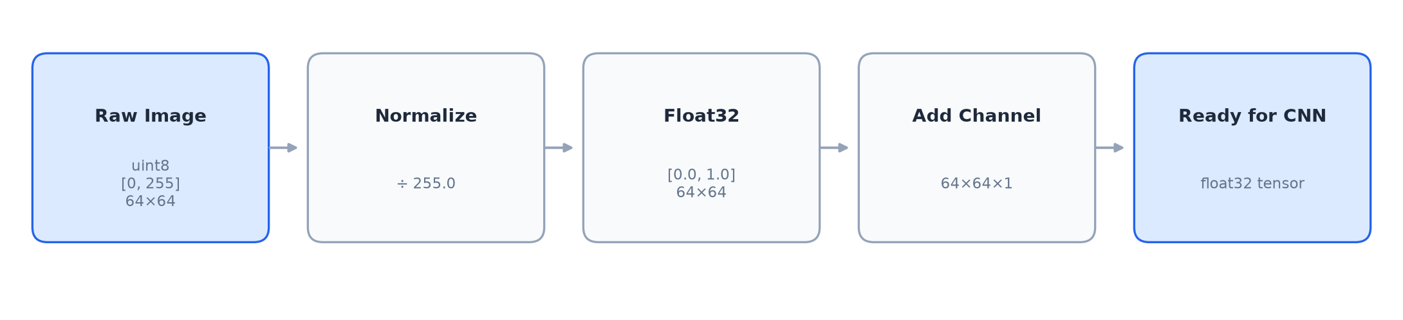
PHASE 1
Preprocessing
Normalization
uint8 [0,255] → float32 [0,1] via fixed division by 255 — no leakage risk
Channel dimension
(64,64) → (64,64,1), required by Conv2D
Labels
Kept as integers, used with sparse_categorical_crossentropy
Applied identically
Same function used for train, validation, and test — no branching
5

Slide 6
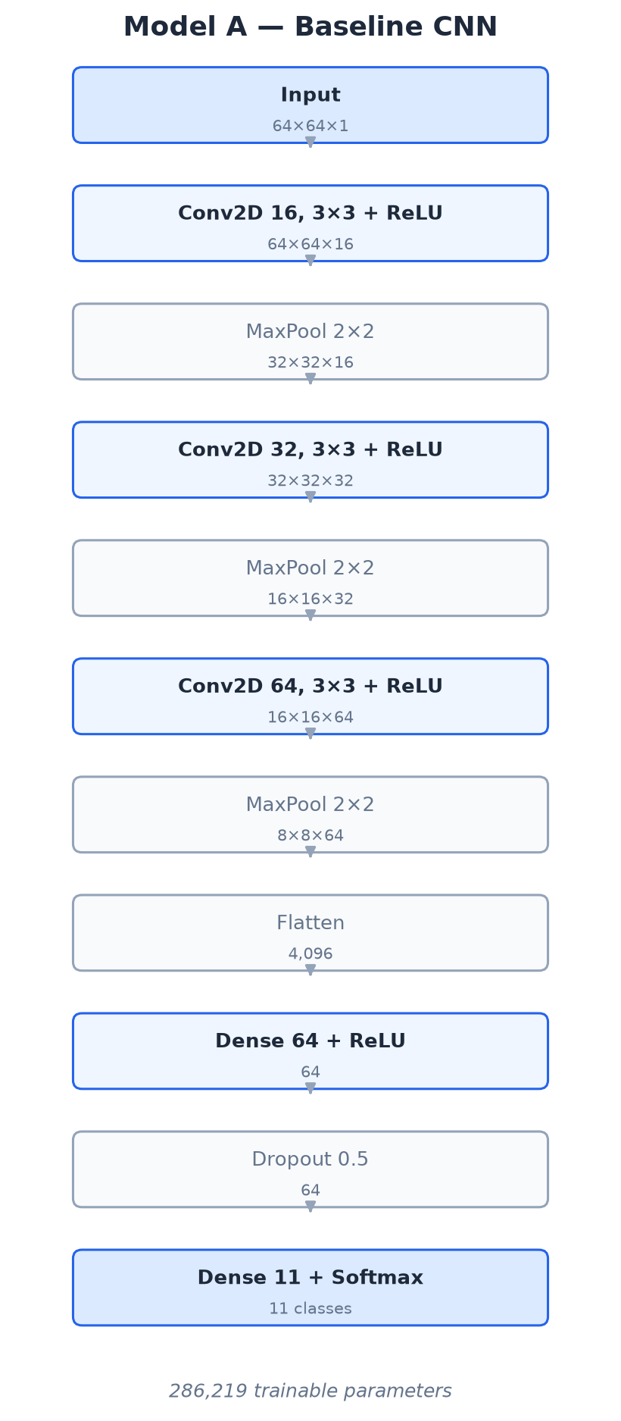
PHASE 1
Baseline Custom CNN — Model A
Design rationale
• 3 convolutional blocks (16 → 32 → 64 filters), each followed by max pooling
• Deliberately lightweight — establishes a reliable, honest starting point
• 64×64 grayscale images are far simpler than natural photos; a shallow net is not automatically underpowered
• Flatten + Dense(64) + Dropout(0.5) before an 11-class softmax output
286,219
Adam
Trainable parameters
Optimizer, lr = 1e-3
6

Slide 7
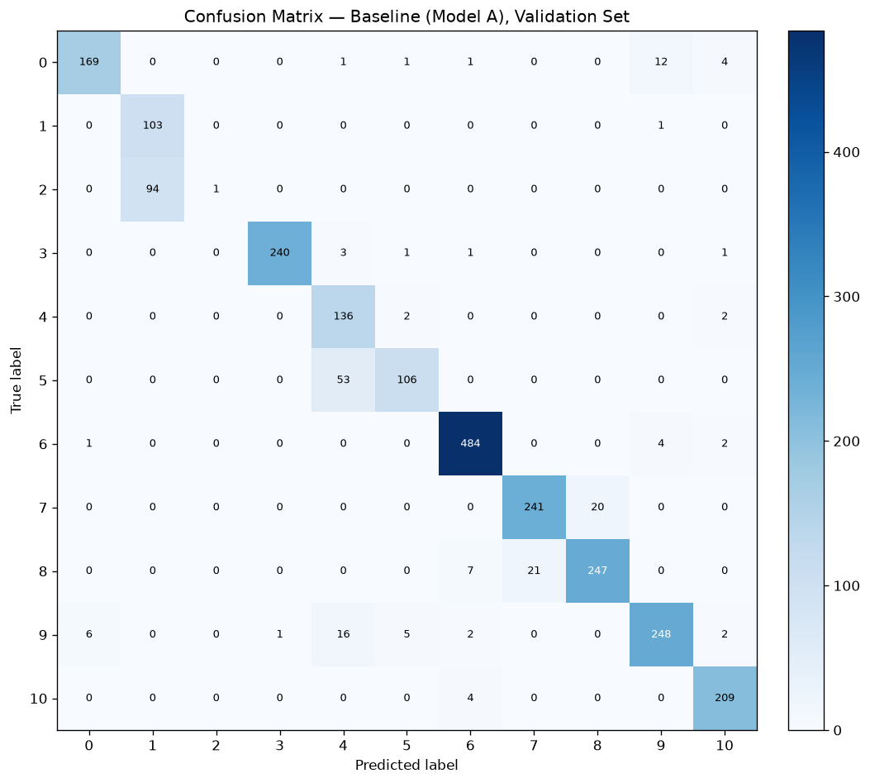
PHASE 1
Baseline Performance
89.07%
80.53%
Validation Accuracy
Validation Macro F1
Overall accuracy is strong — but Macro F1 is noticeably lower. That gap is the first sign of uneven performance across classes.
Key finding
Class 2 F1 = 0.021, despite 89% overall accuracy.
Precision 1.000, Recall 0.011 — the model almost never predicts class 2 at all.
7

Slide 8
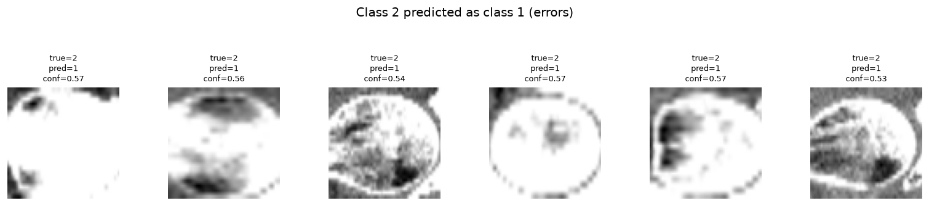
PHASE 1
Where Was the Model Struggling?
94 / 95
True class-2 samples predicted as class 1
This is the single largest confusion pair anywhere in the entire 11×11 matrix — nearly double the next-largest.
Observed, not assumed:
Model confidence on these errors (≈57%) was lower than on correct predictions (≈94%) — genuinely uncertain, not confidently wrong.
Class 2 samples predicted as class 1 (real validation examples)
8

Slide 9
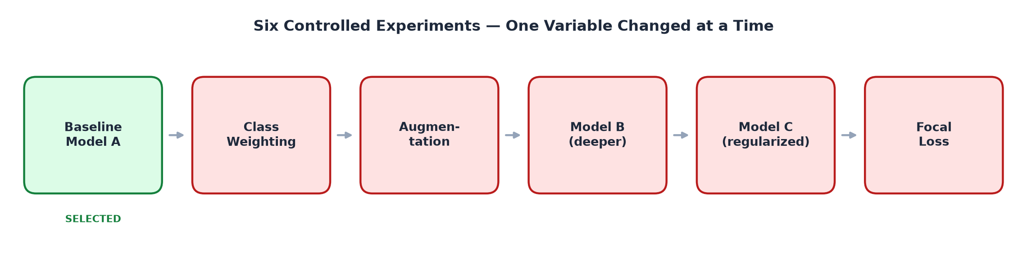
PHASE 1
Systematic Experimental Investigation
Six controlled experiments, each changing exactly one variable relative to the baseline — same data split, same evaluation protocol every time.
9

Slide 10
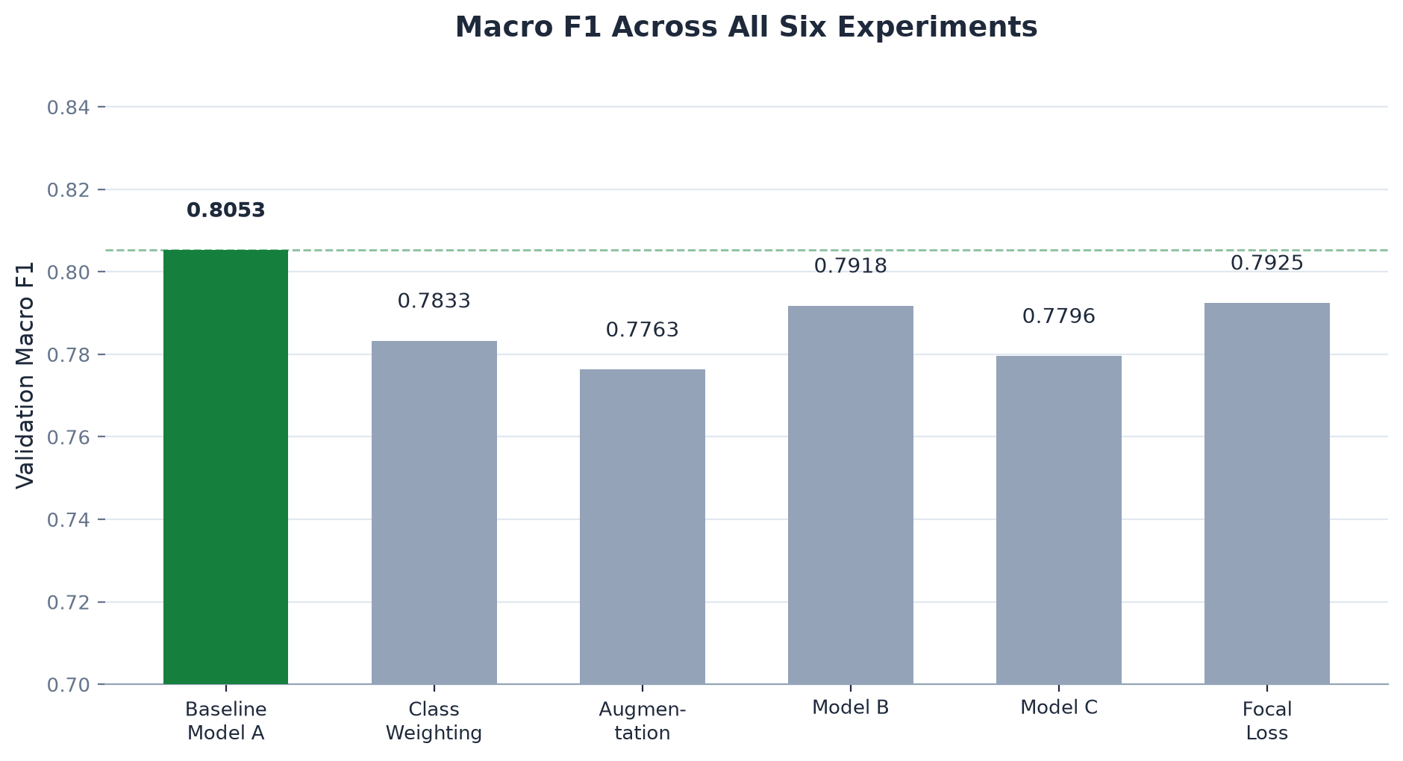
PHASE 1
Experiment Results — Macro F1
Every single alternative reduced Macro F1 relative to the baseline.
10

Slide 11
PHASE 1
What Didn't Work — And Why
Class Weighting
Augmentation
Model B (deeper)
Corrects for frequency, not visual similarity — classes 1/2 have almost equal sample counts
Tested config reduced validation performance — may have disrupted positional cues
Higher capacity (602K params) increased overfitting, not accuracy
Model C (regularized)
Focal Loss (γ=2.0)
Regularization improved stability somewhat but still trailed the baseline
Difficulty-focused reweighting still did not improve Macro F1
11

Slide 12
PHASE 1
Final Model — Why the Simplest Model Won
Selection criteria
✓ Highest validation Macro F1 of all six candidates (0.8053)
✓ Fewest parameters (286K vs. up to 602K for Model B)
✓ Least overfitting of any architecture tested
✓ Selected on Macro F1 primarily — not accuracy alone
0.8053
286,219
Selected: Validation Macro F1
Parameters (smallest viable)
12

Slide 13
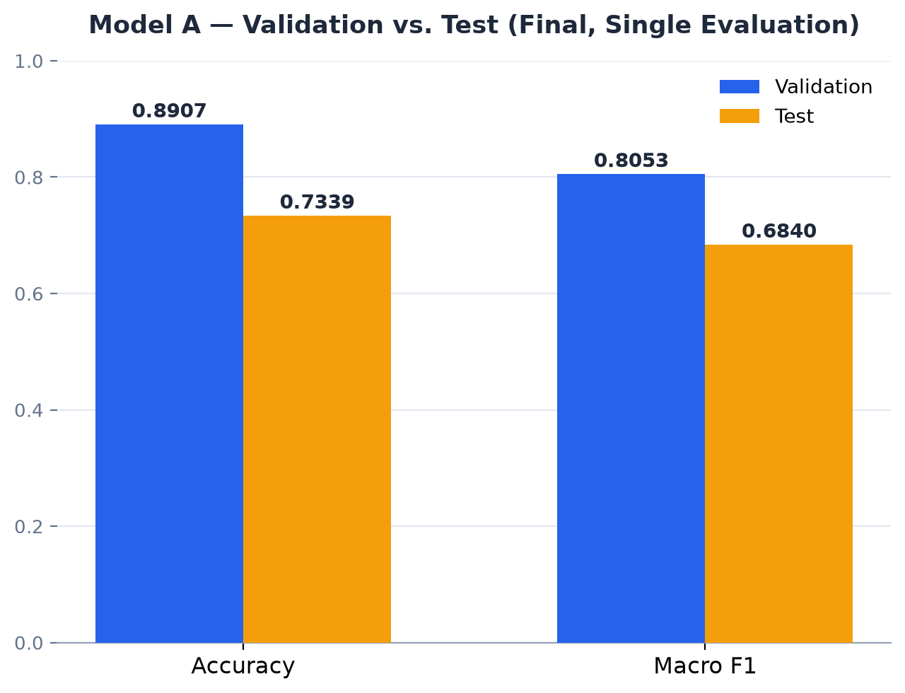
PHASE 1
Final Test Evaluation
73.39%
68.40%
Test Accuracy
Test Macro F1
Honest gap disclosure
Validation Macro F1 (0.8053) → Test Macro F1 (0.6840): a 0.121 drop, larger than normal run-to-run noise.
Evaluated exactly once, after model selection. No tuning followed.
Two honest hypotheses, neither proven: (1) comparing six models on one validation set introduces some optimistic bias, (2) a possible validation/test distributional difference.
13

Slide 14
PHASE 1
Key Findings
1
Custom CNN successfully learned the 11-class task from scratch — no pretrained backbone
2
The simplest architecture (Model A) was the strongest validated approach
3
Increased complexity (Model B) did not automatically improve generalization
4
Class 1/2 confusion remained the dominant, unresolved bottleneck across every experiment
5
Five reasonable, mechanistically distinct interventions all failed to fix it
6
Error analysis — not guesswork — identified and characterized the actual failure mode
14

Slide 15
PHASE 1
Conclusion & Future Work
Conclusion
Future Work (Phase 2 — not started)
Phase 1 established a complete custom-CNN classification pipeline and systematically evaluated multiple approaches — with every result, including negative ones, honestly documented.
• Systematic hyperparameter optimization
• Learning-rate scheduling strategies
• Targeted architecture improvements
• Deeper investigation of class 1/2
• Resolution / additional-data investigation
Phase 1 complete — Phase 2 motivated by the remaining performance bottlenecks.
15

