Slide 1
Sentiment Analysis using LSTM Networks
A Study on Movie Reviews

Slide 2
Introduction
Sentiment Analysis aims to determine the emotional tone behind text.
It is widely used in analyzing customer feedback, social media, and reviews.
In this study, we focus on analyzing movie reviews using LSTM (Long Short-Term Memory) networks.

Slide 3
Objective
To develop a sentiment analysis system using LSTM networks.
To classify movie reviews as Positive or Negative.
To evaluate the performance of the model on benchmark datasets.

Slide 4
What is LSTM?
• LSTM is a type of Recurrent Neural Network (RNN) capable of learning long-term dependencies.
• It overcomes the vanishing gradient problem found in traditional RNNs.
• Ideal for tasks involving sequential data, such as text.

Slide 5
System Architecture
Input Layer: Accepts raw movie review text.
Preprocessing Layer: Cleans and tokenizes text.
Embedding Layer: Converts tokens to vectors.
LSTM Layer: Processes sequential data.
Dense Layer: Outputs sentiment classification.

Slide 6
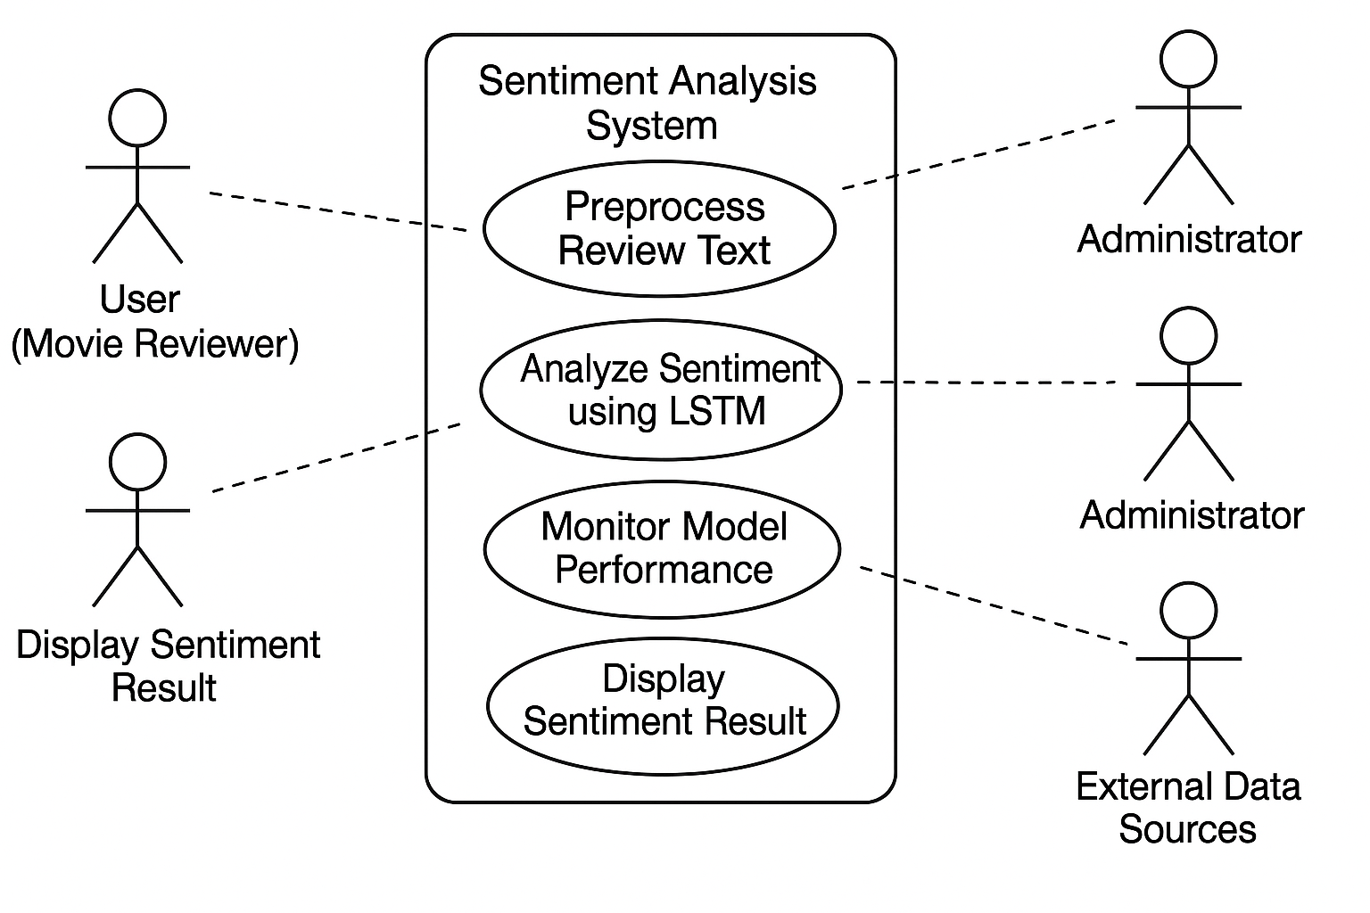
Use Case Diagram

Slide 7
CONCLUSION
• Accuracy: 94.71%
• Precision: 85.3%
• Recall: 86.1%
• F1 Score: 85.7%
• The LSTM model effectively captured sentiment in movie reviews. LSTM networks are highly effective for sentiment analysis on textual data. • The model performed well on movie review datasets. • Future work: Explore bidirectional LSTMs and attention mechanisms.

