Slide 1

HOUSING: PRICE PREDICTION Anchal Awasthi

Slide 2
Problem Statement
Houses are one of the necessary need of each and every person around the globe and therefore housing and real estate market is one of the markets which is one of the major contributors in the world’s economy. It is a very large market and there are various companies working in the domain.
Data science comes as a very important tool to solve problems in the domain to help the companies increase their overall revenue, profits, improving their marketing strategies and focusing on changing trends in house sales and purchases. Predictive modelling, Market mix modelling, recommendation systems are some of the machine learning techniques used for achieving the business goals for housing companies. Our problem is related to one such housing company.
A US-based housing company named Surprise Housing has decided to enter the Australian market. The company uses data analytics to purchase houses at a price below their actual values and flip them at a higher price. For the same purpose, the company has collected a data set from the sale of houses in Australia.

Slide 3
The company is looking at prospective properties to buy houses to enter the market. We have to build a model using Machine Learning in order to predict the actual value of the prospective properties and decide whether to invest in them or not. For this company wants to know:
• Which variables are important to predict the price of variable?
• How do these variables describe the price of the house?
Business Goal:
We are required to model the price of houses with the available independent variables. This model will then be used by the management to understand how exactly the prices vary with the variables. They can accordingly manipulate the strategy of the firm and concentrate on areas that will yield high returns. Further, the model will be a good way for the management to understand the pricing dynamics of a new market

Slide 4
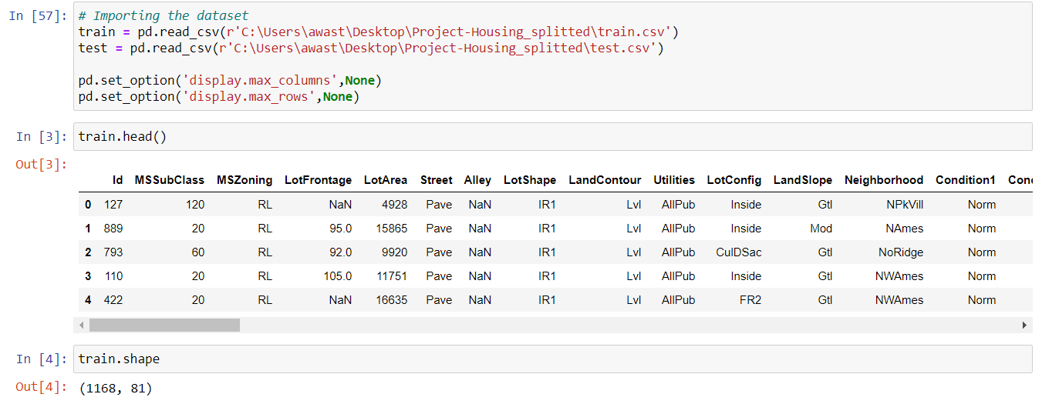
Exploratory Data Analysis
Firstly, we will import all the libraries and then load both the dataset -train and test (csv file) using pandas. We will also check first five rows using .head

Slide 5
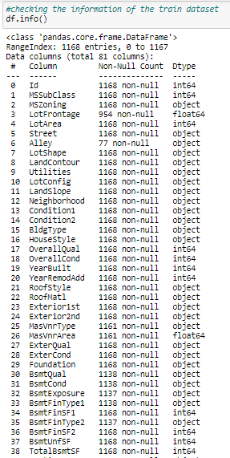
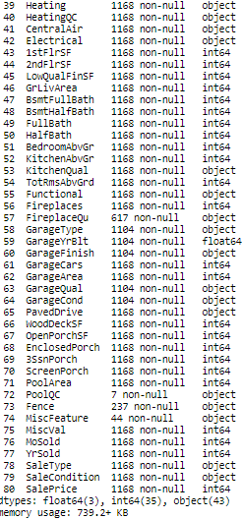
Then we further checked more about data using info, checked datatypes using dtypes, shapes using .shape, columns using .columns, null values using .isnull.sum and further visualize it through heatmap as follows:

Slide 6
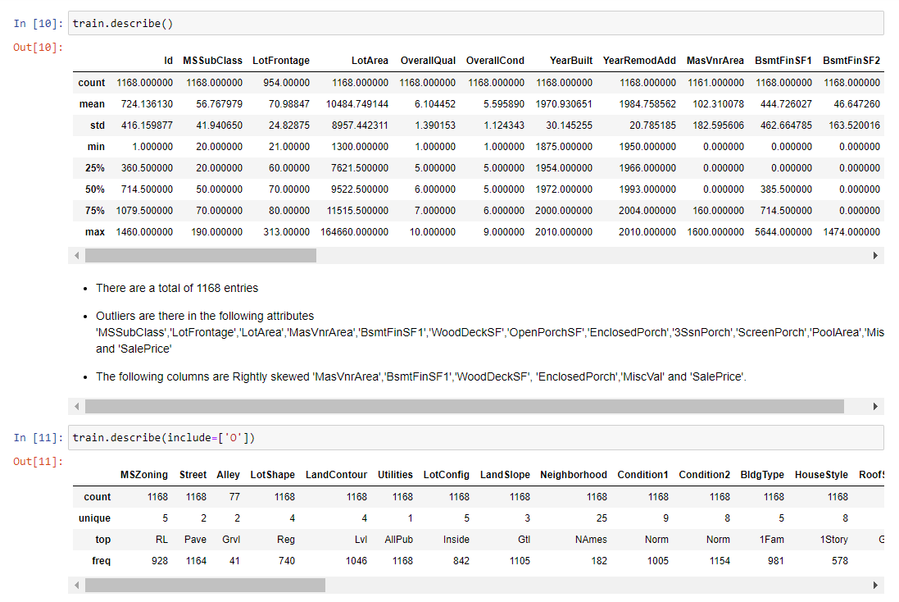

Slide 7
To check the statistical summary of the dataset using .describe from which we have observed that:
Total entries:1168
outliers are there in : 'MSSubClass','LotFrontage','LotArea','MasVnrArea','BsmtFinSF1','WoodDeckSF','OpenPorchSF','EnclosedPorch','3SsnPorch','ScreenPorch','PoolArea','MiscVal' and 'SalePrice'
Mean is greater than median in : 'MasVnrArea','BsmtFinSF1','WoodDeckSF', 'EnclosedPorch','MiscVal' and 'SalePrice'.

Slide 8
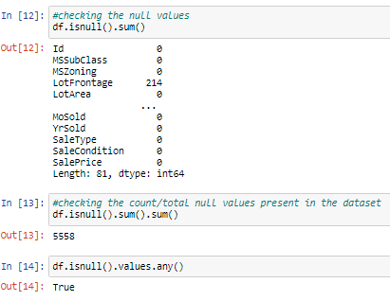

Slide 9
Next we will be checking the correlation using .corr and visualize the same using a heatmap. Also we can check the correlation of all the attributes with the target variable. From this we observe that:
MSSubClass,OverallCond,KitchenAbvGr,EnclosedPorch and Yr Sold are the least/negatively correlated column with target('SalePrice') variable
OverallQual is highly correlated column with target variable followed by GrLivArea and other attributes.

Slide 10
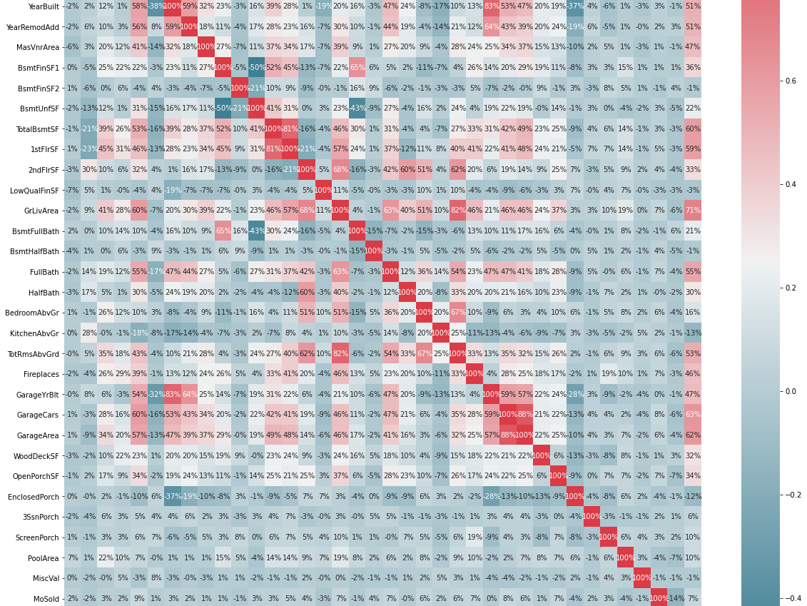

Slide 11
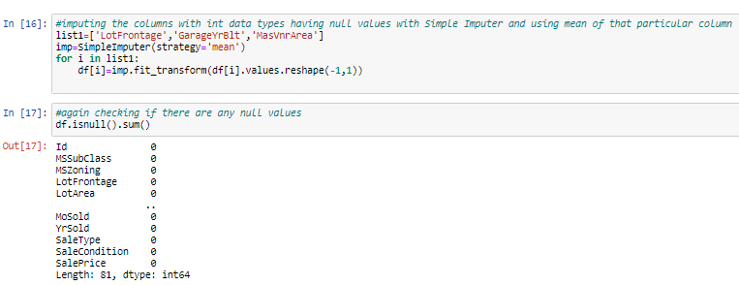
We will be imputing the columns with int data types having null values with Simple Imputer and using mean of that particular column and check again if there are any null values left

Slide 12
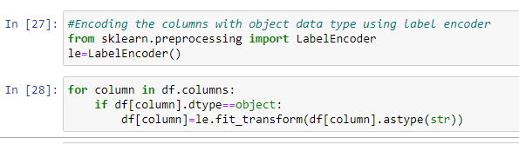
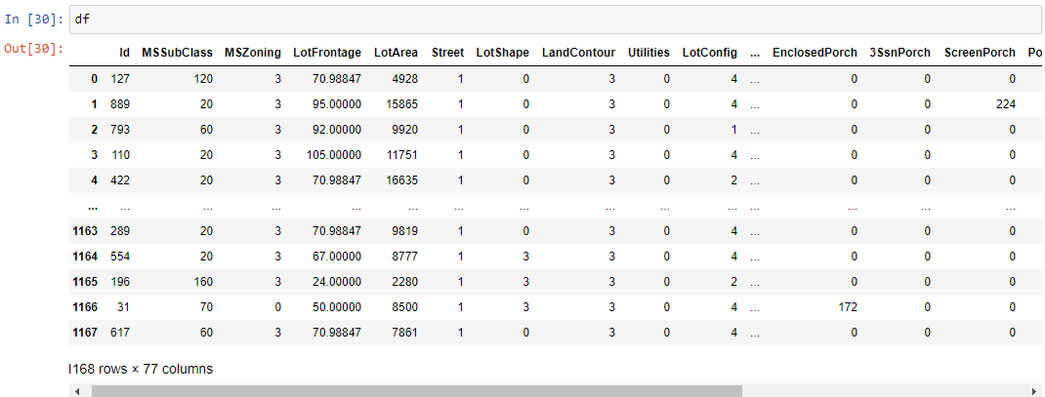
Encoding the columns with object data type using label encoder
It can be observed that all the columns with object data type has been converted to int/float

Slide 13
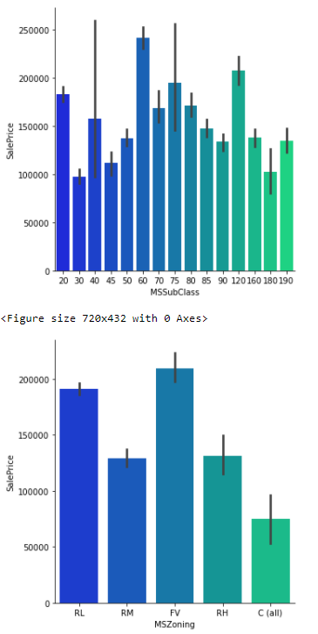
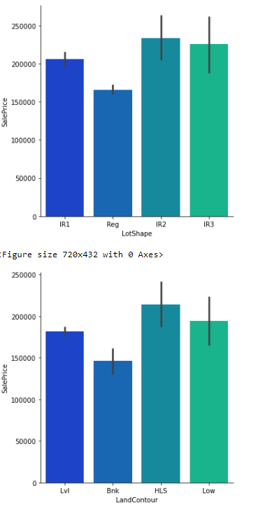
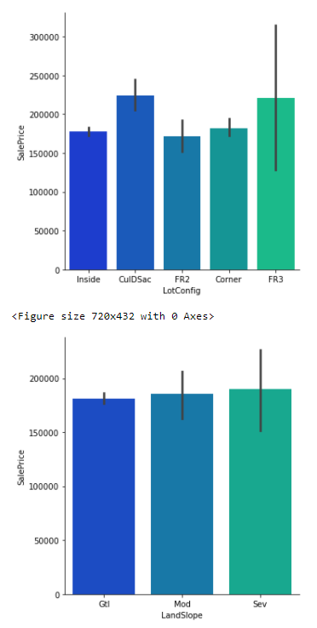
Data Visualization
BIVARIATE ANALYSIS--we'll be checking the impact of each attribute on the 'SalePrice' using catplot.

Slide 14
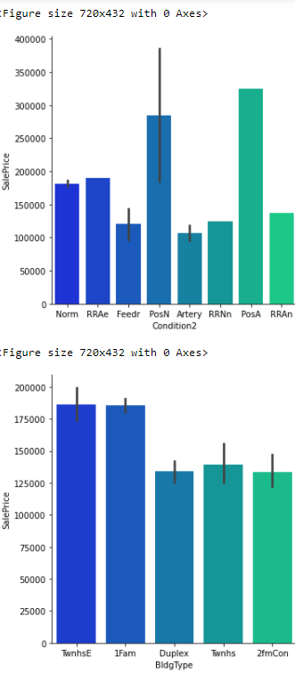
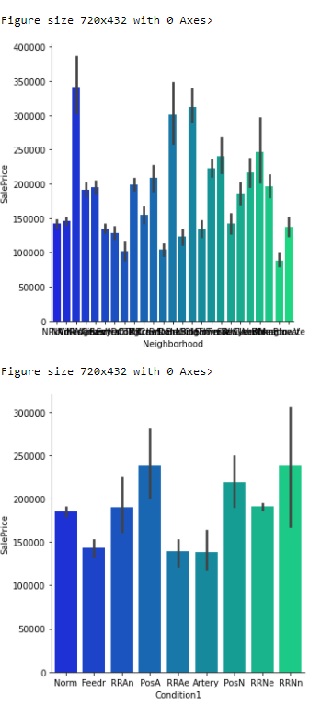
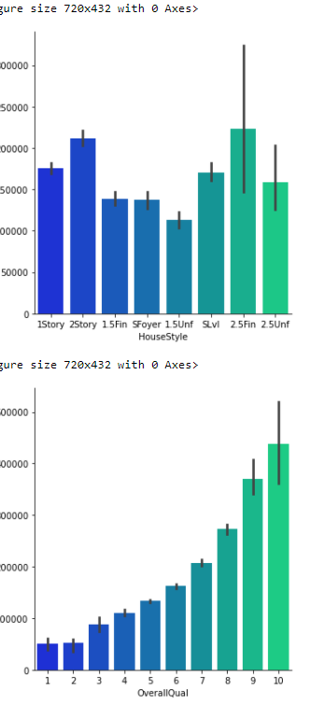

Slide 15
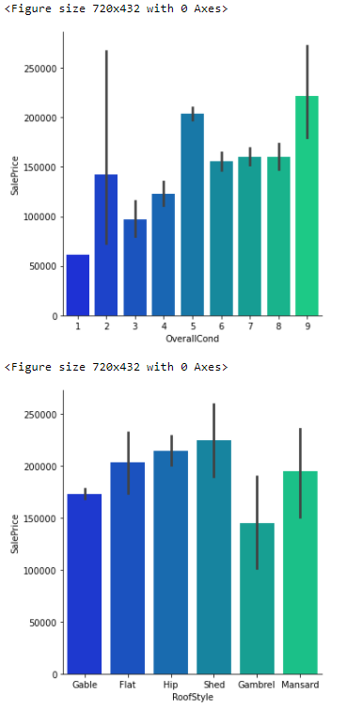
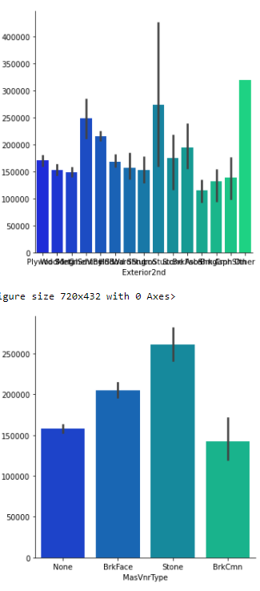
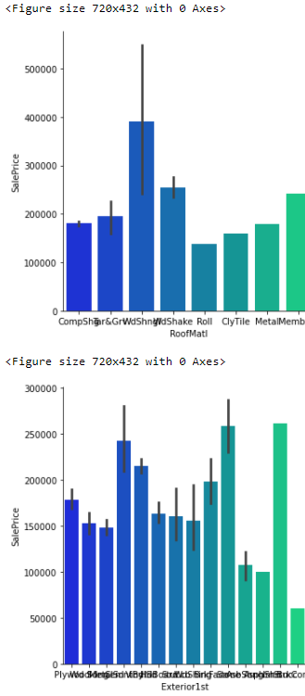

Slide 16
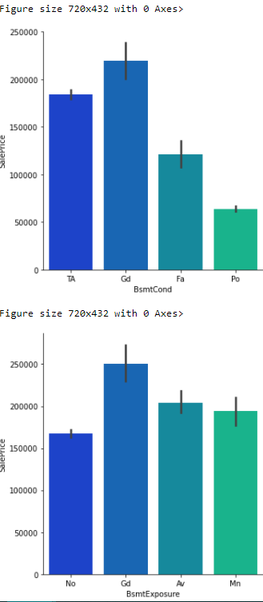
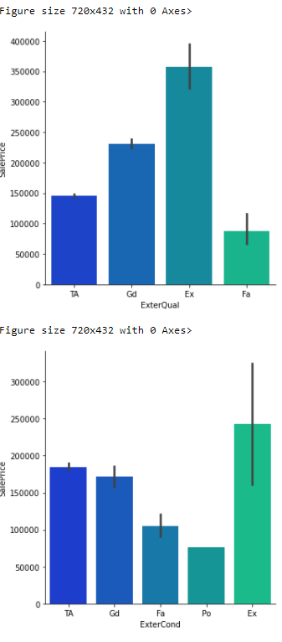
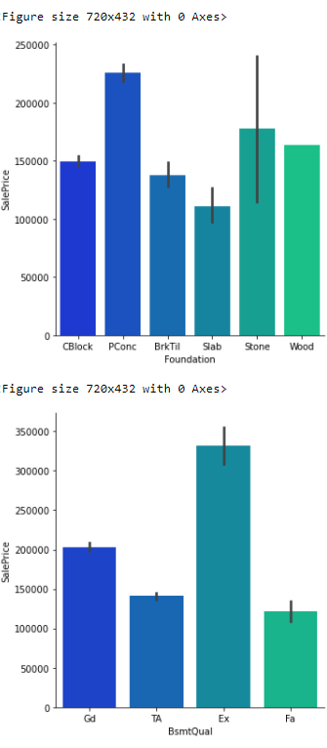

Slide 17
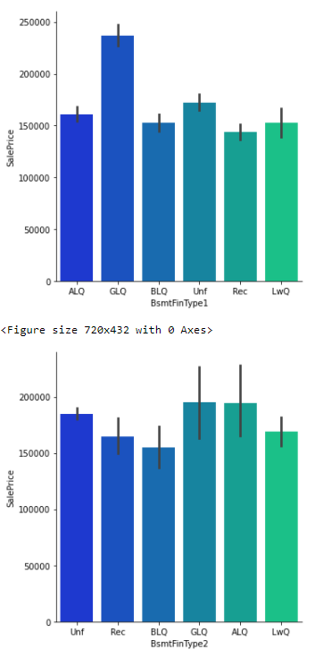
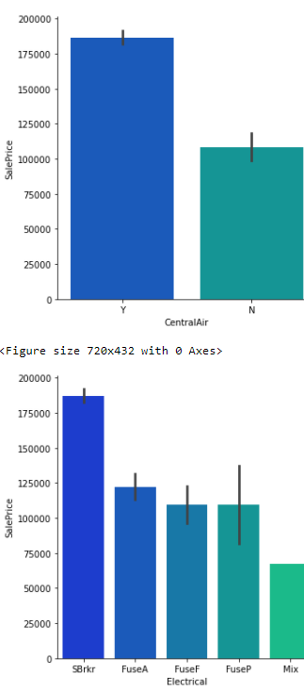
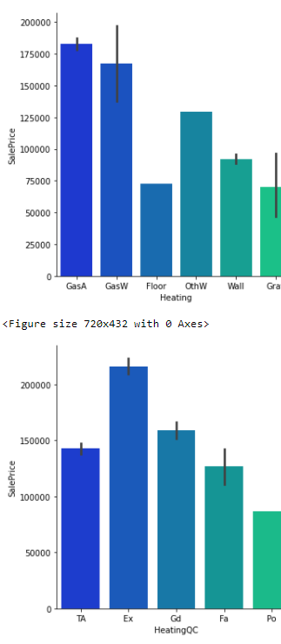

Slide 18
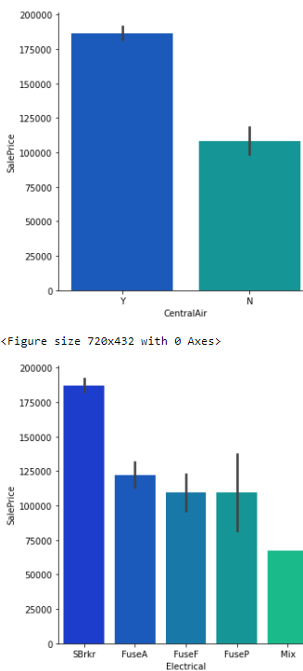
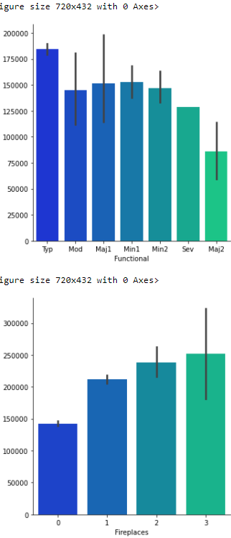
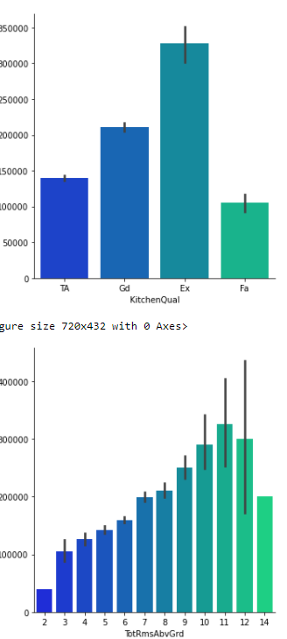

Slide 19
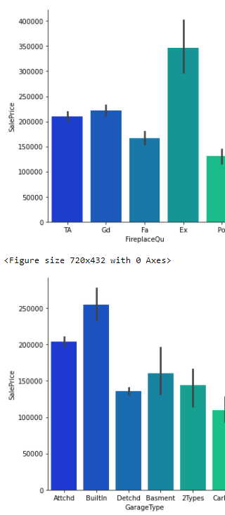
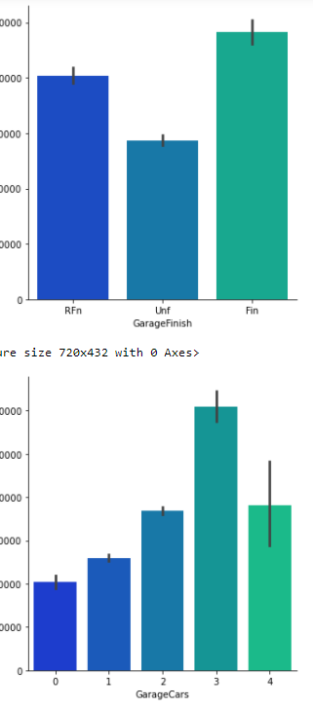
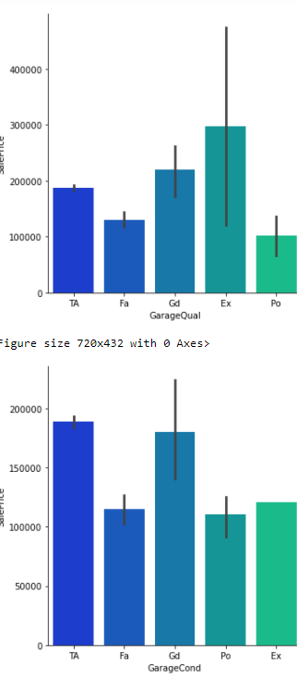

Slide 20
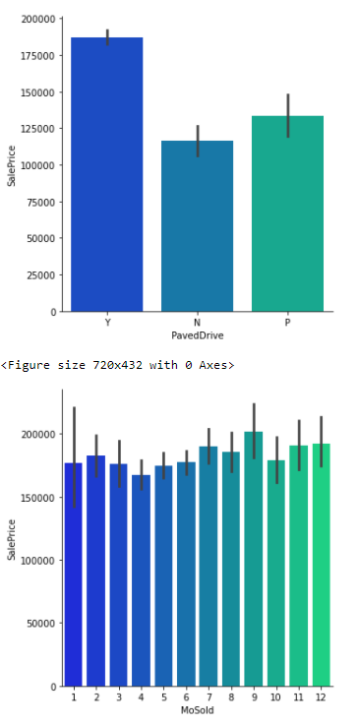
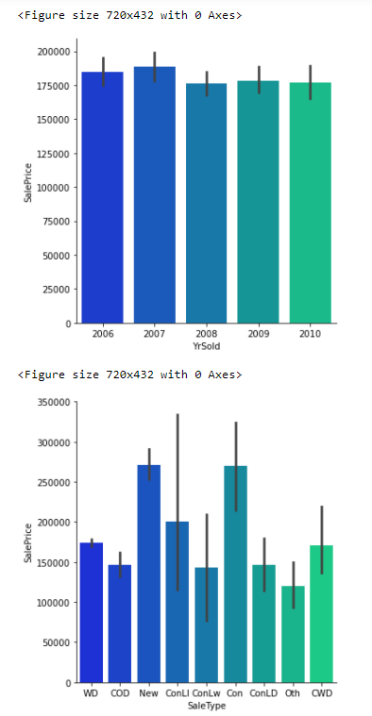
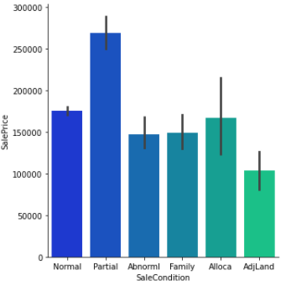

Slide 21
Checking Distribution/skewness
It can be observed that there is skewness present in : 'MSSubClass', 'OverallCond', 'YearBuilt','YearRemodAdd','Exterior1st','Exterior2nd','MasVnrType','ExterQual','BsmtQual','BsmtExposure','2ndFlrSF','KitchenQual','Fireplaces','GarageType','GarageYrBlt','WoodDeckSF'and 'OpenPorchSF'.

Slide 22
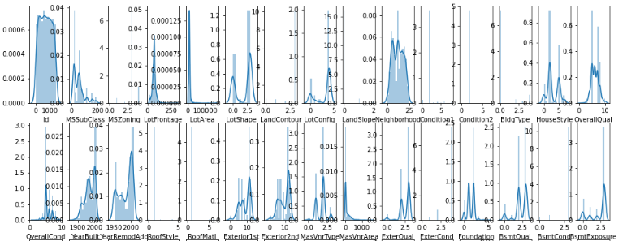
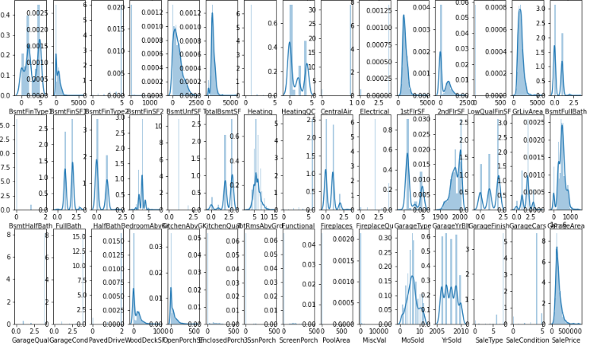

Slide 23
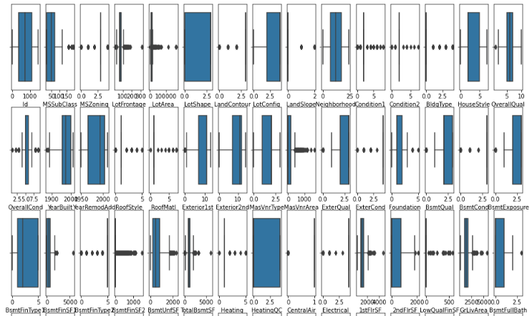
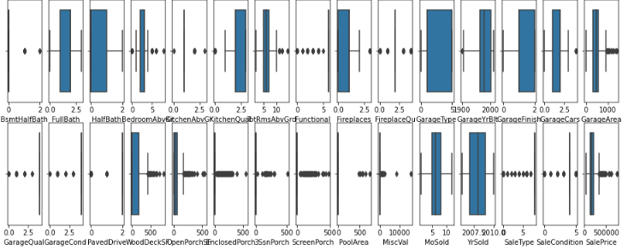
Plotting the outliers using boxplot

Slide 24
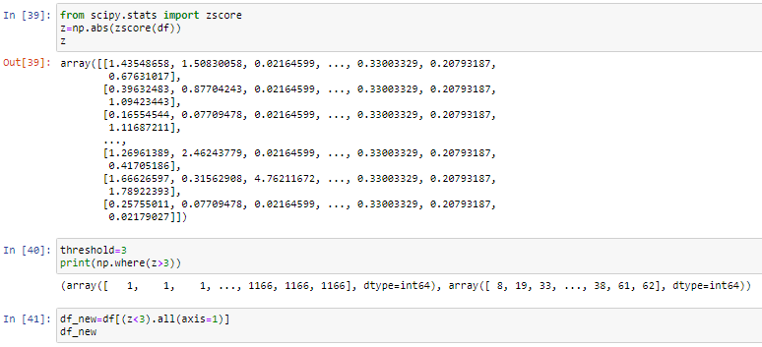
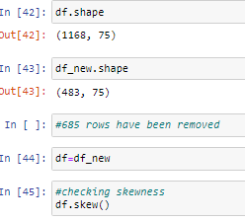
Removing the Outliers using Z-score

Slide 25
Model Training
Firstly, we will be splitting our dataset into input and output variable as x and y respectively.
Then, we will be scaling all our input variables using standard scalar.
Lastly, to develop the model we have used various libraries and metrics from sklearn such as train_test_split, LinearRegression,Lasso,Ridge,ElasticNet, SVR, DecisionTreeRegressor, KNeighborsRegressor, RandomForestRegressor, AdaBoostRegressor, GradientBoostingRegressor, mean_squared_error, mean_absolute_error and r2_score
Next, we will be splitting our data into training and testing with random_state=44 and test_size=0.33. Then we will be checking the shape of train and test data as follows:

Slide 26
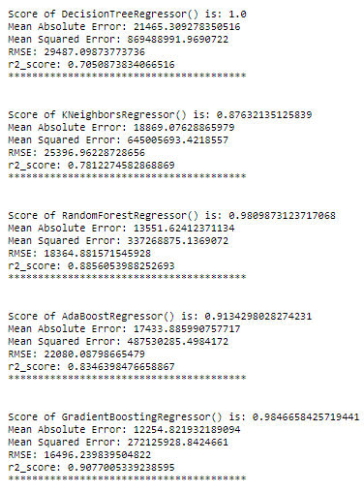
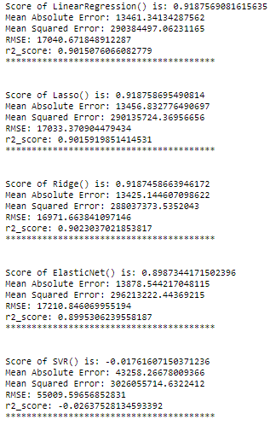
I am choosing GradientBoostingRegressor as our best model since it's giving us best score and it's performing well. It's r2_score is also satisfactory and it shows that our model is neither underfitting/overfitting.
We are performing hyperparamter tuning using GridSearchCV on GradientBoostingRegressor as follows:

Slide 27
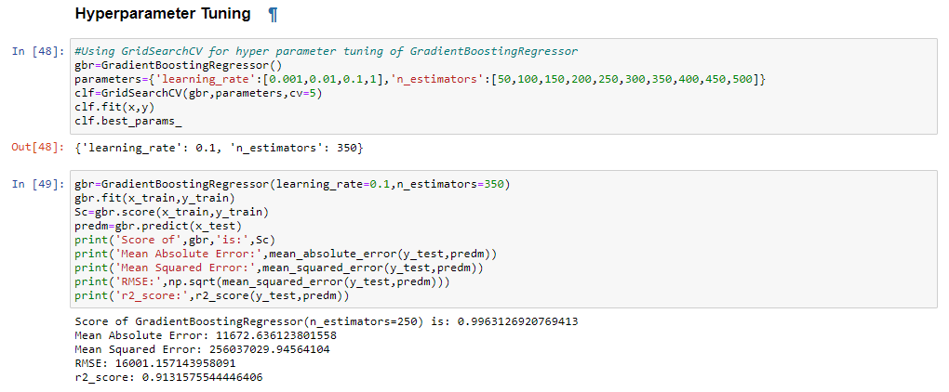

Slide 28
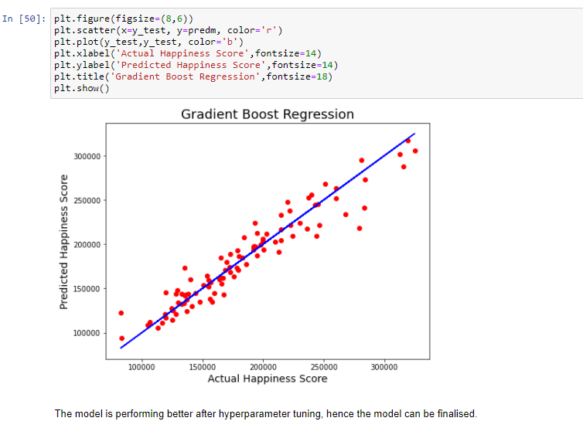

Slide 29
Conclusion
Landconotur corresponding to 1 i.e, HLS Hillside - Significant slope from side to side has maximum price.
Neighborhoot with (15)NPkVill Northpark Villa has maximum sales price and (10)IDOTRR Iowa DOT and Rail Road has least.
1Fam Single-family Detached and TwnhsI Townhouse Inside Unit have maximum saleprice.
In HouseStyle category 3: 2Story Two story has max sale price.
In RoofStyle 5:Shed has maximum.
In Exterior1st 6:HardBoard and 9:Other have Saleprice
In MasVnrType, 3:stone has max saleprice and 0:BrkCmn Brick Common has least
Houses with CentralAir has higher saleprice
GarageType 3:BuiltIn Built-In (Garage part of house - typically has room above garage) has max saleprice
In 2007 maximum houses are sold followed by 2006
MSSubClass,OverallCond,KitchenAbvGr,EnclosedPorch and Yr Sold are the least/negatively correlated column with target('SalePrice') variable
OverallQual is highly correlated column with target variable followed by GrLivArea and other attributes.

