Slide 1
Touch ON–OFF
Sensor Switch
NE555
A simple bistable switching circuit using the NE555 timer IC
ECE Mini Project
TOUCH ON
TOUCH OFF

Slide 2
1. Introduction
What is a touch ON–OFF sensor switch?
Purpose
Main IC
Output
Turns a load ON or OFF using a light touch instead of a mechanical switch.
The NE555 is configured as a bistable (flip-flop-like) circuit.
The 555 output changes state and can control indicator LEDs or another suitable load.
Two touch plates act as the ON and OFF inputs.
A brief touch changes the state; the circuit remains in that state until the opposite touch is made.
This makes the circuit useful as an electronic replacement for a simple push-button switch.
2

Slide 3
2. Components Required
Typical parts used in the shown circuit
NE555 timer IC
2 touch plates
Resistors
Main bistable control element
ON and OFF sensing inputs
Provide bias/current-limiting functions
LED1 & LED2
DC supply
Indicate the output state
Powers the NE555 circuit
3

Slide 4
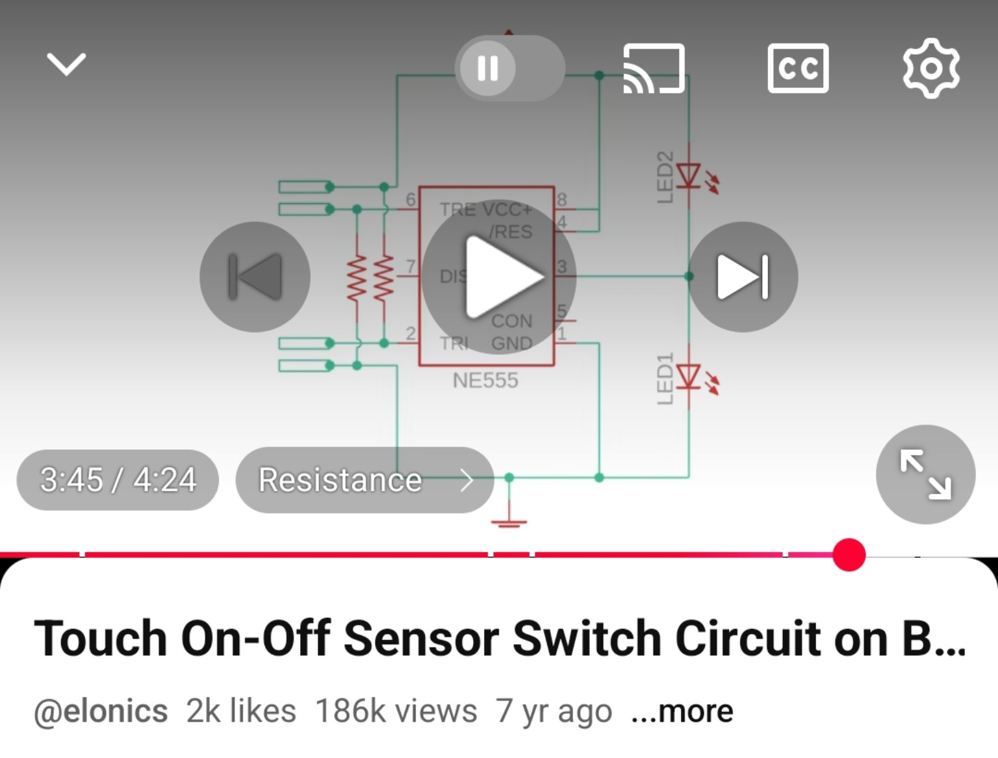
3. Circuit Diagram
Reference circuit provided for the touch ON–OFF switch
+VCC
Touch ON
Pin 7 discharge path
TOUCH ON
Touch the ON/trigger plate to make the 555 output go HIGH.
2 TRIGGER
8 VCC
SET
330Ω
LED OFF
6 THRESHOLD
4 RESET
10kΩ
RESET
NE555
Touch OFF
TOUCH
BISTABLE
OUTPUT INDICATION
Touch the OFF/reset plate to make the output go LOW.
7 DISCHARGE
3 OUTPUT
TOUCH
TOUCH OFF
LED ON
330Ω
5 CONTROL
NC
LED indication
1 GND
Opposite LED states visually show whether the output is HIGH or LOW.
10kΩ
Touch ON → SET → OUT HIGH | Touch OFF → RESET → OUT LOW
GND
4

Slide 5
4. Working Principle
NE555 bistable operation in simple steps
1
Initial state
The circuit powers up in one of its two stable output states.
2
Touch ON
A touch changes the trigger-side voltage so the 555 sets its output HIGH.
3
State held
After the touch is removed, the output stays HIGH because the 555 is bistable.
4
Touch OFF
The reset/threshold-side input is activated, causing the output to go LOW.
5
State held
The output remains LOW until the ON touch is made again.
555 thresholds: ≈ 1/3 VCC and ≈ 2/3 VCC
5

Slide 6
5. ON and OFF Operation
How the LEDs respond to the 555 output
ON state
OFF state
• Touch the ON sensor.
• The 555 output (pin 3) becomes HIGH.
• The ON indicator LED lights.
• Removing your finger does not immediately change the state; the bistable circuit holds it.
• Touch the OFF sensor.
• The 555 output (pin 3) becomes LOW.
• The opposite indicator LED shows the OFF state.
• The circuit remains LOW until the ON sensor is touched again.
6

Slide 7
6. Advantages and Applications
Advantages
Possible Applications
• No moving mechanical switch
• Simple and low-cost circuit
• Easy ON/OFF control by touch
• Output state is latched
• Useful for learning timer IC applications
• Touch-controlled lamps
• Small indicator/control panels
• Electronic project demonstrations
• Educational NE555 experiments
• User-interface prototypes
For larger loads, use an appropriate transistor, MOSFET or relay driver stage.
7

Slide 8
7. Conclusion
The touch sensor uses the NE555 as a bistable switching element.
Two touch inputs provide separate ON and OFF control.
The output remains in its selected state after the finger is removed.
LEDs provide a simple visual indication of the output state.
The project demonstrates practical concepts of touch sensing, thresholds and digital switching.
Thank You
8

