Slide 1
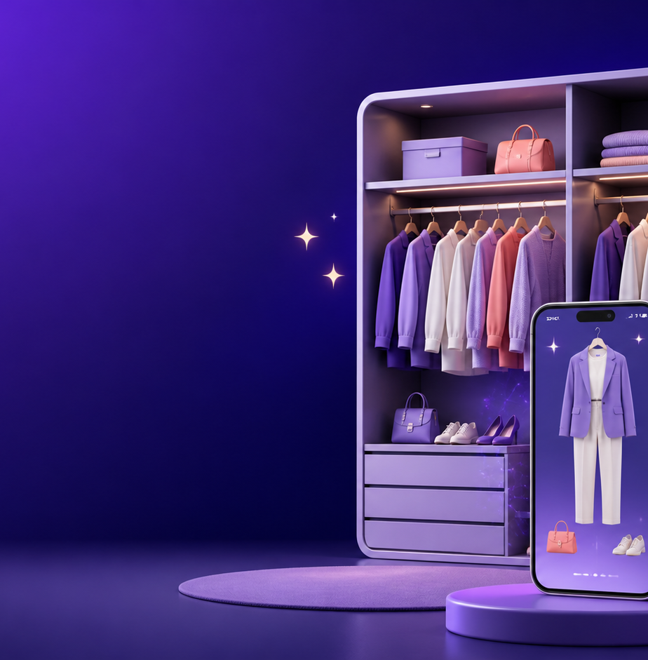
MCA MINI PROJECT • FIRST INTERIM PRESENTATION
Wearlytics
AI Powered Wardrobe and
Outfit Recommendation System
Anchana R P | Master of Computer Applications
College Name • Guide Name
WEARLYTICS
01

Slide 2
PROJECT INTRODUCTION
A smarter way to understand your wardrobe
Wearlytics brings clothing, planning, and recommendations into one digital experience.
Digitally organize every clothing item
YOUR DIGITAL WARDROBE
Upload wardrobe images for easy reference
⌕
✦
▦
Receive AI-based outfit recommendations
Track wardrobe insights and usage patterns
One place for clothes, ideas, and plans.
Plan looks for the upcoming week
Organize
Discover
Plan
WEARLYTICS / MCA MINI PROJECT
02

Slide 3
PROBLEM STATEMENT
Wardrobe decisions are still largely manual
The lack of a single digital view creates friction before the day even begins.
↯
Manual tracking
◌
Matching effort
Clothes are difficult to catalogue and retrieve.
Choosing compatible outfits takes time.
⊙
Repeated purchases
⌁
No insight
Items already owned are easy to overlook.
Wardrobe usage and gaps remain invisible.
The outcome: time-consuming choices and a wardrobe that is underused.
WEARLYTICS / MCA MINI PROJECT
03

Slide 4
PROPOSED SYSTEM
Wearlytics turns wardrobe data into daily decisions
A connected workflow replaces manual browsing with smart, personalized guidance.
Wearlytics
Existing System
Manual selection
✦
AI Outfit Recommendation
▦
Digital Wardrobe
→
No digital record
◷
Weekly Planner
◫
Analytics Dashboard
No recommendations
⌕
Smart Search
◉
User Authentication
WEARLYTICS / MCA MINI PROJECT
04

Slide 5
SYSTEM WORKFLOW
From wardrobe upload to actionable outfit insight
Each step builds a reliable picture of the user’s clothing and preferences.
01
02
03
04
05
06
User Login
→
Upload Clothing
→
Store in Database
→
AI Processing
→
Outfit
Suggestions
→
Dashboard & Analytics
Secure access → Structured data → Intelligent suggestions → Better daily decisions
WEARLYTICS / MCA MINI PROJECT
05

Slide 6
METHODS USED
A practical web stack supports the current build and future AI layer
The architecture uses familiar, maintainable technologies for a smooth implementation path.
01
02
03
Frontend
Backend
Database
HTML • CSS • Bootstrap • JavaScript
Python Flask
MySQL • SQLAlchemy
04
05
Authentication
Future AI
Flask-Login • Werkzeug hashing
Computer Vision • Recommendation System
WEARLYTICS / MCA MINI PROJECT
06

Slide 7
CURRENT BUILD
The core product foundation is already in place
The first interim milestone demonstrates a working Flask application with persistent user accounts.
✓
Authentication
✓
Registration
✓
Login & Logout
✓
Dashboard UI
✓
Sidebar Navigation
✓
Upload Page Design
✓
Analytics UI
✓
Responsive Design
✓
MySQL Connection
✓
Flask Structure
WEARLYTICS / MCA MINI PROJECT
07

Slide 8
PROJECT ARCHITECTURE
A modular architecture separates the user experience from data and intelligence
The current application is ready to extend with AI processing without redesigning the core.
User
→
Frontend
HTML • CSS • Bootstrap
→
Flask Backend
→
SQLAlchemy
→
MySQL Database
Future extension layer
Future AI Module → Outfit Recommendation Engine
WEARLYTICS / MCA MINI PROJECT
08

Slide 9
INTERFACE PREVIEW
The product experience is designed around a calm, guided wardrobe workflow
Add final application screenshots here before the presentation.
+
+
+
Login Page
Registration Page
Dashboard
Analytics
Replace these labelled frames with your own final screenshots.
WEARLYTICS / MCA MINI PROJECT
09

Slide 10
CURRENT STATUS
The foundation is complete; intelligence comes next
The project is progressing from a reliable web product to an AI-enabled wardrobe companion.
Completed
Upcoming
✓
UI Completed
01
AI Recommendation
✓
Authentication Completed
NEXT
02
Upload Processing
✓
Dashboard Completed
03
Wardrobe Management
✓
Database Connected
04
Analytics Logic
✓
Flask Structure Ready
05
Final Testing
WEARLYTICS / MCA MINI PROJECT
10

Slide 11
W
THANK YOU
Questions?
Wearlytics • AI Powered Wardrobe and Outfit Recommendation System
11

