Slide 1
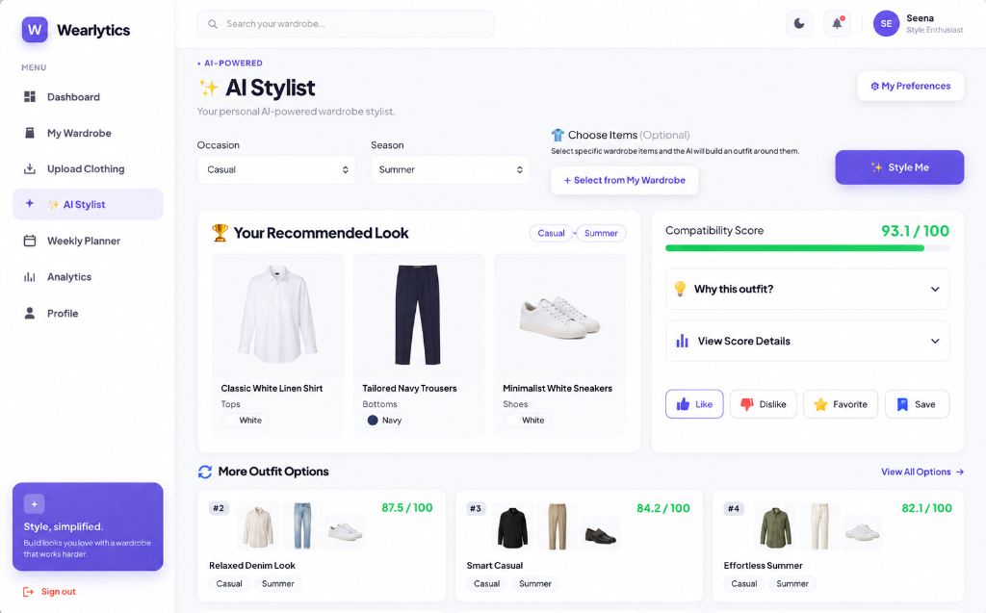
S3 MCA MINI PROJECT
Wearlytics
AI-Powered Smart Wardrobe and
Personalized Outfit Recommendation System
ANCHANA R P • Roll No. 23
S3 MCA
Lourdes Matha College of Science and Technology
Guide: Prof. Bismi K. Charleys
SECOND INTERIM PRESENTATION

Slide 2
02 / WEARLYTICS
A digital wardrobe reduces daily outfit-selection friction
Wearlytics brings wardrobe organization, availability status, and explainable outfit suggestions into one application.
The problem
The response
The outcome
Clothes are difficult to catalogue, track and retrieve. Outfit selection is repetitive, and unused items are easy to overlook.
Digitize wardrobe items, record wear/laundry status, and rank compatible outfit combinations using transparent rules.
A user can make availability-aware outfit choices, save looks, plan a week and review wardrobe utilization.
Implemented in the current Flask application
Image-assisted garment metadata
Weighted outfit compatibility
Planner and wear analytics
S3 MCA MINI PROJECT • Lourdes Matha College of Science and Technology
02

Slide 3
03 / WEARLYTICS
Literature survey: the project sits at the intersection of four research areas
The review informs future validation; the implemented recommender remains rule- and content-based.
1. Apparel image classification
2. Fashion recommendation
Transfer learning with lightweight CNNs such as MobileNetV2 for clothing-category recognition.
Content-based outfit construction, compatibility rules, explainability and cold-start behavior.
3. Personalization from feedback
4. Image colour & sustainability
Explicit likes/dislikes, preference learning, negative feedback and user control through pinned items.
Foreground-aware dominant-color extraction, wardrobe utilization and underused-item awareness.
Current implementation boundary: no embeddings, cosine similarity, collaborative filtering, or learned compatibility model.
S3 MCA MINI PROJECT • Lourdes Matha College of Science and Technology
03

Slide 4
04 / WEARLYTICS
Existing approaches leave wardrobe information and decisions fragmented
Wearlytics addresses concrete gaps through integrated management and transparent ranking.
Existing drawback
Observed gap
Implemented response
Manual cataloguing
Item details and images are hard to retrieve.
→
Searchable wardrobe records
Repeated outfit effort
Users repeatedly decide what pairs well.
→
Ranked compatible combinations
Unavailable items included
Laundry status is easy to forget.
→
Laundry-aware recommendation pool
No utilization view
Underused items remain invisible.
→
Wear counts and analytics
S3 MCA MINI PROJECT • Lourdes Matha College of Science and Technology
04

Slide 5
05 / WEARLYTICS
The proposed system combines a wardrobe, AI assistance, and planning workflow
Implemented features are separated from future extensions for an honest interim status.
1
2
3
4
5
Authenticate
Build wardrobe
Style
Learn
Plan & review
Registration, login and hashed passwords
Upload, classify, color-tag, edit and filter
Score available combinations for occasion and season
Record feedback and update simple preferences
Save outfits, schedule the week and inspect usage
Implemented now
AI Stylist • wearable-item filtering • feedback • planner • analytics
Future / not implemented
Mobile app • notifications • full wear-event history • body/size/fit personalization • learned compatibility
S3 MCA MINI PROJECT • Lourdes Matha College of Science and Technology
05

Slide 6
06 / WEARLYTICS
The application uses a modular Python web stack with local AI services
Server-rendered pages and a relational schema keep the current build simple and extensible.
Frontend
Backend
Jinja2 templates • HTML5 • CSS3 • Bootstrap 5.3.8 • vanilla JavaScript
Python • Flask • Blueprints • Flask-Login • Werkzeug
Data
AI / image processing
SQLAlchemy • Flask-Migrate • Alembic • MySQL support / SQLite fallback
PyTorch • torchvision • MobileNetV2 • Pillow • NumPy • OpenCV • scikit-learn
Testing
Two executable integration scripts using Flask test client and in-memory SQLite
S3 MCA MINI PROJECT • Lourdes Matha College of Science and Technology
06

Slide 7
07 / WEARLYTICS
A clear request flow links the browser, Flask modules, data, and AI services
Recommendation results are derived from the user’s stored wardrobe—not from an external fashion API.
Browser UI
Flask Blueprints
SQLAlchemy Models
AI Services
Response
Jinja2 + JS
auth • wardrobe • stylist
users • wardrobe • outfits
classify • color • score
ranked outfit UI
Persistence: MySQL when DATABASE_URL is configured; SQLite fallback for development/testing.
No external recommendation API
S3 MCA MINI PROJECT • Lourdes Matha College of Science and Technology
07

Slide 8
08 / WEARLYTICS
The dataset is mapped to six categories; the database persists nine actual tables
The dataset is top-heavy, while the schema supports wardrobe, feedback, planning and custom outfits.
Mapped dataset: 5,096 of 5,403 CSV annotations
Actual relational tables
Tops
2461
users
clothing_items
outfits
Bottoms
1155
outfit_items
weekly_plans
user_preferences
Outerwear
521
Shoes
431
outfit_feedback
custom_outfits
custom_outfit_items
Dresses
357
Accessories
171
Excluded labels: Not sure 228 • Other 67 • Skip 12
No user_profiles, preferences, or recommendations table exists.
S3 MCA MINI PROJECT • Lourdes Matha College of Science and Technology
08

Slide 9
09 / WEARLYTICS
Local image upload follows a resilient classification and colour-analysis pipeline
The user can review and apply suggestions; category replacement is not automatic on save.
01
02
03
04
Upload
Classify
Detect colour
Persist
Validate type, secure filename, UUID save
Fine-tuned MobileNetV2; ImageNet, CV and fixed fallbacks
Center crop, background mask, K-Means (k=3), nearest named colour
Store image metadata, confidence and detected hex
Classifier output
Colour output
Human control
Category, default clothing type, confidence, source
Dominant RGB, nearest hex and named colour
Form allows manual category/type/color correction
S3 MCA MINI PROJECT • Lourdes Matha College of Science and Technology
09

Slide 10
010 / WEARLYTICS
The AI Stylist ranks viable wardrobe combinations with transparent weighted scoring
Only available items are considered; pinned items must all appear in a returned combination.
Available wardrobe
Filter & combine
Score
Rank & explain
Exclude laundry items
Season / occasion; top+bottom or dress; optional shoes/extras
Seven weighted components
Top 3, breakdown, feedback actions
Color harmony
Category balance
Occasion match
Season match
Preferences
Novelty
Favorites
25%
20%
20%
15%
12%
5%
3%
Preference feedback: likes/favorites add colours and styles; disliked outfit items are avoided when viable alternatives exist.
S3 MCA MINI PROJECT • Lourdes Matha College of Science and Technology
10

Slide 11
011 / WEARLYTICS
Major modules turn stored wardrobe data into usable daily decisions
The current system is modular rather than a single monolithic route set.
Authentication
Wardrobe
AI Stylist
Register, login, logout, safe redirect
CRUD, upload, search, favorites, wears, laundry
Pinned item selection, scoring, explanations, feedback
Outfits & Planner
Analytics
Profile & Preferences
Save ranked outfits, seven-day plan, custom outfit creation
Usage, category/season/color splits, utilization score
Bio, password, avatar, style/occasion/season preferences
S3 MCA MINI PROJECT • Lourdes Matha College of Science and Technology
11

Slide 12
012 / WEARLYTICS
The classifier reaches 89.19% final test accuracy on the recorded evaluation
Validation peaked at 91.88%; class support imbalance should be considered when interpreting per-class scores.
89.19%
91.88%
Final test accuracy
Best validation accuracy
509 test images
Epoch 12 of 15
Per-class F1 score
Accessories
0.842
Bottoms
0.943
Dresses
0.725
Outerwear
0.731
Shoes
0.970
Tops
0.912
Evaluation source: app/services/model_evaluation.json
S3 MCA MINI PROJECT • Lourdes Matha College of Science and Technology
12

Slide 13
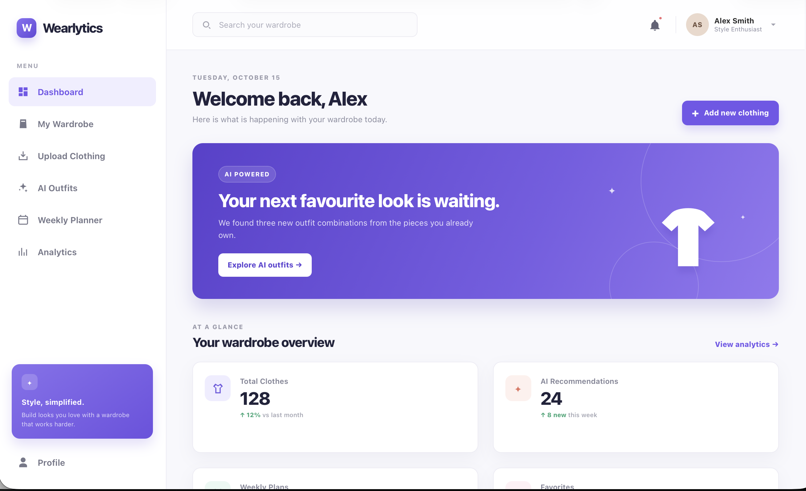
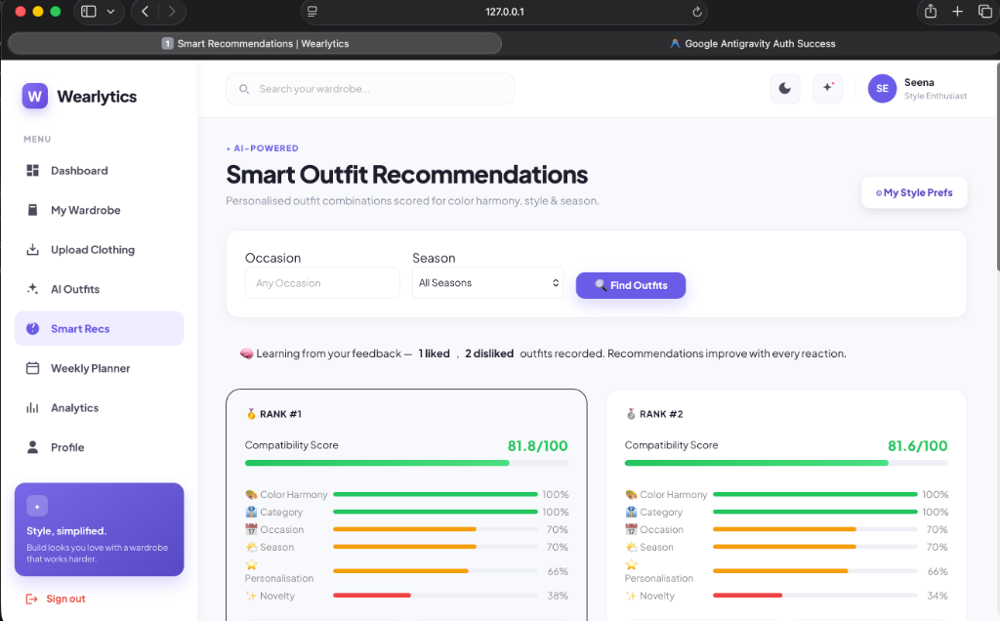
013 / WEARLYTICS
Healthy project screens show the wardrobe-to-recommendation journey
Only functioning application captures are shown; error/debug screenshots are intentionally excluded.
Dashboard
Scored recommendation breakdown
Unified AI Stylist result
Real UI captures from the project workspace
S3 MCA MINI PROJECT • Lourdes Matha College of Science and Technology
13

Slide 14
014 / WEARLYTICS
Wearlytics demonstrates an integrated, explainable smart-wardrobe foundation
The next stage is to strengthen evaluation, reliability and personalization without overstating the current implementation.
Delivered in this interim
Future enhancement priorities
Authenticated wardrobe management, image-assisted metadata, weighted recommendations, feedback, planner, laundry state, analytics and passing integration suites.
Reproducible dataset organization; full wear-event history; robust preference toggles; fixed custom-outfit editing; calibrated classifier evaluation; notifications, deployment and mobile access.
Key conclusion
The project is a working Flask-based smart wardrobe system with measurable image-classification performance and transparent recommendation logic.
S3 MCA MINI PROJECT • Lourdes Matha College of Science and Technology
14

Slide 15
015 / WEARLYTICS
References
Sources used for the verified project facts and literature-survey direction.
01
Wearlytics source code and migrations, local project workspace (accessed September 2026).
02
Wearlytics model evaluation: app/services/model_evaluation.json; training methodology: train_classifier.py.
03
Grigorev, A. Clothing Dataset (Full), Kaggle dataset referenced by the project training script.
04
Sandler, M., Howard, A., Zhu, M., Zhmoginov, A., & Chen, L.-C. (2018). MobileNetV2: Inverted Residuals and Linear Bottlenecks. CVPR.
05
Flask Documentation; SQLAlchemy Documentation; PyTorch and torchvision Documentation.
06
Literature review scope: lightweight apparel classification, content-based outfit recommendation, explicit-feedback personalization, dominant-color extraction, and wardrobe-utilization analytics.
All implementation claims in this presentation are grounded in the inspected Wearlytics project, not inferred features.
S3 MCA MINI PROJECT • Lourdes Matha College of Science and Technology
15

