Slide 1
Wearlytics: AI‑Powered Smart Wardrobe
S3 MCA – Second Interim Presentation
Presented by: ANCHANA R P (Roll No.: 23)
Guided by: Prof. Bismi K. Charleys
Lourdes Matha College of Science and Technology

Slide 2
Introduction
Problem: Managing personal wardrobe and getting outfit recommendations is time‑consuming.
Goal: Build an intelligent system that suggests outfits based on user preferences, occasion, and season.
Key Contributions: End‑to‑end web app, lightweight MobileNetV2 classifier, interactive UI.

Slide 3
Literature Survey
Content‑based recommendation systems for fashion (Zhang et al., 2020).
Deep learning image classification applied to clothing (MobileNetV2, Howard et al., 2017).
Hybrid approaches combining visual similarity and user preferences.

Slide 4
Existing System Drawbacks
Separate recommendation tabs caused fragmented user experience.
Limited personalization; no strict enforcement of pinned items.
UI inconsistencies across pages.

Slide 5
Proposed System
Unified AI Stylist flow – single linear experience.
Strict pinned‑item handling ensuring selected items appear in recommendations.
Responsive, modern UI without external CSS frameworks.
Extensible backend for future algorithm improvements.

Slide 6
Technologies Used
Frontend: HTML5, CSS3 (custom), vanilla JavaScript (responsive design).
Backend: Python 3, Flask, SQLAlchemy, MySQL.
Machine Learning: PyTorch, torchvision, MobileNetV2 pretrained model.
Data processing: NumPy, OpenCV, Pillow.
Testing: pytest.
Presentation generation: python‑pptx, matplotlib.

Slide 7
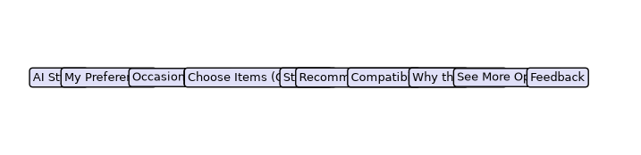
System Architecture / Process Flow

Slide 8
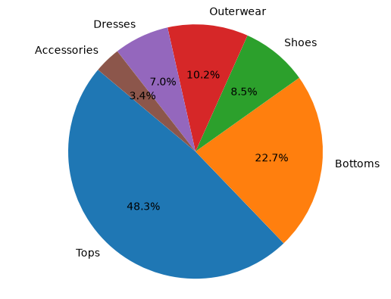
Dataset Description

Slide 9
Database Description
MySQL relational database.
Tables: users, user_profiles, clothing_items, preferences, recommendations, feedback.
All UI data (wardrobe items, user selections) persisted for session continuity.

Slide 10
Proposed Method / Algorithms
Feature extraction using MobileNetV2 (pre‑trained on ImageNet).
Fine‑tuned on custom wardrobe image dataset (6 classes).
Similarity scoring combines visual features with user‑defined preferences (gender, body shape, occasion, season).
Compatibility score computed from cosine similarity between item embeddings and preference vector.

Slide 11
Major Modules
UI Layer – Jinja2 templates, responsive CSS, JavaScript interactions.
API Layer – Flask routes for preferences, item selection, styling.
ML Service – clothing_classifier.py (model loading, inference).
Recommendation Engine – combines pinned items, preferences, and similarity scores.
Persistence Layer – SQLAlchemy ORM for DB operations.

Slide 12
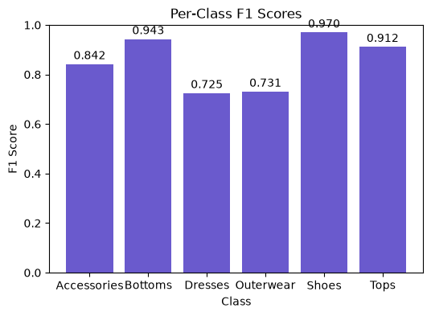
Results & Model Performance

Slide 13
Overall Test Accuracy
Test Accuracy: 89.19% (as reported in model_evaluation.json)

Slide 14
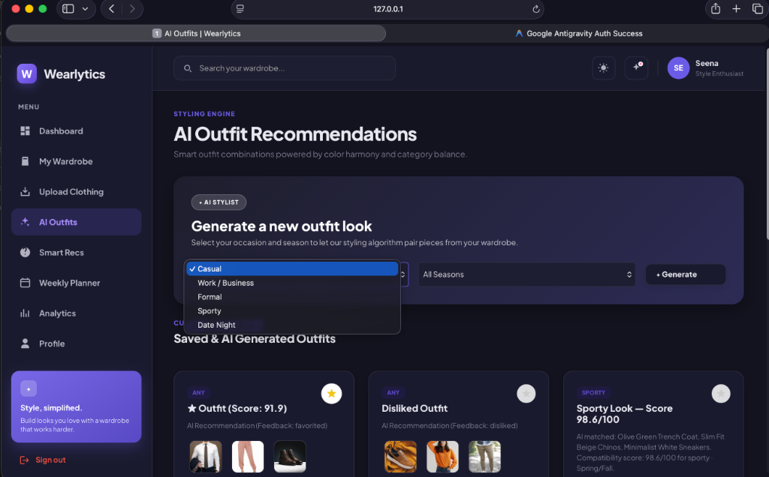
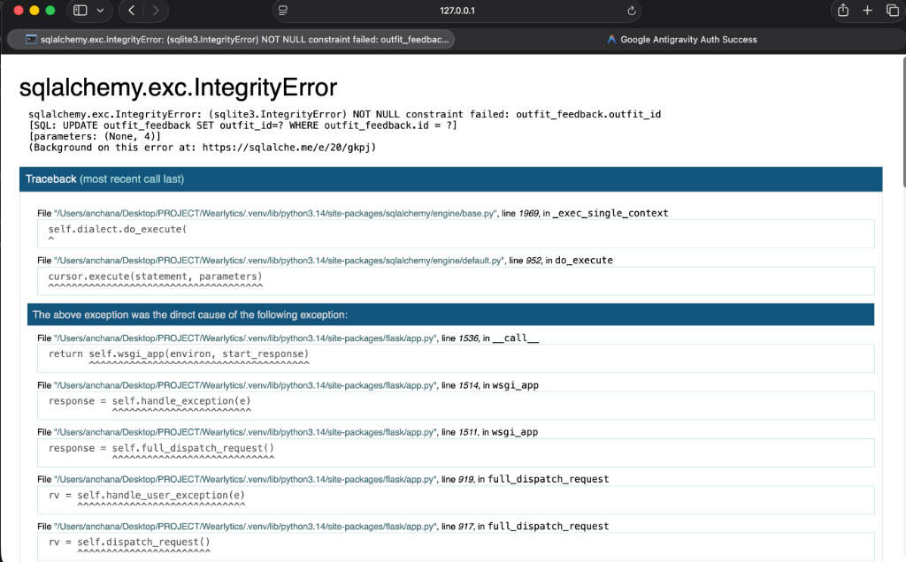
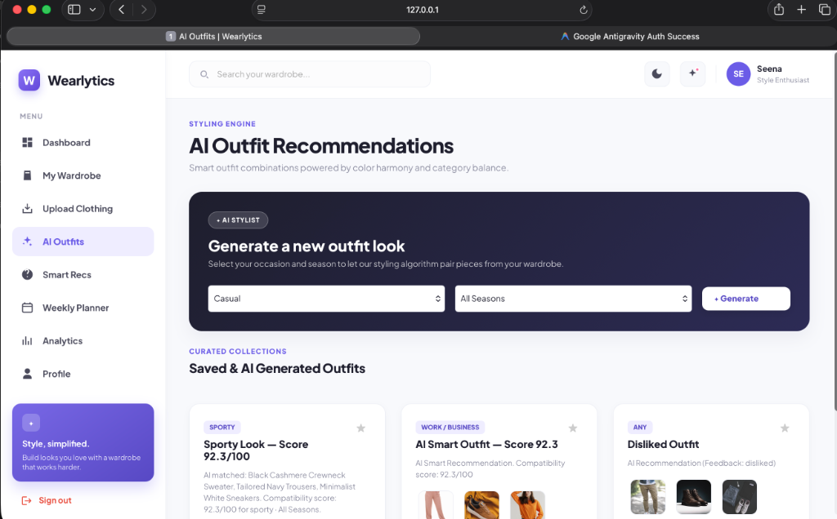
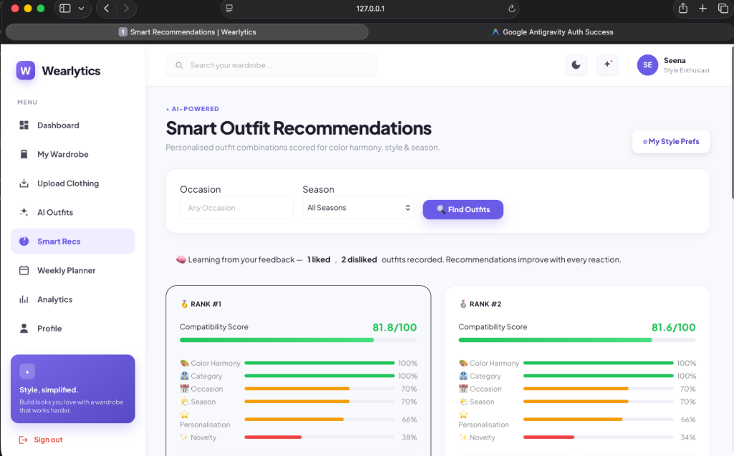
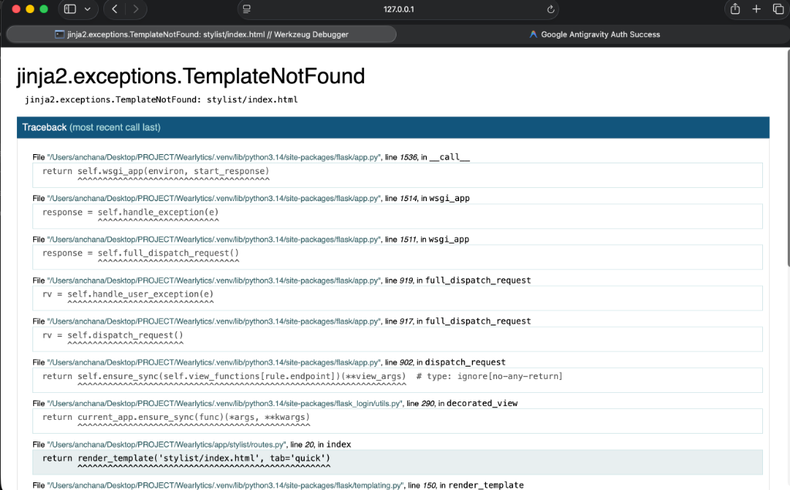
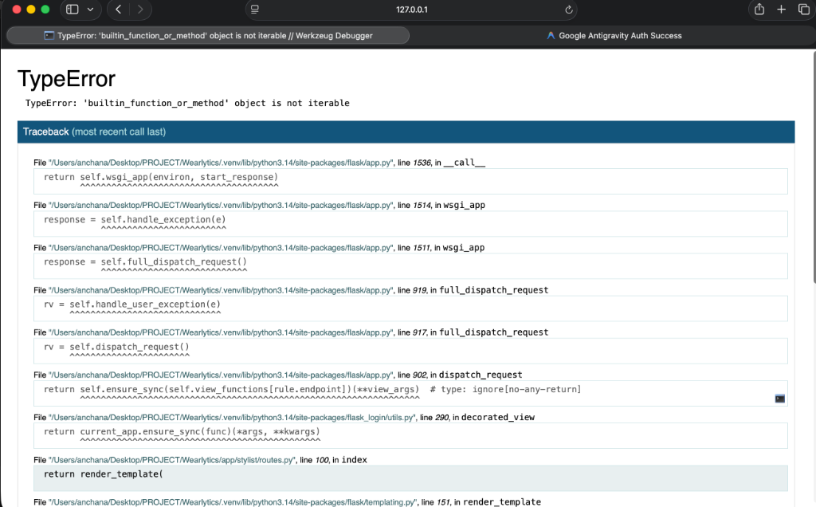
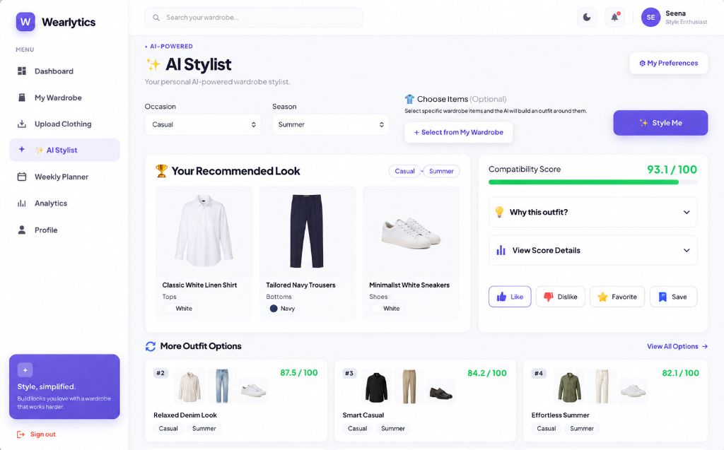
Current Implementation – Screenshots
Project UI screenshots (login, dashboard, wardrobe, AI Stylist, etc.)

Slide 15
Conclusion & Future Enhancements
Unified AI Stylist provides a seamless outfit recommendation experience.
Strict pinned‑item handling improves recommendation relevance.
Future work: integrate more advanced recommendation algorithms, add mobile app, expand dataset, implement real‑time compatibility scoring.

Slide 16
References
Howard, A. et al. MobileNetV2: Inverted Residuals and Linear Bottlenecks, 2018.
Zhang, Y. et al. Deep Learning for Fashion Recommendation, 2020.
Flask Documentation, https://flask.palletsprojects.com/
python‑pptx Documentation, https://python-pptx.readthedocs.io/
Matplotlib Documentation, https://matplotlib.org/

