Slide 1
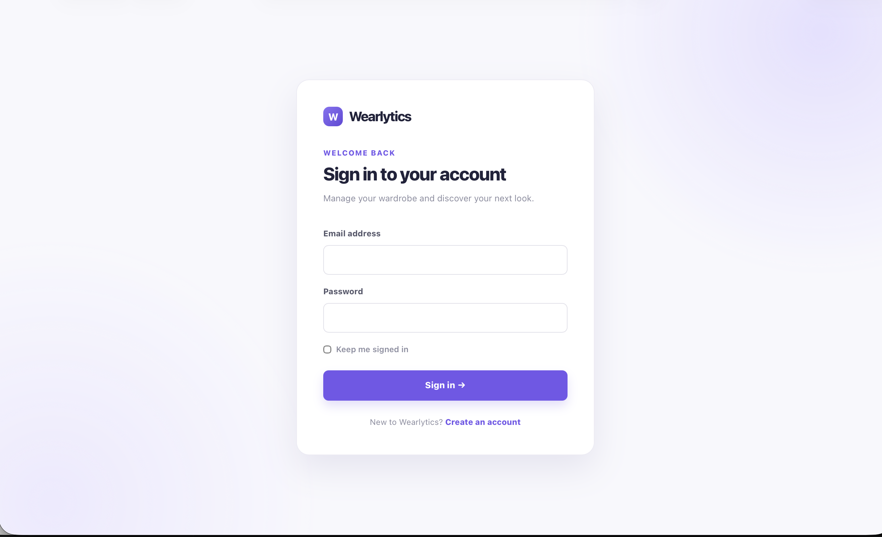
W
Wearlytics
AI-Powered Wardrobe & Outfit Recommendation System
MCA MINI PROJECT — SECOND INTERIM PRESENTATION
Submitted by : Anchana R P
S3 MCA | Roll No: 23
Guide: Ms. Bismi K Charleys

Slide 2
CONTENTS
01
Introduction
02
Literature Survey
03
Drawbacks of the Existing System
04
Proposed System
05
Technology Used
06
System Design / Architectural Design
07
Dataset / Database Description
08
Proposed Method / Module Description
09
Results & Screenshots
10
Conclusion & Future Enhancement
11
References
02

Slide 3
01 · PROJECT INTRODUCTION
What is Wearlytics?
Wearlytics is a web-based smart wardrobe platform that helps users organize clothing, analyze wardrobe usage and receive personalized outfit recommendations.
1
Project Overview
2
Problem Statement
3
Objectives
• Digital wardrobe for personal clothing
• Upload and organize clothing items
• AI-assisted clothing classification and color detection
• Personalized outfit recommendations from available items
• Managing a large wardrobe can be difficult
• Hard to remember available clothing and previous usage
• Choosing suitable outfit combinations takes time
• Repeated use of the same items is difficult to track
• Digitize and organize the personal wardrobe
• Assist clothing classification and color identification
• Generate personalized outfit recommendations
• Support planning, wear tracking and wardrobe analytics
Wearlytics — MCA Mini Project
02

Slide 4
02 · LITERATURE SURVEY
Review of Relevant Research
No.
Research Paper
Author
Year
Publisher
Methods / Technologies
Limitations
Hybrid-Hierarchical Fashion Graph Attention Network for Compatibility-Oriented and Personalized Outfit Recommendation
Static data, computational complexity, category imbalance; higher-order relations not fully explored.
01
Sajjad Saed & Babak Teimourpour
2026
Elsevier
GNN, GAT, hierarchical graph, multimodal learning, attention
OutfitAI: Shop the Outfit with a Deep Learning-based Intelligent Expert System
Semantic Segmentation, CNNs, Transformers, Transfer Learning, Triplet Hard Loss
High computational and memory requirements; possible deployment latency.
02
Emanuele Balloni et al.
2025
Springer
Using Large Multimodal Models to Predict Outfit Compatibility
Chia-Ling Chang, Yen-Liang Chen & Dao-Xuan Jiang
Gemini VQA, keyword extraction, BEiT-3, multimodal fusion, BPR
Mainly top-bottom compatibility; not an integrated personal wardrobe system.
03
2025
Elsevier
Enhanced Content-Based Fashion Recommendation System through Deep Ensemble Classifier with Transfer Learning
Content-based similarity; dataset diversity and generalization can be improved.
04
Suvarna Buradagunta & Sivadi Balakrishna
2024
Springer
Transfer Learning, CNNs, Deep Ensemble, Cosine Similarity
Unifying Heterogeneous and Homogeneous Relations for Personalized Compatibility Modeling
Jinhuan Liu, Lei Hou, Xu Yu, Xuemeng Song & Zhaochun Ren
Graph Neural Networks, relation modelling, multimodal features, adaptive neighbour sampling
Comprehensive relation modelling, sampling and multimodal representation remain challenging.
05
2024
Elsevier
“Existing research focuses mainly on clothing classification, outfit compatibility and personalized recommendation, with limitations in practical wardrobe context and integrated user-level management. Wearlytics combines AI clothing analysis, personalized outfit recommendation, laundry awareness, feedback learning, outfit planning and wardrobe analytics in a unified system.”
RESEARCH GAP

Slide 5
03 · DRAWBACKS OF THE EXISTING SYSTEM
Existing System / Approach | Drawback
Manual wardrobe management | Organizing and managing a large clothing collection manually requires effort.
Manual clothing identification | Users may need to manually enter clothing category and details.
Manual outfit selection | Finding suitable combinations can be time-consuming.
Generic outfit suggestions | User's own wardrobe and preferences may not be fully considered.
Clothes availability not always considered | Clothes in laundry may be included in practical outfit selection.
Separate wardrobe activities | Planning, wear tracking and analytics may not be integrated in one workflow.
KEY PROBLEM
Existing approaches often require manual management and outfit selection, with limited integration of AI analysis, personalization, availability, planning and wardrobe usage insights.

Slide 6
04 · PROPOSED SYSTEM
Overview
Advantages of the Proposed System
Wearlytics allows users to build a digital wardrobe by uploading clothing images. AI assists with clothing classification and dominant-color detection. A weighted recommendation engine generates suitable outfit combinations using color, category, occasion, season, preferences, novelty and favorites. Users can also manage laundry status, save outfits, plan weekly looks, track clothing usage and view wardrobe analytics.
•
AI-assisted clothing classification
•
Color-aware outfit matching
•
Personalized recommendations using feedback and favorites
•
Laundry-aware outfit selection
How it addresses existing limitations:
•
Seven-day weekly outfit planning
→ AI analysis reduces manual clothing categorization
•
Wear tracking and wardrobe utilization insights
→ Personalized scoring improves outfit selection
→ Laundry-aware recommendations avoid unavailable items
•
Integrated wardrobe, recommendation and analytics workflow
→ Planning, wear tracking and analytics are integrated

Slide 7
05 · TECHNOLOGIES USED
Technology Stack
Technologies and tools used to develop the Wearlytics web application
FRONT-END
BACK-END
HTML5 • Jinja2 • CSS3 • Bootstrap 5.3
JavaScript • Google Fonts & Icons
Python • Flask • Flask-SQLAlchemy
Flask-Login • Werkzeug
Responsive UI, templates and client-side interactions
Application logic, authentication and secure file handling
DATABASE
DEVELOPMENT / FRAMEWORKS
MySQL • SQLite (development) • SQLAlchemy
PyMySQL
Flask Application Factory • Flask-Migrate / Alembic
python-dotenv • Git / GitHub • Pytest
Relational storage for users, wardrobe, outfits and plans
Modular architecture, migrations, environment and testing
AI / MACHINE LEARNING
COMPUTER VISION
PyTorch • Torchvision • MobileNetV2
Scikit-learn • NumPy • Pillow
OpenCV • Image preprocessing
K-Means clustering • Dominant-color detection
Clothing classification and dominant-color detection
Image processing and color analysis
Core stack: Python + Flask + SQLAlchemy | AI: MobileNetV2 + K-Means | Database: MySQL / SQLite
Wearlytics — MCA Mini Project

Slide 8
07 · SYSTEM ARCHITECTURE

Slide 9
06 · SYSTEM DESIGN — DFD LEVEL 0
(User → Wearlytics System → User)
Highest-level view: boundary interactions between actors and the Wearlytics system
USER / ADMIN
Wardrobe Owner
Fashion Client
System Admin
request
response
USER / ADMIN
Wardrobe Owner
Fashion Client
System Admin
0.0
WEARLYTICS
SYSTEM
Credentials · Garment details ·
Styling filters · Schedule · Feedback
Auth status · Wardrobe catalog ·
AI outfits · Weekly plan · Analytics
NOTATION KEY
External Entity
Process
Data Store
Labeled Data Flow

Slide 10
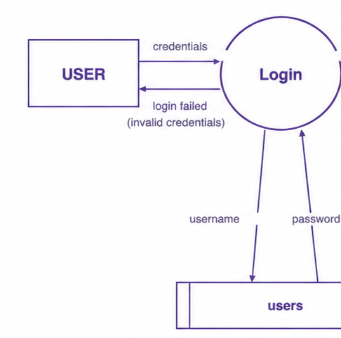
06 · SYSTEM DESIGN — DFD LEVEL 1
Decomposition of end-user functional flows in Wearlytics
add/wear details
Manage
Wardrobe
clothing_items
get clothes details
generate outfit
valid user
AI Outfit
Generator
outfits
valid user
get outfit catalog
credentials
assign schedule
USER
Login
valid user
Weekly
Planner
weekly_plans
valid user
get weekly plan
log wear count
valid user
Wardrobe
Analytics
clothing_items
get utilization stats
username
password
submit rating
Outfit
Feedback
outfit_feedback
users
get feedback data

Slide 11
06 · SYSTEM DESIGN — DFD LEVEL 1
Decomposition of administrator functional flows in Wearlytics
add / update user
Manage
Users
users
get user details
valid user
add preset items
Manage Clothes
& Presets
clothing_items
valid user
get clothing data
credentials
ADMIN
Login
valid user
configure rules
Manage AI
Models & Rules
outfits
valid user
get outfit metrics
username
password
log audit action
Feedback &
Analytics Log
outfit_feedback
login
get feedback stats

Slide 12
07 · DATASET & DATABASE
DATABASE
TRAINING DATASET
Wearlytics Application Schema
Clothing Dataset (Full) · Alexey Grigorev
TABLE
PURPOSE
Purpose: Train and evaluate MobileNetV2 for automatic clothing-category classification in Wearlytics.
users
Accounts & authentication
5,403
5,096
6
clothing_items
Wardrobe items & AI metadata
Annotated records
Usable records
Final categories
outfits
Generated / saved outfits
outfit_items
Items belonging to outfits
Source
weekly_plans
Seven-day outfit planning
Kaggle — “Clothing Dataset (Full)”
user_preferences
User & learned preferences
Key Features / Attributes
outfit_feedback
Like / dislike feedback
Image → 224 × 224 RGB tensor | Target → 6 clothing categories
custom_outfits
User-created custom outfits
Data Split
custom_outfit_items
Items in custom outfits
Training: 3,823 · Validation: 764 · Testing: 509
Main fields: users (id, username, email) · clothing_items (id, user_id, type, color, image_path, season, occasion, wear_count, laundry)
Dataset → Clothing Classification |
Database → Wardrobe, Outfits, Planning, Feedback & Analytics

Slide 13
08 · PROPOSED METHOD / ALGORITHM
CORE ALGORITHMS
ALGORITHM WORKING
1. MobileNetV2 — Clothing Classification
2. K-Means — Dominant Color Detection
User uploads a clothing image.
3. Weighted Compatibility Scoring — Outfit Ranking
01
IMAGE UPLOAD
WEIGHTED COMPATIBILITY
02
AI ANALYSIS
MobileNetV2 → clothing category
K-Means → dominant color
Outfit score is calculated using:
Color Harmony
25%
03
WARDROBE
Store image, category, color and
laundry status.
20%
Category Balance
Occasion
20%
04
COMBINATION
Generate valid outfit combinations
and exclude laundry items.
Season
15%
Calculate weighted compatibility score
using color, category, occasion, season,
preferences, novelty and favorites.
Preferences
12%
05
SCORING
Novelty
5%
Favorites
3%
06
RANKING
Sort combinations and display the
top outfit recommendations.
Total 100%
Higher score → higher recommendation rank
USER FEEDBACK & LEARNING
Like / Dislike / Favorite → update learned preferences → improve future recommendations

Slide 14

08 · PROPOSED METHOD / MODULES
Major Modules & Their Functions
Four integrated modules implemented in Wearlytics
01
USER & WARDROBE MANAGEMENT
02
AI CLOTHING ANALYSIS
Registration & login
Add, edit and delete clothing
Upload images and manage metadata
Laundry status & wardrobe availability
MobileNetV2 clothing classification
K-Means dominant color detection
AI suggestions can be reviewed
Category and color stored with item
03
AI OUTFIT RECOMMENDATION
04
PLANNING & ANALYTICS
Generate valid outfit combinations
Weighted compatibility scoring
Color, category, occasion & season
Preferences, novelty & favorites
Save and manage outfits
Seven-day weekly planner
Wear tracking & last-worn information
Utilization and wardrobe insights
WARDROBE → AI ANALYSIS → RECOMMENDATION → PLANNING & ANALYTICS

Slide 15
09 · RESULTS
Results & Model Evaluation
EXISTING SYSTEM
PROPOSED SYSTEM
ACCURACY IMPROVEMENT
26.13%
89.19%
+63.06 pp
OpenCV heuristic classifier
Fine-tuned MobileNetV2
absolute percentage-point gain
ACCURACY COMPARISON
System
Method
Correct / Total
Accuracy
VALIDATION
Existing System
OpenCV rule-based heuristic
(Aspect Ratio + HSV + Canny Edges)
133 / 509
26.13%
91.88%
Proposed System
Fine-tuned MobileNetV2
(Transfer Learning)
454 / 509
89.19%
Best accuracy
Epoch 12 / 15
Improvement
Proposed − Existing
+63.06 pp
OTHER RELEVANT RESULTS
5,096
509
454 / 509
43 / 43
Dataset images
Test images
Proposed correct
Integration tests
6 categories
10% held-out
89.19% accuracy
All passed

Slide 16
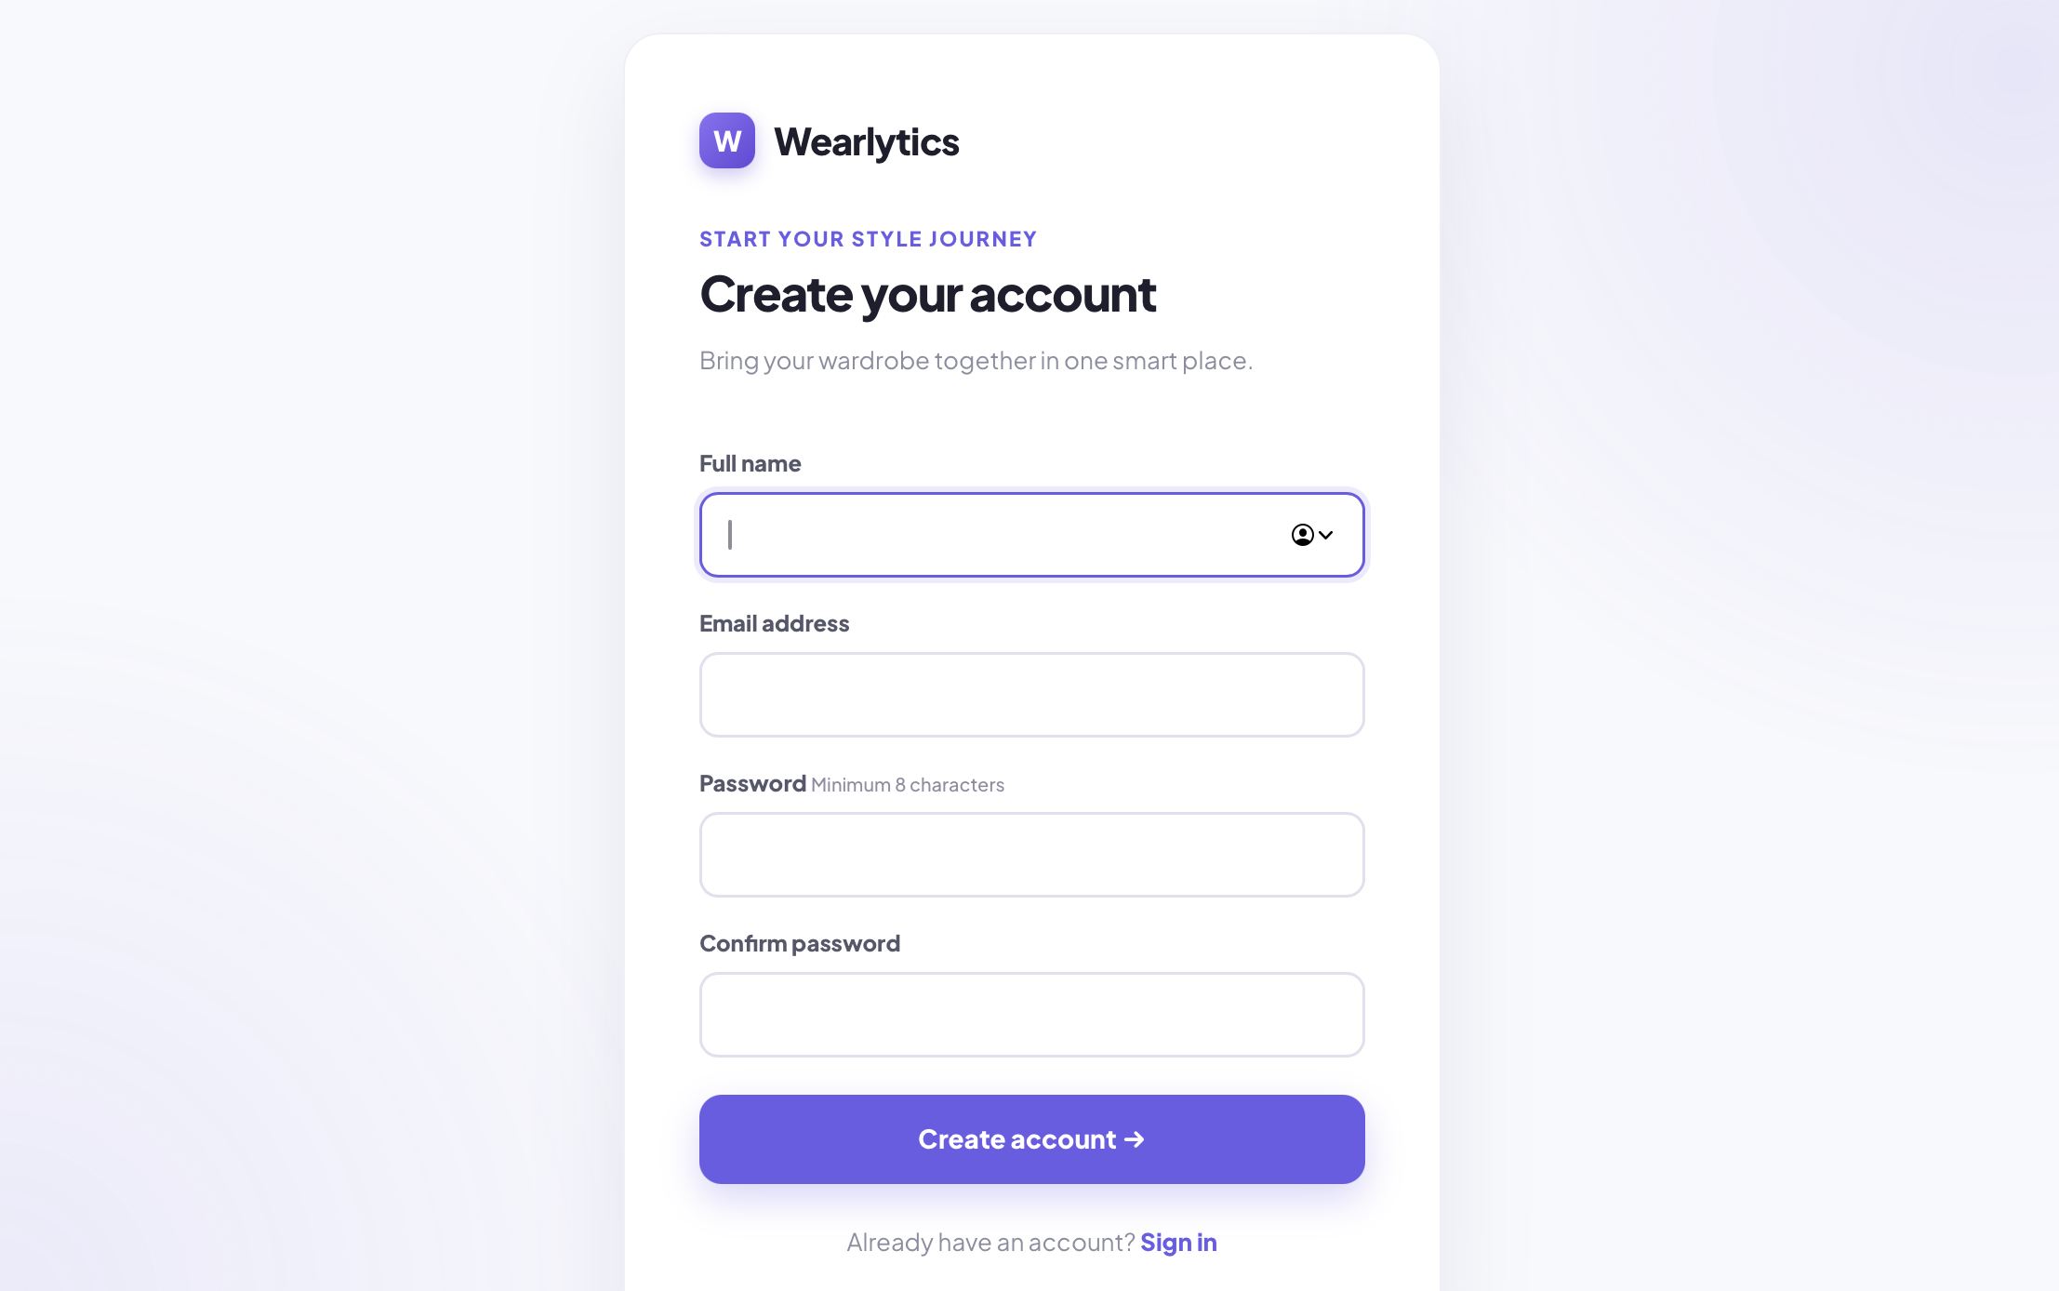
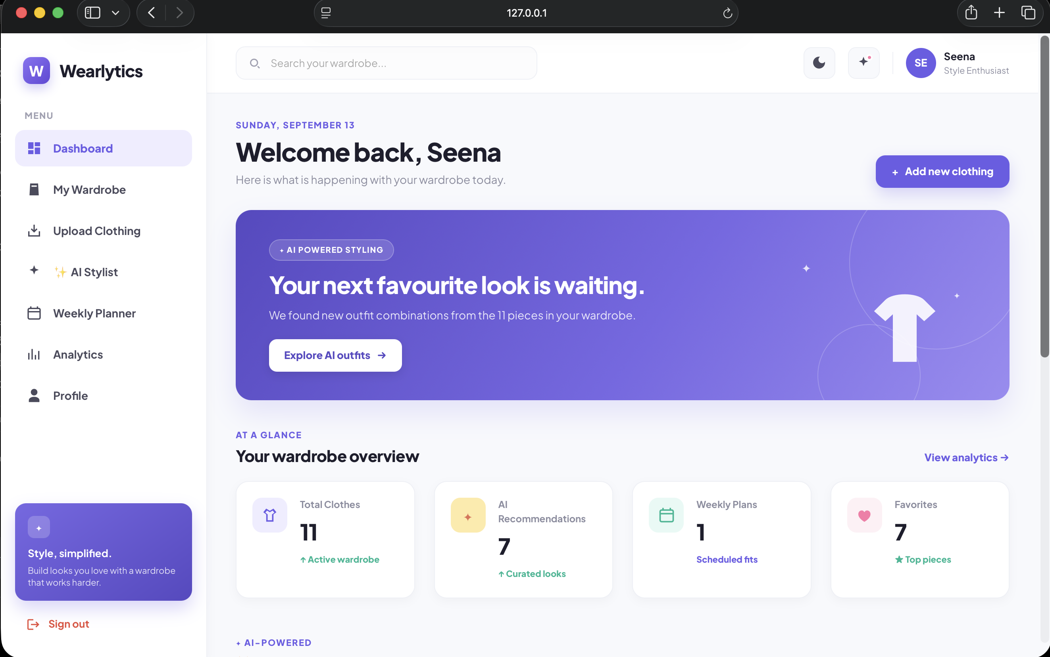
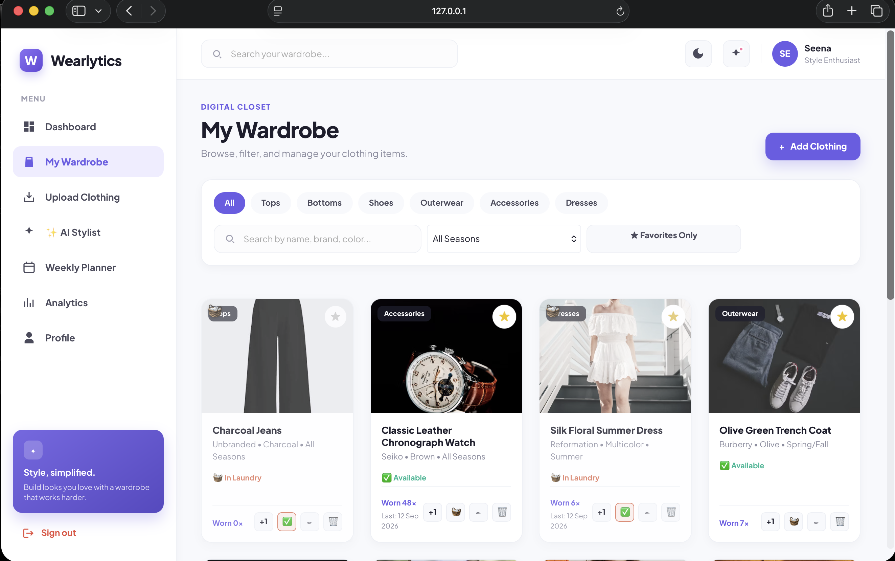
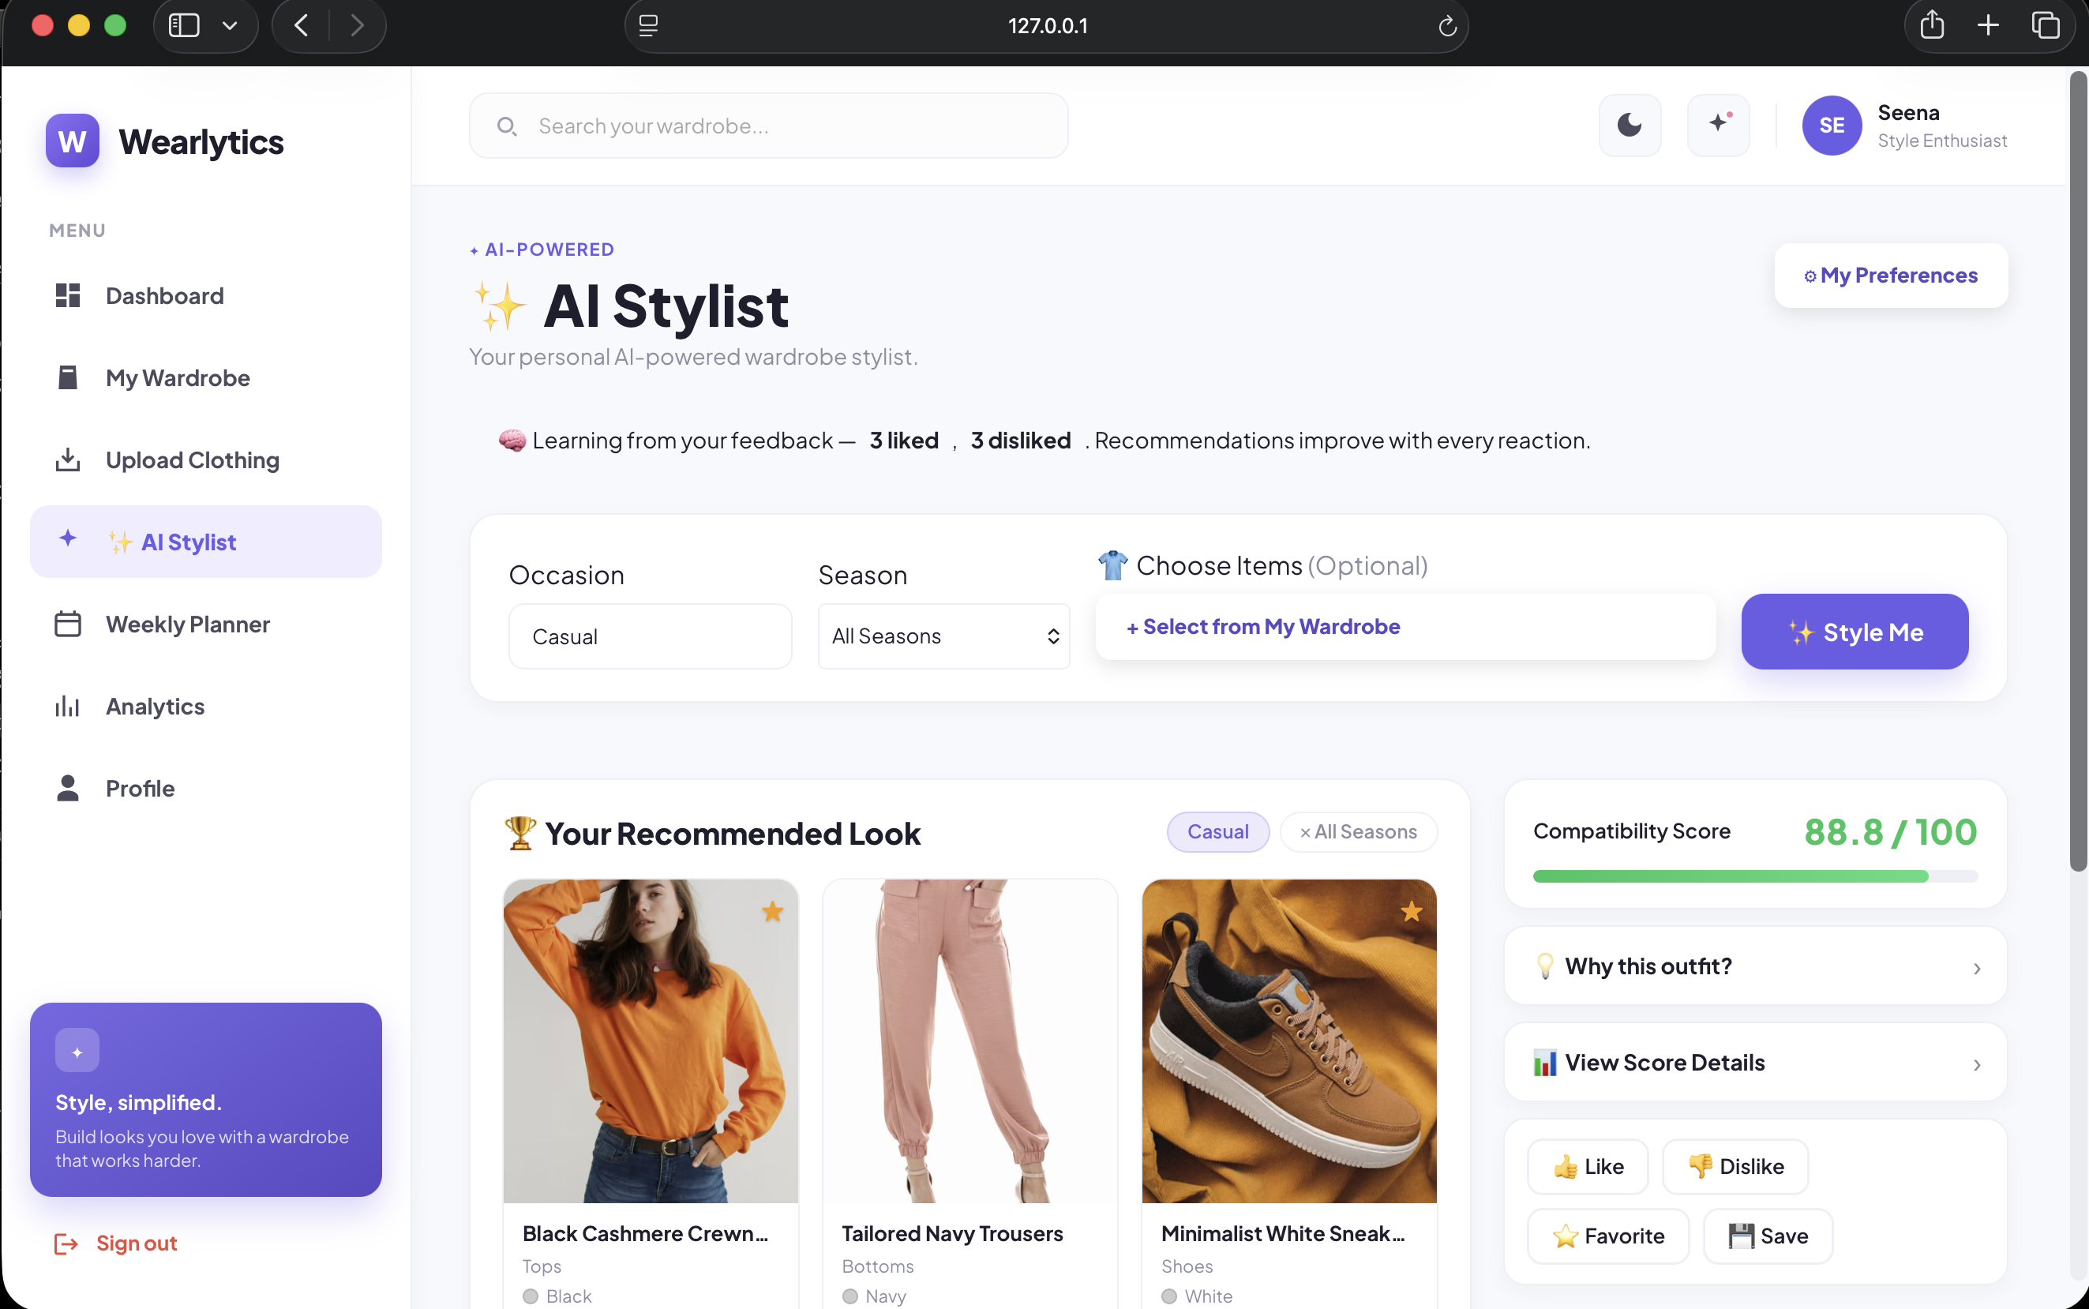
09 · RESULTS
Login / Registration
User Dashboard
Wardrobe
AI Stylist / Recommendations

Slide 17
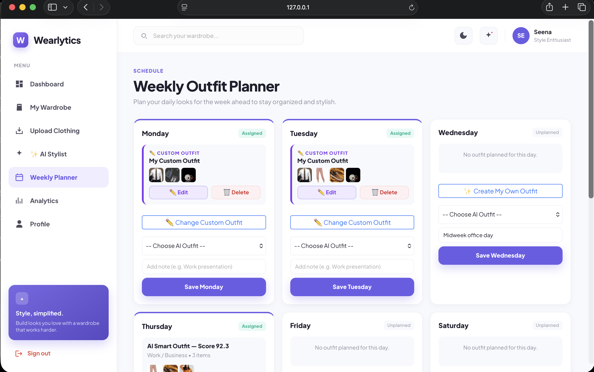
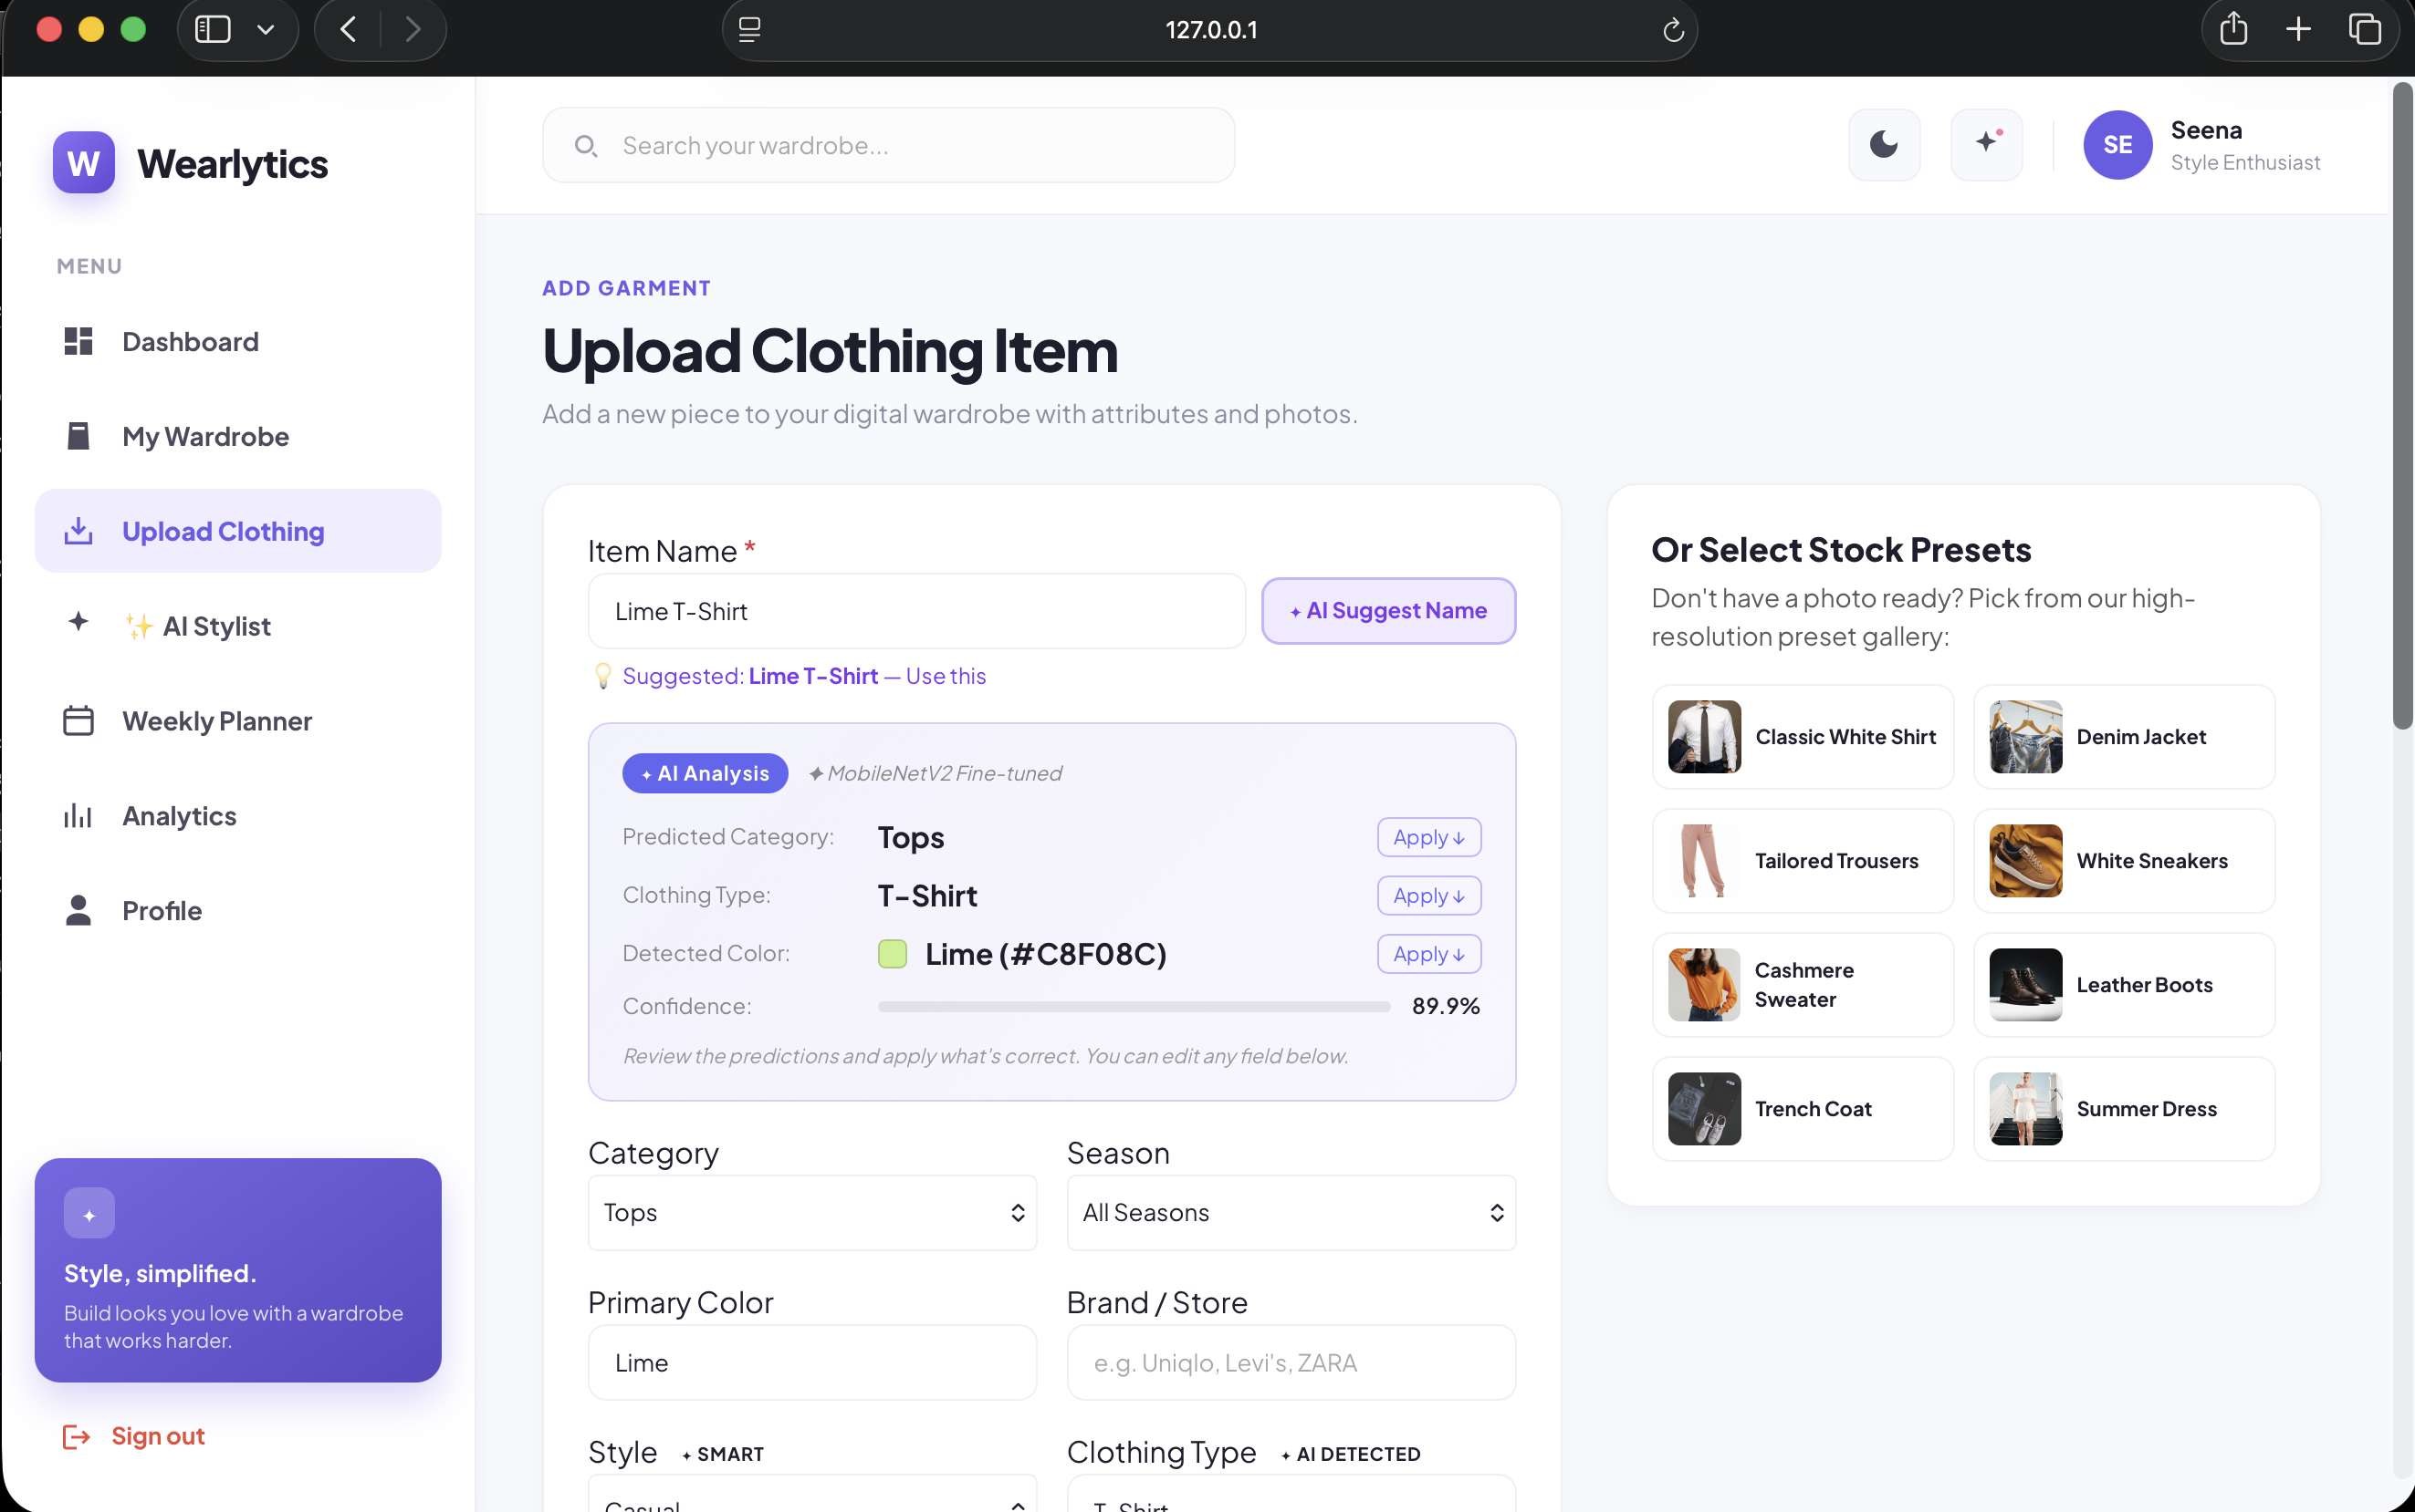
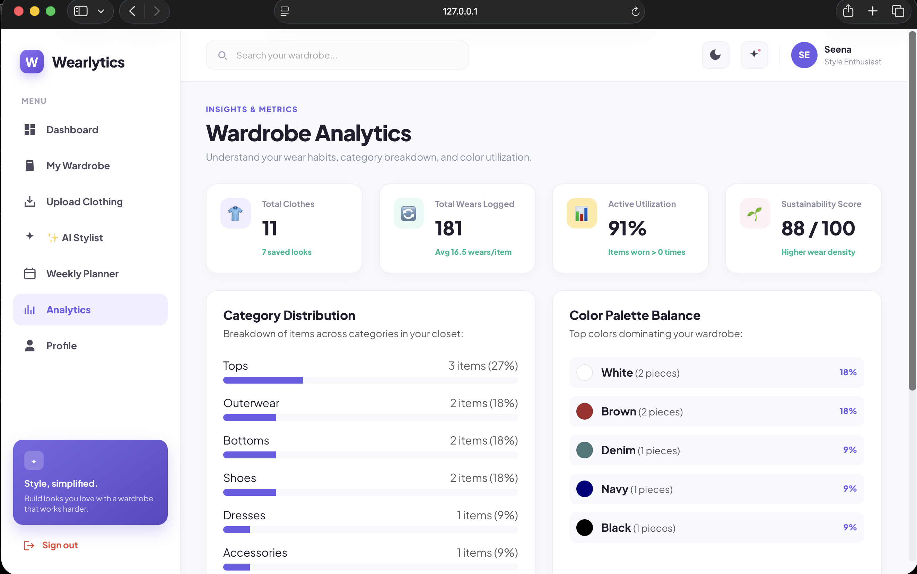
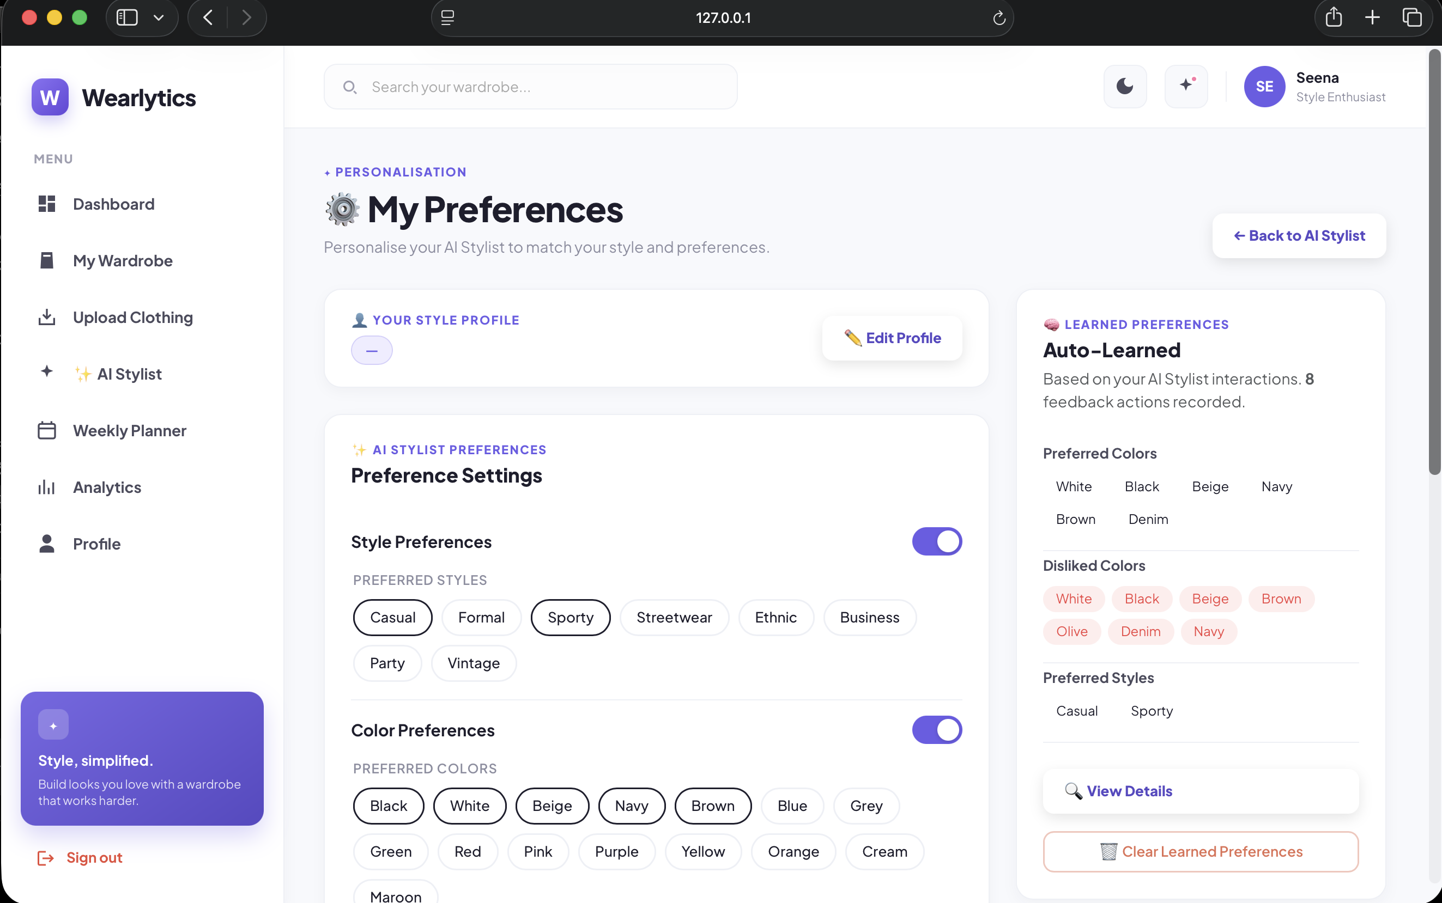
Weekly Planner
Upload clothing item
Analytics
Profile & Preferences

Slide 18
10 · CONCLUSION & FUTURE
Conclusion & Future Enhancement
Completed work, achieved outcome and planned improvements
Conclusion
Future Enhancements
Possible improvements for the next version
89.19%
Final test accuracy
509 test images
Advanced recommendation models
01
02
Dataset expansion
Learned compatibility models and deeper personalization.
Larger, diverse and better-organized training data.
Delivered in this interim
03
Full wear-event history
04
Robust personalization
• Digital wardrobe management
• AI clothing classification + color detection
• Weighted outfit recommendation
• Feedback-based preference learning
• Weekly planner + laundry awareness
• Wear tracking + wardrobe analytics
Store complete wear events and usage history.
Make preference controls fully functional and reliable.
05
Classifier calibration
06
Notifications
Improve confidence calibration and evaluation reliability.
Laundry reminders and outfit/planner notifications.
08
Production deployment
Achieved Outcome
07
Mobile application
Deployment, scalability and stronger security/validation.
A working smart-wardrobe system with measurable AI performance and transparent recommendation logic.
Extend the system to native mobile access.
Priority: stronger personalization • better evaluation • complete tracking • mobile & deployment
WEARLYTICS | S3 MCA MINI PROJECT — SECOND INTERIM PRESENTATION
14 / 15

Slide 19
11 · REFERENCES
Key literature papers, dataset source and official technical documentation
RESEARCH PAPERS
DATASET
01
Saed, S. & Teimourpour, B. (2026)
Alexey Grigorev — Clothing Dataset (Full)
Saed, S. and Teimourpour, B., 2026. Hybrid-hierarchical fashion graph attention network for compatibility-oriented and personalized outfit recommendation. Machine Learning with Applications, p.100802.
Kaggle
02
Balloni, E., Pietrini, R., Frontoni, E., Mancini, A. & Paolanti, M. (2025)
Used for clothing-image classification and model evaluation.
Balloni, E., Pietrini, R., Frontoni, E., Mancini, A. and Paolanti, M., 2025. OutfitAI: shop the outfit with a deep learning-based intelligent expert system. Multimedia Tools and Applications, 84(32), pp.40195-40214.
03
Chang, C.-L., Chen, Y.-L. & Jiang, D.-X. (2025)
Chang, C.L., Chen, Y.L. and Jiang, D.X., 2025. Using large multimodal models to predict outfit compatibility. Decision Support Systems, 194, p.114457.
OFFICIAL TECHNICAL REFERENCES
04
Suvarna, B. & Balakrishna, S. (2024)
• Flask Documentation
Suvarna, B. and Balakrishna, S., 2024. Enhanced content-based fashion recommendation system through deep ensemble classifier with transfer learning. Fash Text 11, 24 (2024) [online]
• PyTorch / torchvision Documentation
• SQLAlchemy Documentation
• scikit-learn Documentation
05
Liu, J., Hou, L., Yu, X., Song, X. & Ren, Z. (2024)
Sun, K., Zhang, P., Zhang, J., Tao, J. and Yuan, K., 2024. PFNet: Attribute-aware personalized fashion editing with explainable fashion compatibility analysis. Information Processing & Management, 61(1), p.103540.
• Bootstrap Documentation
11

Slide 20
WEARLYTICS
Thank You
AI-Powered Smart Wardrobe and Personalized Outfit Recommendation System
ANCHANA R P · ROLL NO. 23
S3 MCA · SECOND INTERIM PRESENTATION

